Slide 1
The IDF Military Colleges
Welcome

Slide 2
IDF Structure
CHOD
DCHOD
Professional
Advisors
Supervision
Department
Chief Reserve
Officer
Financial
Advisor
Chief Gender
Advisor
Chief
Rabbinate
MAG
Services
Commands
General Staff
J1
J2
Navy
Ground
Forces
Air Force
Northern
Command
Central
Command
J3
J4
Corps’
J4
Southern
Command
Home Front
Command
Joint
Command
J5
J6
IDF Colleges

Slide 3
Structure of the IDF Military Colleges
Head of the IDF Military Colleges
(MG Itai Veruv)
Israel National Defense College
(Col Yoni Sayada Marom)
Chief of Staff of the Colleges
(BG Udi Ben-Mocha)
Brigadier Generals Course
Research Center
“Maarachot” Publishing
Tactical and Command College
(COL Pinches Joseph)
Commander of “Alon” Course
(COL Dado Bar Kalifa)
Commander of “Afek” Course
(COL Dr. Yair Barak)
Commander of the Operational Course for NCO
(LTC Ohad Noyman)
Head of the
Instruction Branch
Head of Logistic Branch
Head of Research
And Development

Slide 4
IDF Colleges – The Strategic Environment
Regional instability and change in the nature of warfare
Jointness as a condition of victory
A change in the national priorities and the young standing army
Characteristics of learners – the Millennials (Generation Y)
A qualifying and academic environment

Slide 5
General Information | Product | Duration | Target Audience | Course
Designated for senior Brigadier Generals as well as seniors officials from other defense organizations (such as the Israel Police, Minister of Foreign Affairs and Intelligence organizations) combine this course along with their job routines. Serves as a platform to teach complex problem analyzing and solving. | Brigadier Generals Course Certificate | Once a Month for 2-3 Days, Throughout one Year | Brigadier Generals | Brigadier Generals Course
The INDC (Israel National Defense College) is an academic program oriented towards seniors from the military, and their counterparts in other sectors (such as the Israel Police, Minister of Foreign Affairs, Shin Bet and more). The diverse program provides a shift from a tactical perspective to a strategic one, and includes numerous tours within Israel and abroad. Each class incorporates senior officers from foreign militaries (who move to Israel for a whole year), allowing for an international and complex learning environment. | M.A. in Political Science (National Security Studies) from Haifa University INDC Graduation Certificate | 11 Months | Colonels and their Equivalents in Foreign Militaries | INDC
Students who enter the Afek Course come from senior positions in the General Staff. The main purpose of the course is to broaden their point of view and provide a more complete picture of the IDF and its structure. This includes exposure to the world of combat and to strategic considerations in that regard. Furthermore, the course attempts to strengthen leadership and command abilities. | Afek Course Graduation Certificate | 4 Months (3 Cycles per Year) | Majors (from the General Staff) | Command and Staff College: Afek Course

Slide 6
General Information | Product | Duration | Target Audience | Course
The studies at the Alon Course include analyzing combat doctrines from around the world, leadership abilities and education methods. As part of the program, cadets travel abroad and visit battle sites, as part of the attempt to constantly expose them to different perspectives regarding warfare and operational tactics. | M.A. in Political Science from Haifa University Alon Course Graduation Certificate | 10 Months | Majors (from Combat Units) | Command and Staff College: Alon Course
Cadets in the Tactical and Command College integrate military and academic studies, preparing them to their future roles as company commanders. This includes analyzing battlefields according to the relevant components, gaining educational tools and learning the role of the leader. | B.A. in either Political Science or Economics from Haifa University Tactical and Command College Graduation Certificate | 26 Months | First Lieutenants | Tactical and Command College
The course is divided into two sub-courses, according to rank. The course as a whole focuses on providing the NCO with tools of command and cooperation, through daily classes and simulations. | NCO Course Graduation Certificate | 6 Weeks for High Ranking NCOs 4 Weeks for Low Ranking NCOs | NCOs | NCO Course

Slide 7
Spirit of the IDF Colleges – The Instructing Concept
Student
Physical
Infrastructure
Organizational Infrastructure
Staff
Training Program
Instructing Environment

Slide 8
Spirit of the IDF Colleges
Curious and profound
Initiator and active: ‘teach and be taught’
Courageous, stable and judgmental – also towards himself
Humble, ethical and embodies senior capabilities
Student
Relevant
Comprehensive and Intensive (T)
Attractive
National
Academic
Continuity of Training
An example for military culture
A modern and inviting campus
Home base for officers
Instructing
Environment
Training
Program
Instructor
A commander committed to a 360 degree development
Promotes jointness
Judgmental, initiator and influential
Maintains fitness but specializes in instructing

Slide 9
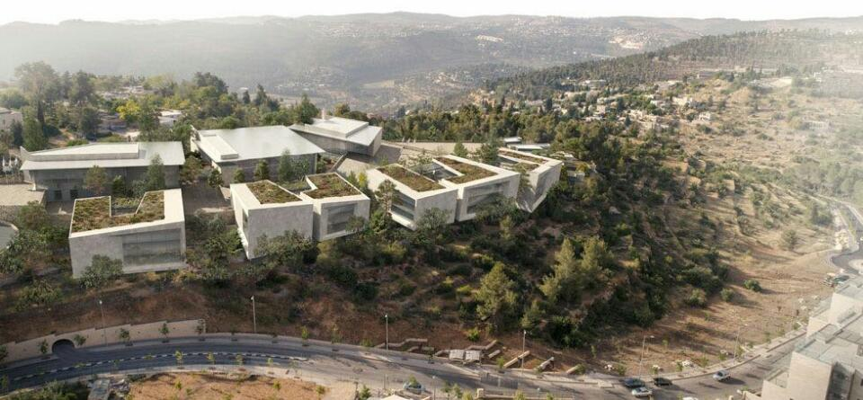
The IDF Colleges are Moving to Jerusalem

Slide 10
Format of Study
Course
Two Teams
Organic Team
Group
Small Group
Singular
Team 4
Team 3
Team 2
Team 1
Team 2
Team 1
Team 1
A
A
A
A
A
A
A
A
A
A
B
B
B
B
B
B
B
B
B
C
C
C
C
C
C
C
C
D
D
D
D
D
D
D
D
Senior
Team
Plenum

Slide 11
Senior Learning
Feedback
and Reflection
Assessment
of Performance
‘Publishing’
and Influence
Writing and Research,
Control, Teaching
Friction, Synthesis, Mediation
Simulation, Leading a Tour,
Team Process, Mentor
‘Argument and Objection’ –
Fighting Materialism
Lectures, Theoreticians and Practical People, Reading and Self Study
A Safe, Qualitative and Rich Learning Environment
An Experienced and Motivated Student / A Meaningful, Diverse and Intimate Team

Slide 12
Methods of Learning
Face-to-face Lectures (Q&A)
Team Discussions
Panels
Seminars
Workshops
Tours (within Israel and abroad)
Self Study and Research
Simulation and Experience (Learning Through Research)
Writing
Centralized Course / Course
Case Study
Online Course, Teleprocessed Content, Podcast
Reflective Tool
Manager’s Exercises
Analyzing Texts
Debate
Exercises, War Simulations, Experiences
Tutoring, Mentoring and Couching
Informal (Drinking Machine)

Slide 13
Connecting the IDF Colleges to the Academy
Fully utilizing the comparative advantages – theory by the academic institution, practice by the IDF colleges
Ability to influence – the content, lecturers and curriculum
Keeping high standards
Attraction and prestige

