Slide 1
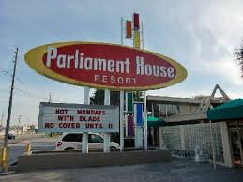

Slide 2
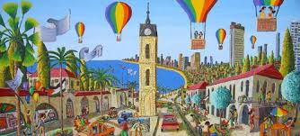
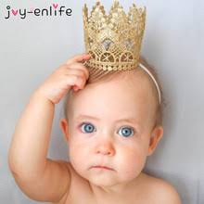
Interests
Student in the middle
Learning environment
Social environment

Slide 3
Designation
Representing and coordinating team, for 45th class NDC’s students -
For promoting consolidation, integration and mutual enriching;
For creating initiative-encouraging and quality learning environment.

Slide 4
Power
B’s ability to make A move towards Y, even though A planned moving towards X.
Power range
Y
B
A = Staff
X
A
A

Slide 5
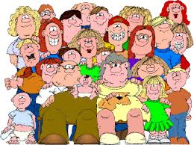
Parents’ committee
Class’
committee

Slide 6
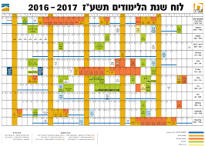
What do we do..!?
(who needs presidency..?)
(participating in..)
Course planning
Staff – students coordination

Slide 7
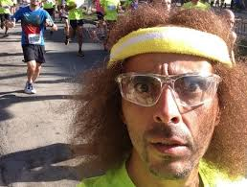
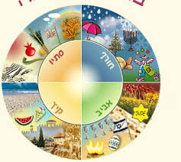
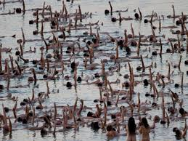
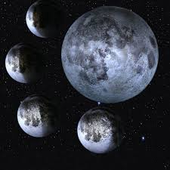
What (else) do we do..?!
Celebrating holidays
Sports
Families’ trips
Waiting for your ideas
First day of Hebrew month
Birthdays

Slide 8
August – October
Kai | Wong Hin | 06/09/1976 | יא אלול תשלו
Sela | Aviram | 25/09/1973 | כח אלול תשלג
Sa’ar | Amit | 07/09/1978 | ה אלול תשלח
Fireaizen | Shay | 23/10/1973 | כז תשרי תשלד
Friedman | Shmuel | 05/09/1966 | כ אלול תשכו
Shapira | Itay | 18/08/1975 | יא אלול תשלה
Shamla | Oded | 30/09/1965 | ד תשרי תשכו
Vaxman | Haim | 14/10/1963 | כו תשרי תשכד
Or | Matan | 13/09/1980 | ג תשרי תשמא
Hallawa | Noy | 16/10/1998 | כו תשרי תשנט
Shimony | Noy | 17/09/1997 | טו אלול תשנז
Azary | Noam | 02/10/1997 | א תשרי תשנח
פעילות ספורט (מליאתית)
טיולי משפחות
חוגגים חגים
(עברי ולועזי)
אנחנו מחכים להצעות
ילדי יום הולדת
פר"ח (פגישת ראש חודש) עברי

Slide 9
World wiew
Schedules
Functionaries
Money / Budjet
Here & Now

Slide 10
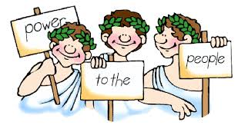
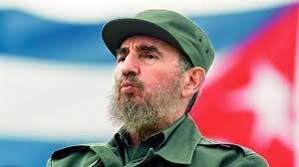
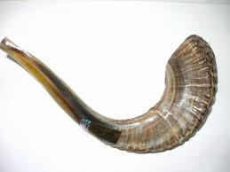
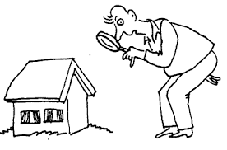
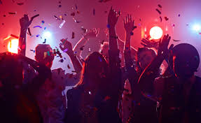
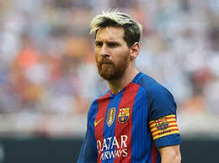
World view
Course presidency
Democracy
But not always…
Uninimously
Criticism
(positive)
Full staff coordination
Atmosphere
Proactivity

Slide 11
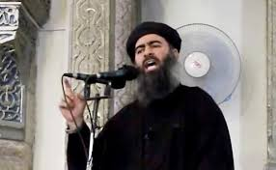
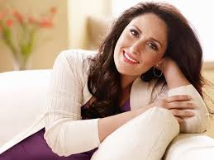
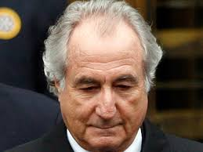
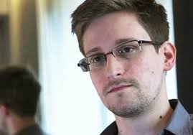
Functionaries
Presidency, +
Spokesmen
Social activity
Finance
Protocols
Aviram
Shmuel
Ziv
Shay

Slide 12
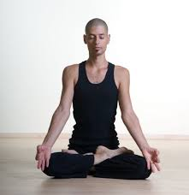
Functionaries (#2)
Volunteers ( )
Yoga
Photography
Summaries
Sports
Zini
Doug&Pinto
Tali
Fisher

Slide 13
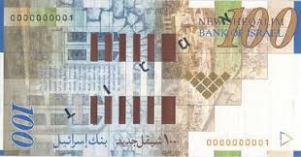
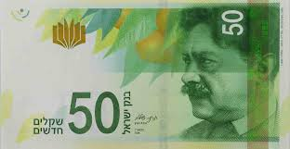
Show me the money!

Slide 14
When do we meet..?
Presidency
Presidency
Presidency
Presidency
Students
Students
Students
Staff
Staff
6
weeks
0

Slide 15
Here & now (#1)
Start on time – end on time!!!
Summaries’ printing (Tali Publishers©)
Teaching environment (fix the mike!!!)
Clothing code - tours
Feedback culture – weekly questionnarie
Learning burden
General reading
Public law
Ben-gurion tour
National security basics – pairs; reducing one question; reducing reading material

Slide 16
