Slide 1
Israel National Defense College
Welcome!
February 2020

Slide 2
Structure of the IDF Military Colleges
Head of the IDF Military Colleges
(MG Itai Veruv)
Israel National Defense College
Chief of Staff of the Colleges
Brigadier Generals Course
Research Center
“Maarachot” Publishing
Tactical and Command College
Commander of “Alon” Course
Commander of “Afek” Course
Commander of the Operational Course for NCO
Head of the
Instruction Branch
Head of Logistic Branch
Head of Research
And Development

Slide 3
The INDC
The Israel National Defense College is the highest institution in the country, which trains the senior staff of the IDF, the defense establishment and the government, for senior command and management positions. Israeli government’s decision, 23 May, 1976

Slide 4
Goals of the Academic Year
Study and research of the components of national security.
Analysis of the interrelationships between the various components of national security.
Developing thinking tools on the strategic level, which are suitable for senior officials’ dealing with national security challenges.

Slide 5
What Distinguishes the INDC?
The most prestigious and senior course in the State of Israel for the training of senior officials:
Training to the rank of seniors and not to a specific job/position
Class composition
Study of national security (global and Israeli) – width and not depth
Integration of national security components - strategic thinking tools
Learning methods tailored to the senior level: small teams, simulations and strategic exercises, study tours, meetings with senior officials, peer study

Slide 6
Participant’s Composition
Military
Security Organizations
Civil Organizations
Internationals

Slide 7
Learning Fields in the INDC
Strategy
Society
Economy
National Defense
Statesmanship and Diplomacy

Slide 8
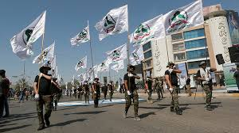
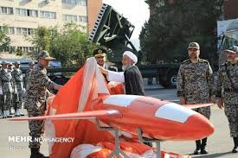
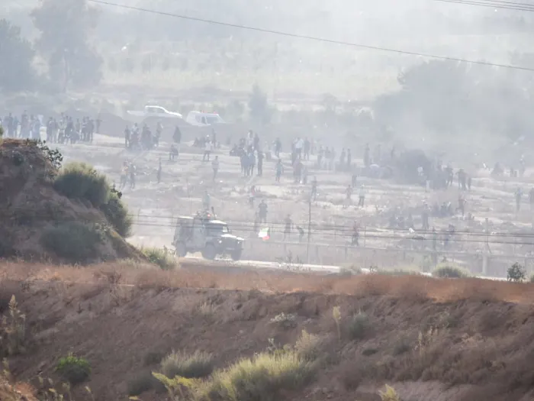
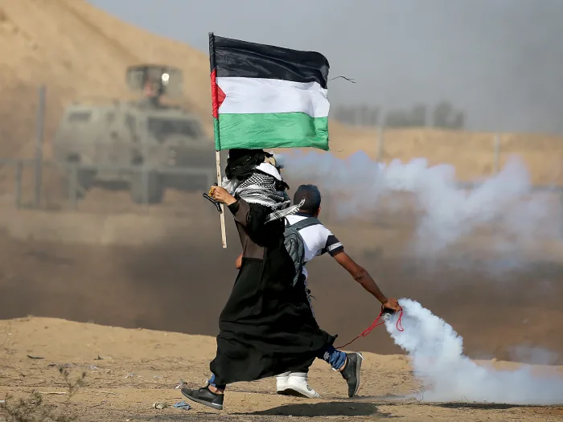
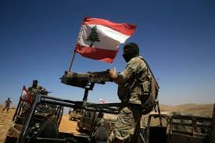
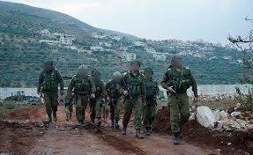
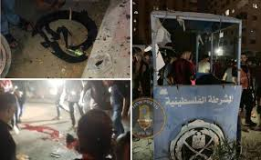
"A quiet night passed on our forces in Suez canal…”
Elections
Economy
U.S
Europe
Defense
Iraq
Iran
Gaza Barrier
Lebanon
Gaza
Inside

Slide 9
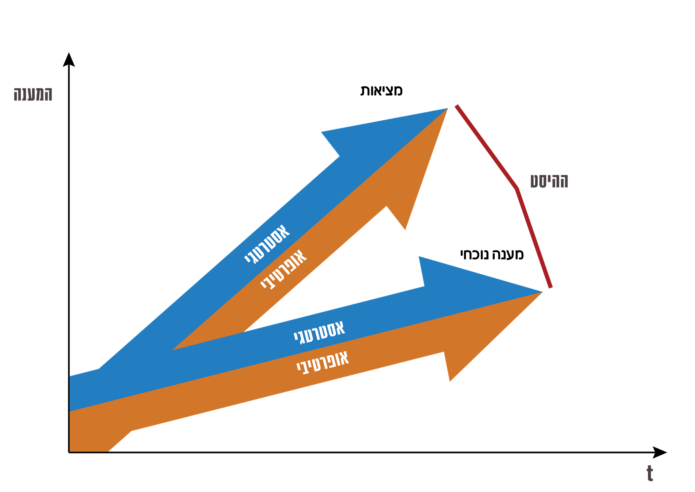
Strategic thinking in INDC
Reality
Response
Offset
Strategic
Current response
Operative
Strategic
Operative

Slide 10
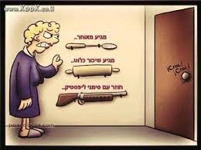
Temporary Solution
Coming late
Comes drunk as a dog
Come with lipstick marks

Slide 11
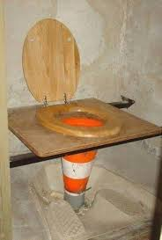
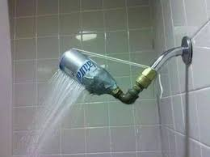
Creative Solution

