Slide 1
Israel National Defense College
Welcome!
November 2019

Slide 2
IDF Structure
CHOD
DCHOD
Professional
Advisors
Supervision
Department
Chief Reserve
Officer
Financial
Advisor
Chief Gender
Advisor
Chief
Rabbinate
MAG
Services
Commands
General Staff
J1
J2
Navy
Ground
Forces
Air Force
Northern
Command
Central
Command
J3
J4
Corps’
J4
Southern
Command
Home Front
Command
Joint
Command
J5
J6

Slide 3
Structure of the IDF Military Colleges
Head of the IDF Military Colleges
(MG Itai Veruv)
Israel National Defense College
Chief of Staff of the Colleges
Brigadier Generals Course
Research Center
“Maarachot” Publishing
Tactical and Command College
Commander of “Alon” Course
Commander of “Afek” Course
Commander of the Operational Course for NCO
Head of the
Instruction Branch
Head of Logistic Branch
Head of Research
And Development

Slide 4
The INDC
The Israel National Defense College is the highest institution in the country, which trains the senior staff of the IDF, the defense establishment and the government, for senior command and management positions. Israeli government’s decision, 23 May, 1976

Slide 5
Goals of the Academic Year
Study and research of the components of national security.
Analysis of the interrelationships between the various components of national security.
Developing thinking tools on the strategic level, which are suitable for senior officials’ dealing with national security challenges.

Slide 6
What Distinguishes the INDC?
The most prestigious and senior course in the State of Israel for the training of senior officials:
Training to the rank of seniors and not to a specific job/position
Class composition
Study of national security (global and Israeli) – width and not depth
Integration of national security components - strategic thinking tools
Learning methods tailored to the senior level: small teams, simulations and strategic exercises, study tours, meetings with senior officials, peer study

Slide 7
Participant’s Composition
Military
Security Organizations
Civil Organizations
Internationals

Slide 8
Learning Fields in the INDC
Strategy
Society
Economy
National Defense
Statesmanship and Diplomacy

Slide 9
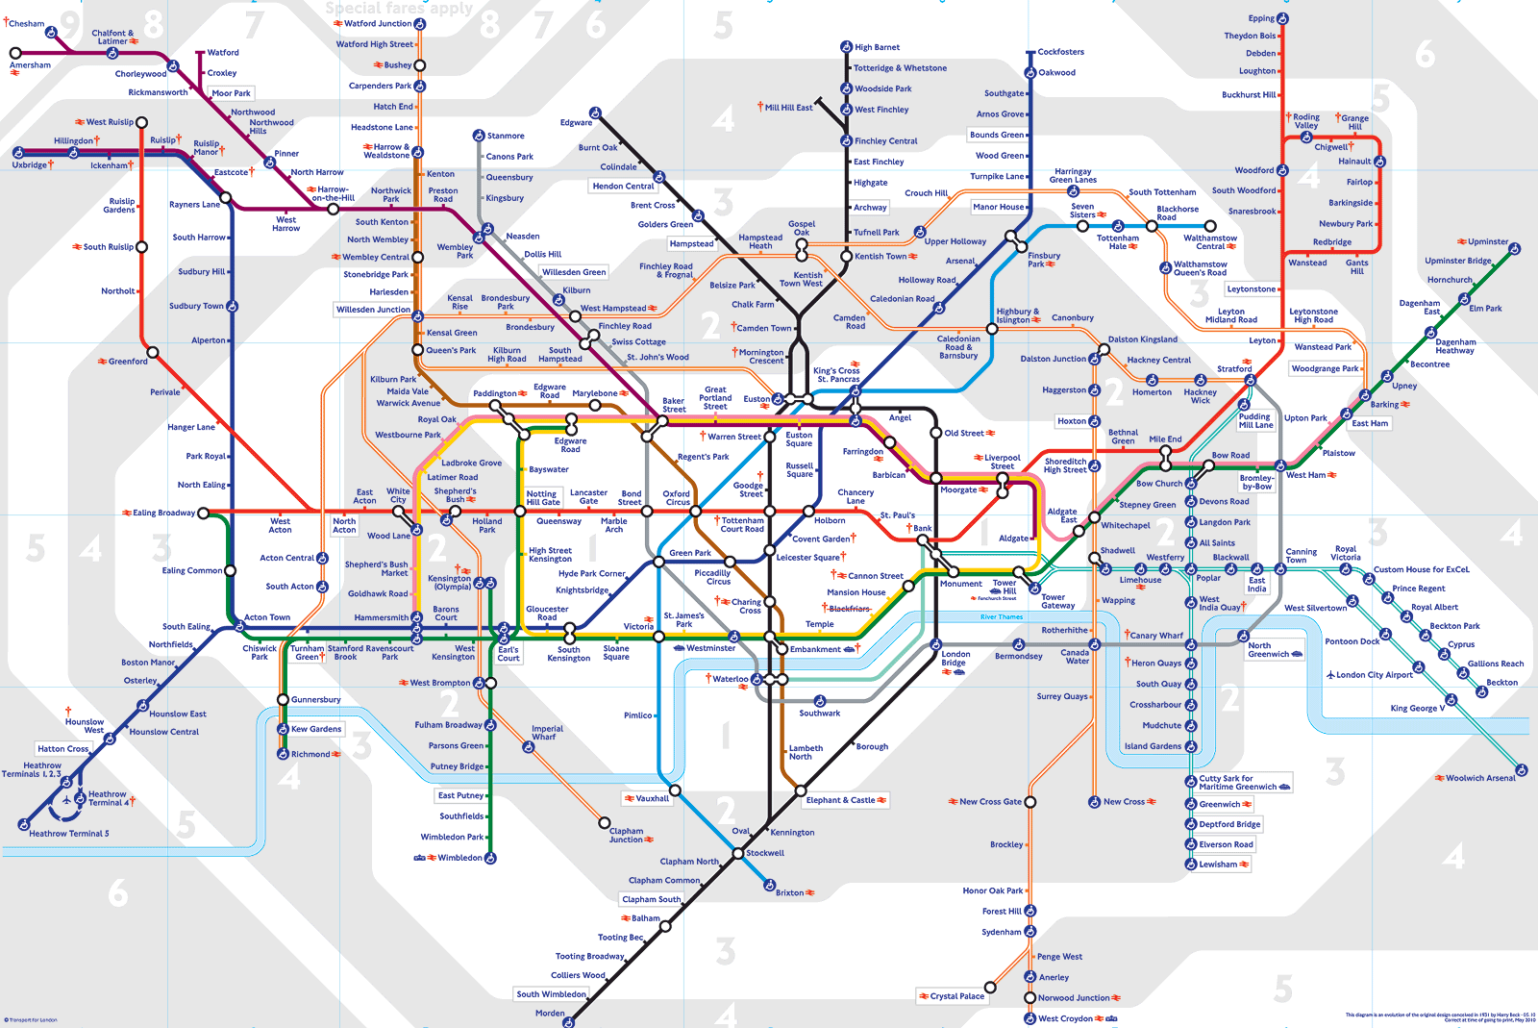
The Metro Metaphor
Visualizing INDC’s Year – Metro Map

Slide 10
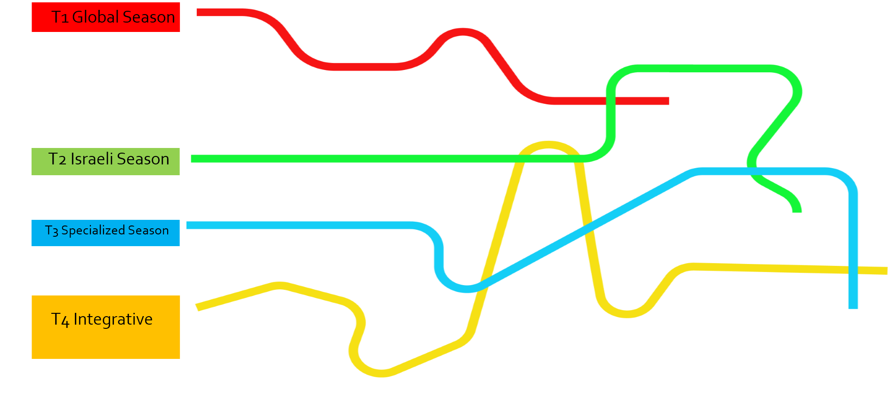
The Seasons

Slide 11
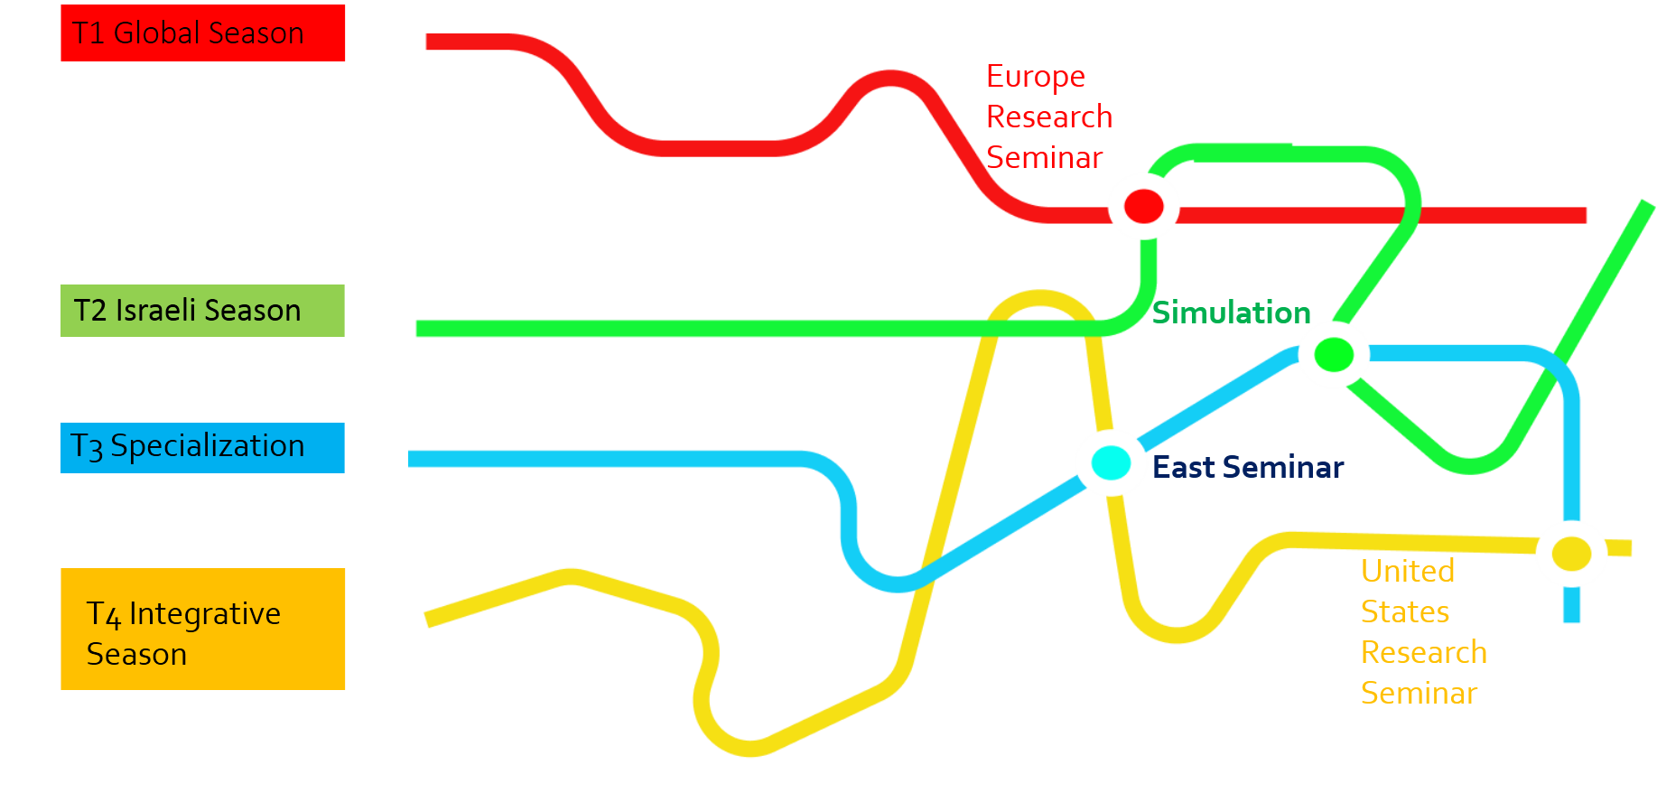
The Seasons and Large Stations

Slide 12
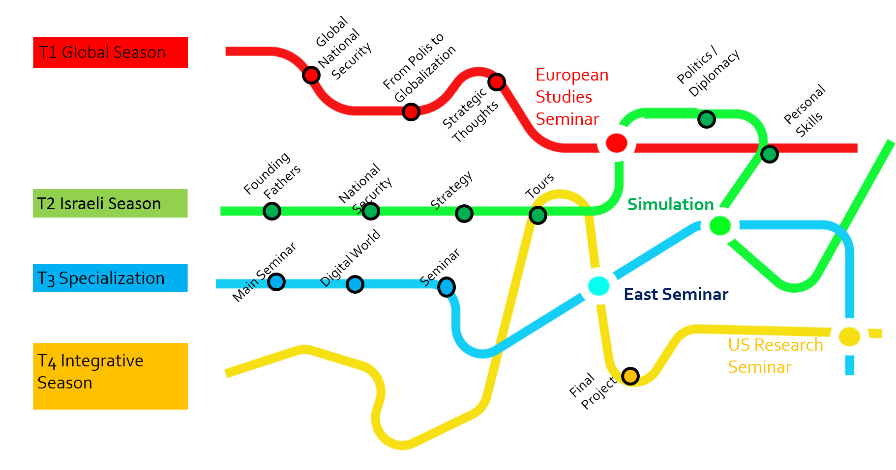
Courses and Seminars by Seasons

Slide 13
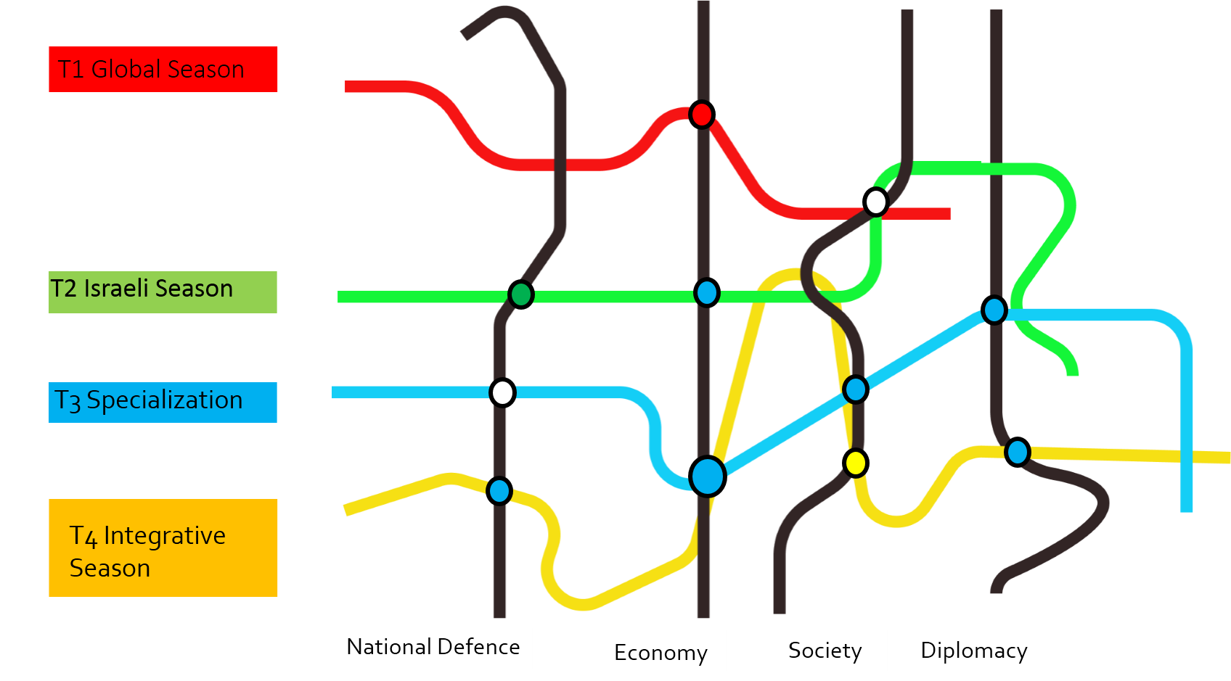
4 Fields of Study – National Security Components

Slide 14
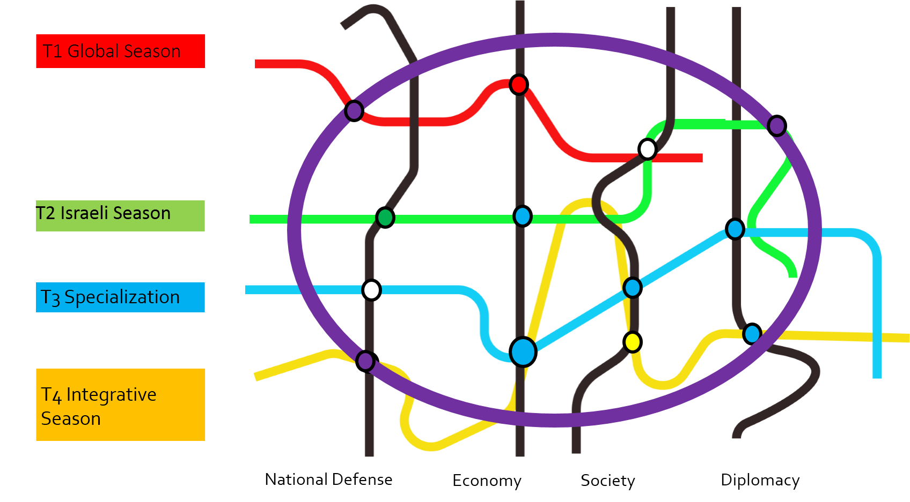
The Purple Line - Strategy

Slide 15
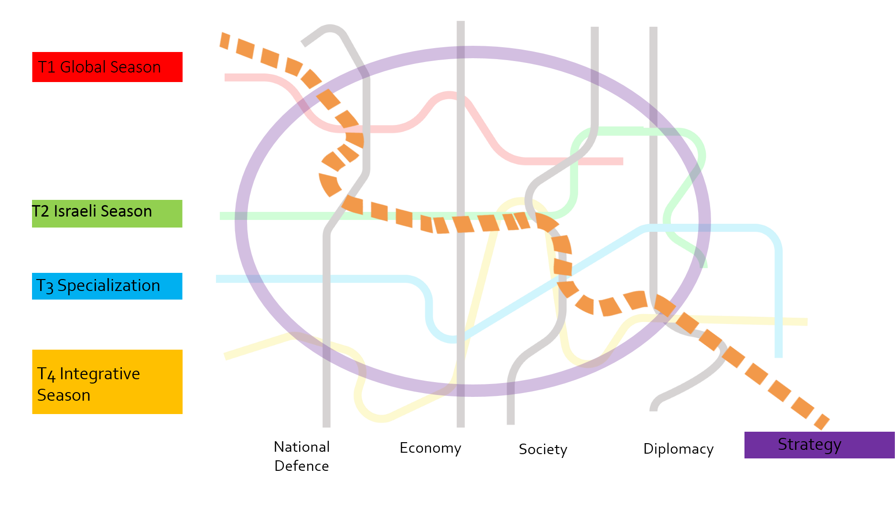
The Orange Line - The Personal Learning Process

Slide 16
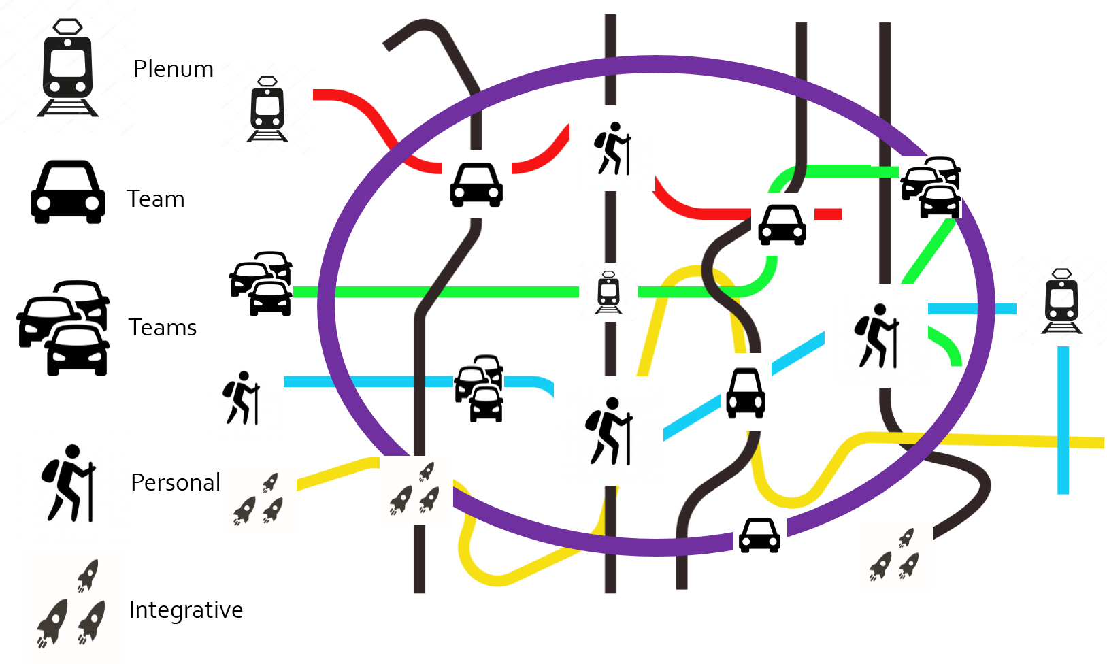
Learning Methods

Slide 17
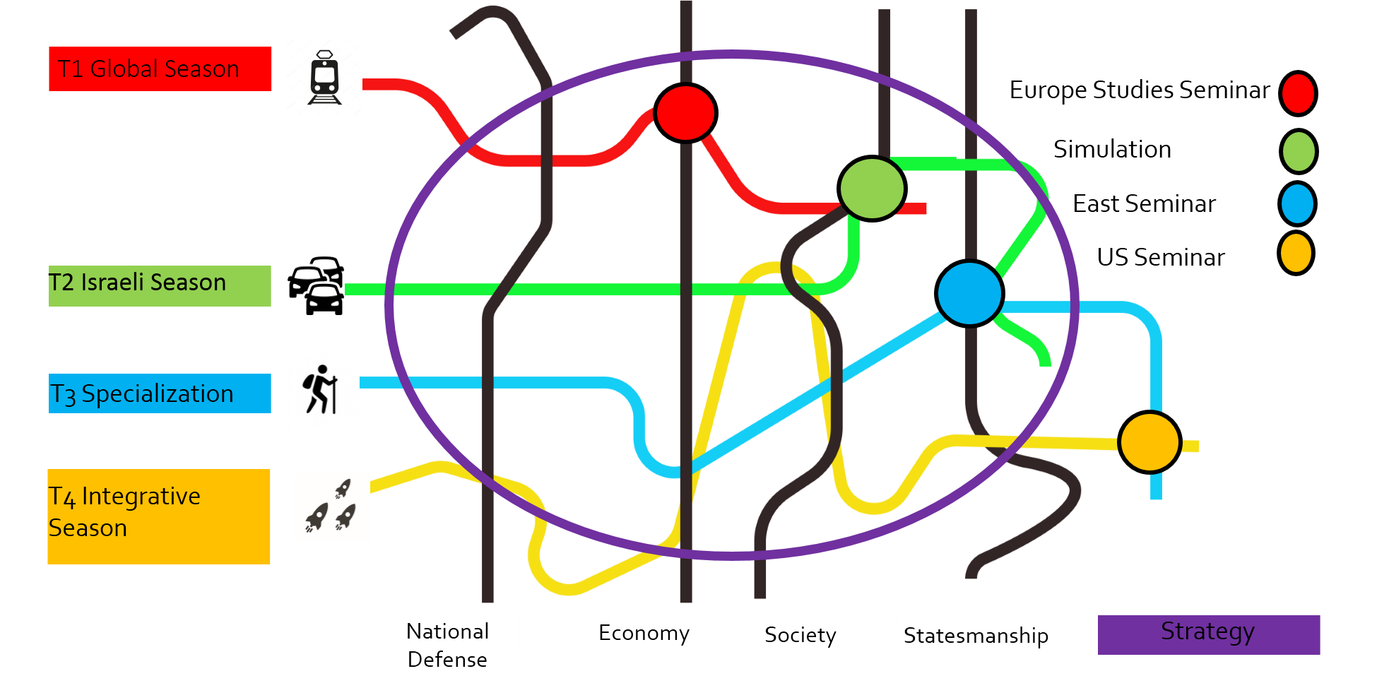
The Vision of the Academic Year at the INDC

