Slide 1
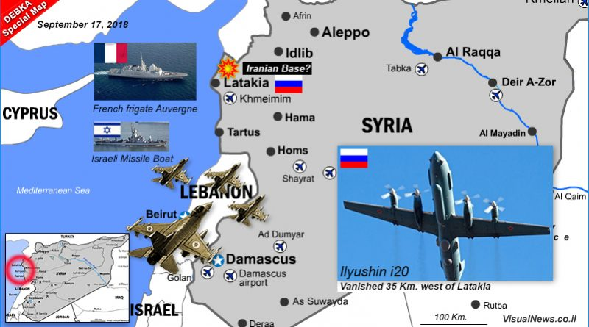
First strategic experience –
The Northern Arena

Slide 2
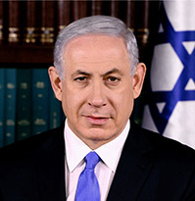
PM Directive
Examine our strategy for the northern arena
Formulate a strategy that will allow us to have degrees of freedom of action in face of the emerging threats

Slide 3
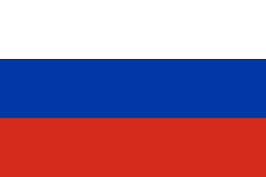
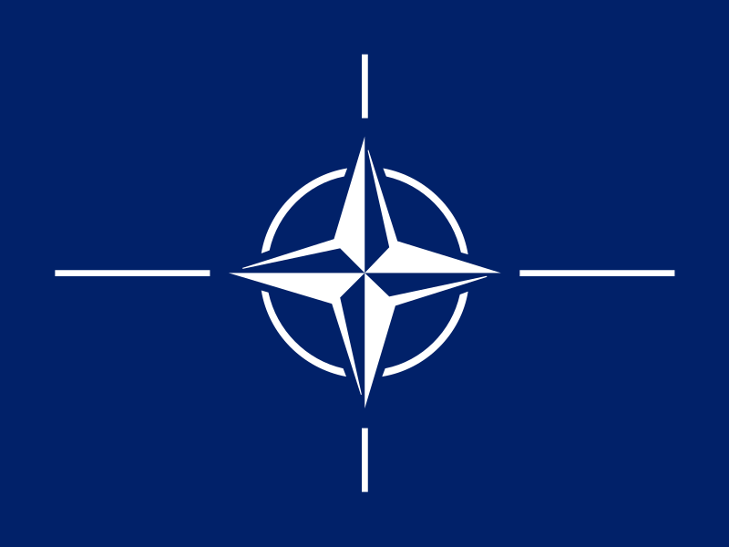
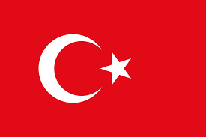
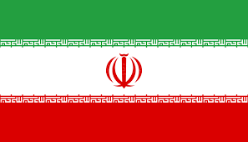
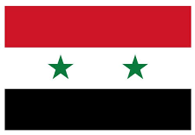
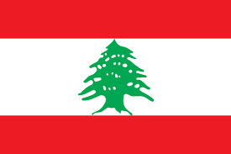
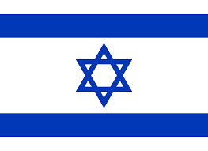
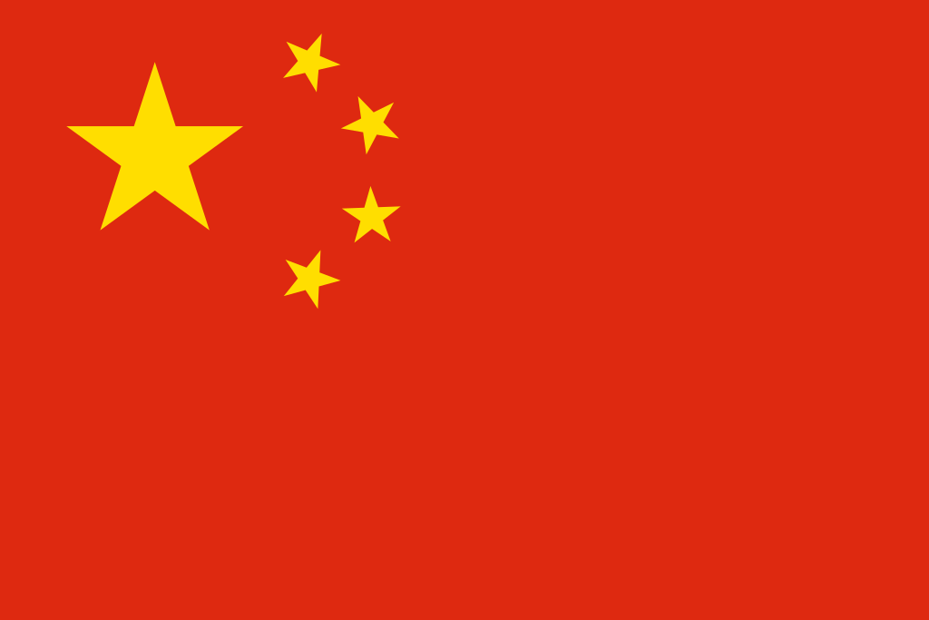
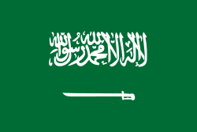

Slide 4
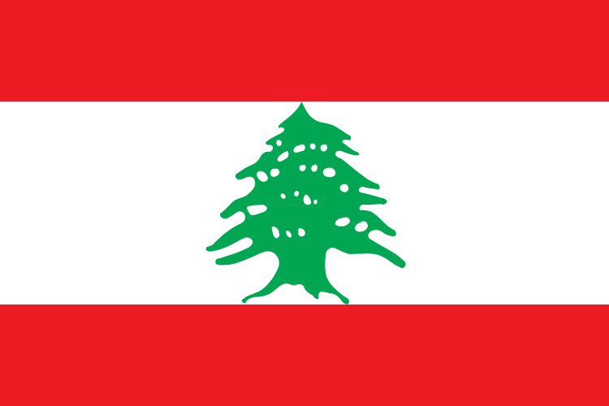
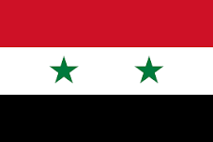
EU
NATO
TURKEY
RUSSIA
K
HEZ
ASSAD
Arena
UN
USA
ISRAEL
Ally
Foe
Mixed
IRAN
SUNNI
Shiite
CHINA

Slide 5
EU
NATO
TURKEY
RUSSIA
K
HEZ
ASSAD
Arena
UN
USA
ISRAEL
Ally
Foe
Mixed
IRAN
SUNNI
Positive connection
Shiite
Negative connection
CHINA
Weak connection
Significant Effect

Slide 6
EU
NATO
TURKEY
RUSSIA
K
HEZ
ASSAD
Arena
UN
USA
ISRAEL
Ally
Foe
economy
Mixed
IRAN
Terror
SUNNI
Positive connection
Military
Shiite
Negative connection
Restoration
CHINA
Weak connection
Ideology
Significant Effect
Partnership

Slide 7
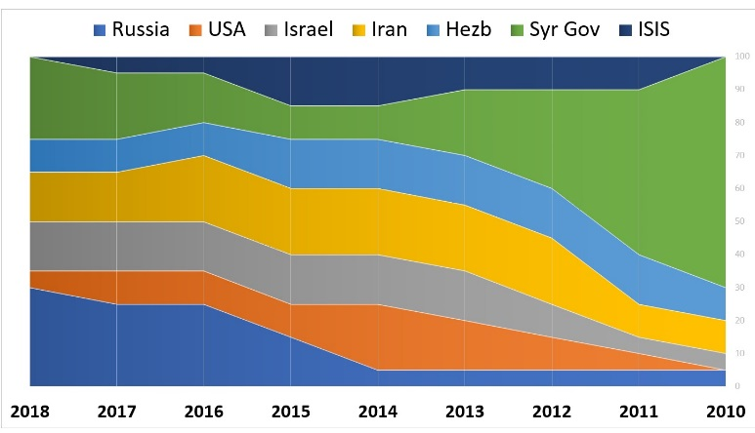

Slide 8
Trends
The Syrian regime and army are back in the game
PGA project is continued in Lebanon
Hezbollah became a key regional player
Russia stays as key player & uses Syria as training area and Mediterranean approach
Sanctions against Iran and Hezbollah can be a game changer
Iran limited by Russia
USA losses interest
The restoration of Syria creates Economic opportunity
ISIS defeated & Kurds become a new player
The Israeli interests
Defense –
Israel as a strong and significant player
Deterrence and Freedom of action
Mitigate PGA capabilities of Hezbollah
Prevent Iranian presence in Syria
Pushing away the Iranians from the border
Diplomacy –
USA & Russia as influencing factors
Optimization of Russian coordination
Syria as a state with a distinct regime
Sunni states cooperation – my enemy’s enemy..
International legitimacy
Economy –
Syria restoration as a stabilizing factor

Slide 9
Main tensions
Secular |  | Religious
Sunni |  | Shiite
1 single arena |  | 2 separate arenas
Strikes in Russia and freedom of action |  | Stability & Russia Satisfied
USA & NATO |  | Russia
Hezbollah in Syria |  | Hezbollah focused in Lebanon
Syrian regime and army as a thereat |  | Syrian regime and army as an opportunity

Slide 10
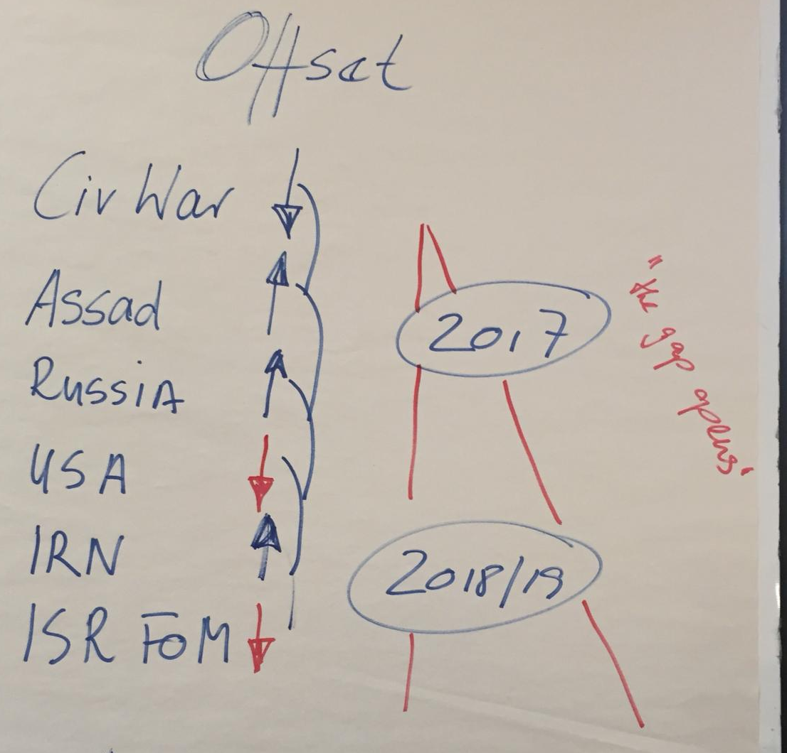
The Offset
While Israel tried to optimize the CBW and therefore force the Iranians out of Syria and damage Hezbollah's PGA program (via exploiting its freedom of operation to conduct airstrikes in Syria based on Syria in civil war and coalition in east Syria)
The Iranian influence has remained but it transformed – east Syria, militias
Hezbollah became a deterrent and a key player
The Russians have become a serious force limiting Israeli freedom of operation in the Northern arena
USA left the land bridge open
2016
CIV WAR
ASSAD
RUS
2017
The Gap Opens
USA
IRAN
2018
ISR FOM

Slide 11
Potentials
Russia
Positive –
Maintain stability by restraining the Iranians
Economical interest - involvement in the restoration of Syria
Negative –
Russian demand to stop the air strikes will decrease the Israeli effectiveness
Getting closer to the Russians can damage the relationship with the US
Assad Regime
Positive –
Regime is in charge
Tension between Assad and Iran – regime domination, religious tension, Militias
Negative –
Assad debt to Iran and Hezbollah, Russian umbrella
Syrian army (mixed with Hezbollah) replaced the presence of rebel forces
Hezbollah
Positive - Hezbollah = Lebanon – committed to stability
Negative – key player that needs to maintain deterrence, risk of Golan front
Iran
Positive –
Severe economical sanctions decreasing Iranian support
Iranian interest in advancing the Nuclear project – stabilizing factor
Negative – Iran invested in Syria a wants to enjoy the success
USA
Positive – increased freedom for action
Negative – Turkey authorized to act

Slide 12
Preliminary Strategy
Logic – the stabilization of the Assad regime creates an opportunity for Israel to move the Russians and Syrians for actions matching the Israeli interests – No Iranians in Syria, Decreased PGA in Lebanon, No Hezbollah in the Golan
Operatively – 2 separate arenas
a Strategic Ambush – an attack on Iranian assets in Syria that will result in a Syrian response will lead to direct attack on regime forces
CPW against PGA (with USA backing), through alternative superiority

Slide 13
Insights from the team work process
Strategic thinking is truly neither intuitive nor linear
Stepped approach through the main milestones is essential in order to stay focused
Genealogy as crucial
Cognitive map as a tool for understanding or describing the system
The Offset needs to be detailed in order to define the right potentials and strategy
Major advantage of the process – the ability to think out of the box
Every strategic logic has an operative shape

Slide 14
Additional Questions
Syria sovereignty is back in the region – what is our strategy?
What is better / stronger? United Northern arena Vs Split states?
Is USA withdrawal from Syria is a part of US withdrawal from the Middle East?
What is the meaning of US withdrawal for the other players?
What is the current role of Turkey?

Slide 15
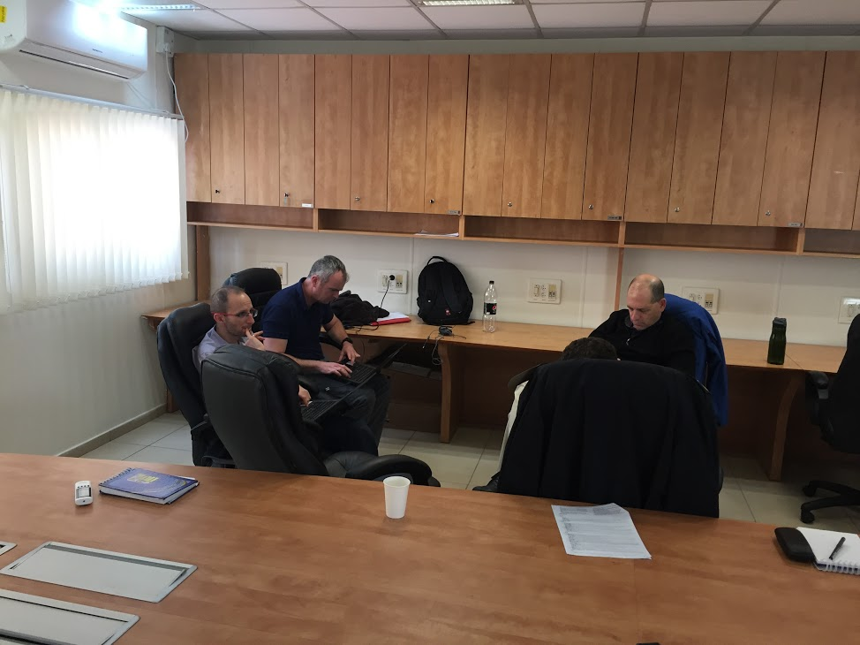
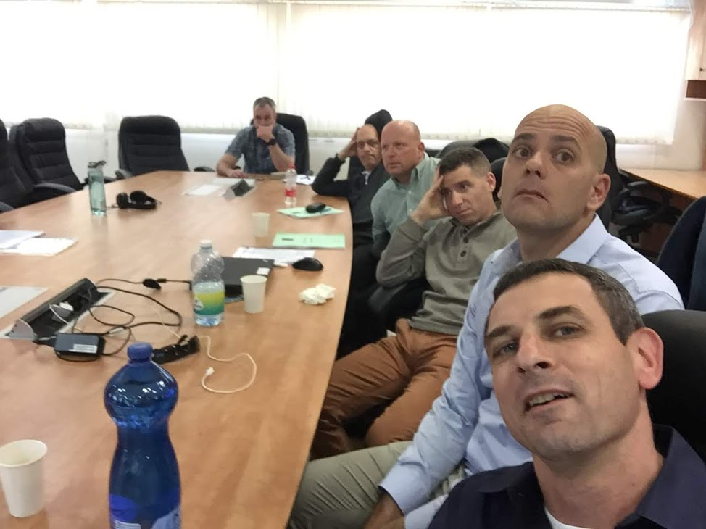
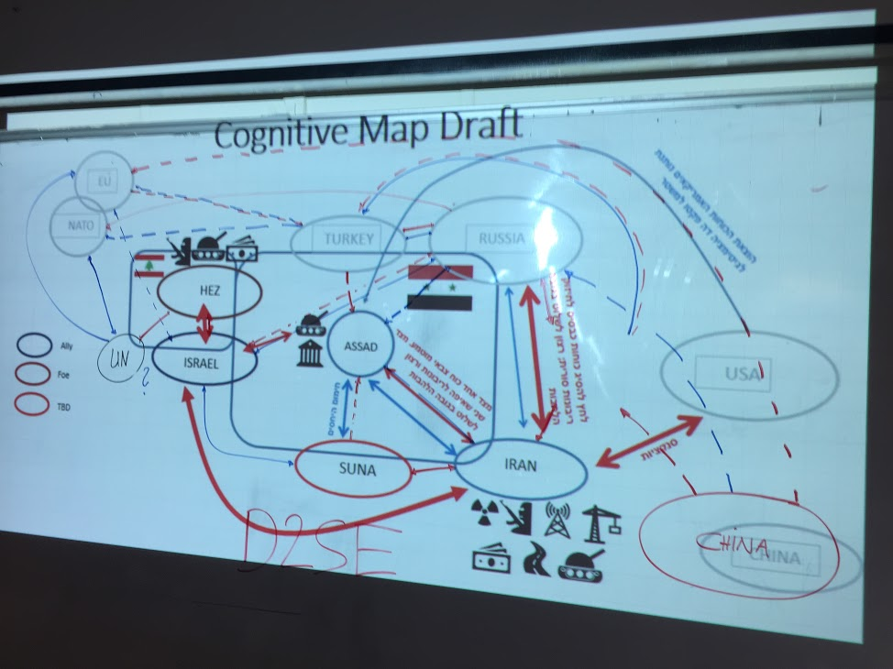
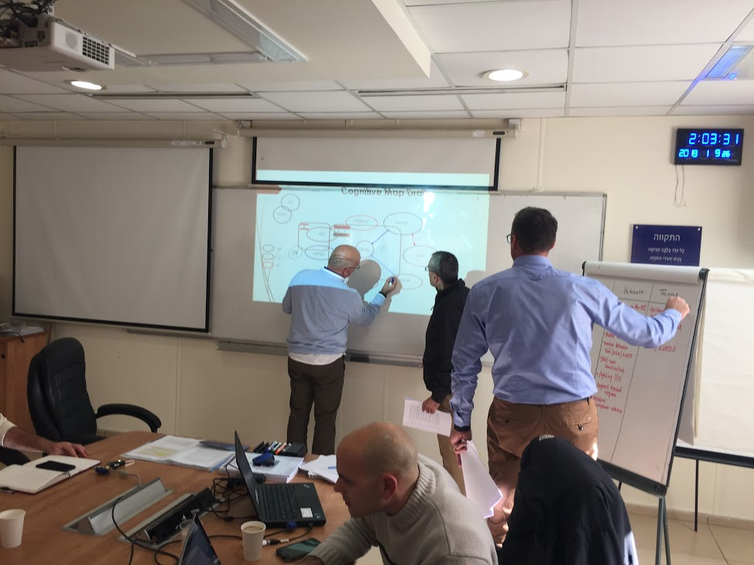
Thank you
Team #1

