Slide 1
The Economic Campaign to Prevent Iran from Acquiring Nuclear Weapons Capability Where are we now ?
Presentation to
National Defense College
January 2018

Slide 2
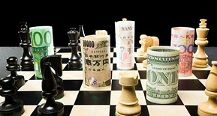
The Strategic Goal of Sanctions and Economic Warfare
Changing the strategic behavior of adversaries through the proper use of diplomatic means, coercive force and economic pressure. The Oxford English Dictionary defines economic warfare or economic war as involving "an economic strategy based on the use of measures (e.g. blockade) of which the primary effect is to weaken the economy of another state".

Slide 3
Rationale
Building an international consensus around understanding the threat.
Recognize the limits of potential partners.
Assess correctly vulnerabilities of adversary.
A broader consensus can be created around a diplomatic-economic campaign.

Slide 4
Understanding the focus: PRE - JCPOA

Slide 5
Remember the Goal
Creating effective economic pressure on the Iranian regime in order to change its behavior regarding its strategic goals in the desired direction.

Slide 6
Rationale
Build an international consensus around the illegitimacy of an Iranian nuclear weapons program.
A broader consensus can be created around a diplomatic-economic campaign than a military one.
Maintain a clear message of “all options are on the table” both towards Iran and the international community

Slide 7
The Goal: Combatting Nuclear Weapons
Can we create an equation in which the nuclear program is no longer seen by leaders as the guarantor of the survivability and stability of the Regime ?
What are the chances of making them understand that continuing on the same path can create a cost that puts the Regime at the greatest risk to its survivability and sustainability ?
If the assessment is negative then we are basically on a fool’s errand.
The chances of success are increased by effective use of complementary nature of various tools.

Slide 8
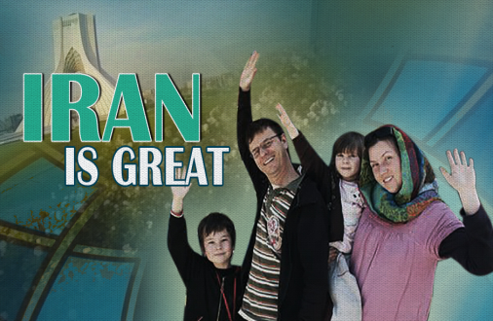
Challenges
Iran as an economic prize
Defining what is legitimate:
Sovereign Rights: Missiles, Central Bank
Economic Hardship Creates Human Suffering
Assessing chances of success in building the pressure – Is it worth the price ?
People wanting to look romantically and predict the future of a “New Iran”
Iran as part of the solution to the emergence of ISIS
Legal Challenges

Slide 9
The Role of Diplomacy
Broad Legitimacy
The Primary Channels are Diplomatic:
Coalition Building
Negotiations Framework: Who is at the Table ?
Creating Frameworks for Pressure: Sanctions are based on political decisions.
Venues are civilian: UNSC, Congress
Interdiction in third countries using political channels
Enforcement Requires Political Decisions Supported by Accurate Intelligence

Slide 10
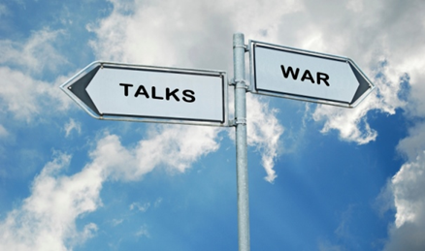
Diplomatic Means are Often Complementary and Part of a Package
Military Force
Intelligence Effort
Covert measures
Interdiction of illicit activity
Legal actions
The need for “cross-agency synergies”: Utilizing each actors comparative advantage

Slide 11
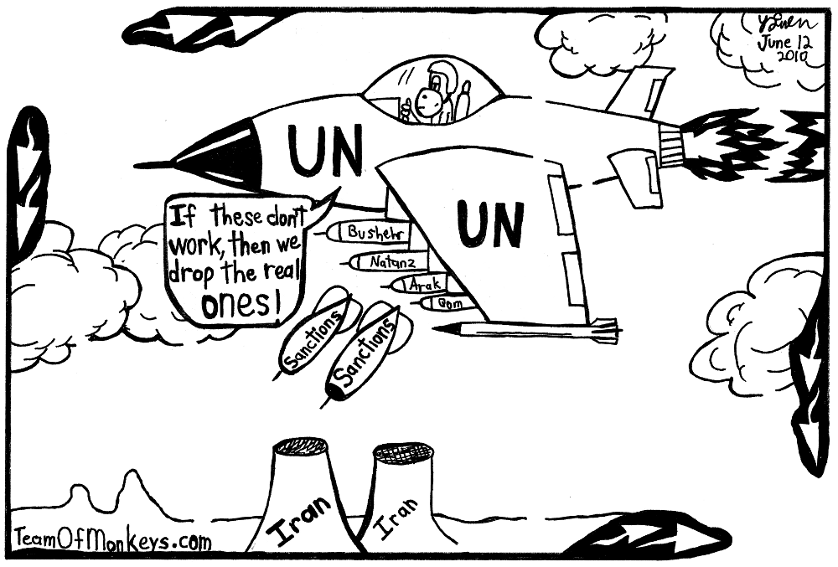

Slide 12
What Were the Tools ?
UN Security Council Resolutions:
Created the broadest possible consensus recognizing the problem, legitimizing actions and creating the common denominator for enforcement.
“Like – Minded” Autonomous Sanctions by European Union, Australia, Canada, Japan, South Korea
United States Sanctions: Forcing international companies to make a choice between business with USA or with Iran
Unique outreach to business community: Creating an atmosphere in which doing business with Iran is bad for business.

Slide 13
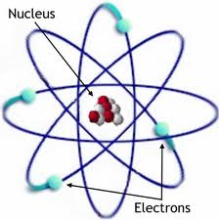
Focusing Pressure on the Regime and Its Strategic Assets
Nuclear Program – Delay by blocking procurement
Energy – “Fuels” the regime
Banking and Insurance – Enables the business
Transport – Blocking Delivery Channels
IRGC – Iranian Revolutionary Guard Corps (Quds Force)

Slide 14
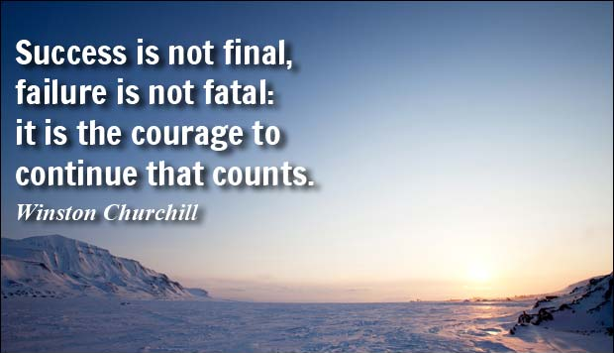
Assessing Chances of Success
What price would regime be willing to pay ?
Are there economic assets to target ?
What tools are available?
Do I have alternative leverage ?
Do I have partners ?
Do I have spoilers ?
What’s the end game ?

Slide 15
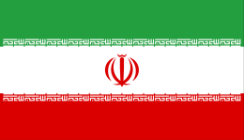
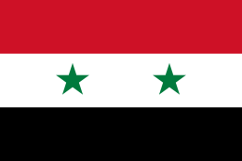
Iran vs. Syria
 | IRAN | SYRIA
Willingness to Pay the Price | Up to a point. Susceptible to pressure of the population. | Very High. Limited circle of supporters who must be considered
Economic Assets | Significant: Oil, Foreign Investment, Access to Financial Markets | Limited: Not a major economic player
Tools Available | Significant | Limited
Other Options – Creating Leverage | Possible | Limited
Partners | Yes (after establishing international legitimacy) | Yes
Spoilers | Possible – China, Russia, India, Venezuela, Turkey | Possible – Russia, Iran, Qatar
Regime Desire for Legitimacy | Yes | No
End Game | Stop Nuclear Weapons Program | Not Clearly Defined

Slide 16
How Can we Assess Effect of Sanctions?
Economic Indicators
Statements by leaders
Behavior in negotiations
Change of internal industrial behavior: Trying to adapt to the changing reality and hardship
Investment in Circumvention activities
Decrease in Foreign Investment
Foreign companies withdrawing because of growing risk
Reaching an agreement

Slide 17
2012 | 2011
2.7 | 3.5 | OIL PRODUCTION (MBD)
1.0 | 2.5 | OIL EXPORTS (MBD)
44 | 87 | REVENUE FROM OIL EXPORTS (BILLIONS OF DOLLARS)
12,260 | 10,616 | RIAL TO DOLLAR EXCHANGE RATE (OFFICIAL)
35,000 | 15,000 | RIAL TO DOLLAR EXCHANGE RATE (BLACK MARKET)
90 (ihs) | APPR. 80 | FOREX RESERVES
-1.9% (APPR. 9 BILLION US$) | 6% | COMMERCIAL SURPLUS / DEFICIT - % of GDP
-4.8% (APPR. 25 BILLION DOLLARS) | -0.9% | FISCAL SURPLUS / DEFICIT - % OF GDP
23.6% (UNOFFICIAL FROM 50% TO 196%) | 20.6% | INFLATION
15.5% (UNOFFICIAL FROM 25% TO 30%) | 14.1% | UNEMPLOYMENT
-1.4% | 1.7% | GROWTH RATE
Notes:
Sources: EIU and IEA estimates

Slide 18
The Toolbox

Slide 19
Designations
Identifying Specific Illegal Actors:
Government of Iran
Central Bank of Iran
Leaders of Nuclear Program
Military Commanders and IRGC Leadership
IRGC Economic Entities
Airlines and Shipping Companies
Port Operators

Slide 20
Sectoral Bans
Mining Industry
Shipping and Ports
Energy Industry
Airline Industry
Auto Industry

Slide 21
Financial Cut-off
Define as Money Laundering Concern
Freezing of Foreign Currency Reserves
Blocking Access to SWIFT messaging platform
Block access to dollar transactions
Cut off correspondent relationships
Designation of banks

Slide 22
Economic Interdiction
Blocking specific transactions and circumvention channels
Preventing free movement of shipping: Classification, Flagging, Insurance
Creating the “Risk Environment”

Slide 23
Intelligence Dilemmas in Trying to Build Economic Pressure on Iran

Slide 24
The Pain Threshold of the Supreme Leader
Can we impact SLK through economic pressure and bring about a change on his strategic nuclear policy – “Defining the Tipping Point”?
Challenges:
The decision lies in the hand of one person who is relatively isolated and in some ways disconnected.
His sense that the ultimate goal is “regime overthrow” and the nuclear option is the guarantor of its survival and sustainability.
Graduate of Iran-Iraq war: He has seen much worse.

Slide 25
Am I Impacting the Right People?
Sanctions are aimed at central sectors of the economy and the nuclear program – Finance, Shipping, Energy and IRGC. Is this the right path to increase pressure on SLK and his close circle ?
Challenges:
Creating enough pressure on the inner circle.
Identifying who is in the inner circle.
Iran has significant coping ability and circumvention avenues to relieve pressure.

Slide 26
Backfire Potential
Is the formula of “pressure from the street” viable or are steps impacting the “man in the street” thus unifying them around the regime?
Challenges:
Creating true economic assessment
Dealing with disinformation, particularly around humanitarian suffering
Consensus around targeting the nuclear program but not the citizens
Raising the bar incrementally each time is an effort: Iran Air, Central Bank, Oil Embargo

Slide 27
$$$$$$$ Oil $$$$$$$
To what extent are we running the risk of creating a shock that would risk the consensus and the play into the pockets of Iran ?
Challenges:
Global Economic Downturn and fear of worsening
Limited global oil reserves and potential production
Energy as a vital lifeline for Asian countries
Keeping everyone on board
Iran circumvention efforts
Ability of Iran to create disruption in Hormuz
Iran benefits if price goes up
The importance of the Energy Sector to Iran’s Economy

Slide 28
Time
Given the progress of the nuclear program is there sufficient time to build effective pressure and are others going along to avoid action ?
Challenges:
Economic pressure accumulates over time
Every action requires time to be adopted and implemented
What is the status of project and when does “window close” for other options ?

Slide 29
Releasing of Information
Does intel reach the right address of those who can use it in real-time who are often civilian–political actors ?
Challenges:
DNA of intel is protecting info and sources
The people responsible for actions and policy are not necessarily in the IC
Use of political and diplomatic channels for interdictions of malign actions
“Evidence vs. Intelligence”
Using the open source world for increasing pressure and “outing” of malign activity and violators

Slide 30
Sanctions Implementation and Enforcement: Creating a New Narrative

Slide 31
Financial Actions Taken
ZTE – $1.2 Billion (Federal)
BNP Paribas – $8.9 Billion (Federal)
HSBC – $1.9 Billion (Federal)
Standard Chartered - $1.02 Billion (Federal and State)
ING - $619 Million (Federal and State)
Tokyo Mitsubishi - $565 Million (State)
Credit Suisse - $536 Million (Federal and State)
ABN Amro (RBS) - $500 Million (Federal)
Deutsche Bank - $258 Million
Lloyd’s - $350 Million (Federal and State)
Barclays - $298 Million (Federal and State)
JP Morgan - $88 Million (Federal)
ABN Amro - $80 Million (Federal)
Citibank - $2 Billion in Frozen Assets
Commerzbank - $650 Million (pending final agreement)
Total Financial Actions:
Greater than $19 Billion fines or frozen assets

Slide 32
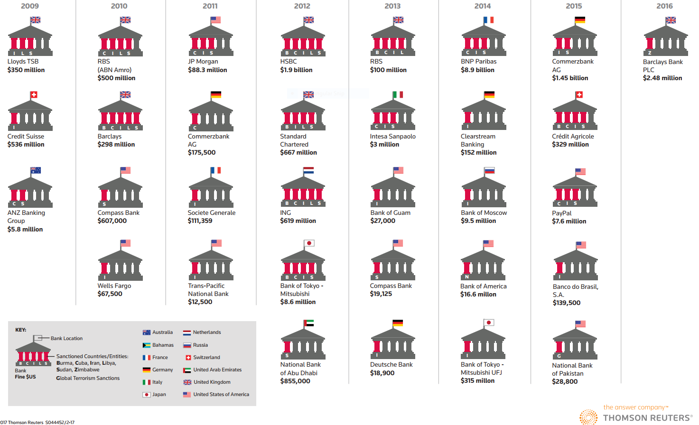

Slide 33
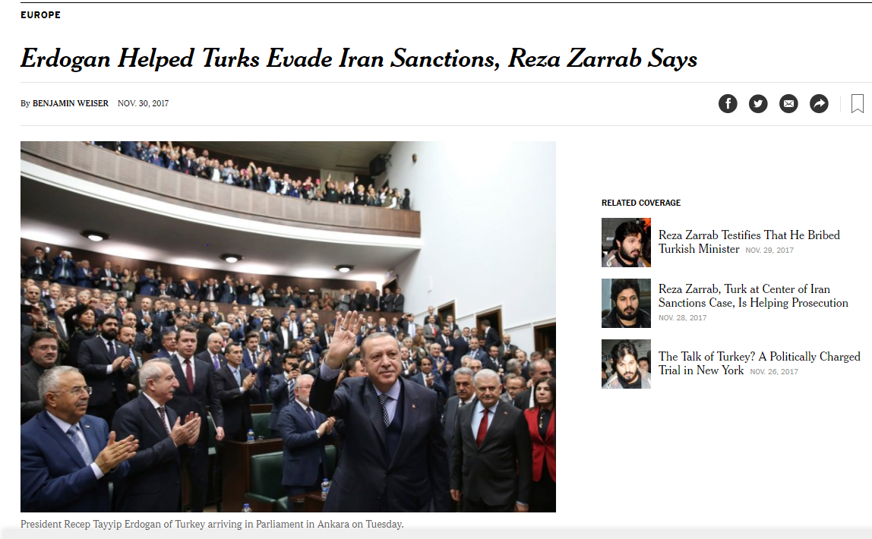

Slide 34
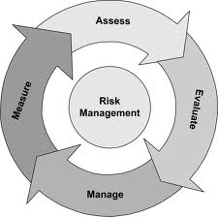
Focusing on Risk
Reducing financial risk:
Danger of facing financial penalties
Losses caused by bad business practice (mortgage exposure on sanctioned vessels)
Inability to receive payments because of international sanctions
Displaying the highest level of fiduciary responsibility
Meeting compliance and due diligence requirements
Mitigating Legal Risk
Avoiding violations of US sanctions
Avoiding Terror Finance and Money Laundering violations
Avoiding fines and legal action
Confronting Security and Safety Risk
Abuse of Transport
Illicit arms and persons
Avoiding Reputational Risk
Bad for business to be affiliated with State that supports terror and is serial violator of human rights

Slide 35
Discussion Points
Monitoring and Implementation:
Look at designation lists
Dissemination of Information:
Govt. must act to protect its own businesses from risk of violation
This is not a “business opportunity”
Enforcement:
Working against the violators and those who enable circumvention
Due Diligence:
Making sure you are in compliance
“Know Your Customer. Ignorance is not a defense”
Mitigating Risk:
Taking steps to eliminate exposure

Slide 36
Fighting illicit IRANIAN ECONOMIC ACTIVITY after jcpoa

Slide 37
Where does this Leave Us on the Day After the Agreement?
Greater funds available for Iran:
Improve military capabilities
Continue illicit activities in violation of UN resolutions regarding missiles and arms transfers
Budget for Revolutionary Guards and Quds Force
Financing activities of proxies in Lebanon, Syria, Gaza Strip and Yemen
Continue Regional Subversion
New access to markets allows freedom to create new financial and procurement networks
Learning the lessons of sanctions regimes – Building immunity in key sectors (banking, foreign currency reserves, financial transfer mechanism)

Slide 38
Focus Areas after JCPOA: Iran Remains Major Concern and Center for Illicit Finance
Nuclear Weapons
Missile Program
Weapons Transfers
IRGC / Quds Force
Support of Regional and International Terror

Slide 39
Primary Goal is to Prevent Actions that Create Significant Threat to Israel’s Security Environment
The Response:
Strict Sanctions Compliance
Credibility of JCPOA
Enforcement of Remaining Sanctions
Monitoring and Intelligence
Exposure and Interdiction

Slide 40
Iran: Has it Reaped the Benefits of the JCPOA ?
Greater access to financial assets abroad
Increased trade with EU and others
Increased oil production and exports Approximately $18 billion annually
Still perceived as high risk environment
Still blocked from USA market
Failure to attract major investments

Slide 41
What’s Holding them Back ?
Budget priorities:
Proxies
Defense Spending
Saving for a “rainy day”
Economic Policies:
Still a bad place to do business
IRGC involvement in the economy
Reinforcing the image as a dangerous actor:
Missile tests
Arms transfers
Actions of proxies
Perception as high risk environment

Slide 42
The Risk Portfolio
Money Laundering: FATF, Patriot Act PML
IRGC and Quds Force Access to Financial Assets
Remaining Sanctions:
Terror
Human Rights
Missiles
Weapons Transfers
Nuclear
USA Unilateral Sanctions on Finance
Other programs: Syria, North Korea, Russia
Snap Back of pre-JCPOA Sanctions

Slide 43
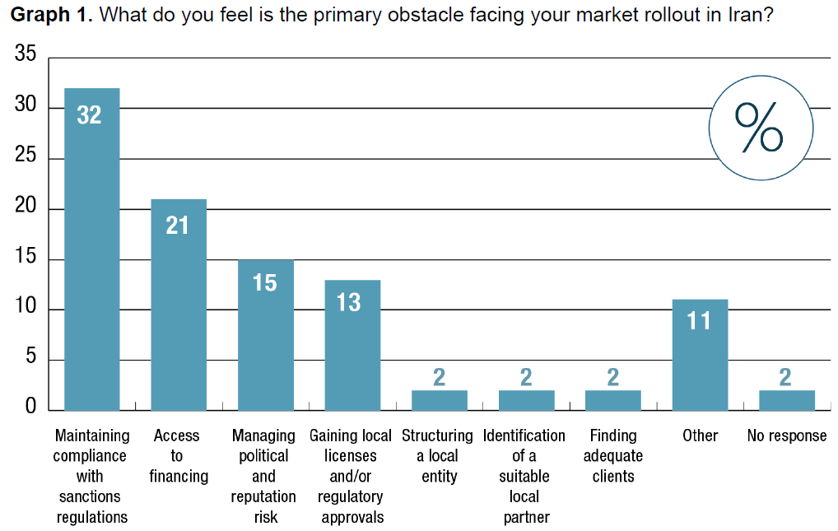

Slide 44
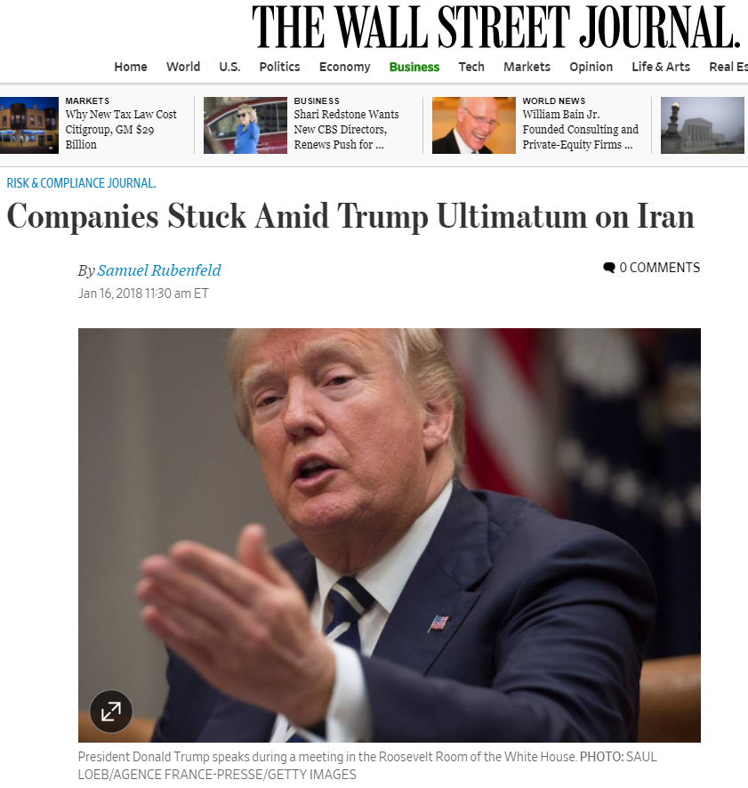

Slide 45
How Does this Fit with JCPOA ?
Remaining sanctions
Able to sanction new entities
Sanctions under new authorities
Remains High-Risk Environment

Slide 46
90 – 120 - 180
Certification or Non-Certification: 90 days
Internal US Process
Triggers ability to begin congressional actions
Suspension of Waivers: 120/180 days
Likely means departure from JCPOA

Slide 47
Now What ?
Risk and uncertainty is very high
Expectation of stricter enforcement of JCPOA and “Small violations”
Greater enforcement of existing sanctions including in 3rd countries
Possibility of new sanctions on non-JCPOA areas: IRGC, Terrorism, Proxies, Arms Transfers, Missile Program and Defense Industries, Human Rights

