Slide 1
Psychical Culture
Maj Efrat Broza
“Top 8” lecture
Israel National Defense College

Slide 2
Who am I… What am I?
Efrat (Itzhaki) Broza, 40 years old+ 2: Ilay + Liya.
Lives in Rishon LeZion. Coach, teacher and athlete.
22 years of service in the IDF in the Combat Training Formation. Positions:
School for Squad Commanders and Infantry Positions / Brigade 401 / Battalion 94 / Adam Training Base / K9 and CT Base / Assistant to the Head of Administration / Deputy Commander of Training Camp 8 / Head of Combat Training check-ups / Head of HR at Combat Training / Training Officer of Ground Forces and today Head of the Sports Culture in the IDF Military Colleges
Instruction in military and civil training
B.A Business Administration / M.A Media

Slide 3
Physical culture is an integral part of military culture and accordingly it’s required to develop sports habits as an individual and as a group. Weekly workouts will expose you to a variety of physical activities, in which anyone can take part and find their “niche” in the colleges. You can also acquire a personal training program and personal guidance with instructors at the gym. Our Goal?
Physical Culture in the INDC

Slide 5
Impart a cultural and personal change which includes improving performance of challenges, feeling capability and self-confidence Perceptional transformation Experience, diversification and fun Professionalism – explain and learn Sports culture agents
Goals of the
Physical Culture Department

Slide 6
I Believe in
The Ability to Command
Connecting the Head, the Legs and the joints
Living a Healthy Lifestyle
Sports Culture

Slide 7
Who likes waking up early? Who likes waking up early for a workout? Who likes waking up early for a workout in winter? Who wakes up mumbling… yes… yes… yes…? ?
What do you do when you wake up in the morning…

Slide 8
Healthy Lifestyle
From Military Leadership / Chief of the General Staff Haim Laskov
The purpose of the IDF as an organization is to allow regular people to do irregular things…
“Even if I cursed my worst moments, even if in hard times I thought how to get out, after the act I am filled with satisfaction and remember those moments with pride”.

Slide 9
Assumptions
TOP 8

Slide 10
1.Knowledge is power ... to know the "human machine"
Running on “Fryer” – Running with “fat”
When was it harder?
Who needs more
Energy/ Calories
In activity and in rest?

Slide 11
Professional - in depth
Strength, resistance and core
Warm up and
calisthenics
Balance
Elasticity, stretching

Slide 12
2. Strength is knowledge
Did you know?
Muscle tissue consumes approx 2.5 times more energy than fat tissue.
No need for just a lot of running in order to lose weight.
To lose weight, we work a lot on strength and resistance !!!

Slide 13
3. Strength and
Stability
What we know and don’t bother telling you
It is important to increase the muscle-strengthening leg exercises and core muscles (deeper muscles in the abdominal region). When these muscles are strong, the shock from strain while running is minimized.
* The impact of landing on the ground is equal to 4 times the body weight.
Upper Body “pull” excersizes+ explosive power: pull-ups, strokes On Hand strength rope climbing, etc.
Torso exercises + power boost : pushups, planks, etc.
Lower body exercises: squats, lunge, etc.
Core stabilization exercises thick front logo and static sidebar pelvic lift abdominal oblique lifts while lying, etc.

Slide 14
Strength Training Principles / Effective Resistance
Using Multiple Muscle Groups
Maintain good Posture
Exercise on several levels
Balance between muscle groups

Slide 15
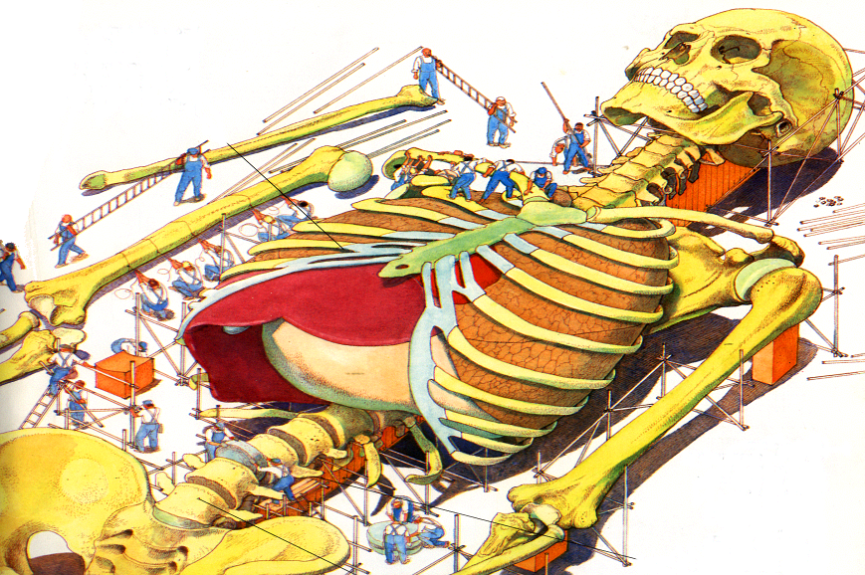
4. Building Process
During the exercise there are destructive processes to the body,
Good recovery after activity will result in building and strengthening processes.
Building
Destroying
Destruction is necessary for building, however if conditions will not be suitable for construction, destruction will lead to injuries, exhaustion

Slide 16
Applause
Bone growth Rules
Definition: The bone grows in direct relation to the load applied to it, depending on the direction, provided it does not exceed the physiological boundaries and is non-contiguous.
What are the Physiological Boundaries?
Weight, age, height, physical strength, build, gender.
What can hurt bone growth?
Overload
Lack of rest and recovery, with an emphasis on the lack of sleep.
Poor nutrition

Slide 17
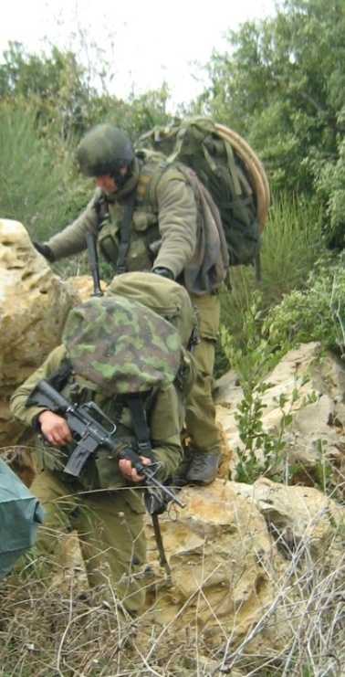
Building Muscle/Muscle Mass: Small Number Of Reps But Add Weight
Types of muscle cramps
Concentric phase requires working with slow movement for developing strength, working properly will prevent injury.
Muscle Activity
Eccentric
Tightening the muscle contracts and lengthens
Ex. Phase going down rock/step
Concentric
Muscle cramps which contracts and shortens
Ex. Phase of increased pain/strain

Slide 18
5. If you suffer more is your workout more effective? Run with pleasure…
Maximum Heart Rate | Workout Intensity | Characteristics
70% - 60% | Mild to moderate-intensity workout, greater volume | Improve aerobic endurance Improve heart function
80% - 70% | Moderate to high intensity workout, great volume | Hard workout, fast paced aerobics. Little use of anaerobic sources
90% - 80% | Very hard workout | Uses mainly anaerobic energy sources Training to raise the lactic acid threshold.
Working with different heart rate changes the intensity of the workout and characterizes properties regulating the intensity required to achieve objectives

Slide 19
Determining Target Heart Rate
Formula for determining heart rate: Karvonen Formula.
The advantage of this formula is that its customized for the person exercising because it takes into account the resting heart rate.
The movement requires:
Maximum heart rate
Resting heart rate
Required level of intensity, in relation to the maximum effort
Pulse reserve. (Pulse reserve = resting heart rate – maximum heart rate)
Heart rate objective = [reserve heart rate x desired %] + resting rate
220-Age dictates the general maximum heart rate

Slide 20
Establishing Heart Rate Objective
“Mabalniks” age 45 are interested in exercise intensity of 70% desired heart rate.
A strong resting heart rate is : 70 (times a minute).
Calculation:
Maximum pulse = age – 220
220-45=175
Heart rate reserve = Maximum heart rate - resting heart rate
175-70=105
Objective heart rate : 70+ [0.7 x 105] = 143.5
Target heart rate = [reserve heart rate x desired %] + resting heart rate

Slide 21
6. Correct running style –
important to ensure
Tilt your body slightly forward
Arms swinging freely and relaxed at your sides
Small steps to save energy
Running in which you tilt your body forward and use powerful strokes, small step size.
Running with proper shoes.
Soft surface is preferable: dirt roads, sand etc. Less on roads.

Slide 22
7. injury while training / rehabilitation from injury
It was found that training while injured improves functional - mental aspect - a sense of competence.
Talking about the rise in the measures similar to that of sedentary lifestyles with no training at all during the injury.
Facilitation that is treated by only resting (in bed) causes an increase in the sense of pain and a longer recovery time.

Slide 24
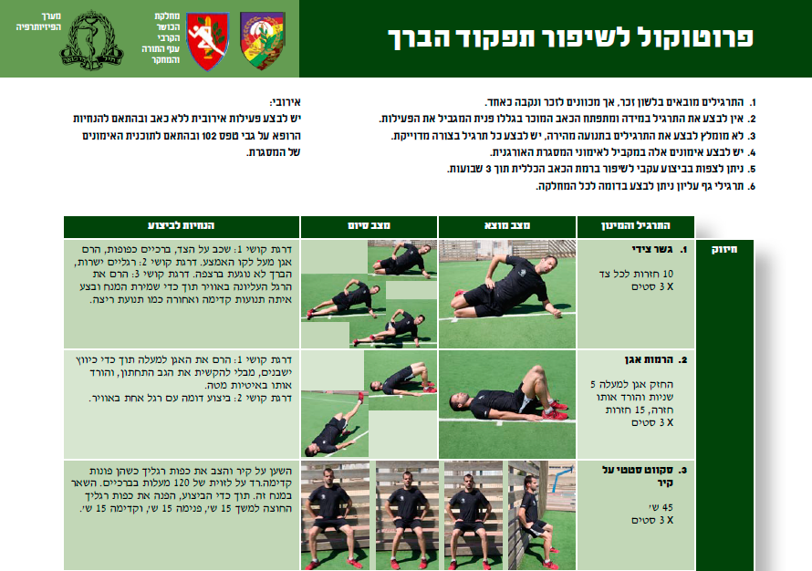
Protocol to improve the functioning of the knee
The exercises are presented in the masculine, but intend to male and female alike
Do not perform the exercise if the familiar pain (that you stopped the activity because of it)develops
We do not recommend fast motion exercises, each exercise should be performed accurately.
These workouts should be performed in with your regular training
You can expect with consistent performance an improvement in the overall pain level in three weeks.
Upper back exercises can be performed to the whole department.
Aerobics:
Aerobic activity should be performed without pain and within physician guidelines102 and in accordance with the training program of the framework.
Guidelines
End state
State of origin
The exercise and the amount
Level of difficulty 1: lay on your side,
knees bent, lift waist above the middle
line. Level of difficulty 2: straight legs,
knee doesn’t touch the ground. Level
of difficulty 3: lift the outer leg in the air
while keeping your spine position
straight and move it forward and
back in a running motion.
Side bridge
10 reps on
each side x 3
sets
Strength
Level of difficulty 1: lift your waist
upwards while squeezing your bottom,
without arching your lower back, and
lower slower back down.
2. The lift of the waist
Keep waist up for 5 seconds and lower it back down, 15 reps x 3 sets
Lean on the wall and place your feet
facing forward. Go down to a 120
degree angle with your knees. Stay in
this position. During the exercise, face
your feet outward for 15 seconds, inside
15 seconds, and forward15 seconds.
3. Static squat on the wall
45 seconds
X 3 sets

Slide 25
8. !!YES YOU CAN
Video: Dick and Rick Hoyt

Slide 27
No more excuses
Clothing and a towel - you received
Training program - to all those interested
Guided training - we are at your service
All level training – we are experts at it
Advanced fitness room - free of charge
Personal trainers in the fitness room - 24 hours in advance
Protocols to improve functioning - Personal
All that remains is to decide whether to make a revolution and make physical activity into a culture !!

