Slide 1
MFA Asia Pacific Deputy Director General Briefing to National Defence College

Slide 2
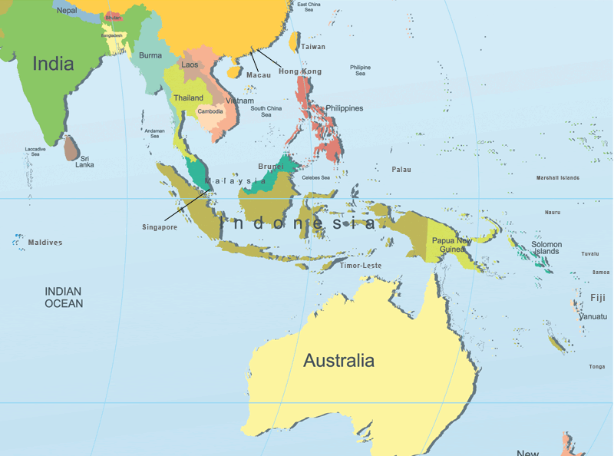
Who are we?
36 countries
11 Foreign missions in Israel
19 Israelis missions
12 MFA Employees
650 diplomats and Israeli employees in the region, of them 67 MDA diplomats, (150 including families, excluding security personnel)

Slide 3
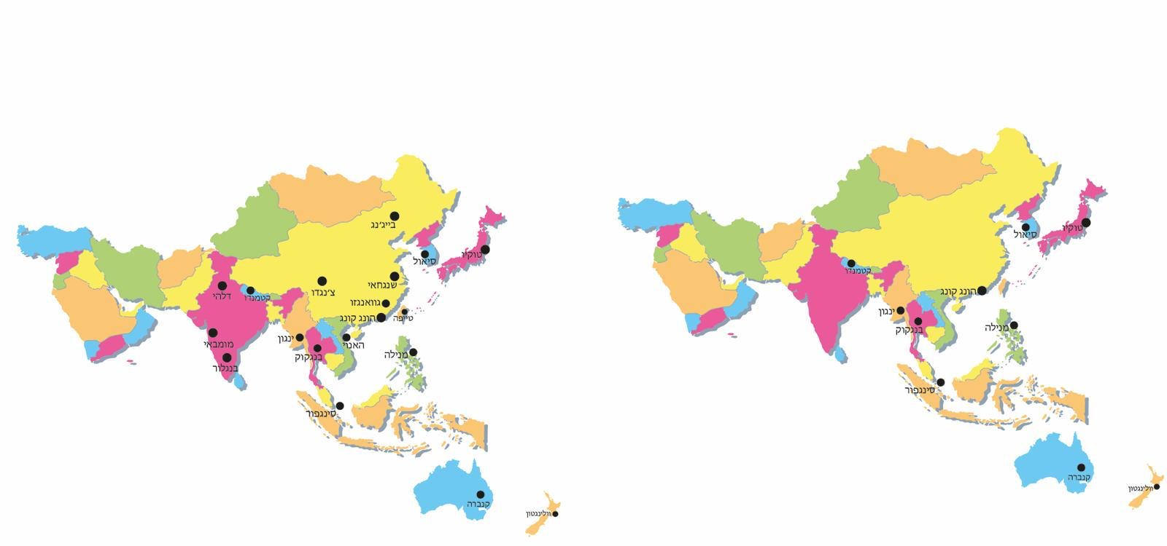
Diplomatic deployment in the region 1990-2020
Goal: Resident embassies of Singapore and New Zealand in Israel

Slide 4
Asia today
55% of the worlds population
Global economic growth powerhouse: according to the World Economic Forum, Asian growth in 2030 will account for 60% of global growth
This year, Asia’s GDP will account for over 50% of global GDP
Diverse continent in every aspect: in countries’ sizes and clout, economic development, regimes, ethnic groups
Regional impact of China-US tension
The Middle East – first and foremost as an energy supplier

Slide 5
Asia in Israeli eyes
Economic opportunities: trade, investment, tourism, defense
COVID-19: mutual assistance, procurement and donations, medication, joint research
Mainly economy-oriented relationships, political issues not the key focus
International Organzations: positive trend, further endeavors needed
No anti-Semitism, positive disposition towards Israel in local populations

Slide 6
Economy
Goals:
FTA’s with China, Korea, Vietnam
PTA with India
Commencement of FTA Negotiations with Japan, Thailand
ADB membership
Joint cooperation: MFA, Ministry of Economy, PIBA
Promotion of export and investment
Energy

Slide 7
Defence cooperation
Emerging markets: Japan, Phillippines, India, Vietnam, Australia.
Existing: Singapore.
Goal: Second Poli-Mil dialogue with Japan
Goal: Designation of Hizbullah in Australia

Slide 8
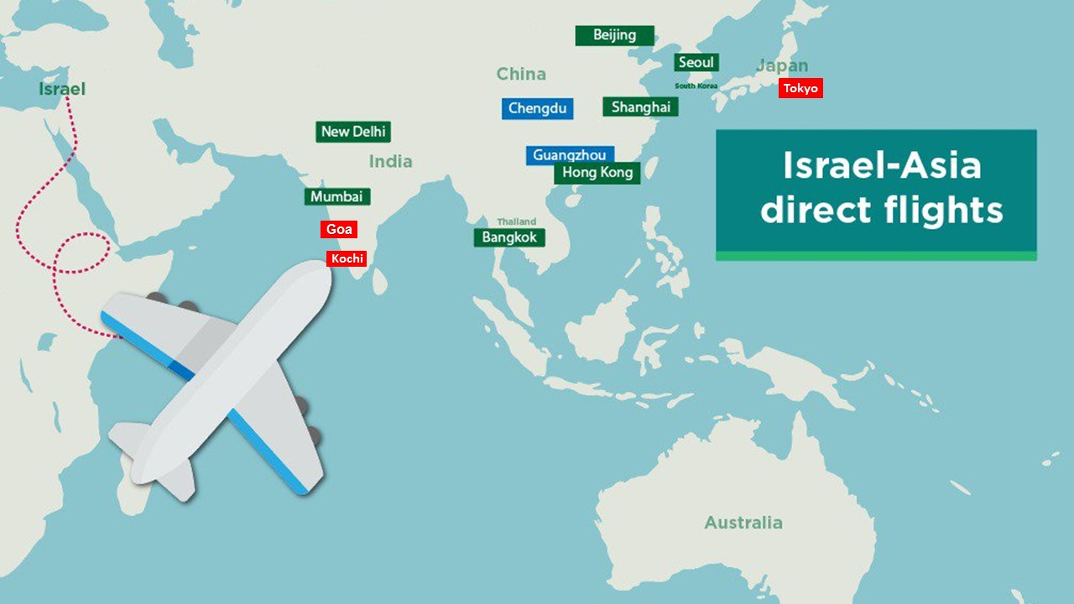
Tourism

Slide 9
Foreign labor
Owing to bilateral treaties, most of the foreign laborers in Israel in construction, agriculture, tourism and elderly care come from Asia
Existing treaties with China, Thailand, Sri Lanka, Phillippines
Negotiations with Vietnam and Nepal underway

Slide 10
Thank you

