Slide 1
Rabbi Kook and the National-Religious Tension: Territory, Symbols and Sovereignty
Prof. Yosef Shilhav
Lecture at the National Defense College
4.10.2018

Slide 2
The Catch
Zionism and its daughter, the State of Israel, who arrived at the Western Wall in the means of military occupation, as the fulfillment of national messianism, will never be able to abandon the Wall and leave the occupied parts of the land of srael without denying its own historiosophic conception of Judaism. Realizing Zionism was caught in the net of its own achievements. To abandon them means acknowledging its failure as a spokesman for the historical continuity of Judaism. The secular Messiah can not retreat; He could only die. In this he pays the price for his bold attempt to give the fate of Judaism to the circle of secular history. [...] A retreat reveals the fracture in the historic continuum, which is the one and only truth. The rest was an illusion.
Baruch Kurzweil, "External Observation Our Situation"

Slide 3
Zionism as a National Movement that Demands a Nation-State and Sovereignty for the Jewish People in Israel
Under the influence of European nationalism of the 19th century

Slide 4
Religion and Nationalism
Netziv of Volozhin (1817 - 1897)
On the vengeance of Shimon and Levi on the inhabitants of Shechem: "that two of the sons of Jacob, Simeon and Levi, Dinah's brethren, took each man his sword, [...] because they had defiled their sister." (Genesis 34).
"The second" box "is superfluous ... and it came to teach us that we were united in great anger to destroy a city and its entirety, and also united to bring themselves to great danger," they were two - we were different in the opinion that ignited this fire. One comes with a human opinion that zealously protected the honor of his father's house, and he brings such fire and he is a foreign fire, as is known, and A. comes to the knowledge of God's zealousy without any face and desire, and it is a fire that is the flame of the Lord. And even from such a fire, one must be very careful about the direction of the place and the time, and in this case it spoils a lot "
Rabbi Meir Simcha HaCohen of Dvinsk (1843 - 1926)
Sympathy, enthusiasm, and admiration as emotional responses to natural phenomena and human traits are often translated into religious concepts of holiness. Sacred attribution that stems from human emotion to various elements of natural and human reality is idolatry.
"And it is Important to understand that the source of all the holy places is not religion but the nation and the roots ... and Mount Sinai is the place of religion, since the Divine Presence has departed from it - sheep and cattle would be sacrificed ... Therefore it is said that a person‘s worth is not determined by a location, but a location’s worth is the determined by a person (Ta'anit 21) and that is a worthy idea. and therefore in the eternal home whose sanctity is forever... They should not imagine that the holiness is of the building itself"

Slide 5
What is Religious Zionism?
In Zionism there are believers and atheists, liberals and conservatives, socialists and capitalists, rich and poor, Ashkenazi and Sephardi. What is special about Zionist religious people?

Slide 6
The Development of Halacha as a Precedent-Setting Law
Of the 1,000 questions addressed to the rabbis - 900 "technical" answers can be found ;
Another 99 questions will require judgment, review and comparison to similar precedents;
One question out of the thousand is unprecedented and will require a new Halachic creation.

Slide 7
The Halacha Crisis
"In such periods, exceptional intellectual flexibility and an acute appreciation of reality are required in order to think creative Halachic thought about a very wide range of matters;"
"A new Halachic creation - an unconventional way of thinking, a sharp analysis of reality or a new enlightenment of an well known concept"
Eliezer Goldman (1918 - 2002), one of the founders of Kibbutz Sde Eliyahu.

Slide 8
Religious Responses to Zionism
Rejection - most of the religious leadership
Compartmentalization - Rabbi Yitzchak Ya'akov Reines (1839-1915)
Paternalistic Annexation - Rabbi Avraham Yitzchak HaCohen Kook (1865 - 1935)

Slide 9
The Religious Kibbutz Against a "Sabbath Gentile"
Security: fear of hostile Arabs entering the Kibbutz property;
Hygienic: Caution from infecting cows with diseases;
Ideological: A complete and independent Jewish life can not depend on the work of foreigners.

Slide 10
The Ruling of Rabbi Kook
Milking during the Shabbat is an absolute prohibition and a terrible desecration of the Sabbath, and God forbids it, and there is no way but to have gentile people milk on the Sabbath like our forefathers did.
A Jewish settlement must have a number of gentiles, as there are some things only they can do during Shabbat and Good Days.
The laws of the Torah are certainly more powerful than any of the made up customs that people have created. They are the essence
of our lives, the length of our time and the foundation of our resurrection in the Holy Land.

Slide 11
Is it a Commandment to Immigrate to Israel?
The essence of the commandment is only the inheritance and being a person who minds his own business, to conquer the Land of Israel that will be under our inheritance [...] And the last of the matzos were eaten, because the essence of the commandment is eating. And taking the wheat for the sake of a commandment, and the kneading and the baking are not the end of the commandment. And in any event, it is certainly a great commandment [...] because the kibbutz is the beginning of redemption.
Rabbi Yisroel Yehoshua Trunk (1891), Rabbi of Kutana, responsa Yeshua Molcho

Slide 12
Halachic Accessibility to National Questions?
In my opinion, there is no doubt that it is difficult to find a permit for ourselves to write and sign that we are giving up the largest part of the Land of Israel, that there will no longer be the Land of Israel but the land of Ishmael [...] Such concessions can be made between all peoples and countries, but not in regard to the eternal connection between the people of Israel to its country, which is not only its national land but also the Holy Land [...] and just as if we are forced to deny the sanctity of the Torah we are obligated to give our souls [...] And even more so that we can not deny the sanctity of the land, signing this concession is a heresy in the sanctity of the land, for nothing holy can be negotiated and sold.
Rabbi Moshe Avigdor Amiel (1882 - 1945), 13 Menachem-Av 1936

Slide 13
Halachic Accessibility to National Questions?
Regarding the current question of the Royal Commission's report, if we were asked to relinquish a part of Israel, it is simple and clear that we shouldn't, since no matter what kind of concession he makes in the sanctity of the country, whether it be a large or small part, there is not difference between admitting just a part of it isn't holy or its entirety isn’t. [...] Just as if one would say that the entire Torah is from heaven except for one letter, he is a heretic, one who says the entire land of Israel belongs to Israel except for one step of it would remove from the sanctity of the land and will dictate it's spirit.
Rabbi Ya'akov Moshe Harlap (1882-1951), 13 Menachem-Av 1936

Slide 14
National Identity and Sovereignty
The components of the national identity exist in human consciousness and experience - "imagined reality";
To reinforce the imagined reality, people shape objective reality according to its principles and beliefs;
Territoriality is the "geographical body" of the nation that is part of the identity of;
The modern state establishes this "body" by a census and mapping;
In doing so, the state makes the abstract concept "nation" into a tangible thing.
Anthony Smith

Slide 15
The Regional Significance of Culture
Human beings form an identity with sites, places and landscapes as part of its components;
This design is based on processes that contain indoctrinating elements of iconographic elements;
In order to assert territorial identity and to be recognized by external factors, people present their presence by influencing the landscape in the spirit of their culture.
Paul Claval

Slide 16
Iconography
Multicultural existence on a shared space is possible when each cultural group has its own territorial symbols;
When different cultural groups begin to compete for the same territorial symbols, common existence encounters difficulties;
Transition from economic emphasizes to power indices.
Paul Claval

Slide 17
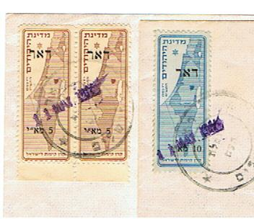
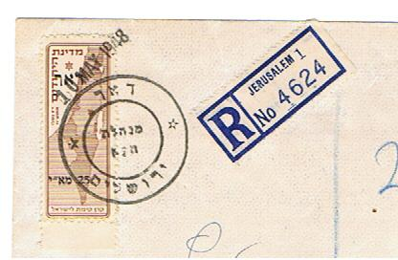

Slide 19
A national iconography usually stops at a boundary; the frontier line is in grave danger when such is not the case.
(Jean Gottmann, 1952)

Slide 20
Rabbi Yehuda Halevi (Rihal) 1075 - 1141
And the land of Canaan is special to the God of Israel, and the deeds will not be paid but in it, and many commandments are nullified for those who are not in the Land of Israel, and the heart and soul are not pure and just but in a place where they know is special to God.
"The Kuzari," article five

Slide 21
Rabbi Kook on the Land of Israel
The Land of Israel is not an external thing, an external property of the nation, only as a means of general incorporation and the maintenance of its material existence or even its spiritual existence.
The Land of Israel is a central division connected with life to the nation, surrounded by the inner qualities of its reality. It is therefore impossible to discern the content of the sanctity of the Land of Israel and to carry out the depth of its importance in any rational, human education, but in the spirit of God, on the nation as a whole.
"Orot," Mossad Harav Kook, 1982, p.

Slide 22
On Sanctity
Judaism has always held the opinion that holiness is not an objective matter inherent in the essence of any object and does not exist in the sacred object independent of the way it is treated. We reject the notion that holiness exists on its own, a constant metaphysical gift that does not take into account person's relation to the object. Such an approach to the concept of holiness will be limited by fetishism and primitive taboos. Holiness is born through the actions of man and through his experiences, and even determined by them [...] It is more an experience than a feature of value. If you do not experience any object or institution as holy, then they lose their unique and numinous character.
Rabbi Soloveitchik (1903 - 1993)

Slide 23
On Sanctity
‘Sanctity’ is a substantial and realistic reality, not a humanistic and emotional phrase. The reality of sanctity is not determined by us; God decided that we are a holy people, a fact of reality; holy souls in holy bodies, which are expressed as an all-Israeli soul, which is all holy. There exists the reality of a place of sanctity, a piece of land chosen by God […] and so it was determined: this is the holy land and this is the holy people! […] the materiality of Israel is holy. Of course, all that belongs to all of Israel is holy […] every criminal in Israel is holy – whether they like it or not!
Zvi Yehuda Kuk (1891-1982), Independence Day of 1966, published in “Religious Zionism and the State”, Dep. Of Education and Culture in the Diaspora, Jerusalem, 1978

Slide 24
What did Rabbi Yehuda Kook Lament Over?
On that famous night, when the decision by the rulers of the nations regarding the establishment of the State of Israel reached the country, when the whole nation ran outside to celebrate and express its happiness, I could not go out and join them. Alone I sat, with a burden on my heart. During those first hours I could not accept what happened, the terrible news which validated God’s word: “they divided my country”! The next day, the Gaon Rabbi Ya'akov Moshe Harlap came to our house. He felt the need to come… shocked, we sat in silence.
Le’Netivot Israel, 3

Slide 25
The Concept of a “Place of Sanctity”
Wherever Chazal deals with a place of sanctity, they define the level of sanctity by the number of Mitzvahs (religious decree) that one can fulfill in that place.
A place of sanctity is measured by the extent to which that place provides a basis for religious actions (fulfilling Mitzvahs). As long as these actions continue – the place is holy.
There is a fundamental difference between the role of the Land of Israel and that of Jerusalem and the Temple Mount.

Slide 26
The Sanctity of the Synagogue
Houses of prayer should be treated lightly: a person should not seek shelter in them from the sun or the rain; one should not eat, drink, sleep, or travel in them […] but you should read, discuss and debate in them.
Tosefta, Megillah, 82

Slide 27
About the Song of Songs
He who reads a line of the Song of Songs and does so in the form of singing, and he who reads a line in a house of feasts in the wrong context, both bring harm to the world, because the Torah stands in front of God and says: for God’s sake, your children have made me a violin to be played on by jokers.
Babylonian Talmud, Sanhedrin

Slide 28
What is the Sanctity of the Land of Israel?
The land of Israel is the holiest of the lands; and what is its sanctity? That the first fruit and bundles of grain comes from it, and is not brought from other countries.
Mishnah, Kelim 81, 46
Maimonides, Beit ha-Bekhira Laws

Slide 29
What makes Jerusalem Special?
Jerusalem was not divided into tribes, Yoma 12, Megillah 26
People cannot rent houses in Jerusalem because it is not their own, Tosefta, 42

Slide 30
“Hot Springs of Tiberias” in ?Jerusalem
Why did He not create in Jerusalem a place of warmth such as the hot springs of Tiberias? So that a man should not say to his friend: “we shall go to Jerusalem, if only for one bathing, dayenu (-it’s enough). And the travel becomes means to an end.
Homiletical sermon by Tanna Rabbi Dustai Bar Yanay, fifth generation Tanna, end of the 1st century AD.
Babylonian Talmud, Pesachim, 8, 2)

Slide 31
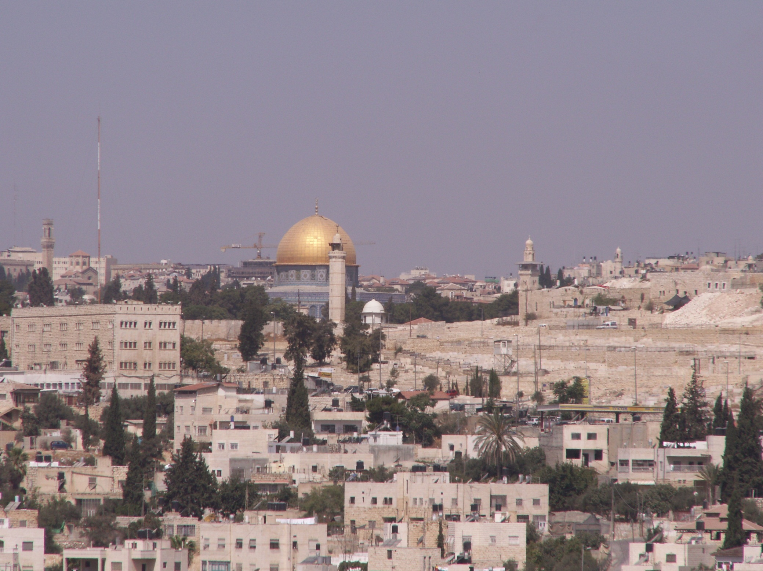
A person shall not enter the Temple Mount with his stick or shoe or in his vest or with the dust on his feet ... The Temple Mount shall not be entered through a way of shortcut. And one will not enter it unless for the purpose of religious precept
Maimonides, Beit ha-Bekhira Laws, 87

Slide 32
Religion and Nationalism
Netziv of Volozhin (1817 - 1897)
On the vengeance of Shimon and Levi on the inhabitants of Shechem: "that two of the sons of Jacob, Simeon and Levi, Dinah's brethren, took each man his sword, [...] because they had defiled their sister." (Genesis 34).
"The second" box "is superfluous ... and it came to teach us that we were united in great anger to destroy a city and its entirety, and also united to bring themselves to great danger," they were two - we were different in the opinion that ignited this fire. One comes with a human opinion that zealously protected the honor of his father's house, and he brings such fire and he is a strange fire, as is known, and A. comes to the knowledge of God's zealousy without any face and desire, and it is a fire that is the flame of the Lord. And even from such a fire, one must be very careful about the direction of the place and the time, and in this case it spoils a lot "
Rabbi Meir Simcha HaCohen of Dvinsk (1843 - 1926)
Sympathy, enthusiasm, and admiration as emotional responses to natural phenomena and human traits are often translated into religious concepts of holiness. Sacred attribution that stems from human emotion to various elements of natural and human reality is idolatry.
"And it is Important to understand that the source of all the holy places is not religion but the nation and the roots ... and Mount Sinai is the place of religion, since the Divine Presence has departed from it - sheep and cattle would be sacrificed ... Therefore it is said that a person‘s worth is not determined by a location, but a location’s worth is the determined by a person (Ta'anit 21) and that is a worthy idea. and therefore in the eternal home whose sanctity is forever... They should not imagine that the holiness is of the building itself"

Slide 33
Can religion and sovereignty be separated?
“Be sure to appoint over you a king […] Do not place a foreigner over you, one who is not an Israelite.” (Book of Deuteronomy chapter 17)
Non-Jews, foreigners and women are rejected from kingship, but also from any form of authoritative appointment over the public (Maimonides, Kings’ Laws, chapters 1-5)
In light of this principle, historical questions arose regarding the leadership of Deborah the prophetess and of Shemaiah and Abtalion the foreigners

Slide 34
Can religion and sovereignty be separated?
Rabbi Ben-Zion Meir Chai Uziel allowed the appointment of a woman to leadership positions in democratic elections, and one of the reasons was a religious commandment.
Rabbi Aryeh Leib Grosens, Av Beit Din (chief justice rabbi) of London, permitted the appointment of a 'ger' (biblical- foreigner; non-Jew) to head a school because "he can not do it alone, only with the agreement of the committee."
Rabbi Shaul Yisraeli allowed to choose a 'ger' for administrative governmental institutions, out of the democratic principle.

Slide 35
What is “authoritative appointment ”?
Complete authority
A life-long appointment that cannot be annulled
Bequeathing the appointment to an offspring (son)

