Slide 1
The Strategic Echelon – INDC 46th Class

Slide 2
Objectives
Exposure to the historical background, accumulating theoretical knowledge and analytical tools that enable the investigation, design and conduct of a military-defense strategy in the context of National Defense policy.
Creating an intellectual experience of theoretical and practical encounter with history. The theory and practice of strategic military thinking in National Defense contexts.
Exposure and familiarity with a public business strategy.

Slide 3
Objectives
To provide the participants with tools for system understanding and tools to lead strategic thinking processes as required in their positions as Brigadier Generals and their counterparts in the governmental and civil services.
To develop the field of leadership and systemic thinking (an ambiguous, variable, and frictionless environment) in order to better relate the tactical-operative actions to the wisdom of strategic action.
To encourage the challenge of the closed doctrine and to define the certainty of knowledge.
To expose the participants to the strategic complexity and various aspects of strategy, both in the public service and in the business world

Slide 4
Objectives
Providing practical analytical tools for systemic understanding and leading strategic thinking processes required for senior officials in the civil service and the security forces.
Developing the field of leadership and system thinking that links the tactical-operative actions to the wisdom of strategic action.
Encouraging critical thinking that challenges perceptions and a definite definition of knowledge.
Exposure to the strategic complexity and various aspects of the public service and the business world.

Slide 5
Participants:
Influencing, Contributing, Enriching and Leading Group
Staff:
Learning, evolving, committed and experienced
Leaders, influencers, those with vast knowledge, military leaders
National Defense
Various customized fields of content are taught in numerous methods, incorporating academia and practical applications
National Defense
International Affairs and Diplomacy
Economy
Society
Strategy – The ability to discern the required change, the ability to realize plans by being familiar with the tools
Campaign – Realizing the strategy by the use of diverse practical actions that are uniquely incorporated
Action – Carrying out the operation within the professional and thematic expertise that is integrated into the entire campaign
The State of Israel: values, interests, and national interests

Slide 6
Strategy is not Science, but Art
Development of Strategic Thought
Prof. Adam Adamsky
Strategic Thinking
MG Amir Baram
The Design Method
“The Dado Center”
What Enters the Pantheon?
First Experience “Northern Arena”
Second Strategic Experience
Political Security Simulation
The Palestinian Conflict
Public and Economic Strategy
Third Strategic Experience
“East Tour”

Slide 7
Orientation Map Strategic Echelon
The Development of Strategic Thought Prof. Dima Adamsky
The development of military strategic thought
Strategic Thinking MG Amir Baram
Background
Approaches and schools of thought
The history of strategic thought and the development of conventional warfare
History of Strategic Thought The Age of Hybrid Warfare
History of Strategic Thought in the Nuclear Era
Intelligence diagnosis and strategic planning
Design approach
"Dado Center"
Environmental characteristics and research approaches
Systems thinking
Strategy and learning
case study
Design approach
Design approach
Design approach
Russian strategy in the Middle East
Cyber
First strategic experience
"Northern Arena"
Reference
Experience in the design approach
Summary
Second strategic experience - political security simulation
Palestinian conflict
Reference
Simulations
“Unveiling"
Summary
Public and business strategy
“Evolution” of strategic thinking in the business world
New approaches
The diffusion of strategic thinking into the public sector
Strategic thinking diffusion into the public sector Tasting meal - an overview of the arsenal of strategy-supporting tools
Presenting, competing and discussing real life scenarios
Case studies from the experience of senior officials
Third Strategic Experience -
"East Tour"
Preparation and analysis
East Tour
Research and conclusions
Advanced season
Core season
Infrastructure season
Summary of the Strategic Echelon

Slide 8
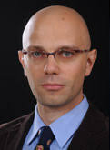
Development of Military Strategic Thought Prof. Dima Adamsky
The place of the institution of war in international relations
The development of modern strategic thinking
The birth of strategic studies in the academic world
The development of strategic thinking in the era of conventional warfare
The development of strategic thinking in the era of hybrid warfare
The development of strategic thinking in the era of nuclear warfare
Intelligence assessment, Net Assessment, Strategic planning

Slide 9
Development of Military Strategic Thought - Prof. Dima Adamsky
Date | Number of Durations | Notes
07.10.18 | 2
14.10.18 | 2
21.10.18 | 4
28.10.18 | 2
04.11.18 | 2
In Total | 12
23.12.18 | 1 | The Russian strategy in the Middle East (Prof. Adamsky)
27.03.19 | 2 | Cyber Strategy (Prof. Adamsky)
In Total | 15

Slide 10
Strategic Thinking Course - MG Amir Baram, Commandant of the Colleges
Essence, complexity and the paradox of strategic thinking.
A strategy between a static-rational approach and a dynamic-holistic approach.
Systemic thinking, systemic approach and systemic level - conceptual clarification.
Strategy as a learning-essence system and a process of systematic investigation.
Strategic planning as a systematic process of developing systemic knowledge
The design approach (Dado Center).

Slide 11
Strategic Thinking Course – Commandant of the Colleges, MG Amir Baram
Date | Number of Durations | Notes
11.11.18 | 2
18.11.18 | 2
02.12.18 | 2
In total | 6
 | 1 | Strategic learning
22.05.19 | 1 | Summary of the strategic echelon
In total | 8

Slide 12
The Design Approach, Brig.-Gen. (Res.) Dr. Meir Finkel
Date | Number of Durations | Notes
12.12.18 | 2
12.12.18 | 1 | Team Processing
In Total | 3

Slide 13
First strategic experience? “Northern Arena"

Slide 14
First Strategic Experience, The Northern Arena
Date | Number of Days | Notes
03.01.19 | 4 | Preparation Day
08-10.01.19 | 10 | Experience
In Total | 14

Slide 15
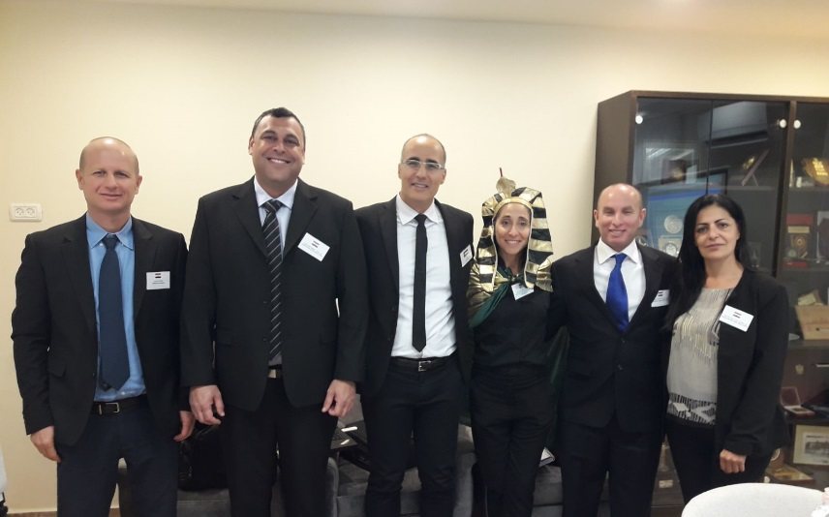
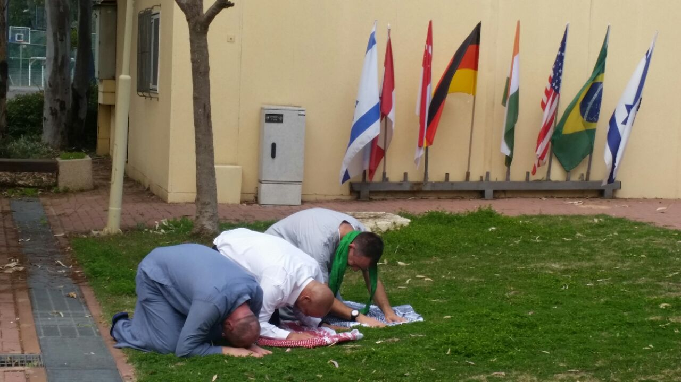
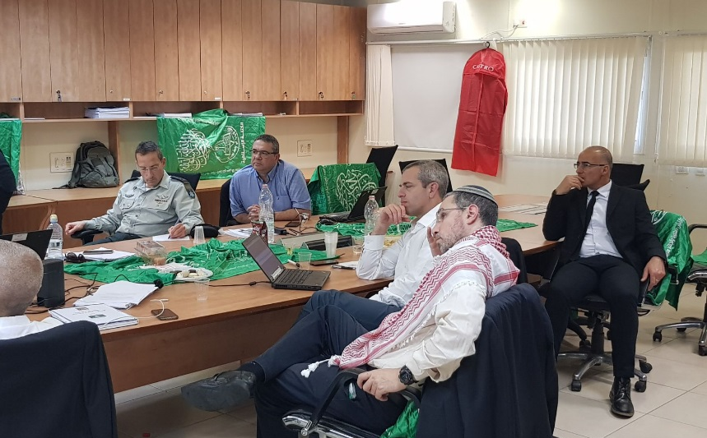
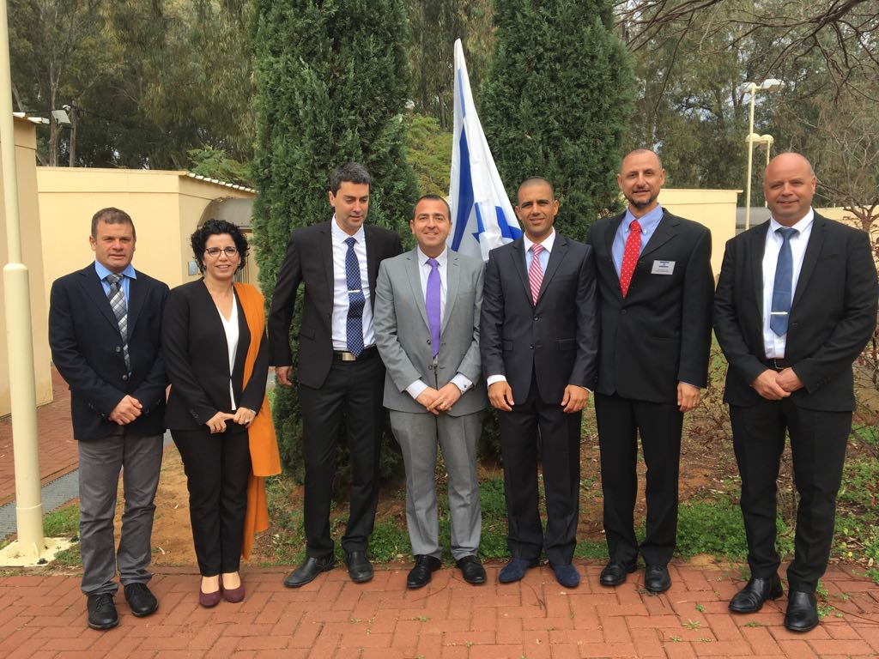
Second Strategic Experience - Political-Security Simulation Palestinian Arena

Slide 16
Political-Security Simulation - The Palestinian Arena
Date | Number of Days | Notes
10-14,18,19,21.02.19 | 7 Days | Preparation Day
20.02.19 | 1 | Simulation
24-25.02.19 | 2 | Simulation
26.02.19 | 1 | Unveilign and Research
In Total | 11

Slide 17
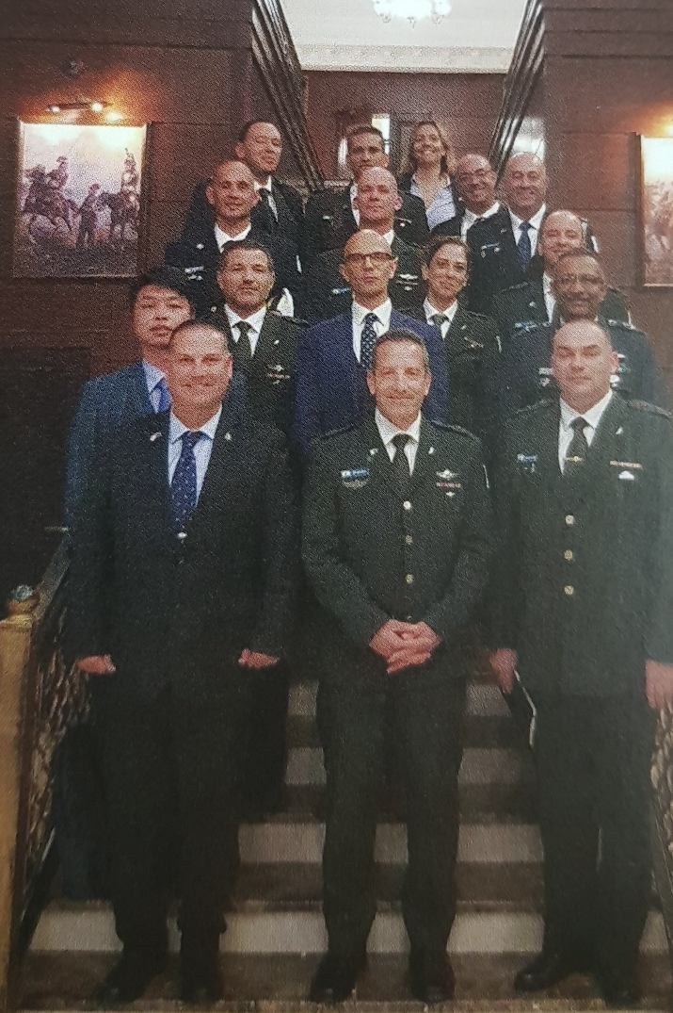
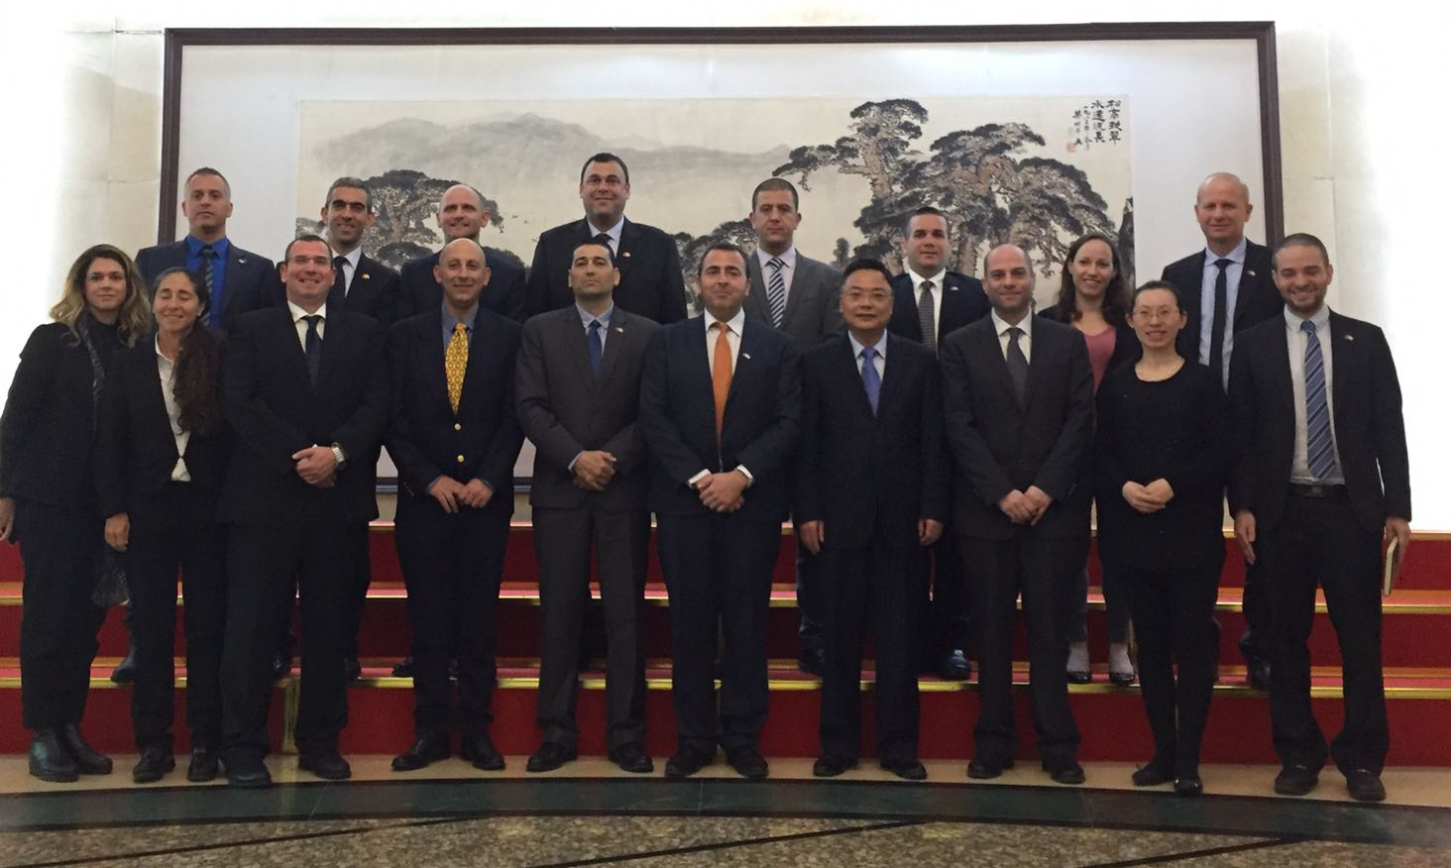
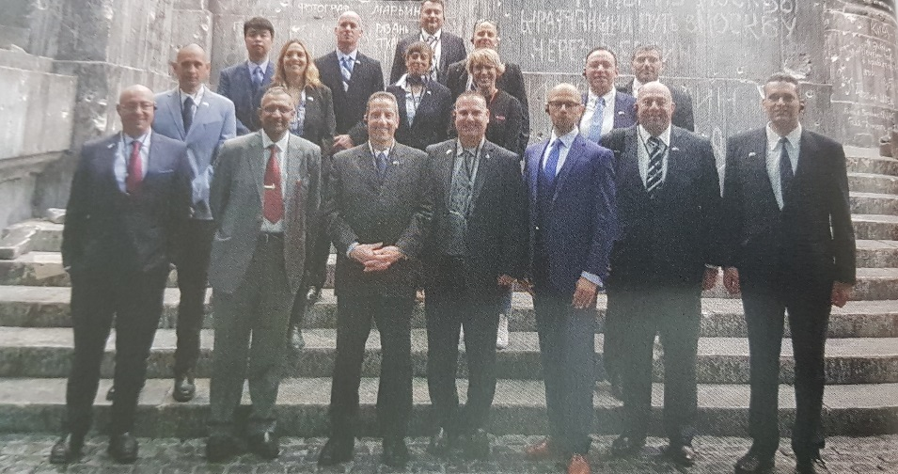
Third Strategic Experience East Tour

Slide 18
Concluding Experience – Tour to the East
Date | Number of Days | Date
Preparation Days | 5 | 29-30.04.19 01-06.05.19
Tour to the East | 5 | 12-16.05.19
Inquiry of the Tour to the East | 2 | 21-22.05.19
 | 12 | In Total

Slide 19
אסטרטגיה עסקית – חברת Deloitte (עידן אורמן ומומחי תוכן רלוונטיים
תאריך | מספר משכים | הערות
13.03.19 | 1 | "אבולוציית" החשיבה האסטרטגית בעולם העסקי - יסודות קלאסיים באסטרטגיה עסקית: BCG Porter’s 5 forces Value chain Blue-Red Ocean - הזרם החתרני מול הקלאסי (Fast Strategy)
20.03.19 | 1 | גישות חדשות (Cascade of Choice, 10 types of innovation) דוגמאות מקרה בולטות תרגול case study
28.03.19 | 1 | דיפוזיית החשיבה האסטרטגית למגזר הציבורי התאמות נחוצות במעבר לייעוץ למגזר הציבורי כלים ושיטות שאומצו ע"י המגזר הציבורי: סגמנטציה, מטריצת ישימות/השפעה, Benchmark ,Gap analysis, מודל SOI/RSOI דוגמאות מקרה בולטות תרגול case study

Slide 20
אסטרטגיה עסקית – חברת Deloitte (עידן אורמן ומומחי תוכן רלוונטיים
תאריך | מספר משכים | הערות
04.04.19 | 1 | ארוחת טעימות – סקירה של ארסנל כלים תומכי אסטרטגיה (דיגיטל, RPA, Big Data Analysis, ניהול ידע) חלוקת תרגיל לקבוצות real life scenario – זיהוי אתגרים ציבוריים/כשלי שוק
17.04.19 | 1 | הצגה, תחרות ודיון real life scenario עתיד האסטרטגיה 2025? XBC/Solution Economy שיתוף ציבור/חוכמת ההמונים ...?
סה"כ | 5

Slide 21
At the End of the Year
The INDC Graduate-
Possesses strategic thinking capabilities, tools and skills to act in the strategic environment of National Defense contexts

