Slide 1
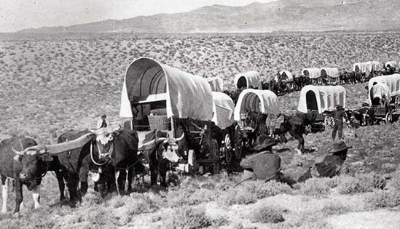
Start Up Nation…ver 1

Slide 2
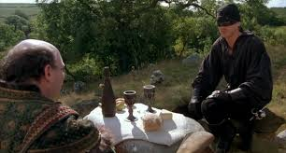
USA Quiz time…

Slide 3
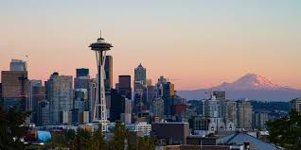
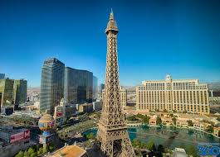
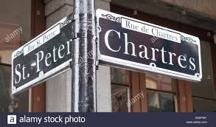
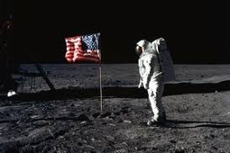
Name the city…

Slide 4
If California was a country what would its GDP be ranked?

Slide 5
How many countries does the United States have military personnel operating?
Bonus: Which country has the most US military?

Slide 6
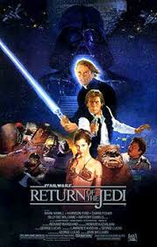
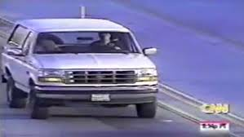
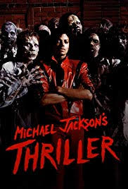
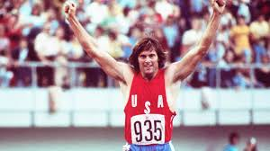
Put them in order

Slide 7
History of the USA

Slide 8
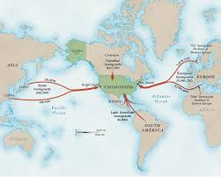

Slide 9
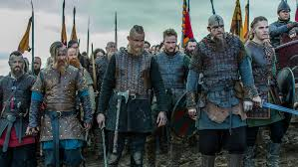

Slide 10
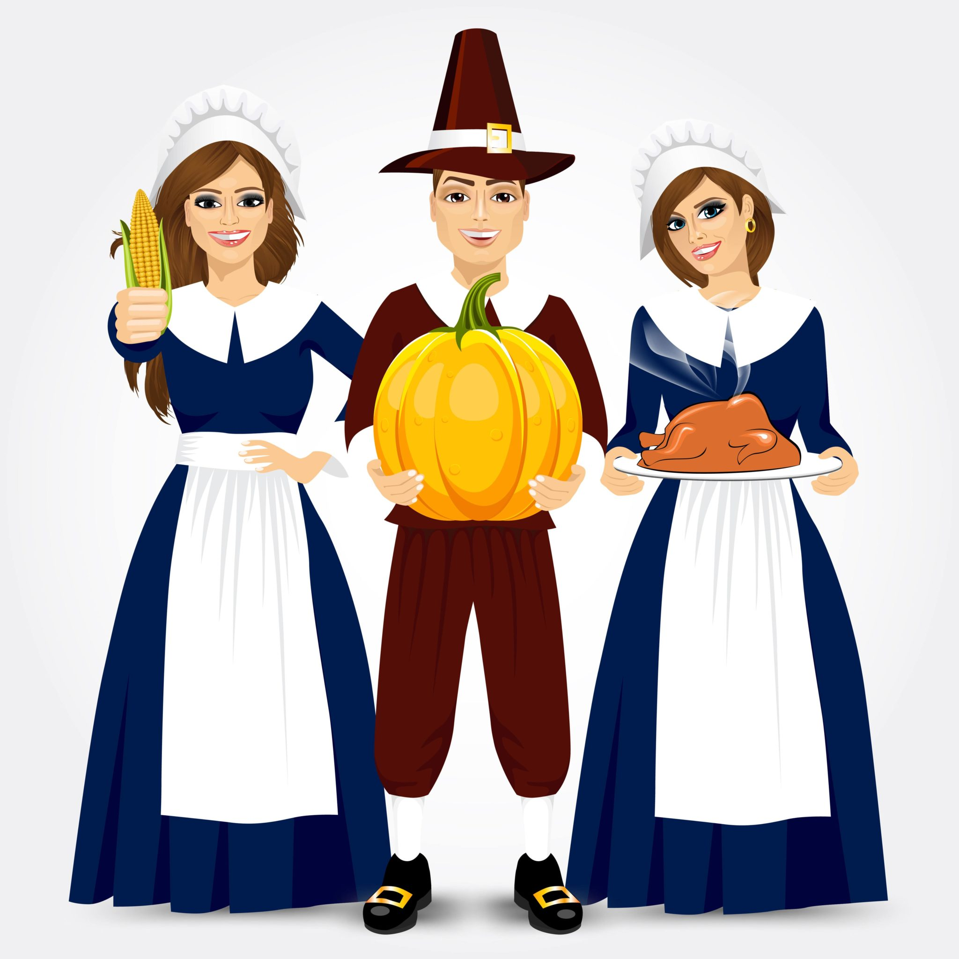

Slide 11
#BREXIT1776

Slide 12
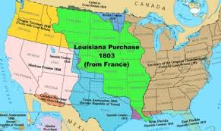

Slide 13
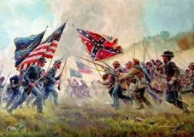

Slide 15
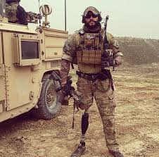
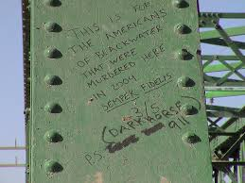
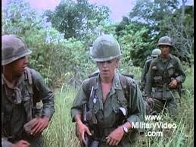
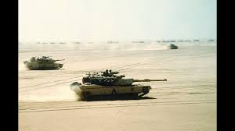

Slide 16
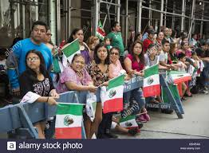
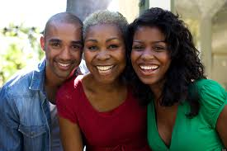
People

Slide 17
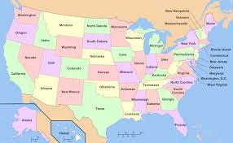
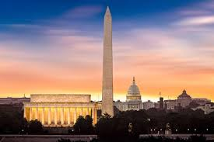
Government

Slide 18
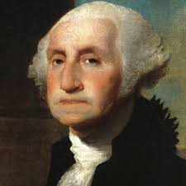
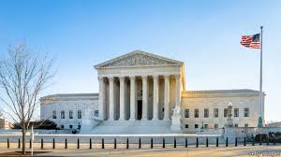
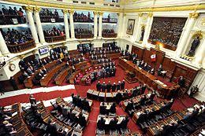
Government

Slide 19
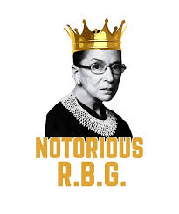

Slide 20
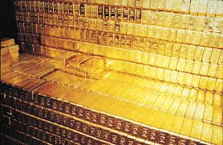
Economy

Slide 21
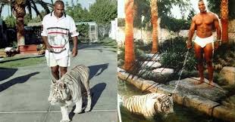

Slide 22
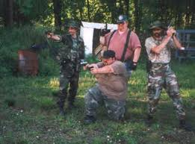
Military Structure

Slide 23
Military Structure
Secretaries
Joint Chiefs
Service Chiefs vs Geographic Commanders
Services
Army
Navy
Air Force
Marines

Slide 24
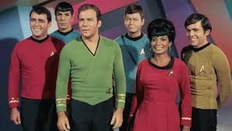
Space Corps?

Slide 25
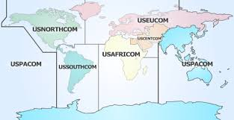
The World according to the USA

Slide 26
Strategy
National
Security
Defense
Service

Slide 27
Military Focus
Russia in Europe
The Levant
Afghanistan
The rise of China
GWO Terrorism
Equipment and modernization

Slide 28
Where are we now?
Economy big…but China?
Politics stable…but divided?
We are all Americans…but racially troubled?
Military strong…but tired?
We are still a country that fights for freedom…but are we losing our role as leader?
Entertainment good…but the Kardashians?

Slide 29
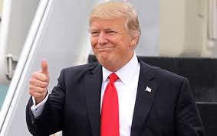
Questions???

