Slide 1
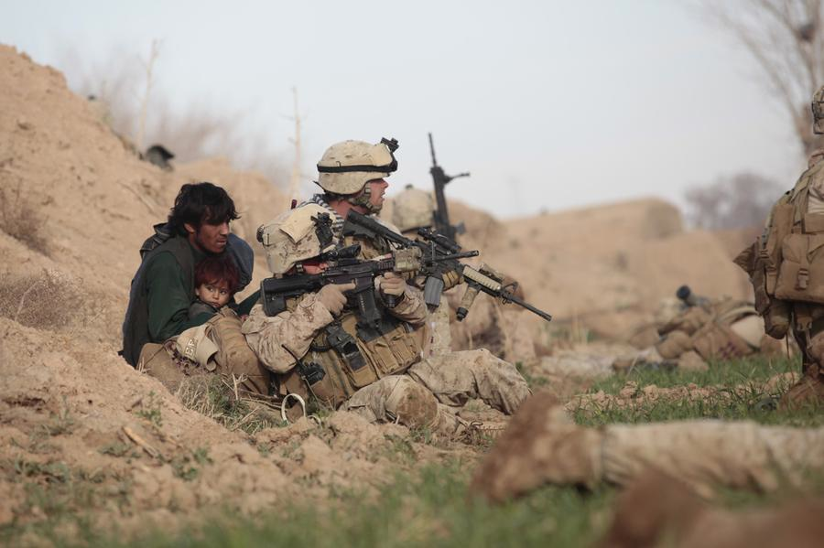
The UNITED STATES MILITARY
LtCol S.W. MacCutcheon, USMC

Slide 2
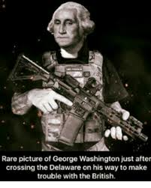
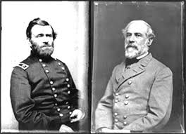
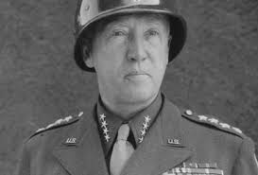
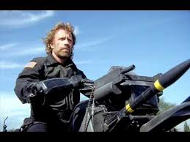
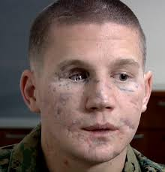
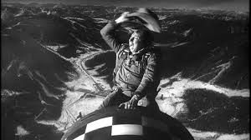
Name the person…

Slide 3
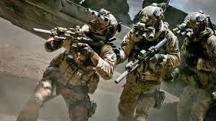
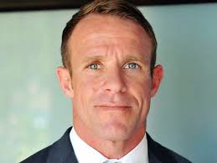
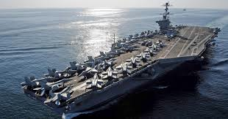
What are your perceptions of the US Military?

Slide 4
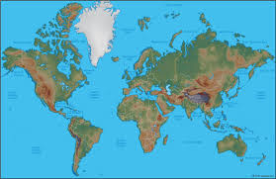
Our Area of Operations…
People in 150+ countries

Slide 5
History
Citizen Soldiers/ Volunteer Military
1939: 334,000
1945: 12,209,000
1951: 1,300,000
Small, build, hurt, learn, good, go away
The Korea/Vietnam change
Now

Slide 6
Size 2019
People
  Army 472,000
  Navy 326,000
  Air Force 323,000
  Marines 184,000
  Total Active 1,347,000
  Reserve 808,000
  Coast Guard, National Guard…

Slide 7
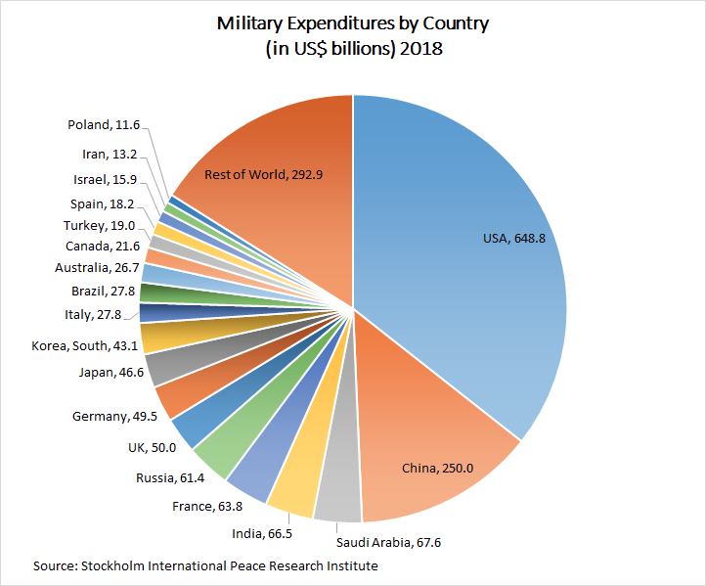
Budget

Slide 8
Demographics
All volunteer force; less than 3% of US population will serve
Approximately 15% women
  19% Air Force (high)
  8% Marines (low)
Approximately 40% minority
  18% Black
  14% Hispanic
  4% Asian
2/3 of Military under age 30
Religious preference is not tracked
All 50 states and all US territories are represented
  Recruiting based on census not preference

Slide 9

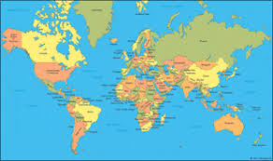
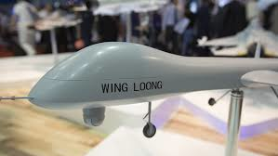
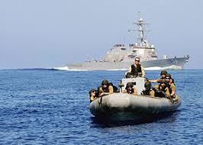
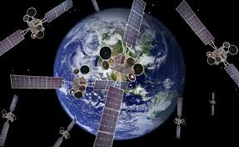
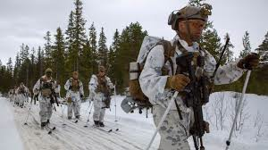
Challenges/Role

Slide 10
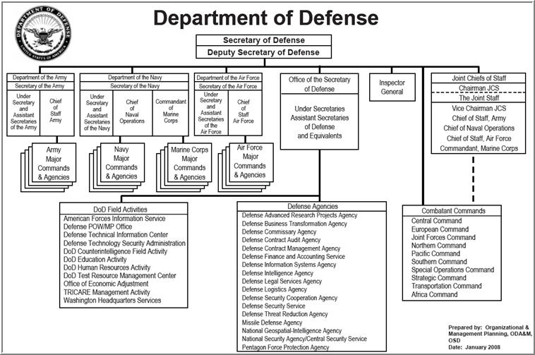
Structure

Slide 11
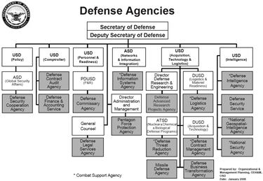
Structure DoD

Slide 12
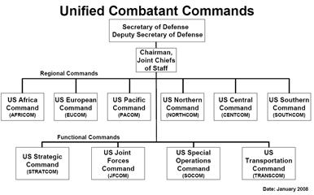
Combatant Commands

Slide 13
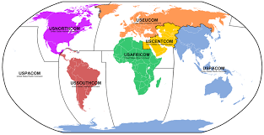
Combatant Commands

Slide 14

US Army
Formations are role specific
  Mechanized, Tanks, Airborne, etc
Aviation assets assigned
  AH-64, Kiowa, etc
Contributes to SOCOM
Ready forces and follow on forces
Large reserve component

Slide 15

US Navy
Surface
Submarines
Nuclear Submarines
Aircraft
NSW (SEALs)
Built around the fleets (geographic)
Arctic, maritime security, war, etc

Slide 16

US Air Force
2,400 x F-35
Attack and bombers
Drones
Nuclear capable
Space/cyber leaders
SOCOM contributions

Slide 17

US Marine Corps
Infantry division based
Own air force (300+ F-35)
Fixed and rotary wing aircraft
SOCOM contributors
Heavily forward deployed
  Ground and ship

Slide 18

Others
Stratcom
  Nuclear, information, space
Transcom
  Movement
  Wins wars
  Afloat and shore logistics
SOCOM
  Small wars, etc
Research
  DARPA, etc
  Services

Slide 19
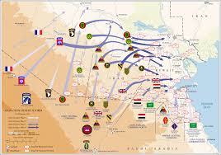
How we go to war in the modern era… the CJTF

Slide 20




Slide 21
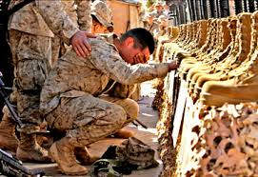
Questions?

