Slide 1
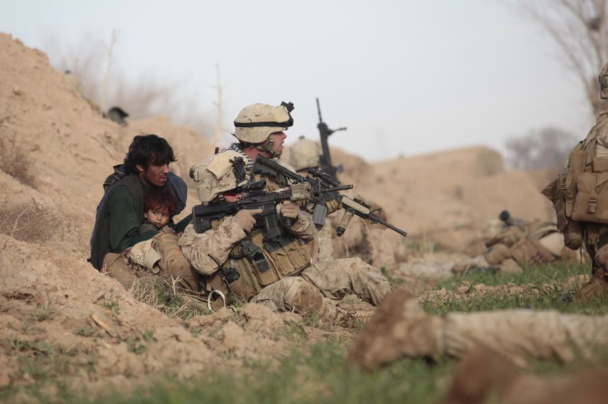
The UNITED STATES MILITARY
LtCol S.W. MacCutcheon, USMC

Slide 2
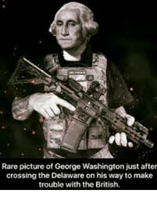
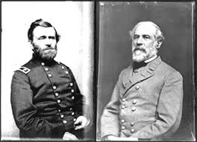
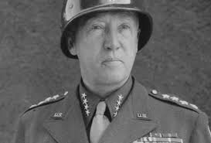
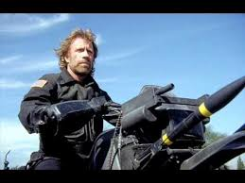
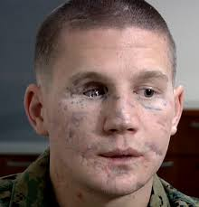
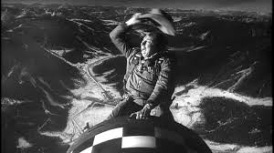
Name the person…

Slide 3
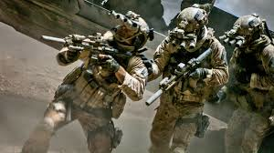
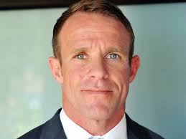
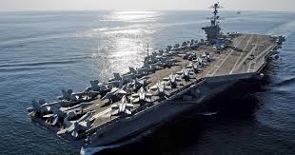
What are your perceptions of the US Military?

Slide 4
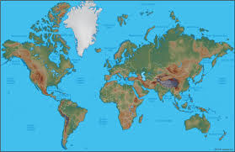
Our Area of Operations…
People in 150+ countries

Slide 5
History
Citizen Soldiers/ Volunteer Military
1939: 334,000
1945: 12,209,000
1951: 1,300,000
Small, build, hurt, learn, good, go away
The Korea/Vietnam change
Now

Slide 6
Size 2019
People
Army 472,000
Navy 326,000
Air Force 323,000
Marines 184,000
Total Active 1,347,000
Reserve 808,000
Coast Guard, National Guard…

Slide 7
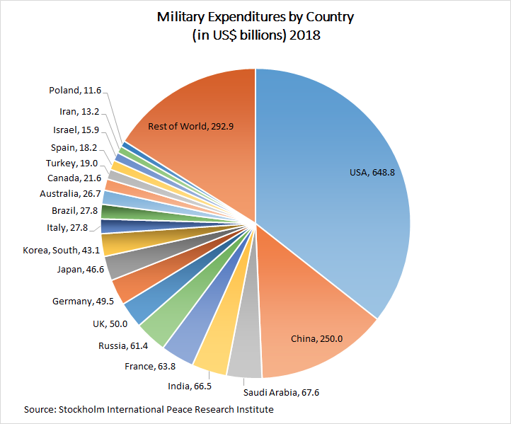
Budget

Slide 8
Demographics
All volunteer force; less than 3% of US population will serve
Approximately 15% women
19% Air Force (high)
8% Marines (low)
Approximately 40% minority
18% Black
14% Hispanic
4% Asian
2/3 of Military under age 30
Religious preference is not tracked
All 50 states and all US territories are represented
Recruiting based on census not preference

Slide 9
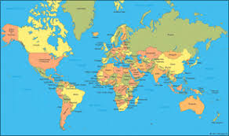
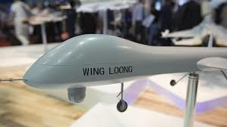
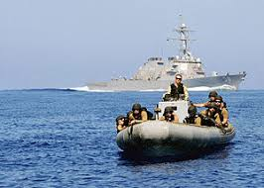
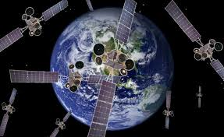
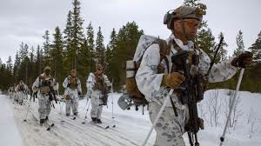
Challenges/Role

Slide 10
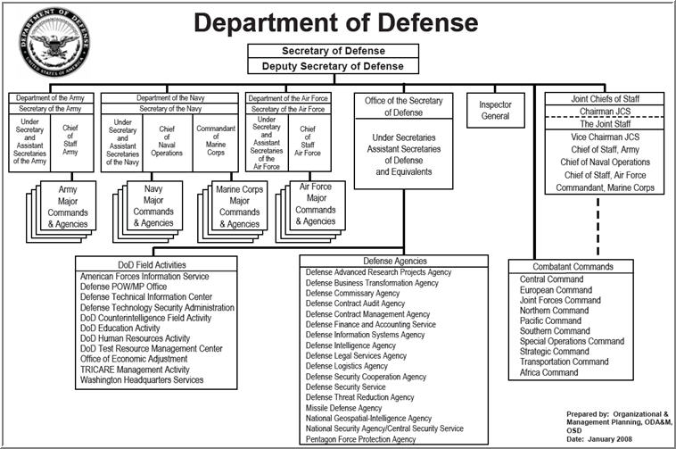
Structure

Slide 11
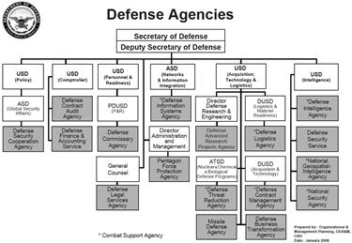
Structure DoD

Slide 12
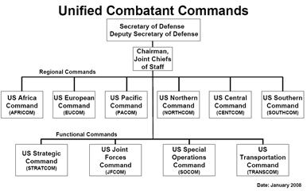
Combatant Commands

Slide 13
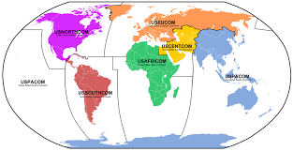
Combatant Commands

Slide 14
US Army
Formations are role specific
Mechanized, Tanks, Airborne, etc
Aviation assets assigned
AH-64, Kiowa, etc
Contributes to SOCOM
Ready forces and follow on forces
Large reserve component

Slide 15
US Navy
Surface
Submarines
Nuclear Submarines
Aircraft
NSW (SEALs)
Built around the fleets (geographic)
Arctic, maritime security, war, etc

Slide 16
US Air Force
2,400 x F-35
Attack and bombers
Drones
Nuclear capable
Space/cyber leaders
SOCOM contributions

Slide 17
US Marine Corps
Infantry division based
Own air force (300+ F-35)
Fixed and rotary wing aircraft
SOCOM contributors
Heavily forward deployed
Ground and ship

Slide 18
Others
Stratcom
Nuclear, information, space
Transcom
Movement
Wins wars
Afloat and shore logistics
SOCOM
Small wars, etc
Research
DARPA, etc
Services

Slide 19
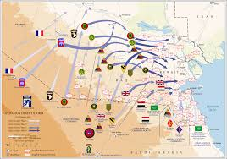
How we go to war in the modern era… the CJTF

Slide 21
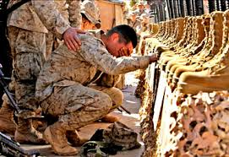
Questions?

