Slide 1
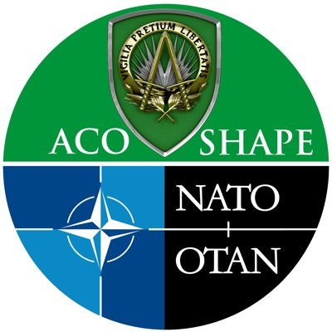
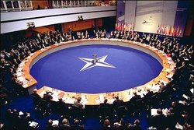
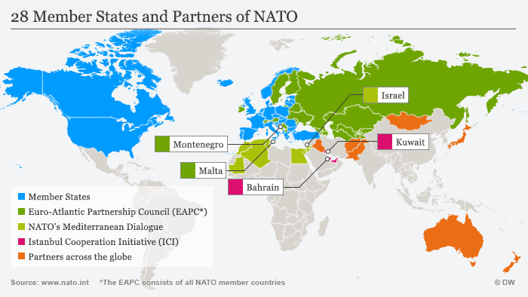
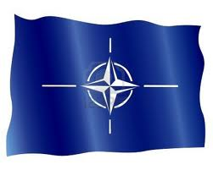

Slide 2
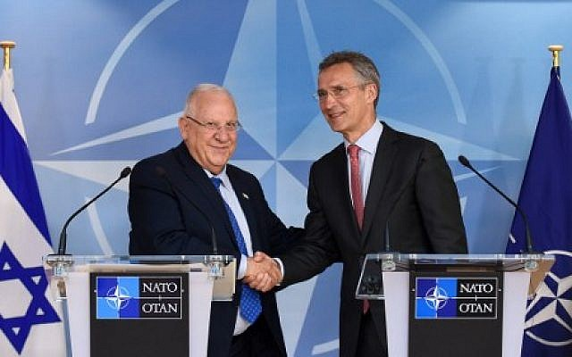
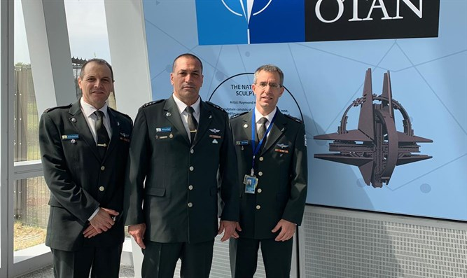
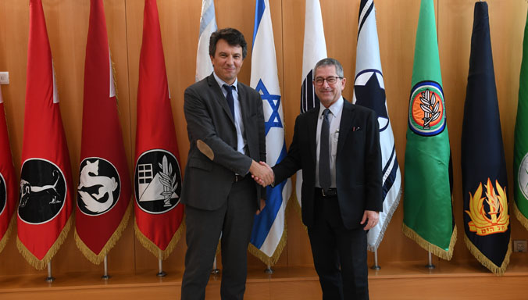

Slide 3
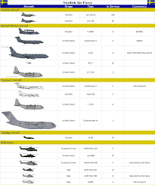
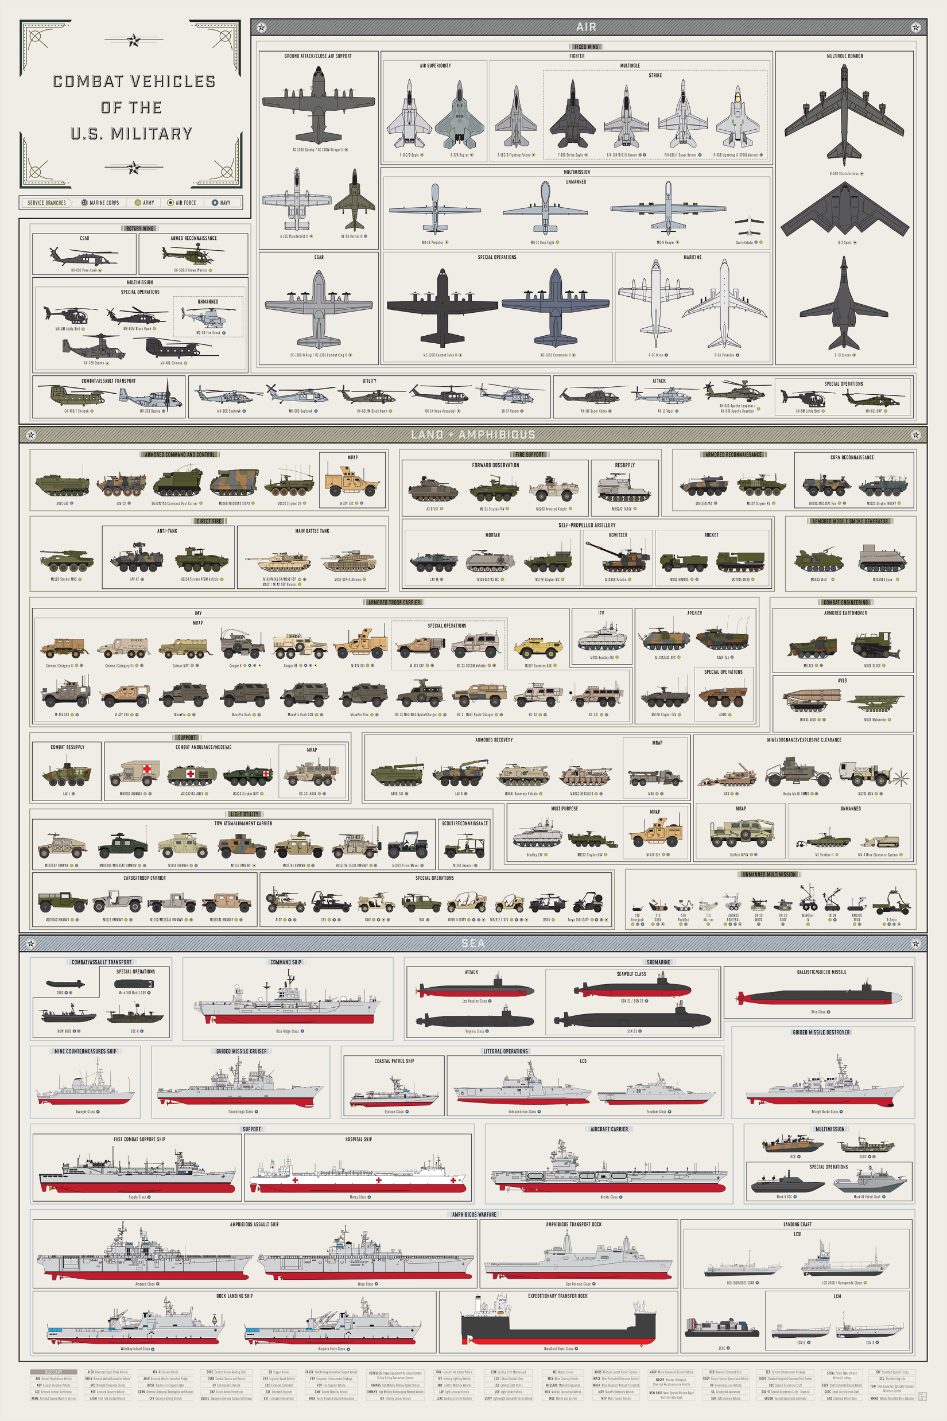
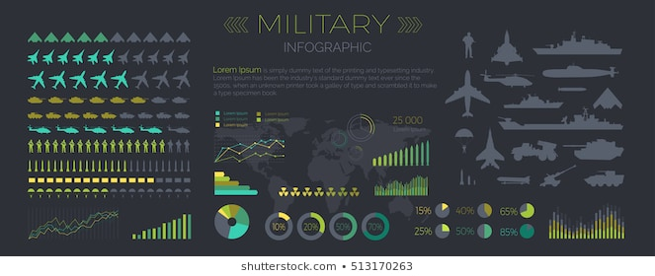
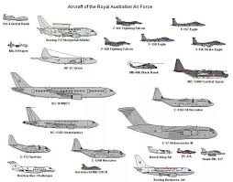

Slide 4
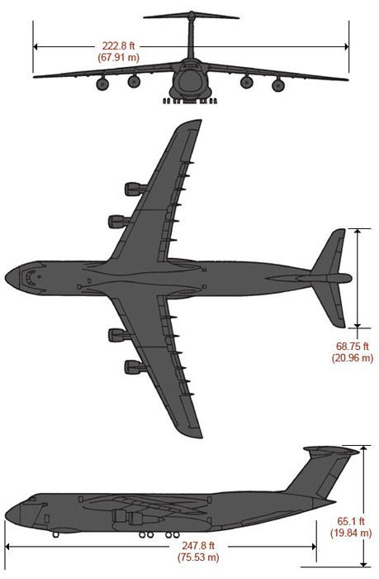
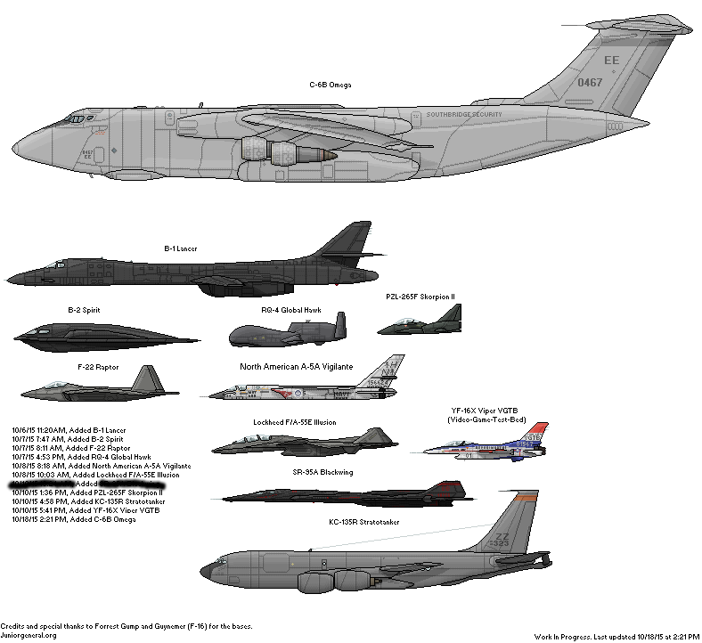
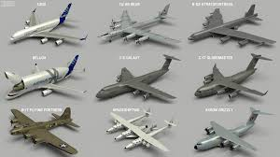
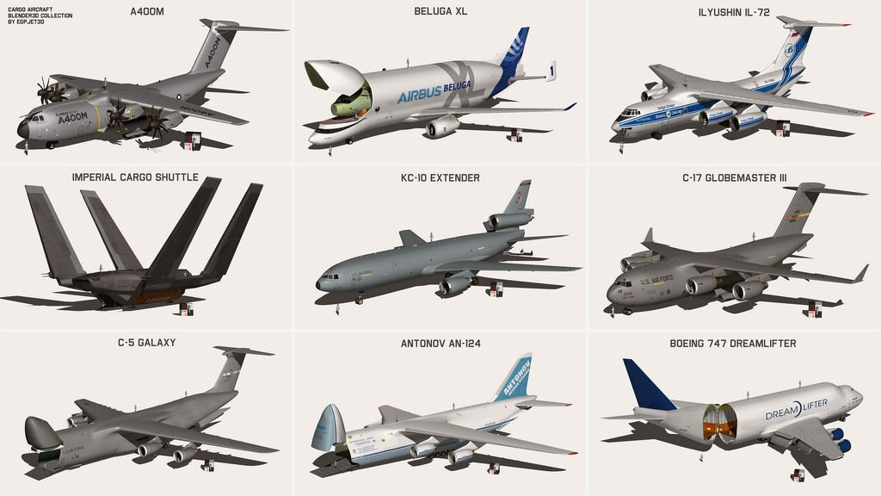

Slide 5
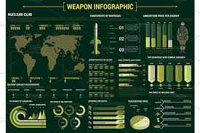
DASBOARD ceceg

Slide 6
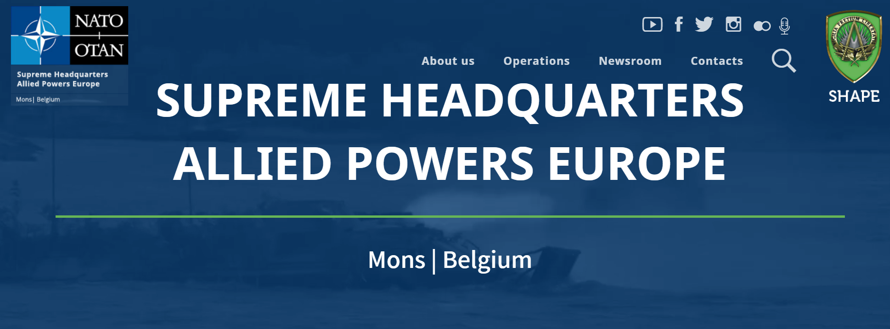
נסיעת רח"ט תוה"ד למפקדת נאט"ו

Slide 7
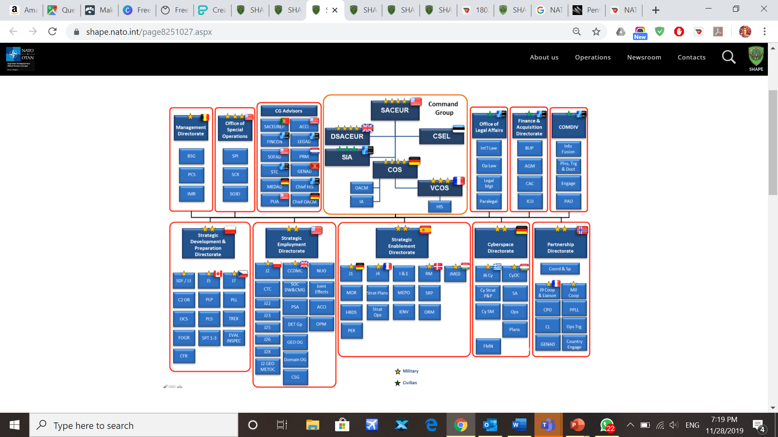

Slide 8
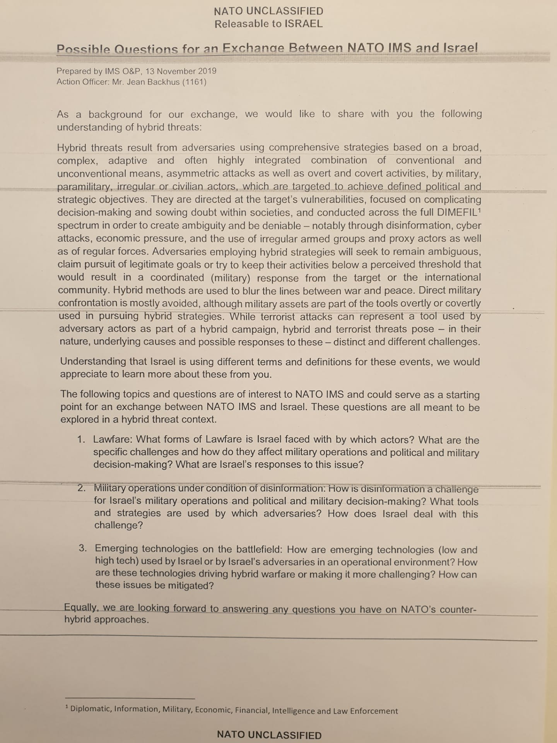

Slide 9
NATO WORKING STRUCTURE
MEMBER COUNTRIES
NATO Delegations
MILITARY
Representatives
Nuclear Planning Group
North Atlantic Council
MILITARY Committee
Subordinate Committees
SECRETARY GENERAL
Allied Command Operations
Allied Command Transformation
Notes:
9
28 NATO member countries.
NATO DELEGATIONS. Each member country has a permanent delegation at NATO’s political headquarters in Brussels. Each delegation is headed by an “ambassador”, who represents his/her government in the Alliance’s consultation and decision-making process. Each NATO member country has a delegation at NATO Headquarters in Brussels, Belgium.
The delegation has a status similar to that of an embassy. It is headed by an “ambassador” or “permanent representative”, who acts on instructions from his or her capital and reports back to the national authorities.
The Nuclear Planning Group. The Nuclear Planning Group has the same authority as the NAC with regard to nuclear policy issues. Nuclear Planning Group acts as the senior body on nuclear matters in the Alliance and discusses specific policy issues associated with nuclear forces. The Alliance's nuclear policy is kept under constant review and is modified and adapted in the light of new developments. The Defence Ministers of all member countries, except France, meet at regular intervals in the NPG, where they discuss specific policy issues associated with nuclear forces. The Alliance's nuclear policy is kept under review and decisions are taken jointly to modify or adapt it in the light of new developments and to update and adjust planning and consultation procedures.
The North Atlantic Council (NAC) is the principal political decision-making body at NATO. Each member country has a seat at the NAC. It meets at least once a week or whenever the need arises, at different levels. It is chaired by the Secretary General who helps members reach agreement on key issues. The North Atlantic Council is the principal political decision-making body within NATO. It brings together high-level representatives of each member country to discuss policy or operational questions requiring collective decisions. In sum, it provides a forum for wide-ranging consultation between members on all issues affecting their peace and security. All members have an equal right to express their views and share in the consensus on which decisions are based. Decisions are agreed upon on the basis of unanimity and common accord. There is no voting or decision by majority. This means that policies decided upon by the North Atlantic Council (NAC) are supported by and are the expression of the collective will of all the sovereign states that are members of the Alliance and are accepted by all of them.
Military Committee. When the implementation of political decisions has military implications, the key actors involved are: the Military Committee, composed of the Chiefs of Defence of NATO member countries; the International Military Staff, the Military Committee’s executive body; and the military command structure, composed of Allied Command Operations and Allied Command Transformation. NATO has very few permanent forces of its own. When an operation is agreed by the NAC, members contribute forces on a voluntary basis. These forces return to their countries once the mission is completed.
Subordinate committees. NATO has a network of committees to deal with all subjects on its agenda, from political to more technical issues, therefore bringing national representatives and experts from all NATO member countries together on a regular basis.
The Secretary General. The Secretary General is the Alliance’s top international civil servant. This person is responsible for steering the process of consultation and decision-making within the Alliance and ensuring that decisions are implemented. The Secretary General is also NATO’s chief spokesperson and heads the Organisation’s International Staff, which provides advice, guidance and administrative support to the national delegations at NATO HQs. The post is currently held by Anders Fogh Rasmussen, former Prime Minister of Denmark, who took up his responsibilities on 1 August 2009.
Allied Command Operations (ACO). Allied Command Operations (ACO) is responsible for the planning and execution of all Alliance operations. It consists of a small number of permanently established headquarters, each with a specific role. The Supreme Allied Commander, Europe - or SACEUR – assumes the overall command of operations at the strategic level and exercises his responsibilities from the headquarters in Mons, Belgium: the Supreme Headquarters Allied Powers Europe, more commonly known as SHAPE.
Allied Command Transformation (ACT) is leading, at the strategic command level, the transformation of NATO’s military structure, forces, capabilities and doctrine. It is enhancing training, particularly of commanders and staffs, conducting experiments to assess new concepts, and promoting interoperability throughout the Alliance. located in Norfolk, Virginia.

Slide 10
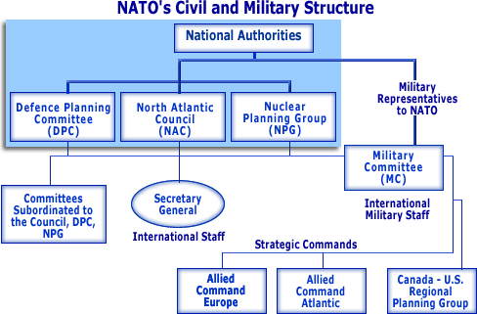
NATO WORKING STRUCTURE
Notes:
10

Slide 11
NATO MILITARY OPERATIONS
ARTICLE 5
Collective Defence
“The Parties agree that an armed attack against one or more of them in Europe or North America shall be considered an attack against them all […].”
NON-ARTICLE 5
Crisis Response
Preserve peace, prevent war, enhance security and stability
IN-/ OUTSIDE
NATO AOR
NATO AOR
Notes:
11
Collective Defence. NATO member nations participate fully within the Alliance and are equally committed to the terms of the Washington Treaty, particularly to the reciprocal undertaking made in Article 5 namely to consider an attack from an external enemy against one or more of them as an attack upon them all. This is known as “Collective Defence.” The Parties will assist the Party or Parties attacked by taking forthwith such action, as they deem necessary, including the use of armed force, to restore and maintain the security of the North Atlantic area.
Crisis Response. NATO activities falling outside the scope of Article 5 are referred to collectively as “NA5CROs.” One principal difference between Article 5 operations and NA5CROs is that there is no formal obligation for NATO nations to take part in a NA5CRO while in case of an Article 5 operation, NATO nations are formally committed to take the actions they deem necessary to restore and maintain the security of the North Atlantic area.

Slide 12
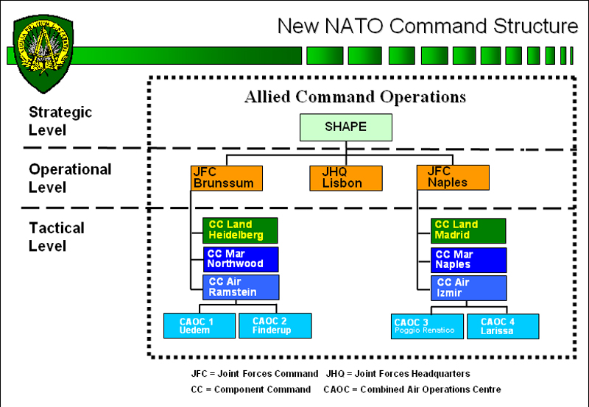
NA5CRO Command and Control
NAC
MC
Notes:
12
The NAC provides continuous political control and strategic direction for all NATO-led military operations to include:
Guidance in an Initiating Directive issued through the MC to the Supreme Allied Commander in Europe (SACEUR) or SHAPE.
The Military Committee MC:
-Advises the NAC on military implementation of an Initiating Directive. -Responds to supplementary NAC directives. -Develops military planning guidance. -Participates in liaison activities between the Alliance and other security organisations. -Recommends to the NAC the Allied HQ, and approves a commander for conducting operations.
SHAPE: SHAPE is a strategic headquarters. Its role is to prepare, plan, conduct and execute NATO military operations, missions and tasks in order to achieve the strategic objectives of the Alliance. As such it contributes to the deterrence of aggression and the preservation of peace, security and the territorial integrity of Alliance.
The operational level consists of two standing Joint Force Commands (JFCs): one in Brunssum, the Netherlands, and one in Naples, Italy. Both have to be prepared to plan, conduct and sustain NATO operations of different size and scope. Effectively, they need to be able to manage a major joint operation either from their static location in Brunssum or Naples, or from a deployed headquarters when operating directly in a theatre of operation.
In the latter case, the deployed headquarter is referred to as a Joint Task Force HQ should be able to operate for a period of up to one year.
CC - Command Component. CAOC - Combined Air Operations Centre.

Slide 13
NATO – where agencies fit in
N a t i o n a l A u t h o r i t i e s
Permanent Representatives
Ambassadors to NATO
Military Representatives
to NATO
North Atlantic Council (NAC)
Nuclear Planning Group (NPC)
Military Committee
Subordinate Committees
Secretary General
International Military Staff
International Staff
Strategic Commands
ACO
ACT
NCIA
NAHEMA
NSPA
…
JFCB
JFCN
…
JWC
JFTC
NSO
NATO Agencies
Operations
Exercises

Slide 14
Agency Direction
Vision: ... NATO’s premier life cycle management (including acquisition) and services provider, effectively and efficiently delivering integrated capabilities for NATO, its Nations and Partners including support to operations and exercises.
Mission: … provide responsive, effective and cost-efficient acquisition, including armaments procurement; logistics; operational and systems support and services to the Allies, NATO Military Authorities and partner nations, individually and collectively, in time of peace, crisis and war,
… maximize the ability and flexibility of their armed forces, contingents, and other relevant organisations, within the guidance provided by the NAC, to execute their core missions.

Slide 15
Agency Direction
Vision: ... NATO’s premier life cycle management (including acquisition) and services provider, effectively and efficiently delivering integrated capabilities for NATO, its Nations and Partners including support to operations and exercises.
Mission: … provide responsive, effective and cost-efficient acquisition, including armaments procurement; logistics; operational and systems support and services to the Allies, NATO Military Authorities and partner nations, individually and collectively, in time of peace, crisis and war,
… maximize the ability and flexibility of their armed forces, contingents, and other relevant organisations, within the guidance provided by the NAC, to execute their core missions.

Slide 16
