Slide 1
The American System
Amy L. Atchison
Associate Professor
Amy.Atchison@valpo.edu

Slide 2
The Overview
Federal system
Presidential democracy
Winner-take-all elections

Slide 3
Government Units in the US
Government Level | Number
Federal | 1
State | 50
County | 3,033
Municipal | 19,492
Town/Township | 16, 519
School Districts | 13,051
Special Districts | 37,381
Total | 89,527

Slide 4
Federal Government Reigns Supreme (Mostly)
The Division of Power
Supremacy Clause, Article VI of the Constitution states the following are supreme:
The U.S. Constitution
Laws of Congress
Treaties
Yet, national government cannot usurp state powers.
Tenth Amendment

Slide 5
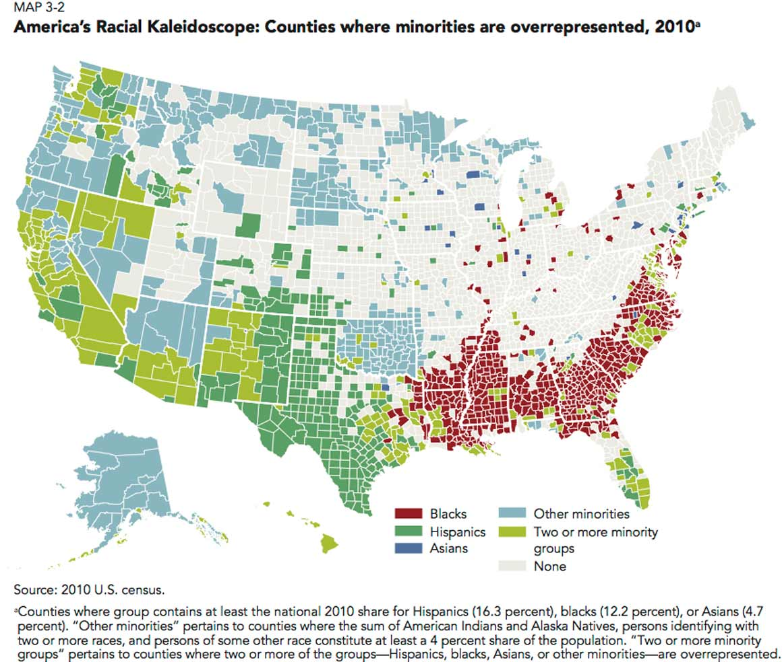
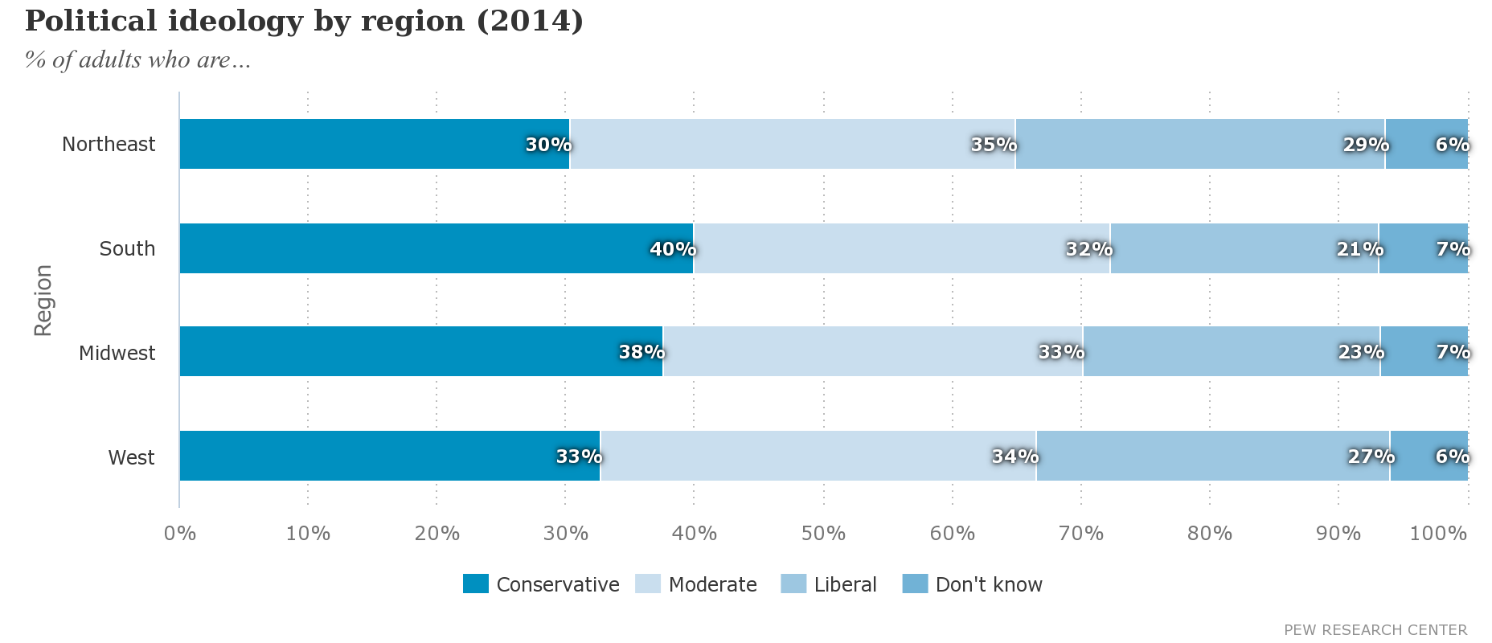
Why federalism?
Large country
Regions have different political leanings
Large population
And very diverse

Slide 6
Advantages & Disadvantages
Increases access to government
Local problems can be solved locally
Hard for political parties or interest groups to dominate all politics
States have different levels of service
Local interest can counteract national interests
State can counteract local
Too many levels of government and too much money

Slide 7
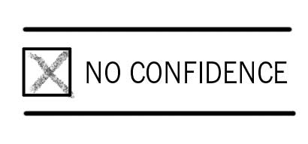
It’s a hard system to maintain
Juggling a wide variety of perspectives
Fixed terms

Slide 8
It’s a hard system to maintain
3. Winner-take-all elections
4. Two-party system
5. Citizen focus is on Federal government
But state & local elections are (arguably) more important
And local tends to be less partisan (our city is a good example)

Slide 9
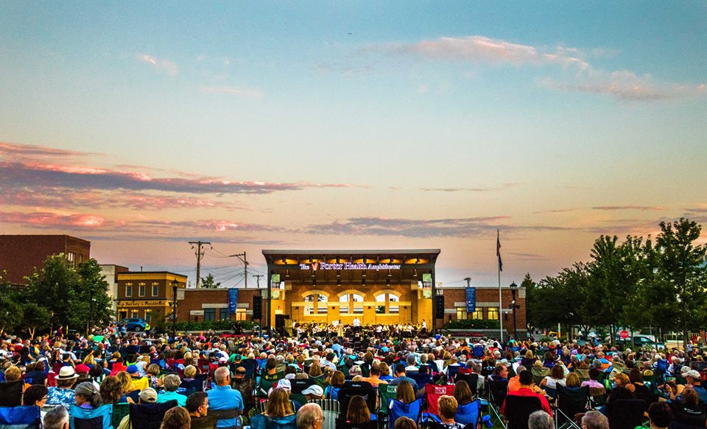

Slide 10
Questions?

