Slide 1
The Threat of Terrorism in Europe Preparation for the Europe Tour

Slide 2
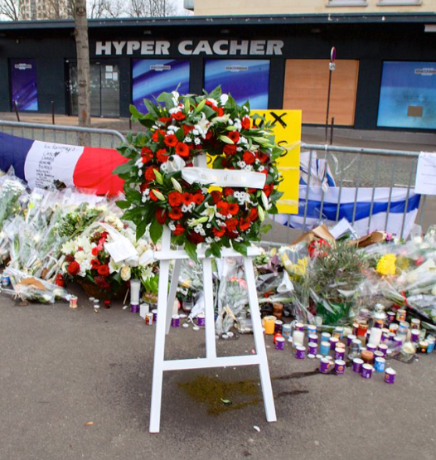
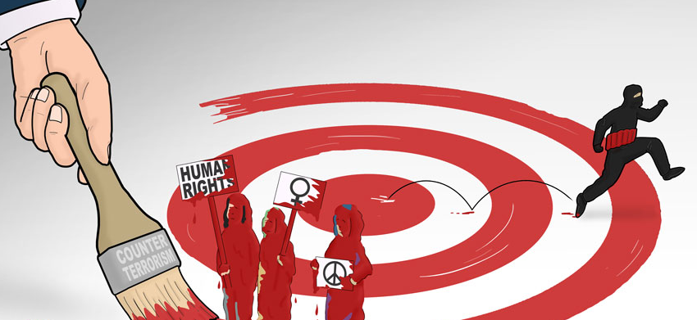

Slide 3
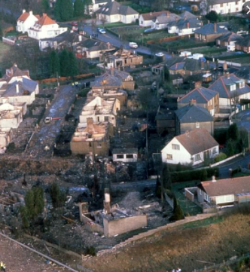
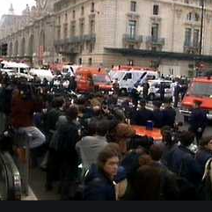
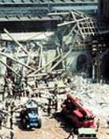
Lockerbie, December 1988 270 Killed
London, June 1982
Israeli Ambassador in London Severely Injured
France, July-October 1995
8 Killed, 200 Wounded
Bologna, August 1980
85 Killed, More than 200 Wounded

Slide 4
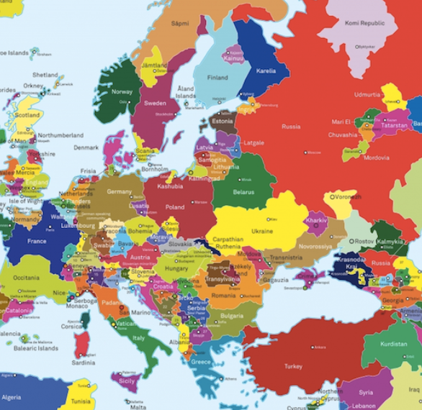
The 80’s and 90’s Where does terrorism come from?

Slide 5
The 21st Century Did something change?

Slide 6
https://www.youtube.com/watch?v=cpWhUA7SCsk

Slide 7
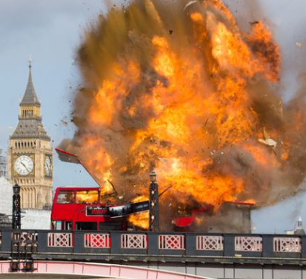
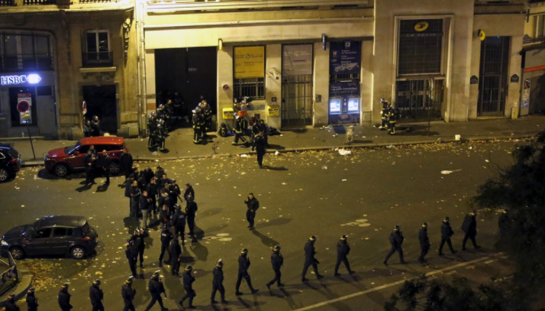
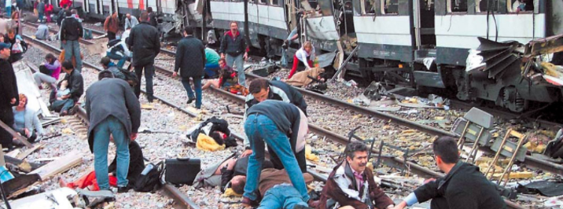

Slide 8
The National Security Connections
Madrid attacks (March 2004, 190 killed, more than 1,500 wounded) - three days before the general election; an attempt by the government to lay the blame on the Basque underground; Spain ceases to participate in international coalition in Iraq.
London attacks (July 2005, 56 killed, 700 wounded) - during the G8 conference; Tony Blair links Israeli-Palestinian conflict; wave of attacks on Muslims in Britain; France restricts entry to the country.
Paris attacks (November 2015, 130 killed, 368 wounded) - Significant increase in French partnership in international coalition against ISIS.

Slide 9
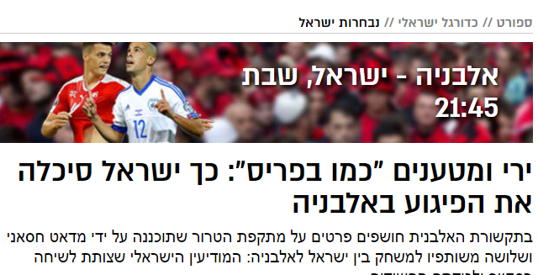
Sport // Israeli soccer // National Team
Albania – Israel, Saturday
21:45
Shooting and explosives “like in Paris”: This is How Israel Thwarted the Attack in Albania

Slide 10
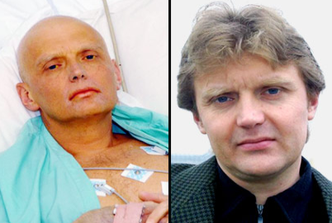
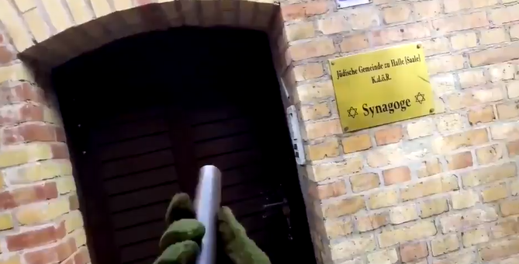
איומי טרור נוספים
https://www.maariv.co.il/news/world/Article-723165

Slide 11
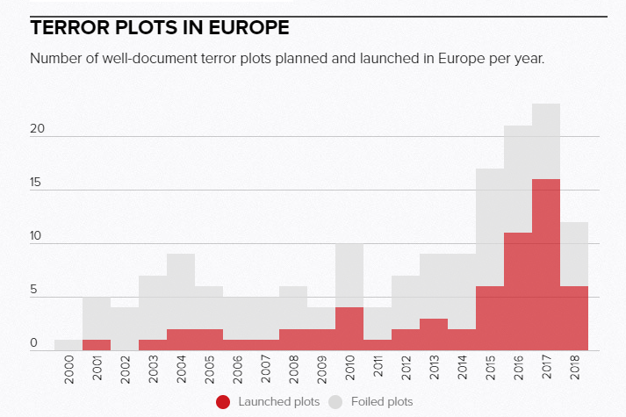
Source: Norwegian Defence Research establishment (FFI)

Slide 12
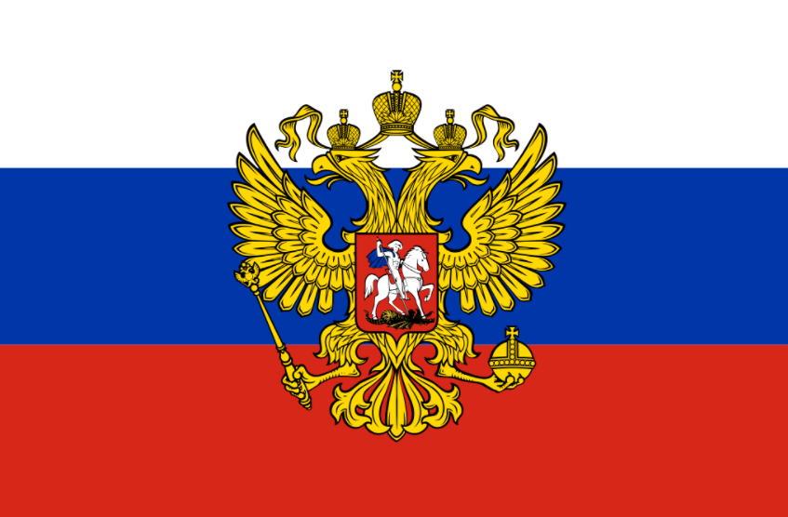
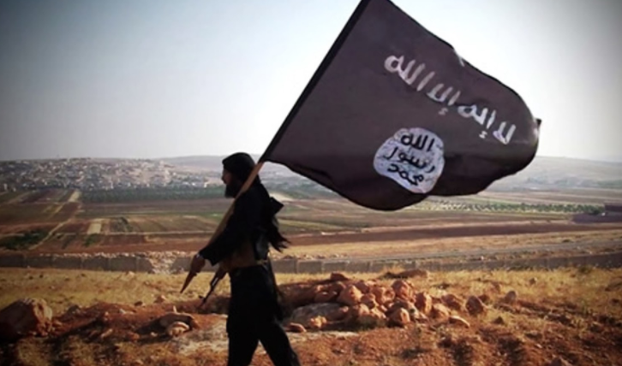
Threatening factors in the last two decades

Slide 13
Main points of the European analysis
Jihadist terrorism still poses a significant security threat to Europe. This is a global problem, combining broad geopolitical aspects and internal aspects.
Russia and Iran are working in Europe to harm opposition figures.
Russia is trying to increase its grip on Europe and influence public opinion in order to undermine the "democratic and liberal order".
The phenomenon of far-right terrorism is first and foremost an internal challenge and has international aspects. This is a politically and socially complex issue.

Slide 15
Europe’s national security policy in the face of terrorist threats
Active participant in the battle field
Legislation, sanctions and increased enforcement
Defending the borders
Education and integration
Increasing internal collaboration- European and international
Immigration dilemma

Slide 16
Some financial details
Germany's defense budget has grown by 10% in the last year and reaches $49.3 billion (2% of the budget).
The defense budgets of France and Britain also range from $48 billion to $50 billion.
Over a period of 12 years, the terrorist attacks caused a loss of about 180 billion euros in the GDP of the 28 EU member states (according to a study by the European Union).

Slide 17
Discussion
How does the terrorist threat in Europe affect other national security issues that concern the countries of the continent, for example -Turkish activity in the Mediterranean
Europe-Iran relations
Dealing with the Covid-19 pandemic

