Slide 1
NATO and the EU
Tensions in Strategy

Slide 2
Shift in Global Military Power

Slide 3
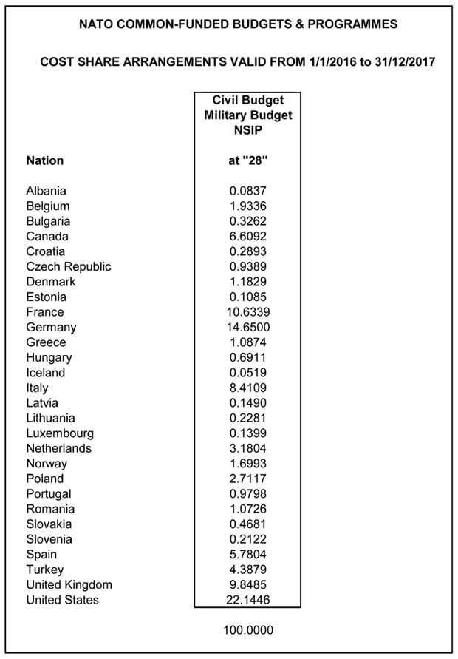
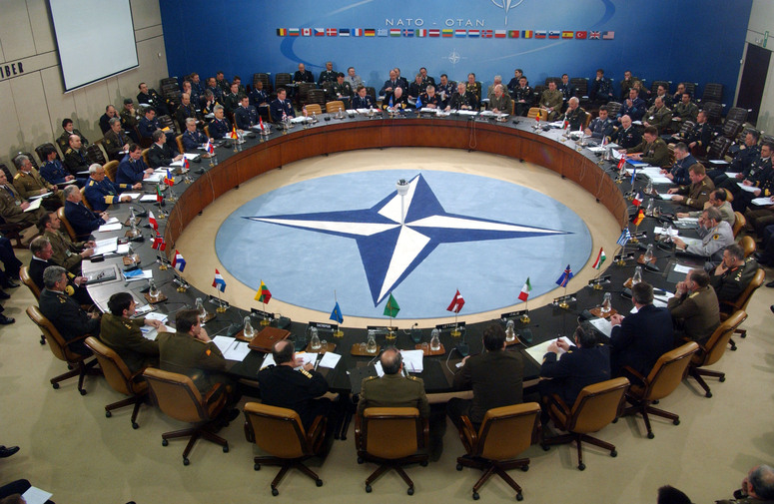
NATO Resourcing
Notes:
Member countries contribute to NATO in accordance with an agreed cost-sharing formula based on Gross National Income. Direct contributions to budgets managed by NATO are made by members in accordance with an agreed cost-sharing formula based on relative Gross National Income. These contributions represent a very small percentage of each member’s overall defence budget and, generally, finance the expenditures of NATO’s integrated structures.
14 NATO countries have so far announced their defense budgets for 2015. Of those fourteen, only the US and Estonia have passed the 2% of GDP threshold that every NATO nation pledged to have as their goal for military expenditure.
The military budget for 2016 is € 1.16 billion

Slide 4
NATO Strategy – “Active Engagement / Modern Defense” (Lisbon 2010)
Reconfirm the bond between member nations to defend one another against attack, including against new threats to the safety of our citizens.
Commit the Alliance to prevent crises, manage conflicts and stabilize post-conflict situations; work more closely with international partners, i.e. UN and EU.
Offer partners more political engagement with the Alliance, and a substantial role in shaping the NATO-led operations to which they contribute.
Commit NATO to the goal of a world without nuclear weapons – but reconfirms that, as long as there are nuclear weapons, NATO will remain a nuclear Alliance.
Restate commitment to keep door to NATO open to all European democracies that meet the standards of membership; enlargement contributes to peace.
Commit NATO to continuous reform towards a more effective, efficient and flexible Alliance, so that taxpayers get the most security for the money.

Slide 5
Realities of the NATO Strategy
Collective Defense / Crisis Management / Cooperative Security
Strategic Risks
Euro-Atlantic area is at peace and the threat of a conventional attack against NATO territory was historically slow but that is changing with Russia’s posture
Consequences for international stability and Euro-Atlantic security that are difficult to predict.
Terrorism poses a direct threat to the security of the citizens of NATO countries, and to international stability and prosperity more broadly
Instability or conflict beyond NATO borders can directly threaten Alliance security, including by fostering extremism and trans-national illegal activities

Slide 6
Key Tensions in NATO Strategy
Security through Defense:
The greatest responsibility of the Alliance is to protect and defend our territory and our populations against attack, as set out in Article 5.
Deterrence remains a core element of our overall strategy carry out the necessary training, exercises, contingency planning and information exchange for assuring our defense against the full range of conventional and emerging security challenges, and provide appropriate visible assurance and reinforcement for all Allies
Security through Crisis Management
Best way to manage conflicts is to prevent them from happening
Where conflict prevention proves unsuccessful, NATO will be prepared and capable to manage ongoing hostilities
Security through Cooperation
NATO seeks its security at the lowest possible level of forces. Arms control, disarmament and non-proliferation contribute to peace, security and stability, and should ensure undiminished security for all Alliance members.

Slide 7
EU Strategy – A Secure Europe in a Better World (Brussels 2003)
Address the Threats
Build Security in the European Neighborhood
Seek an International Order Based on Effective Multilateralism
Main Impediments to EU progress
Missing political will
Traditional “NATO-first” reflexes
Fragmentation of military cooperation
“Even the strongest soft powers cannot make do in the long run without at least some integrated defense capacities”

Slide 8
Realities of the EU Strategy
NATO remains the EU’s ultimate security guarantee, with the participation of 22 EU Member States and a strong transatlantic link.
Member States are slow to accept that they need to go beyond a model where defense is a matter of strict national sovereignty.
Traditional methods of cooperation have reached their limits and proved insufficient. European defense needs a paradigm change.
EU still lacks crucial capacity to do contingency planning, as well as the appropriate command-and-control framework to plan and run operations

Slide 9
Key Tensions in the EU Strategy
Be more capable
Transform militaries into more flexible, mobile forces (resource pooling)
Stronger diplomatic capability
Have a system that combines resources of Member States with those of EU institutions
Improved sharing of intelligence among Member States and with partners.
EU-NATO permanent arrangements, in particular Berlin Plus, provides the framework for the strategic partnership in crisis management
Be more coherent
Bring together different instruments and capabilities: European assistance programs and the European Development Fund, military and civilian capabilities from Member States and other instruments
Work with partners
The EU and the United States can be a formidable force for good in the world

Slide 10
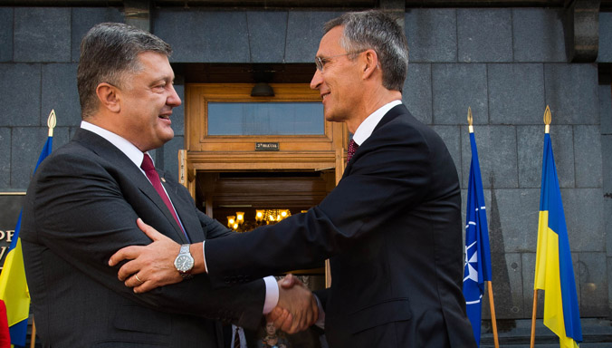
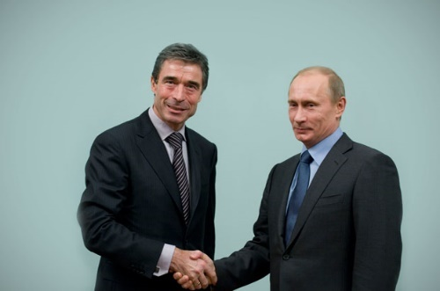
NATO-Ukraine-Russia
Ukraine
Joined PfP (1994) and NATO-Ukraine Commission to take cooperation forward (1997)
The only partner to have contributed actively to all NATO-led operations and missions.
Russia-Ukraine conflict
Ukraine invoked Article 14 of the NATO-Ukraine Charter and requested a meeting of the NATO-Ukraine Commission, which took place in March 2014.
Allies condemned Russia’s military action as a breach of international law, which also contravenes the principles of the NATO-Russia Council and PfP
NATO suspended civilian/military cooperation efforts with Russia on 1 Apr 14 and deployed an advisory support team of civil experts to Kiev.
NATO agreed on a comprehensive and tailored package of measures to help Ukraine better provide for its security in late 2014.
Notes:
The Allies believe that a sovereign, independent and stable Ukraine, firmly committed to democracy and the rule of law, is key to Euro-Atlantic security. Relations date back to the early 1990s and have since developed into one of the most substantive of NATO’s partnerships. Since 2014, in the wake of the Russia-Ukraine conflict, cooperation has been intensified in critical areas.

