Slide 1
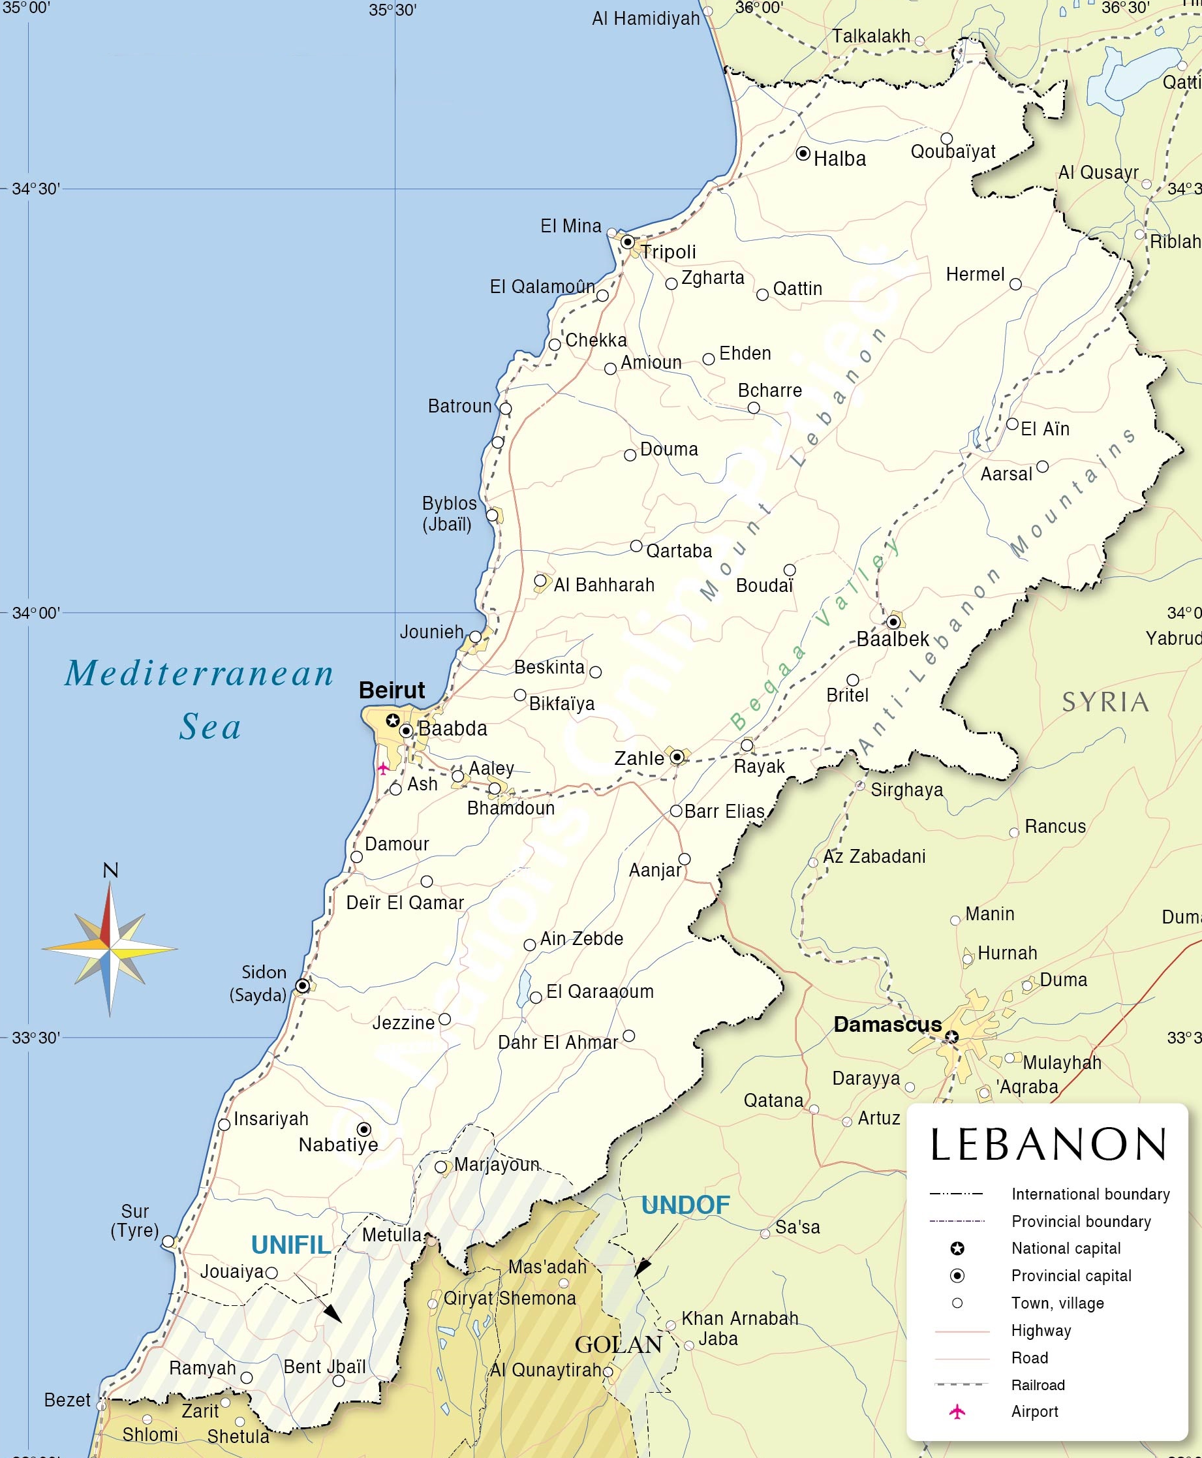
TF 5.1 (SFL) Laydown
UNCLASSIFIED//CUI
20 Nov 2020
Hamat Air Base
1 x SF ODA (-)
1 x Civil Affairs Team
1 x AF SOF Team
36SYC 46530 97216
Amchit
1 x Marine SOF Team
36SYC 42619 82496
Ghosta
1 x SF ODA (-)
36SYC 47319 63015
US Embassy
1 x SF Liaison Team
36SYC 40120 57959
Rayak
1 x SF ODA
1 x Civil Affairs Team
1 x Military Police PLT
36SYC 77360 50040
Roumieh
1 x SF ODA
1 x PSYOP Team
1 x Marine SOF Team
36SYC 39650 52200

