Slide 1
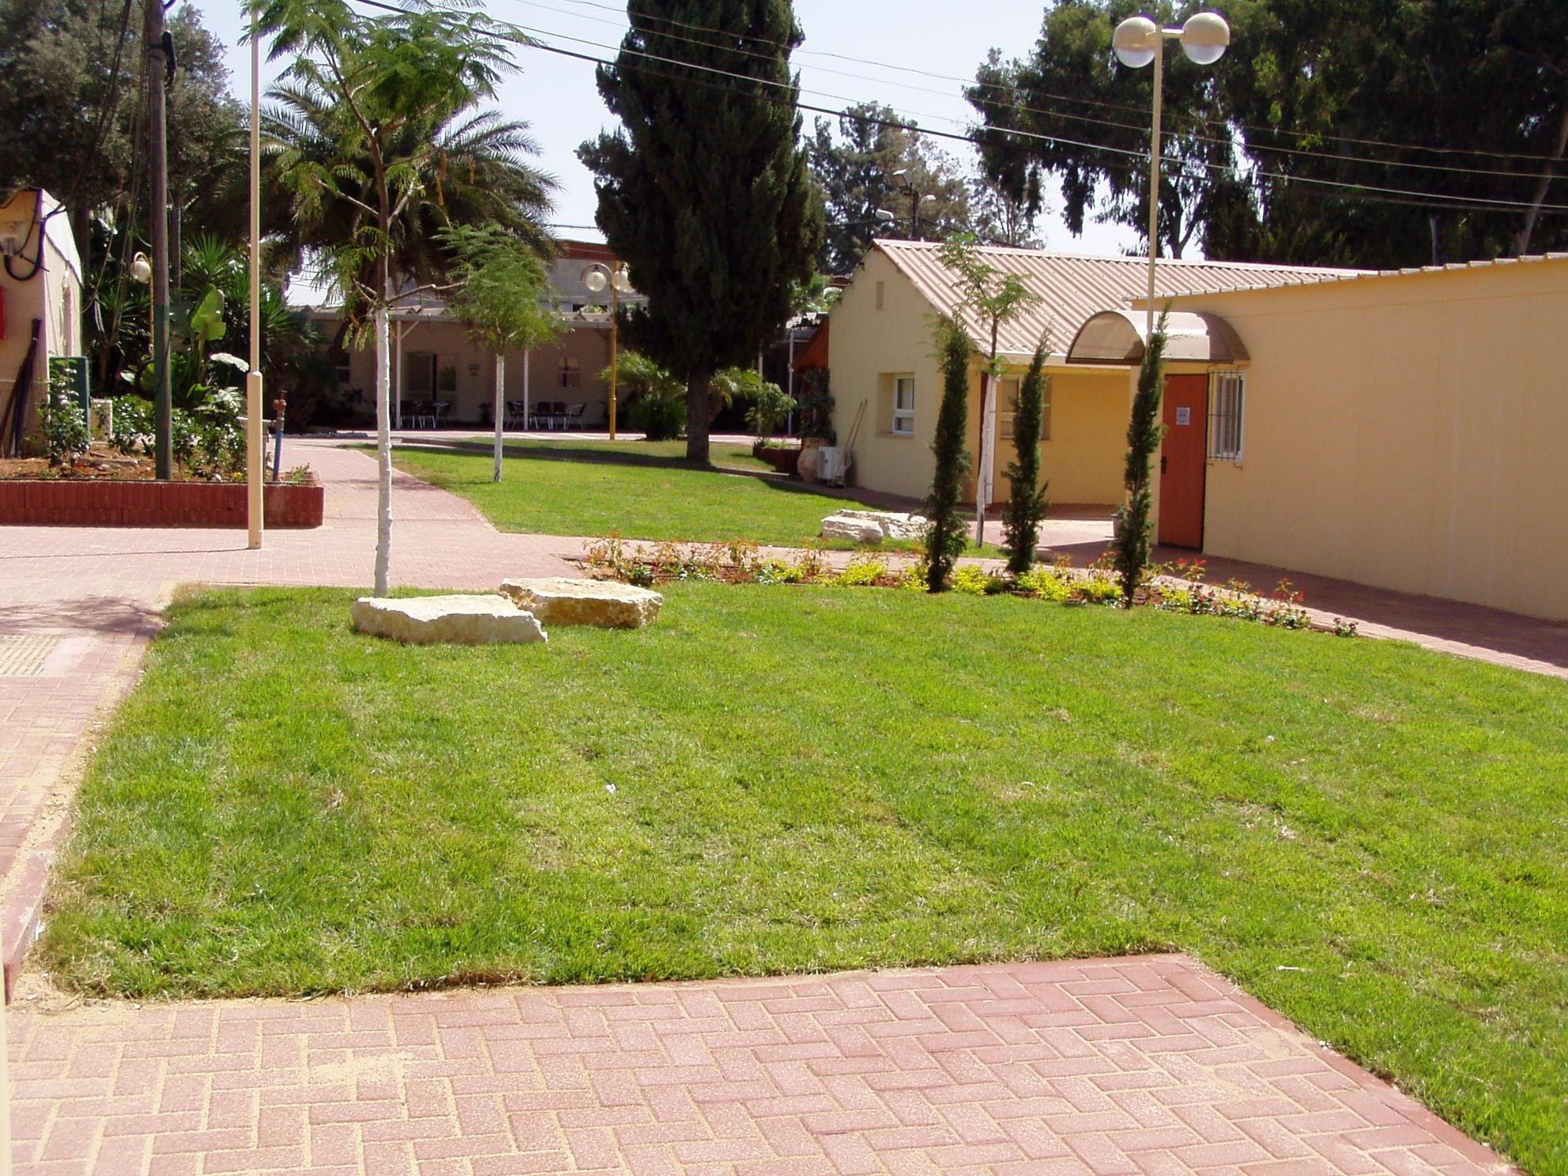
Israel National Defense College
Summarizing the Foundational Season
Presenting the Core Season

Slide 2
Objectives
Summarizing the Foundational Season and presenting the Core Season
Extracting information and continually implementing conclusions
Collecting data in real time for staff inquiries during the recess

Slide 3
The School Year Objective
Training the Student to Become a “National Security Strategist”
Developing tools for thinking and analyzing; comprehending the process and navigating through it on a strategic level, in a way that deals with complex challenges in national security
Providing knowledge on Israeli national security and its scope, by studying and researching the components of national security
Analyzing the relationship between the different aspects of national security

Slide 4
Main Principles for Learning
Interdisciplinary program
Various methods for learning – simulations, seminars, etc.
Versatile study spaces – one on one, plenum, group sessions, etc.
Variance among students as a resource – creating partnerships
Attendance and active participation
Students teaching areas of study
Social network as a force multiplier
Tolerance, openness, inspiration and intellectual courage

Slide 5
The Academic Curriculum – The Road So Far… (42 Credits)
Foundations Studies Semester
Core Studies Semester
Advanced Studies Semester
Course | Credits
5 | Basic Concepts in National Security
5 | Sum
Credits | Course
4 | The Geography of National Security
4 | Approaches and Schools of Thought
2 | Foreign Policy
4 | Israeli Society
2 | Israel's Economy
4 | Public Law
20 | Sum
Credits | Course
3 | The U.S – Course and Tour
3 | Tour to the East
2 | Seminars
8 | Sum
Regional National Security Tours (4)
Strategic Thinking (5)
Final Paper

Slide 6
Curriculum of the Israel National Defense College – 45th Class
July
June
May
April
March
February
January
December
November
October
September
Seniority
Strategy
National Security
Diplomacy
Economy
Society
Conceptual Foundation and a Zionist Ideological Basis
משוב והתייעצות עמיתים
Leading Change
Expertise
Marking Strengths
Preparing for Senior Positions
Practicing Objectives
Identifying Objectives
a. Campaign
Strategic Thought
Strategic Thought
1
Cyber Seminar
Israel Police
Intelligence Branch
Shin Bet
Mossad
Military-Society Seminar
National Security
Foundational Season
Middle East
Concluding Experience
Europe Tour
USA Tour
Tour to the East
Political-Security Seminar
Tour
Judea and Samaria Tour
Northern Tour
Haifa Tour
2nd Jerusalem Tour
1st Jerusalem Tour
Foreign Policy
Infrastructure Tour
Southern Tour
Advanced Season
Core Season
Recess
State Budget Seminar
Global Economy Seminar
Tour
Analyzing Scenarios
Israel’s Economy
Introduction
Governmental Corruption Seminar
Tour
Israeli Society
Colleges Conference
Interdisciplinary Seminar
Ben-Gurion Seminar
Forefathers
Democracy Seminar
Public Law
The Geography of National Security
Approaches and Schools of Thought
Basic Concepts in National Security

Slide 7
Insights Up to This Point
Planning your schedule while having the academic workload in mind
Forming a research proposal - Final papers
The Presidency
High level of involvement and Active participation

Slide 8
Comments?

Slide 9
Refreshing the INDC Rules
Chatham House Rule
Appearance
Computers, Discourse, Welcoming Seniors in the Plenum, Cellphones
Microphones
Delays and Absences
Submitting Papers
Tours and Trips
Please respect the rules and your place as students

Slide 10
To Our Continued Success!

