Slide 1
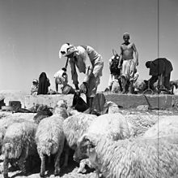
First strategic experience –
The Northern Arena

Slide 2
Theory - Design
The essence of the design process:
Critical examination, knowledge development and change
Product of the design process:
Campaign / systems perception
Design - the first step in the broad process
Planning is based on design and generates a plan
Design produces perception
Notes:
עשוי לדרוש יותר משקופית אחת

Slide 3
Bottom Line - What are the Stages?
Building the thinking process according to context
Setting the relevance gap / offset
Creating an initial strategic framework
Critical questioning and creating a constitutive strategy
Developing an idea and configuration for a campaign / operation system – creating a perception
Checking the Validity of the Perception
Notes:
עשוי לדרוש יותר משקופית אחת

Slide 4
The Approaching Week
Preparation for the 1st Simulation
January
Strategy + Statesmanship
University
Experience No1
Self – Learning
Public Law + Economy
Experience No1
Public Law + Economics
Intl. Students on holiday
8/1-10/1 – Two days of the 1st simulation on the northern arena
And its presentation in the plenum
3/1 – Background briefings on relevant players in the sector

Slide 5
Main Stages
Structuring - designing the learning process itself (in view of the unique strategic context)
Mirroring the emerging system and legacy on the northern front
Constructing a conceptual map - connections and tensions of the system
Setting the relevance gap:
1. What is wrong with the current concept?
2. What is the offset between the current concept and its validity in regards to the new situation
5. Finding opportunities and risks (potential)
6. Initial strategic framework - basic principles of strategy
Notes:
עשוי לדרוש יותר משקופית אחת

Slide 6
Current system - forming
The past - heritage system
Identify the relevance / offset gap
Conceptual map
Identifying potential (opportunities and risks)
Future system - desirable
The main points of the initial strategy

Slide 7
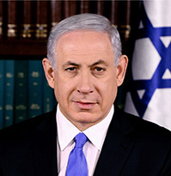
Strategic Context
The Strategic Context - The Current Situation in the Northern Arena.
The Prime Minister is guiding the establishment of a national think tank to carry out a strategic investigation in the northern arena

Slide 8
PM Directive
Since the Russian plane crash, we have found it difficult to create strategic and operational degrees of freedom in the Syrian arena. We launched Operation ‘’Northern Shield’’ and we are facing a challenging year. In light of reality as we perceive it now I understand:
The Iranians are determined to remain in Syria.
Arming the Syrian army with advanced systems .
Arming the Syrian army with advanced systems .
The possibility of Syrian attack partners on the Idllib enclave at the end of winter.
The United States announced its withdrawal from Syria.

Slide 10
PM Directive
In view of the dramatic developments in the arena, we must examine our strategy for the northern arena and formulate a strategy that will allow us to have degrees of freedom of action in face of the emerging threats

Slide 11
What is Required of the Team
Collaboration
Methodology / Systematization
Documentation
Convergence into schedules
A variety of perspectives
Challenging and Contrasting

Slide 12
Stage 1 - Thinking About the Process
Today –
What are the boundaries of the system we will investigate?
Who are the relevant players and what are their affinities? (Primary and secondary)
What are the main tensions?
What are the emerging trends and phenomena?
What are the main threats?
What is the concept that exists in the context in question? What are the basic assumptions? What are the plans?
From which point in time will we begin to understand the emerging context ("genealogy")?

Slide 13
Stage 1 - Thinking About the Process
What is the proper investigation process?
With who will we share our learning process with?
What are the materials required for the learning process?
What are the learning methods?
How long do we have to learn?
What are the perspectives that will serve the learning process?
Are there people whose opinion deviates from the norm?
What are the possible barriers to systemic understanding of reality?

Slide 14
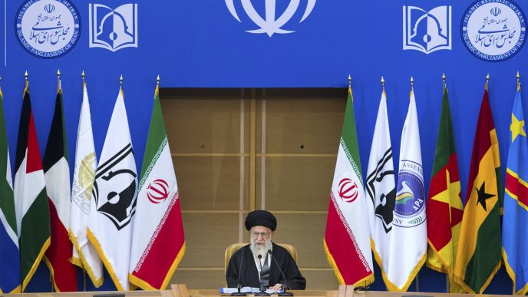
Stage 2 – Evolving / Emerging System
Tuesday
From the Russian plane crash to the present day
Dividing into 3 groups according to the following:
A rival system (Shiite axis - Iran, Hezbollah, the Syrian regime, etc.) - Samuel, Luff, Inbal
International system (Russia, USA, Turkey, moderate Sunni, etc.) –
Klaus, Pat, Raju
Israel - Madanes, Kobi, Guy Levi, Eyal

Slide 15
Stage 2 - Key Questions
Interests in order of importance
Players’ affinities and tensions
Leading systematic logic and trends
Sources of power and weakness and centers of gravity
Purpose, goals and objectives
How to affect the system

Slide 16
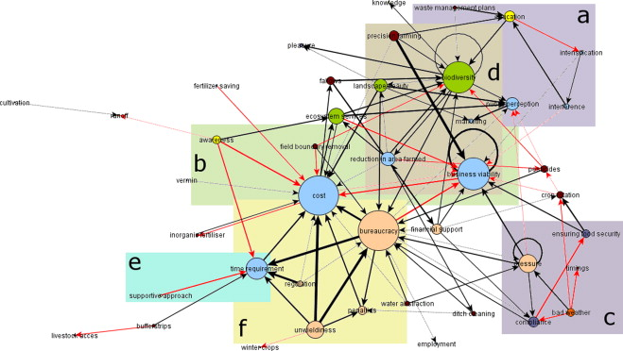
Stage 2 – Evolving / Emerging System
The required product –
Creating a cognitive map - we will combine all three of them in the evening
For each of the groups –
Major trends and phenomena
Main tensions
Interests

Slide 17
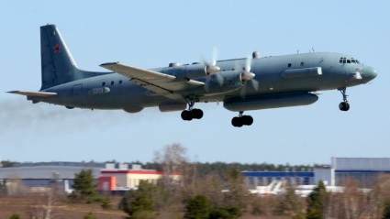
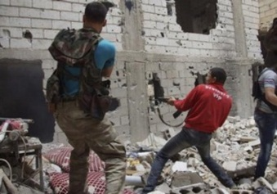
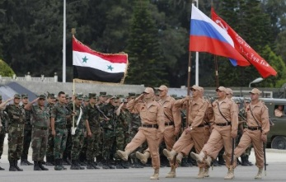
Stage 3 – Inherited System – History Research
Wednesday morning
Until the Russian plane crash
Understanding the developments along the timeline - the reading materials
A rival system
International system
Israel
The product –
Concentration of developments along the timeline
Conclusions from the genealogy process
Identifying the point in which the offset occurred

Slide 18
Stage 4 - The Relevance Gap - Offset
Wednesday afternoon
Method of work: division into two groups / team discussions
Key questions::
Is the existing concept appropriate to the current situation?
If not - what is the source of the gap (from the source of the "inconvenience" or "embarrassment")? Are our premises still relevant?
Does the existing organization fit the current situation? What are the constraints that limit the existing organization from functioning well in the current situation?
Required product:
Defining the offset and short and concise as possible- two hours !!
While ... Therefore…

Slide 19
Stage 5 – Identifying the Potential
Working method:
Two groups–
Positive potential (opportunities)
Negative potential (risk)
Potential (opportunities and risks) - The overall positive and negative possibilities inherent in the currently emerging system. It would be advisable to act in order to influence them in our favor for creating the desired future system.
The potential may also be positive - such that its development / extraction will advance us to the desired future situation, and also negative - one that can act against progress to a desirable state.
Required product:
Defining the potential in text (including positive / negative)
Schematic markings on the cognitive map

Slide 20
Stage 6 – Preliminary Strategy
Thursday morning -
Working method:
Formulation of the initial strategy
A brief and concise statement that contains as many aspects that derive from the offset and will lead to the realization of the potential

Slide 21
Five slides: 1.Present the offset 2.Cognitive map 3.Defining potential and preliminary strategy 4.Insights from the team work process
Final Product

Slide 22
Schedule
Preparation for the 1st Simulation
January
Strategy + Statesmanship
University
Experience No1
Self – Learning
Public Law + Economy
Experience No1
Public Law + Economics
Intl. Students on holiday
9,10/1 -
Offset
Potential and Preliminary strategy
8/1 -
Emergent system
Inherited system
3/1 -
Constructing

