Slide 1
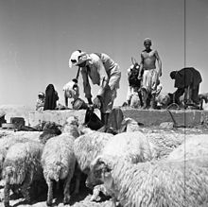
Strategy Design Approach

Slide 2
Motivation:
Survival Of The Fittest: Adapt Or Die

Slide 3
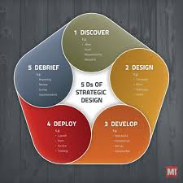
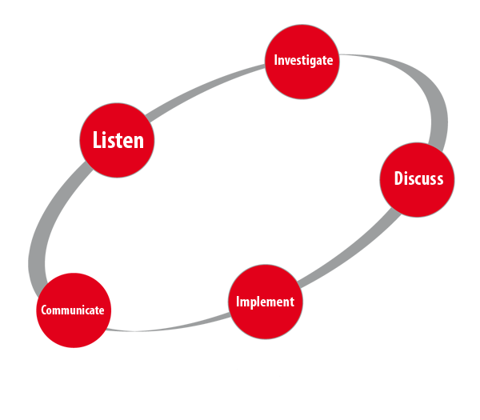
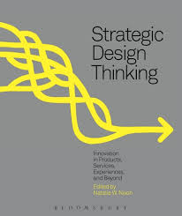
Infinite Models ....

Slide 4
Before We Begin… There's no magic solution… adopt your method and start working…
Principles:
Clear methodology, built-in, clear process
Lead by the commander
Time
Collaboration and openness:
A committed crew
A variety of opinions
Available
Notes:
עשוי לדרוש יותר משקופית אחת

Slide 5
Design - Goal
"Feeling uncomfortable" - reality changes
Learning Process | Identifying a need for conceptual change
Develop a framework for a strategy with respect to environmental change
To formulate a concept for the use of force - a systematic idea
Notes:
עשוי לדרוש יותר משקופית אחת

Slide 6
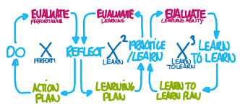
Assessing ability versus assessing learning ability
The only way forward in a world where there is no knowing what the students will face in the future
Notes:
עשוי לדרוש יותר משקופית אחת

Slide 7
Design - core principles
The change is not local | Required to learn |The problem is completely unclear, certainly not the solution
Criticism:
It is necessary to challenge the founding conventions and assumptions in order to allow the initiation of a matching process
It will not come of its own, requires a "method of thinking"
Notes:
עשוי לדרוש יותר משקופית אחת

Slide 8
Theory - Design
The essence of the design process:
Learning and knowledge development
Product of the design process:
Campaign / systems perception
Design - the first step in the broad process
Design produces perception
Planning is based on design and generates a plan
Notes:
עשוי לדרוש יותר משקופית אחת

Slide 9
Theory - Planning
From conception- to plan
Is written in light of the concept and under existing assumptions
The purpose of the program - implementing the concept - the systemic idea - achieving a required achievement that will serve the systemic idea
Heart of the program:
Definition of the purpose of the force I Efforts and tasks I Techniques and methods of organization I Over time and space I In unique circumstances
Notes:
עשוי לדרוש יותר משקופית אחת

Slide 10
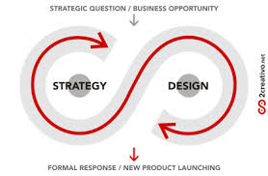
The Relationship Between Design and Planning
Design | Planning
Abandons basic assumptions | Is based on existing assumptions
Requires time, a complex and slow learning, and when we embark on the road the end is not clear | Targeted, defined in time, a clear target
Produces perception | Produces a plan
Preserves the relevancy of the organization over time | Allows effective operation against an existing problem
There is a complementary contrast between design and design
It is necessary to maintain both processes simultaneously
Each process has its own expression, with a dedicated team
Notes:
עשוי לדרוש יותר משקופית אחת

Slide 11
Practice
How do you realize ?
Notes:
עשוי לדרוש יותר משקופית אחת

Slide 12
Perception as Derived From Design - What Does it Include?
An explanation - how does it serve the strategic interests of the state?
Principles of the campaign - a form of action and realization
A clear and reasoned structure - on the basis of which a critical examination can be made in the light of change
Notes:
עשוי לדרוש יותר משקופית אחת

Slide 13
What are the Stages? Components of The Design Process:
Building the thinking process according to context
Setting the relevance gap
Creating an initial strategic framework
Critical questioning and creating a constitutive strategy
Developing an idea and configuration for a campaign / operation system
Checking the Validity of Perception
Notes:
עשוי לדרוש יותר משקופית אחת

Slide 14
The Steps In Detail
Structuring - designing the learning process itself (in view of the unique strategic context)
Setting the relevance gap:
1. What is wrong with the current concept?
2. What are the opportunities for a more relevant strategy and campaign concept?
3. Initial Strategic Framework - Basic lines for strategy / various alternatives
4. Critical questioning and creating a constitutive strategy - red power ...
5. Developing an idea and configuration for a campaign / operation system
Moving to the planning stage and building a system to examine the validity of the concept
Notes:
עשוי לדרוש יותר משקופית אחת

Slide 15
Survival Of The Fittest: Adapt Or Die
This is Your Task – Make Them Survive (Or Others)

Slide 16
Who Is The Next One to Go Bankrupt? Why?

