Slide 1

2030
10 Years From Now

Slide 2
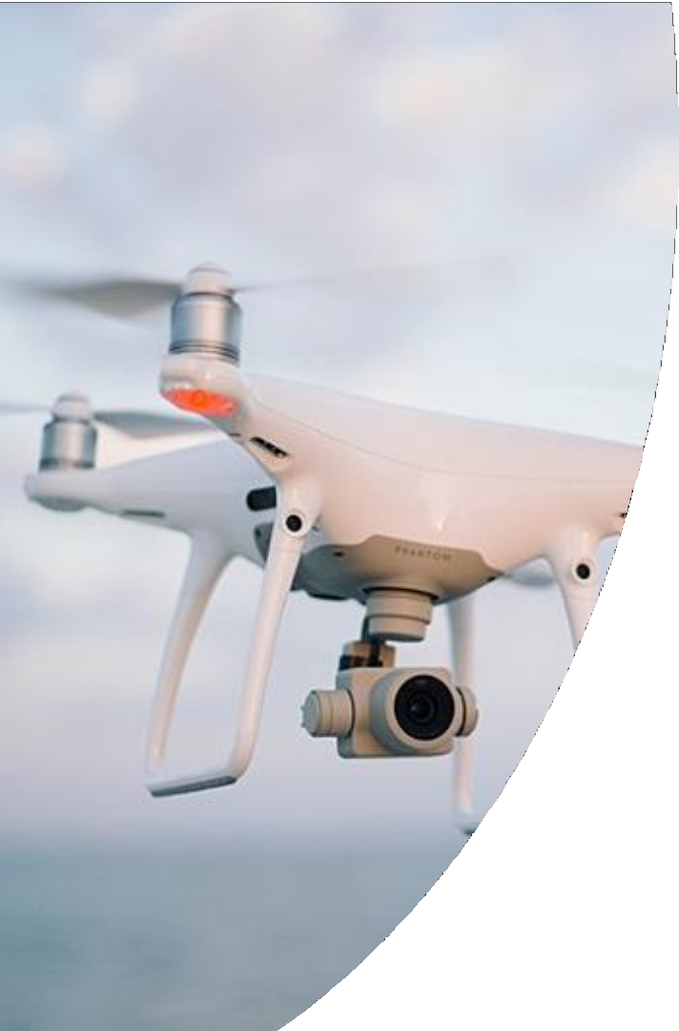
The year is 2030
A photo taken by a drone is received. It depicts the Negev area –
Be’er Sheva Metropolis

Slide 3
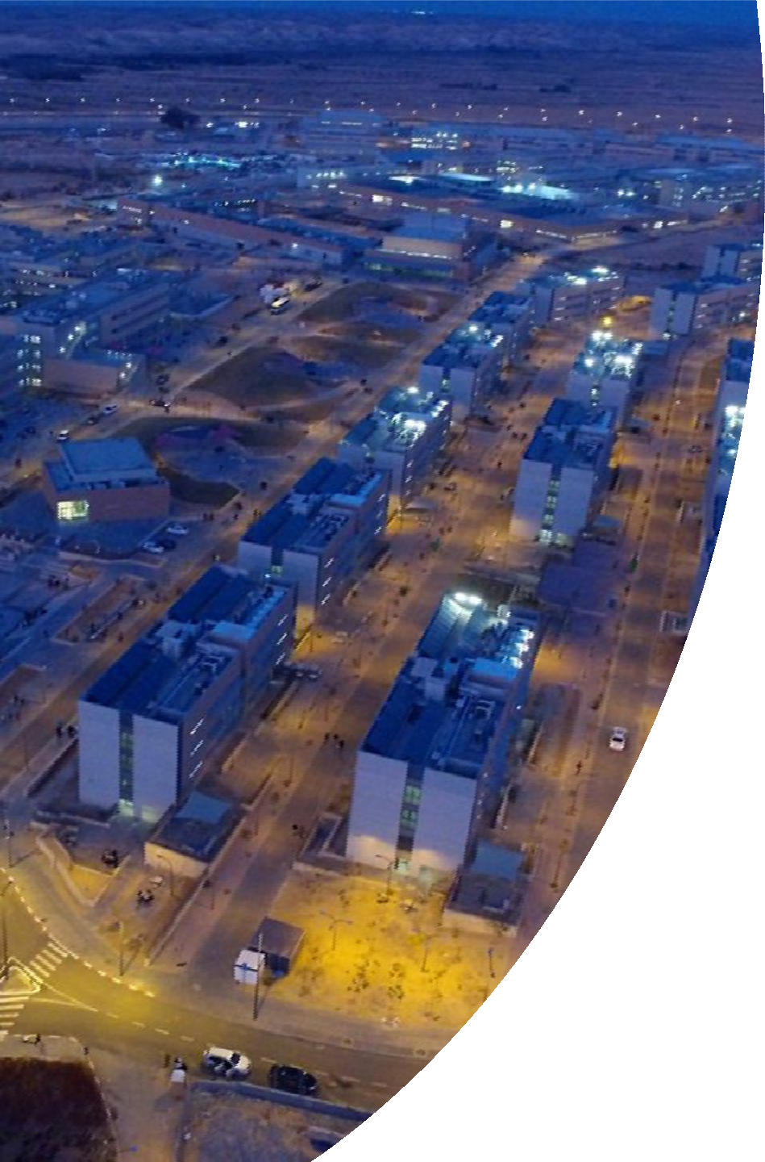
The Training Bases Complex has expanded and now holds 15,000 recruits
2019
Currently, the expansion and option utilization efforts of the Training Bases Complex are coming to an end.

Slide 4
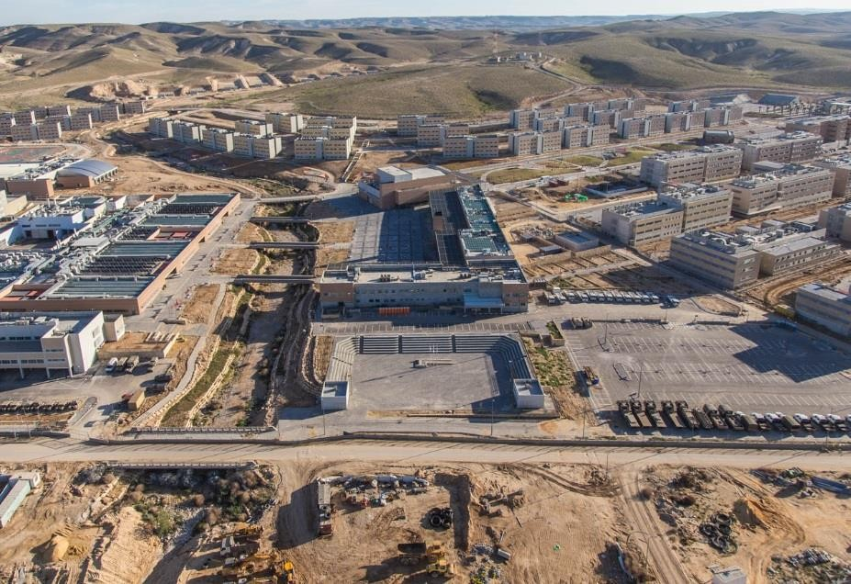
7 Combat Support Training Bases – 10,000 recruits at any given time – more than 90,000 people yearly

Slide 5
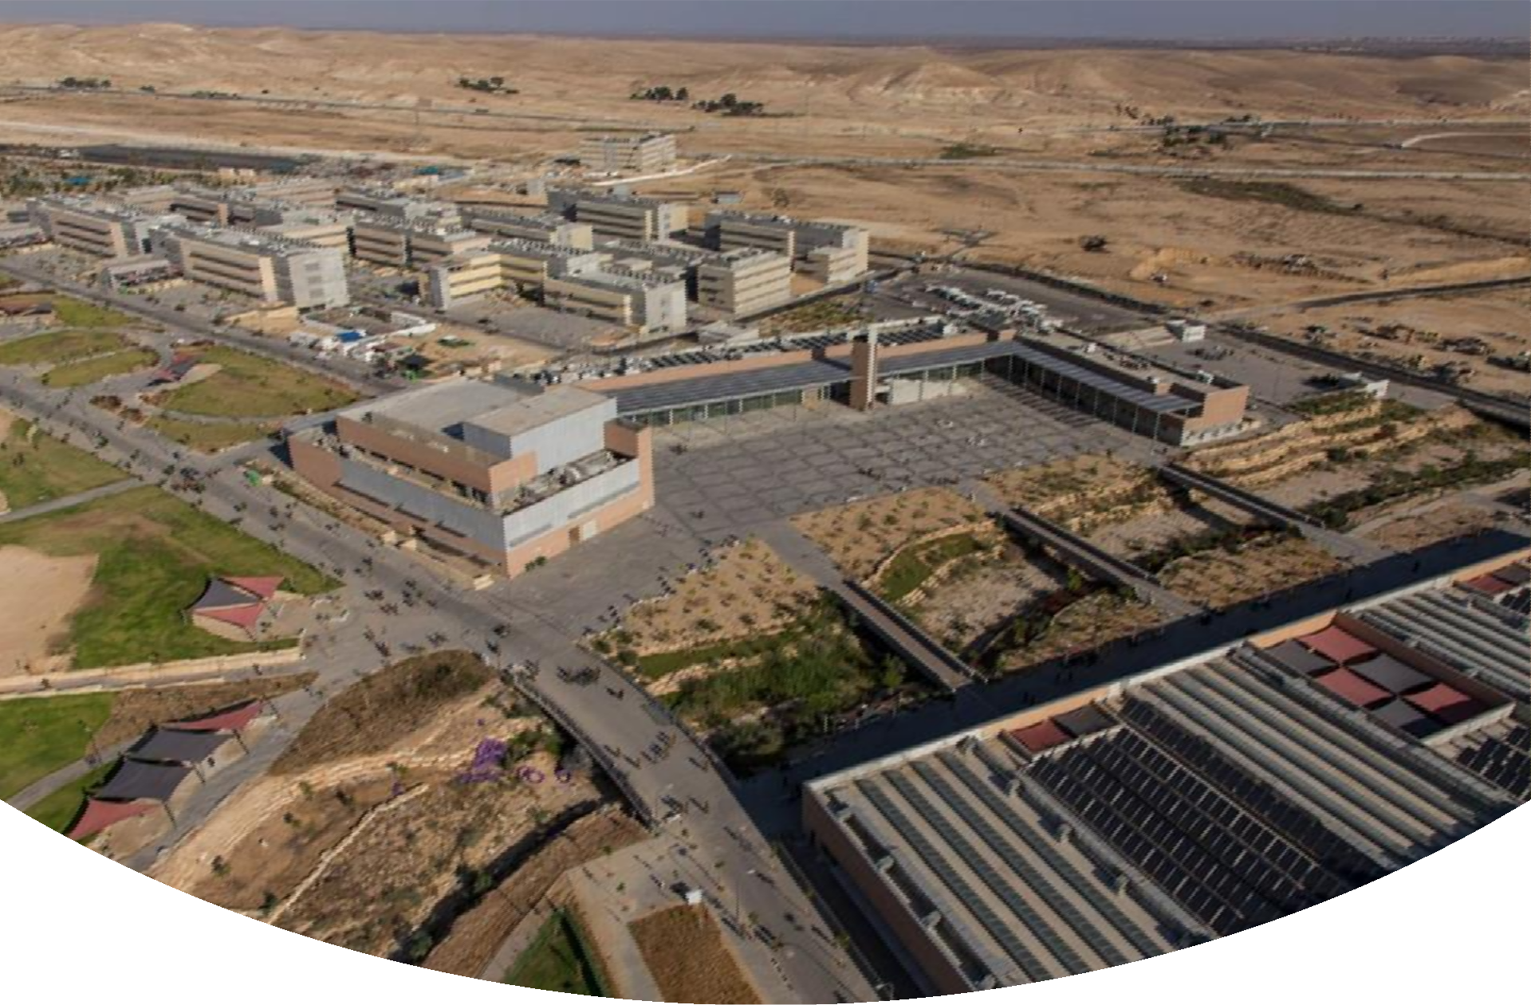
More than 250,000 sq of built space, in an area of about 618 acres.

Slide 6
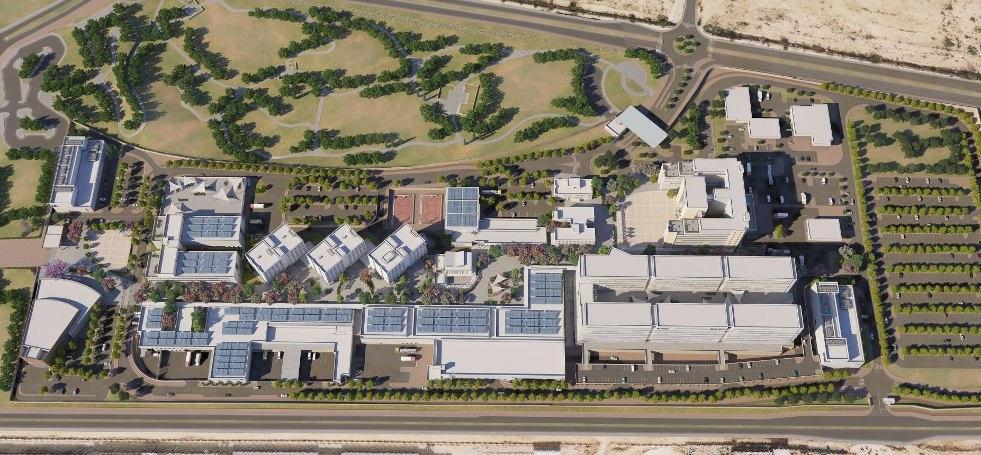
The C4I Corps (or Teleprocessing Corps) Center is based in Be’er Sheva, it holds 6,000 recruits, of them 1,500 are permanent army personnel
2019
As we speak, works have begun
and are expected to continue for about 4-5 years.

Slide 7
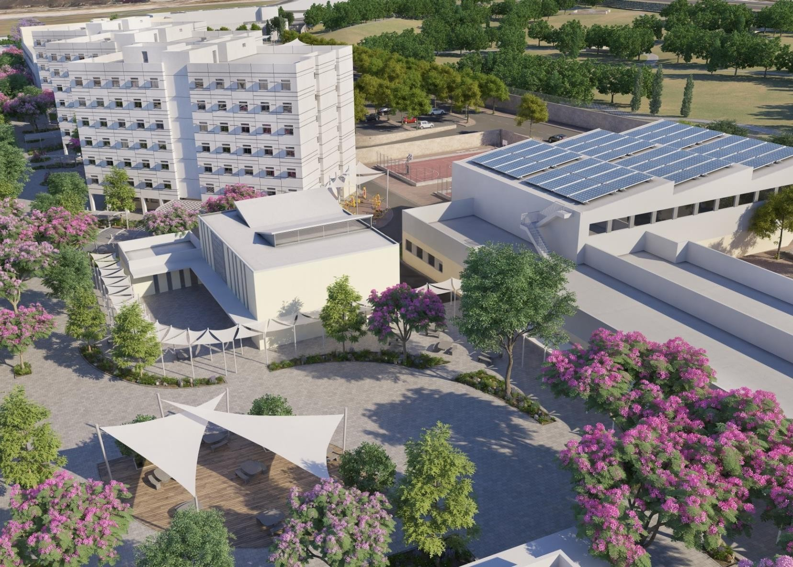
The Digital C4I Center will house side by side the Communications Directorate, the “Ofek” unit of the IAF and HQ of the Southern Command

Slide 8
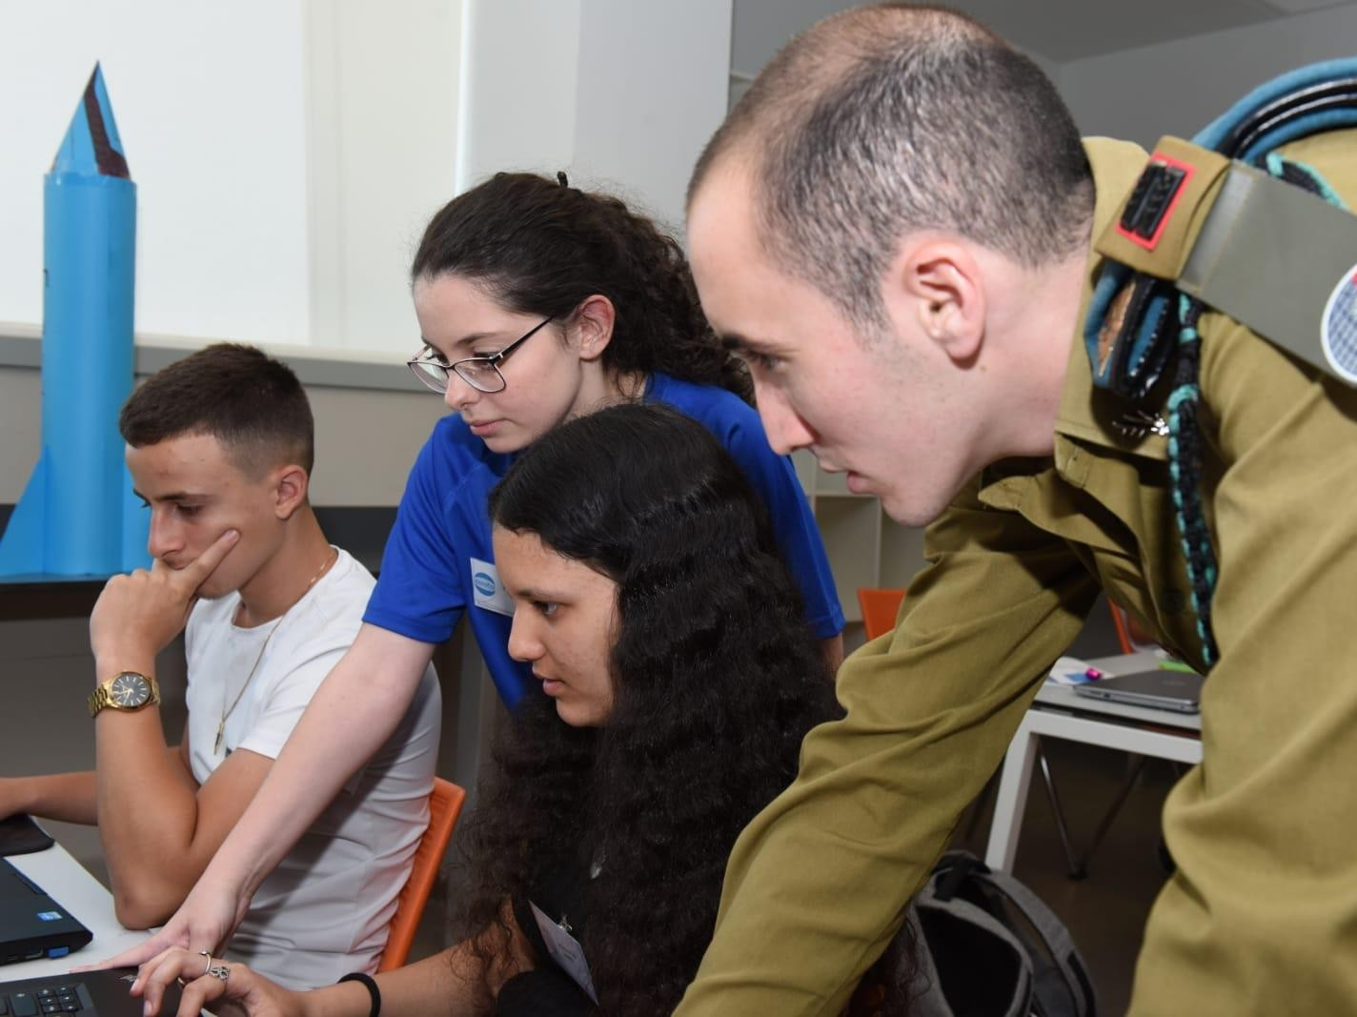
Students from the Negev, who are studying science as part of excellency programs, come to visit the C4I Center

Slide 9
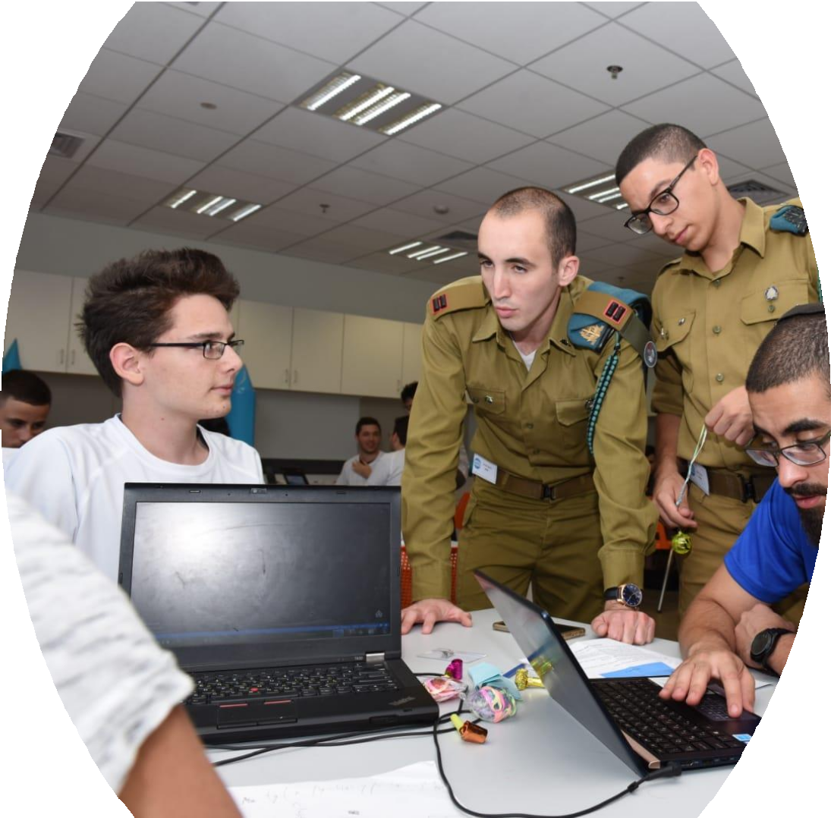

Slide 10
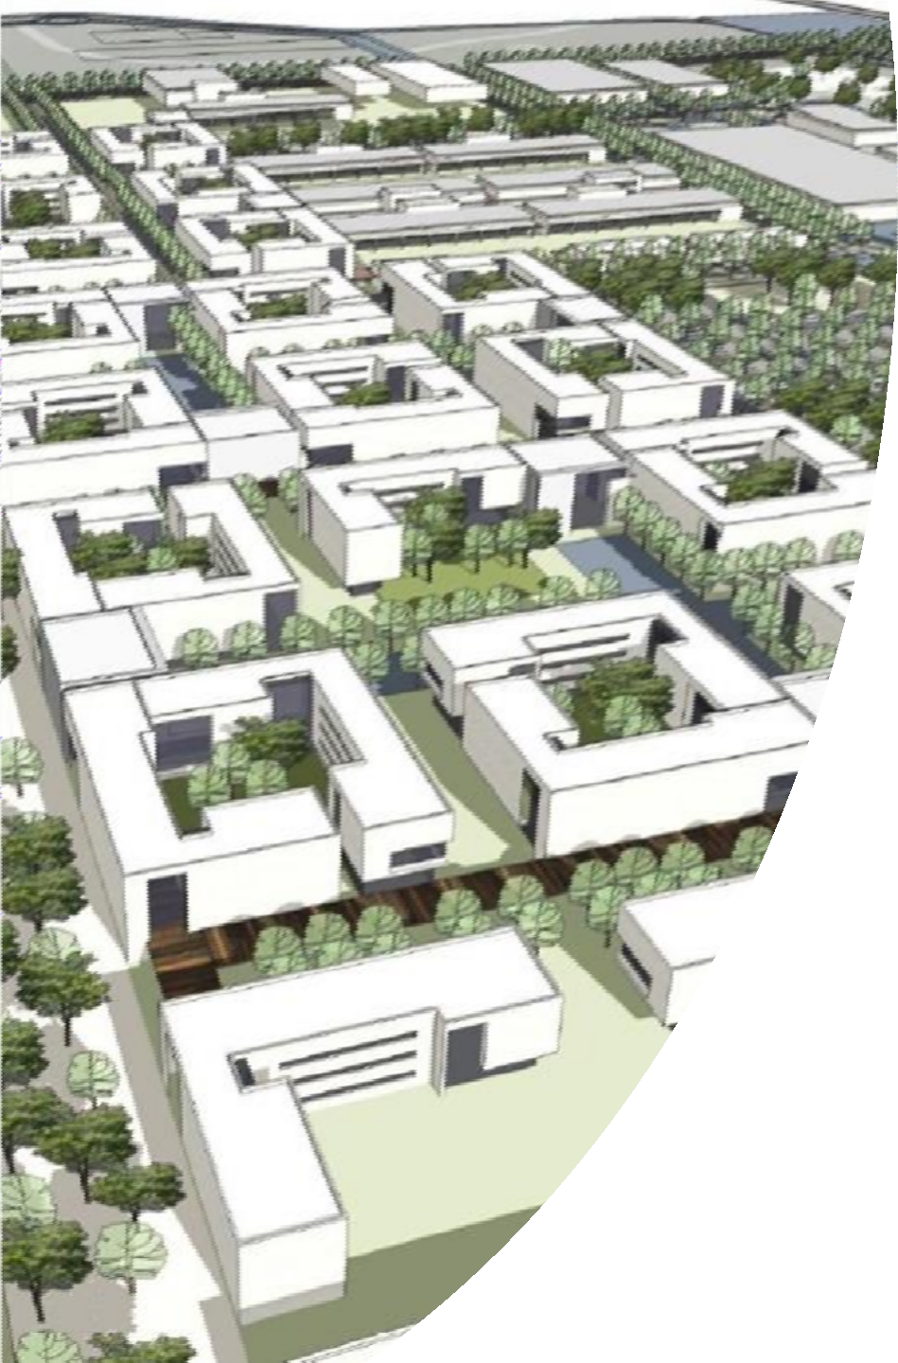
The Intelligence Center is a city that holds 12,000 people
2019
We are currently at the end of the bidding process, a winning company will be announced at the end of the first quarter of 2020.

Slide 11
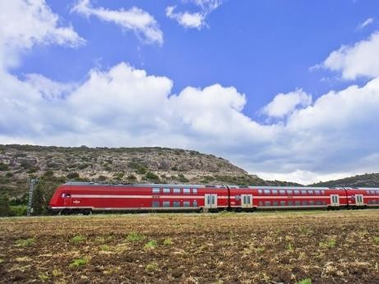
People who serve at the Intelligence Center will be able to arrive directly by train from Central Israel and Be’er Sheva

Slide 12

Direct and fast trains to Be’er Sheva
A 45 minute ride from Tel Aviv to Be’er Sheva
2019
Plans for a high-speed train to the Be’er Sheva metropolitan area are currently underway. Expected to be completed by 2040.

Slide 13

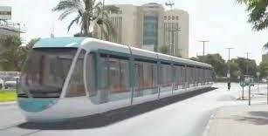
2019
A team was assembled to begin planning construction of an intra-city train
The Intelligence Center is connected by light rail to the city of Be’er Sheva

Slide 14
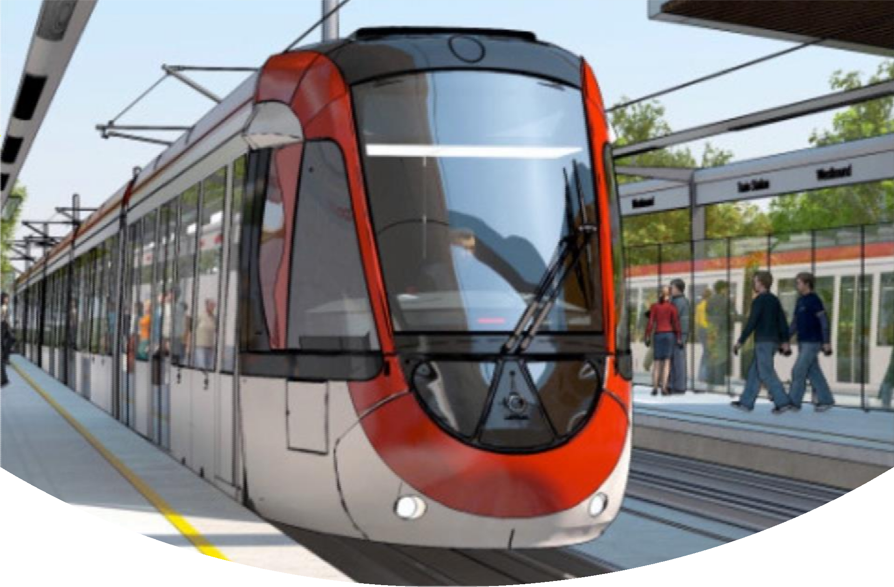
The light rail connects parts of the city together and from there continues to surrounding communities and towns, and strengthens the entire metropolis

Slide 15
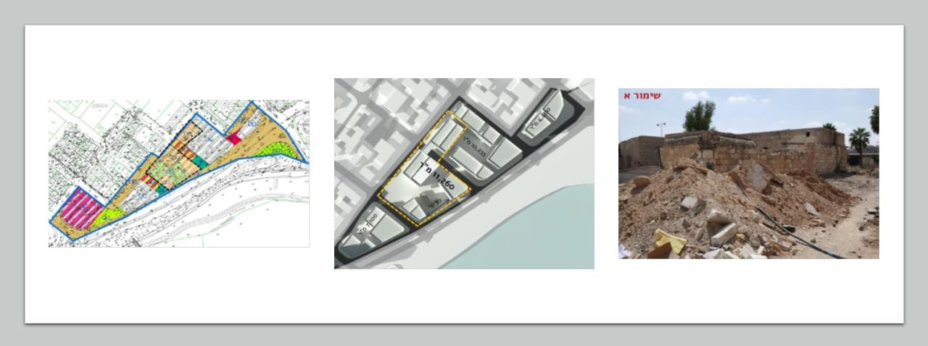
On the Imber axis, a cultural center has grown that continues to attract young people from all over the country

Slide 16
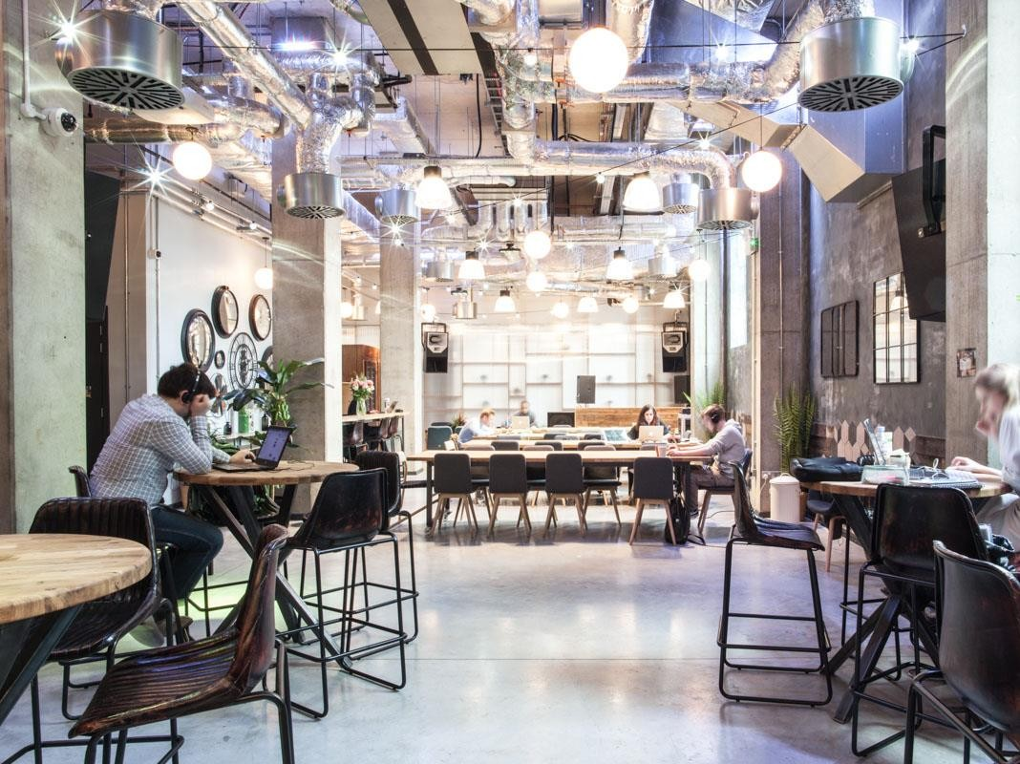
At its center is an innovative residential complex with a collaborative approach. It houses 200 permanent military personnel, who chose to live in the city.
2019
A program has been agreed upon with the Municipality of Be’er Sheva, the District Planner and the Ministry of Housing for the construction of the residential complex

Slide 17

2019
The proposal includes small apartments and shared living spaces, and aspires to create a community.

Slide 18
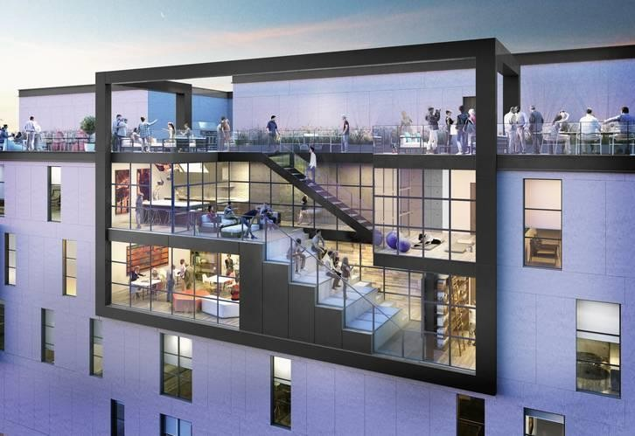

Slide 19
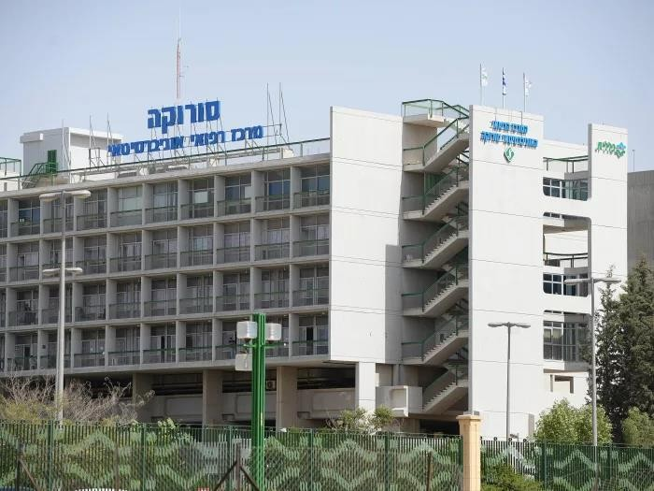
‘Sorkoa’ Medical Center maintains a research center connected with the Innovation Quarter of the City of Be’er Sheva
2019
As part of the assessments for the creation of the Innovation Quarter, the focus is on collaborative work - the city, the university, the hospital, the industry and the Ministry of Defense.

Slide 20
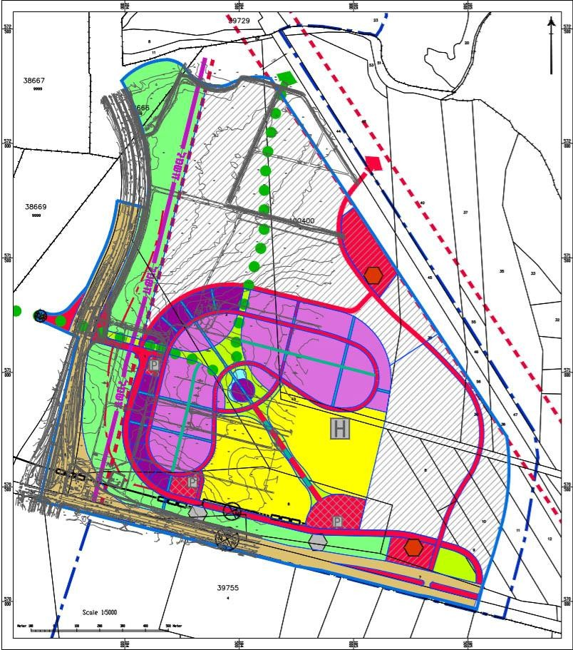
Specialist Doctors can also be seen at the New Shimon Peres Medical Center
2019
As part of a government decision of 2025, it was decided to establish another medical center in the city of Be’er Sheva

Slide 21
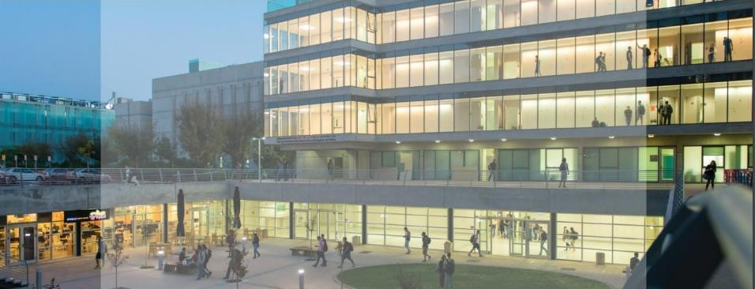
The Negev Academy is Expanding
2019
An agreement was signed between the Prime Minister's Office, the Council for Higher Education, the Ministry of Finance, Ben-Gurion University and the Ministry of Defense, to prepare the University to the move of the IDF's elite technological units to Southern Israel

Slide 22
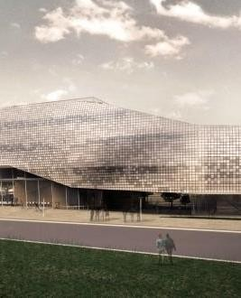
An academic-Industrial and military discussion is taking place in the new cyber building, and dozens of new lecturers who started working at the Ben Gurion University are participating in it

Slide 23
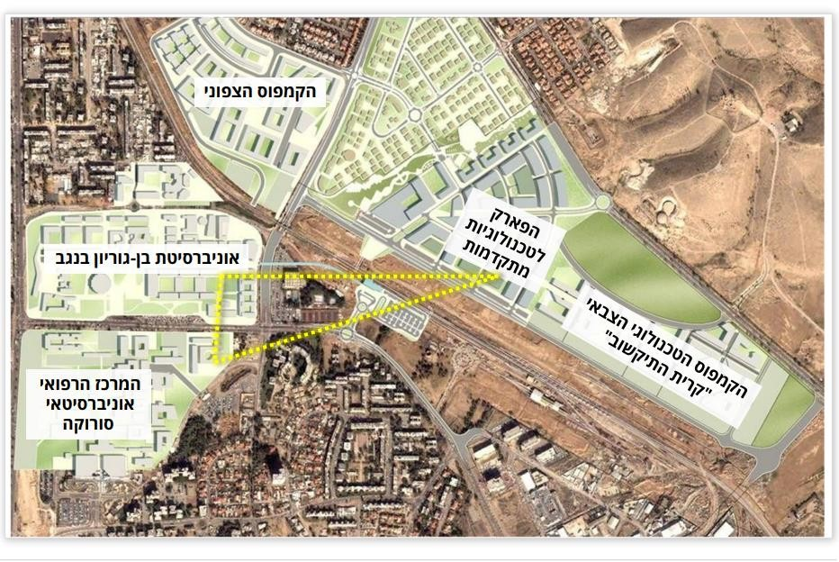
The Northern Campus
Advanced Technologies Industrial Park
Ben-Gurion University
The Technological Military “C4I Center”
Sorkoa Medical Cener
2019
Joint Academia-Soroka-Industry-Military plans are being formed, and the ‘Innovation Quarter’ is taking shape

Slide 24
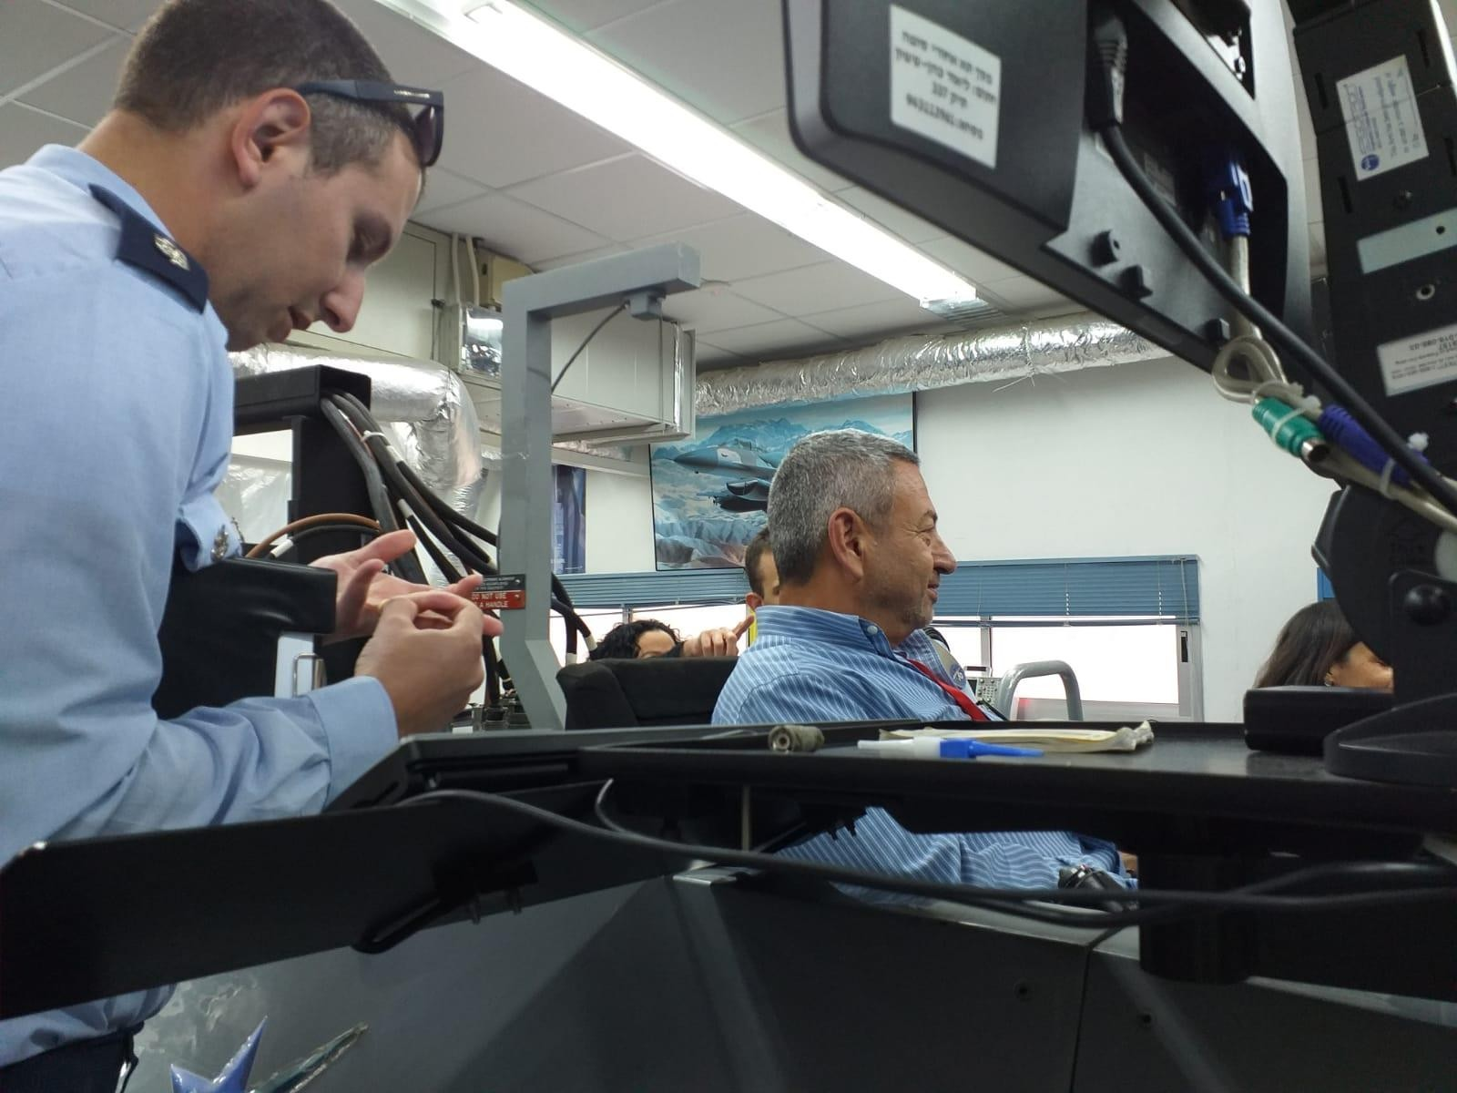
The university holds joint classes for permanent military staff and high-tech workers in the area

Slide 25
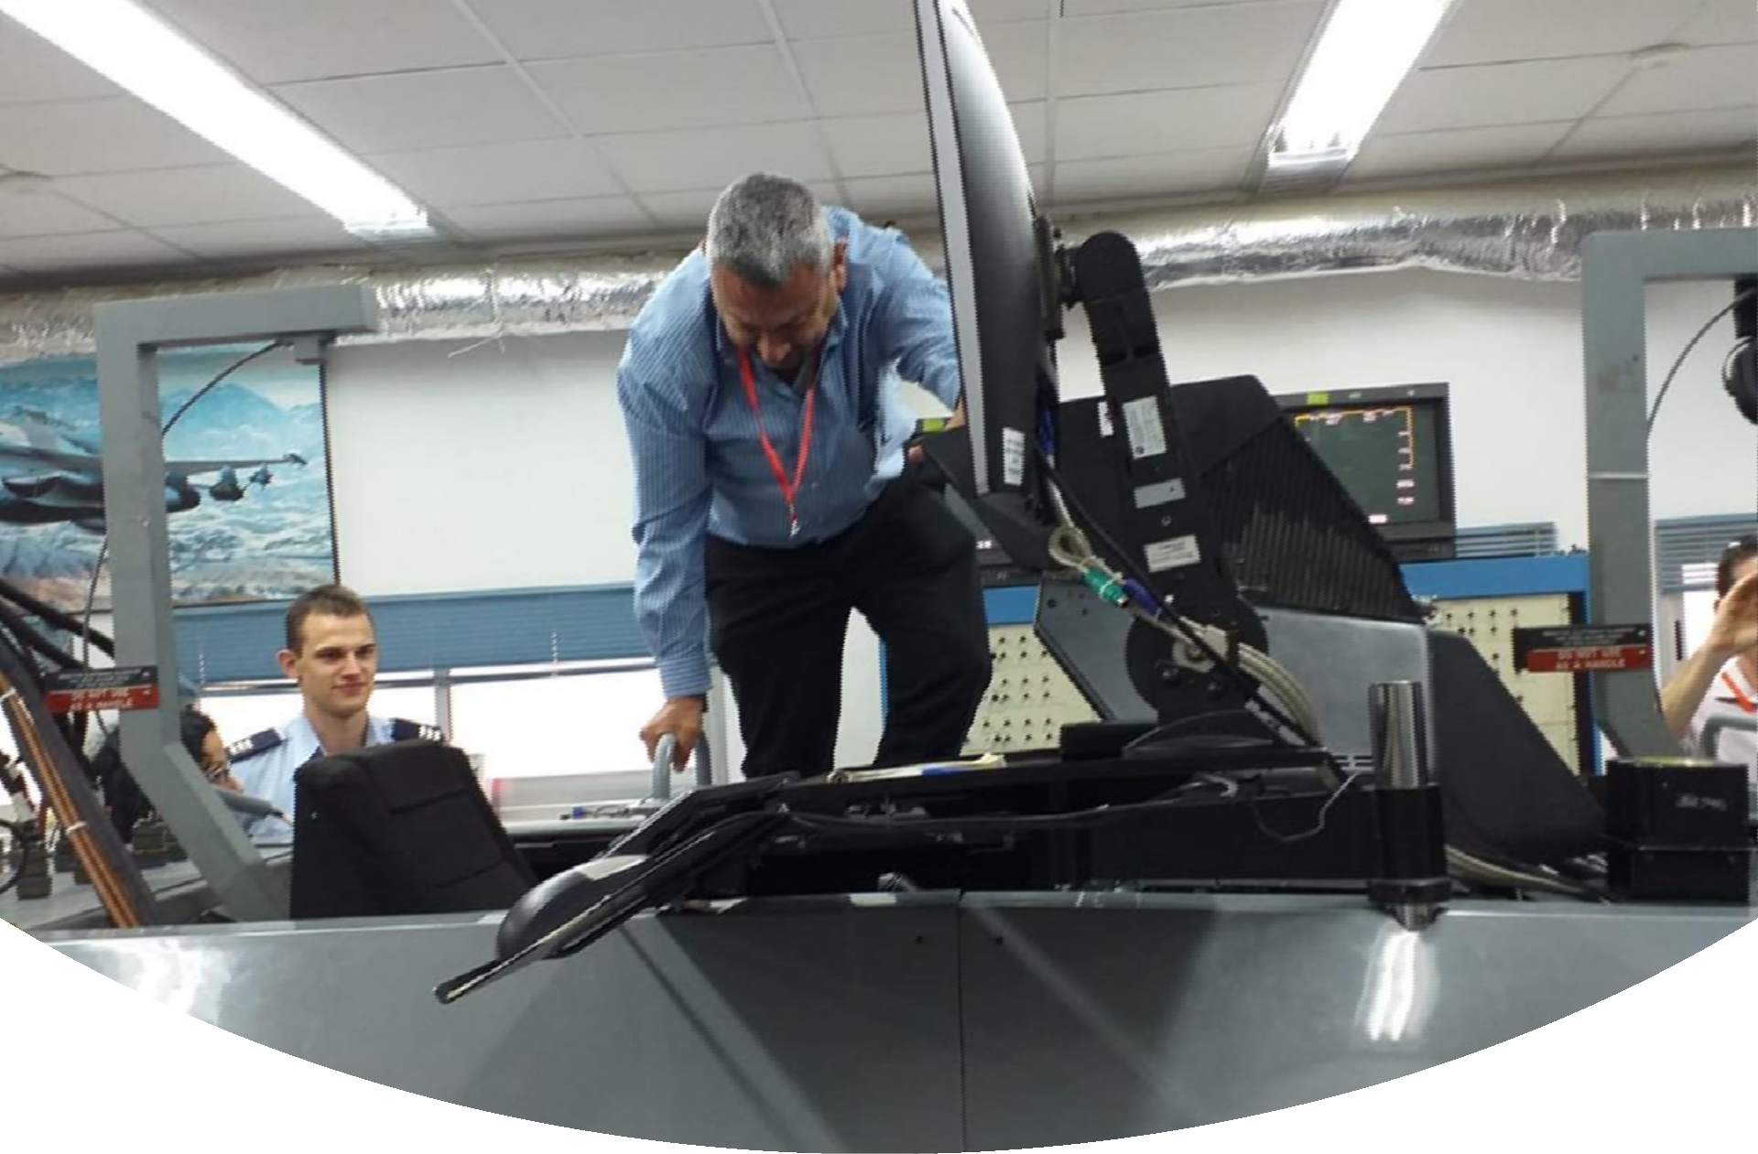

Slide 26
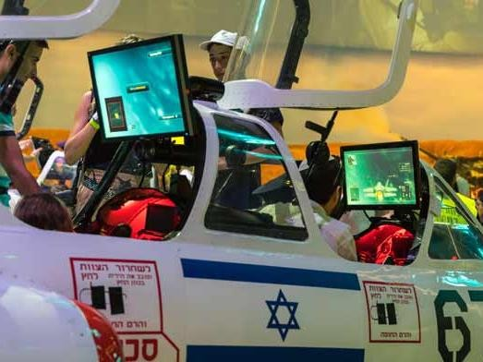
A short walk away is the Innovation Quarter, which is home to the Joint Research Center

Slide 27
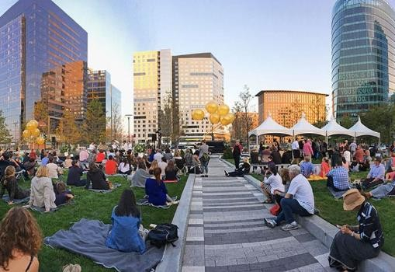

Slide 28
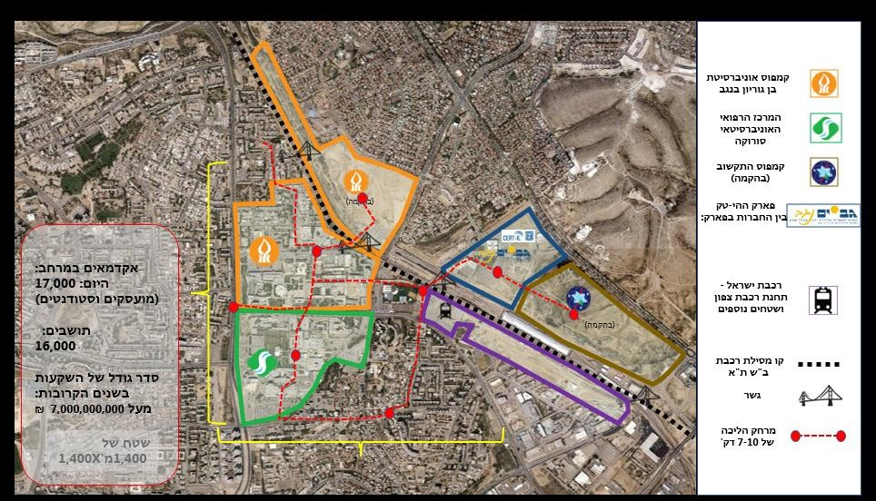
From Rager Blvd. through the Gimmel Neighborhood and all the way to Ramot, lies the Innovation Quarter which has received many international awards for its achievements
2019
Be’er Sheva was chosen as the first city to create an Innovation Quarter

Slide 29
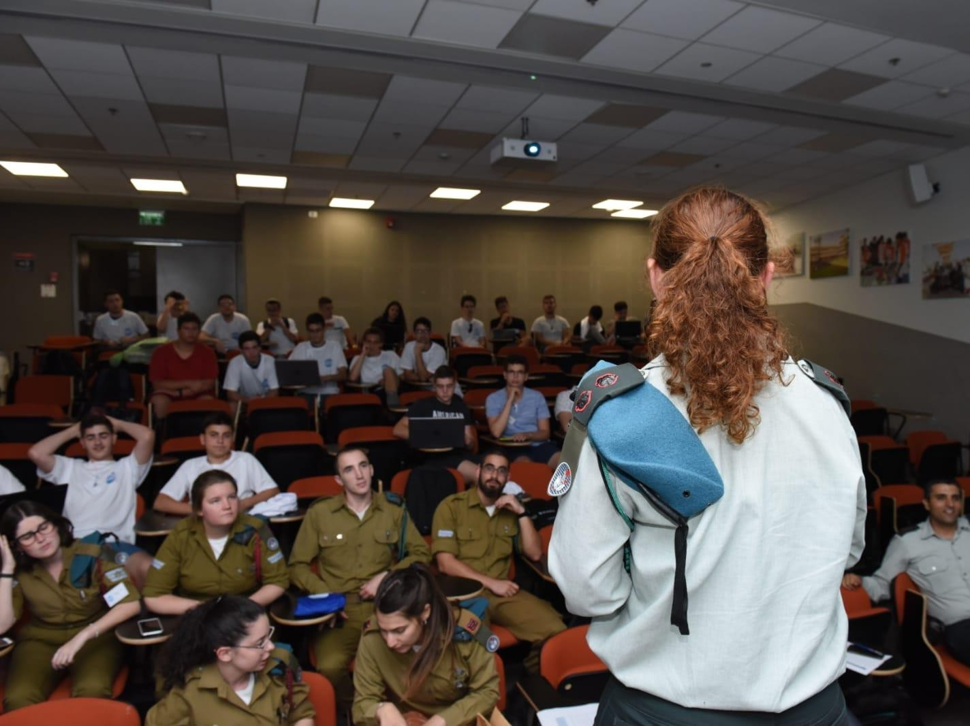
Students from the Negev communities come to the Innovation Quarter to study, in tandem with renowned researchers

Slide 30
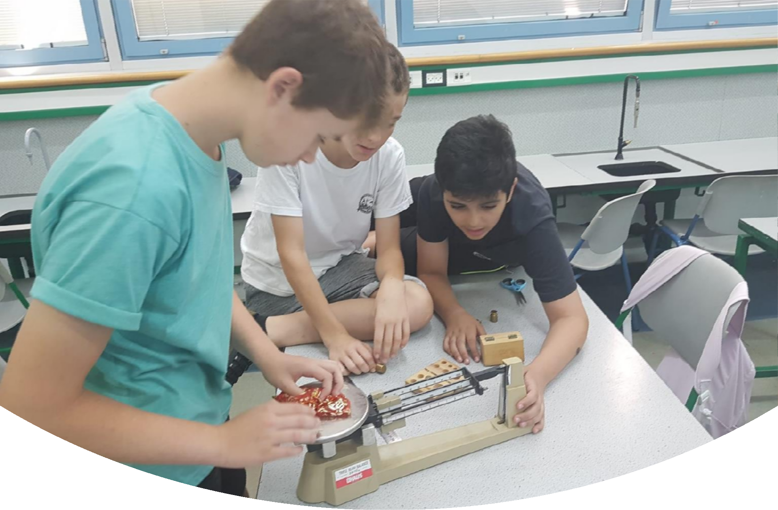

Slide 31
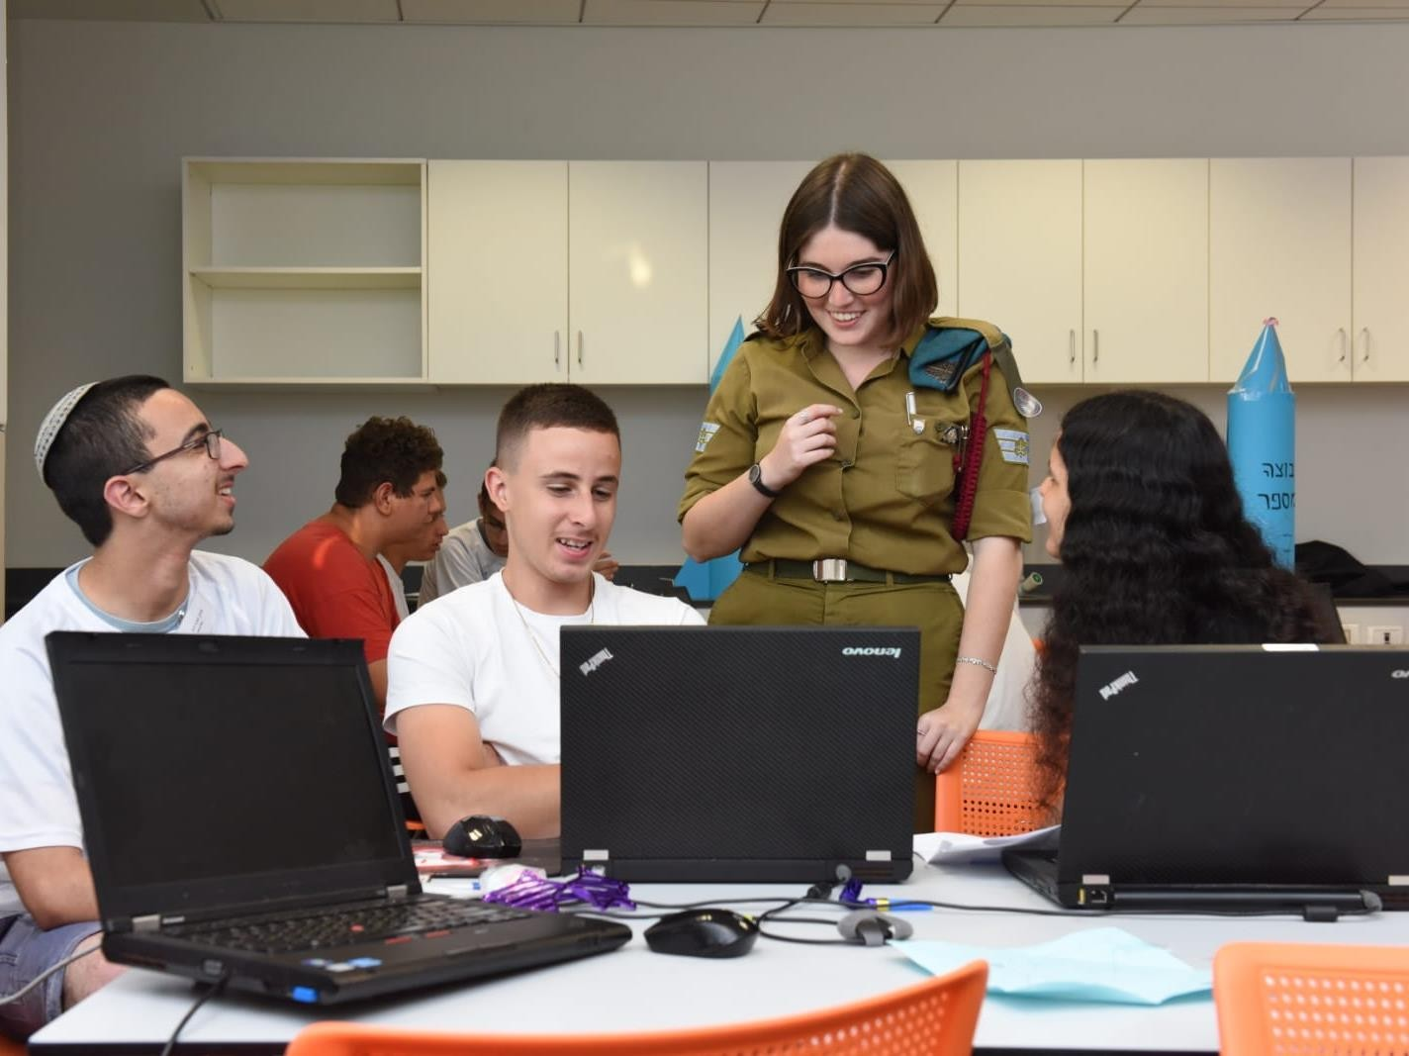
2019
The Defense Ministry and the Ministry of Education have excellency programs emphasizing sciences in the various Negev communities
20 percent of the recruits in the technology units come from the surrounding communities

Slide 32
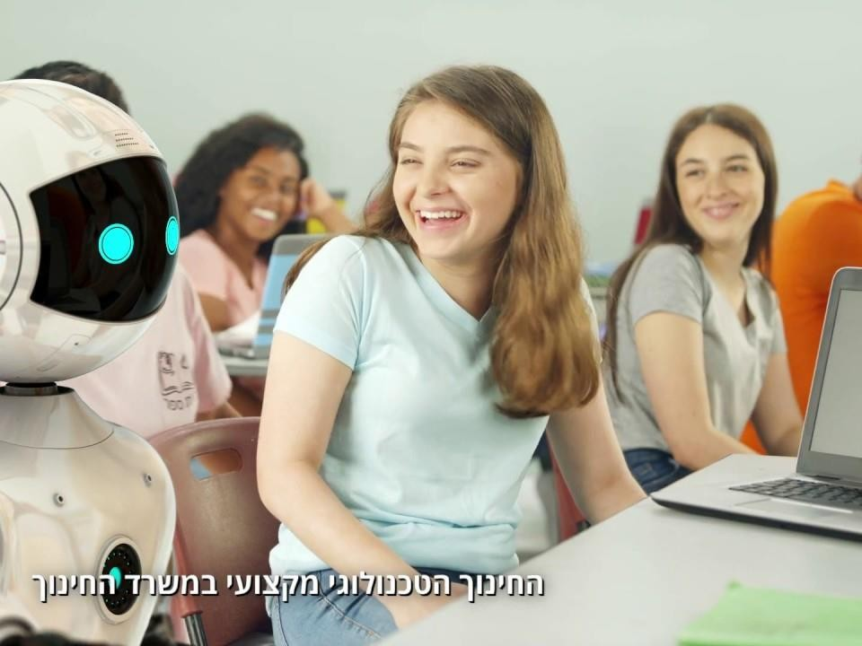
2019
In total 2000 children take part in the programs
The Negev produces excellency programs that began in the southern communities and have now spread to other areas of the country

Slide 33
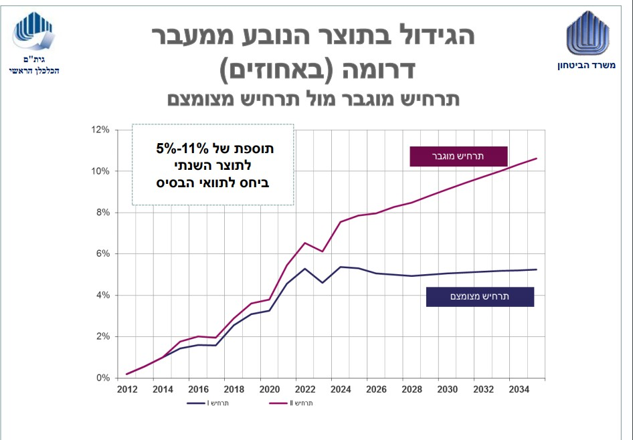
The entire process with all of its outcomes, has contributed to a 10 percent growth in GDP
The growth in GDP stems from the move to Southern Israel (%)
Enhanced scenario and limited scenario
An increase of 5-11% to the GDP in comparison to the original conditions
Enhanced scenario
Limited scenario

Slide 34
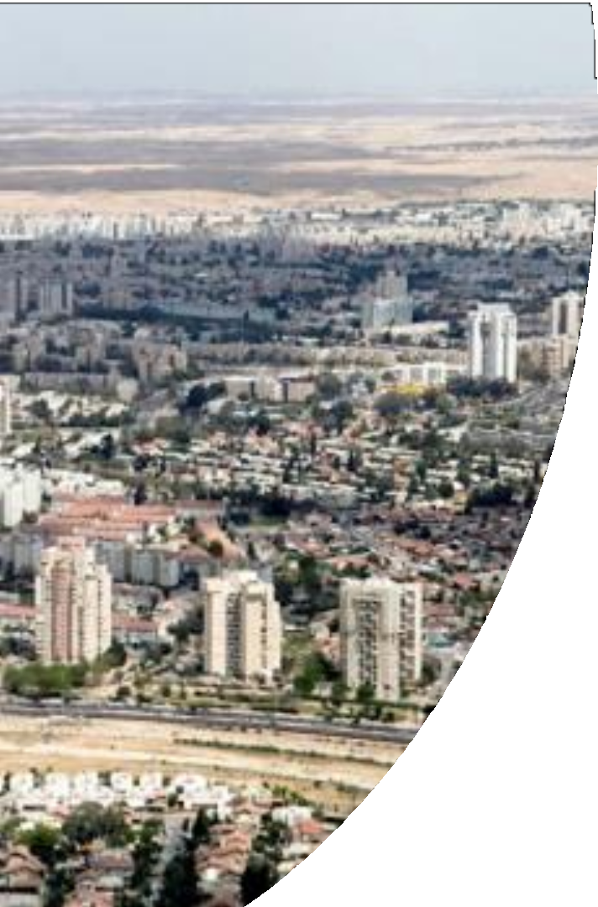
Communities in the Negev continued to grow and expand. Many families chose to live in the Negev, and the Negev grew to a population of a million and a half residents

