Slide 1
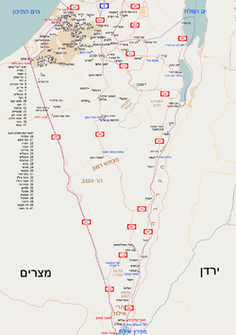
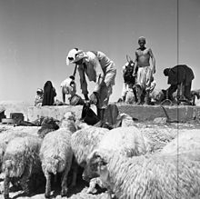
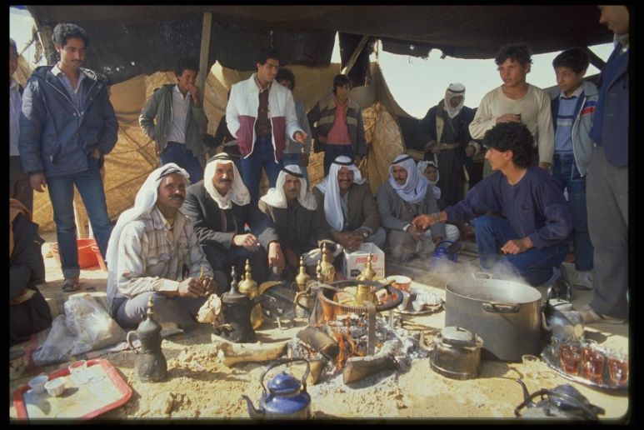
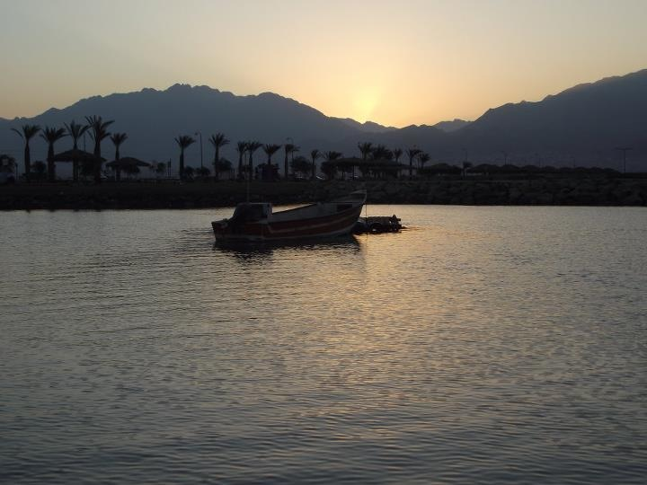
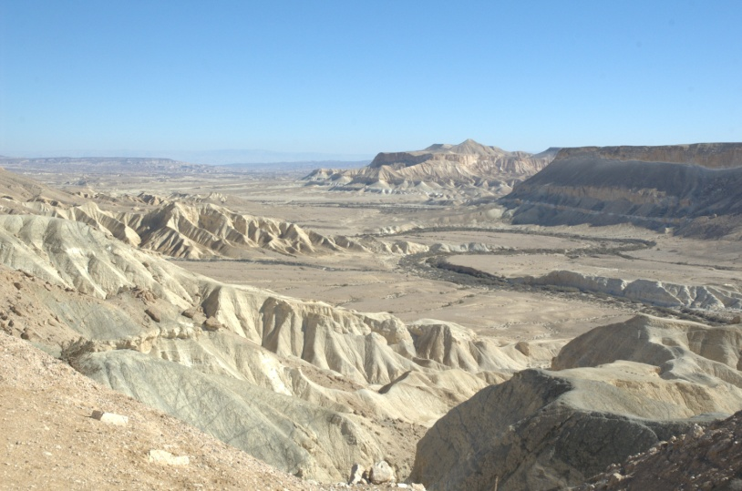
Team 2 46th Class
Southern Tour Plan Presentation to the College Commander
25-28 / 11/2018

Slide 2
Issues for decision and gaps - needs to be updated
Gaps:
Flights
Coordination of lecturers
administration?
Update according to the gaps on Wednesday

Slide 3
General:
On 26-28.11.2018, a tour of the National Security College in the south of the country will take place with a great deal of the central subjects taught at the National Security College.
A preparatory day will take place on 25.11.2018 at the INDC.
Main Goal:
Familiarity with the southern region in view of Israel's national security challenges with its components - security, foreign relations, society and economy.

Slide 4
Extended Goal:
The Southern Region, the Gaza Strip and the surrounding areas, the Be'er Sheva area, the Dimona-Nevatim region, and the city of Eilat. Understanding the characteristics of space, the opportunities and challenges of all the delegates, its importance and its impact on national security.
Sub-goals:
Understanding the security, social and economic challenges in the Gaza and surrounding areas.
Familiarity with the Negev Bedouin issue, challenges and looking ahead.
Familiarity with the unique space of Eilat in security, economic and social contexts.
Familiarity with the "Transition to the Negev" trend with all its components, and the uniqueness of the space in aspects of national infrastructures.
Focusing on each of the pillars of national security relevant to the political, security, social and economic space, through meeting with people in the space and the ability to understand and direct study through them.
Enjoyment and social cohesion.

Slide 5
Lessons from North Tours
Conservation:
Touching the feet of the National Security
Focusing the tours to the core spaces - "what adds value to sitting in the classroom"
The quality of the lecturers and the focus of the lecturers on the relevant content
Social Action
Improvement:
Time to process teams
Schedule spacing
Reference materials - digital media, films. A focused booklet.
Flight back
Are there other lessons - make sure in front of the staff

Slide 6
The Logic of the Parade in the Tour
Security
The scene of Gaza and all its components
Political
Economy
Gaza Envelope - Agriculture and its Challenges
Cultural
The Challenge of Settlement in the Gaza Envelope
The political context in the Gaza Strip
The transition to the south - economic influences
An alternative airport to the Ben Gurion Airport
Beer Sheva's development and centrality in the economic context
The Bedouin economic challenge
The marine arena in the economic context
The political context on the Egyptian border in the arena of a spatial division 80
The maritime arena in the political context
The unique context of nuclear research
As a component of national security
80 The spatial division and its unique characteristics
Challenge of Governance in the Negev in the Bedouin Context
Bedouins in the Negev
Be'er Sheva as the capital of the Negev
Eilat - The uniqueness of the city
Moving south - indeed (army, society, infrastructure, economy)

Slide 7
Preparation Day 25/11
Hour | Subject | Lecturer | Echelon
13:00-14:00 | Southern Command Challenges | MG. Hartzi Halevi - Commander of the Southern Command | Security Echelon
14:00-14:45 | Bedouin settlement in the Negev | Yair Maayan - Director General of Bedouin Development and Settlement Authority in the Negev | Socio-economic Echelon
14:45-15:15 | Break
15:15-16:00 | The Gaza Strip - the coordination effort | Major General Poli Mordechai, COGAT | Economic and political security Echelon
16:00-16:30 | Briefing and updates | Tishler / Chaim / Michael
Notes:
עשוי לדרוש יותר משקופית אחת

Slide 8
Wednesday 21/11
Hour | Subject | Lecturer | Echelon
15:00 – 15:45 | Put Kalman here? Maybe Racheli?
15:45-16:15 | Tour Preparation | Tishler / Chaim / Michael

Slide 9
Monday, 26/11/2018 - The Gaza Strip I Beer Sheva I Dimona
Hour | Subject | Lecturer | Place
13:00 14:30 | Lunch + conversation with Amir Peretz Socio-economic Echelon | Amir Peretz | Resturant in sderot
14:30 15:00 | A trip to Be'er Sheva
15:00 16:00 | A conversation with the mayor of Be'er Sheva Socio-economic Echelon | Rubik Danilovich | The mayor's office -maybe one of the city's projects?
16:00 16:30 | En route to Hura
16:30 17:30 | Visit a girl Echelon Socio-economic | ?????? | The Bedouin village of Hura
17:30 19:30 | Traveling to the hotel in Dimona + regrouping
19:30 20:00 | Processing teams
20:00 | Dinner + pub + concert
Hour | Subject | Lecturer | Place
07:00 | Exit from Sde Dov (Sand Parking Lot) |  | Military Sde Dov
08:30 09:00 | Breakfast |  | North of the Strip
09:00 09:45 | Overview - Security Challenges in Gaza Social security echelon | Physical Training in Gaza | North of the Strip
09:45 10:15 | A review of the barrier Security echelon | BG Eran Ophir | North of the Strip
10:15 11:00 | Tour of the tunnel Security echelon | Head of the Northern Division | Northern Division region
11:0011:30 | En Route to Nir Am
11:30 12:30 | The Challenges of Settling the Gaza Envelope Economic and social security echelon | head of the Council | Nir Yam
12:30 13:00 | En Route to Sderot

Slide 10
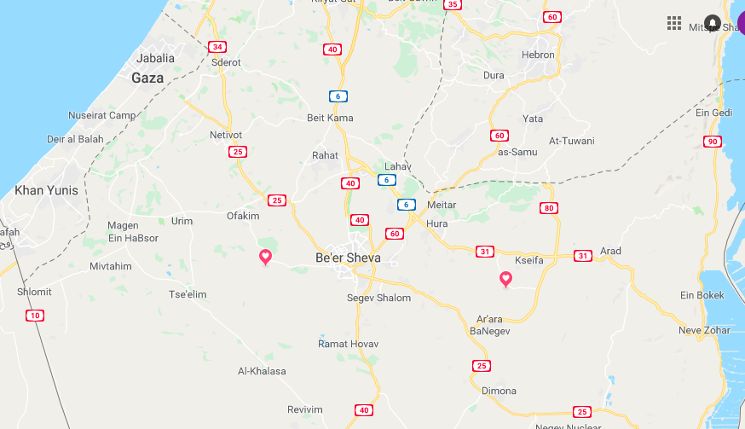
The Tour Area - Monday

Slide 11
Tuesday, 27/11/2018 - Dimona I Northern Region I Arara | Nevatim
Hour | Subject | Lecturer | Place
14:3014:45 | Traveling to the Nevatim base
14:45 16:45 | Tour + Overview at the Nevatim Base - Socio-economic security echelon | MG of the Nevatim Base - Brigadier General Eyal Grinboym Director l of the Negev Council - Johann Atlan | Nevatim base
17:00 17:30 | Flight to Eilat
17:30 19:30 | Travel to the hotel, organize in rooms |  | Eilat - The Nova Hotel
19:30 20:00 | Team Processing |  | Eilat - The Nova Hotel
17:30 19:30 | Traveling to the hotel in Dimona + regrouping |  | Eilat - The Nova Hotel
19:30 20:00 | Team Processing |  | Eilat - The Nova Hotel
20:00 | Dinner and Free evening | Check out dinner option at the restaurant | Eilat - The Nova Hotel
Hour | Subject | Lecturer | Place
06:30 | Physical training (optional) | There is an indoor pool at the hotel | Hotel Drachim Dimona
07:30 08:30 | Breakfast |  | Hotel Drachim Dimona
08:30 09:30 | Overview - Challenges of the Southern Region Social security echelon | Commander of the Southern District - Moti Cohen | conference hall Hotel Drachim Dimona
09:30 10:00 | En Route to the Nuclear Research Institute
10:0012:00 | Nuclear Research Institute tour Rotem Factory Socio-economic security echelon | Head of the Nuclear Research Institute | Nuclear Research Institute Dimona / Rotem plant
12:00 13:00 | Lunch |  | Nuclear Research Institute Dimona / Rotem plant
13:00 13:30 | Trip to Arara
13:30 14:30 | Bedouins in the Negev Socio-economic security echelon | ?????????????????? | Arara

Slide 12
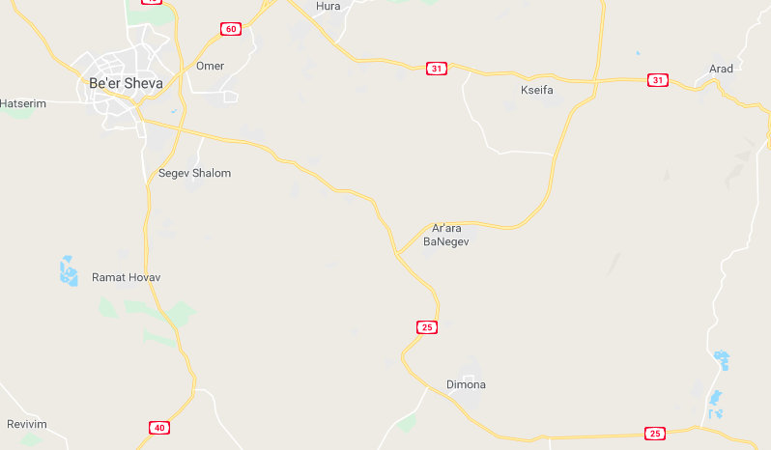
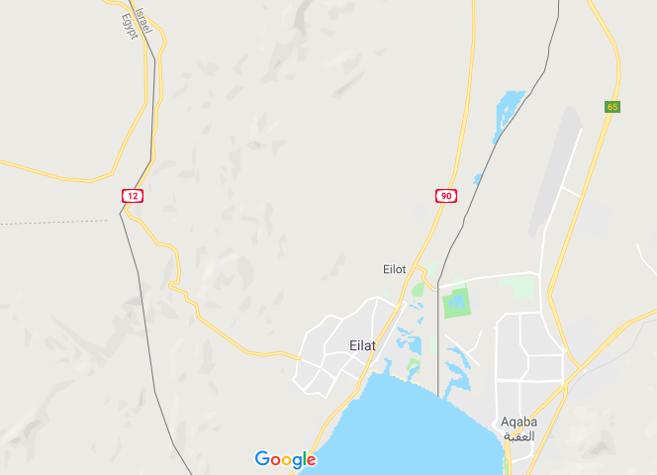
From the Tour -Tuesday

Slide 13
Thursday, 28/11/2018 - Peace Boundaries, infiltrators, Red Sea, Eilat
Hour | Subject | Lecturer | Location
06:15 07:30 | Physical Activity (Optional) | Check Kayaking options?
07:30 08:30 | Breakfast |  | Hotel Nova
08:45 09:45 | A conversation with the Mayor of Eilat Social, economic Echelon | Head of the Eilat municipality | The lecture hall at the hotel
09:45 10:15 | A trip to Eilat
10:15 12:00 | Review of the commander of the sea scene + sailing Security echelon | Commander of the Eilat Sea Arena | The scene of the Red Sea
12:00 13:15 | trip to Space Division 80 + Lunch |  | Spatial division 80
13:15 15:15 | Tour and review - the challenges of Division 80 and the overall response to the defense of the borders of peace Security, social, economic and political echelon | Spatial division 80 | The Red Sea
Hour | Subject | Lecturer | Location
15:15 15:45 | Travel to Eilat Airport
16:00 | Flight to Hatzerim -> Sde Dov -> Ramat David

Slide 14
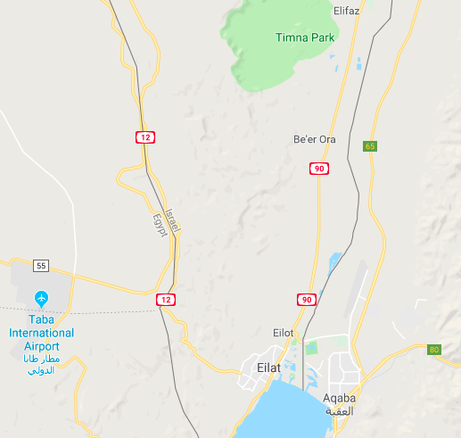
The Tour Area - Wednesday

Slide 15
The Manner of Implementing the Four Legs of National Security into the Course of the Tour
Political | Security |  |  | Social |  | Financial
 |  |  |  |  |  |  |  | Preparation Day
 |  |  |  |  |  |  |  | Monday
 |  |  |  |  |  |  |  | Tuesday
 |  |  |  |  |  |  |  | Wednesday
legend
Political | Security | Social | Financial

Slide 16
Instruction
Coordination of the lecturers - closing the gaps.
Booklet for a National Security Tour in the South - in accordance with the Southern Tour Guides.
Videos and lots of media supports the topics of the tour.
Simultaneous translation.
Full coordination with the commanders, mayors and lecturers.
Sending CVs, completing a summary, and giving gifts to civilian lecturers.

Slide 17
Administration
Closing the flights (back and forth).
Bus nearby.
Meals are coordinated.
Medical response - Dr. Shahar Shapira with a doctor's backpack.
Security - 4 members with personal weapons (pistol).

Slide 18
Questions for Team Processing
According to the analysis model s.w.o.t the "soft underbelly" is the encounter between the weakness and the threat What is your understanding of the soft underbelly of national security in the south?
According to the sw.o.t analysis model, "levers" are the encounter between strengths and opportunities.
National security is based on four pillars - security, political, economic and social. Do you think there is a balance between the different legs in the context of national security in the south (or are there very strong legs compared to very weak ..)?
Do you think Ben Gurion's vision to settle the Negev in the realization trend? What are the main challenges? Does the slogan "moving south" really materialize?

Slide 19
Add a Summary Slide - After Everything is Ready.

