Slide 1
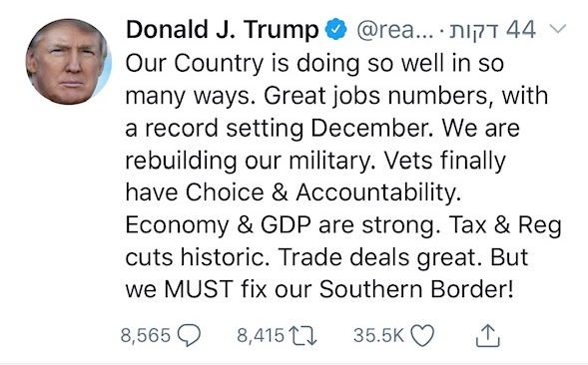
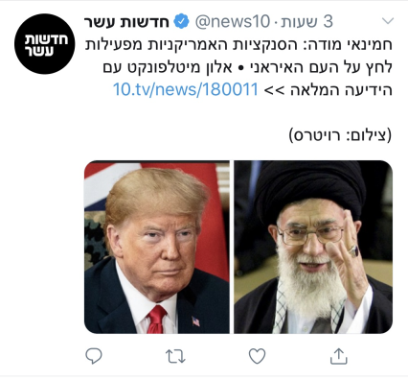
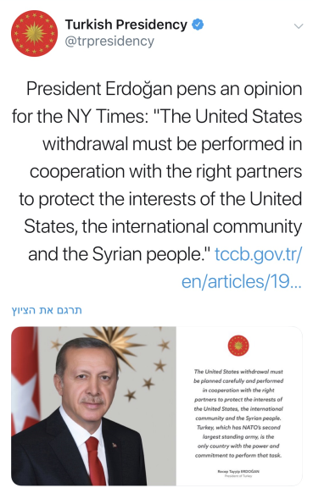
Strategy Northern Arena

Slide 2
Israel
US – a friend. The main ally Russia – FRN. A relationship with a changing nature, security coordination Sunni states – friend. “under the table” cooperation Iran – enemy. Consistently calls for the annihilation of Israel Syria – enemy. Historic animosity. Separation of forces agreement | Affinities
Economic power American sanctions Military power and deterrence Capability of mediating between super-powers | Strengths
The departure of the US and low function of international forces Lack of shared interests with the super-powers against the establishment of Iranian presence Impatience of the public for a significant operation The bully of the region | Weaknesses
Routine – total war. Walking on the line Economic-military prices | Tensions
Ensuring security and stability Strengthening Israeli deterrence Avoiding a military conflict in high intensity Harming Iran’s nuclear development capability | Purpose
Campaign between campaigns – international legitimacy and mediation led by the US Creating a strategic space of conduct Ambiguity and reducing formal intervention in the arena | Logic
Preventing Iranian establishment in Syria Preventing the strengthening of Hezbollah with tiebreaker weapons Postponing the next war | Goals
Removing the Iranian presence from the Golan Heights border Attacking the weapons transfer axis Removing the offensive capabilities from the enemy Creating internal and external legitimacy | Targets

Slide 3
The Enemy
Israel – a main enemy, ideologically and physically US – enemy. Combat. Sanctions. Nuclear. Russia – FRN. Supports Assad. Interest. Current. Arab states – Sunni enemy An axis of shared interests alongside opposing internal needs | Affinities
Oil A military opponent considerable weapons and human resources | Strengths
A poor economic situation which relies on Iranian economy Disturbances with internal stability – multiple interest | Weaknesses
Sunni-Shiite-Christian Religious-secular Economic-ideological Preservation and establishing regime presence – Iranian/Hezbollah foothold | Tensions
Spreading and creating a Shi’a hegemony in the Middle East and the entire world National defense and leadership survival Preserving and improving independence and space of conduct and maneuver | Purpose
Preserving and stabilizing the rule no matter the price (Syria) Fighting in all arenas (proxy) with soft measures (conscious) and hard measures (Iran) From a local to a regional player (Hezbollah) | Logic
Creating a Shiite continental hallway Increasing regional influence and pushing the enemy Creating regional deterrence destabilizing hostile regimes | Goals
Creating multiple front lines for the enemies Force build-up of unconventional weapons Accuracy project | Targets

Slide 4
The Super-powers
First power – economic imperialism Support of a protégé for governmental stability | Purpose
Regional control and political and economic influence Preserving a supervised tension Logical sufficiency Fair mediator that enhances dependence | Logic
Foreign policy in favor of economic interests while using minimum resources Fighting Islamic terror – harming interests and their home | Goals
Preserving dominance and dependency of other players Leading interests – leading and not being led | Targets
FRN for the entire arena – friendship imbued with interests Every power takes a protégé. US – Israel. RU Shiite axis The powers are each other’s enemies Terror organizations - enemy | Affinities
Superpower – military, political and economic power | Strengths
Problematic image of leaders An ally of fragile interests Internal conflict of interests (between powers) Governmental stability (US) | Weaknesses
Internal: Russia-US | Tensions

Slide 5
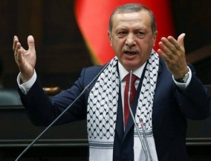
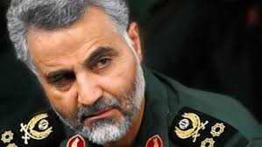
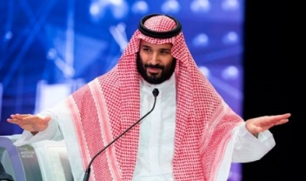
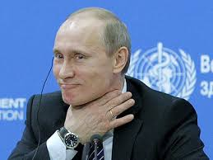
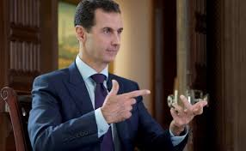
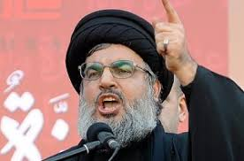
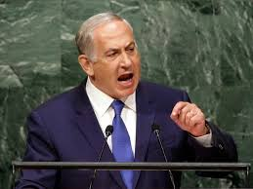
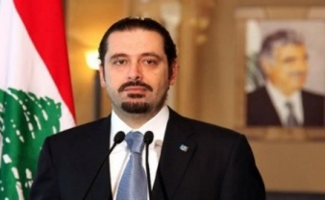
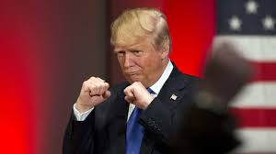
Emergent System – Preliminary
Affinity Legend:
Enemy
FRN
Friend
Interests
MIL
ECON
HEGEMONIC
RELIGIOUS

Slide 6
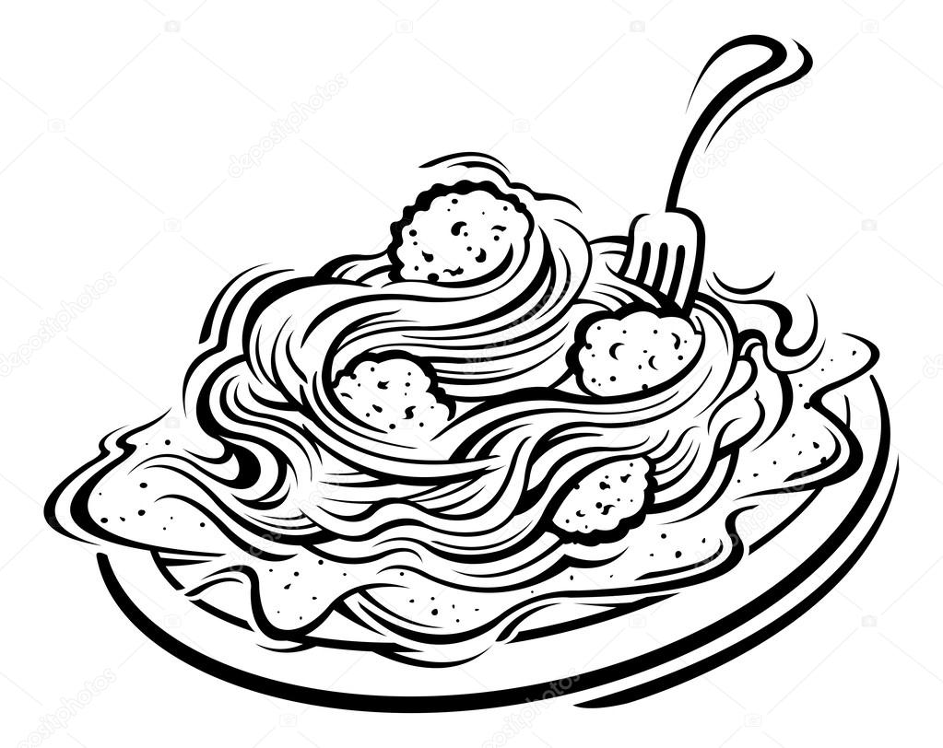
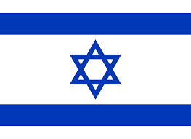
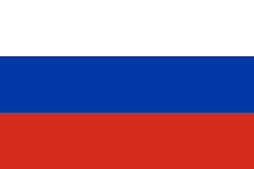
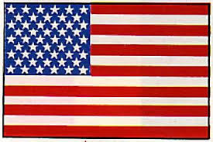
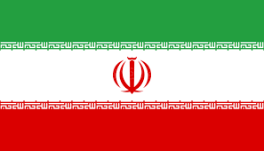
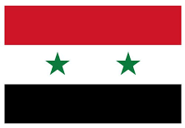
McCrystal’s Spaghetti

Slide 7
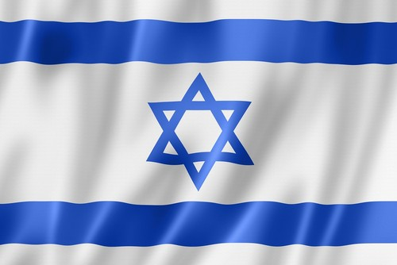
Northern Arena – Affinities and Tensions Focus from an Israeli perspective
Struggle between powers
השפעה באזור
דתי חילוני
גרעין - כלכלה
Economy
שיעי - סוני
כלכלי
Religious - secular
Main trends
Ending the civil war – Syrian rule and sovereignty
Economic interests in the area
Religious tension
Nuclear: American sanctions – Iran
Struggle over regional influence
Powers in the ME: Russia, US
Legend (in regard to interests)
Enemy/foe
Friend
FRENEMY
Religious - secular

Slide 8
p
Genealogy
Tiebreaker weapon
Fall of ISIS
A campaign against the establishment of Iran and a tiebreaker weapon
Conflict intensity
In Syria
Common enemy- ISIS
Intensity of Israeli actions
Incubation
Maturation – intervention of powers
Offset
Relevancy gap
T
11
12
13
14
15
16
17
18
19
Civil war
Hezbollah joins in
Activating nuclear weapons
The rise of ISIS
Establishment of Iranian presence
A shift in the campaign – battle of Haleb
The fall of Raqqa / ISIS
Completing the campaign
Northern Shield
Demilitarization of nuclear weapons
Massive ground to air missile attack
Indifference
Establishment of division 210
The F-16 crash
"Good neighboring” operation
Missile incidents
Shooting over Jordan
"House of Cards”
Western campaign against ISIS
US and Russia join
Rise of Trump
US attack
Demilitarization of nuclear weapons agreement
Crash of the Russian plane
Turkish barrier zone
Leaving the nuclear agreement
Tarsus agreement
The nuclear agreement
US declares it’s leaving Syria
Attacks in light of stray missiles
Campaign between campaigns 1.0
Campaign between campaigns 2.0

Slide 9
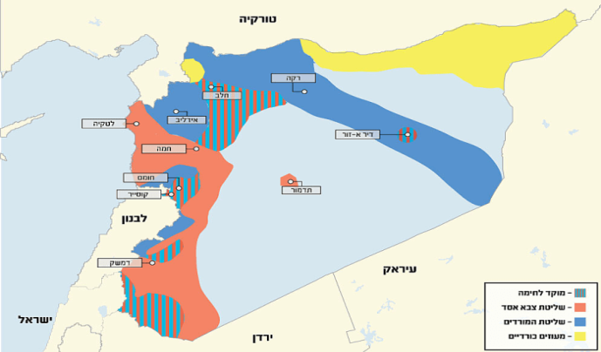
Offset – Relevancy Gap
Transition from a paradigm of a campaign in disarray to a system in a reality of emergent order
An open playground
Rehabilitation of Syria
Interest that disturbs the powers
Interest that harms the powers
Hezbollah a regional factor
Hezbollah a regional factor
Return of Syria to the Arab league
Ambition for a Shiite crescent
Disarray
Syria’s need for as hug from Iran/Hezbollah
The hug is “suffocating” and no longer appropriate
Emergent order

Slide 10
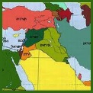
Bringing the dominant players on board for actions that contribute the interest of taking Iran out and returning Hezbollah to Lebanon
Taking a risk and attacking in the Lebanon and Syria arenas
SUPWEPOWER TENSION AND REGIONAL INFLUENCE
MIL
Emphasizing the Shiite-Sunni friction
Influencing the moderate Sunni states to return Syria to the Arab League
RELIGIOUS
ECONOMIC
Continuing American sanctions on Iran and Hezbollah
Iran and Hezbollah in Syria harm the stability and the Russian economic interest
Promoting the gas project of Lebanon

Slide 11
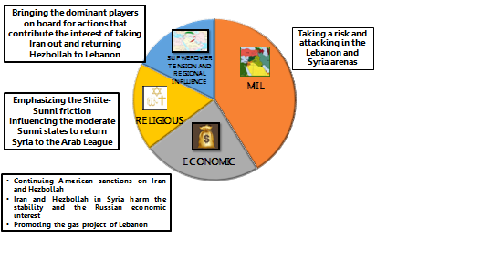
Preliminary Strategy
Transitioning from an operation in a chaotic system to an operation in a stabilizing arena through intervention and influence. Copying the center of mass from a clear military system to a combined system, which relies on military actions while taking risks (including in Lebanon) and actions: economic and political – diplomatic, in order to restraint Iran from establishing in Syria and neutralizing Hezbollah’s arming with a tiebreaker weapon, in face of the window of opportunities that currently opened up.

Slide 12
Insights from the Process
The importance of aligning and synchronizing the knowledge between the team personnel
A methodological process with intermediate stops that examine our position.
Pairing people from different disciplines creates multiple opinions and development of knowledge in a broader sense.

Slide 13
Thank you

