Slide 1
The Expenditure of the Israeli Security and Economy
A lecture to the INDC
12 March, 2019

Slide 2
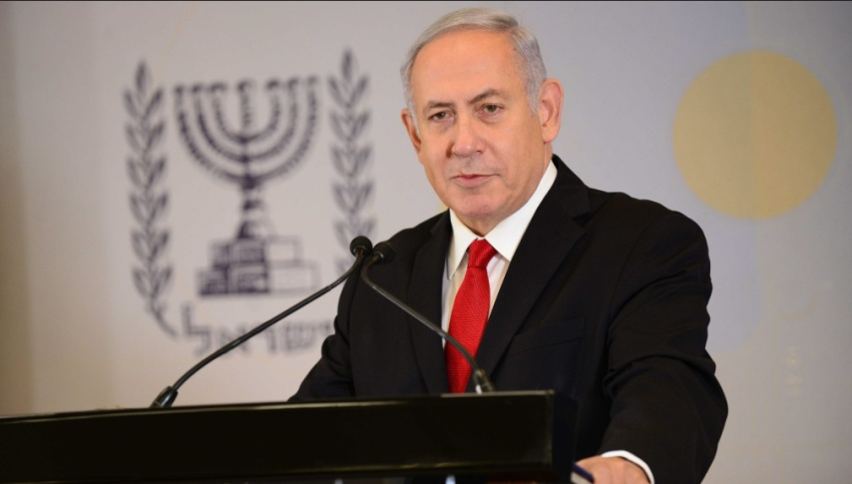
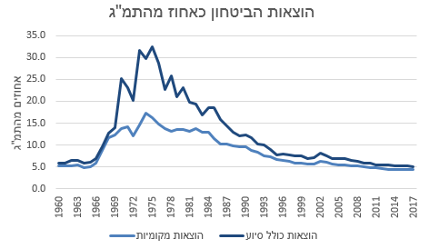
The Security Concept
In presenting the “Security Concept of 2030” to the Cabinet, the Prime Minister announced that he intended to increase the security budget by 0.2-0.3% of the GDP, an addition of NIS 3-4 billion a year). The increase in the budget is intended for raising the expenditure of all security agencies (IDF, ISA, Mossad and others). The goal is to increase the expenditure on security to a rate of 6% of the GDP (currently 5.7%-5.8%) “which will inevitably cause cuts from the government spending on civilian services.”
(Israel Calcalist, 15.8.2018)

Slide 3
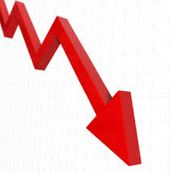
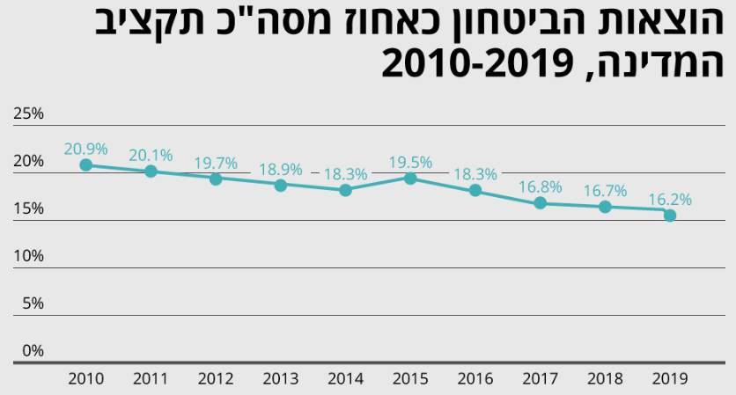
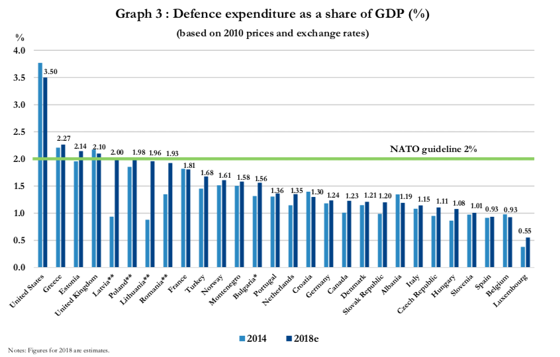
Expenditure on Security Over the Years
Security expenditure as a percentage of total state budget 2010-2019
???
The security expenditure as a percentage of GDP,
Israel versus average, OECD 2000-2014
Israel
Average
Origin:

Slide 4
The Uniqueness of the Security Budget
The main difficulty: the measurement and definition of the security output, and accordingly, terming the budget in alternative cost definitions.
-Difficulty in linking the ability and the level of operational readiness with the financial expenditure
-It is difficult to assess the budget needed to maintain sufficient deterrence.
-In contrast to other systems, such as education and health, whose main activity is continuous over time, the preparedness of the security establishment is examined relatively infrequently (every few years). The events are very intensive and very different from each other.

Slide 5
The Security Budget VS Social Budgets
Social budgets: Mainly, individual consumption budgets: Anything that is not covered by the public system is covered by private consumption (private education, private health insurance)
The security budget: collective consumption. Only the government is authorized to maintain a military and security services
The dilemma: how to divide the resources between security consumption and civilian consumption, in order to balance between the security needs directed against the external risks and the socio-economic needs directed inward and affecting the stability of society and the economy

Slide 6
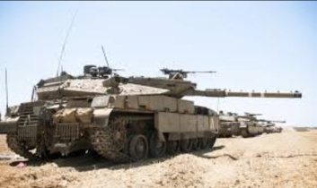
The Security Budget VS Education Budget
The rate of change in the security and education budgets in relation to the change in the state budget
Education Budget
Security Budget

Slide 7
Ministries of Finance and Defense - Different Perspectives
The Ministry of Finance - demands a deep cut in the security budget, but does not bear responsibility for national security and is not the expert in analyzing the security threats and the means of action required
The Ministry of Defense - requires a large security budget that will not bear responsibility for social needs and for the stability of the economy

Slide 8
Approaches in the Security Budget Versus the Civilian Budget
The Trajtenberg Committee (2011): "At the present time, the social risks are no less significant than the security risks and require a change in the relative emphasis given to them in the state budget“
The Tishler Committee (2012): "The security budget set by the Brodet Committee constitutes a lower limit for the proper security budget for the State of Israel"

Slide 9
Approaches in Determining the Security Budget
Top Down – Determined according to the sources (mostly, on the basis of percentages of the GDP) . It is relied on the assumption that the distribution of the state budget between security expenditure and civilian expenditure in the past was almost optimal and therefore serves as the basis for the next year.
Assumptions: There is no dramatic change in the threat picture, changes in technology are not dramatic, and substantive wars are not expected in the near future
Bottom up - Emerges from the picture of threats relevant to the state and assumes that it is possible to assess the military force required to provide an appropriate response to these threats
Assumptions: relatively rapid changes in the threats and geopolitical situation, sharp changes in technology and the risk of a war breaking out soon is not negligible. Hence, the distribution of the budget in the past can not serve as a basis for determining the future budget

Slide 10
The Contribution of Security to the Israeli Economy
Preventing economic damage from costs of insecurity (expenses or losses caused to the economy) = security stability. Examples:
"Defensive Shield" - restoring quiet and economic growth
Establishment of the security fence along the Egyptian border - preventing the infiltration of infiltrators
"Iron Dome" - a dramatic reduction in casualties and property damage
Indirect economic benefits
A source for skilled workers (especially in technology)
Contribution to technological development
Contribution to the security industries
The IDF serves as a training center of great value to the civilian economy.
Social Contribution
Social integration and support for the periphery and equal opportunities
Break down entry barriers to formal education for those who continue in the career path in the military
Employment for workers and contractors from the periphery
Enabling social and economic life in communities exposed to security risks

Slide 11
The Cost of Security for the Israeli Economy
The annual budgetary cost and the future obligations in relation to the welfare / social alternative
Loss of human capital to the economy - late entry into the labor force for compulsory soldiers; Permanent soldiers in place of civilian employment
Alternative cost of land in areas of demand (army bases and fire zones)
Limitations on the environment (e.g.: foothold along the coastline, damage to the landscape)
Limitations on Trade (Ministry of Defense, intellectual property)

Slide 12
Government Committees Dealing with the Security Budget since the Second Lebanon War
The Brodet Committee (2007)
Trajtenberg Committee (2011)
Tishler Committee (2012)
Locker Committee (2015)

Slide 13
The Brodet Committee
Was established in November 2006 and submitted its recommendations after six months
Main Recommendations: - Improving the efficiency of the security system. Within this framework, raising the retirement age;
- Adjustment of the budget to IDF programs and to the "reference scenario", while emphasizing before the government what security risks the budget covers and which it does not;
- The introduction of a multi-year budget for the IDF, at least for the next five years, and setting a threshold (such as maintaining preparedness and competence);
- Creating a link between GDP growth and the security budget;
- External control of the budget by the NSC, as a control organ on behalf of the Prime Minister;
- Transparency of the security budget;
The main recommendations were approved and implemented in relation to the security budget

Slide 14
The Trajtenberg Committee and the Security Budget
The main recommendation is the allocation of NIS 30 billion over five years for civilian uses (with an emphasis on education and welfare), mainly (about 60 percent) at the expense of cuts in the security budget
The need to shift resources from safety to welfare: "In our case, the main significance of a change in priorities is a significant reduction in the security budget, in order to enable a parallel increase in social budgets, and it is not simple and involves taking significant risks and managing them wisely. We find that the social risks are no less significant than the security risks and require a change in the relative emphasis given to them in the state budget "
The government adopted the Trajtenberg report, but the security expenditure for 2012 actually increased

Slide 15
Tishler Committee
Established in October 2011. It submitted its recommendations to the Minister of Defense in August 2012
Main Recommendations:
- Continuation of the Brodet outline, as a lower barrier to the budget for 2013-2017. A budgetary response to additional expenses imposed on the system after the Brodet report is required
- A new retirement model for the IDF was formulated (the new career model was based on it)
- It was recommended to formulate a multi-year outline for the transition of IDF bases to the Negev
- The need to update the Mafat (Administration for the Development of Weapons and Technological Infrastructure) budget in light of the technological challenges and to determine ways to ensure compensation for the realization of the intellectual property developed in the security system
Defense Minister Barak accepted the committee's recommendations, but in light of the firm opposition of the Finance Ministry, the recommendation regarding the security budget was not implemented

Slide 16
Loker Commission
Was established by Prime Minister Netanyahu in 2014
Main recommendations:
- The need to formulate a security concept in light of a dynamic security reality
- The preliminary budget will be NIS 59 billion. Efficiency as a budgetary source
- Budget anchors: Physical exercise to maintain IDF fitness
Research and development to preserve the IDF's technological
advantage
Increasing the involvement of the NSC and the Ministry of Finance in supervising
the implementation of the budget
Significant reduction in the number of personnel in the IDF and in wage
expenditure. Significant decrease of headquarters.
Shortening the compulsory service for men to two years
The recommendations met with strong opposition from the security system and the P.M. decided to freeze their implementation

Slide 17
Development of the Security Budget
In NIS Billions
“With the changes" - the gap between the initial allocation within the state budget framework and the actual budget at the end of the year after receiving the additions during the year

Slide 18
So How is the Security Budget Actually Determined?
External committee
Will formulate the budget proposal based on security perception and quantity of the response to the threats
Negotiations between the Ministry of Finance and the Ministry of Defense-
“Any Means necessary“
The Ministry of Finance: When there is a surplus in the collection of taxes, they
work to lower taxes so as not to
encourage additional security requirements;
Leaks to the press about waste / salaries / pensions;
Harnessing social factors that will require a cut in the security budget as a source of funding for social budgetary requirements;
Ministry of security: Intimidation of the public (by current and former officials);
Reduction in training;
The threat of closing "painful" frameworks;

