Slide 1
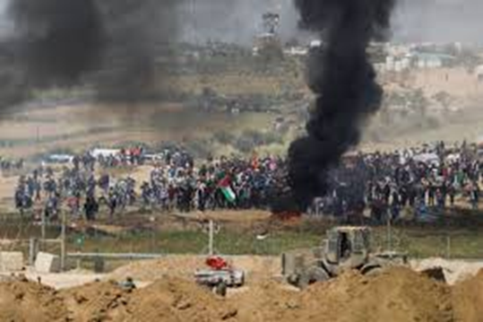
Exercise no. 1: Clashes on the Israel-Gaza Fence

Slide 2
Task – Timeframe
08:30-09:00 – Assembly Briefing
09:00:09:10 – Task and Teams
09:10-10:00 – Building a term map and writing the trends
10:00-10:30 – Break
10:30-11:00 – The Middle Idea and Tensions
11:00-11:30 – Debriefing
11:30-12:30 – Presenting the findings and composing a unified presentation
12:30-13:30 – Lunch Break
13:30-15:00 – Assembly Presentation

Slide 3
Working Teams
Team A: Amihai, Randy, Zvika, Gal, Nithin
Team B:Edri, Lars, Ido, Nurit

Slide 4
Guidelines
Read the Gaza border clashes background material.
Note that the exercise takes place a week prior to May 14th, 2018.
Each team must examine the events from a different point of view.
Team 2’s perspective is “Israel’s diplomatic security campaign”
The team must answer the following questions:
1. Strategy as an environment – draw a term map including affinities and relations between the various players (see slide 3).
2. Strategy as an understanding – marches of return in the context of the opening of the US embassy in Jerusalem and the eve of the Naqbah as a new reality coming together in the area. Compose the commentary framework according to which you drew the term map; explain the trends and occurrences shaping the new reality that has come together as reflected in your map.
Try to address the “unseen” layers, for example – while massive riots take place with many injured, what exactly is Hamas aiming for? (the Iceberg model)

Slide 5
Guidelines
3. Try to explain the “Middle” idea via the various players. How does an abstract idea or vague, general directives trickle down to the operative level (the field); is there an “architect” or “architects” in the framework you represent in this exercise? Try to give an example for tensions created in the context of the incident between the various levels.
4. “Strategy as a plan and strategy as an action”
a. How do you understand the campaign rationale that was planned and implemented in this incident judging by the action that was actually taken.
b. Explain the rationale of the campaign and its boundaries as reflected in this incident.

Slide 6
Term Map
PM and Cabinet
Chief of the General Staff
Minister of Foreign Affairs and MFA Executive Director
IDF Spokesperson
US Ambassador to Israel
Military Advocate General
Attorney General of Israel
Commander of the Gaza Division
3rd Circle
Commander of the Homefront Command
Israeli Diplomatic Missions Abroad
Northern Brigade Commander
Chief of Police; Chiefs of the Southern and Jerusalem Districts
Southern Brigade Commander
Moderate Arab Countries: Egypt, Jordan, Gulf
UNSC and International Organizations
COGAT
Foreign Ambassadors Stationed in Israel
Public Opinion in Israel
Gazan rioters on he fence
Public Opinion in the Arab World

Slide 7
Trends and Occurrences
This slide should explain the trends and occurrences reflected on the term map

Slide 8
The “Middle” Concept
Explain the idea via the players
Is there an architect or architects

Slide 9
Tensions
What where the tensions formed between the various levels

Slide 10
“Strategy as a Plan and Strategy as an Action”
Conduct your own task debriefing

