Slide 1

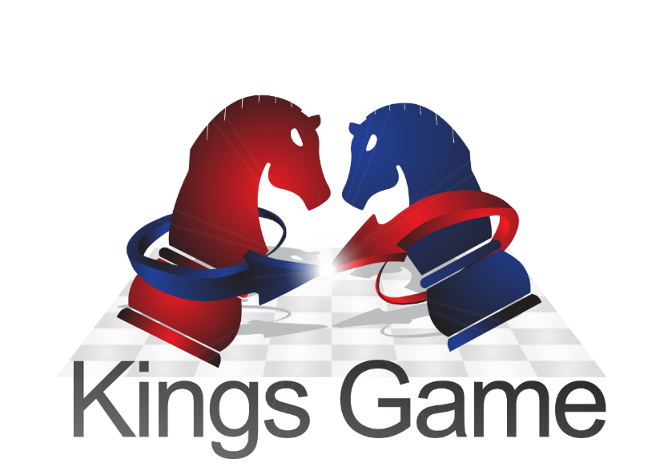
Syntactic Arena Generator
For
War-Fighting Simulation and Research
It’s All About Decision Making…

Slide 2

Syntactic Arena Generator – SAG
SAG is large scale simulation system based on military drills and doctrine, physical behavior models and operations research models to create a realistic combat situation picture which integrates all elements of combat land, air and sea from a single combat element to the general HQ.

Slide 3
General Capabilities
Create militaries units from a single component up to the general HQ.
Full automatic C2 procedures in accordance to forms of war.
Simulate complex war gaming and realistic War-Fighting syntactic environment for all military services.
Full interfaces to and from operational C4i systems.
Interface to tactical and high fidelity simulation systems.

Slide 4
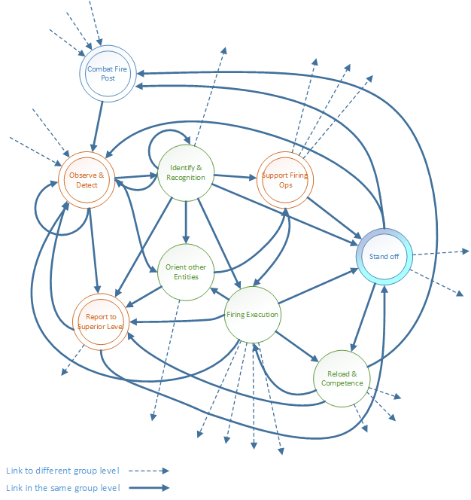
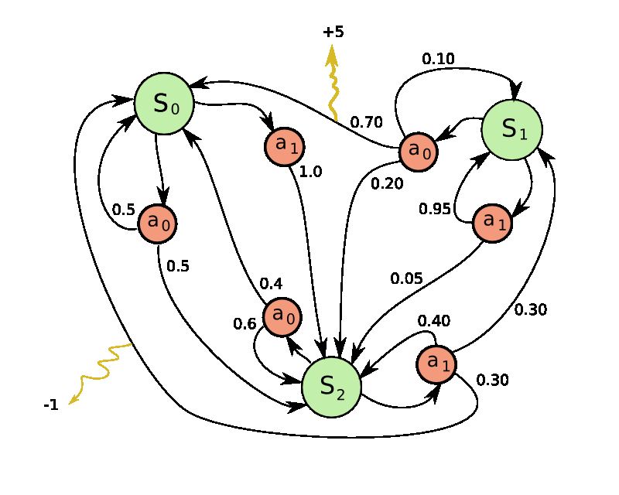
SAG Framework - MDP Model
Markov Decision Processes (MDP) - provide a mathematical framework for modeling decision making in situations where outcomes are partly random and partly under the control of a decision maker.

Slide 5
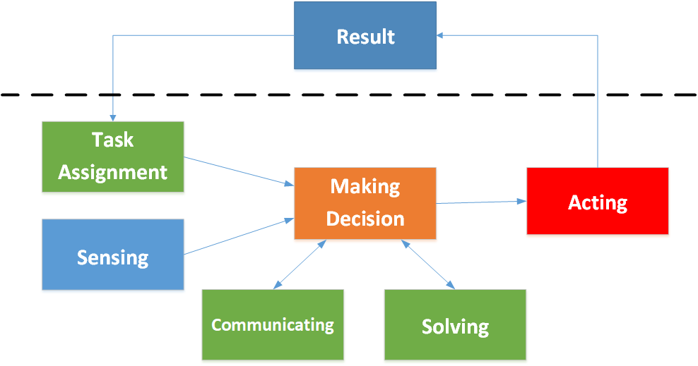
SAG State Model - ABM
Agent Based Model (ABM) - simulating the actions and interactions of autonomous agents from the lower level to a higher level (individual or aggregate).
The key notion is
  Simple behavioral rules generate complex behavior.
  The whole is greater than the sum of the parts.

Slide 6
SAG Heuristics Solving
The heuristic solving give us a tool to simulated the human making a decision prosses.
The key notion is
  It is not optimal or perfect, but sufficient for the immediate goals.
  It using an intuitive judgment, stereotyping, profiling, or common sense.
  The primary objective of applying Heuristic algorithms is that they do not require to be mathematically proven.
Heuristic Model
M.O.R Data
Military Drills & Doctrine
Physical Behavior Model

Slide 7
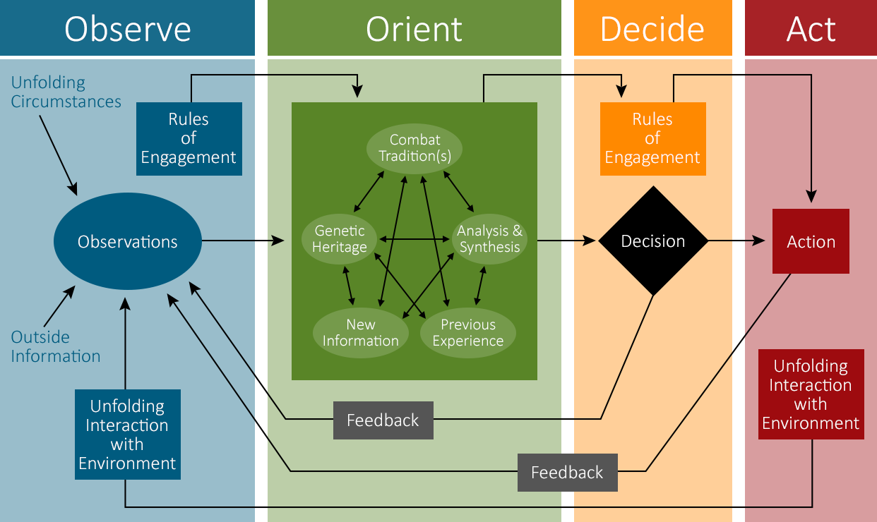
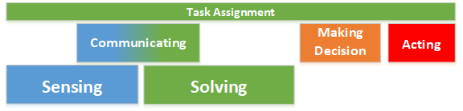
SAG Model and military decision making – OODA loop
The relationship between the SAG models and John Boyd theory. This relations helps understands the ABM behavior.

Slide 8
War Gaming With Kings Game
Preparation In Simulation LAB
Loading the chosen COA
War Gaming Control Center
A decision making for debriefing events
War Gaming Conference Room
Actual war gaming
After Action Review (AAR)
Commanders and Staff officers
Analyze and insert the COA to the simulation according to the operation order
Discussion and analysis with the commander and the war gaming control center team about the debriefing possibility points and the presentation methods
The actual war gaming with the relevant commanders and staff officers
The commander s and the staff officer discuss on the COA point debriefing

Slide 9
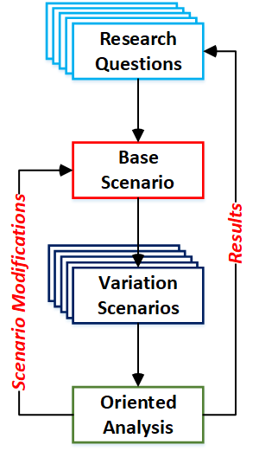
Research Simulation Procedure
Research Questions – define the problem or dilemma.
Base Scenario – a scenario that represent the currant situation with the appropriate assumptions and missing data or knowledge.
Variation Scenario – a set of scenarios which contains modifications adjusted according to the research questions.
Oriented Analysis – according to the research questions and scenario assumptions.

