Slide 1
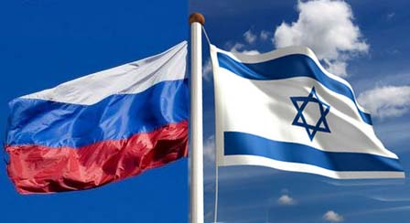
Russia-Israel

Slide 2
General
The FSU - a unique space
Close to the Middle East
There is no dependence on energy from the Middle East
A significant Muslim minority (Russia)
Large potential for Aliya
1.2 million Russian speakers in Israel – an advantage
The discussion - often emotional

Slide 3
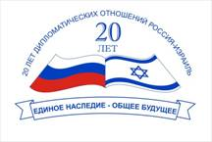
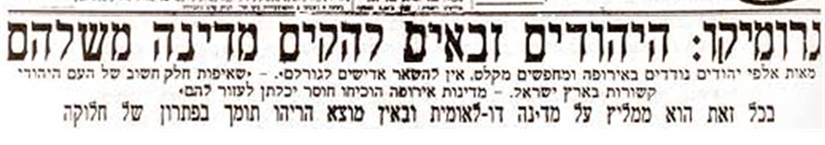
Russia - Israel, Common Heritage
Hundreds of years of close ties
Pilgrims to the Holy Land
1880: About 75% of the world's Jews live in the Russian Empire
Zionism was born and flourished in Russia
  Pinsker, Bialik, Trumpeldor
The Jews in the Revolution
  Most of the members of the first Politburo were Jews
Russian immigrants established the Yishuv in Palestine
  Jabotinsky, Ben-Gurion, Golda ...
WW2 - Joint fighting and the liberation of camps
First recognized in the State of Israel
The rift during the Cold War
The massive Aliya

Slide 4
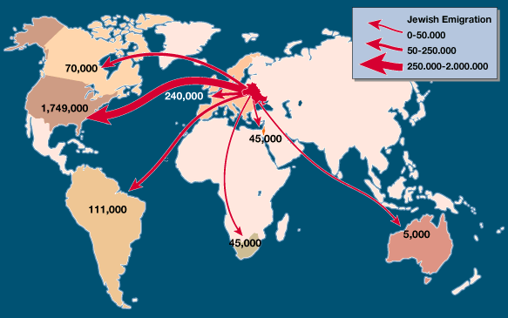
Jewish Emigration from Russia: 1880 - 1928

Slide 5
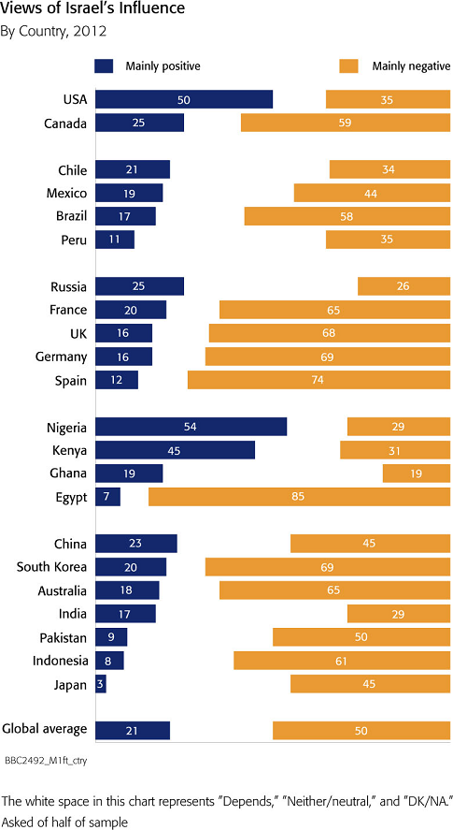
The relationship today -basic sympathy
  Today: a positive attitude toward Israel
  Anti-Semitism is diminishing
  Positive image of Israel
    A developed society
    A developed economy
    A country that knows how to defend itself
  The uniqueness of the connection to Israel
    A comparative advantage - Russian-speaking Israelis
    Shared heritage
    Russian - speaking Jews

Slide 6
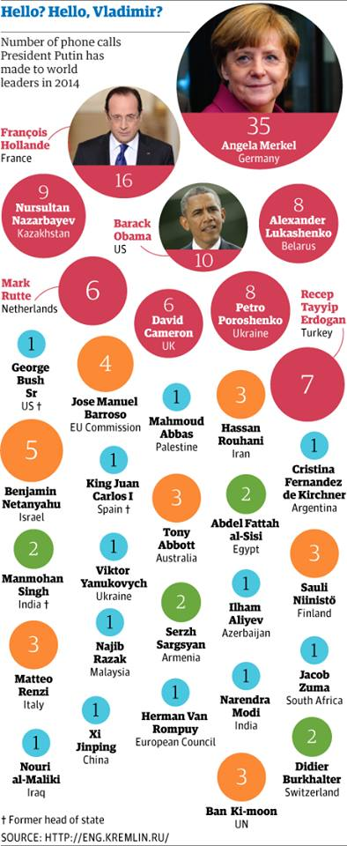
In 2016, there were eight phone calls between President Putin and Prime Minister Netanyahu.
According to the Russians, Netanyahu was the leader with whom Putin had the most talks.

Slide 7
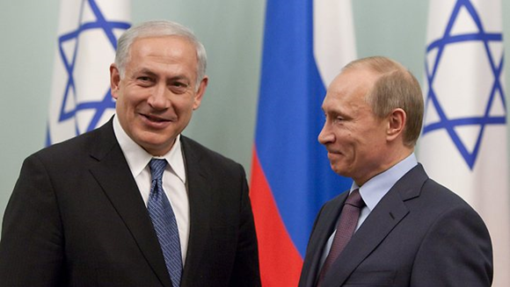
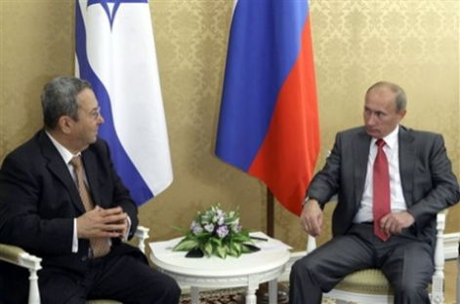
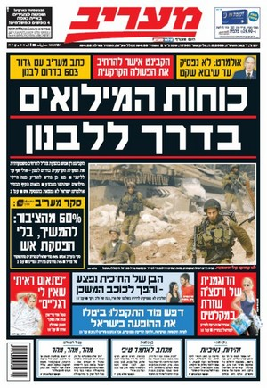
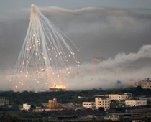
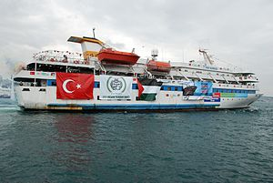
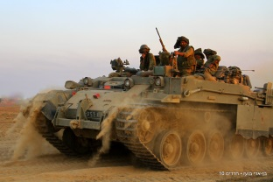
Security Issues
There is dialogue and cooperation
Iranian nuclear issues
Syria
  The dismantling of CW
  Military involvement (September 2015)
Sales of Russian weapons
Responsible conduct
  The Second Lebanon War (July 2006)
  Operation Cast Lead (December 2008)
  The Gaza Flotilla (May 2010)
  Operation Cloud Page (November 2012)
  Operation Tzuk Eitan (July 2014)

Slide 8
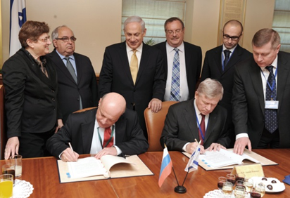
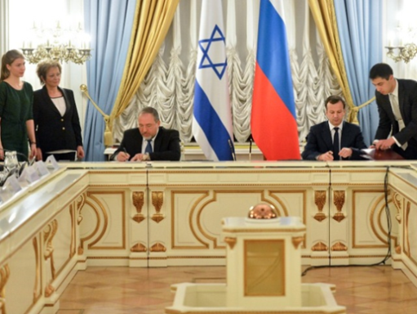
Trade and Science - Complementary Economies
Trade of about $ 4 billion [about $ 3 million with the PA]
  About 50% of agricultural exports of fresh produce
Agriculture
Infrastructure
Medicine
Hi-Tech
Gas and energy
Examples of projects
  Construction of a tunnel for the Tel Aviv-Jerusalem train by the Moscow Metrostroy
  Teva: A plant in Yeroslavl

Slide 9
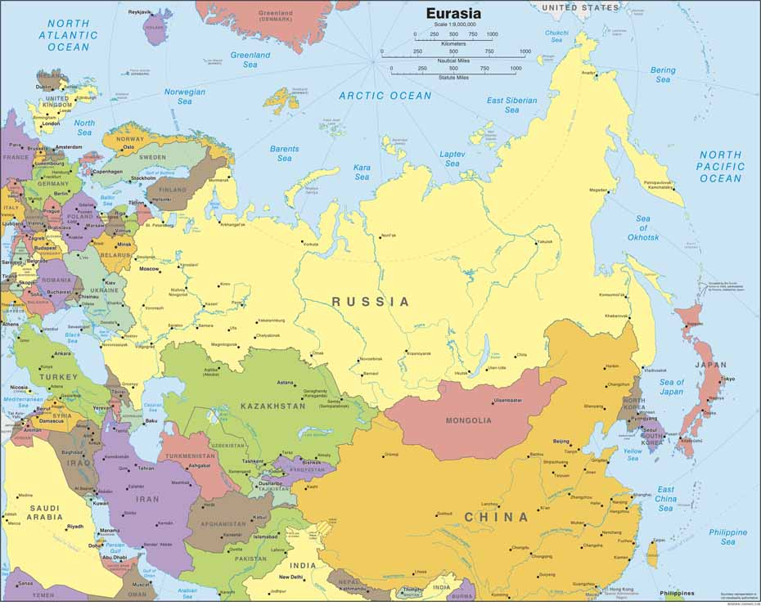
Tourism without Visas
From 100,000 (2007) to 600,000 (2014).
Income - $ 2 billion
Jobs - 20,000
There are no negative aspects (crime, prostitution, trafficking in women)
Flights from Russia to Israel
  About 15 destinations across Russia
  About 90 flights a week -
  Moscow, SPb, Kazan, Yekaterinburg, Rostov, Krasnodar, Mineralniye Vody, Irkutsk, Omsk, Perm, Nizhny Novgorod, Orenburg ...
Saint Petersburg
Moscow

Slide 10
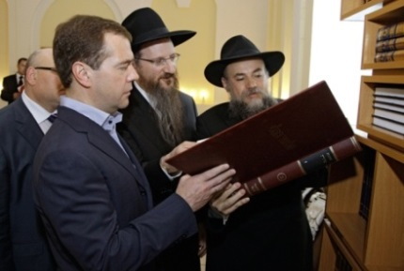
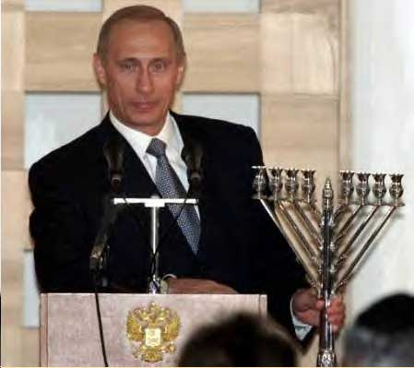
Jews In Russia
There is no anti-Semitism of the state
Philo-Semitism gradually replaces anti-Semitism
  Church: still in development in this context
Jewish communities can develop freely
Free Aliya from FSU about 50% of the total Aliya
In the elite - Jewish roots
Putin shows warmth for Jews
Challenges
Continued immigration
Strengthening of Jewish identity
Anti-Semitism
 | Olim from FSU | % of total
2003 | 12,600 | 51
2004 | 10,400 | 46
2005 | 9,500 | 41
2006 | 7,800 | 37
2007 | 6,700 | 34
2008 | 5,600 | 36
2009 | 7,000 | 42
2010 | 7,300 | 39
2011 | 7,500 | 39
2012 | 7,500 | 40
2013 | 7,600 | 40
2014 | 12,000 | 45

Slide 11
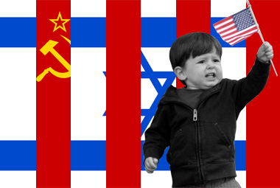
Russian Speaking Jews
A transnational community - "draws on social connections and on the shared experiences in the Soviet Union, the recognition of the value of Russian culture and language, a tendency toward intellectualism and professionalism and the need to adapt values, beliefs and lifestyles from the past to a different reality."
The former USSR - up to 1,500,000
Israel - 1,200,000
USA - 800,000
Germany - 250,000
Canada - 70,000
Australia - 50,000
In general
  Not part of existing Jewish organizations
  Desire for a close relationship with Israel
  A desire for close contacts with Jews in the FSU
Total Russian Speaking Jews In The World: Up To 4 Million

Slide 12
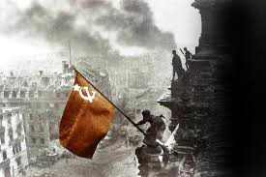
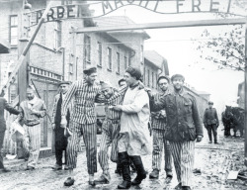

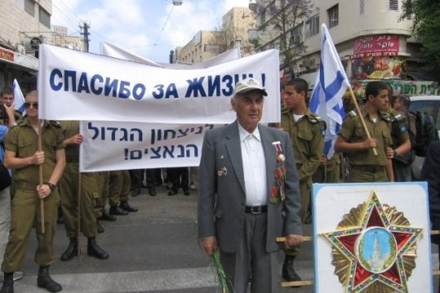
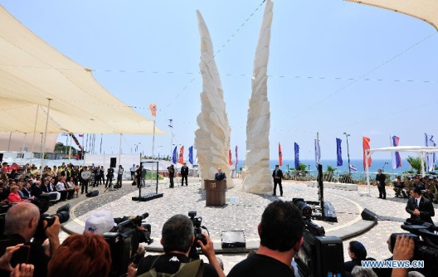
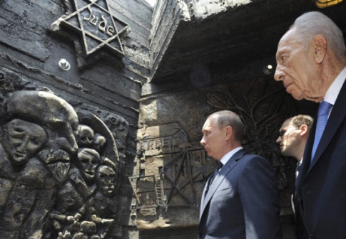
WWll And The Holocaust
Jewish soldiers in the Red Army
  500,000 soldiers (about 40% of the Jewish soldiers)
  200,000 killed (about 80% of the Jewish soldiers)
  The largest Jewish army ever
The liberation of the death camps
  The liberation of Auschwitz - 27.1.1945
Today: Opposition to the revisionism of the Holocaust

Slide 13

“I cannot forecast to you the action of Russia. It is a riddle wrapped in a mystery inside an enigma; but perhaps there is a key. That key is Russian national interest.” (W. Churchill, BBC Broadcast, 1.10.1939)
Thank You For Your Attention!

