Slide 1
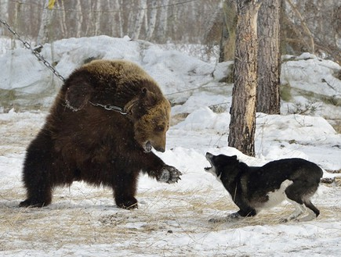
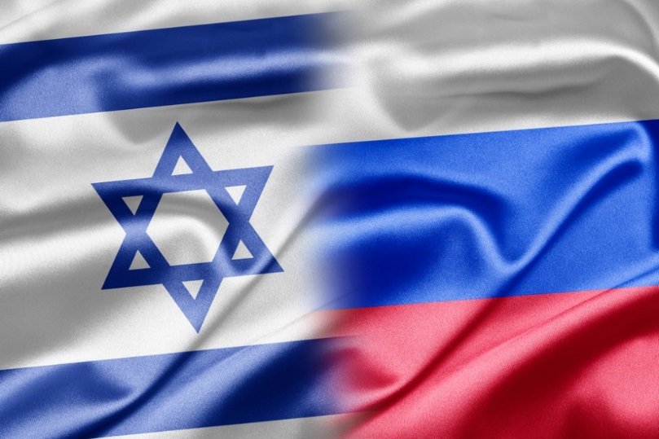
Eastern Tour - Russia
The Russian Bear and the hotheads -
A continued love story....

Slide 2
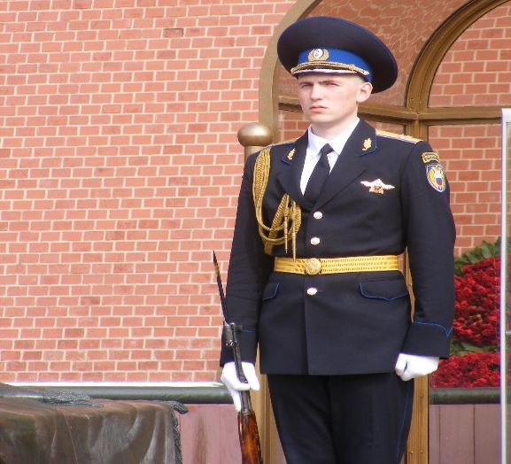
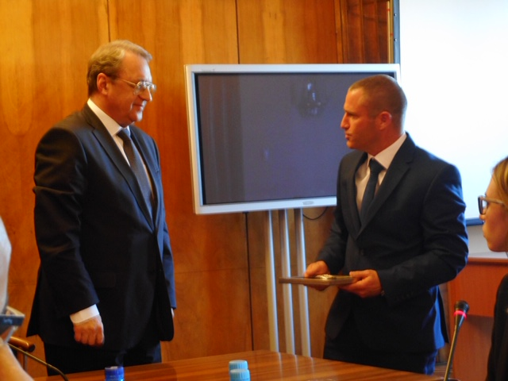
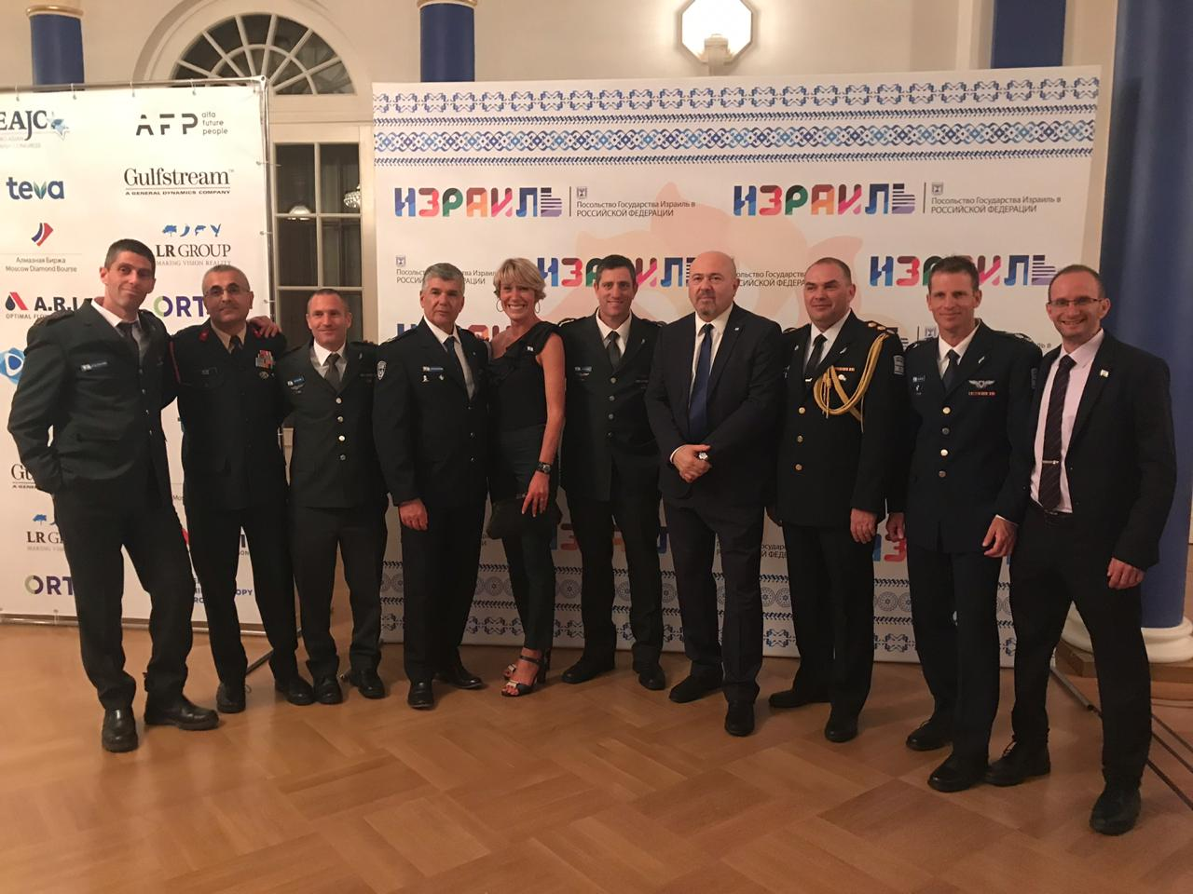
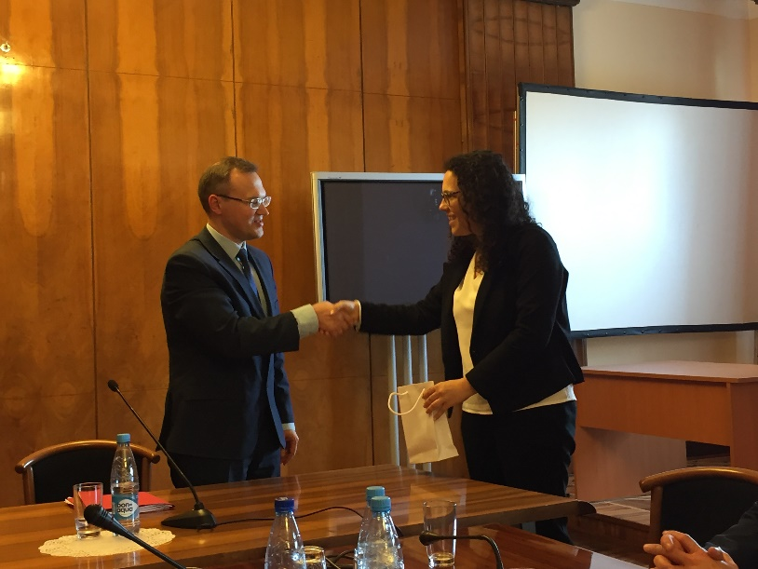
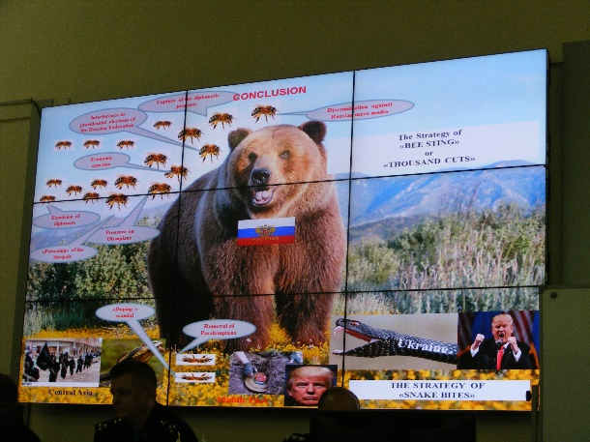
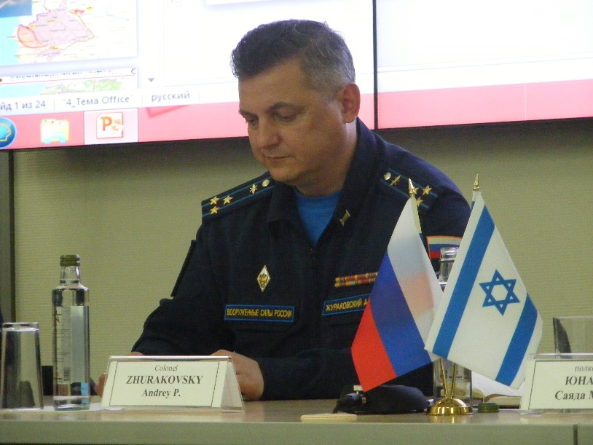
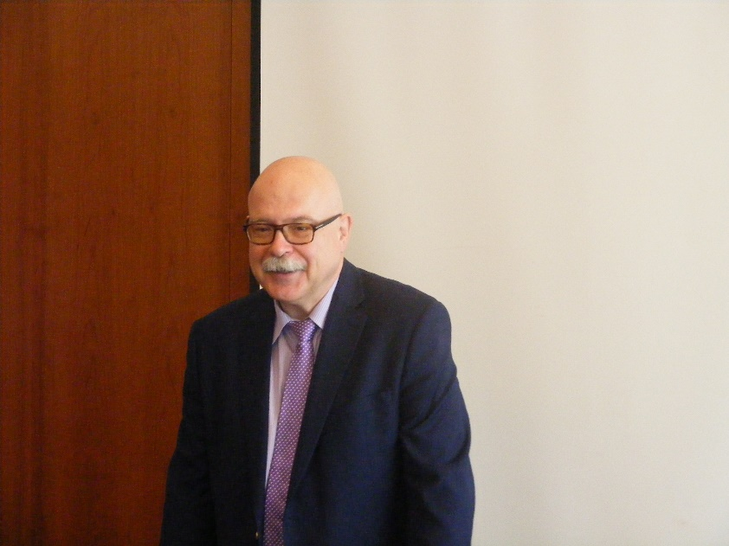
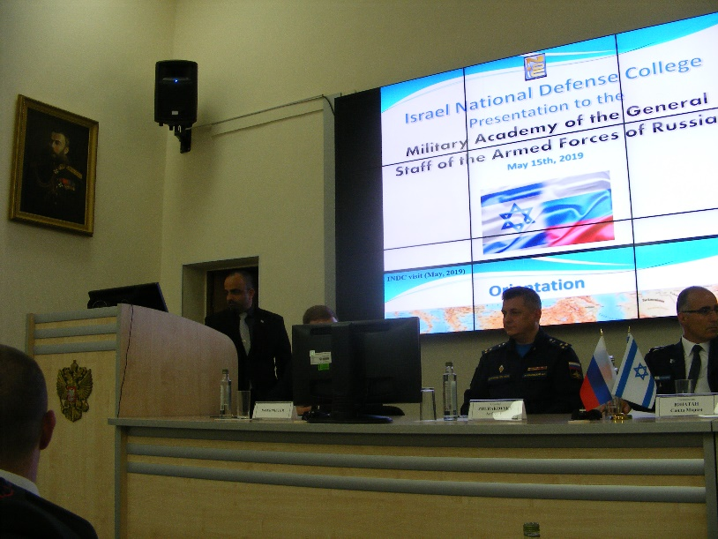
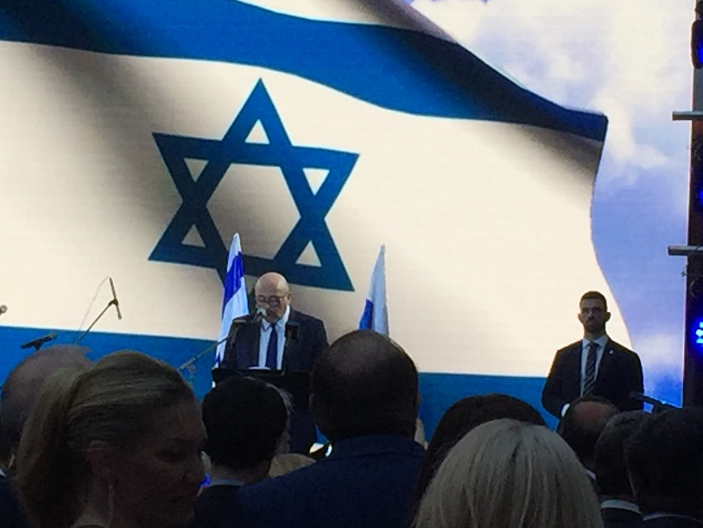

Slide 3
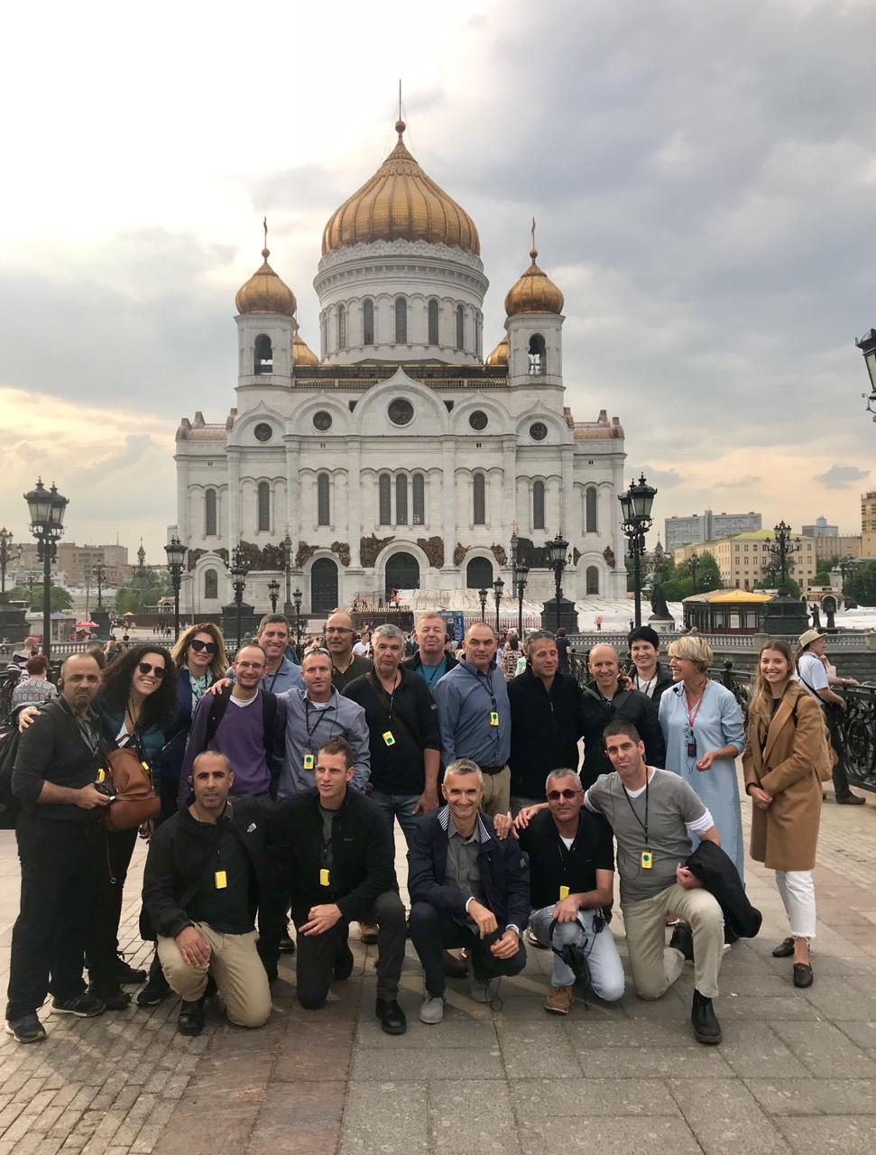
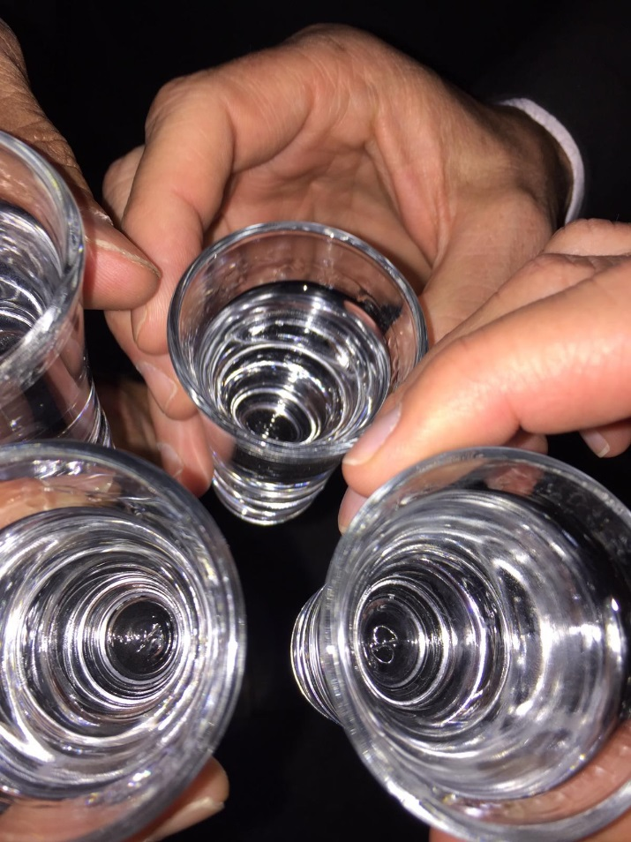
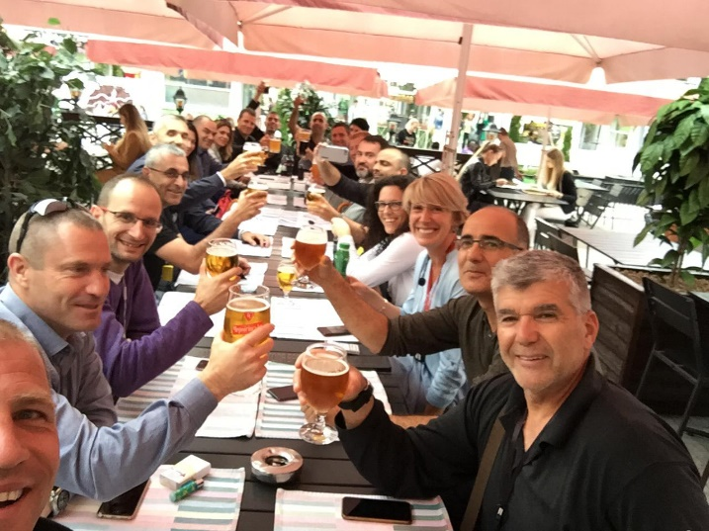
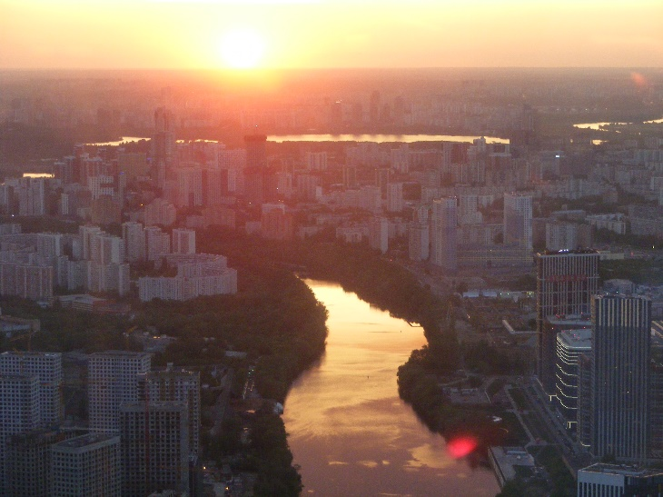
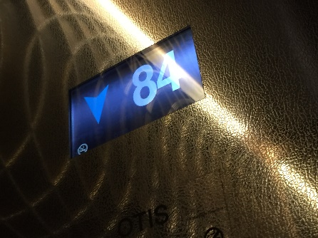
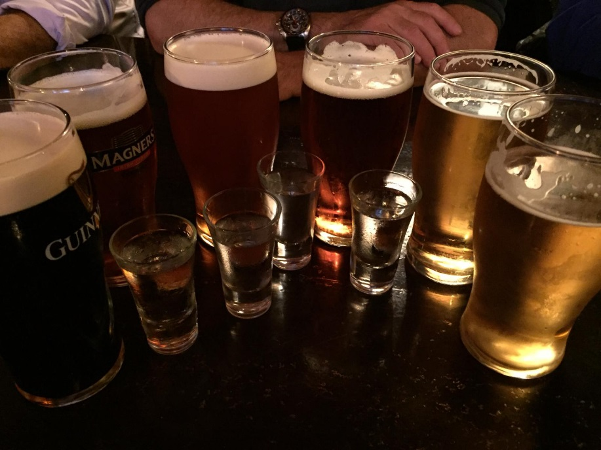
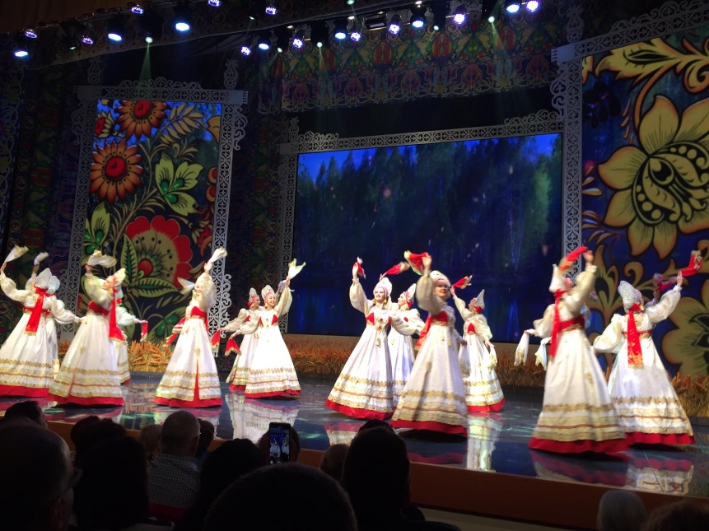
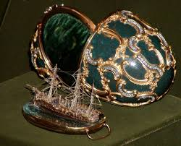

Slide 4
“I cannot forecast to you the action of Russia.
It is a riddle
wrapped in a mystery
inside an enigma;
but perhaps there is a key.
That key is Russian national interest.”
W. Churchill, BBC Broadcast, 1.10.1939

Slide 5
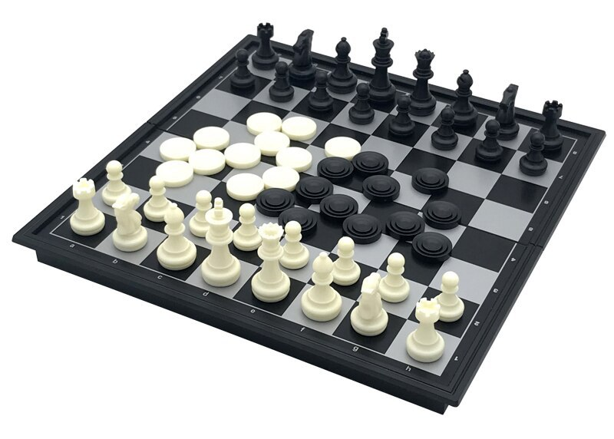

Slide 6
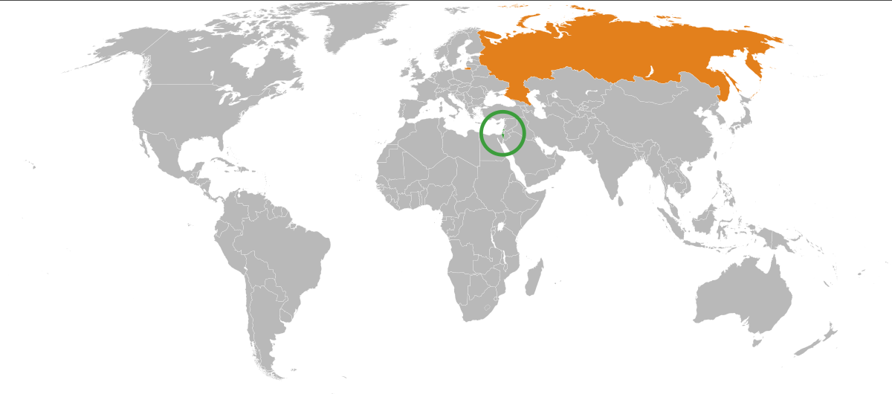
Ratio | Israel | Russia
823:1 | 20,770 | 17,098, 242 | Size Sq km
17:1 | ~9 | ~148 | Population (M)
13:1 | 317 | 4,016 | GPD (PPP) B$

Slide 7
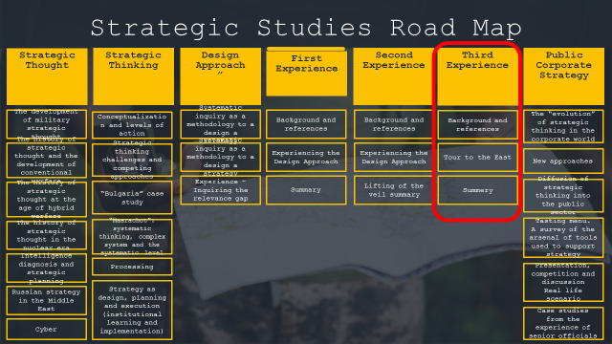
Outline
  The East-Russia tour of the INDC 46th class will take place on 12-16 May 2019
  The tour is part of the strategy echelons of the INDC curriculum and is led by Chen Almog, under the guidance of the staff instructor Rafi Shcutz
  This tour will be preceded by five days of preparation to be conducted at the Institute for National Security Studies (INSS), the National Intelligence Institute and external tours
  Academic course of 3 weekly hours- Group final assignment

Slide 8
Outline
  Objective: To recognize Russia as a central actor in the international system characterized by "different" strategic thinking
  Knowledge of culture, heritage and roots, the “DNA”
  Understanding national security and the strategic culture
  A fun, meaningful experiential learning

Slide 9
Participants
 | Rafi Shcutz - Leading Instructor | 1
Week end | Chen Almog (4) - Leading Participant | 2
Week end | Eyal Argov (1) | 3
 | Raju Baijal (1) | 4
 | Eros Zaniboni (2) | 5
 | Teng Shin Fong (2) | 6
 | Omer Tishler (2) | 7
Kosher | Itzik Cohen (2) | 8
Week end | Michael Shafshak (2) | 9
 | Shay Hannuna (2) | 10
 | Yair Nathans (3) | 11
Weekend | Maya Goldschmidt (3) | 12
Kosher | Yehuda Wach (3) | 13
Weekend | Eyal Calif (4) | 14
Kosher / Vegetarian, Weekend | Anat Chen | 15
Kosher / Vegetarian, Weekend | Ester Hagag | 16
17 | Yonathan Sayada Marom – Chief Instructor | 17

Slide 10
Tour Schedule
' 16/05 | '15/05 | ' 14/05 | ' 13/05 | 12/05
Victory Park + The Great Patriotic War Museum (World War II) | Travel | Power Relations | Ambassador of Israel in Russia | "Halutzim" flight Saturday evening
 | Military Academy tour Official uniform) ) | Internal Policy | Foreign and Security Policy of Russia | Landing at DME (LY 611)
 |  | Russian Policy in the Middle East | Internal political situation | Traveling + getting organized
Travel |  | Lunch | Travel to the Foreign Ministry + lunch
 |  |  |  | Lunch
Concluding lunch (Jerusalem Restaurant) | Travel + Lunch |  | Russia - Middle East Deputy Foreign Minister for the Middle East and Africa and the President's envoy to the region, Mr. Michael Bogdanov Foreign Policy Planning
 |  |  |  | Defense attaché
 |  | Guided tour of the Kremlin
Travel to the train - Weekend St. Petersburg
 | Strategy and National security |  | Free time | Introductory tour Central Moscow / Kremlin Complex
Free Time
 | Dinner + Travel | Lunch + getting organized
Drive to the airport |  | Independence Day Reception at the Embassy of Israel in Moscow (official uniform) | Night tour in Moscow
 | Culture performance
 |  |  |  | Free evening
DME Take-off

Slide 11
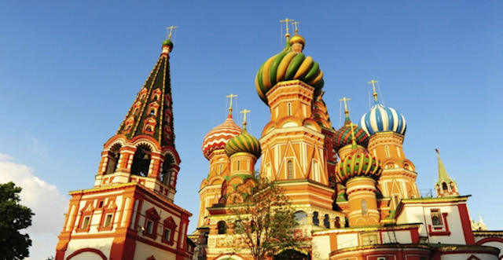
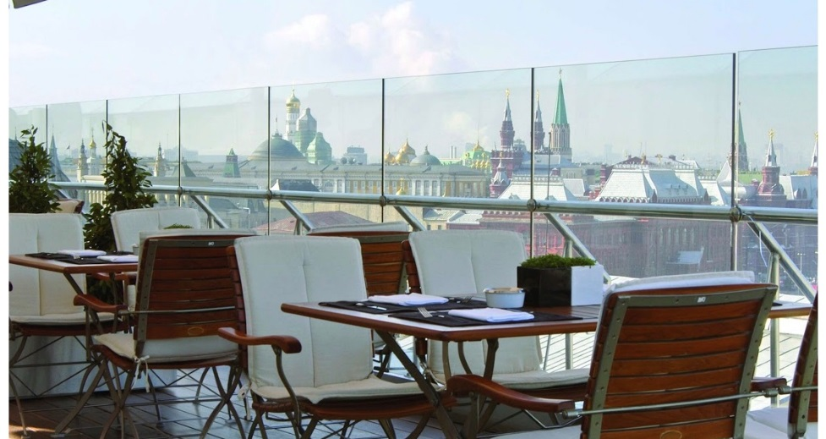
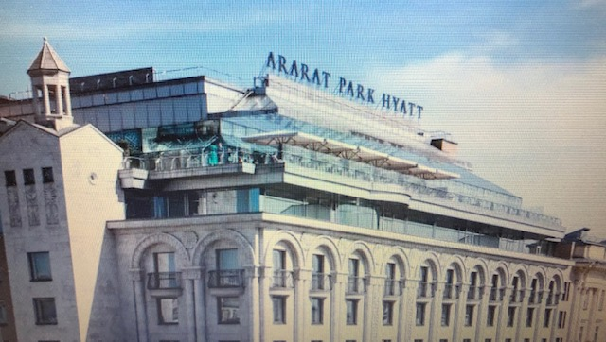
Special Schedule Tour - Sunday 12/5
Hour | Activity | Speaker | Place
02:30 | Travel from INDC to Ben Gurion Airport
05:50-10:05 | flight LY611 |  | The Domodedovo Airport
 | Travel to the hotel + Lunch |  | Ararat Park Hyatt
13:30-15:00 | Israel - Russia relations | Attaché - Colonel German (Hebrew) | Hotel
16:00-20:00 | A guided tour of Moscow | Anna | Central Moscow / Kremlin Complex (Patriarch's Bridge, Alexander Gardens, the Kremlin Compound, Red Square)
23:00 – 20:00 | Free evening (Independent dinner)

Slide 12
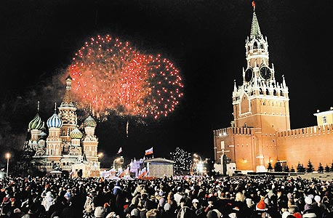
Individual Schedule Tour - Monday, May 13th
Hour | Activity | Speaker | Place | Gift
8:00-9:00 | Breakfast in the presence of the Ambassador - Mr. Gary Koren |  | Dining room Hotel Restaurant PLAZMA 10th Floor
9:00-10:00 | Relations between Russia and Israel | Ambassador of Israel to Russia, Mr. Gary Koren (Hebrew) | Hotel - a suit SCHEPKIN Hall, 2nd floor
10:00-10:45 | Foreign policy and security | Mr. Dmitry Trainin Academic Researcher, Former Colonel (English)
11:00-11:45 | The economic situation in Russia and its effects on internal policy | Mr. Evgeny Gutmacher Chairman, World Economic Research Institute
11:00-11:45 | Lunch
11:45-12:30 | Travel
13:00-14:00 | Russia - Middle East | Deputy Foreign Minister for the Middle East and Africa and the President's envoy to the region, Mr. Michael Bogdanov (Russian) | Ministry of Foreign Affairs - a suit
14:15-15:00 | Planning Russian foreign policy | Mr. Sergei Bezadnikin, Deputy Head of the Department of Political Planning (Russian)
15:00-19:00 | Free time- Independent dinner
19:00-23:00 | Night Tour in Moscow(Anna)

Slide 13
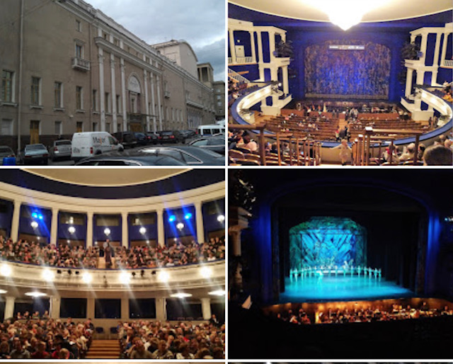
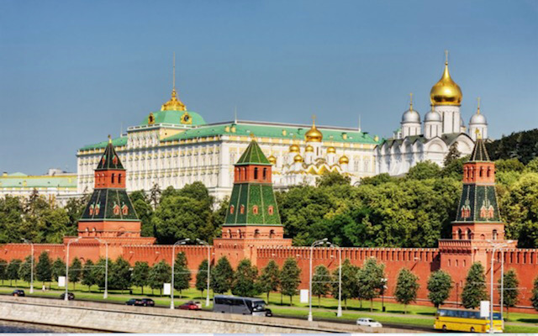
Individual Schedule Tour - Tuesday 14/5
Hour | Activity | Speaker | Place
8:00-9:00 | Breakfast |  | Dining room Hotel
9:00-9:45 | The economic situation and its impact on domestic policy | Mr. Yevgeny Guntmacher, Former International Economic Adviser | hotel a suit
10:00-10:45 | Foreign policy and security | Mr. Dmitry Trainin Academic Researcher, Former Colonel
11:00-11:45 | Russia's Middle East Policy | Mr. Yuri Barmin, Researcher and Commentator on Russian Strategy in the Middle East
12:00-13:00 | Lunch
14:00-17:00 | A Tour of the Kremlin | אניה | Kremlin - a suit
17:00-19:00 | organization |  | Hotel
19:00-22:00 | Israeli Embassy for Independence Day |  | The Opera House - Stanislavsky Theater Official Uniform

Slide 14
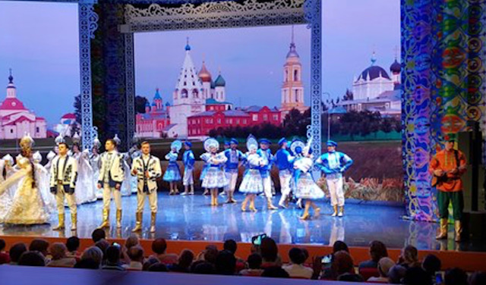
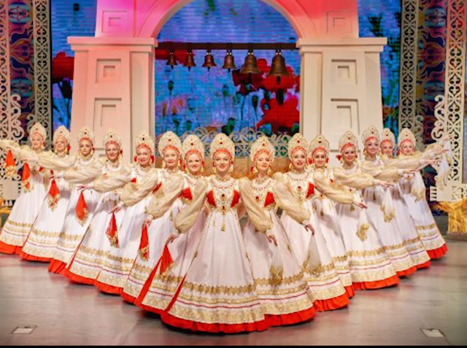
Individual Schedule Tour - Wednesday 15/5
Hour | Activity |  | Speaker | Place
8:00-9:00 | Breakfast |  |  | Dining room Hotel
9:00-10:00 | Travel
10:00-11:00 | Visiting the Military Academy | Russia's security concept | (Russian) | Military Academy - Official Uniform
11:15-12:00 |  | Lessons learned from fighting in Syria | (Russian)
12:15-12:45 |  | Lecture National Security in Israel | Mr. Eyal Kalif / Chen (Hebrew / English)
12:45-13:00 |  | Laying a common wreath - a monument | The entire delegation
 | Travel + Lunch
16:00-17:00 | Strategy and national security |  | Mr. Khudryonuk Michael (Russian) | Hotel - Suit / INDC code
17:00-18:00 | Processing teams
 | Evening
19:00-21:00 | Folklore Show - "Golden Ring" |  |  | Theater - INDC Code

Slide 15
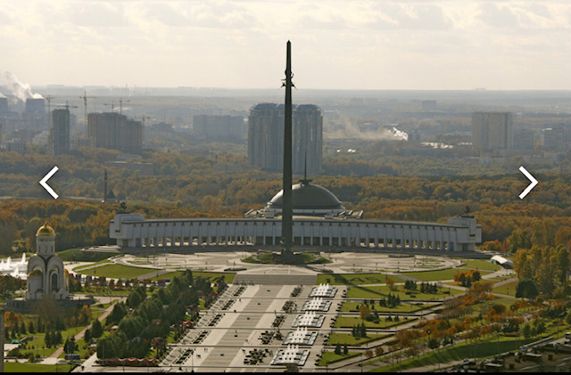
Individual Schedule Tour – Thursday 16/5
Hour | Activity | Speaker | Place
8:00-9:00 | Breakfast + Checkout |  | Dining room Hotel
9:00-10:00 | Travel
10:00-12:00 | Victory Park + Great Patriotic War Museum | Anna | Code INDC
12:00-14:00 | Lunch - Jerusalem Restaurant (Kosher)
14:00-15:00 | A minibus from a train station to St. Petersburg
14:00-17:30 | Free time
17:30-19:00 | A trip to the DME
21:55 | Flight back- LY614 |  | Domodedovo Airport

Slide 16

Preparation Schedule
5/5 | 6/5 | 7/5 | 8/5 | 9/5
Independent leaning – preparing the tour files | Shlomo Kashi – Russian involvement in the Middle East | Commander’s evening – INDC | Memorial Day for Israel’s Fallen | Independence Day
 | Yaakov Livne – Foreign Ministry – Bilateral relations Israel-Russia | Mentioning Israel’s Memorial Day and Independence Day
 | Lunch in a Russian restaurant | Lunch
 |  | Team Processing – summarizing the preparation
28/4 | 29/4 | 30/4 | 1/5 | 2/5
Dima – background lecture – “Russia in the 3 formative eras” | Presenting the tour and the research question (Chen) | Independent learning – preparing the tour files | Rafael Tour | Holocaust Memorial Day
 | Intelligence lecture – Russian security concept”
 |  |  |  | Tzvi Magen – Russia – “Interests, economy”
Lunch |  |  |  | Lunch
Watching a movie – “The Brother 2” | Anna – Dado Center – “The New Russian Stratgey” |  |  | Internal treats lecture (Shabak)
Discussion and summary |  |  |  | Arkadi Malman – Russia’s economy

Slide 17
Learning Products - Unification
    What is the strategic culture, the strategic approach, and how the "otherness" is expressed
    Presentation of the structure of the government vis-a-vis the exterior and the interior, and how decisions are made (slide 1)
    (Responsibility - Maya, Shay Hannuna, Nathans)

Slide 18
Research Questions
Political Aspect – Russian-US influence, Russian-NATO - Implications and Influence on Israel's Foreign Policy.
(Responsibility - Itzik Cohen, Eros)
Security Aspect - What are the Russian interests in the Middle East and Israel, and their influence on Israel's security concept
(Responsibility - Tishler, Wach)
Economic Aspect - Economic Significance and Potential for Israel - Russia Trade.
(Responsibility - Eyal Argov, Shin Fong, Raju)
Social Aspect - Challenges and trends of social depth in Russia and the potential and risks inherent in them from an Israeli perspective.
(Responsibility - Shafshak, Anat Chen)

Slide 19
Strategic culture

Slide 20
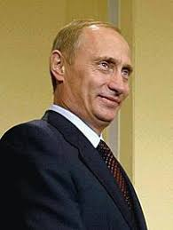
The structure of the Russian government
The government is based on a federal, presidential, and republican regime.
In 1993, the Constitution of the Russian Federation was adopted.
The President of Russia is the head of state, directing domestic and foreign policy. He serves as the supreme commander of the military forces and appoints members of the government with the approval of the parliament. The President signs laws passed by Parliament for the purpose of their entry into force, unless they were adopted by a majority of 2/3 in Parliament.
The government is the executive branch and the most senior federal body in state administration. But - the power of the prime minister is limited and important decisions are passed through the president.
As of 2008, the constitution states that the term of office of the President is 6 years
2024 - The Day After?

Slide 21
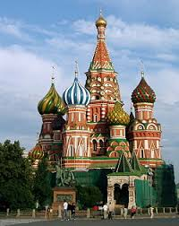
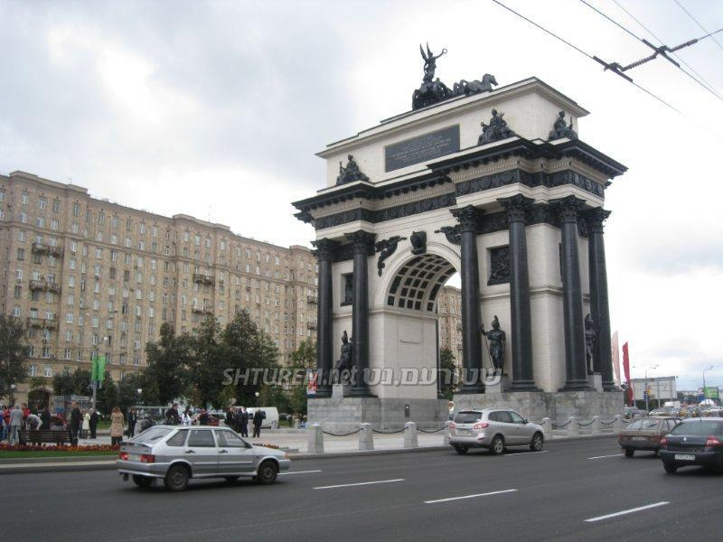
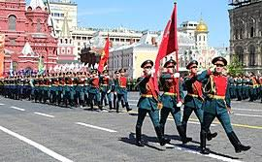
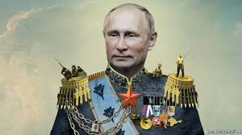
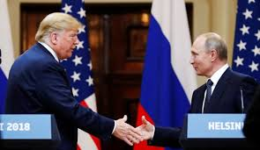
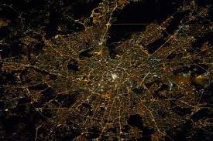
Strategic Culture Foundation
Victory Commemoration - Napoleon + Great Mushroom War
Empire - Rodina
The importance of religion
The leader - the return of the Tsar
Do not accept a unipolar world
Perception of the siege

Slide 22
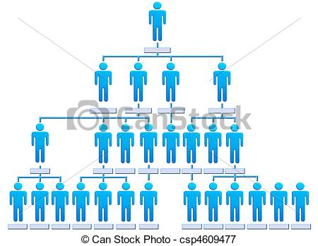

Slide 23
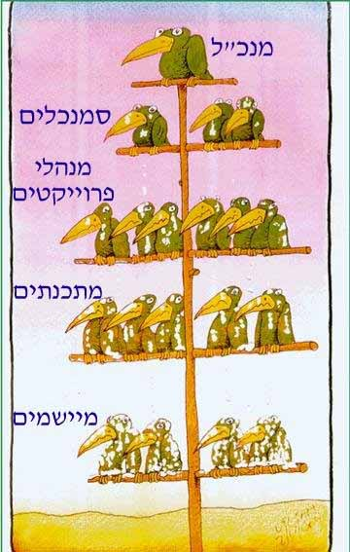
The President
???
responsibility?
Echelon / level

Slide 24



WEST
EAST

Slide 25
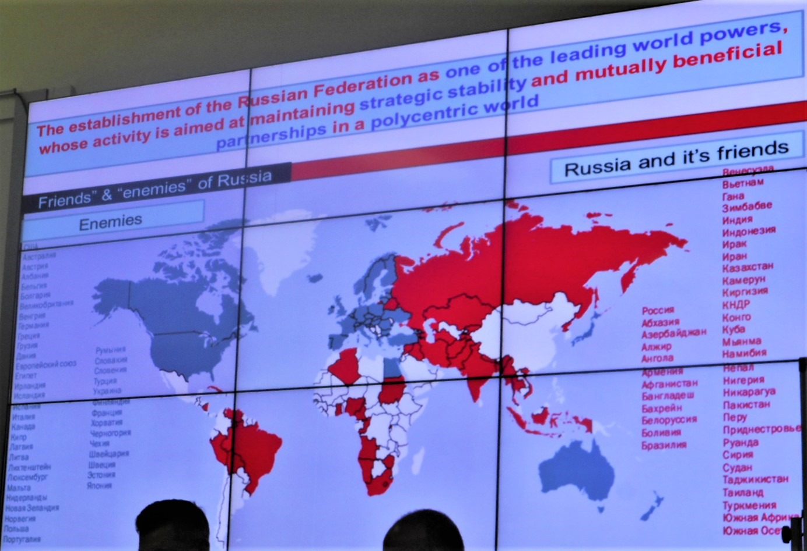

Slide 26
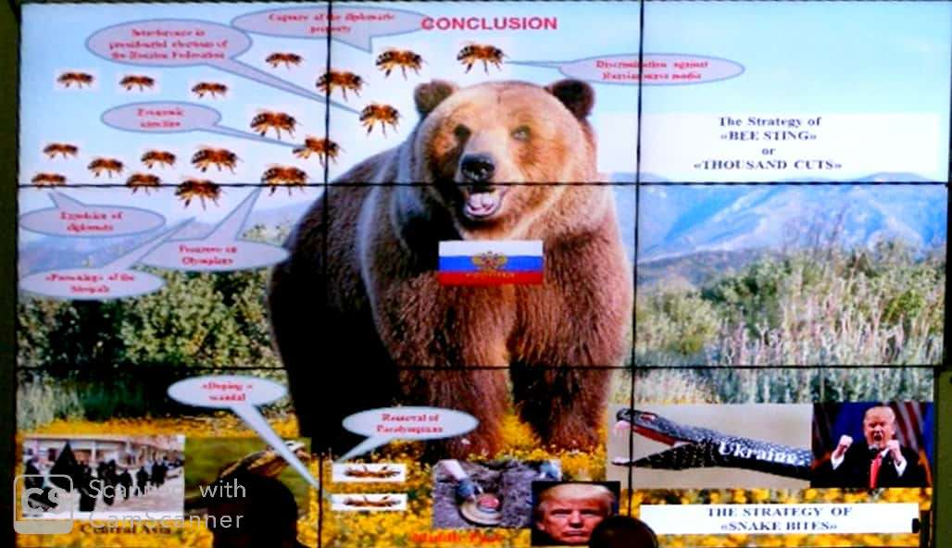

Slide 27
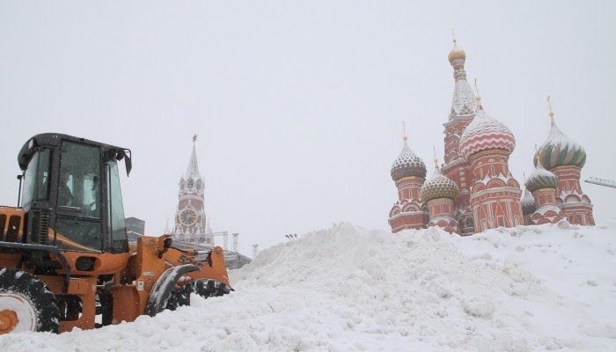
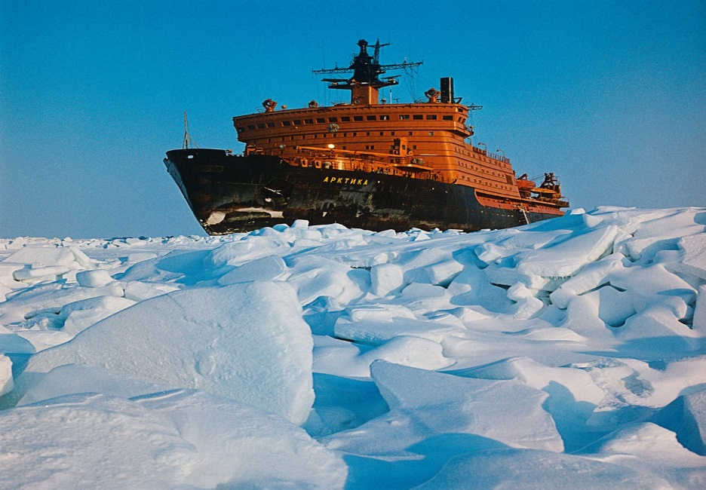
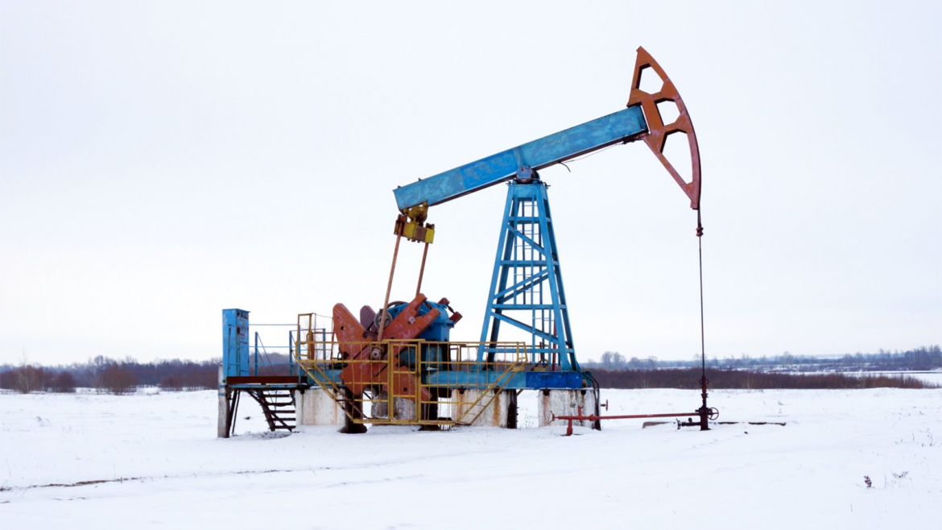
Economy

Slide 28
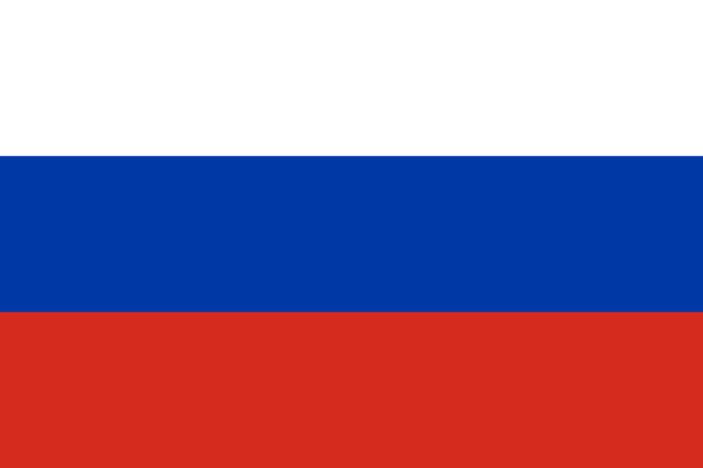
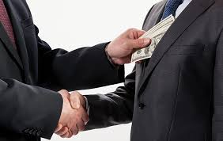
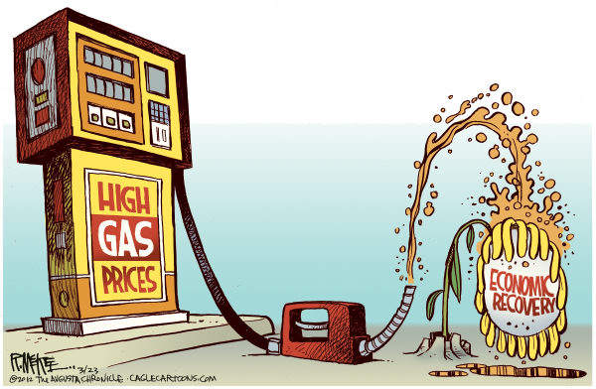
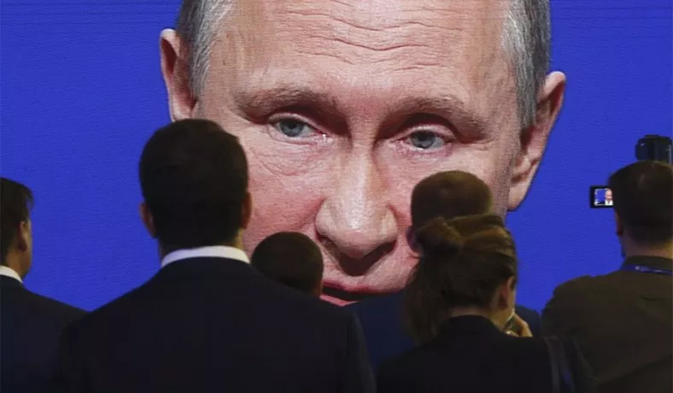


ID. Economy of Russia
Russia is recovering from the economic crisis of 2014 (sanctions and a drop in energy prices)
Concentrated capital, capital-government, corruption
Population - 148 million
GDP - $ 3.8 trillion
GDP per capita - $ 25.5 thousand
Economic goals for the next six years: growth, poverty reduction, investment (infrastructure, education and health) and reduced government involvement
Deep government involvement in the economy
Oil and Gas Power:
25% of government revenues
60% of Russia's exports

Slide 29
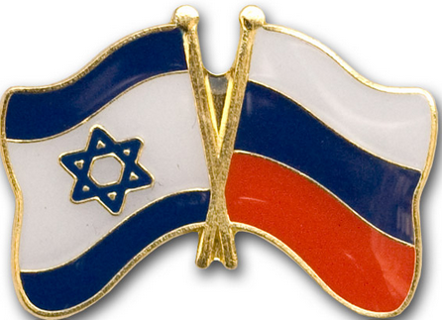

Israel's Trade Relations with Russia
Israel imports from Russia: diamonds and raw materials for production
Israel's exports to Russia: agriculture, industrial products, scientific and technical services (a bit of high-tech).
Incoming tourism to Israel: A significant share of Russia.

Slide 30

Strengths and barriers to trade Israel with Russia
Strengths:
Geographic proximity.
Russia is interested in technology from Israel.
Russian speakers in Israel
Barriers:
Geopolitics
Sanctions
Corruption and government involvement in Russia.
The exchange rate is sensitive to shocks.
Russia is a poor economy.

Slide 31

Society

Slide 32

Russia - Society
Birth crisis
Proportions
Ratio | Israel | Russia
823:1 | 20,770 | 17,098, 242 | Size Sq km
17:1 | ~9 | ~143 | Population (M)
13:1 | 317 | 4,016 | GPD (PPP) B$
Life Expectancy -
Low in 10 years from the OECD
The Big Cities
Religious distribution
Population
District
Name
Rating
Moscow
Moscow
Leningrad
St. Petersburg
Novosibirsk
Novosibirsk
Sverdlovsk
Yekaterinburg
Nizhny Novgorod
Nizhny Novgorod
Tatarstan
Kazan
Chelyabinsk
Chelyabinsk
Omsk
Omsk
Samara
Samara
Rostov
Rostov on Don

Slide 33

Social unrest in Russia
    D.N.A. of a society governed by closeness and faith in the homeland, and also from fear ...
    People are willing to stand hard for the greatness of the nation.
    Disintegration of the Soviet Union - the penetration of "Western values"
    In practice - economic disintegration and society in a confused identity, the formation of the "new Russian“
    Trust and broad support for the president, but there is a creeping devaluation

Slide 34




Eid al-Fitr (the end of Ramadan), Moscow

Slide 35



Russian Jewry
    A broad and profound history - 19 - 2/3 of the Jewish world
    The Russian Orthodox Church accepts and relies on Judaism – symbols
    The roots of Zionism and the establishment of the state
    Today - sympathy for the Jews (Putin's inspiration), several million

Slide 36


"Apartment for Rent"

Slide 37
"Apartment for Rent"
    The housing issue in Soviet and post-Soviet Russia is an excellent example of understanding the influence of ideology on a social aspect
    The Communist era–
      Housing crisis
      National housing - takes time, a small apartment
      Without a "private sphere" as a communist ideological tool
    Gorbachev :
      "The goal is to build 30 million apartments and private homes."
      "There are nearly 4.5 million families with less than five square meters of living per family"
      91'The dismantling of the Soviet Union - the houses are transferred to private ownership
      Today - there are still people who live (some of them by choice) in a communal apartment

Slide 38


"Apartment for Rent" - Moscow - Tel Aviv
Apartment for roommates in Tel Aviv (April 2019)
A kitchen in a shared house - 1997

Slide 39


Security aspect

Slide 40


Defense Budget [B$, ppp]
58
95
40
710
50
45
230
42
110
35

Slide 41





Challenges seen from Moscow
"The West" -U.S.A. EU, NATO
Extreme Islamic terrorism
China
Above all, the stability of the government

Slide 42
The Russian interest in Syria, and its influence on Israel's national security
Russia's entry into Syria in 2015 was due
for local reasons
And broader Russian global motives
War to Kill, not a War to Win

Slide 43




Russia's entry into Syria (2015) - Local motives:
Syria - a Russian anchor in the Middle East for years.
A potential fall of Assad - a direct threat to Russian interests in the Middle East

Slide 44

Global interest:
  From power as a global power. Regional patron, expanding its global influence.
  An opportunity to deepen the hold on the Middle East, with an emphasis on the coastal area and resources.
  Breaking the trend of international isolation and reducing sanctions.
  The survival of the Assad regime and the jihadist threat posed by Syria to Russia itself.

Slide 45

The Israeli angle, challenges and opportunities:
Challenges:
Spatial reduction and volume of Israeli activity.
Reducing Israeli freedom of action.
Assad is gaining confidence and reacting actively.
The presence of Russian space poses a threat in informational security.
Russia is rebuilding the Assad army by providing weapons, military advice and continuous guidance.

Slide 46

Opportunities in connection with the Russian presence:
Russia views Israel as a regional power. Fertile ground for expanding Israeli influence.
Convergence of interests in the Iranian context.
Expanding the local connection to realizing broader interests (political, economic, etc.).
Russia as a restraining factor.
Playing in a court of superpowers.

Slide 47


Political aspect

Slide 48

Political Aspect – Russian-US influence, Russian-NATO - Implications and Influence on Israel's Foreign Policy
Foreign Relations
Core Interests
Internal Stability
Superpower in a Multipolar World

Slide 49
Russian-US relations
Strategic competition as great (Nuclear) powers (UNSC members)
2014 Crimea crisis - US/ international sanctions and interrupted diplomatic relations
No direct confrontation but mistrust and rivalry on spheres of influence (Syria, Iran, ME)
Russian ambitions as great/major power (equal role with the US) vs small economy based on energy export and arm sales
Russian pragmatic relations with third state and non-state actor (Iran, Hezbollah, Hamas, North Korea)
  "The United States will not agree to see itself as worth it
  Russia will not agree to see itself as a superior "

Slide 50
Russian-NATO relations
Stop of dialogue after 2014 Crimea crisis
Mistrust on NATO enlargement and resulting military buildup near the border
Destructive military potential on both sides (conventional, nukes, cyber, space)
Russian exploitation of hybrid warfare (cyber, Info ops, “little green men”)
Exploitation of opportunities to undermine NATO cohesion (gas to Europe and S-400 to Turkey)

Slide 51
Implications and Influence on Israel's Foreign Policy
Israel: priority on preserving special relation with the US
Russian regional presence to reestablish sphere of influence
Interest-based dialogue to ensure deconfliction and freedom of action in Syria for Israel
Russian role as peace broker in the ME, and possible mediator with Iran, Hezbollah and Hamas
Common interests on counterterrorism and Russian immigrants in Israel

Slide 52


Nathans – we love you , good luck !

Slide 53


Many thanks and appreciation to
German, the military attaché and his team,
And the Ambassador Gary and his team
And Anna the guide

Slide 54

Thanks to the team for the learning experience

Slide 55

Questions?

