Slide 1
Resiliency: Israel and the Jewish People & Student Engagement and Learning @ IDC
With freedom, comes responsibility
Dr. Eric Zimmerman IDC Herzliya
HWR – The Berlin School of Economics and Law, Berlin 19 December 2018

Slide 2
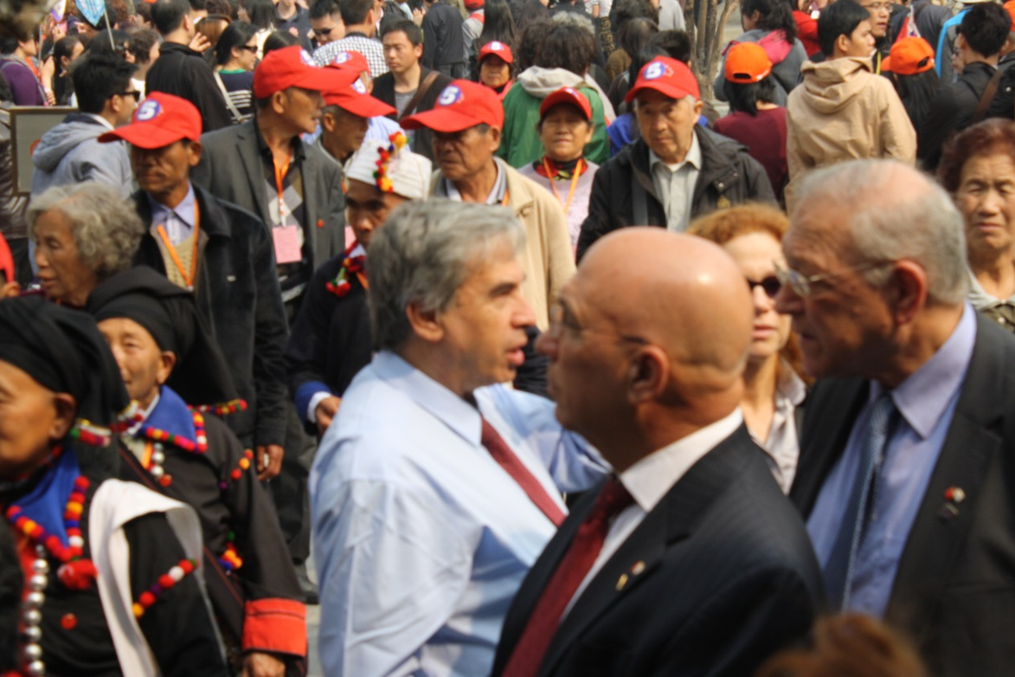
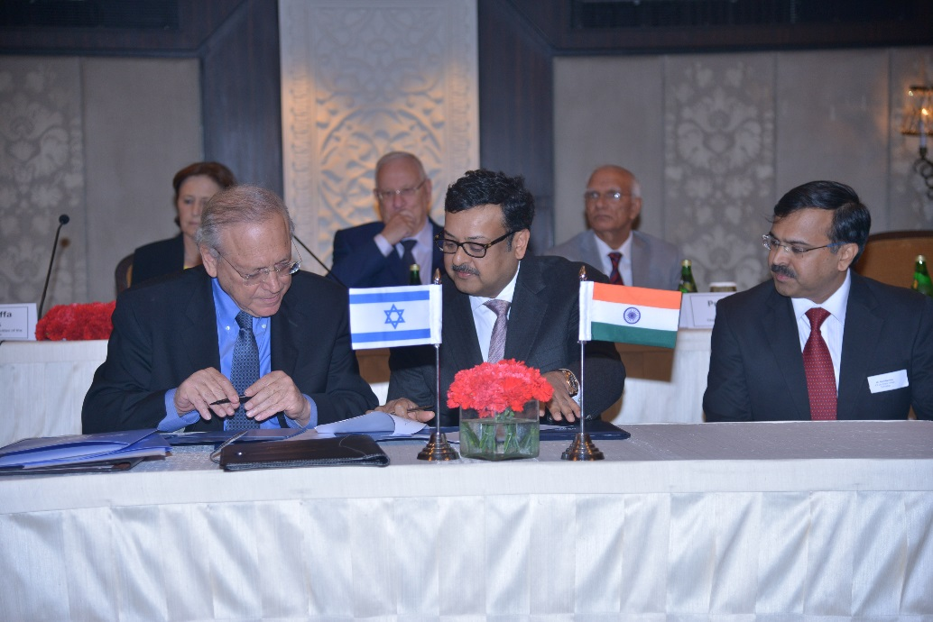
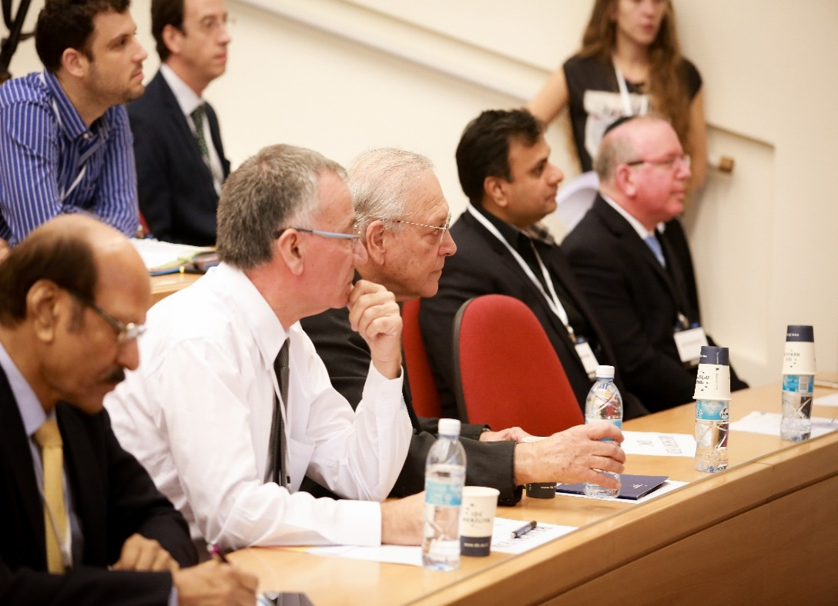
Its about people; not cities

Slide 3
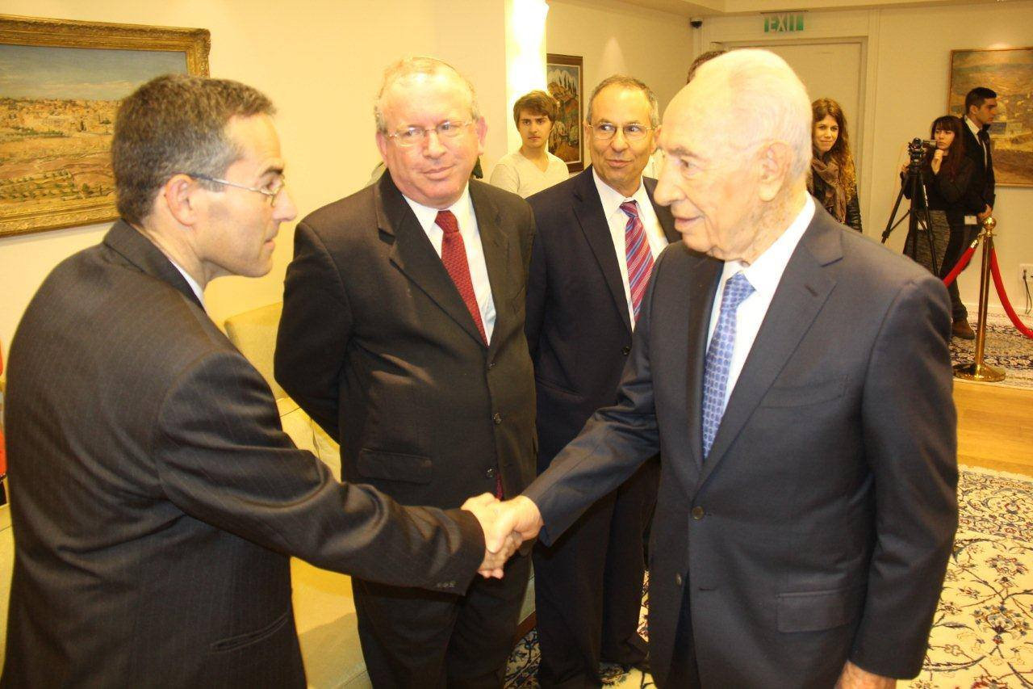
People NOT Institutions
X
Institutional partnerships
Institutional agreements
Bilateral collaboration
Corporate partnerships
Joint programs / dual programs
Cross-border work
Cross-disciplinary research

Slide 4
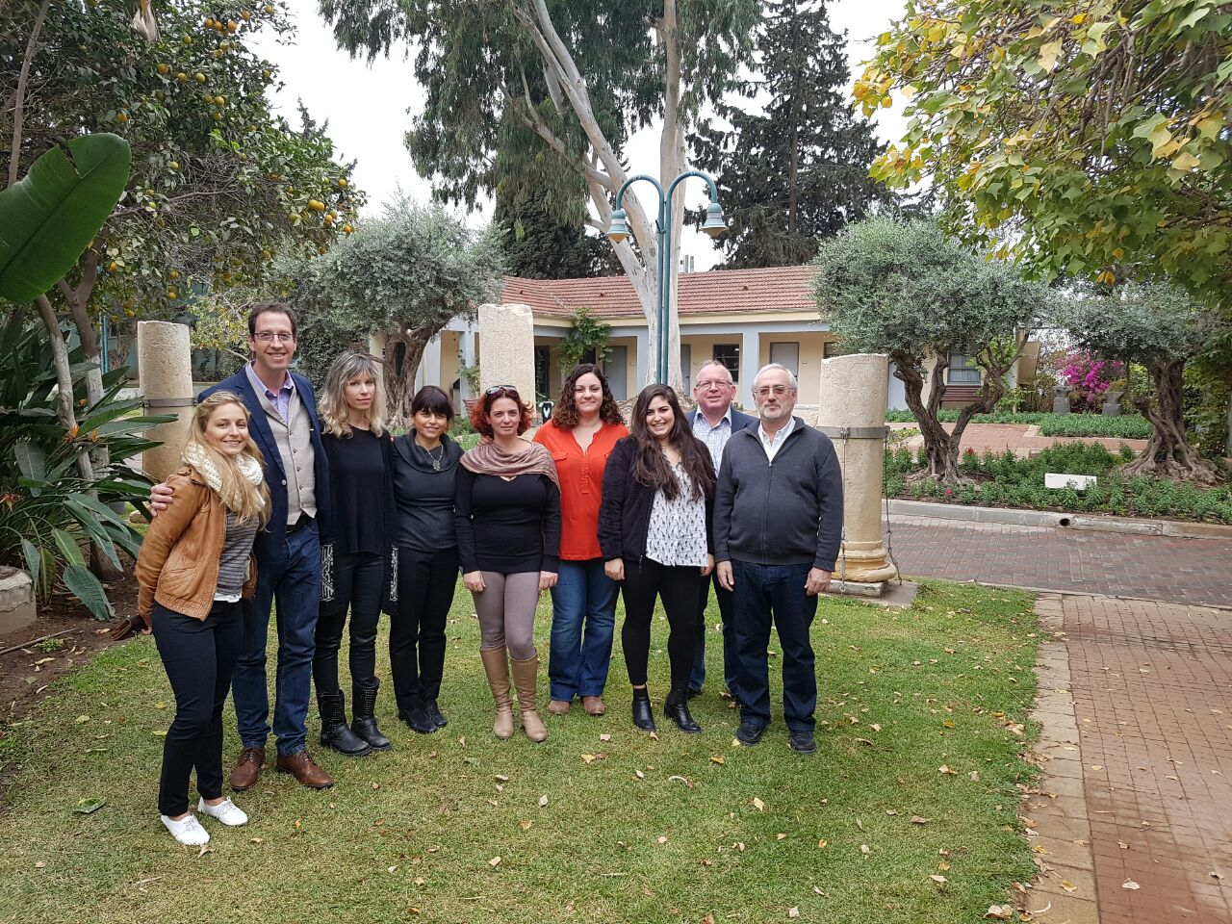
People NOT Institutions
Floors and walls don’t work together; people do!
Its not about bricks and mortar; its about connection and shared purpose
Its about relationships; not simply memoranda of understandings
It’s about respect for diversity
Its about collaboration; not mere cooperation
Cities are not resilient; people are!

Slide 5
Roadmap for our brief journey – an ambitious plan
Defining resiliency
Israel and Israelis
From the sources
Coping mechanisms
The happiness factor
Other indicators of resiliency
On failure
Teaching failure at IDC – freedom and responsibility
Engaging at IDC
Summing it all up

Slide 6
Defining Resiliency
Maintaining functionality in the face of disruption
Recovering from difficulty
Businesses fail; people fail; societies fail; civilizations fail
Springing back? Or becoming something new?
From crisis to renewal. An unending cycle. 1945-1948.
Joshua 1:9
Have I not commanded you? Be strong and courageous. Do not be frightened, and do not be dismayed, for the Lord your God is with you wherever you go.”

Slide 7
Israel & Israelis – perception vs reality
Israel the land
Old and new
Traditional and innovative
At war but safe
Uncertainty but strong economy
Immigrant society but unique culture emerging
Etc…
Israel the people
Characteristics - (some) as double-edge sword
Chutzpah
Independence at young age
Problem-solvers
Rule-benders
Education
Family
Small country for maximum networking - Zero degrees of separation
Thinking out of the box; critical thinking
The army; unit 8200
Etc…

Slide 8
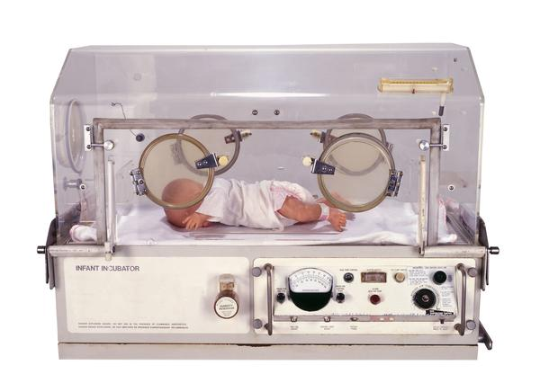
Israel & Israelis
In Israel from an early age youth are taught to be independent and responsible, yet team players. The youth movement and army are incubators for this life skill. The flat family nature of the Jewish/Israeli people coupled with the small country size have also been key for the near instant national networking. There are virtually zero degrees of separation in Israel.

Slide 9
From the sources – collective responsibility
An ancient rabbinic saying:
All of Israel is responsible one for the other.
No one is left alone; we are all responsible for the welfare of the other.
Zero degrees of separation

Slide 10
From the sources – on flexibility
Israel is likened to a reed that grows by the river bank. It is flexible and allows to sway in the wind, as opposed to a stronger tree which may be felled in times of great disturbance.
On the other hand, there are sources that liken us to a tree in the field (Deuteronomy 20:19), resilient and deeply rooted

Slide 11
From the sources – on unity
The unity of the Jewish people has been of utmost importance. The great sage Maimonides ruled that he who did not consider Jewish unity to be a central part of ones life to be a great sin, without repent. Indeed one was condemned to not enter the next world.
Israel is able to withstand turbulent times by its flexibility, its ability to adapt to changing environments. Together as one, united in purpose.
Yalkut Shimoni on the Esther Scroll (3)

Slide 12
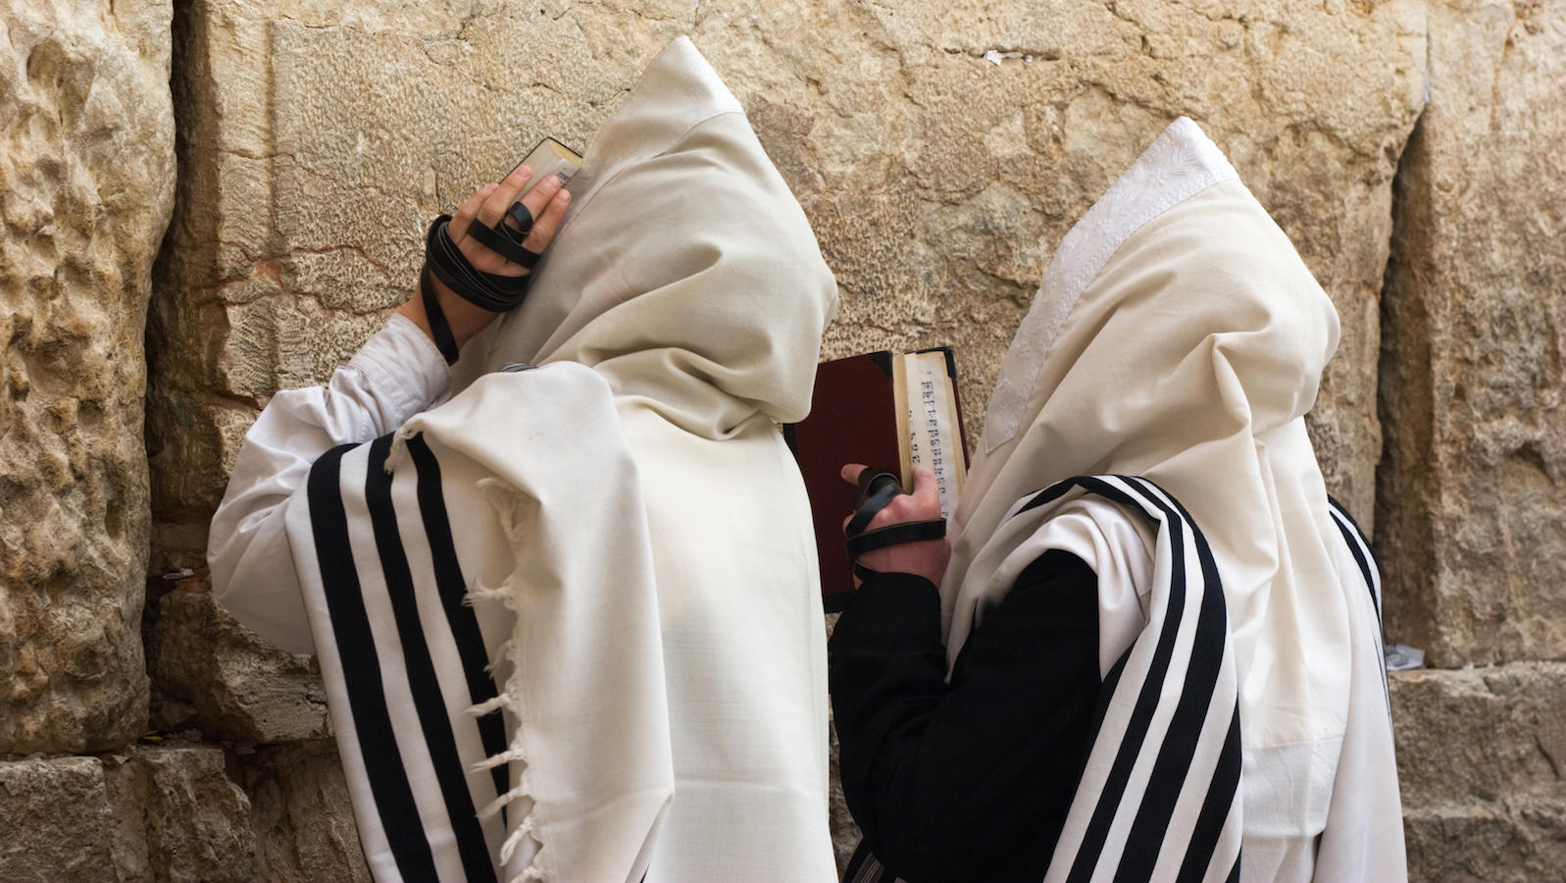
From the sources – on redemption
According to Maimonides, again, there are 12 great ideas concerning faith, one being the incessant looking forward to a better tomorrow, to the coming of the messiah.
The story of the Exodus. Success against all odds.
So too the story of modern Israel, the State.
In prayer, each day, for thousands of years, several times a day, we speak about the Return To Zion; this is captured in prayer and in song – this is an ideal of a better tomorrow.
This held us together in the long exile and diaspora. A common aspiration.

Slide 13
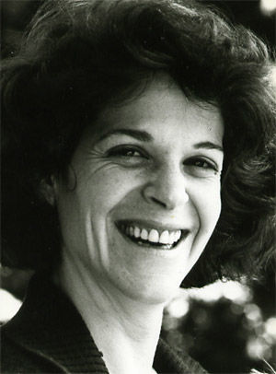
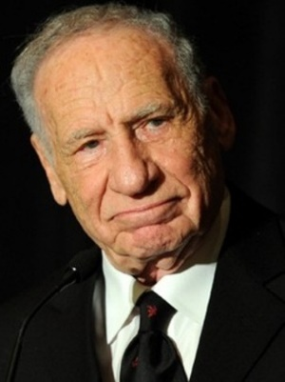
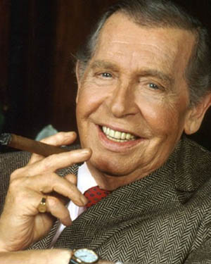
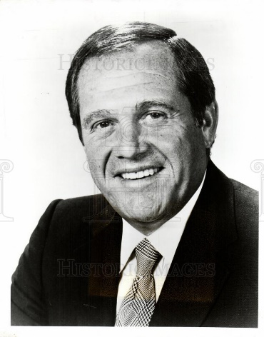
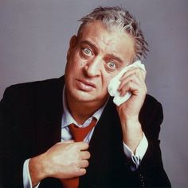
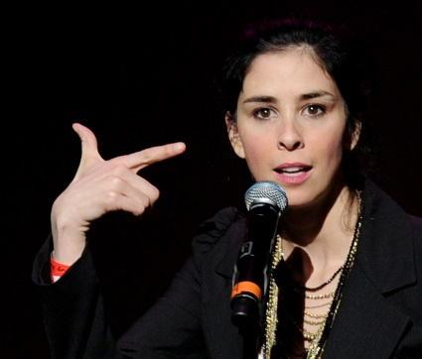
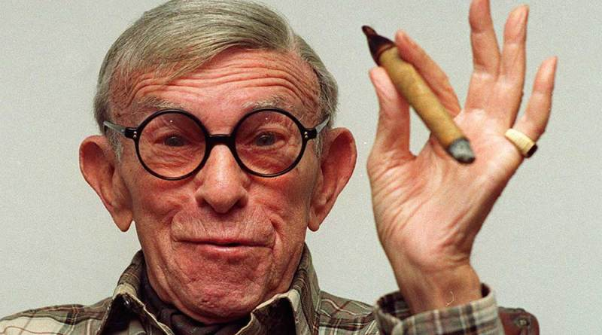
(Some of) Our weapons
Music is a portal to the soul, born out of deep sorrow but strong optimism
Leonard Cohen – Who by Fire
Barbara Streisand – Avinu Malkeinu
Avraham Fried – Ale Katan
Humor too is our secret weapon; not taking ourselves too seriously: for every Jew there are two opinions; every Jew has two synagogues – one he goes to and one where he will not set his foot, etc…

Slide 14
Resiliency leads to happiness
In Israel today there is a thirst for spirituality or belonging, or to feel Israeli, to think Israeli, to be different, to be collectively happy about our achievements, to be proud and positive
It is not cool to be overly critical about Israel , but we do like to complain
We are a happy people
See https://en.wikipedia.org/wiki/World_Happiness_Report; we are #11 (Germany is #15)

Slide 15
Economic Indicators of a resilient country
 |  | reference period: | Latest figure | Previous figure
1. | GDP per capita ($ thousand, purchasing power parity basis) ⁽¹⁾ | Q2/2018 | 40.0 | 39.0
2. | Economy's growth rate (percent) ⁽²⁾ | Q2/2018 | 2.0 | 4.0
3. | Bank of Israel forecast of economy's growth rate (percent) | 2018 | 3.7 | 3.4
4. | Unemployment rate (percent) | Q2/2018 | 3.9 | 3.7
5. | Composite State-of-the-Economy Index (percent) | 07/2018 | 0.4 | 0.3
6. | Ratio of surplus in current account of balance of payments to GDP (percent) ⁽¹⁾ | Q1/2018 | 2.2 | 4.0
7. | Inflation rate (percent) | 07/2018 | 1.4 | 1.3
8. | Inflation expectations derived from the capital market (percent) | 08/2018 | 1.4 | 1.5
9. | Bank of Israel interest rate (percent) | 09/2018 | 0.10 | 0.10
10. | Change in representative exchange rate, NIS per $1 (percent) | 08/2018 | 1.8 | 2.7
11. | Means of payment: M1 (NIS billion) | 07/2018 | 397.9 | 352.8
12. | Ratio of public debt to GDP (percent) ⁽³⁾ | 12/2017 | 60.4 | 62.0
13. | Ratio of external debt to GDP (percent) ⁽³⁾ | 12/2017 | 24.2 | 27.3
14. | Change in Tel Aviv 100 Index (percent) ⁽¹⁾ | 08/2018 | 17.5 | 0.0
15. | Gross return of unindexed 10 year government bonds (percent) | 08/2018 | 2.0 | 2.1

Slide 16
Measuring resiliency
Life expectancy; Israel is #8 overall 82.5 for men; 84.3 for women
Germany is #24 – 81 for men and 83.4 for women
see https://en.wikipedia.org/wiki/List_of_countries_by_life_expectancy

Slide 17
Questions. Answers?
Is a culture that expects to learn from failure more resilient?
Is a culture / religion / people that has experienced repeated failure as a collective, programmed to become resilient?
Is it engrained in our DNA?
Is this peoplehood Darwinism?
Can we teach one to be resilient?
Is there a lesson for academia?

Slide 18
Resiliency and failure
Building a resilient culture involves recognizing that failure can and will occur, and that in innovation, for example, the odds of failure may increase dramatically.
We are prepared. We export our preparedness to others in need.
See https://metiv.org/international-trauma-resilience-summer-course/.
See http://mashav.mfa.gov.il/
Earthquake relief. Syrian field hospital. Mobile trauma units.
Success, entrepreneurship is recognizing failure and the ability to bounce back to something new

Slide 19
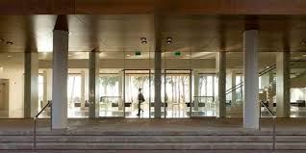
IDC Foundational Pillars
FEAR: Forget Everything and Run (source unknown)
FEAR: Face Everything and Rise (source unknown)
FAIL: First Attempt in Learning (source unknown)
Face and Embrace

Slide 20
"Success is not built on success. It's built on failure. It's built on frustration. Sometimes it's built on catastrophe." Sumner Redstone

Slide 21
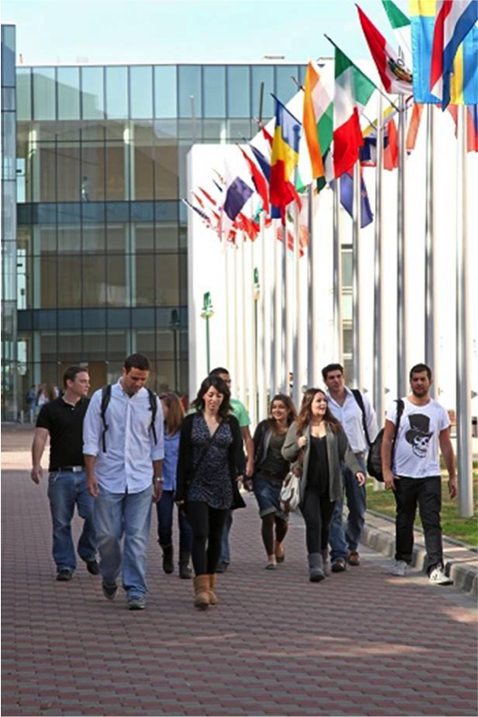
IDC Herzliya
Independent
Interdisciplinary
International
1 of 63 - HEIs
1 of 12 - Privates
1 of 8 - PhD awarding

Slide 22
IDC – basic facts & figures
IDC Herzliya: dedicated to the pursuit of excellence in education and research, and to training future leaders, by offering innovative, interdisciplinary, and practical educational programs.
President & Founder, Prof. Uriel Reichman
Independently-funded; not-for-profit
25 years, 24,000 graduates
9 academic schools; 32 labs, institutes and research centers
Hundreds of ongoing funded research projects
Thousands of published papers, numerous patents
7,000 students, 30% from 86 different countries
Core values: freedom and responsibility, entrepreneurial thinking, research integrity, partnership-based

Slide 23
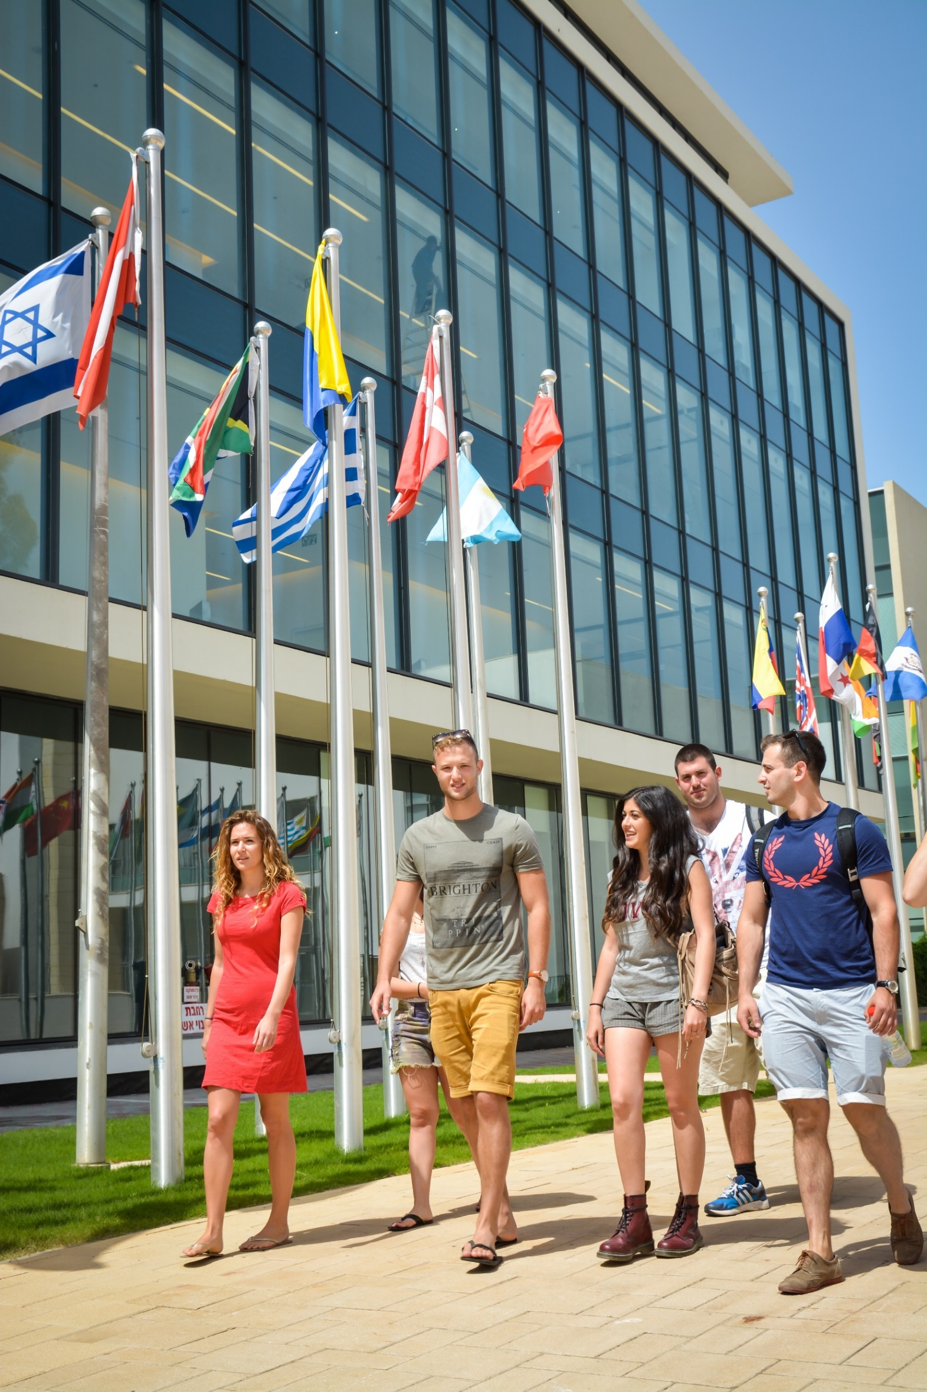
IDC Herzliya
Freedom & Responsibility
Freedom of choice and expression; responsibility to family and society – to bring about change

Slide 24
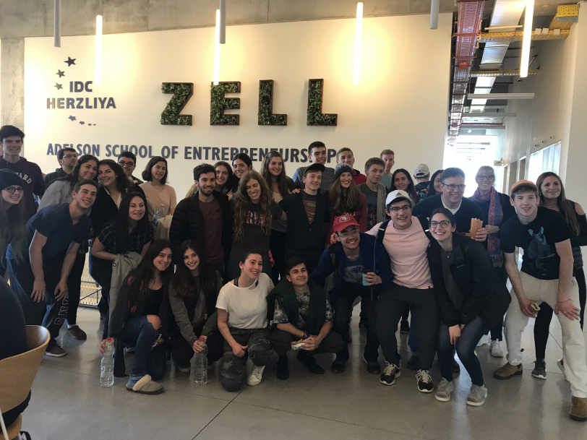
Teaching to fail; teaching to be resilient
One example at IDC
The Zell Entrepreneurship Program (undergraduate) - https://www.idc.ac.il/en/specialprograms/zell/pages/home.aspx
17 years active
345 alumni
124 start ups
76 active start ups
$721,398,000 raised
2,698 jobs created around the world

Slide 25
Student engagement activities; it’s not a right – it’s a duty
Legal clinics
Psychology clinics
Court assistance
SME clinic
Needy family clinic
Friday on campus
Academia at the bar
High school instruction
Urban planning projects
Radio Station

Slide 26
Act.IL
Herzliya Run
Hackathons
Israel Hope (under leadership of the President of Israel)

Slide 27
Teaching to Engage
One example at IDC
The legal clinics https://www.idc.ac.il/en/schools/law/clinics/pages/home.aspx
14 clinics
300 students
4 clinics do policy work, without specific clients.
10 clinics with 230 students work from Netanya to Ramla.
We reach over a 1,000 people.
14 clinical teachers, 11 in-house; 6 academic faculty members.

Slide 28
learning by doing
IDC Herzliya

Slide 29
team dynamics
IDC Herzliya

Slide 30
getting dirty
IDC Herzliya

Slide 31
soft skills
IDC Herzliya

Slide 32
hard rules
IDC Herzliya

Slide 33
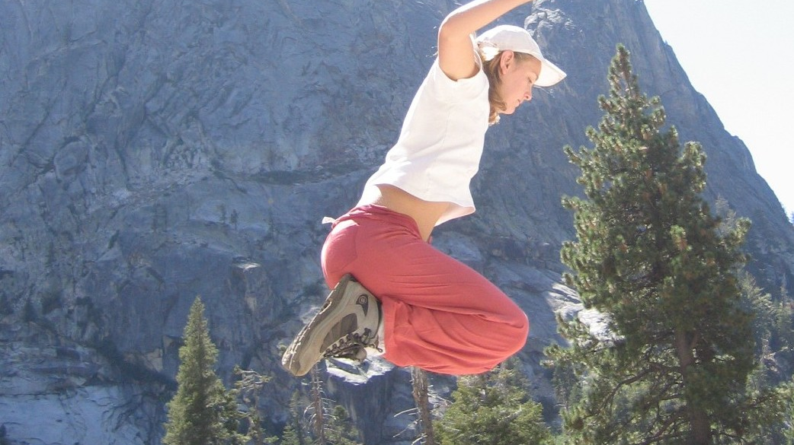
leap of faith
IDC Herzliya

Slide 34
life changing experience
IDC Herzliya

Slide 35
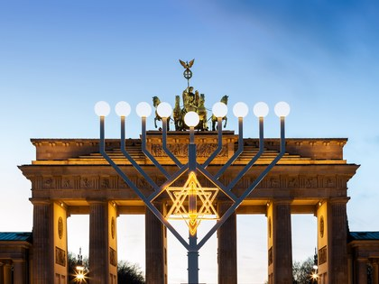
The Jewish and Israeli Experience – to recap
Looking forward, not backwards
Personal and National resilience
Shoah partisan movement; was not against civilians
No revenge rampage afterwards in Europe
Berlin is little Israel today.
What a paradox.
In one generation.

Slide 36
The Jewish and Israeli Experience
Creation. Slavery. The Exodus. Encountering the Amalekites. Hatikvah.
Memory. Resiliency. Hope
Hanukkah, earlier this month, as an example.
commemorating the rededication of the Second Temple in Jerusalem at the time of the Maccabean Revolt against the Seleucid Empire
Resiliency - Our secret defense against trial, tribulation, trouble, and terror

Slide 37
So….
Memory vs hope
Commanded to remember, but there are limits, even in mourning
Revenge no; Reconciliation yes
Sign of strength
Future yes; Past in context
Balancing act
Quickly recovering
Try fast, Fail fast, try again
Isaiah 41:10
Fear not, for I am with you; be not dismayed, for I am your God; I will strengthen you, I will help you, I will uphold you with my righteous right hand.

Slide 38
WE NEED YOU
… to work with us to build bridges with young Palestinians, our neighbors to the North and to others further afield. We need to accept each other, and move on together to a brighter tomorrow, side by side. Dwelling on the past and perpetual victimhood is not a recipe for a better tomorrow.

Slide 39
Dignity of Difference (Jonathan Saks) enlarged by difference; not threatened by it

Slide 40
21st Century Social Engineers
International educators are the 21st Century Social Engineers; the ultimate Social Entrepreneurs
Building sustainable bridges that bond people; spanning minds

Slide 41
Tearing Down Walls of Ignorance
by Building Bridging between Peoples

Slide 42
THANK YOU Danke

