Slide 1
THE RATIONAL APPROACH
APPROACHES TO POLITICAL SCIENCE

Slide 2
Rational Choice Theory (RCT)
Definitions of Rationality
Classical vs. Modern RCT
Three Assumptions:
Completeness
Transitivity
Independence of Irrelevant Alternatives
Individual’s Effect on Society

Slide 3
Criticisms of RCT
Post-Hoc Theory Development
Tautology
Unrealistic Assumptions
Responses: Bounded Rationality, Merged Fields
Individual vs. Collective
Methodological Individualism vs. Sociology

Slide 4
Other Questions Raised
Why would people ever act in ways that benefit others at the expense of achieving the most desired goal?
Nash Equilibrium
Why do people follow social norms that cause them to interact in the best interest of others?
Karl-Dieter Opp

Slide 5
“Norms & Rationality. Is Moral Behavior a Form of Rational Action?”
Definitions
Norms, Morality/Internalization
Wide vs. Narrow Interpretations of RCT
Why does it matter?

Slide 6
Autonomy Thesis
Narrow Interpretation of RCT
External Outcomes
Norm compliance is about doing one’s duty
Costs & benefits are not considered
Then what motivates individual to follow norms?

Slide 7
Incentive Thesis
Wide Interpretation of RCT
Internal & External Outcomes
Norm Compliance
Costs & Benefits
Internalization
Learning Process

Slide 8
Author’s Conclusion
Arguments against the incentive thesis are not enough to refute it. In fact, they support it.
This conclusion is reached based on the adoption of a wide version of RCT, where both internal and external outcomes are viewed as motivations.
This wide version seems to explain social phenomena that researchers are interested in. More research must be done as to why many authors adopt a narrow version of RCT instead of the wide version.
Perhaps evidence of hesitancy to adopt a new paradigm?

Slide 9
Arab Culture & Norms
Are Arab norms irrational?
American Norms
Authority Positions
Suicide Terrorism
Dictator vs. Chaos
Acceptance of Second-Class Status by Women

Slide 10
Game Theory - Schelling
Purpose
Soft vs. Hard
Split or Steal
Payoff Matrix
Anticipating vs. Influencing
Promises, Threats, Bribes

Slide 11
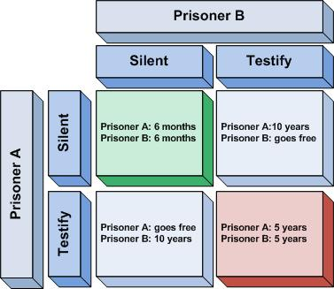
The Prisoner’s Dilemma
The Situation
Suspected Robbery
Lack of Evidence
Interrogation & Dilemma
Why?
Dilbert's Dilemma

Slide 12
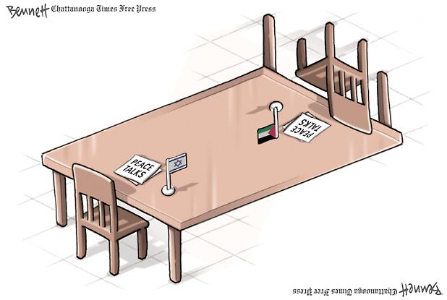
Israel’s Dilemma
The Blackmailer Dilemma
Israel & the Palestinians
Applying Game Theory
Robert Aumann

Slide 13
Review
Rational Choice Theory
Norms & Rationality
Incentive Thesis
Arab Culture & Norms
Game Theory
Prisoner’s Dilemma
Israel’s Dilemma

