Slide 1
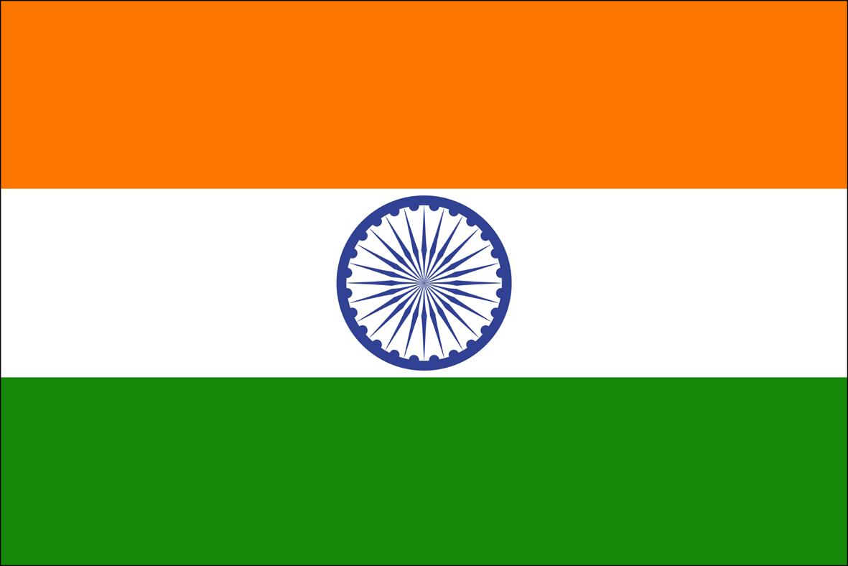
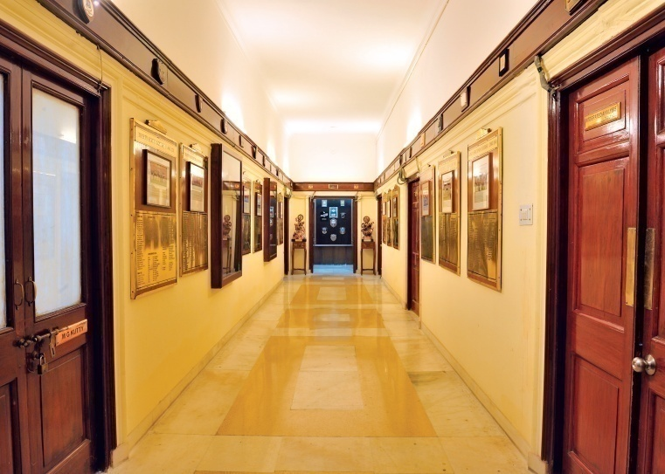
GREETINGS FROM THE NATIONAL DEFENCE COLLEGE, NEW DELHI
“Abode of the Strategic Thinkers : The Highest Seat of Strategic Learning. Wisdom gained here Enables the officers in crafting the best possible solutions. Not only to security dilemmas but also other diverse issues that come their way in the business of Governance and Nation Building”

Slide 2
PREVIEW
India – Traditional Strengths
Overview : National Defence College
India’s Global & Regional Perspective

Slide 3
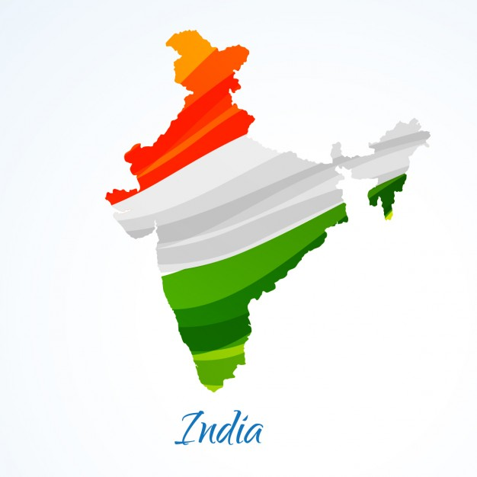
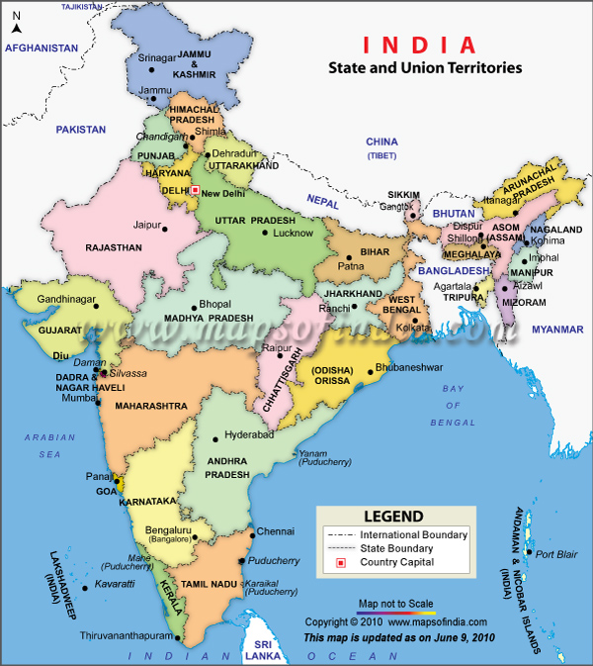
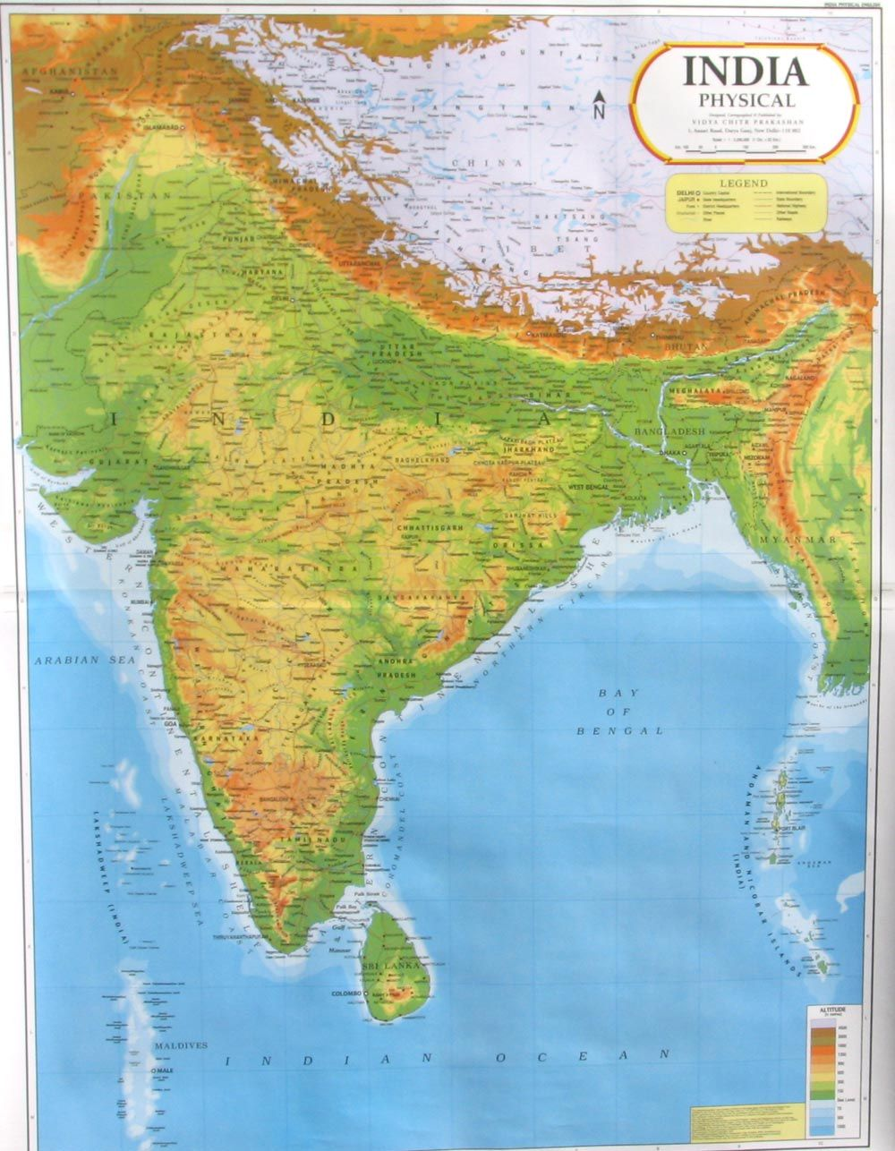
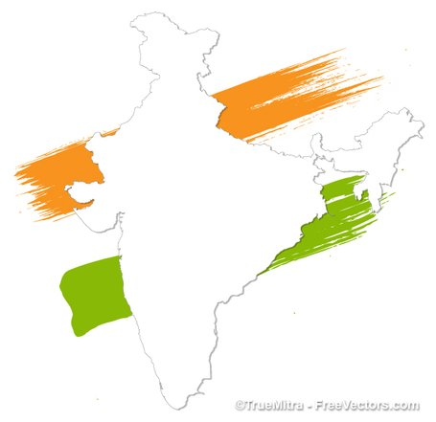
INDIA : TRADITIONAL STRENGTHS

Slide 4
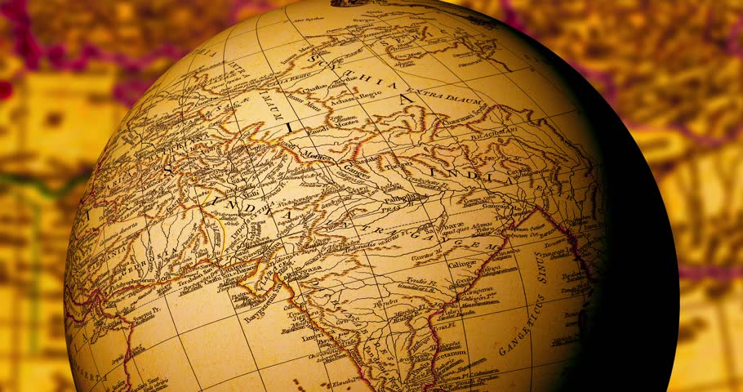
TRADITIONAL INDIAN STRENGTHS
Survived test of time in which many civilisations have perished.
Idea of One World Family philosophy (Vasudhaiva Kutumbakam) - ancient, yet relevant to the modern times.
Ahimsa – a philosophy of non violence, important aspect of native Indian faiths.
World’s Largest Democracy, granted universal adult franchise immediately on attaining Independence.
A multi lingual society with 179 languages and 544 dialects.
Soft Power – home to data and digital revolution.
Fastest growing economy (6th largest) at $ 2.6 Trillion GDP.

Slide 5
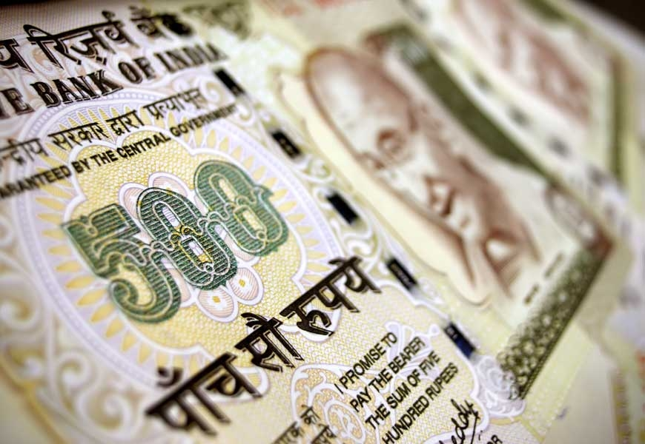
INDIAN ECONOMY
By 1500 AD, India’s GDP was 25.1 % of the World’s Net GDP – India had the highest GDP in 1000 & 1700 AD with significant margins.
India's share of world income collapsed from 22.6% in 1700, almost equal to Europe's share of 23.3% at that time, to as low as 3.8% in 1952 - at the beginning of the 20th century.
Fastest growing economy -Currently 6th largest economy at $ 2.6 Trillion & 3rd in PPP terms.
Average growth of economy in last 20 yrs between 6 to 7%.
3rd largest Steel producer, largest centre for polishing gems and producing jewellery, largest milk producer .
4th largest railway network of world - 23 million every day (Approx equal to the population of the Scandinavian countries !) ; fastest growing aviation market in the world-131 million passengers a year.

Slide 6
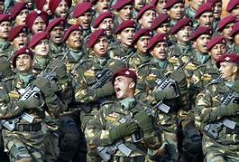
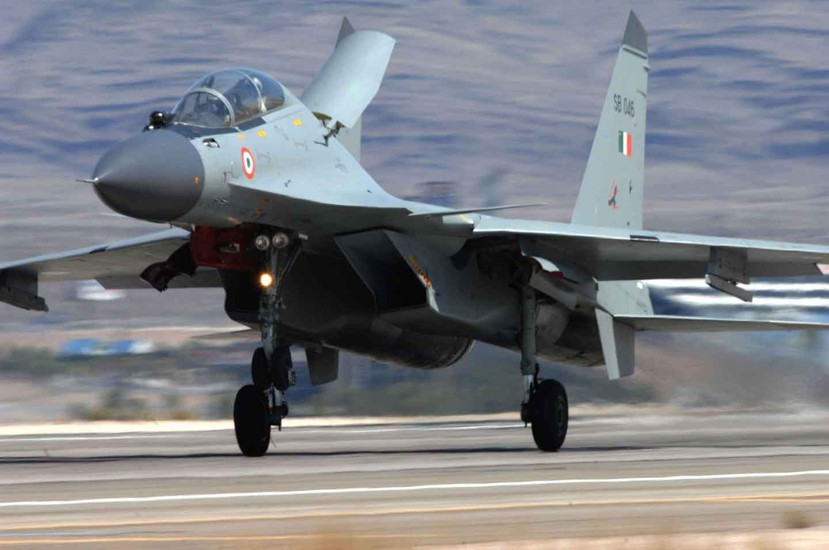
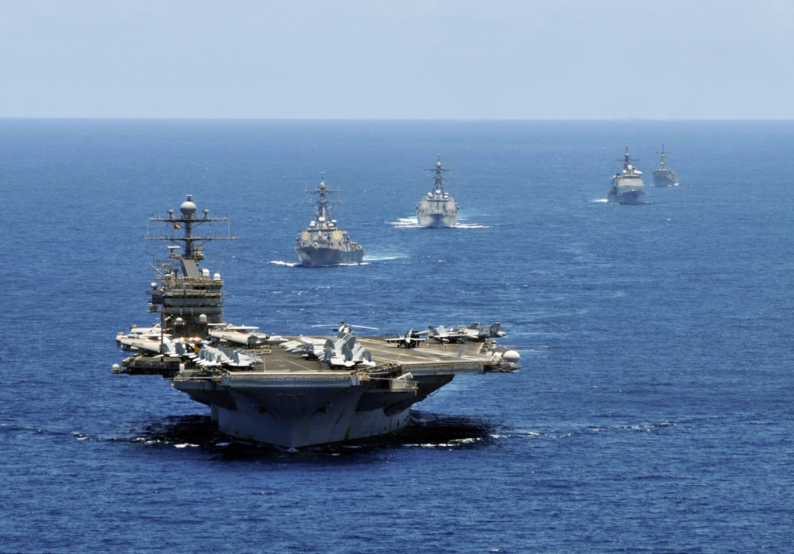
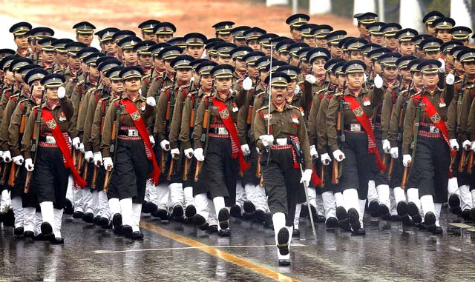
INDIAN ARMED FORCES
Indian Armed Forces contributed over 2.5 million volunteer troops each to the World Wars as part of British Indian Army.
World’s second largest army - 1.3 million - modern, volunteer & professional force.
Deployed along two active borders with experience of 5 major wars in last 70 yrs. Employed in anti terror / insurgency operations since 1960s.
Organised into three services (Army, Air Force & Navy).
Supreme Commander is the President of India and functional control under Ministry of Defence headed by a Cabinet Minister.
Each service headed by a four star and having regional commands headed by a three star.
The Armed Forces maintain the Nuclear Triad of the country.

Slide 7
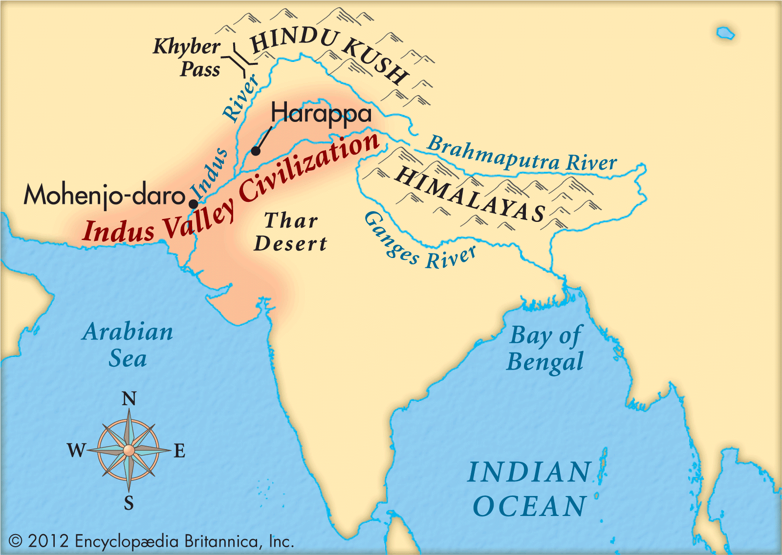
ANCIENT INDIAN HISTORY
7500 BC Civilisation of Gulf of Khambat, in present day Gujarat, on the Arabian Coast.
2500 to 1500 BC, the Indus Valley Civilisation flourished in India.
Wealth of India pulled Alexander to invade India in 326 BC, however could not succeed entirely.
During reign of King Ashoka (273 to 232 BC), India’s geographical boundaries extended from Persia to present day Myanmar.
India gave birth to four major religions. Islam reached India in 629 AD.
Zero Invented by Aryabhatta in 5th century BC.
Worlds first university was established in Takshila in 7th century BC.
Sanskrit, the oldest attested human language originated here.

Slide 8
INDIA : GEOGRAPHY
Peninsular India – 7500 km coast line
Land Borders with Afghanistan, Pakistan, TAR, Nepal, Bhutan, Bangladesh & Myanmar
Great Himalayan Range
Large Rivers
All types of terrain segments including deserts

Slide 9
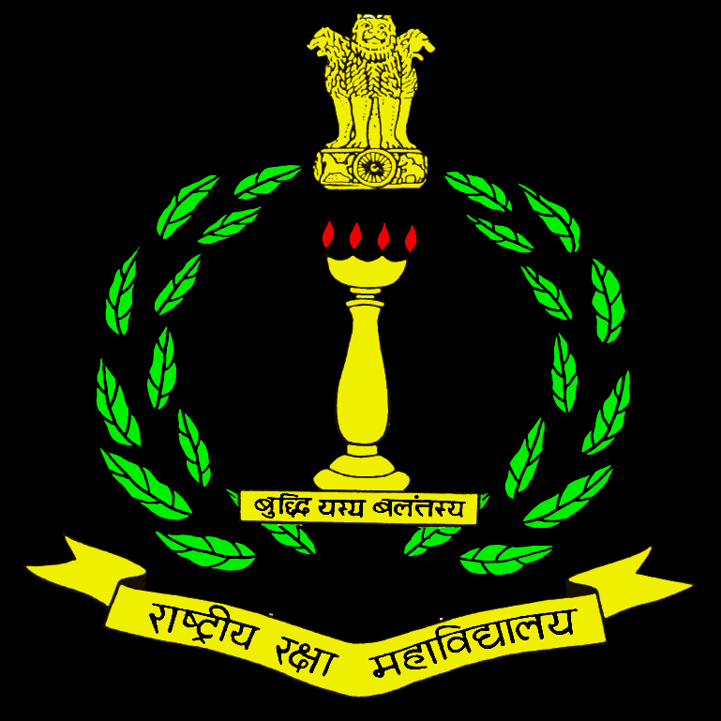
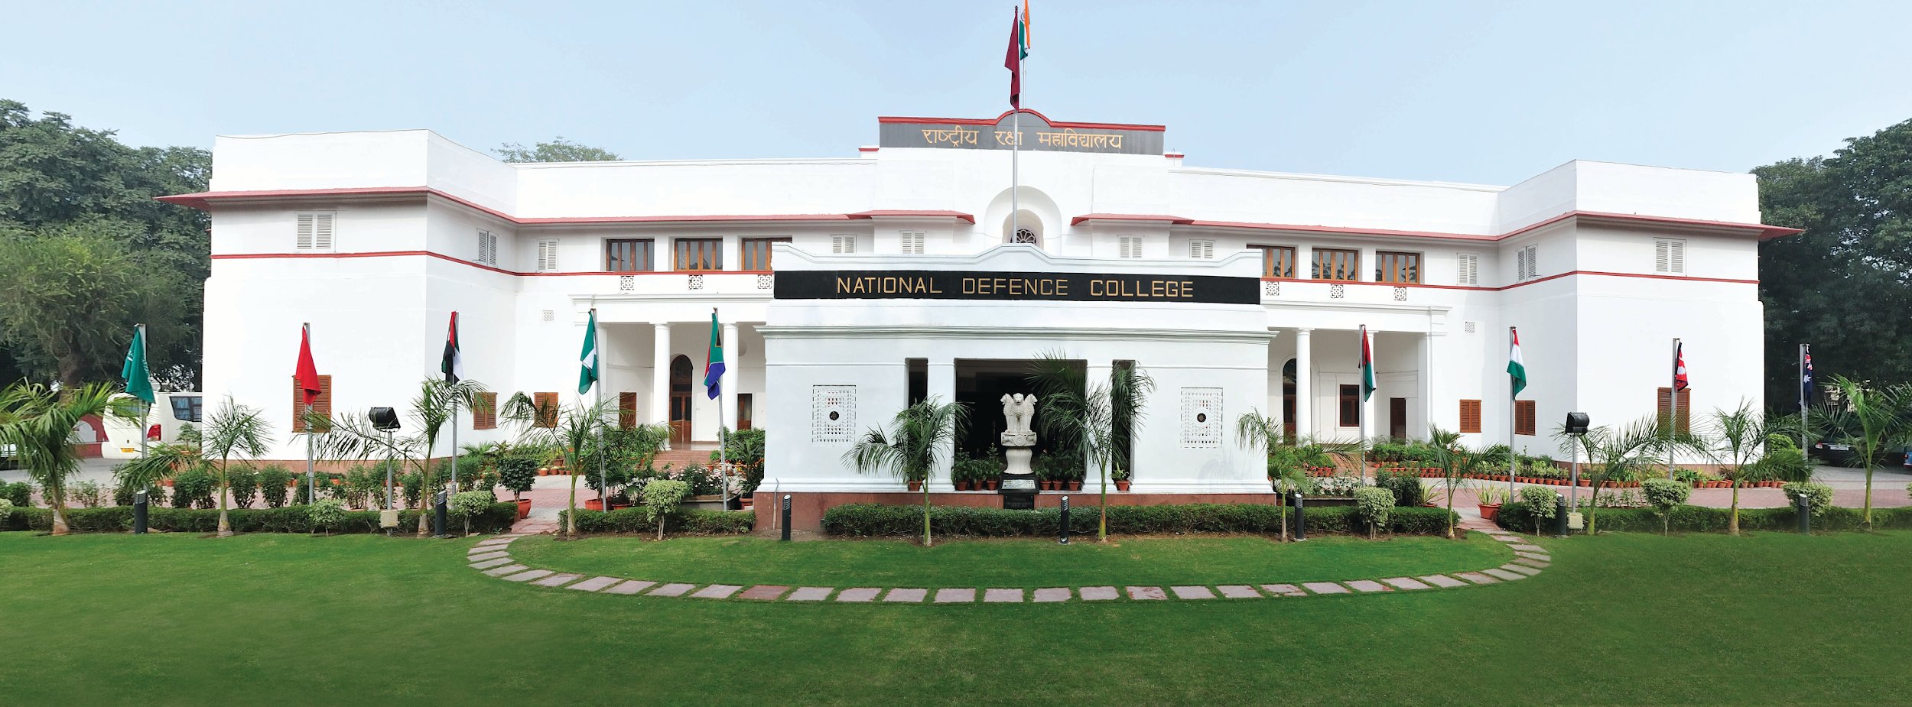
OVERVIEW : NATIONAL DEFENCE COLLEGE, NEW DELHI

Slide 10
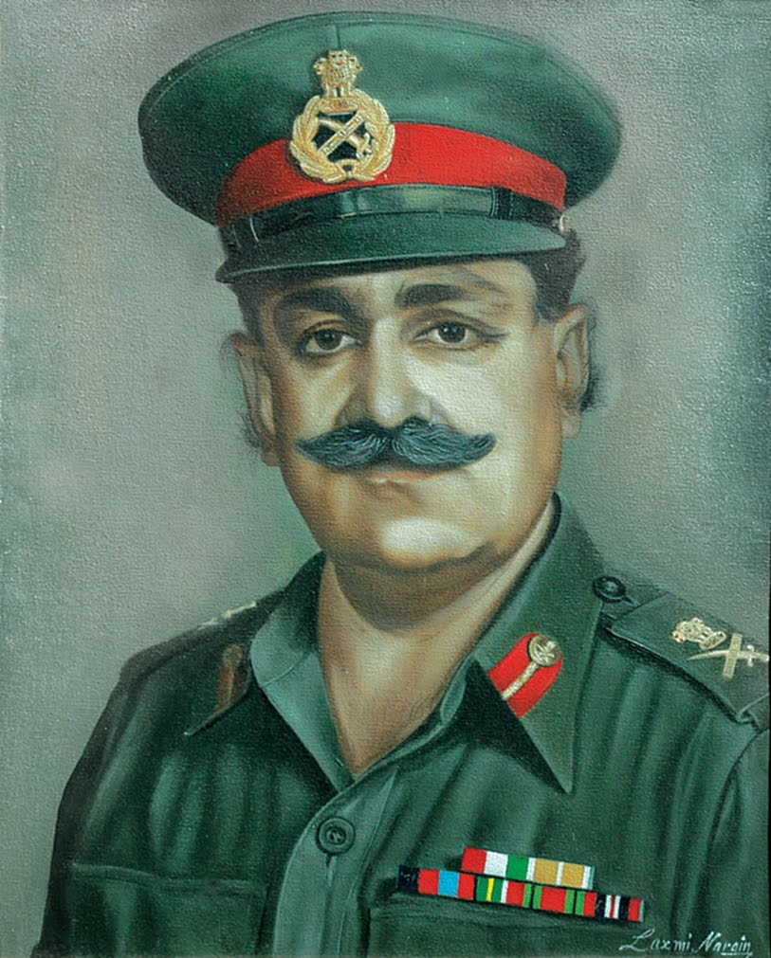
BRIEF HISTORY
Post independence, some senior
officers sent to
Imperial Defence College, UK
Need felt for larger numbers to be
trained in National Security Studies
Approved by the Cabinet-May 1959
Inaugurated by Mr Jawahar Lal
Nehru, PM - 27 Apr 1960
Directive - “..for providing
instruction to senior service and civil officers in the wider aspect of higher direction and strategy of warfare”
Lt Gen K Bahadur Singh,
Founding Commandant

Slide 11
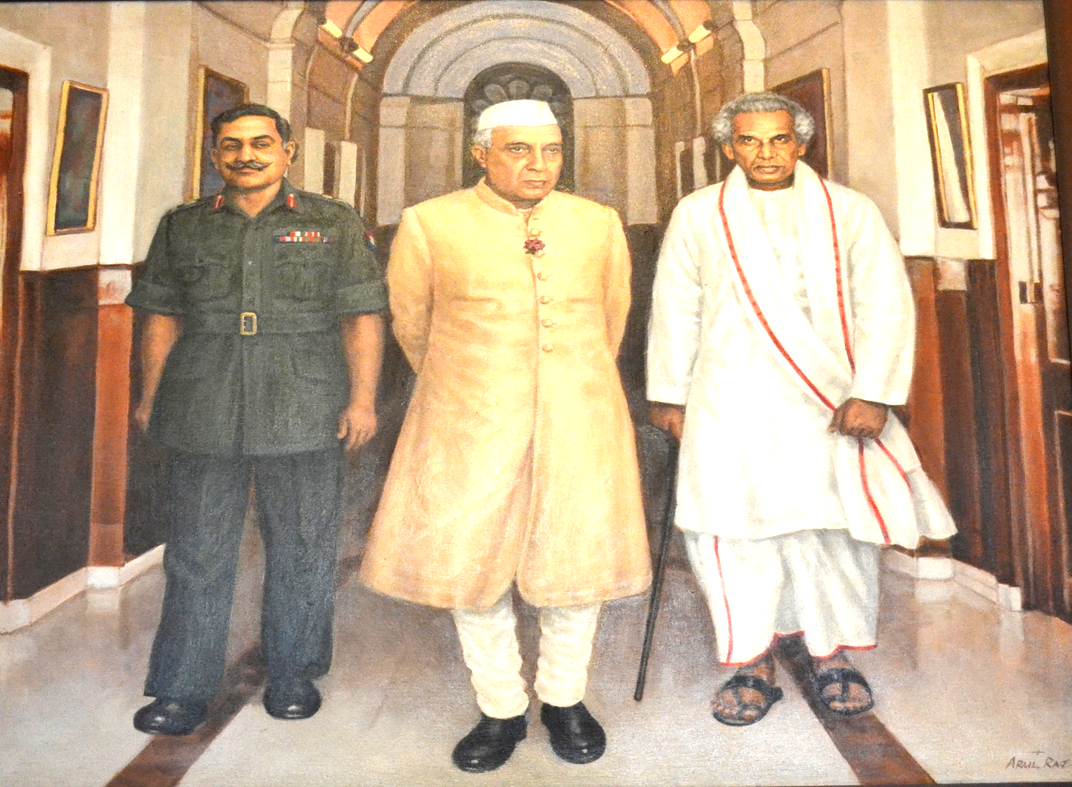
Lt Gen K Bahadur Singh, MBE the first Commandant of NDC with Pandit Jawahar Lal Nehru and Shri V K Krishna Menon on the Inaugural Day , 27 April 1960

Slide 12
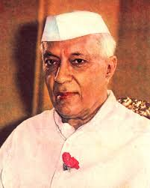
WORDS OF THE FIRST
INDIAN PRIME MINISTER
“Our desire is to continue to live peacefully and cooperatively with all our neighbours. Nevertheless, no defence apparatus can exist in a purely idealistic way. It has to be realistic and remain prepared for any emergency. The National Defence College has become a positive necessity to meet defence problems as they are likely to be in future”
Pandit Jawaharlal Nehru
(extracted from his inaugural speech on 27 April 1960)

Slide 13
AIM
“To equip future policy makers with the background necessary for a broad understanding of the varied social, economic, political, military, scientific and organisational aspects involved in the planning of national security and strategy”

Slide 14
ROLE
Provide a structured exposure to diverse issues related to national security
Facilitate individual development by creating the necessary academic environment related to national security issues
Develop a lasting mutual understanding between different organisations of the Government of India and foreign countries.
To be an instrument for the Government of India to foster better mutual co-operation and desirable linkages in the national, regional and international security arena

Slide 15
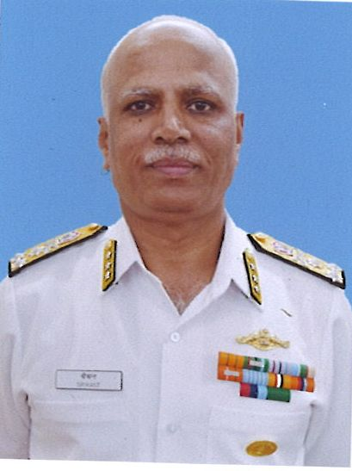
ORGANISATION
Vice Adm Srikant, AVSM
COMMANDANT
FACULTY
SECRETARY
SDS – Senior Directing Staff
CIVIL
SERVICES
FOREIGN
SERVICE
ARMY I
ARMY II
ARMY III
NAVY
AIR
ADMINISTRATION

Slide 16
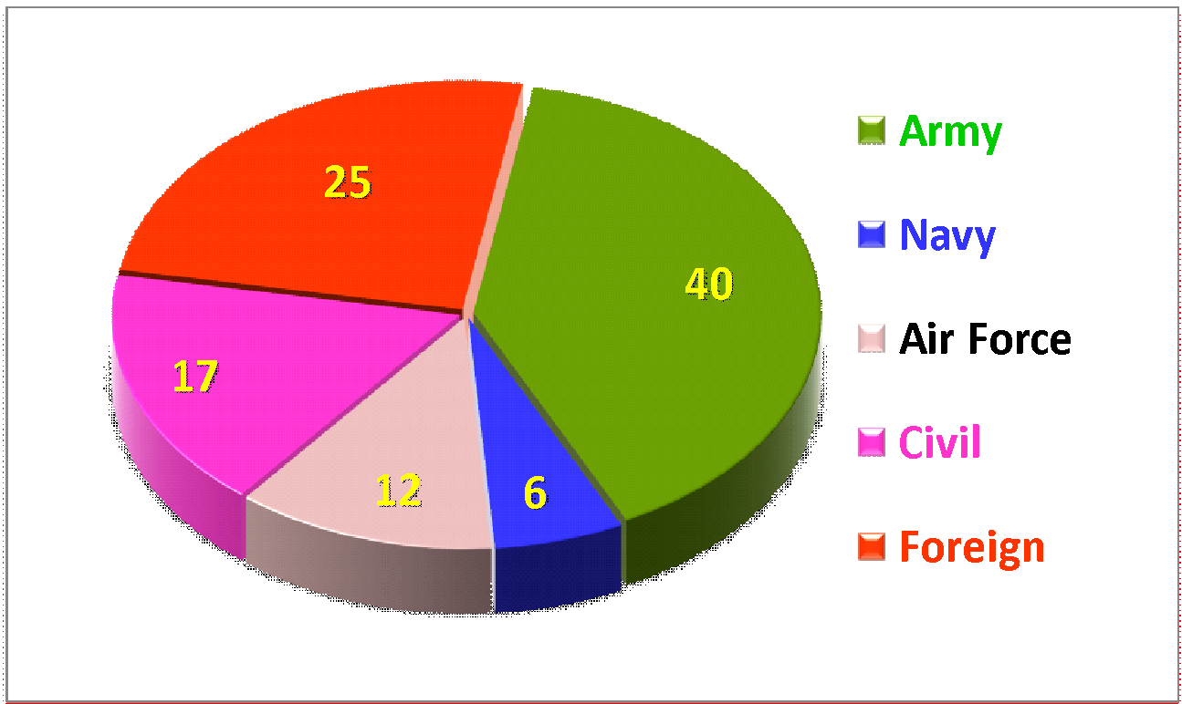
COURSE COMPOSITION NDC-58
Offrs from all 6 continents

Slide 17
STRATEGIC WAR GAMING
Think Tank tasked for Conceptualising the Event
Theme Selection
Creation of a Scenario e.g. Taiwan & a Cuban Missile Crisis Scenario in the South China Sea
Choose the actors and players, their options, inject varied angles
Evaluate scope for bilateral and multilateral diplomacy, big power plays if applicable
Military Options, role of UN, AU etc
Role of Media
Interests of every player governing their behaviour brought out

Slide 18
NDC ALUMNI
Total Alumni since 1960 - 3698
Foreign Alumni from 69 Countries - 801
Most senior officers of Indian Defence Forces:-
Army Chiefs- 19
Air Chiefs - 12
Naval Chiefs- 10
Senior diplomats, Civil servants, Police officers and administrators in Government – Numerous Secretaries, Chief Secretaries, Director Generals of Police & Distinguished Personalities

Slide 19
FOREIGN COUNTRIES
REPRESENTED: (1960-2018)
01. Afghanistan 19
02. Algeria 01
03. Australia 36
04. Bangladesh 48
05. Bhutan 08
06. Benin 01
07. Brunei 03
08. Brazil 07
09. Burkina Faso 01
10. Cuba 01
11. Cambodia 02
12. Egypt 14
13. Ecuador 02
14. Ethiopia 01
15. Fiji 02
16. France 10
17. Germany 09
18. Ghana 22
19. Greece 02
Guyana 01
Hungary 01
22. Indonesia 28
23. Iran 07
24. Iraq 13
25. Ireland 01
26. Israel 05
27. Japan 10
28. Jordan 02
29. Kazakhstan 07
30. Kenya 21
31. Korea (ROK) 17
32. Kyrgyzstan 02
33. Lesotho 01
34. Maldives 03
35. Malaysia 39
36. Mexico 01
37. Mongolia 02

Slide 20
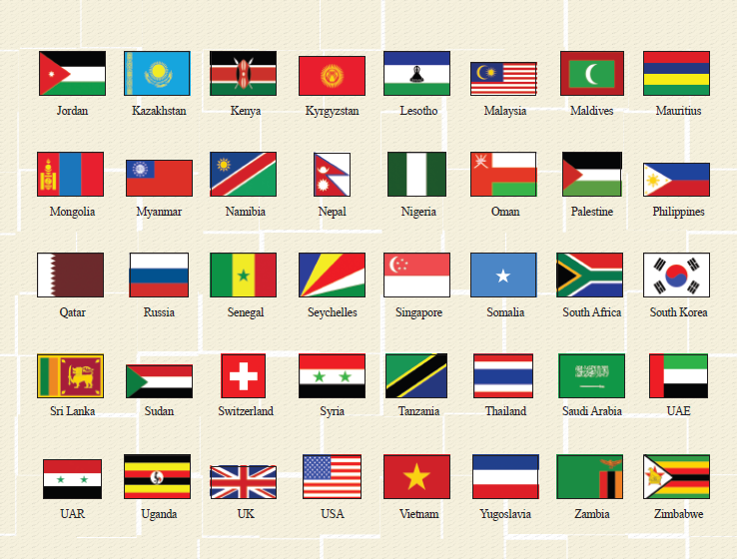
FOREIGN COUNTRIES
REPRESENTED: (1960-2017)
38. Mauritius 02
39. Myanmar 21
40. Namibia 02
41. Nepal 28
42. Nigeria 53
43. New Zealand 02
44. Oman 26
45. Palestine 02
46. Philippines 07
47. Peru 01
48. Qatar 02
49. Russia 09
50. Saudi Arabia 11
51. Seychelles 01
52. Singapore 06
53. Somalia 01
54 South Africa 05
55. Sri Lanka 74
56. Sudan 14
57. Senegal 01
58. Syria 05
59. Switzerland 01
60. Tanzania 19
61. Thailand 22
62. UAE 25
63. Uganda 07
64. UK 57
65. USA 34
66. Vietnam 18
67. Yugoslavia 01
68. Zambia 16
69. Zimbabwe 02
TOTAL 801

Slide 21
FOREIGN PARTICIPANTS – NDC 58
Afghanistan
Australia
Bangladesh (2)
Bhutan
Brazil
Egypt
Indonesia
Israel
Japan
Kenya
Myanmar
Nepal
New Zealand
Nigeria (2)
Oman
Saudi Arabia
South Korea
Sri Lanka (2)
Tanzania
UK
USA
Uganda
22 Countries
25 Officers

Slide 22
STRATEGIC NEIGHBOURHOOD TOUR -2018
Uzbekistan
Israel
Myanmar
Oman
Sri Lanka
Malaysia
Kenya

Slide 23
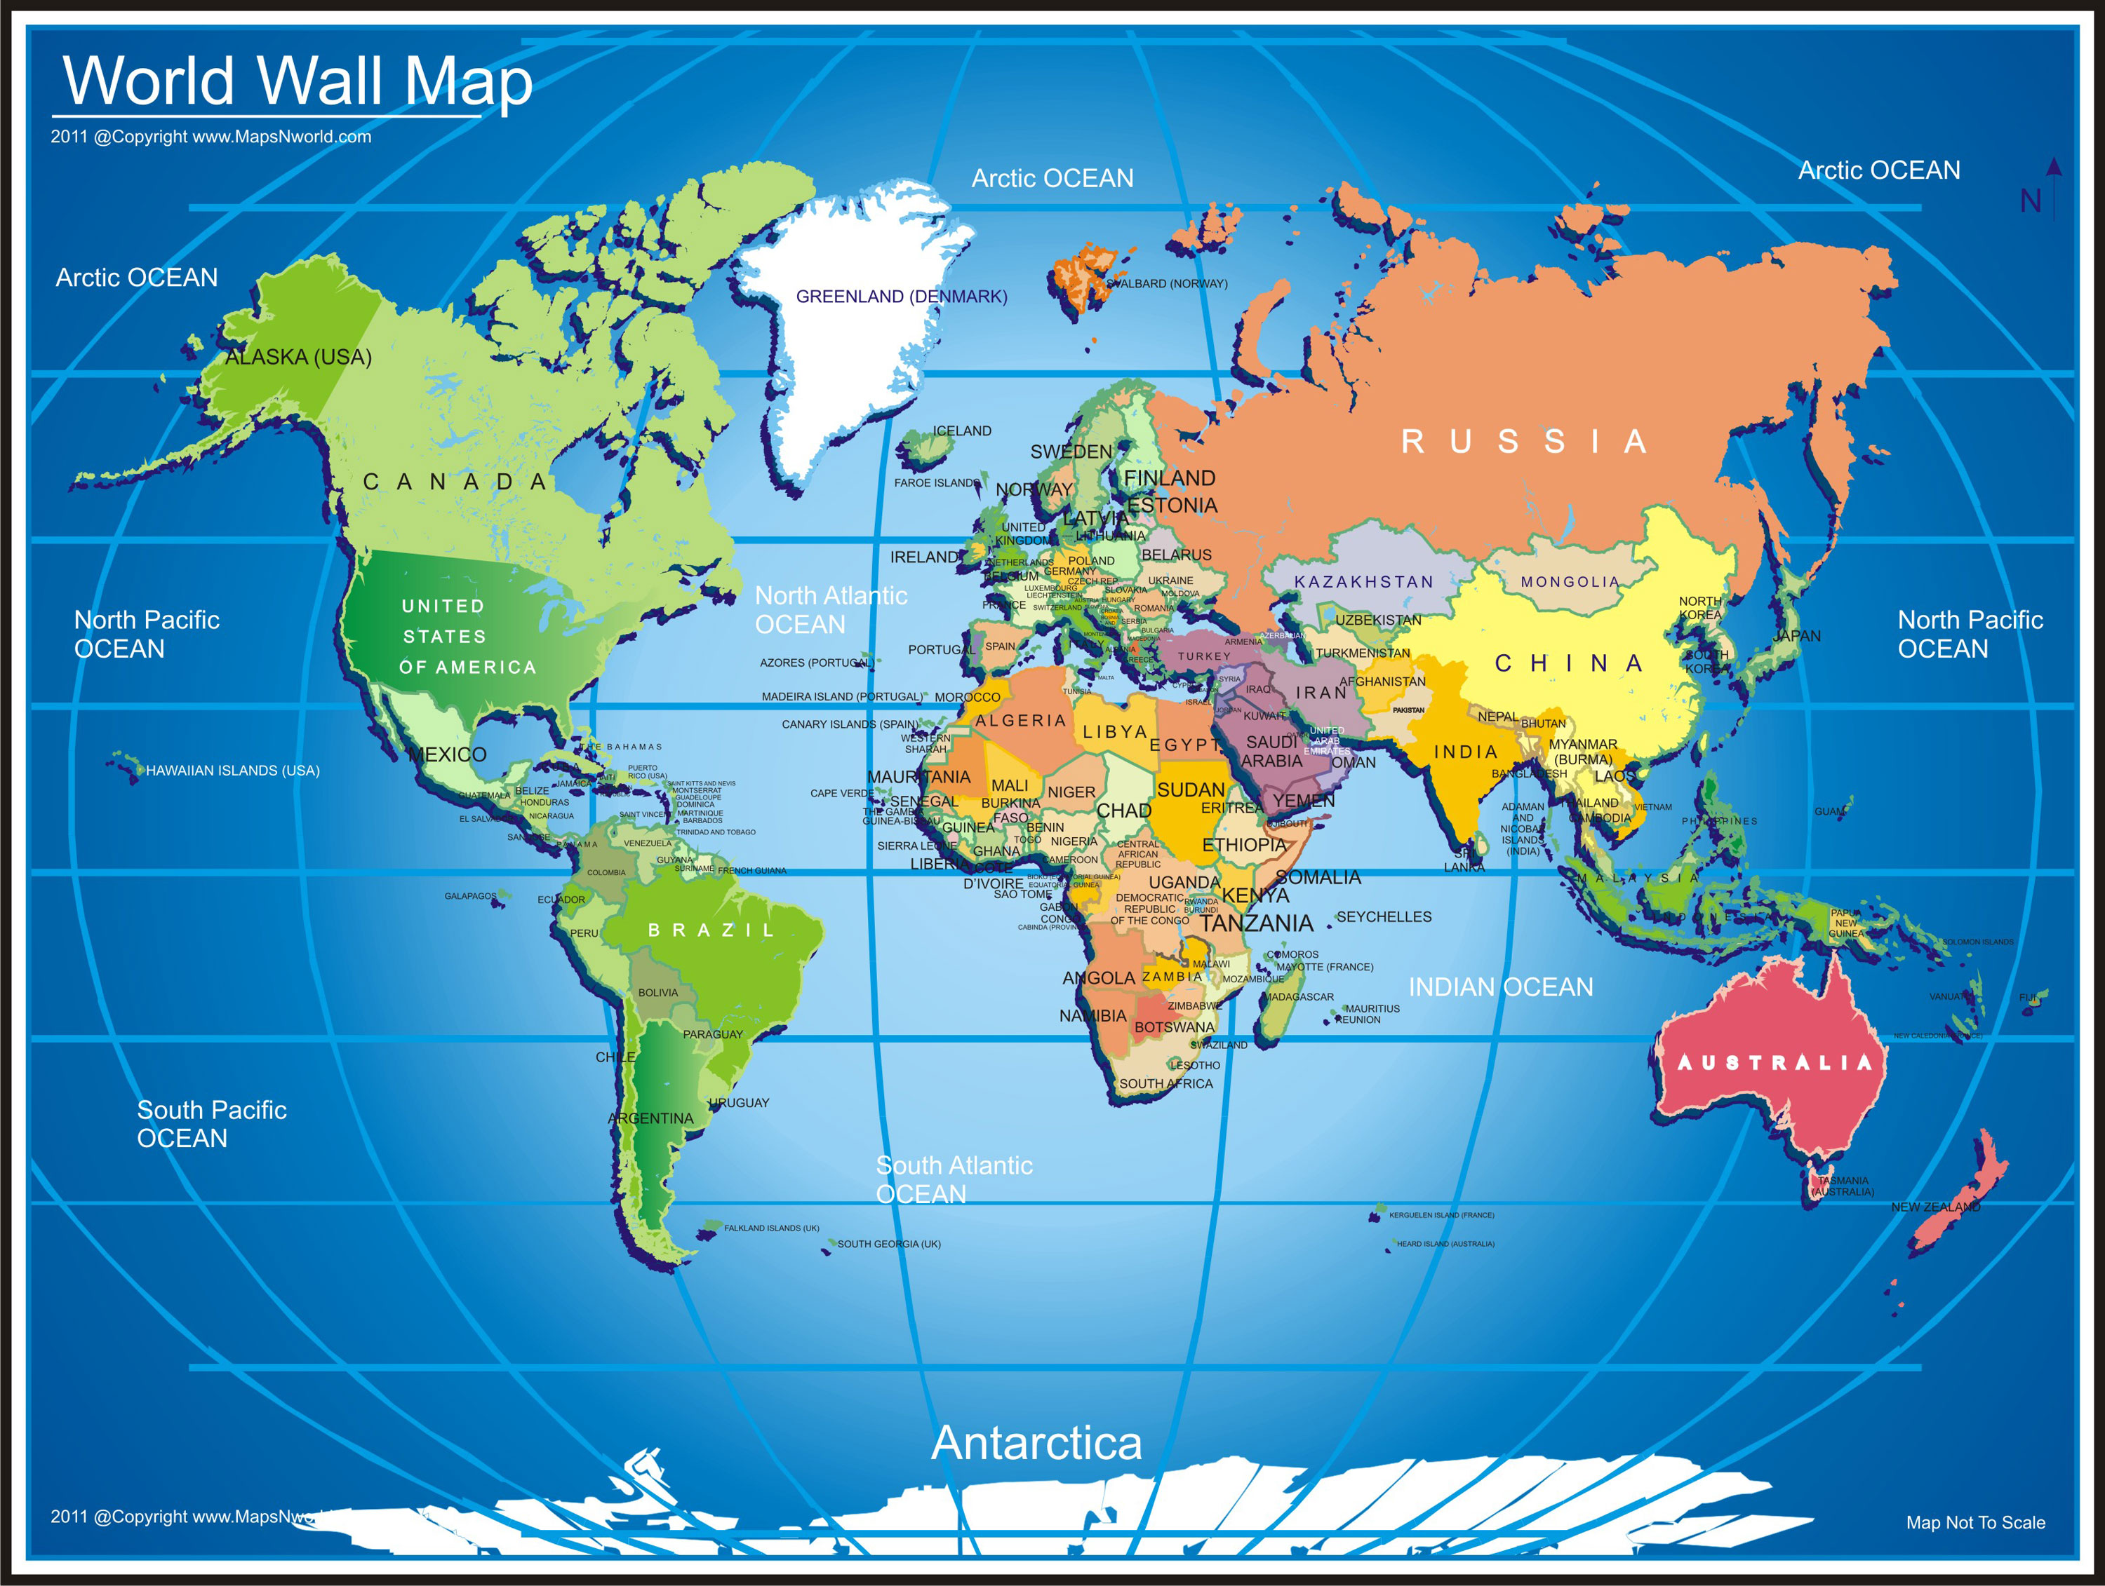
FOREIGN COUNTRIES STUDY TOUR - 2018
Norway
Russia
UK
Germany
Mongolia
USA
France
Egypt
Mexico
Cambodia
Uganda
S Africa
Chile
New Zealand

Slide 24
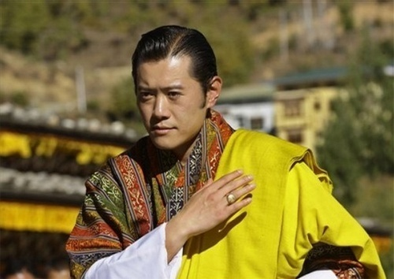
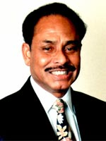
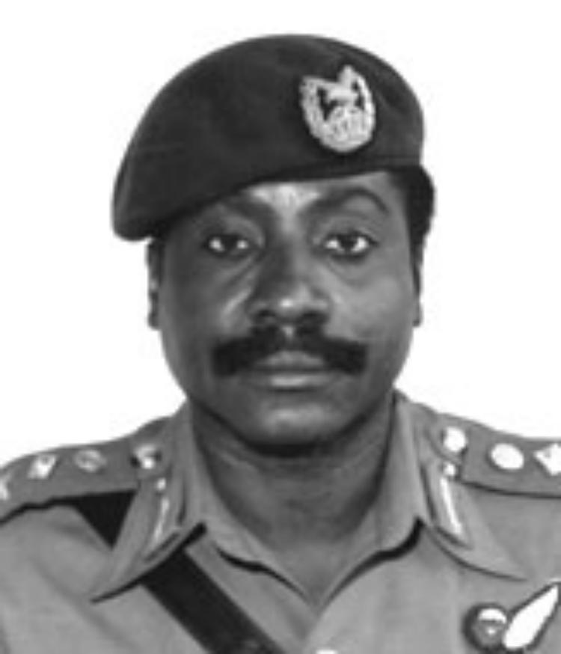
PROMINENT NDC ALUMNI
HE GEN THE HONOURABLE
SIR PETER COSGROVE AK MC (RETD) GOVERNOR GEN OF
THE COMMONWEALTH OF AUSTRALIA
HIS MAJESTY JIGME WANGCHUK,
KING OF BHUTAN
GEN AKUFFO
PRESIDENT GHANA
PRESIDENT ERSHAD BANGLADESH

Slide 25
NATIONAL SECURITY &
STRATEGIC COURSE
“A strategic perspective with the whole spectrum of India’s Comprehensive National Security. The course addresses such elements and seeks to integrate them in the framework of a National Strategic System- taking into account the pressures of International Politics, the effects of Geopolitical Factors & the structural context of our Society & National Economy”

Slide 26
COMPREHENSIVE NATIONAL SECURITY
Comprehensive National Security
Economic Security
Military Security
Food Security
Environmental Security
Personal Security
Health Security
Energy Security
Political Security
Community Security

Slide 27
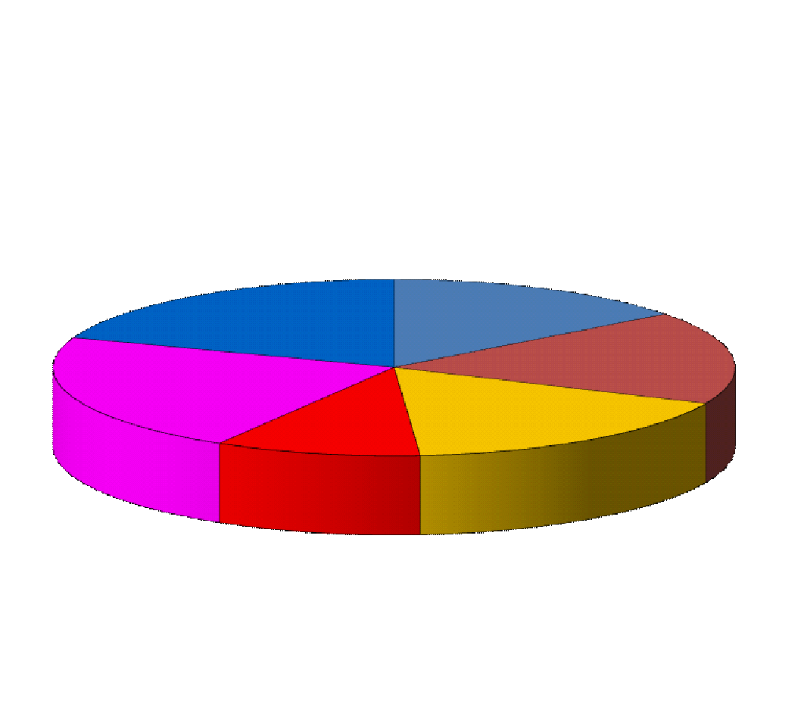
CONDUCT OF THE COURSE
STRATEGIES AND STRUCTURES FOR NATIONAL SECURITY
SOCIO-POLITICAL STUDY
10
6
7
10
ECONOMIC
SECURITY
5
7
INDIA’S STRATEGIC NEIGHBOURHOOD
INTERNATIONAL
SECURITY
ENVIRONMENT
GLOBAL
ISSUES AND SCIENCE & TECHNOLOGY
COURSE DURATION – 47 WEEKS

Slide 28
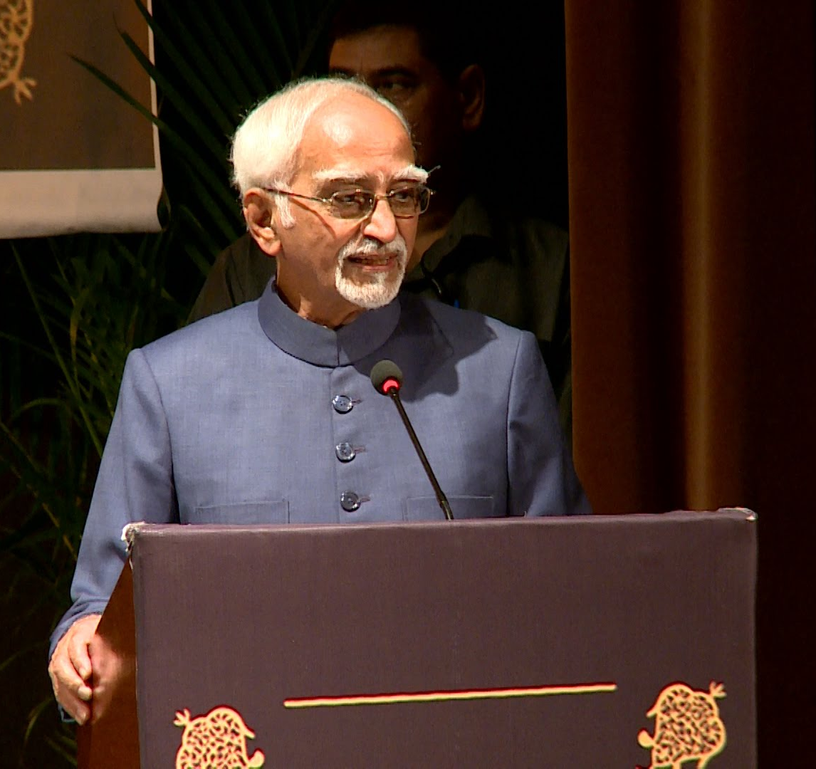
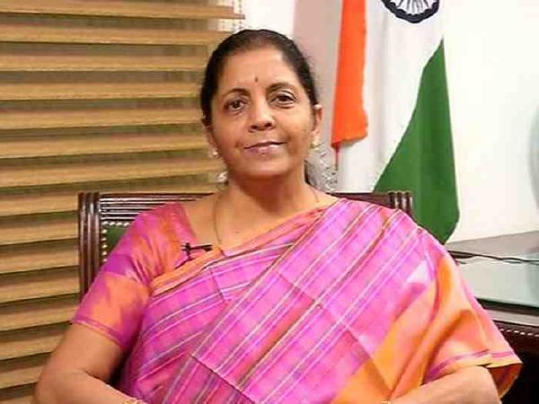
METHODOLOGY
Lectures by Eminent Speakers
Question / Answer Session
Group Based Research
Individual Research and Thesis
Study Tours within India and Abroad
Two Strategic Gaming Exercises

Slide 29
EMINENT SPEAKERS AT NDC
Honourable Presidents
Honourable Prime Ministers
Honourable Ministers
Honourable Ambassadors & High Commissioners
Service Chiefs
Academicians, Authors, Economists of Global Fame
Distinguished Personalities With Expertise & Fame
National Security Advisors

Slide 30
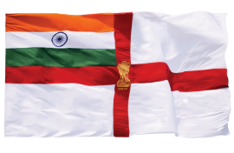
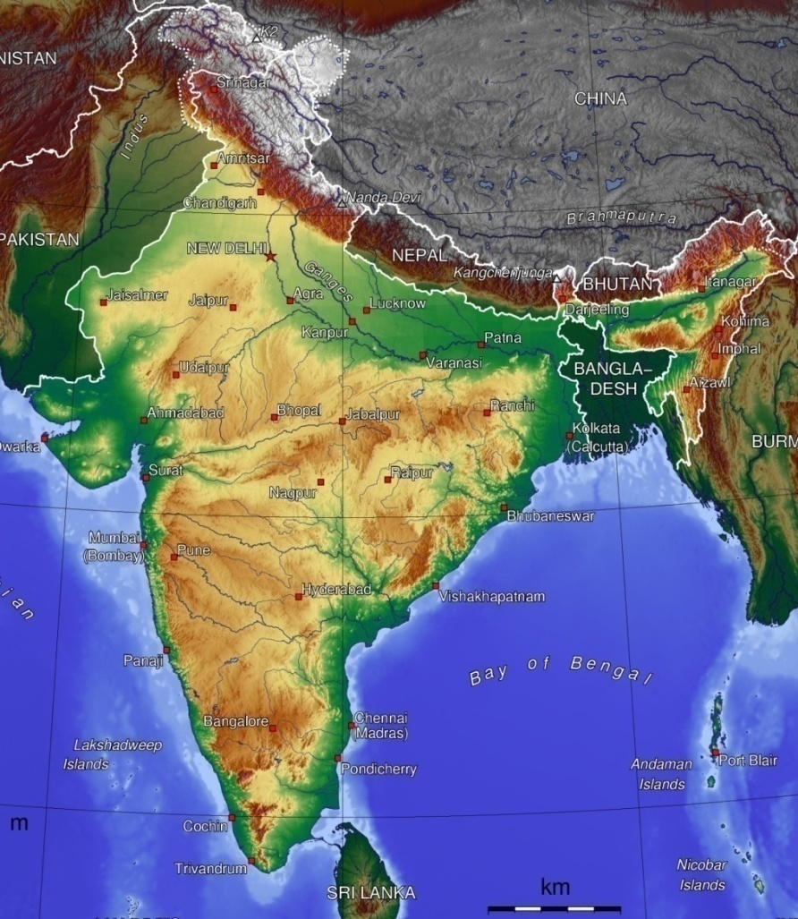
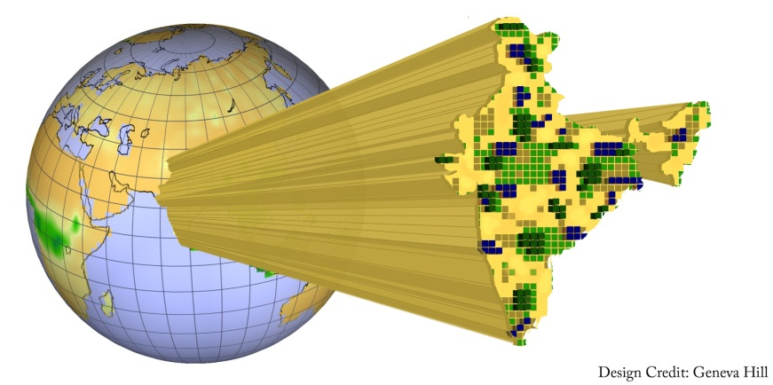
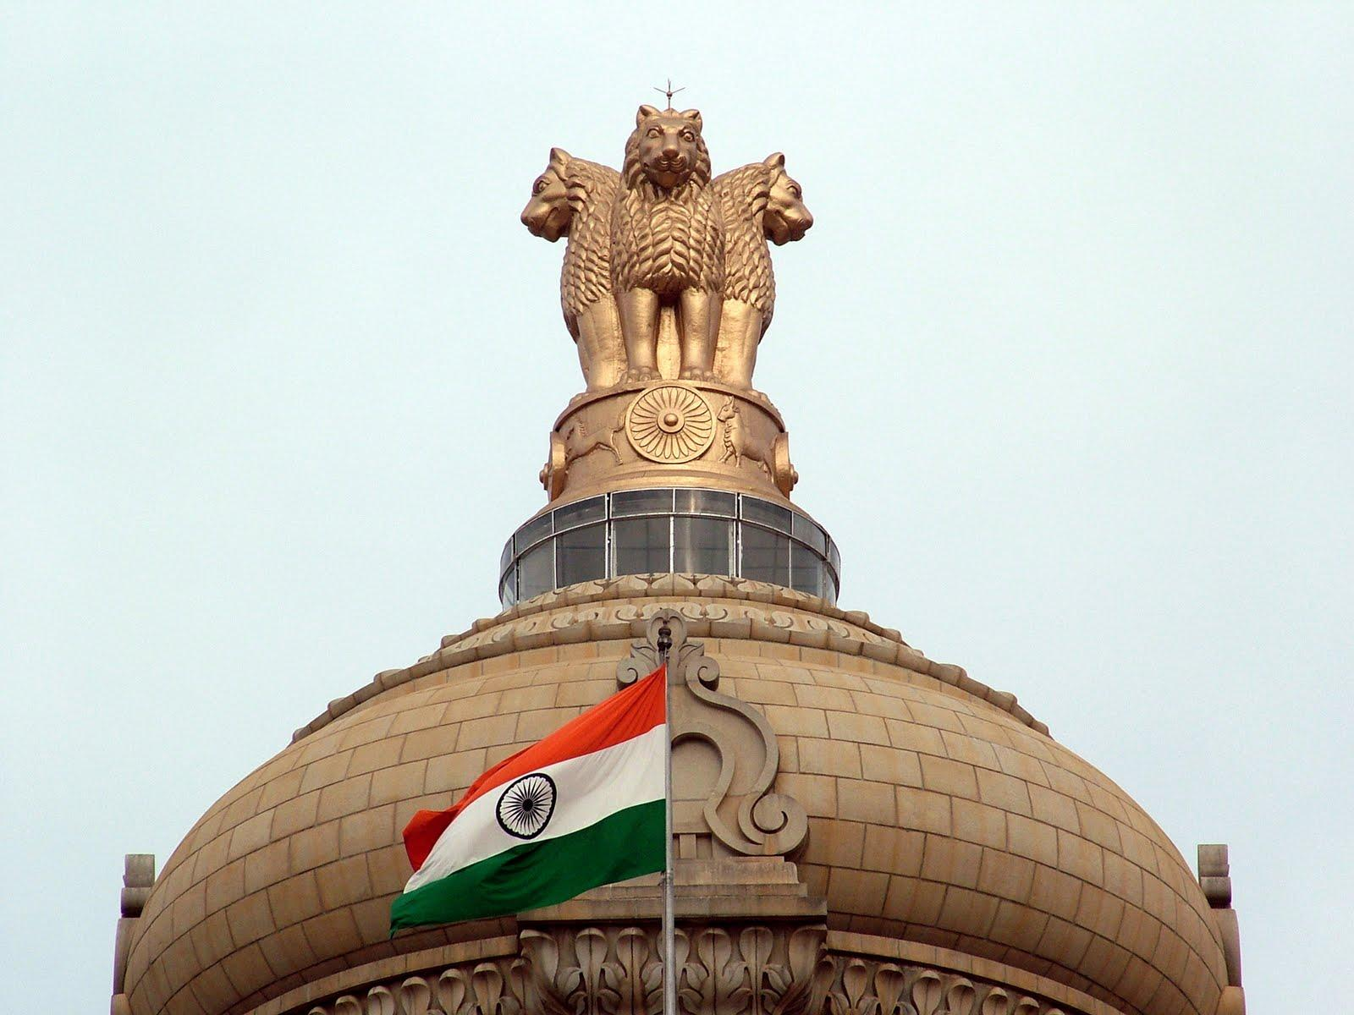
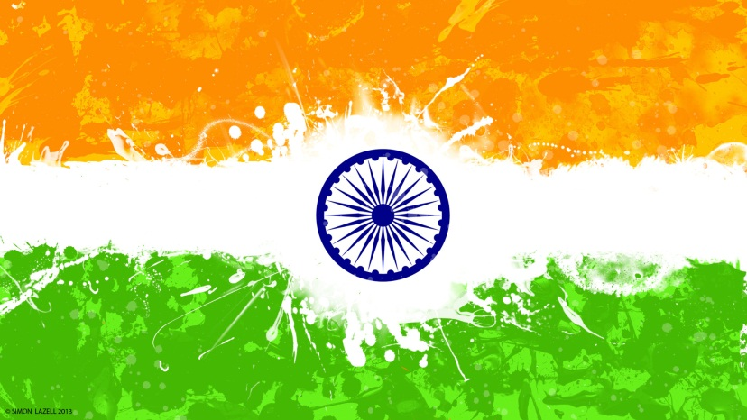
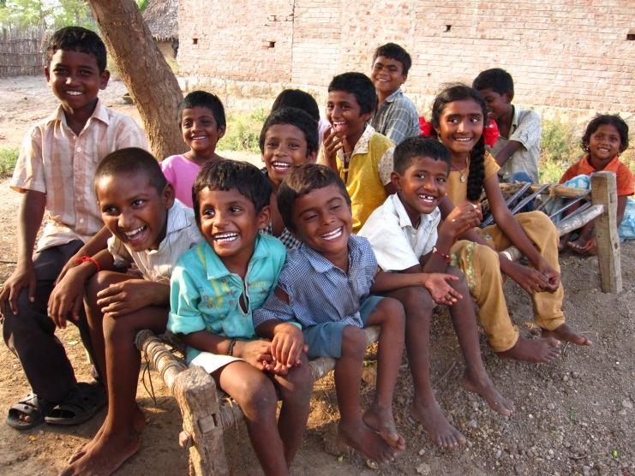
NATIONAL SECURITY
NATIONAL SECURITY
National Security: Directly linked to India’s development
Notes:
The principal function of a nation state is to protect its people, territory and institutions from external threats as well as internal dangers. ‘National security’ encapsulates this function.
▲National security is critical for a nation as it provides the necessary freedom by removing fear and hindrances to the pursuit of life, happiness and prosperity for its citizens. This provision of national security is a key component of India’s national strategy and is directly linked to India’s development.

Slide 31
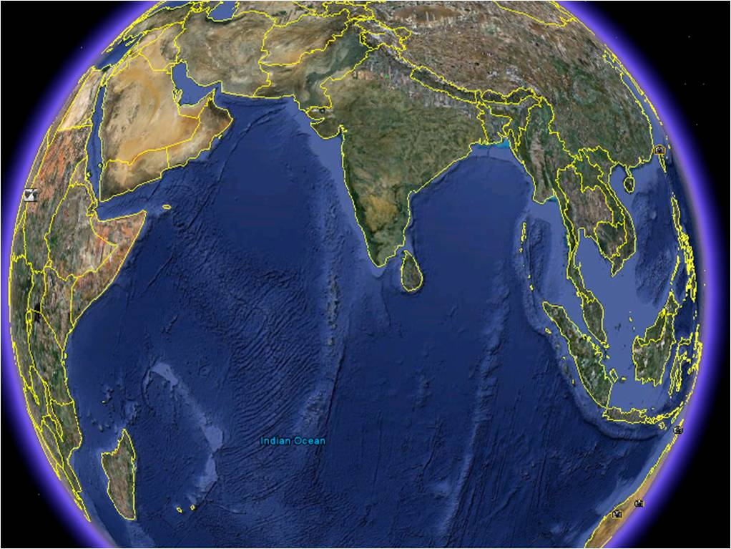
THREATS TO NATIONAL SECURITY
THREATS TO INDIA’S SECURITY
Both conventional and non-conventional threats emanating from external sources
Climate change, pandemics and natural disasters
Internal challenges: economic disparity, illiteracy, communalism, population pressure and organised crime
Notes:
While a nation’s geography can place it in an advantageous position, as is the case with India, it could also pose challenges. India’s long-drawn-out borders, coastlines, island territories and Exclusive Economic Zone, do remain subject to
▲both conventional and non-conventional threats emanating from external sources. There are also emerging issues such as
▲climate change, pandemics, natural disasters, and governance of global commons which are dynamic and morphing at an increasing pace. Added to these are multiple
▲internal challenges such as economic disparity, illiteracy, extremism, communalism, population pressure, and organised crime.

Slide 32
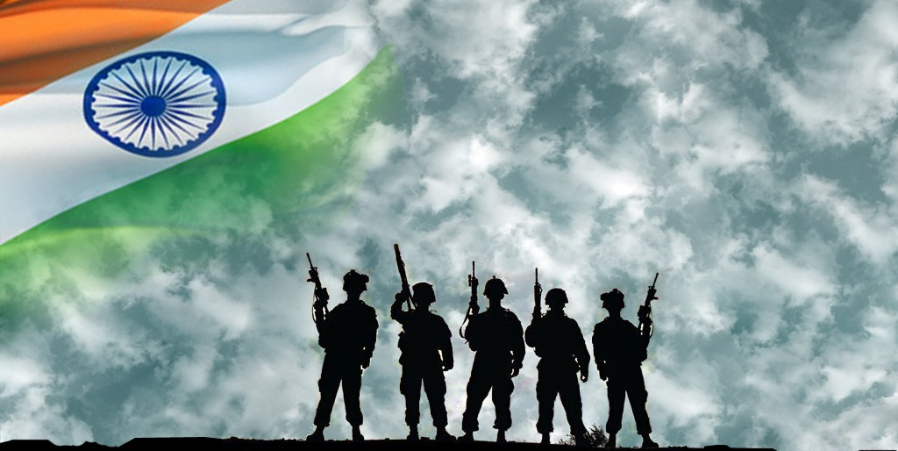
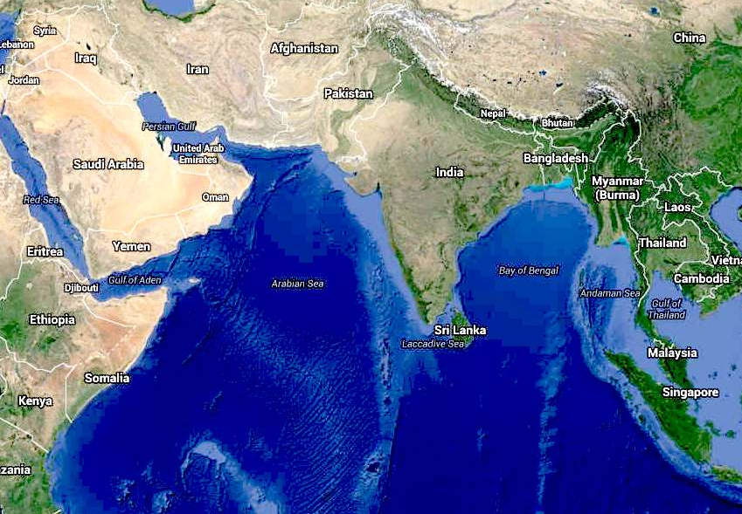
ENSURING NATIONAL SECURITY
ENSURING NATIONAL SECURITY
Peaceful and stable internal environment
Peaceful, stable and friendly neighbourhood
Whole of Government approach
Notes:
There is no doubt that India’s security would be best served by a
▲peaceful and stable internal environment together with a
▲peaceful, stable and friendly neighbourhood that is oriented towards mutually beneficial growth and development. Addressing national security therefore requires a
▲‘whole of government’ approach involving multiple arms and institutions of the government.

Slide 33
KEY POSTULATES
ENSURING NATIONAL SECURITY
Multipolar World Order
Expanded UNSC
Comprehensive Global Ban on Terror
Nuclear Doctrine : No First Use & Unilateral Moratorium
Notes:
There is no doubt that India’s security would be best served by a
▲peaceful and stable internal environment together with a
▲peaceful, stable and friendly neighbourhood that is oriented towards mutually beneficial growth and development. Addressing national security therefore requires a
▲‘whole of government’ approach involving multiple arms and institutions of the government.

Slide 34
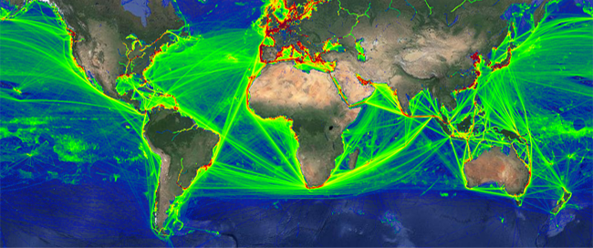
GLOBAL ENVIRONMENT SCAN
GLOBAL ENVIRONMENT SCAN
Globalisation
Increased economic exchange amongst nations
Information revolution: empowerment of individuals
Emergence of Sub-State and Non-State Actors
Notes:
Firstly, the phenomenon of globalisation has led to increased economic exchange amongst nations. It has broken down traditional barriers by enabling exchange of ideas across the world. Globalisation, supported by the
▲information revolution, has empowered individuals. These aspects of globalisation have however also aided the
▲emergence of sub-state and non-state actors, including those who employ violence to further extremist ideological and political aims.

Slide 35
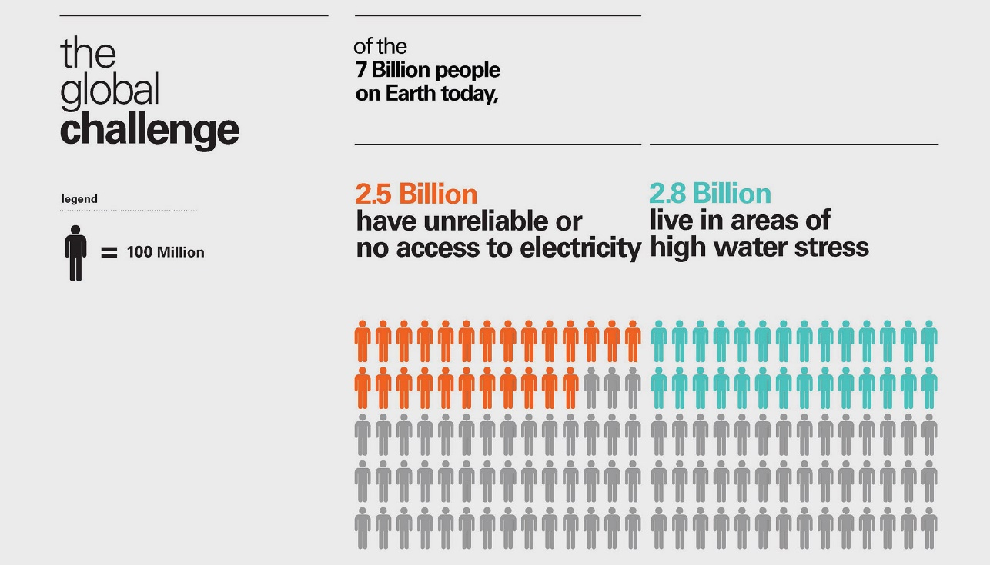
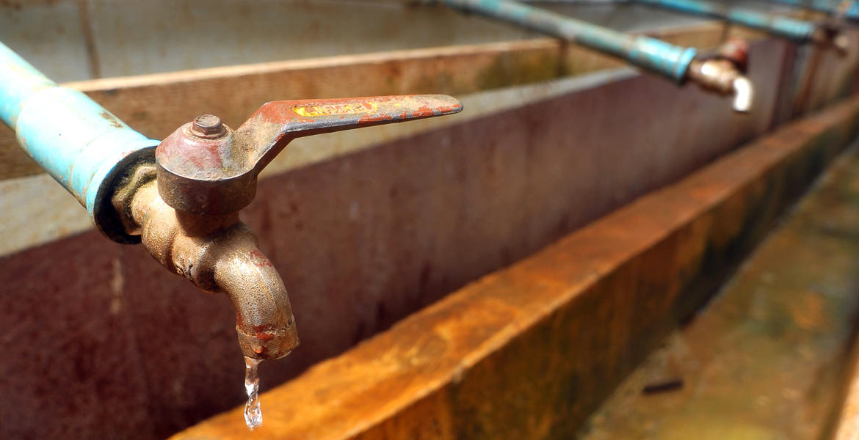
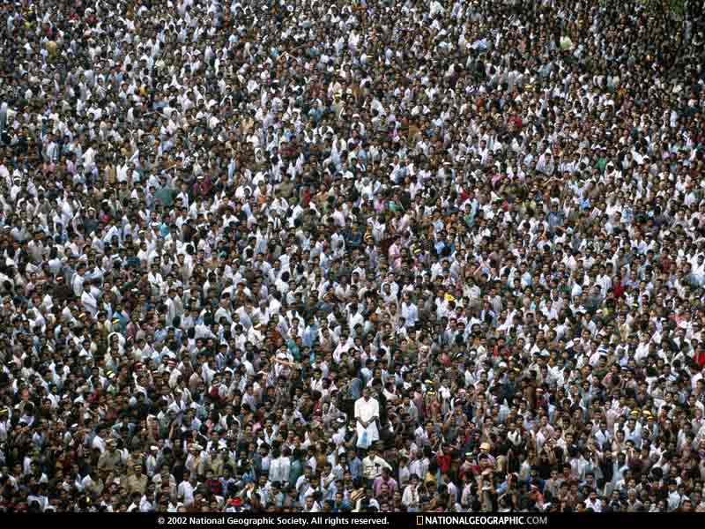
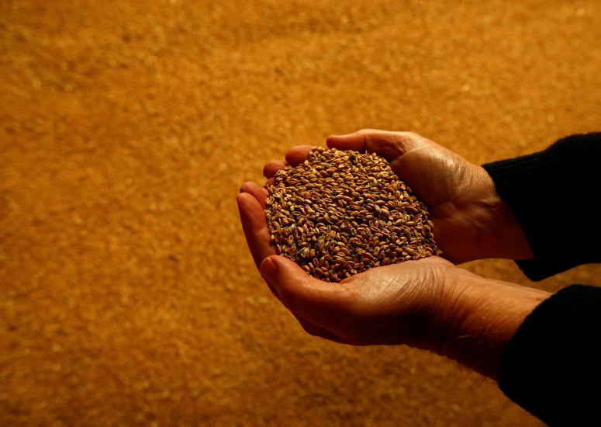
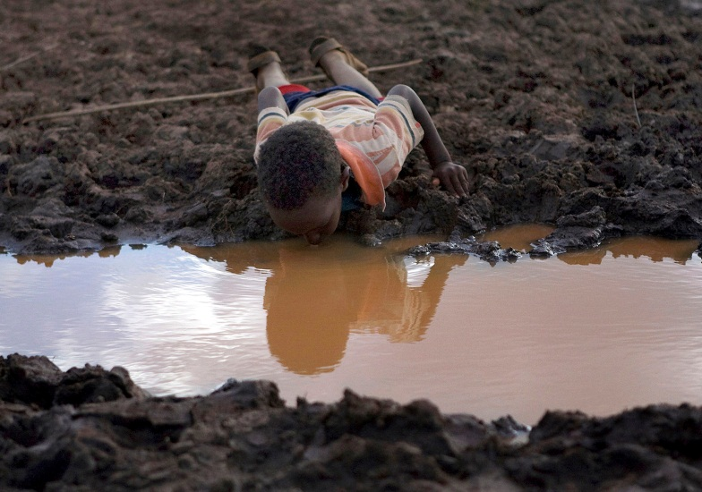
GLOBAL ENVIRONMENT SCAN
GLOBAL ENVIRONMENT SCAN
Resource Scarcity
Increasing global population: 9.2 Bn by 2050
Growing national appetites for resources – food, water & energy
Resource scarcity shaping national behaviours
Notes:
Resource scarcity is the third issue that I would like to flag. United Nations had estimated that in 2014 the world’s population was 7.2 billion.
▲Global population is estimated to grow to 9.2 billion by 2050. A significant portion of this growth will take place in developing countries, largely because of increasing life-expectancy, declining levels of child mortality and continuing high birth rates. Rising populations and surging economies are likely to fuel
▲growing national appetites for resources around the world, particularly food, water and energy. In the foreseeable future, water and food scarcity is likely to co-exist with the need to identify new sources of energy.
▲Resource scarcity is gradually shaping national behaviours and will demand careful monitoring and analysis, with renewed emphasis on cooperative and comprehensive security.

Slide 36
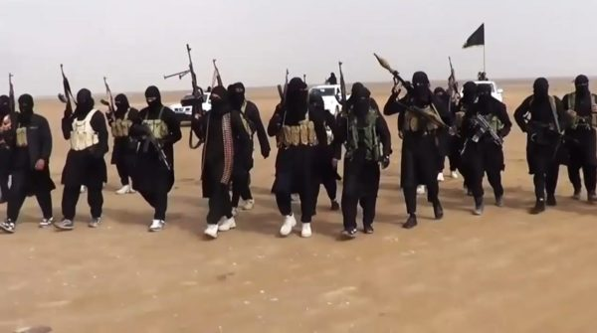
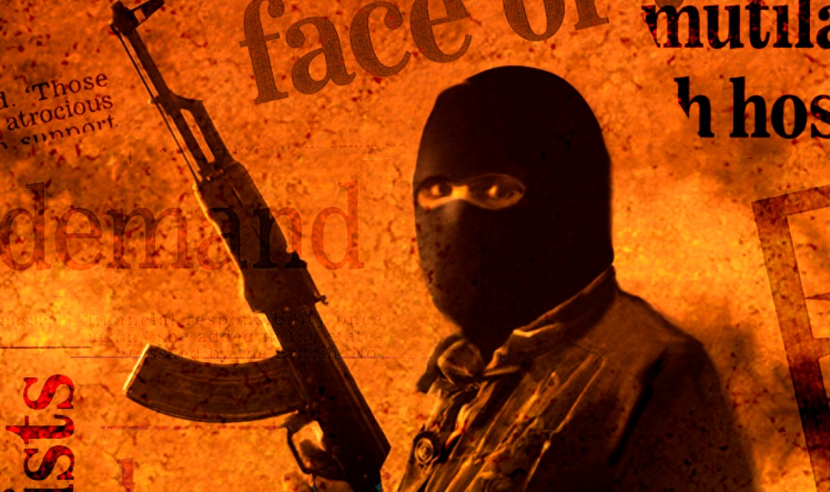
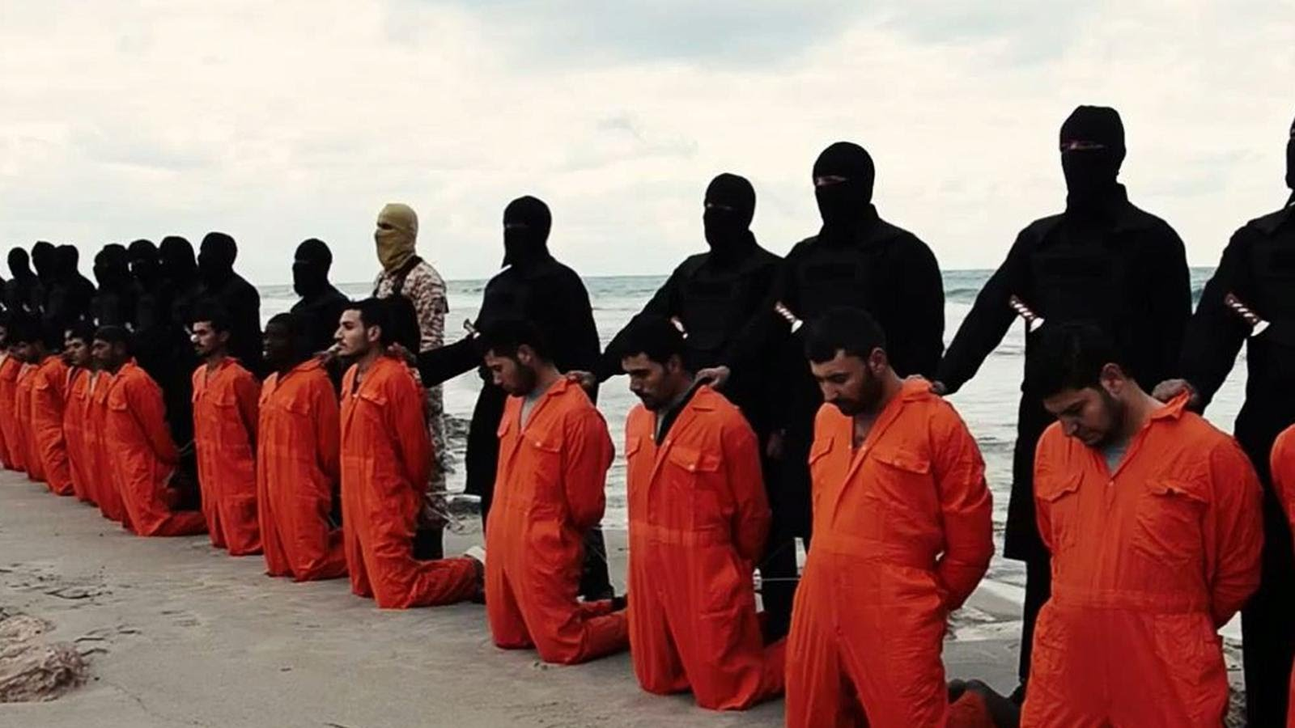
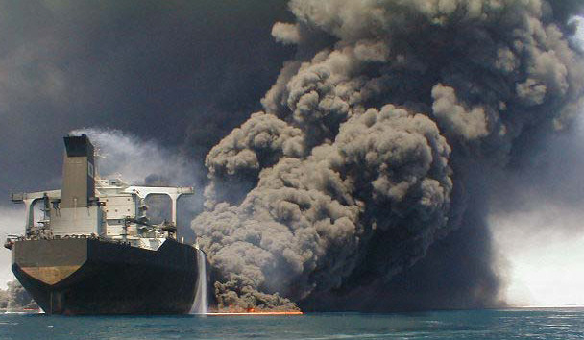
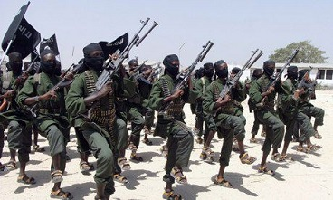
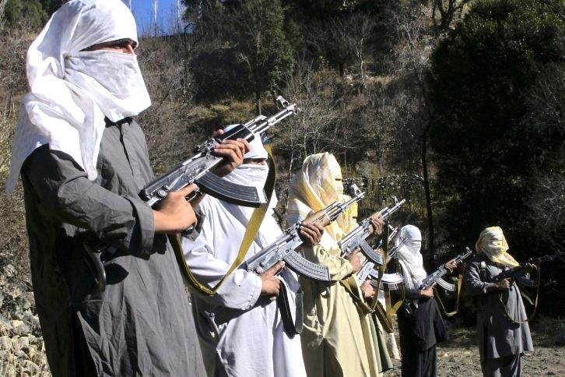
GLOBAL ENVIRONMENT SCAN
GLOBAL ENVIRONMENT SCAN
Terrorism
Epicenters of terrorism: exploiting poor socio-economic conditions and government deficits
Being employed as statecraft
Prominent feature of our modern security environment
Notes:
Simultaneously, a variety of asymmetric security challenges, due to non-state, trans-state and state-supported actors have risen since the 1980s.
▲Epicentres of terrorism have come into being. They are exploiting poor socio-economic conditions and governance deficits by invoking religious and cultural sentiments.
▲Terrorism is also being employed by some countries as statecraft. Terrorism, in its numerous dimensions, has therefore become a
▲prominent feature of our modern security environment. In the maritime domain, terrorism has also manifested in the shape of several non-traditional challenges. These range from

Slide 37
INDIAN OCEAN – GLOBAL ECONOMIC HIGHWAY
INDIAN OCEAN
GLOBAL ECONOMIC HIGHWAY
100,000 ships pass through the Indian Ocean annually
Notes:
In the Indian Ocean, which is networked by some of the busiest sea lanes in the world, globalisation has manifested in more than
▲100,000 ships traversing over its waters every year.

Slide 38
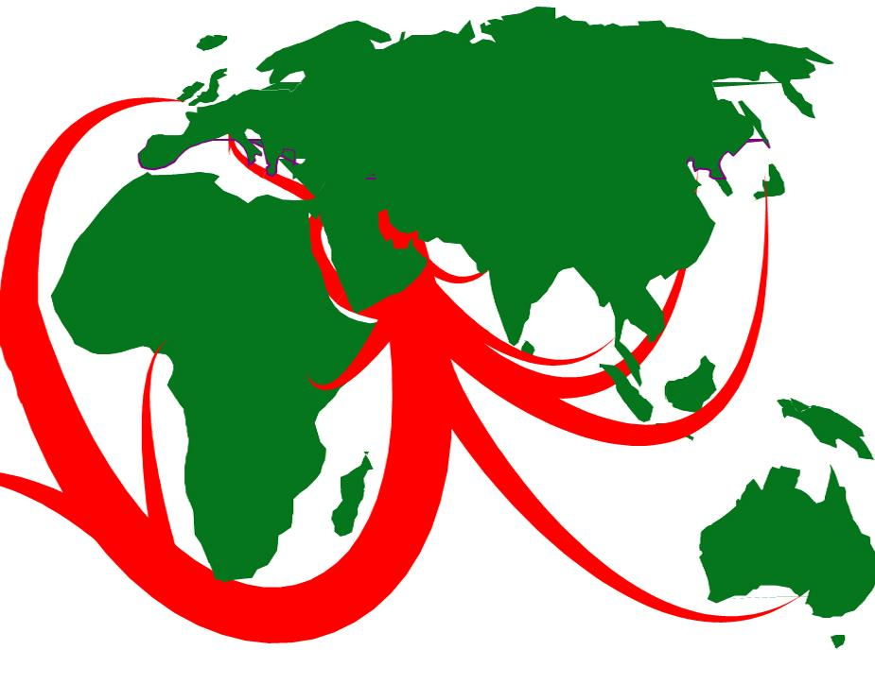
INDIAN OCEAN – GLOBAL ECONOMIC HIGHWAY
INDIAN OCEAN
GLOBAL ECONOMIC HIGHWAY
2/3rd of world’s oil
1/3rd of world’s bulk cargo
Half of world’s container shipments
Notes:
The waters of the Indian Ocean carry
▲two thirds of the world’s oil shipments,
▲one third of its bulk cargo, and
▲half the world’s container traffic. Any disruption to the flow of shipping in the Indian Ocean will therefore have profound effects on the global economy.

Slide 39
INDIAN OCEAN – NATURAL RESOURCES
NATURAL RESOURCES IN
INDIAN OCEAN REGION
50% of world’s oil reserves
1000 million tonnes of oil passes through Indian Ocean
Indian Ocean: Supply route of global energy
Notes:
The Indian Ocean has more than half of world’s oil reserves, is also the world’s largest oil producing region. 44% of the world’s offshore production come from the Indian Ocean, and we have
▲One thousand million tonnes of oil which transits through the Indian Ocean. This region is also highly rich in Gas resources, and is home to nearly 48% of world’s Gas reserves. As the
▲Indian Ocean represents the supply side of energy, any challenge to the free flow of energy in the region can lead to major conflict, with profound effects on regional and global economies.

Slide 40
NON TRADITIONAL SECURITY CHALLENGES
Cyber Security
Narcotics/Arms/ Human trafficking / Piracy
Counterfeit Currency
Environmental degradation & natural disasters
Water Security

Slide 41
INDIA’S MARITIME INTERESTS
INDIA’S MARITIME INTERESTS
Energy Security: Dependence on the Seas
Nearly 80% of India’s Crude Oil imported over seas
11% Crude Oil requirement met from off-shore
Safety of Energy Assets : a strong maritime element and national priority
Notes:
Nearly 80% of India’s crude oil requirement is imported over the Indian Ocean, and another
▲11% is met from off-shore sourceswithin the Indian Exclusive Economic Zone. After also taking into account our petroleum exports, our ‘sea dependence’ for oil is estimated to be about 93%.
▲Safety of the various energy assets, including supply sources, production infrastructure and means of transportation, has a strong maritime component and remains India’s national priority. Maintaining unimpeded flow of energy and other commodities over the sea is therefore a prime concern.

Slide 42
NON TRADITIONAL MARITIME CHALLENGES
NON-TRADITIONAL MARITIME CHALLENGES
Maritime Terrorism
Piracy
Human Trafficking
Drug Smuggling
Gun Running
Notes:
maritime terrorism to piracy, human and drug trafficking, to proliferation of arms and ammunition. They engage our attention most of the time, even as conventional threats loom large on the horizon.

Slide 43
Strategy for Conflict
Strategy for Deterrence
Shaping favourable and positive maritime environment
INDIAN MARITIME SECURITY STRATEGY
Strategy for Maritime force and Capability development
Strategy for Coastal and Offshore Security
Notes:
The core strategy of the Indian Navy is centred on five pillars.These are
▲‘Strategy for Deterrence’, a
▲‘Strategy for Conflict’,
▲‘Strategy for Shaping a Favourable and Positive Maritime Environment’, a
▲‘Strategy for Coastal and Offshore Security’, and
▲‘Maritime force and Capability Development’.

Slide 44
SHAPING A FAVOURABLE
MARITIME ENVIRONMENT
SHAPING A FAVOURABLE AND
POSITIVE MARITIME ENVIRONMENT
Securing the seas of the region
- collective responsibility of regional navies
Notes:
With the passage of time, the responsibility of securing the seas of our region has become an increasingly collective one, with participation of all regional navies.

Slide 45
SHAPING A FAVOURABLE
MARITIME ENVIRONMENT
Promoting peace, security and stability in our
maritime neighbourhood
Strengthening good order and international legal
norms at sea
Creating a secure maritime environment conducive
for India’s economic growth
Notes:
The Indian Navy looks towards promoting peace, security and stability in our maritime neighbourhood, through open, transparent, inclusive, balanced and cooperative measures. The Indian Navy seeks to
▲strengthen good order and international legal norms at sea, to provide freedom and safety of global commons, for our own and mutually beneficial interests. Our maritime strategy remains aligned to
▲create a secure maritime environment that is conducive for India’s economic growth and pursuance of developmental activities.

Slide 46
DISCUSSIONS

Slide 47
V Adm Srikant, AVSM
REMARKS OF THE COMMANDANT
NATIONAL DEFENCE COLLEGE

Slide 48
SHALOM – JAI HIND

