Slide 1

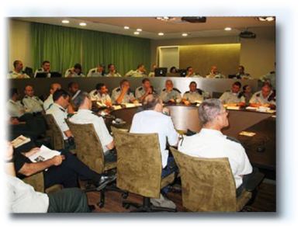
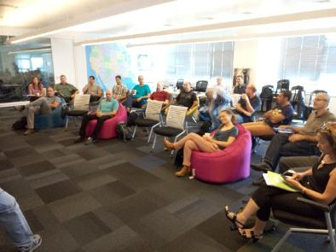
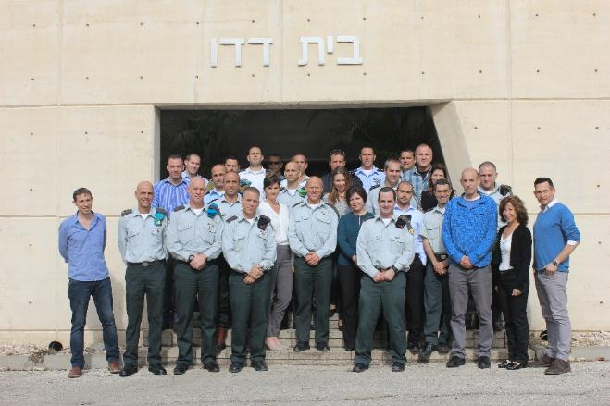

Slide 2
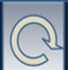
Dado Center Mission: To be the IDF expert for Strategic & Operational level learning and knowledge development processes, to develop the field, to assimilate it in the IDF, and to assist IDF bodies in its implementation.
War games
(Strategic and military)
“Laboratory” for Knowledge
Learning Processes in Major HQs
Dado Center Journal
for Issues in Operational Art
School for
Senior Leaders
Think Tank
Developing new ideas & knowledge
Identifying organizational blind spots
Research to support processes
Design Theory
Theoretical foundation for systems analysis and operational art
(for force design and employment)

Slide 3
Purpose and Role
Dado Center Mission: To be the IDF expert for Strategic & Operational level learning and knowledge development processes, to develop the field, to assimilate it in the IDF, and to assist IDF bodies in its implementation.
Roles:
To be the subject matter and process expert on General Staff - Headquarters systems thinking processes.
To research characteristics of conflicts and the region as a basis for creating concepts and identifying new challenges, and for supporting major processes.
To support systemic knowledge development processes regarding overall concepts for operational theaters at the GS-HQ level and the major commands.
To research tools and processes for knowledge development and systems learning.
To guide and instill thinking processes in workshops and other learning events.
To develop professional connections in these subjects with the GS-HQ, partner militaries, and relevant bodies in major commands.
In war – To assimilate into GS-HQ planning processes.

Slide 4
Main Efforts
Develop Systems Thinking Theory and Methodologies, Learning Process
(Develop Design concept, research on methodologies of thinking, research on learning processes)
1
Core Learning Processes with Major Command HQs
(“IDF Strategy”, Southern, Central, Northern, Cyber, Ground Forces, GS war games)
2
Research Center
(Support learning processes, develop operational-strategic concepts)
3
The Dado Center Journal for Operational Art
(Platform to advance IDF conceptual-systemic writing)
4
Senior-level Design Courses
(Colonel/GS courses, Design in National Defense College)
5
Learning Processes with Allied Militaries
(US J7, UK)
6

Slide 5
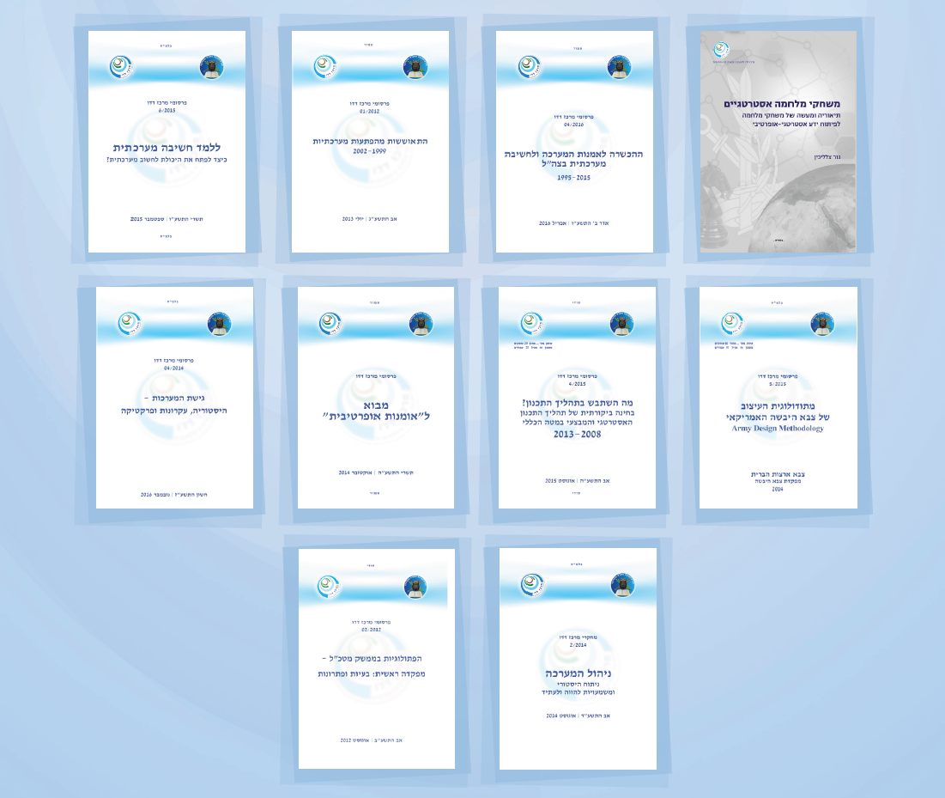
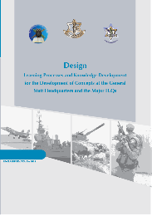
Develop Systems Thinking Theory and Methodologies, Learning Process
Educating for Operational Art and Systemic Thought in the IDF, 1995-2015
Strategic
War Game Methodologies
Teaching Operational thinking
Recovery from Operational Surprises
Methodologies
of Thinking
Introduction to Operational Art
US Army Design Methodology
The Systems Approach
What went wrong with the Planning Process?
Supreme Headquarter: issues and solutions
Campaign
Management

Slide 6
Develop Systems Thinking Theory and Methodologies, Learning Process
History of IDF Learning Processes
Summary of Learning Process –”Sinai Gates”
Knowledge development process in northern command
2000-2006
Strategic and operational knowledge process in context of Gaza strip and Southern Command
Knowledge Development Process in Central Command
What Can We Learn from the Development Process of the IDF Strategy 2006
Knowledge Dev. Process for Northern Theater 2000-2006
Organizational Learning in Hamas (2005-2015) and Hezbollah (2000-2015)
Development of the Use of Subterranean Domain and Adaptation by the IDF
IDF Strategy 2015- The Knowledge Development Process

Slide 7
Research Projects - 2019
Author | Title
Shmuel Shmuel | Methodologies for Military Net Assessment
Dvir Peleg | Defense-Strike Complex
Anna Elron | Strategic Signaling
Meir Finkel | “Oketz Plada” exercises as “Asufa” learning process
Yaniv Friedman | Red Star – GS Force Employment in Light of Soviet Presence 1969-1970
Yaniv Friedman Lazar Berman | “The Borrowed Sword”: Proxy Warfare in the Middle East
Shmuel Shmuel | Light Infantry-Fire Division – IDF Multi-Domain Defense-Strike Complex
Dvir Peleg | Infantry-Fire Division (99)
Udi Golan | Unintended Escalation as a Cause of War in the ME
Lazar Berman | Operations in the Shadow of a Ceasefire
Meir Finkel | Mole Cricket 19 – The IAF against Syrian SAMs in 1982

Slide 8
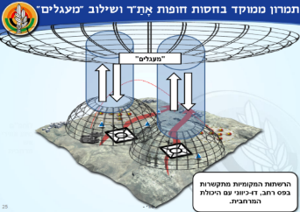
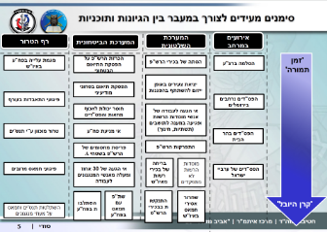
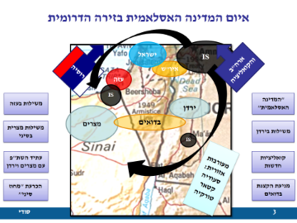
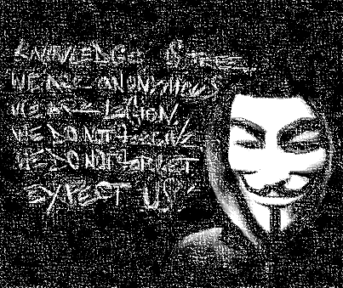
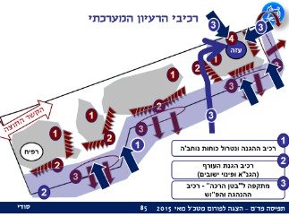
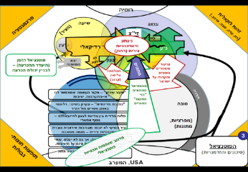
Core Learning Processes with Major Command HQs
2
CentralCOM
SOUTHCOM
Sinai
“Land Ahead”
Cyber
SOUTHCOM
Gaza
GS
War Games
(~5 per year in 2015 and 2016)
NORTHCOM
“Arrow of Knowledge”
Operating Concept for Victory Workshop -
Military Transformation

Slide 9
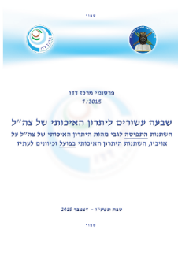
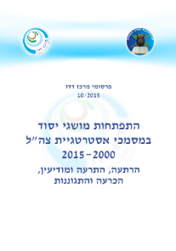
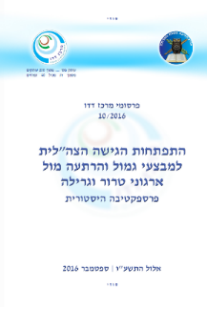
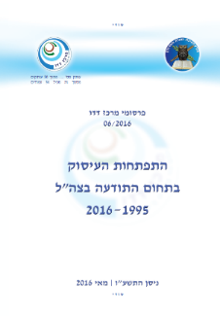
Research Center
3
Development of Military Language 1970s-present
Coming Soon:
Coercion
Dev. of Basic Concepts in IDF Strategic Documents 2000-2015
Strategic, operational concepts and terms
Proxy Warfare in the Region
Coming Soon:
Dev. Of Border Defense Concept
(Research supporting learning processes)
Dev. of the IDF Approach to Retaliation and Deterrence Operations against Terror and Guerrilla Organizations
Dev. Of IDF Involvement with Cognitive/ Consciousness 1995-2016
Coming Soon:
Research Series on Russian Military Concepts
In process:
Research series on cyber

Slide 10
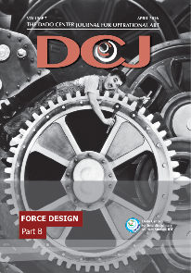
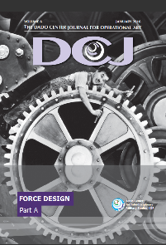
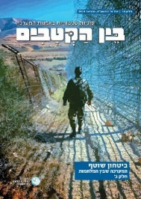
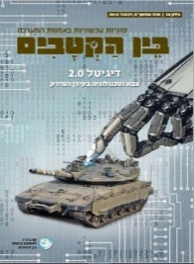
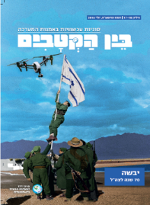
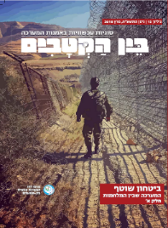
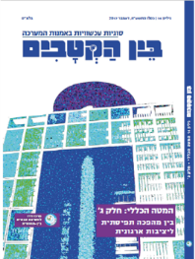
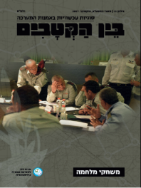
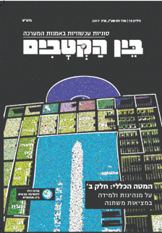

The Dado Center Journal for Operational Art
4
8
7
6
5
4
3
2
1
19
18
16-17
15
14
13
11-12
10
9
13
9
Coming Soon:
22-23
20-21
Superiority
Land Warfare
part B
Manpower
Military Diplomacy

Slide 11
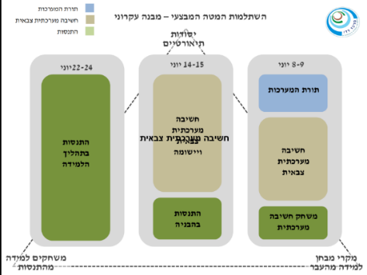
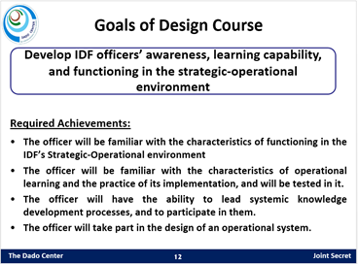
Senior-level Design Courses
5
Colonel/GS Courses
Strategic Studies in Design Theory

Slide 12
Goals of Design Course
Develop IDF officers’ awareness, learning capability, and functioning in the strategic-operational environment
Required Achievements:
The officer will be familiar with the characteristics of functioning in the IDF’s Strategic-Operational environment
The officer will be familiar with the characteristics of operational learning and the practice of its implementation, and will be tested in it.
The officer will have the ability to lead systemic knowledge development processes, and to participate in them.
The officer will take part in the design of an operational system.

Slide 13

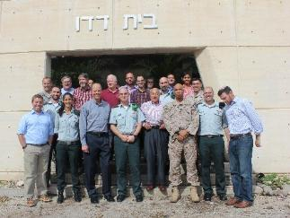
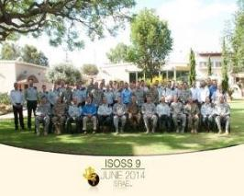

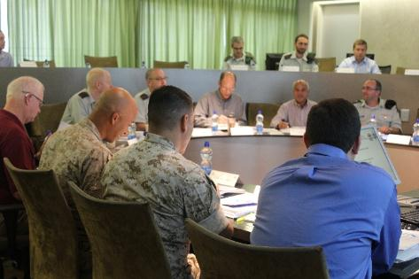
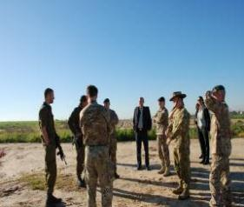
Learning Processes with Allied Militaries
6
Under examination: Joint training of senior officers
Dado website and translation of DCJ
J7 2017: Joint workshop on legitimacy
J7 2016: Joint workshop on military innovation
AWG 2017 :
CDM, Russia, Urban

Slide 14
Annual Joint Seminars – Dado Center/J7
The annual seminars focus on joint development of conceptual understandings around contemporary warfare challenges, combined arms warfare, and coalitions.
Past workshops
  2018 – War Game
  2017: The Battle for Legitimacy
  2016: Innovation for Contemporary Conflicts
  2015: Coping long-term with violent non-state actors (VNSAs)
  2014: Coping with rockets in the hands of VNSAs
  2012: Deterring non-state adversaries and recovering from operational surprise
  2010: Coping with hybrid adversaries + taking and maintaining the initiative
  2009: Characteristics of the response to hybrid threats
  2008: The nature of the threat- hybrid warfare
  2007: Coping with non-conventional adversaries
JFCOM

Slide 15
Question

