Slide 1
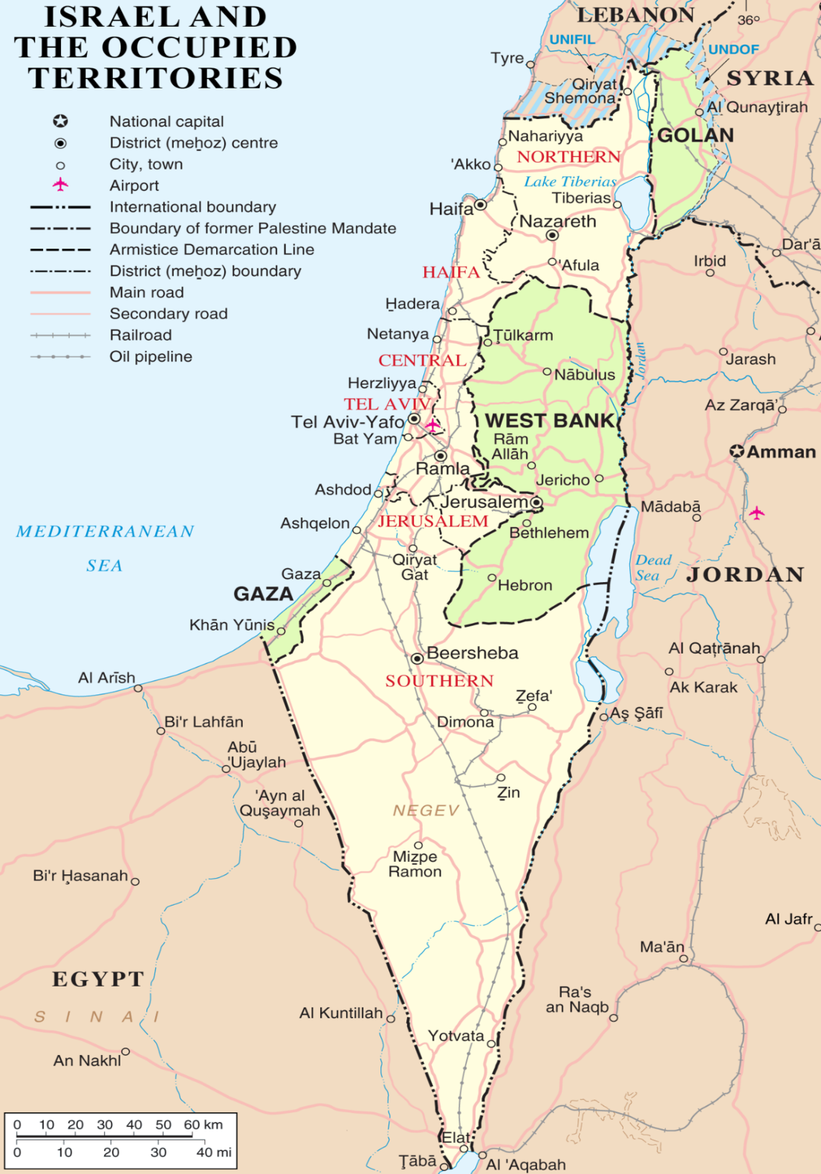
Task Force Jerusalem /
Op PROTEUS
November 2020
This briefing is classified
UNCLASSIFIED
Underhill.NJ

Slide 2
Op PROTEUS Background
Since 2005, Canada has been part of the USSC Mission in the Middle East. Task Force Jerusalem - Op PROTEUS was created to support the USSC in implementing US Government policy with respect to the coordination of security matters between Israel and the PA. Op PROTEUS has achieved significant success in its 2 main priorities: furthering Canada-US bilateral defence relations & improvement in the Palestinian Authority Security Forces.

Slide 3
Op PROTEUS Mission
TFJ will promote PA Security Sector Reform by providing advice and assistance at the operational and strategic levels in order to enhance transparency, ownership, accountability and legitimacy. By enhancing reform efforts, TFJ will empower the Ministry of Interior (MOI) in order to better contribute to the development of a self-sustaining PSS, facilitate coordination between PASF and ISR Security Services and further CAN/US Bilateral Defence Relations.
Notes:
For Canadian Audience (From Comd TFJ R20 Msn Stmt – D&G)

Slide 4
Op PROTEUS Objectives
To support Canadian strategic objectives within the region, the following operational effects are to be achieved:
Establish broad professional respect and understanding for the USSC command and control (C2) construct;
Provide RNSE functions within TFJ in support of TFH;
Enable the USSC, while demonstrating Canadian technical competency, personnel proficiency, and tactical acumen throughout the deployment;
Maintain and promote Canada's role in the region as a strong and impartial supporter of the MEPP; and
Ensure the execution of those duties and responsibilities that have been provided to you and your staff from the USSC chain of command.
Notes:
For Canadian Audience (From Comd TFJ R20 Msn Stmt – D&G)

Slide 5
Op PROTEUS Engagements/Relationships
JTF-I
JTF-I
CTAT-J
CTAT-L
Op Calumet
ROC
Op JADE
Embassy to Israel
Op PROTEUS
US 21
Embassy to Jordan
USSC
CJOC

Slide 6
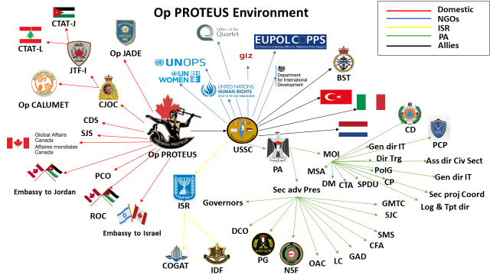
Key Stakeholders

Slide 7
TFJ Op PROTEUS R21 Org Chart
Annex A
14 Sep 20
Comd TFJ and
USSC DCoord PP&S
BGen Boucher
Cultural Advisor
DComd TFJ and
USSC Dir of Support
Staff Officer
Cultural Advisor
Sly Harb
Col Delisle
USSC Directorate Teams
Capt Gauthier-Imbeault
Sam Wazwaz
National Command and Support Element (NCSE)
Plan O / TF J5
Directorate of Sp
COS
Directorate of Ops
SJA Directorate
Ops O (TF J2/3/7)
Maj O’Connor
Maj Noel
Log PM / LC Adv / AP6
CIS PM / AP13
SSWG Action
Officer (AO)
DCO Advisor / AP4
NSF Advisor/AP8 Alt
Senior Police
Advisor (PCP)
LCol Palfrey
LCol Yu
Cdr Walker
LCol Siokalo
LCol Lussier-Nivischiuk
Supt Thompson
Log O (TF J1/4/8)
Ops / Signals NCO
Supply Chain PM
TAV – Dep CIS PM /
TF J6
Administrative
Program (AP) AO
Trg Advisor MOI
Human
Resource PM / AP2
Police Advisor (Judicial)
Lt(N) Boucher
Sgt Le Brun
Maj McCharles
Maj Champion
Maj Pinto-Canas
Maj Matiowsky
Maj Lawlor
S/Sgt Rose
MOI Advisor TMS
Sr FSA
CIS Tech
Log Services Officer
Infrastructure PM
Maj Andrews
Police Advisor (CD/CBP/PG)
Sgt Frampton
MCpl Sutherland
Maj Shea
Maj Any (vacant)
Sgt Purvis
GMTC Training Advisor
TF HRA
Transport Coord
Capt Labranche
MCpl Fortier
Gabi Zambil
Permanent:
US21 LA POC
Drivers
Tamara Qumsieh
Mathew Murad
USSC Only
Augmentation
(as required):
Ramzi Khayyo
Dual-hatted:
USSC and TFJ
TAV – TFJ
Shukri Ghanem
TFJ
Rank and Trade TBC
Fadi Saeed
Consular support
TAV – USSC
US21 Contractors
Rank and Trade TBC
Embassy TLV Liaison
Hannah Bordowicz

Slide 8
HQ section
USSC Organizational
Coordinator Personal Staff
Regional Advisor
Polad
Coordinator
Aide
Driver
Provide insight on PA Leadership
Advise Coordinator on all aspects of Palestinian society & governance
Provide oversight of USSC language translation capability
Part of Coord Cmd Group
Advise Coord on all aspects of USG policy
Interlocutor for USSC w/ DOS
Provide insight on GOI/IDF activities
GOI/IDF Senior Leadership
PA Leadership
Intl Heads of Mission/Representatives
SSWG Senior-Level Representative
Senior USG Engagements
Translator
GOI LNO
XO
Maintain close relationships w/ GOI, including IDF, COGAT, MOFA
Lead for coord w/ US-only activities
Lead for US VIP visits
SJA
Plans
COS
HQ Section Head (admin spt)
QA/QC Staff Products
Assists Aide w/ estab appt
Lead for Life Support from EMB
Lead for USSC IM/KM
Admin support
Coordinator’s Action Group
Campaign Assessment
Engagements → Campaign Objectives
Lead for International coordination
Chair of Engagement/Assess WG
IDF J5 / J3 linkage to PSS
Supervise Staff processes
Lead for DOS support from NEA
Provide guidance to GOI LNO & XO
Dual-hatted as SSWG Core-level Rep
Oversight of USSC Advice to APs
Chair of SSWG WG (USSC WG)
US EMB
Advise Coordinator on legal issues
Dual-hatted as Security Justice Advisory Director
Office Manager
DOS Admin Support
DFiD
BST
International Coord
Engagements
Engagements/Public Affairs (USA)
Assessment Planner
Strat Plans
SSWG AO
X2 AP Planner
Program Manager Spt
ROC
Political support
Aide
Aide
BST
DC-O&R
DC-PP&S
NLD
Dual-Hatted as CDR, BST
Lead Coord for Reform on: Human Resources; PSS budgetary sys (CFA); Accountability; Complaints; Gender; Joint Ops; Trg
Lead Coord for NSF, DCO, PG, GMTC, & OAC
Provide guidance to Dir Ops; coordinate w/ national training efforts
Chair Plans WG
Dual-hatted as CDR, TF-Jerusalem
Lead Coordinator for Sustainment of PSS Logistics, Infrastructure, Supply, & CIS
Lead Coordinator on Rule of Law
SSWG Technical-level Representative
Governors, Area Commanders, & IDF
Lead Coord for SFJC, LC, CBP, PCP, CD, & GAD
Provide guidance to COS, Dir SJAD, and Dir Support
Chair SRB/PRB
ITA
TUR
EUPOL COPPS
Natl efforts to train Services
OQ
UN
Ops
Dir Operations
Dir SJAD
Dir Support
Efforts by IGO
Training reform where MOI implements TMS → GMTC provides oversight & management → Training Centers execute w/ Services
Advise NSF, DCO, GMTC, & OAC
USSC lead (or rep) in facilitating PSS-wide incorporation of APs 2, 3, 4, 7, 8, & 9
Institutional Reform initiatives ISO AC-R (incl PSS budgetary processes via CFA)
Chair of Operations and Reform WG (USSC WG)
Dual-hatted as SJA (legal advice to Coord)
Security-Justice Sector synergy
Advice for Rule of Law processes MOI / MOJ
Advise SFJC, CBP, PCP, CD, PG, & Judicial Police
USSC lead (or rep as appropriate) in facilitating PSS-wide incorporation of APs 1 & 10
Project/Program Oversight (incl DIRLAUTH for MOF & COGAT)
Assist the PA in the development of a national-level, joint sustainment enterprise that enables Police Primacy in the PSS
Revise MOI sys to centralize oversight & management → Commissions → Services for sustainment of Logistics,
Infrastructure, Supply, Infrastructure (and environment)& CIS
USSC lead (or rep as appropriate) in facilitating PSS-wide incorporation of APs 6 & 13
Advise MOI, LC, GAD, and Services’ sustainment/logistics/ infrastructure maintenance/CIS elements
Interface with other Ministries responsible for sustainment activity affecting PASF organizations
Chair of Sustainment WG (USSC WG)
Legend:
OPCON
TACON
Coordinating
Resource Manager
X3 Trg Advisor (MOI TMS + APs 4, 7, 9)
X3 Service Advisors (NSF, DCO, GMTC)
X2 Civilian BST SME (APs 3, 8)
X3 NLD AOs
X2 TUR AOs
ITA AO to support (MIADIT)
Human Resources SME (AP 2)
Deputy SJA (AP 1)
Program Manager
Judicial Police Advisor (RCMP) (AP 10)
X2 RCMP Police Advisor (PCP, CD, CBP)
Security Sector / Justice Sector Synergy Planner
X2 Logisticians (AP 6)
X4 Logisticians
2X CIS SME (AP 13)

