Slide 1
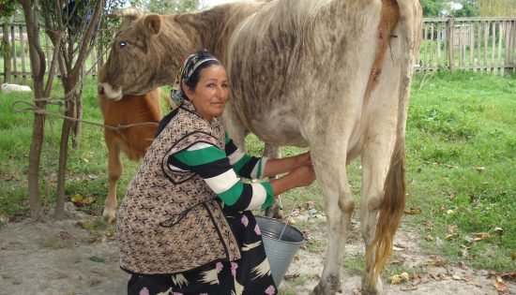
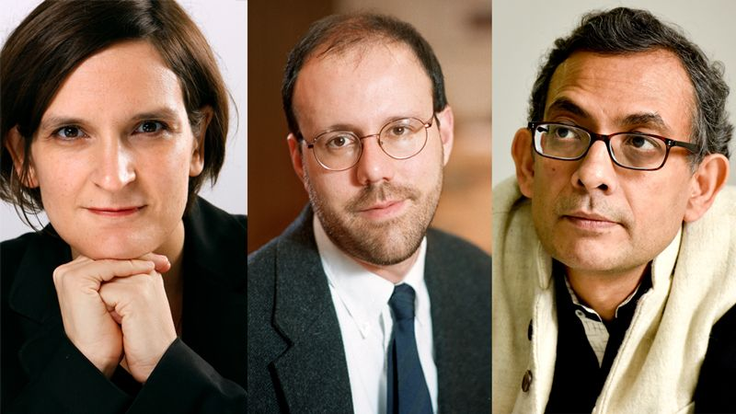
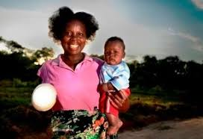
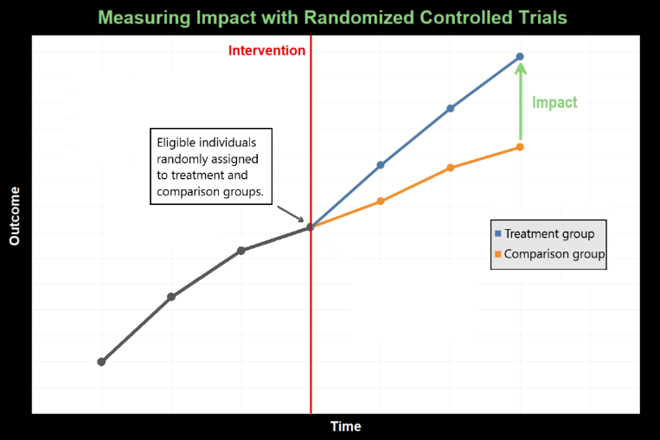
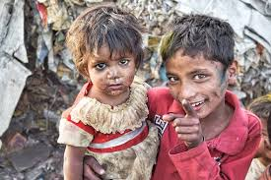
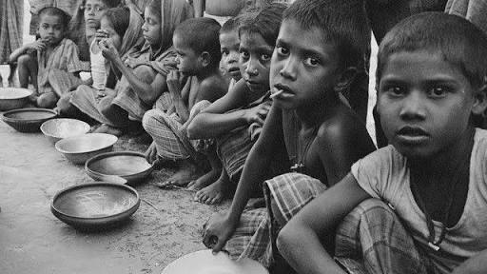
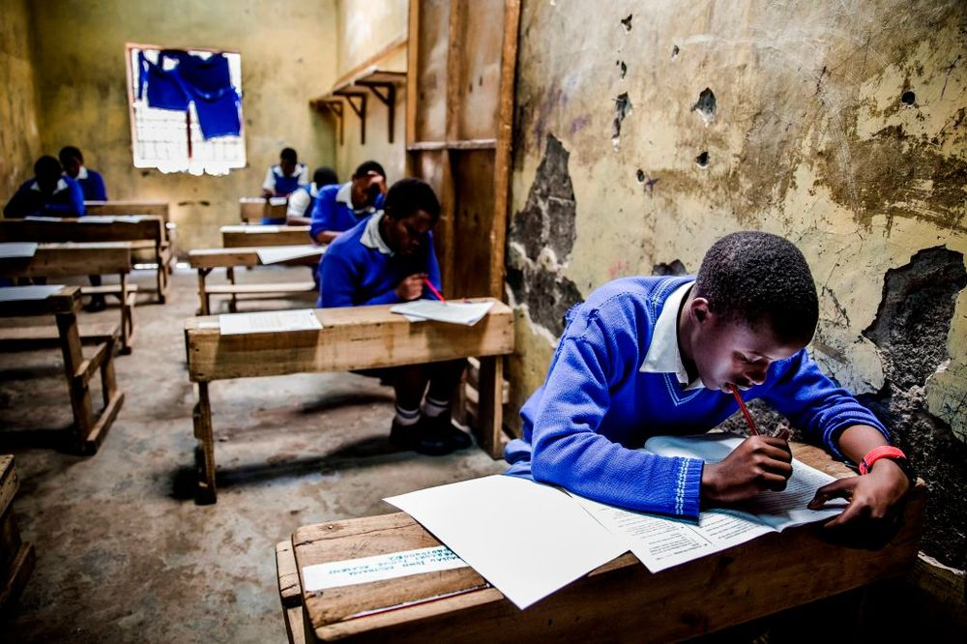
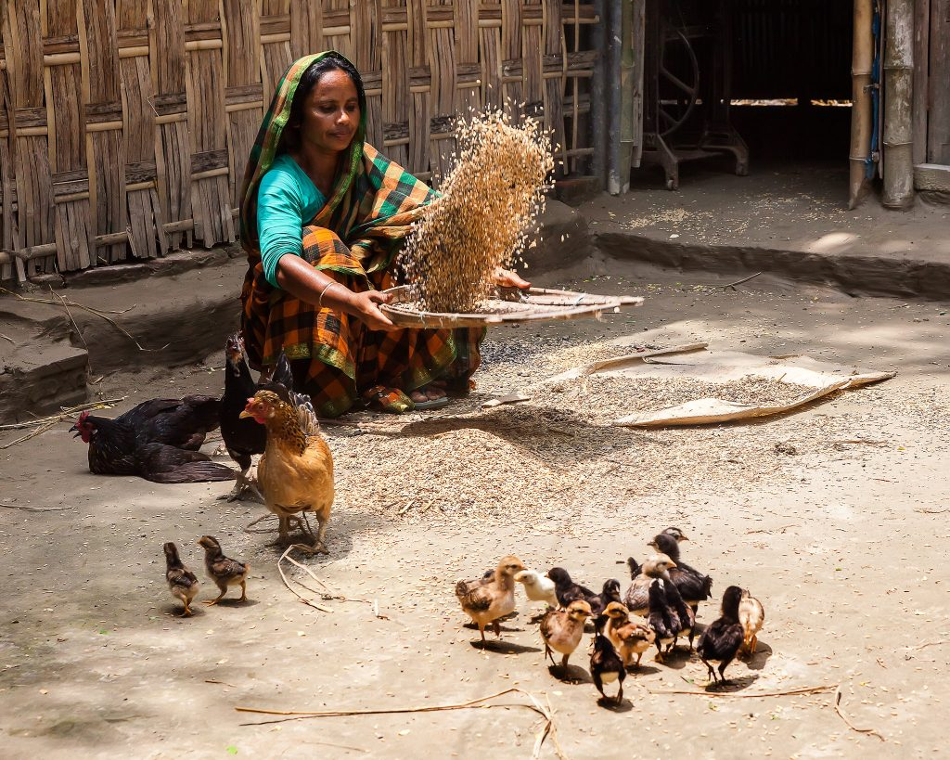

Eradicating World Poverty: Hope, Disappointment, Success
Omer Moav

Slide 2
Hope
The idea that people and countries are trapped by poverty has led to hope that with wise, generous aid, poverty can be eradicated
But what is a poverty trap?

Slide 3
Hope
Based on the view that credit constraints prevent the poor from accessing profitable investment opportunities, thousands of microcredit NGOs have been established to offer the poor billions of dollars in loans at affordable interest rates, aiming for a significant reduction in poverty
The UN declared 2005 the Year of Microcredit and the 2006 Nobel Peace Prize was awarded to Muhammad Yunus and the Grameen Bank for their contribution to the reduction in world poverty

Slide 4
Hope
Based on the view that credit constraints prevent the poor from accessing profitable investment opportunities, thousands of microcredit NGOs have been established to offer the poor billions of dollars in loans at affordable interest rates, aiming for a significant reduction in poverty
The UN declared 2005 the Year of Microcredit and the 2006 Nobel Peace Prize was awarded to Muhammad Yunus and the Grameen Bank for their contribution to the reduction in world poverty

Slide 5
Disappointment
Microcredit failed to deliver significant levels of productive investment: the poor tend to turn down the opportunity to borrow at a reasonably low interest rate and avoid investing in high return projects
Banerjee et al. (2015) find low take up of microcredit, no increase in number of business owners, the average business remained small and not very profitable. Similar findings in Banerjee et al., 2013; Crépon et al., 2015, and Angelucci et al., 2015. Tarozzi et al. (2015) find higher take up in Ethiopia, but no significant impact on business creation.
Microcredit availability encouraged borrowing for consumption, increasing debt and poverty (not addressed here)

Slide 6
Disappointment
Aid to poor countries hasn’t led to economic growth
(Aid broadened governments and enhanced corruption)

Slide 7
Success
Poor countries are showing growth and poverty rates are decreasing
Probably unrelated to aid programs…

Slide 8
https://www.gapminder.org/tools/#$state$time$value=2001;;&chart-type=mountain

Slide 9
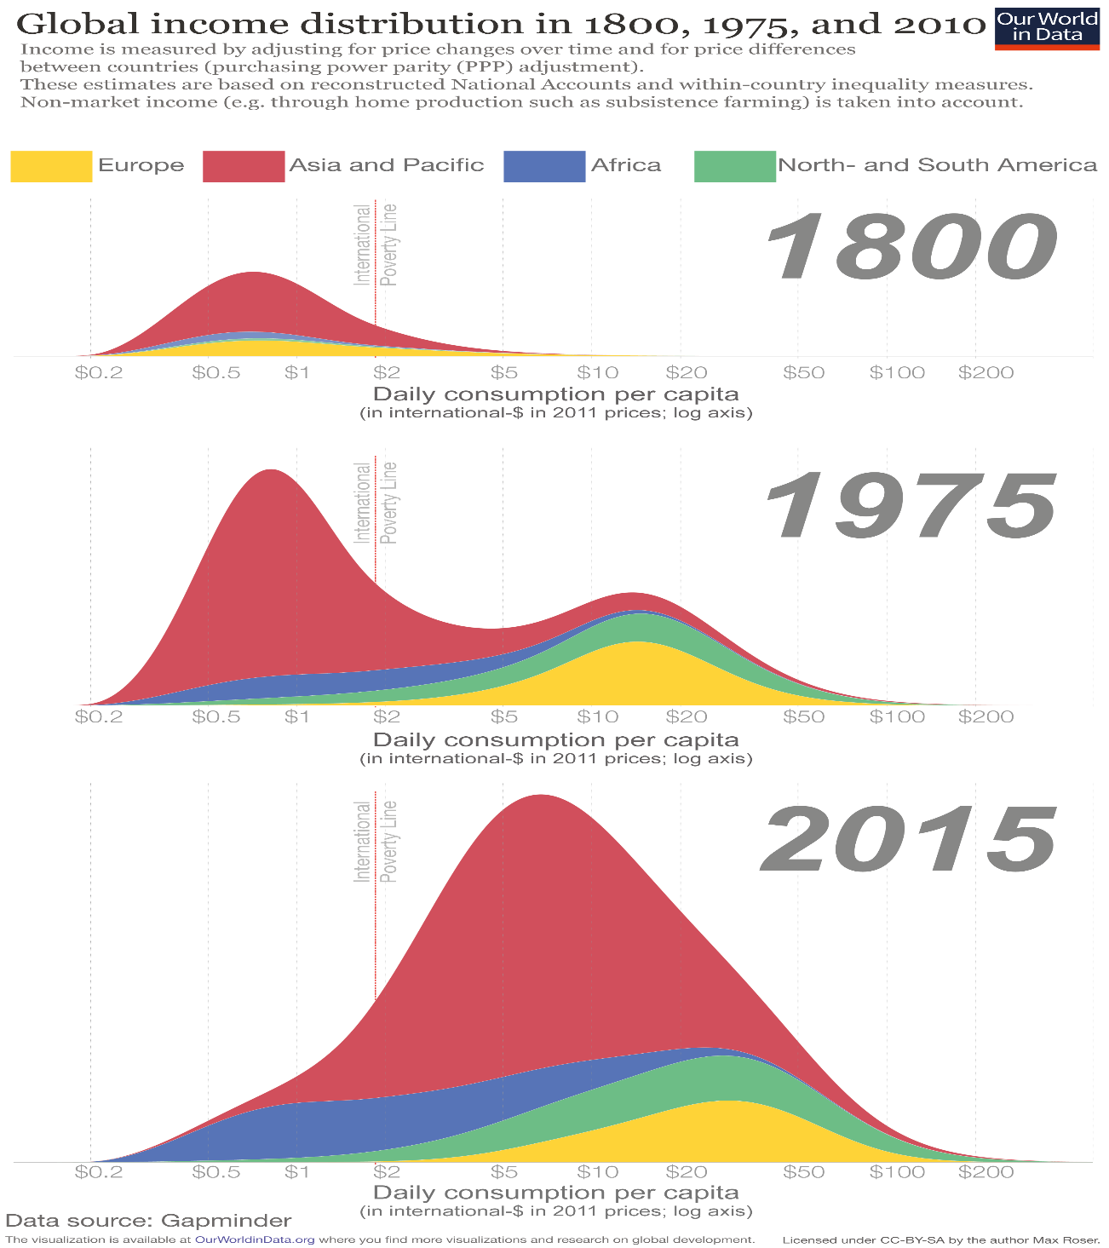

Slide 10
Theory of poverty traps
Child’s income as an adult
Investment in Children’s Education
Children’s Education
Parents’ Income

Slide 11

Theory of poverty traps
Child’s income as an adult
Investment in Children’s Education
Children’s Education
Parents’ Income
Child’s income as an adult
$$$$
Parents’ Income

Slide 12

Theory of poverty traps
Child’s income as an adult
Investment in Children’s Education
Children’s Education
Parents’ Income
Simple assumptions on behavior and technology do not lead to poverty traps
Child’s income as an adult
45⁰
$$$$
Parents’ Income

Slide 13









45⁰
$$y_{t+1}$$
$$$$
$$y_{3}$$
$$y_{2}$$
$$y_{1}$$
$$y_{2}$$
$$y_{3}$$
$$y_{t}$$
$$\overline{y}$$

Slide 14





Theory of poverty traps
?
45⁰
$$y_{t+1}$$
$$$$
$$\overline{y}L$$
$$\overline{y}H$$
$$y_{t}$$

Slide 15

High Income
Poverty Trap

Slide 16
Back to the drawing board
Child’s income as an adult
Investment in Children’s Education
Children’s Education
Parents’ Income

Slide 17





Child’s income as an adult
Investment in Children’s Education
S-shape production function
השכלת הילדים
Parents’ Income
45⁰
Dasgupta-Ray (1986)
Banerjee-Newman (1993)
Galor-Zeira (1993)
Et al
$$y_{t+1}$$
$$$$
$$\overline{y}L$$
$$\overline{y}H$$
$$y_{t}$$

Slide 18
Recent research suggests that “the evidence is inconsistent with technology-based (fixed costs) poverty traps”
(Kraay and McKenzie, 2014)
In plain Hebrew: S-shaped production function is inconsistent with the facts
Piketti (1997) demonstrates the challenge of removing the S-shaped production function from poverty trap models (multi-equilibrium)

Slide 19
In the introduction to his article he writes:
“[Galor and Zeira’s] mechanism is different from ours in that it relies entirely on a non-convex technology … our multiplicity is based upon … and not upon threshold effects in wealth accumulation”
In plain Hebrew: Piketty claims that, unlike Glamor-Zeira, his model does not rely on non-standard technology and a threshold effect in capital accumulation
But reading the model shows that it misleads readers. It assumes two levels of effort - consider the S function in effort - and the result is a threshold effect in capital accumulation

Slide 20
Back to the drawing board
Child’s income as an adult
Investment in Children’s Education
Children’s Education
Parents’ Income

Slide 21

Child’s income as an adult
Savings rates increase with income
Investment in Children’s Education
Children’s Education
Parents’ Income
Moav (2002)
Moav (2005)
Chakraborty-Das (2005)
Banerjee-Mullainathan (2007)
Moav-Neeman (2010, 2012)
Bernheim-Ray-Yeltekin (2015)
45⁰
$$y_{t+1}$$
$$$$
$$y_{t}$$

Slide 22




חזרה למיגור העוני
סיוע למדינות עניות?
תקווה ואכזבה על בסיס רעיונות דומים: למדינות עניות אין את המשאבים להשקיע ואין להן גישה לשווקי הון. הן עניות בגלל שהן תקועות בעוני, לא בגלל מוסדות גרועים או שחיתות
45⁰
GDP the Following Year
$$(yt)$$
המודל הוביל לחשיבה של חיסול העוני על ידי “big push theory”
$$\overline{y}L$$
$$\hat{y}$$
$$\overline{y}H$$
GDP in a Particular Year

Slide 23
High Income
Poverty Trap

Slide 24
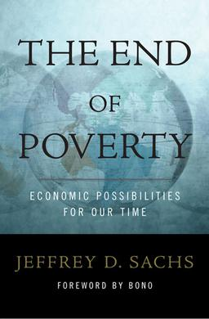

Sachs: poverty can be eliminated globally by the year 2025, through carefully planned development aid
Bono, the lead singer of U2, uses his celebrity to promote for action to end hunger, poverty and disease

Slide 25
Sachs presents successful examples of the Western donors’ experiences in helping poor countries:
The green revolution for food production in Asia,
Vaccinations and treatment of anti-malarial diseases
Oral rehydration treatment
Agricultural renew for soil nutrients
Antiviral medicines
The increase of family planning programs
And many others

Slide 26
Sachs claims that foreign aid should be allocated to:
Cover living costs for poor families, especially in emergency cases, such as food aid in times of drought
Finance the deficit in the general budget to fund public investments
Aid private companies such as small business
If foreign aid is big enough, public capital will rise and facilitate the transition of poor families into a stage above self-sufficiency. The poverty trap will be broken, and economic growth will emerge
The “big push” theory led to policy which resulted in the spending of trillions of dollars to aid poor countries with very disappointing results

Slide 27
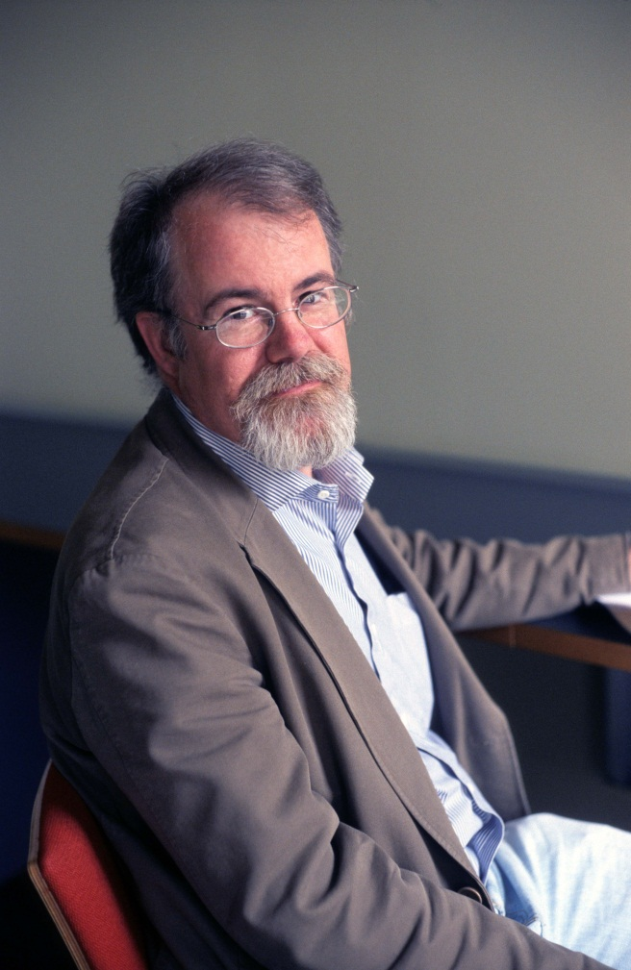
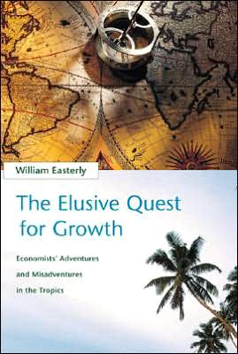

Sachs's recommendations are remarkably similar to those first made in the 1950s and 1960s in development economics.
The Big Push recommendation overlooks the unsolvable information and incentive problems facing any large scale planning exercise.
A more promising approach would be to design incentives for aid agents to implement interventions piecemeal whenever they deliver large benefits for the poor relative to costs.
William Easterly

Slide 28
Easterly (Journal of Economic Growth, 2006) finds that
Poverty traps - zero growth for low-income countries - are rejected by the data
Over 1950–2001 growth for the lowest quintile isn’t significantly different than other quintiles
The claim that “well-governed poor nations” are caught in poverty traps - is rejected by the data
Takeoffs are rare in the data, most plausibly limited to the Asian success stories. Even then, the takeoffs are not associated with aid, investment, or education spending as the standard narrative would imply

Slide 29
Peter Boone, European Economic Review, 1996, finds that foreign aid:
Does not significantly increase investment
Does not benefit the poor as measured by improvements in human development indicators
Does increase the size of government

Slide 30
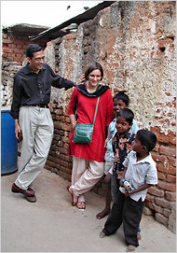
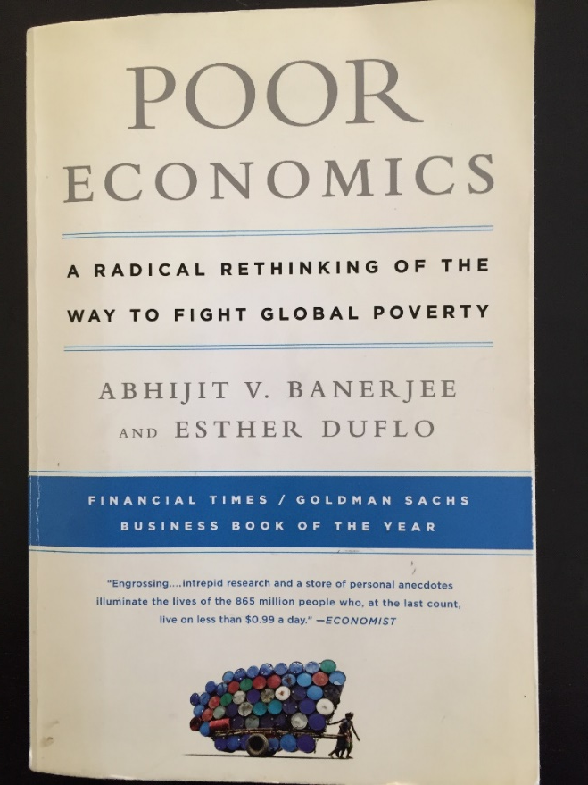

Randomized Control Trials (RCTs)
Experimental programs focusing on helping the poor, and not on large-scale development aid
“Over 400 million people have been reached by programs that were scaled up after being evaluated by J-PAL affiliated researchers. Many more have benefitted from the several broader ways evidence can inform policy, outlined below…”

Slide 31
Controlled Experiment the Led to Policy:
Millions of children in many poor countries receive pills against intestinal worms.
Millions of families in Indonesia have been given an ID card that allows them to participate in social programs.
Tailor-made curricula have impacted millions of children in India and Africa.
Eliminating payment for preventative medicine (e.g. mosquito nets) has significantly increased its use.
A plan to reduce corruption in resource allocation to help those in need in India.
Eliminating failed plans.
“Over 400 million people have been reached by programs that were scaled up after being evaluated by J-PAL affiliated researchers. Many more have benefitted from the several broader ways evidence can inform policy, outlined below…”

Slide 32
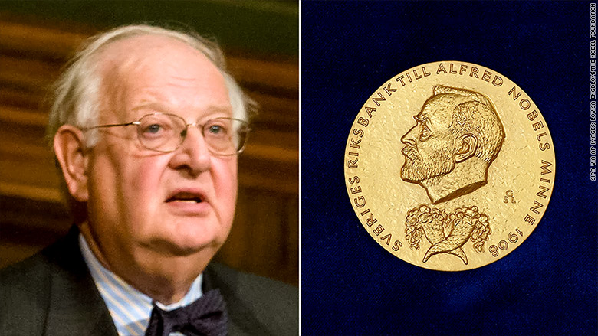
“RCTs can play a role in building scientific knowledge and useful predictions but they can only do so as part of a cumulative program, combining with other methods, including conceptual and theoretical development, to discover not “what works,” but why things work” (Deaton and Nancy Cartwright, 2016)

Slide 33
Does subsistence income prevent the poor from saving? (Moav 2002)
Banerjee-Duflo (2007) show that the typical poor:
scarcely invest in their children's education, are poorly fed and suffer from health problems
are worried and anxious to an extent that interferes with their sleep and work
fail to make trivial investments in their businesses, and save so little that they cannot avoid cutting on their meals when they suffer a temporary decline in income
Yet, they spend a large fraction of their income on alcohol, cigarettes, and festivals, among other goods that seem useless in alleviating poverty

Slide 34
More Criticism
General Balance: indirect influences of treatment are unidentifiable.
Focusing on micro-intervention that creates a measurable impact in the short term, while neglecting to address macroeconomic problems as well a governments’ urging to address important issues.

Slide 35
The RTO approach diverts attention from urging and pushing government policy that could improve protection of propriety right, tax revenue and investment in infrastructure; health and education; improvement of regulation and bureaucracy.
It is somewhat ironic that the RCT researchers are obsessed with accurately “identifying” treatment impact (the difference between association and causality), but when it comes to conclusions regarding policy, they are less stringent.

Slide 36


Inequality and economic growth
Galore-Zeira's approach - "Capital market failure to approach"
45⁰
$$y_{t+1}$$
$$$$
$$\overline{y}L$$
$$\hat{y}$$
$$\overline{y}H$$
$$y_{t}$$

Slide 37
Inequality and economic growth
Galore-Zeira's approach - "Capital market failure to approach"
$$\overline{y}L$$
$$\hat{y}$$
$$\overline{y}H$$
$$y_{t}$$

Slide 38




Inequality and economic growth
Galore-Zeira's approach - "Capital market failure to approach"
B
Equality contributes to growth!
A
$$\overline{y}L$$
$$\hat{y}$$
$$\overline{y}H$$
$$y_{t}$$

Slide 39

Inequality and economic growth
Galore-Zeira's approach - "Capital market failure to approach"
B
Reverse results if the critical threshold is higher than the average wealth
A
$$\overline{y}L$$
$$\hat{y}$$
$$\hat{y}$$
$$\overline{y}H$$
$$y_{t}$$

Slide 40
Inequality and economic growth – the Classic Approach
The main growth engine is investment.
Savings as a source for investment.
Savings grow as income increases.
-> inequality increases savings and as a result, investment
-> inequality contributes to economic growth
Does consumption contribute to growth?

Slide 41
Inequality and economic growth – the Political Approach
Inequality generates political pressure applied by the poor for redistribution of income by taxation and allowances Persson-Tabellini 1994 Alesina-Rodrik 1994
Inequality generates political pressure applied by the poor to reduce government services that contribute to growth Benabou 2000
-> Inequality increases taxation and allowances therefore damages incentives to work and invest
-> Inequality damages efficient government services
-> Inequality damages economic growth

Slide 42
Inequality and economic growth – the Integrated Approach (Galor-Moav 2004)
Inequality increases savings and investment
Inequality harms investment opportunities and consequently investment efficiency, especially in human capital.
-> In historical times, when investment played a modest part in economic growth, inequality contributed to growth – the Classic Approach was dominant.
-> With the increase in importance of human capital, inequality damaged growth – the approach of an unimproved stock market became dominant.

Slide 43
Inequality and economic growth – what do the numbers say?
A Lot of research, but difficulty in reaching a clear conclusion. Inequality is not random, so its impact is difficult to isolate.
Still, the data suggests that more egalitarian countries are also growing faster.
Policy:
Is the redistribution of revenue (taxation and allowances) a wanted practice for encouraging economic growth?

Slide 44
Back to the Poverty Trap
Does income on the verge of subsistence prevent the poor from saving and investing, for example in the future of their children, as some of the theories claim? According to the overview by Banerjee-Duflo (2007) the poor in the poor countries:
Do not invest in children's education, do not consume proper food and suffer from health problems.
Worry about their condition which gets in their way of sleeping and working.
Fail to make investments, even on a negligible scale, in their businesses despite high returns, living hand to mouth and having to reduce food consumption when they have a temporary drop in income.
However, they spend a significant portion of their income on alcohol, cigarettes, celebrations, and other products that do not help them escape poverty.

Slide 45
The New York Times (May 22, 2010)
"Moonshine or the Kids?"
The reporter argues that “if the poorest families spent as much money educating their children as they do on wine, cigarettes and prostitutes, their children’s prospects would be transformed”
The Obamza family from the Congo Republic is eight months behind on the $6-a-month rent and is in danger of being evicted.
The Obamzas have no mosquito nets, even though they have already lost two of their eight children to malaria. They say they just can’t afford the $6 cost of a net.
Nor can they afford the $2.50-a-month tuition for each of their three school-age kids.

Slide 46
And yet…
Mr. and Mrs Obamza lay out $10 each month on their cellular phones
Mr. Obamza sits at a bar a few times a week spending $12 a month
Other villagers say that Mr. Obamza drinks less than the average man in the village.

Slide 47
Festivals amount to 15% of household expenditures in rural India (Rao, 2001)
Households in South Africa spend the equivalent of a year's income for an adult's funeral, financed, in many cases, by borrowing (Case et al., 2008)

Slide 48
Economic Research Explanations
" Extravagant Consumption”
Moav-Neeman (2010, 2012)
“Temptation”/”Self Restraint”
Banerjee-Mullainathan (2007)/ Bernheim-Ray-Yeltekin (2015)

Slide 49
Do the facts fit the story of extravagant consumption?
Weddings in India play a major role in signaling economic success. The cost of a daughter's marriage - dowry and celebrations - comes to six times the family's annual income (Bloch-Rao-Desai, 2004)
Missy Elliott: The bling culture encourages black young people to spend their money irresponsibly

Slide 50
The New York Times (March 18, 2010)
“For India’s Newly Rich Farmers, Limos Won’t Do”
A newly rich farmer who sold land for about $109,000, rented a helicopter for $8,327 to transport his son to his wedding two miles away.
The claim in the article, supported by statements from family members and experts, is that the intention is to impress other villagers with the family’s new status and spending power.

Slide 52
Tajikistan's President, Imomali Rahmon, banned gold teeth, the use of cell phones in universities and big birthday parties.
The President criticized wealthy citizens “for ‘showing off their wealth’ by throwing elaborate parties and thereby setting a standard for others who try to appear wealthy by holding a large party despite having only modest incomes."
The President restricted the number of people at weddings to prevent Tajiks from “using their life savings just to compete with their neighbors”

Slide 53

Congo Dandies: ‘I could buy a piece of land, but bought a pair of shoes’

Slide 54

“When you dress up you really are the best,” Maxime Pivot from Brazzaville, the capital city of the central African country, told RT’s documentary channel RTD.

Slide 55
The quest for status is part of human nature
Pinker (2003) How the Mind Works: status is in our genes and conspicuous consumption is universal
Women make men neglect the thought of the future and spend money extravagantly
Wilson-Daly (2004): pretty women inspire men to discount the future
Griskevicius et al. (2007): mating goals in men increase their willingness to spend on conspicuous luxuries (and display heroism or dominance). In women, mating goals boost public helping

Slide 56

We are humans (at least men), we are not that special…

Slide 57

Wow!

Slide 58

And what about the alternate story - temptation?

Slide 59
Back to Micro-financing
Poverty traps are based on the lack of credit, so why did giving credit not help the poor escape poverty?
The mechanisms that explain poverty persistence, particularly low savings levels, are (probably) important to understanding the failure of micro credit: poor people are particularly susceptible to risk.
(The theory of Hazanov, Moav, Ne’eman and Zoebi is based on “Risk Aversion”)

Slide 60
The Importance of Risk Aversion
Banerjee and Duflo (2011)
“risk is a central fact of life for the poor, who often run small businesses or farms . . . with no assurance of regular employment. In such lives a bad break can have disastrous consequences.”
Investment is like buying a lottery ticket. Education for example, may lead to a better job but not necessarily.

Slide 61
Banerjee and Duflo argue that the poor understand the economic environment well and take a variety of measures to reduce risk
Banerjee and Duflo provide further support for the claim that risk plays a central role in the decisions of the poor who understand their economic environment
They argue that the poor are constantly worrying about the future, particularly about imminent disasters, and take a variety of ingenious and costly precautionary measures to limit the risks they are subject to, such as managing their businesses conservatively and diversifying their portfolio of activities, including by marriage and temporary migration

Slide 62
More Testaments of Risk Aversion
The poor avoid low cost seasonal migration that is highly rewarding because of the fear of failure (Bryan et al., 2014)
Insurance against adverse weather shocks can induce farmers to invest more in high return risky production options (Karlan et al., 2014; Cole et al., 2016)

Slide 63
More Testaments to Risk Averse
“[The] poor are highly risk averse and reluctant to engage in the high-risk, high-return activities that could lift them out of poverty”; “[a]s households move closer to extreme poverty and destitution, they become very risk averse” (The World Bank 2001)

Slide 64
Economic Theory
Regular expenses (S function) and risk aversion prevent the poor from investing.
-> Failure is too painful; it leaves the poor with both low income and debt

Slide 65
However…
Banerjee and Duflo argue that there is no evidence of substantial regular expenses:
Returns on education for example, is very high even on smaller scales
“[E]very little bit of education helps…People who go on to secondary education are more likely to get a formal-sector job, but even those who don’t are able to run their businesses better.”
Modest investments in health substantially reduce risk of diseases, therefore they have a high return. The cost of the disease – treatment and loss of income can be devastating to the poor.

Slide 66
Further evidence of no substantial regular expenses
Despite high returns, many farmers avoid investing in fertilizers
(Duflo et al., 2011)
Shop owners keep an inventory that is too small
(Kremer et al., 2011)
There is no need for a large initial investment to start a small and profitable business in poor countries. A $100 investment may bring about returns of up to 20% per month
(McKenzie and Woodruff, 2006, de Mel et al., 2008, 2009, 2012, Fafchamps et al. 2014)

Slide 67
Conclusion of the empirical study (reminder)
the evidence is inconsistent with technology-based (fixed costs) poverty traps
Kraay and McKenzie (2014)

Slide 68
Standard modeling of investment with risk without fixed costs: The probability of success is typically exogenous, optimization by the agent is with respect to the scale of the project
In a project in which the rate of return is drawn from an exogenous distribution, and the technology is convex, the expected utility of a risk averse agent is a concave function of investment
UTILITY
WEALTH
WEALTH
0
Optimal investment
INVESTMENT

Slide 69
How can one explain the micro-credit failure without being able to establish a base of regular expenses?
1. According to Banerjee and Duflo the production function is S shaped
“In reality, there should not be an education-based poverty trap: Education is valuable at every level. But the fact that parents believe that education is S-shaped ... create[s] one.”
Their argument is not consistent with their description of the
poor as people who understand well the economic environment

Slide 70
2. Scarcity of complementary factors of production (skills, education, infrastructure), and in fact it is argued that enthusiasm for microfinance is based on an overestimation of the business potential facing the poor
Banerjee et al. (2015)
How can one explain the micro-credit failure without being able to establish a base of regular expenses?
However…
As part of an experiment, poor women were given a financial asset: two milking cows and basic training. The experiment showed that with that aid, the women successfully ran a small business that helped to escape poverty. Bandiera et al. (2017)
Financial grants aןג programs have contributed to labor productivity and consumption among the poor. Handa et al. (2018)

Slide 71
So, what’s our story?
We show that risk-averse individuals' preferences create a corner solution when investing is in the project's chances of success
-> The observed behavior is consistent with S-shaped production function or with false beliefs in such a production function
UTILITY
INVESTMENT

Slide 72
Explanation
Lottery with zero average return expectancy:
P chances -> one Shekel
P-1 chances -> zero Shekels
P probability depends on the investment. Namely, the investment = P
The results of 0 investment and 1 Shekel investment are certain and identical
Any investment between both ends yields at zero expectancy but with risk

Slide 73
Any rational person is indifferent between P=0 to P=1, and if they are risk averters, they prefer these two alternatives over any other alternative
UTILITY
0
1
INVESTMENT

Slide 74
Why don’t the poor invest?
Consider two changes to the lottery:
UTILITY
0
1
INVESTMENT

Slide 75
Why don’t the poor invest? Our explanation
Consider two changes to the lottery:
UTILITY
0
1
INVESTMENT

Slide 76
Why don’t the poor invest? Our explanation
Consider two changes to the lottery:
Positive return (the prize for a successful outcome > 1)
P_{max} < 1
UTILITY
0
P_{max}
1
INVESTMENT

Slide 77
Why don’t the poor invest?
Risk averse agents choose between one of the two corners
    Expected positive return
    No risk
Low risk aversion
High risk aversion
UTILITY
0
P_{max}
1
INVESTMENT

Slide 78
Why don’t the poor invest? Our explanation
→ A wealth (risk aversion) threshold above which individuals invest in the project and below which they don’t
WEALTH
Optimal investment
WEALTH
UTILITY
0
P_{max}
1
INVESTMENT

Slide 79
Conclusion
The hope that aid to the poor and poor countries will reduce poverty has led to disappointment.
Economic growth, the result of adopting competition and economic freedom policies, entrepreneur-friendly regulation, and property rights protection, has led to poverty reduction worldwide.
The new hope – RCT – might succeed where others disappointed.
  -> Hundreds of millions of dollars have financed many studies and promoted careers of researchers but for the time being, it is hard to say that there are any significant advancements in eradicating poverty…
At this point, it is Milton Friedman’s (capitalist economy) that has helped reduce poverty with no comparison with any other approach.

Slide 80
Thank you

