Slide 1
Policy document for the captain iNDC -November 2018

Slide 2
Policy document - a link in the process
The policy document - a link in a complex process leading to a decision that can change an existing reality.
In the process there is interaction between factors with different characteristics. This is the arena of practical statesmanship.
Understanding the characteristics of the overall arena is essential to the authors of the policy paper if they wish to influence.

Slide 3
What is a political planning paper?
Who is the paper for? (KSG)
Affect. (And those who are afraid to write ...)
Paper design as an important but not a single element in the "impact" process (additional tools demo / survey ...)
Different types of political planning papers
Why you?
Is there a difference between military and political planning?

Slide 4
Well-constructed paper is not good paper yet
An infrastructure of understanding causality, trends, possibilities, patterns of change, dangers and alternative futures.
Realistic understanding of the effectiveness of various policy tools, organizational capabilities, and politics.
Creativity - design and identification of new possibilities
Proper communication and successful recruitment of stakeholders.

Slide 5
The abyss between the worlds of the counselor and the captain
Characteristics of the political world (when is the water boiling?)
Different time horizons
Compartmentalization
Coalitions and ongoing advocacy
Fuzzy directives
Public opinion and communication
Easy to advise, difficult to perform (Jerusalem)
Can the "abyss" be bridged?

Slide 6
A professional with the head of "Entrepreneur Policy"
Policy entrepreneur
Understanding the complexity of political and country behavior.
Understanding the dynamics of the arenas relevant to the success of a policy initiative.

Slide 7

Understanding political behavior
Basic model:
Graham Allison (Essence of Decision: Explaining the Cuban Missile Crisis)
-Rational player analysis
- Organizational analysis
-Political analysis
-Personality analysis
-Cultural analysis

Slide 8
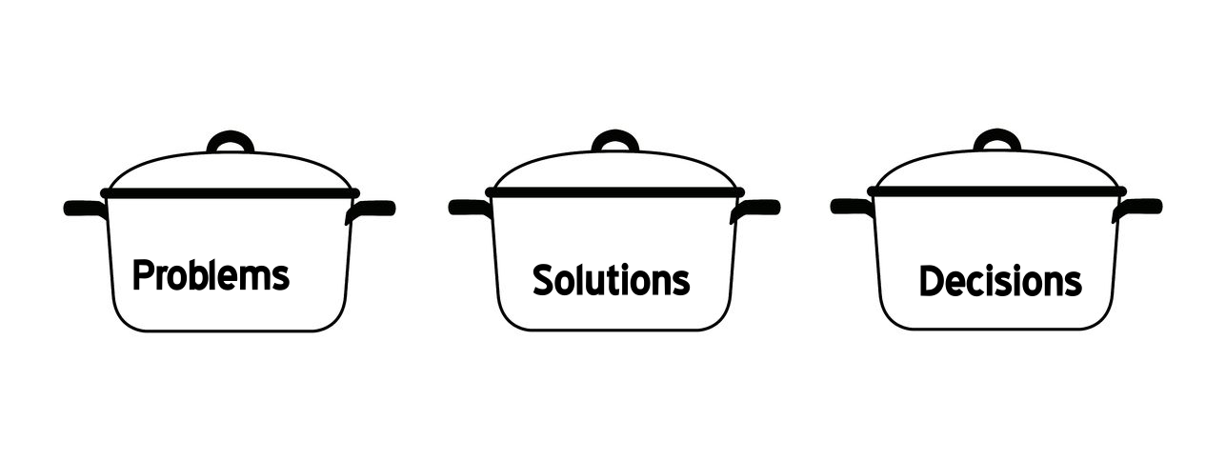
Making paper a reality
John Kingdon (Agendas, Alternatives, and Public Policy)

Slide 9
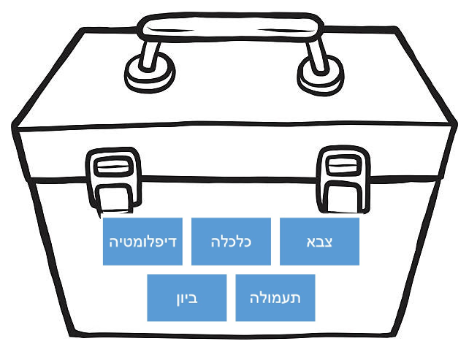
A political toolbox
Diplomacy
Economy
Army
Intelligence
Propaganda

Slide 10
Five minutes of ethics
Lack of integrity in paper writing (options, incentives for the captain, power drunkenness)
"The Reverse Pyramid".
The temptation to manipulate.
A partner in government pathology,
What do you resign?

Slide 11
EXERCICE
What is good and bad about the paper below?

Slide 12
4.10.95
אל: שה"ח
From: Avi
OSLO II - WHAT ARE WE EXPECTED TO FIGHT? (SELECTED AND PARTIAL COLLECTION).
Failed negotiations on a final status agreement and the absence of an agreement after five years of an interim arrangement.
- The Palestinian Council will violate the restrictions on the conduct of foreign relations.
The three phases of the FRD (redeployment) will not be met by the Palestinians
The Palestinian police will violate the rules of movement in Area B.
- The Palestinians will feel deceived by the extent of our willingness to release restrictions on their movement in Area B.
- The Palestinian Police will deviate from the restriction of not dealing with incidents involving Israelis.
- will fail to disarm Hamas.
- The scope of release of prisoners will not provide.

Slide 13
- will hit the collaborators.
- There will be a dispute over the meaning of the term "Palestinian Authority over Territorial Waters". (Digging wells without a permit, etc.).
- Laws that contradict the agreement will be enacted.
- will be urged to use a mechanism of mediation and transfer of disputes to arbitration.
- The dispute in the DP Committee will be intensified.
Will fail at the PNC meeting to change the Convention (two months after the Council was established).
- will argue that they were raised on the issue of the Jiftlik (the issue is to be discussed by Israel in the first phase of the FRD).
- will argue that Israel's commitment to any security arrangement will not harm the development, construction, and "physical and moral dignity" of the Palestinians.
- will not be satisfied with their struggle against terrorism.
Will provoke disputes over the meaning of the Israeli right to "take any measures necessary to evacuate and treat the injured ... anywhere within the Gaza Strip or the West Bank."
- Israel's right to oppose the recruitment of candidates to the police will not be honored.

Slide 14
- They will not transfer the names of the policemen.
- There will be malfunctions in operating the safe passage.
- will arrest Israelis (Jewish tourists), violating the restriction on "delay until the arrival of the joint tour."
- will not meet the construction restrictions in the areas of labor.
- Candidates for the council "seeking to implement their goals by illegal means" shall not be disqualified.
- will fail to preserve archaeological sites of historical importance to Israel.
- will be built in such a way as to damage the infrastructure, etc. of settlements and military installations.
- Issuing stamps and postage stamps not in the spirit of peace (as determined by the agreement).
- will not turn over suspects. (They will conduct false trials and false arrests).
Violations on economic issues.
Avi

Slide 15
A POSSIBLE STRUCTURE FOR A POLITICAL PLANNING PAPER
What is the question? What is the problem? (Sharon, the village on the mountain)
Background (How did others take care?)
What is the goal (or goals)?
Discussion (with reference to relevant information, intelligence, etc.)
Options and their examination according to relevant criteria
Recommendations
The logic behind the recommendation
Application tests (expected problems, examination of assumptions)
Preliminary lines for the implementation plan (implementation team, support building, public relations, etc.)

Slide 16
WHAT TO CONSIDER?
Incentives for decision makers
Concise ("Take off fast")
Reveal author biasing
Leaks
The big picture and the long range
Oral presentation
Boss and mission
Clarity, and sharp reference to difficult problems
Treatment of uncertainties

Slide 17
WHAT ARE THE VALUE OF THE SCENARIOS?
Methodological thinking about future possibilities.
Estimation of the probability of the occurrence of alternative "futures".
Assistance in formulating strategies for achieving a preferred future and preventing an undesirable future.
Identifying obstacles and finding ways to overcome them.
Identify opportunities and find ways to exploit them.
Understanding the implications of our actions.

Slide 18
CREATIVITY
Looking ahead requires creativity
Creativity can also be encouraged and stimulated
Example: brainstorming (reject judgment stage, create many ideas, "time" unconventional ideas, rely on others' ideas).

Slide 19
BASIC RULES
Get ready for what the future holds for you
Watch Future Needs
Use information, even if it is partial
Watch the unexpected
It is important both short term and long term
"Dream" effectively
Learn from your predecessors

Slide 20
AN ERA OF FAST TRANSITIONS
"Dominant trends" ((Super-Trends:
technological progress
Economic growth
Improved health
High mobility
Environment in retreat
cultural shock

Slide 21
TRENDS CONTROLS AND FUTURE
"Dominant trends" - a bridge between the present and the past into the future.
Extrapolation of trends controls - "a future without surprises". (Example: Trends in the Political Process)
Work question: What may happen so that the expected will not happen?
Alternative scenarios:
"There are no surprises"
"optimistic"
"pessimistic"
("Asuni" and "Nissi")

Slide 22
SCENARIO PRODUCTION
Forward incarnation of relevant trends (and events) and, as a result, painting future images.
Painting alternative future images and subsequently "rolling backwards". ("Normative forecasting").

Slide 23
WHAT ARE THE VALUE OF THE SCENARIOS?
Methodological thinking about future possibilities.
Estimation of the probability of the occurrence of alternative "futures".
Assistance in formulating strategies for achieving a preferred future and preventing an undesirable future.
Identifying obstacles and finding ways to overcome them.
Identify opportunities and find ways to exploit them.
Understanding the implications of our actions.

Slide 24
PREDICTION METHODS
Consultation with experts (surveys, Delphi)
game theory
Use of models
Simulations
Vision

Slide 25
CONTINUITY BETWEEN PAST AND FUTURE
Continuity of existence
Continuity of change (linear, bouncy, cyclic)
Continuity of pattern
Continuity of causality - its understanding allows intervention to hasten, stop or slow down trends. ("The systems approach")

Slide 26
THE SURPRISE - IF THERE ARE NO SURPRISES
Looking ahead requires creativity
Creativity can also be encouraged and stimulated
Effective management of discussion.
Brainstorming (rejecting the judging stage, creating many ideas, "time" unconventional ideas, relying on others' ideas).

