Slide 1
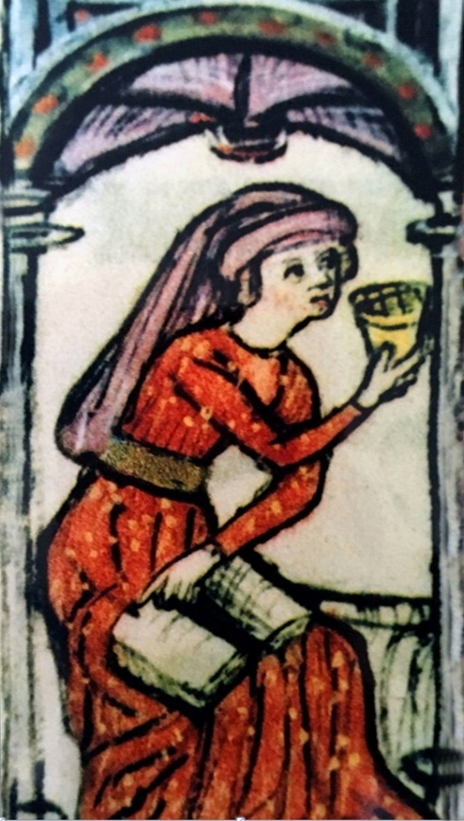
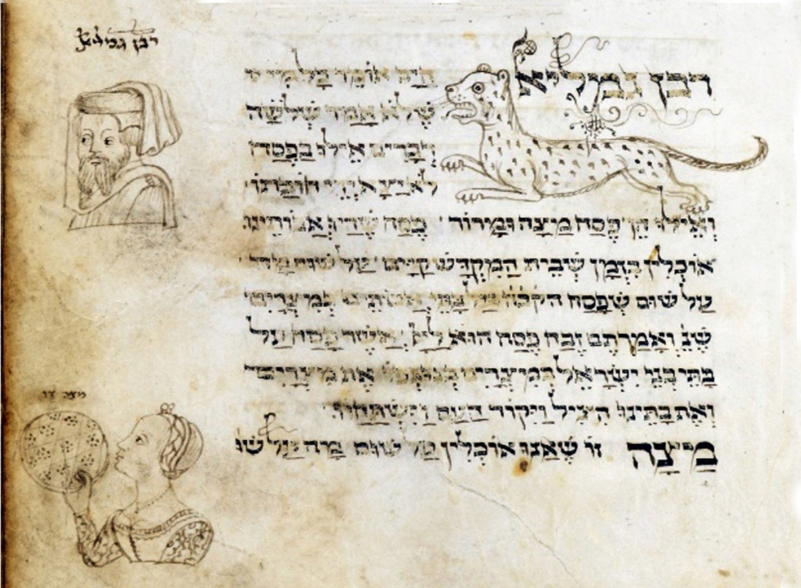
Jewish Art in the Haggadah of Pesach
Dr. Anat Chen
Passover
Israel National Defense College
46th Class
Yoel Ben Shimon, Italy, 15th century

Slide 2
This is the bread of affliction that our fathers ate in the land of Egypt. Whoever is hungry, let him come and eat; Whoever is in need, let him come and conduct the Seder of Passover. This year [we are] here; next year in the land of Israel. This year [we are] slaves; next year [we will be] free people.
Jewish art developed in the Middle Ages within the Passover Haggadahs’. Alongside the text, on the margins and on entire pages, illustrations that told the story of the Jewish people appeared in pictures.
The illustrations depict how the Jews lived, what they earned, how they dressed, and what special customs they adopted.
Contrary to popular belief that in Judaism it is forbidden to paint or sculpt, we can see that for hundreds of years Jews aspired to bring artistic expression to their lives just as in the non-Jewish environment in which they lived.
This is the bread of poverty of the Jewish art that could not have developed on the walls of synagogues or noble houses, but rather contented itself with the text of the Haggadah as an endless source of illustrations in every generation.
Reylands’ Haggadah, Spain, 14th century

Slide 3
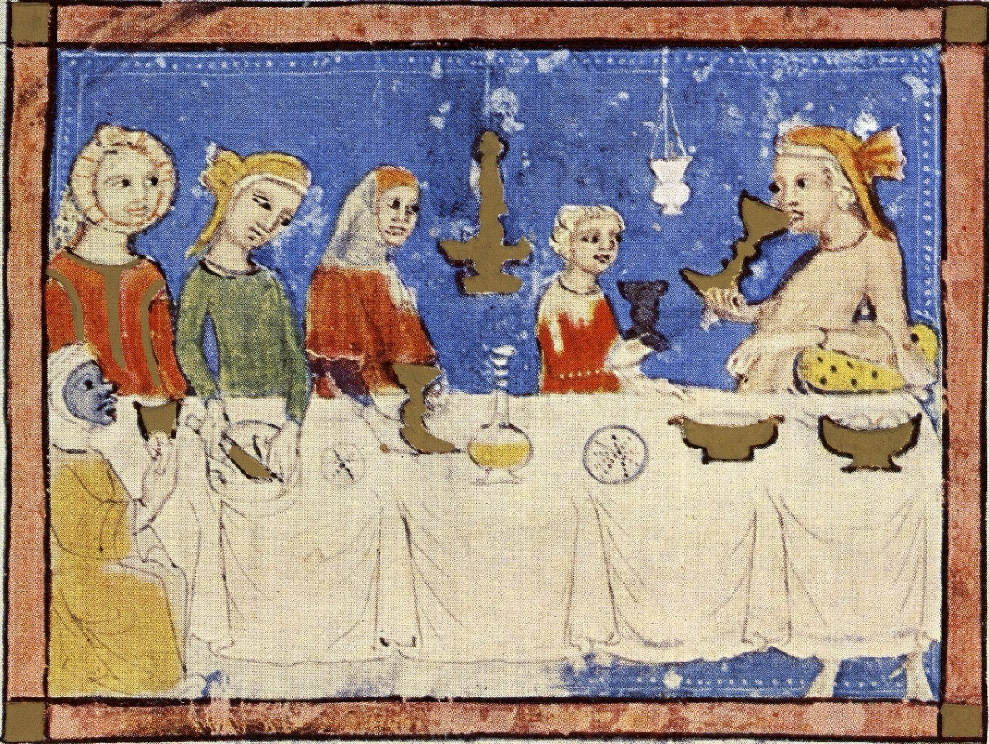
What makes this night different from all [other] nights?
The landlord sits on the right, at the head of the table. He leans against a cushion and drinks while conversing. Such a gathering is considered a gathering of masters and free people. The women participate as well. The landlord is probably the only man in this picture, the rest of the characters are women and each has a colorful and unique head covering. This is a strange composition, because even during periods when a man was permitted to marry more than one woman, men had no more than two women.
On the other side of the table, on a low chair sits a dark-skinned servant. She also takes an active part in the Passover Seder. She holds a matzah. The Haggadah conveys a message of reversal of fate. From being slaves to being free. Even when sitting around the table as free people there are still those who are under slavery.
The Haggadah of Sarajevo, Spain, 14th century

Slide 4
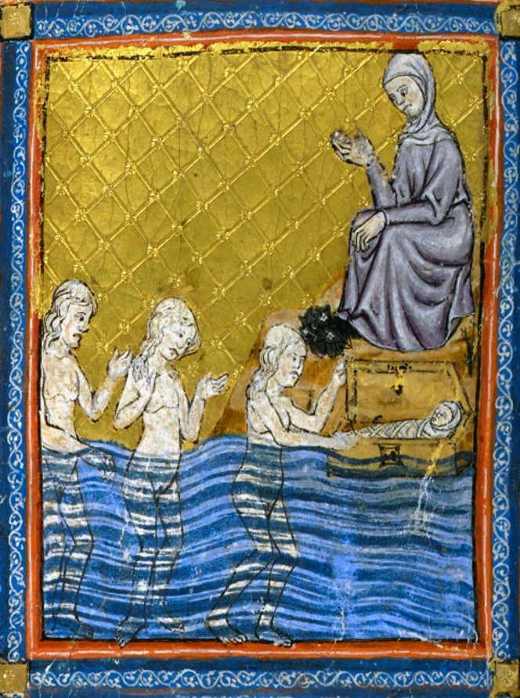
Bathing
Pharaoh's daughter is the most popular woman in Jewish art and is depicted in most Passover Haggadot. In the picture we see three naked women standing in the river. Miriam, the older sister is sitting and watching the baby from a distance. Moshe lies wrapped in a diaper inside the box.
Art researchers discuss who is seen in the pictures retrieving Moses out of the water. Was this the daughter of Pharaoh herself or one of her own daughters? In the book of Exodus it is written as follows: "And she saw the tabernacle between the bulrush, and sent her servant, and took it.“
The word Hebrew word for servant (‘Amma’) has two meanings: hand and servant. Either Pharaoh's daughter sent her hand and took the box out of the water herself, or she sent her maidservant to remove the box from the water.
Why is Pharaoh's daughter drawn naked? Chazal (Jewish sages of the Mishna and Talmud) said that Pharaoh’s daughter went down to the river for a conversion. In the Jewish conversion ceremony, the immersion in water takes place without any separation. The ceremony comes to symbolize rebirth as a son or as a daughter of another religion.
The Golden Haggadah, Spain, 14th century

Slide 5
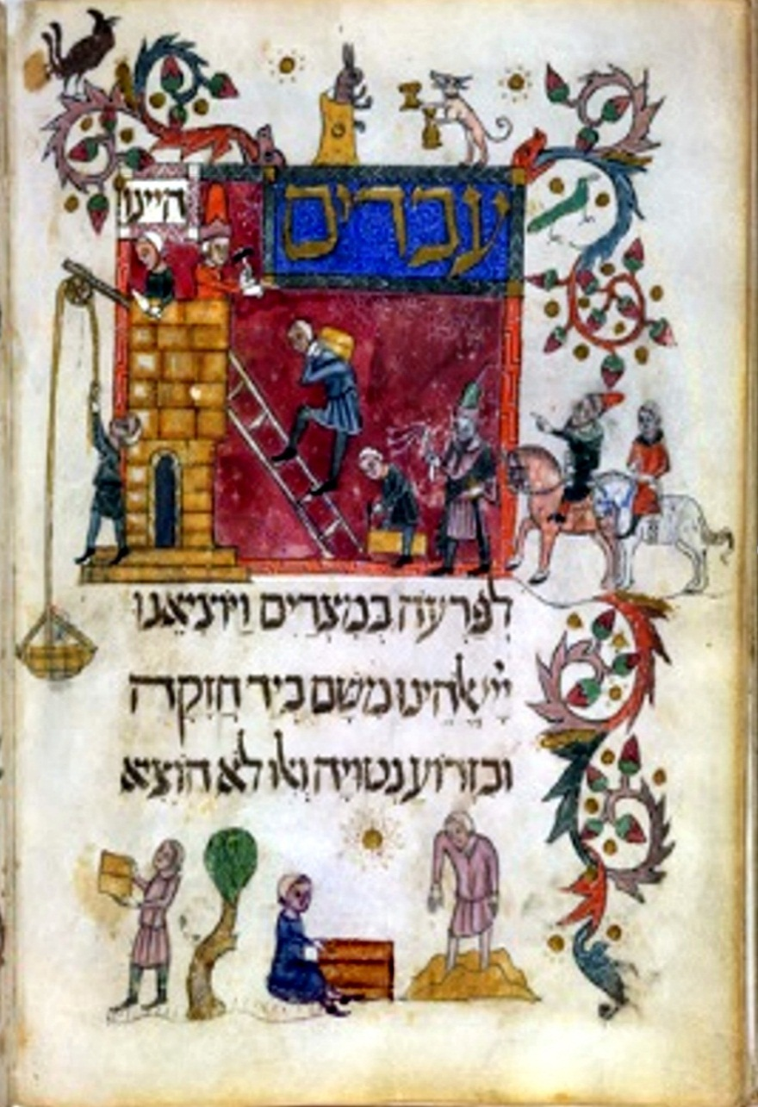
We were slaves to Pharaoh in Egypt, and the Lord, our God, took us out from there with a strong hand and with an outstretched arm?
The picture depicts men and women engaged in construction. The workers carry the heavy construction materials up the ladder, where a woman is waiting for them to drop material onto the wheel towards a man standing and waiting. Another woman is sitting down and is busy making the bricks. One of the men is stomping his feet on the cement, preparing the material from which the woman will prepare the bricks from a pre-made template.
The template allows for precise work - that all bricks are one size. The picture is intended to prove the integration of Jews into all aspects of life, and not only in commerce or economics.
In the general popular art of the period, anti-Semitic illustrations were published emphasizing the lack of productivity of the Jews, their laziness and isolationism. The fact that Jews can also be productive and work in hard physical labor is reflected in the story of the Haggadah and its illustrations.
Barcelona Haggadah, Spain, 14th century

Slide 6
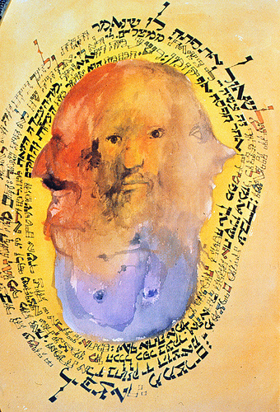
The Torah speaks of four children: One is wise, one is wicked, one is simple and one does not know how to ask.
The paintings of the four sons in the Haggadah are the mirror of the society and the period in which they were painted. In the medieval Haggadahs, you see the wicked son dressed in knightly clothes or a soldier holding a sword. The son who does not know how to ask is usually dressed in clown clothes.
But in modern Haggadot the paintings of the four sons were given a new interpretation. Instead of separating the boys into different and contrasting characters, they began to portray them as brothers in the same family or even as four faces of one individual person.
This is to teach us that there is no one who is absolutely wise or permanently evil, but that these four types are in each and every one of us as depicted in the picture of the painter Leonard Baskin, who combined the boys into one illustration. Once wise and sometimes evil. Once he is innocent and once he does not know how to ask. It all depends on your perspective.
Leonard Baskin, Passover Haggadah (The Four Sons), 1974

Slide 7
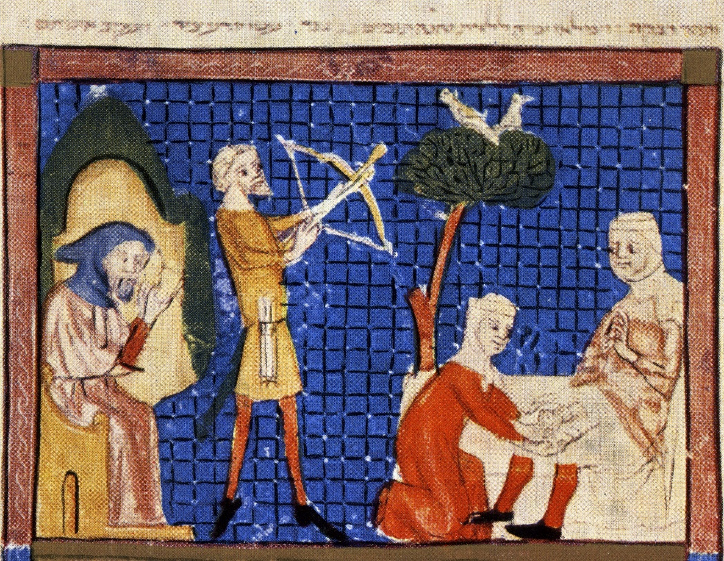
To Isaac I shall gives Jacob and Esau. And I shall give Mount Seir to Esau, and Jacob and his family went down to Egypt.
In the painting we see Rebecca on the right when she gives birth to Jacob and Esau with the help of a midwife. On the left, Jacob and Esau are already big, and the difference between them is clear. Esau is a hunter and holds the bow and arrow while Jacob sits in a building and studies.
How does the story of Jacob and Esau relate to the Haggadah? Jacob's sons were the ones who descended to Egypt and began the period of slavery there. The family conflict turned into a story of slavery and enslavement.
It is also possible that the illustrator was familiar with Rashi's interpretation of the story of the theft of the birthright. Rashi explains there about when Isaac sends Esau to bring him the hunt from the field on the eve of Passover. Why? Rashi apparently intended that on the same date in the future, the children of Israel would celebrate Passover, hence the connection between the theft of the firstborn and the firstborn plague.
The Haggadah of Sarajevo, Spain, 14th century

Slide 8
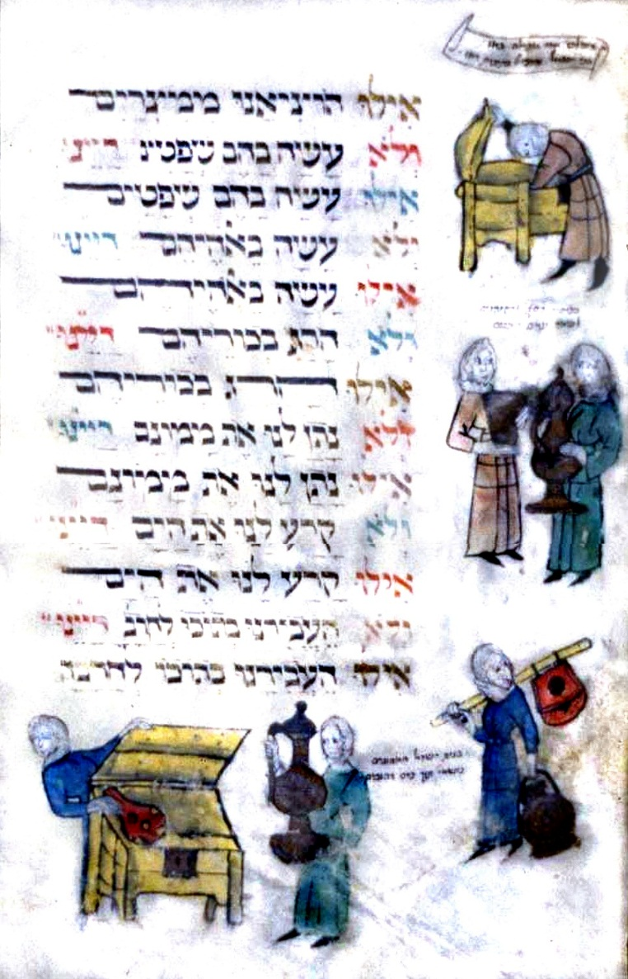
Blessed he who keeps his promise to Israel, blessed he. Through the covenant God promised Abraham:
Know that your seed will be foreign to the land, and they shall be enslaved and tortured for four hundred years. And then, they shall be free and rich.
Abraham was promised that the Israelites would come out of Egypt with great wealth, and indeed before the Exodus from Egypt, the promise was fulfilled: "but every woman shall ask of her neighbor, and in her house, jewels of silver, and jewels of gold, and raiment; and ye shall put them upon your sons, and upon your daughters.”
The idea was that the Israelites would borrow tools and property from the Egyptians, but in practice the loan would be long-term, not to return. In the photo you can see a variety of women who are engaged in asking for property. In some of the pictures the Egyptian woman hands out a tool to her Jewish neighbor, and in some of the pictures the women search for what can be taken.
The Second Nuremberg Haggadah, Germany, 15th century

Slide 9
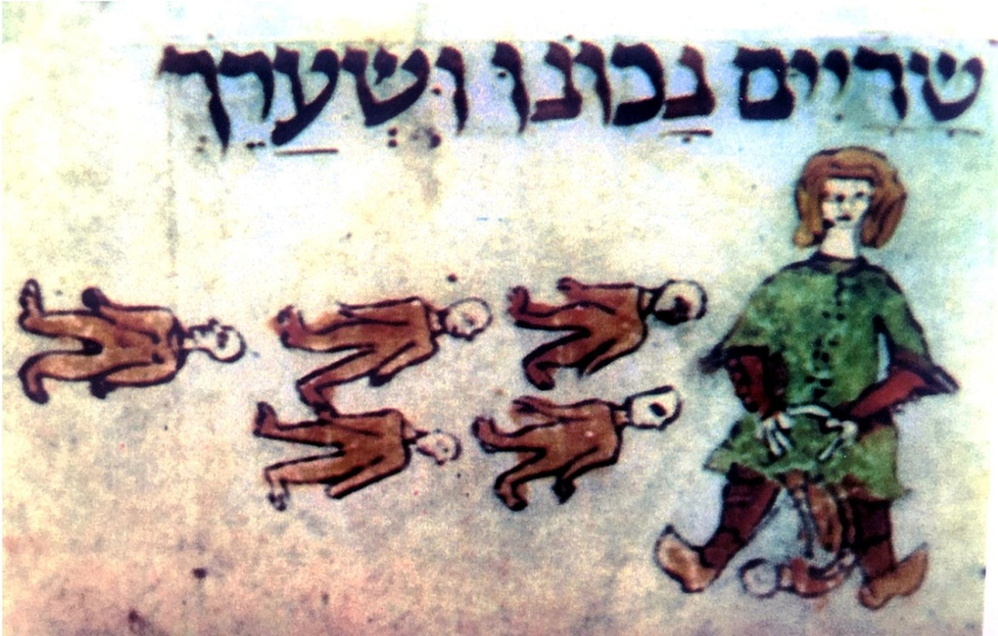
And there they became many and great... as was said: and the sons of Israel were fruitful and eager, and they multiplied and were very mighty, and the land was filled with them.
According to Rashi, a Jewish woman in Egypt would give birth to six babies at once. The panting depicts a woman standing with her legs apart. A baby comes out while five other babies are to her left, and all of them were born in one birth. This description of birth is not meant to demonstrate the process of birth, but to act as a symbol of multiple births. Medically speaking, it is clear that a woman could not survive six births before the invention of modern medicine.
The increased birth rate during a period of slavery is perceived as supernatural. The illustrator manages to show us, very vividly, the miracle that happened to the Israelites in Egypt.
The Dragon Haggadah, France, 13th century

Slide 10
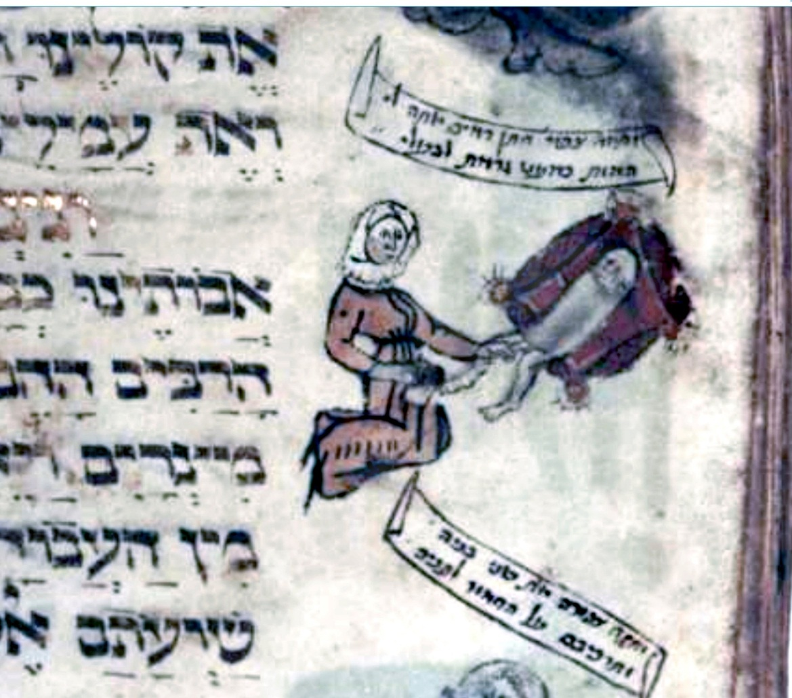
When I passed by you and saw you wallowing in your blood, I said to you: Live in spite of your blood. Yes, I said to you: Live in spite of your blood!
In the picture we see an illustration of the story of the "bridegroom of blood" mentioned in Exodus. When Moses returns with Zipporah and his two sons from Medin to Egypt, the angel of God meets him on the way and asks to kill him. The reason for this is not mentioned. But Zipporah saves his life. How? She takes a flint stone and circumcises her son.
In the picture we see Zipporah kneeling and circumcising a baby lying on a blanket. What is the connection between the story of a bridegroom of blood and the story of the Exodus from Egypt, and why did the illustrator choose to paint Zipporah in the Haggadah?
The reason is related to the interpretation of the story of the bridegroom of blood as a foreshadowing of the story of exodus from Egypt. Just as Moses's life was saved by virtue of the blood of circumcision, so the lives of the Israel people will be saved by virtue of the blood of the Passover sacrifice that they will spread over the doorposts.
The Second Nuremberg Haggadah, Germany, 15th century

Slide 11
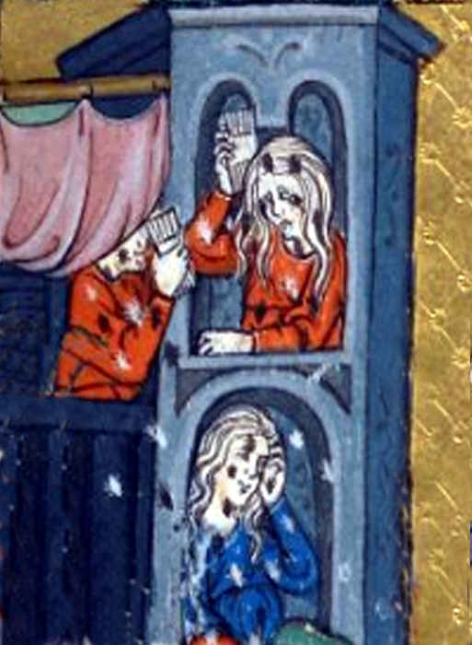
These are the Ten Plagues which the Holy One, blessed be He, brought upon the Egyptians, namely as follows: Blood. Frogs. Lice. Wild Beasts. Pestilence. Boils. Hail. Locust. Darkness. Slaying of the First-born.
Women stand in the window and brush their hair with a thick comb in search of lice.
In the past, houses were different from what we know today. There were no private rooms, children's rooms or master bedrooms. There was no separation between kitchen and living room and there were no bathrooms. Men and women didn’t take a shower. Most people just washed their face and hands. It was very rare for women to wash their hair. Rich people bathed in baths and poor people bathed in the river. The house was full of people such as servants, guests, adults, young and older children. The space was versatile.
They slept, cooked, ate, washed, and checked lice. There was only a bit of fixed furniture. And certainly there was no light, so the women had to check lice near the window. It did not bother them that they were seen by other people.
The Golden Haggadah, Spain, 14th century

Slide 12
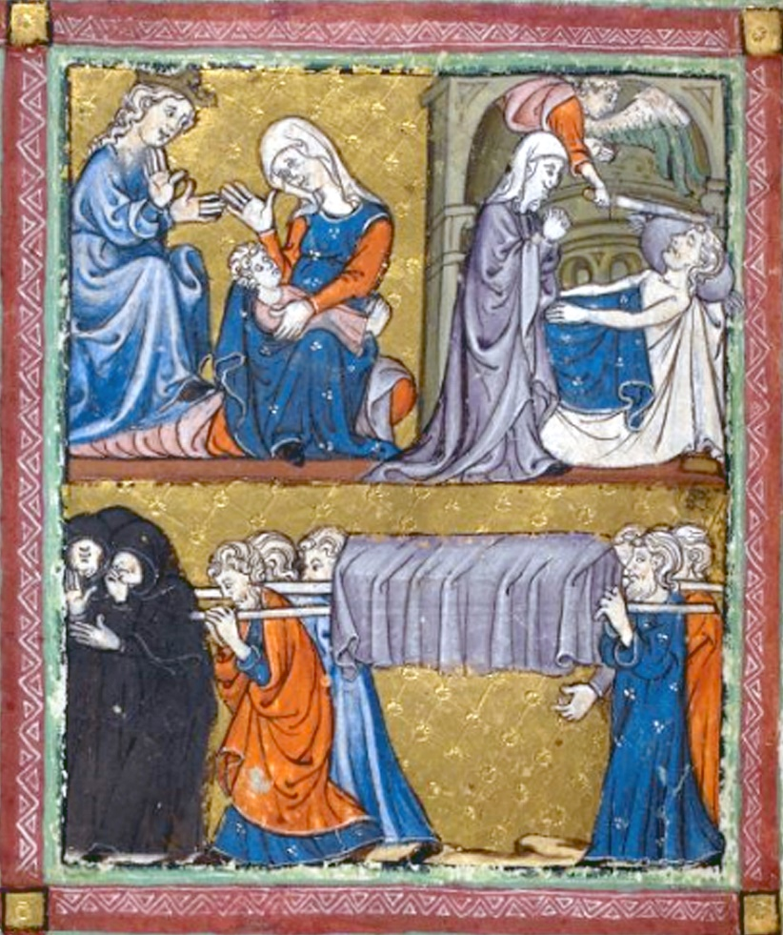
"And the Lord took us out of Egypt" - not with the help of an angel or a messenger, but [directly by] the Holy One, blessed be He, Himself.
In the picture of the firstborn plague, you see the angel of death lifting his sword at a man lying naked in bed. A woman stands next to the bed, and she leans over the dead and takes her hands.
In the left corner, two women talk leisurely when one holds a baby. The other woman has a crown. The picture illustrates the separation between the firstborns of Egypt and the firstborn of Israel. The bottom picture depicts a funeral. Weeping women dressed in black clothes walk before the bed, as was costumed in those days when the Haggadah was drawn.
According to Jewish interpretation, not only were the firstborns of Egypt sentenced to die in the plague of the firstborns, but also the firstborn of the Israelites. Therefore, to this day, the fast of the "Bechorot" on the eve of Pesach is still mentioned, to remind the firstborn that in fact they were supposed to die, but their lives were saved. The paintings of the plague of the firstborns in the Haggadot are also a reminder that the Israel people were miraculously saved.
The Golden Haggadah, Spain, 14th century

Slide 13
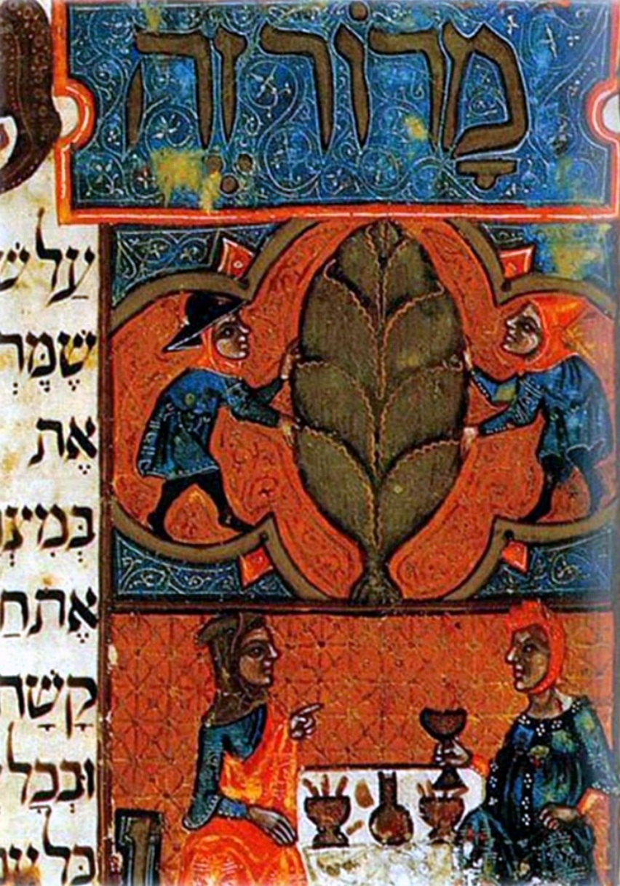
This marror [bitter greens] that we eat, for the sake of what [do we do it]? For the sake [to commemorate] that the Egyptians embittered the lives of our ancestors in Egypt.
The picture shows a man and a woman sitting on either side of the table. The woman is sitting on the right, holding a glass. The man points to her with his left hand. Above them are the words “Maror Ze” (lit. ‘this marror’). The man points to his wife when he says the words “Maror Ze”.
Some scholars say that it was a common practice to point out the woman when they say on the Seder night, “Maror Ze”. Probably as a kind of "joke". And where did this custom come from? Apparently influenced by the Book of Ecclesiastes, where it says: “I find the woman more bitter than death.”
Smart women who saw these illustrations in the Passover Haggadot added the following reservation in handwriting: "This is the male tongue" meaning that if the intention was for the woman, it should have said “Zo“ and not “Ze” (In Hebrew the word ‘this’ has a gender marker expressed in its suffix). And apparently the marror sign is male rather than female.
Reyland’s Haggadah, Spain, 14th century

Slide 14
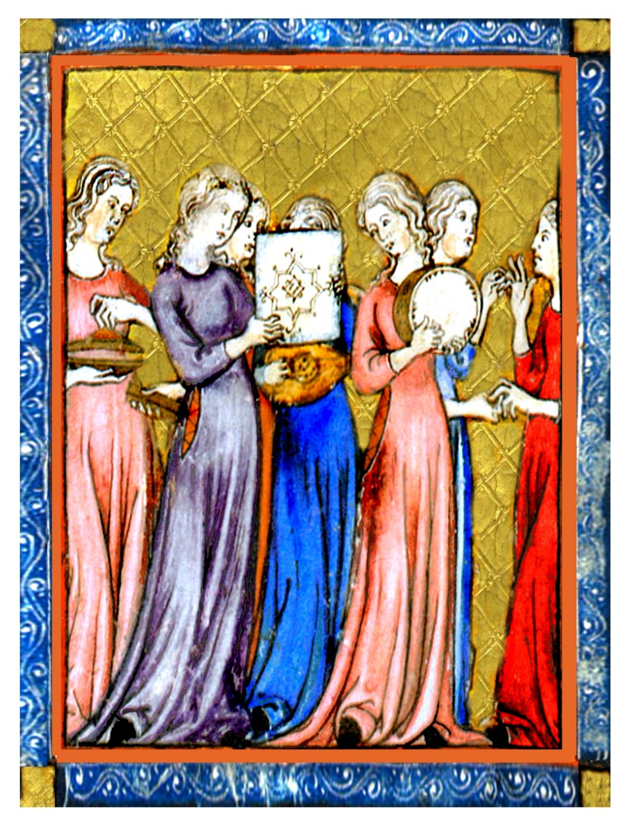
When Israel came forth out of Egypt, from the house of Jacob to a people, Judah became His sanctuary, Israel His dominion.
The picture illustrates the song of Miriam, showing women dancing and playing various instruments: round and square drums, castanets, the lute and cymbals. All the instruments except the lute are percussion instruments, while the lute is a string instrument. On the drums there are magical illustrations.
The drum is the main instrument used in celebrations of victories and heroism. It has many attributed meanings in ancient civilizations. The rhythm of the drums is similar to the beat of the heart. The drum was used in the past and is still used today in healing rituals. In ancient cultures, the drum was perceived as a feminine tool for two reasons. First, it's easy to operate, only requiring being hit with the palms, and easy to carry. Second, its hollow round shape is likened to a woman's stomach. Archaeologists discovered figurines of drumming women, and the discovery increased the conclusion that the drum was a musical instrument used by women and for women.
The Golden Haggadah, Spain, 14th century

Slide 15
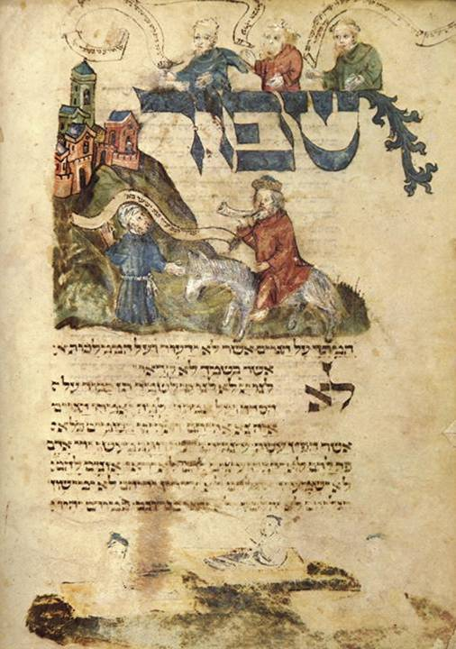
Pour out your wrath on the nations that refuse to acknowledge you--on kingdoms that do not call upon your name.
The saying of "pouring out your wrath on the nations" was added to the Haggadah by virtue of the distress of the Jews at the end of the Middle Ages. During the Passover season in particular, the Jews suffered from manifestations of anti-Semitism, riots and blood libels. On the Seder night while saying "pour out your wrath," they would open the door in the hope that Elijah would arrive at this very moment.
In the illustrations, alongside the words "shed your wrath," they used to paint Elijah the prophet, the harbinger of redemption, riding on a donkey and blowing the shofar. Before him goes the Messiah and together they march towards the built Jerusalem.
In the Haggadot that were printed after the establishment of the state, and especially after the Six-Day War, the painted image of Elijah the Prophet was replaced by the image of an IDF soldier, thus linking the Haggadah with the story of the present redemption and the establishment of the State.
Yoel Ben Shimon, Washington Haggadah, Florence, 1478

Slide 16
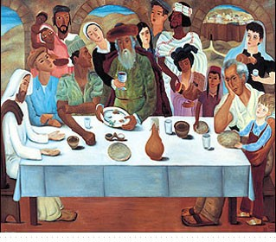
Next Year in Jerusalem
In his painting, "Seder Be’Yerushalayim" Reuven Rubin placed around a single table the Chasidic with the Shtreimel, the Palmachnik fighter, the pioneer, the new immigrants from Yemen and Morocco, and himself. He painted the painting in 1950, when many immigrants came to Israel from different places.
The artist is the man in the white shirt sitting on the right side of the table with a child on his knees. Behind them is a woman with a kerchief on her head, probably the artist's wife who also appears in other of his paintings. In the background is a desert landscape and in the distance the city of Jerusalem.
Why did Reuven paint a Palmahnik and not an IDF soldier? The Palmach was dismantled two years earlier when the state was established. Because in Reuben's eyes the Palmachnik symbolizes the values ​​of brotherhood and friendship, and this is the central message of the picture, that everyone can sit around one table despite differences of opinion.
Reuven Rubin, Passover in Jerusalem, 1950

