Slide 1
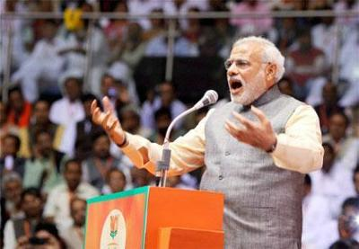
SURGICAL STRIKES LIKE ISRAELI ARMY'S EXPLOITS, SAYS PM (INDIAN MEDIA EXCERPT)
UPDATED: OCT 19, 2016, 10:09 IST, FILE PHOTO. PM NARENDRA MODI
MANDI (HP): IN HIS FIRST DIRECT REFERENCE TO THE SEPTEMBER 29 SURGICAL STRIKES+ ACROSS THE LINE OF CONTROL (LOC), PRIME MINISTER NARENDRA MODI SAID THAT WHILE ISRAEL HAS BEEN KNOWN FOR SUCH OPERATIONS, THE INDIAN ARMY HAS PROVED IT IS NO LESS CAPABLE. “TODAY THE ENTIRE NATION IS TALKING OF THE VALOUR OF OUR ARMY. EARLIER, WE USED TO HEAR OF ISRAEL HAVING DONE SOMETHING LIKE THIS. BUT THE COUNTRY HAS SEEN THAT THE INDIAN ARMY IS NO LESS THAN ANYONE ELSE" THE PM SAID, ADDRESSING A RALLY HERE ON TUESDAY .

Slide 2
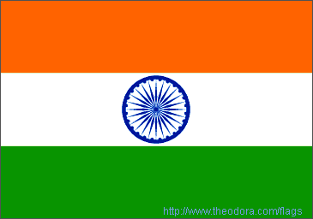
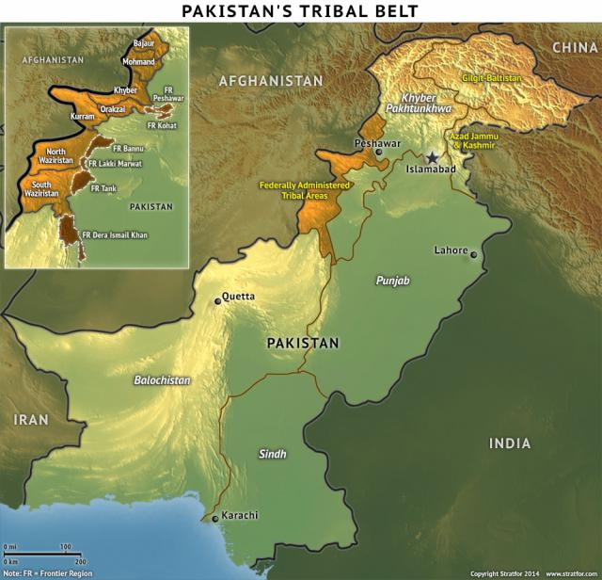
PROXY WARS OF INDIA & ISRAEL: LESSONS FOR INDIA’S COUNTER PROXY WAR STRAT IN KASHMIR
PAK : GLOBAL HUB OF TERROR
HIGH - ISLAMIST RADICALISM & SECTARIAN VIOLENCE
CONTINUES TO SUPPORT TALIBAN & HAQQANI NW
INIMICAL APCH & PROXY WAR AGAINST INDIA
LAND BDR– 3269 KM

Slide 3
KASHMIR
NW- INDIAN SUB CONTINENT
BDRS -AFGHAN, PAK & CHINA
INCLS
JAMMU & KASHMIR
PAK OCCUPIED KASHMIR,NORTHERN AREAS & AKSAI CHIN (CHINA}
J&K REGIONS
KASHMIR- 5.5 MN, 97 % Muslims
JAMMU- 4.5 MN, 70% HINDUS
LADAKH – 2.3 MN – BUDDHISTS 58 %
AFGANISTAN
CHINA
NORTHERN AREAS
PAK OCCUPIED KASHMIR
PAKISTAN
AKSAI CHIN
A’ KASHMIR
JAMMU & KASHMIR

Slide 4
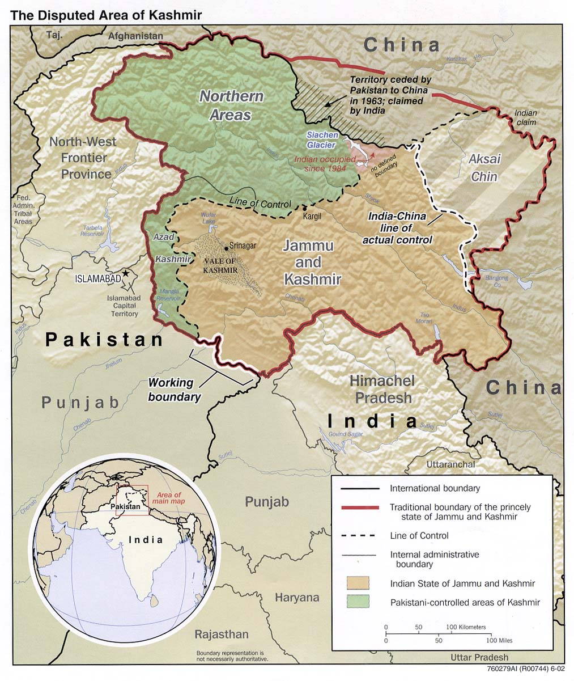
HISTORICAL PERSPECTIVE
MID 18TH CENTURY - PRE 1947 – INDIA UNDER BRITISH RULE
1947 - INDEPENDENCE AGREEMENT- PARTITION
KASHMIR ACCEED TO INDIA, FIRST WAR INDIA & PAK
1948 – UN RESOLUTION – CEASE FIRE LINE(LOC)
1957 – DECLARED A STATE OF INDIA UNION
1965 – INFILT BY PAK- SECOND WAR WITH PAKISTAN
1971 – INDIA LIBERATED EAST PAK (BANGLADESH}
THIRD INDIA PAK WAR- SHIMLA AGREEMENT
1989 – PAK SP UPSURGE TO INSURGENCY
1999 – PAK VIOLATED LOC- KARGIL WAR
2005 – CEASE FIRE
2010- 12 – FRESH ROUND OF MILITANCY
2016 –UPSURGE & INTERNAL UNREST

Slide 5
INDIA
PAKISTAN
ACCESSION LEGAL & INDISPUTABLE
RELIGIOUS ISSUE IRRELAVENT
AN INDIAN STATE – DEMOCRATIC
GOVT
PAK SPONSORED TERROR TO
DISRUPT DEMOCRACY
LARGE MUSLIM POPU SP ACCESSION
INTERNAL & BILATERAL ISSUE
TWO NATION THEORY - KASHMIR BELONGS TO PAK
NO MTRL SP TO INSURGENCY IN KASHMIR
INDEGENOUS STRUGGLE OPPOSED TO INDIAN RULE
KASHMIRIS-CHOOSE BETN INDIA & PAK
UN/INTERNATIONAL MEDIATION

Slide 6
IMPACT OF PROXY WAR
MIL- INTENSE INVOLVEMENT- EASY INTRUSION(TRN)
ECO DEPRIVATION & LACK OF OPPORTUNITIES / INFRA IN BDR As
ETHNIC STRIFE & CONFLICTS WITHIN THREE DISTINCT REGIONS
SOCIAL – VICTIMISATION, PEOPLE BEING GOADED TO JOIN INSURGENCY & LOW LITERACY RATE
RELATIONS WITH PAK (INSTABILITY- IMPACT DEVP)

Slide 7
ISRAEL’ S PROXY WAR
MAJ SECURITY CHALLENGE SINCE INDEPENDENCE
HAMAS, PALESTINIAN ISLAMIC JIHAD & HEZBOLLAH – PROXIES OF INIMICAL STATES
HEZBOLLAH- A POTENT MIX OF MIL, POL, SOCIAL ORG & A TRTS GP
MANIFESTATION
INTIFADA TERROR(SUICIDE ATTACKS)
HIGH TRAJECTORY RKT & MSL FIRE
RESPONSE –OFFN(PUNITIVE) DETERRENCE

Slide 8
LINKAGES AND CHALLENGES :
PROXY WARS OF INDIA & ISRAEL

Slide 9
WHAT IS DIFFERENT ?
INDIAN APCH AIMED AT POL ACCN & RECONCILIATION VS ISRAELI APCH AIMED AT BREAKING MIL CAPB
INDIA’S PROXY WAR UNDER A NUC OVERHANG ENTAILING A CALIBRATED APCH VS ISRAELI PREEMPTIVE STRIKES AIMED AT EXISTING & POTENTIAL THREATS
INDIA -GRID DPLY ENTAILING PHY CONT OF AREA VS. ISRAELI MODEL RELYING ON INT TO UNDERTAKE CLINICAL STANDOFF STRIKES
INDIA UNLIKE ISRAEL DOES NOT ENJOY FORCE ASYMMETRY & CONDUCTS MOST MIL OPS IN As DOMINATED BY OWN POPU

Slide 10
CHALLENGES & LINKAGES
DECISIVE VICTORY OVER TERRORISM RARE
COUNTERMEASURES BLOCK ONE AVENUE – TRTS IMPROVISE
PHY BARRIERS (UNDERGROUND TUNNELS, RKTS & MSLS)
INTELLIGENCE & USE OF TECH AS A FM
EMP OF SPL FORCES
CLAUSEWITIZIAN ‘TRINITY’
GOVT - ‘RATIONAL’
PEOPLE AS ‘IRRATIONAL’ POL WILL
MILITARY AS ‘NON-RATIONAL’ LONG LASTING SOLN

Slide 11
GOAL OF THE PAPER
TO STUDY PROXY WARS OF INDIA & ISRAEL AND DRAW LESSONS FOR INDIA’S COUNTER PROXY WAR STRATEGY IN KASHMIR
RELEVANT TO INDIAN CONTEXT FROM ISRAELI EXPERIENCE
LESSONS FROM ISRAELI OP STRATEGIES & SPL ORG
SPECIALISED INT OPS
CO-OPTION OF MODERN TECH TO STRENGTHEN PHY SECURITY INFRA AT BDR As & HINTERLAND BASES
RELEVANT TO ISRAELI CONTEXT FROM INDIAN EXPERIENCE
DESIGN, NATURE AND SCOPE OF COUNTER TRTS OPS WAGED AGAINST A NUC ARMED NEIGHBOUR
COUNTER TRTS OPS IN INCREASINGLY RADICALIZED SOCIETY
SPECIFIC RESEARCH QUESTIONS

Slide 12
METHOD OF PRESENTING IDEA OF RESEARCH
CHAPTER 1. HISTORICAL BACKGROUND - PAK SPONSORED TERRORISM IN J&K (PARTITION ON RELIGIOUS LINES, INDIA EMERGING AS MULTI ETHNIC, MULTI RELIGION & LIBERAL DEMOCRATIC SOCIETY WITH NUMEROUS FAULT LINES)
CHAPTER 2. INDIA’S STRATEGY IN KASHMIR AND ITS SHORTCOMINGS
POL LEVEL CONFLICT MGT VS. CONFLICT RESOLUTION
INABILITY TO HOLD PAK ACCOUNTABLE FOR IMMORAL & UNJUST WAR
PERSECUTION OR ALIENATION OF KASHMIRI AWAM.
MIL LEVEL
BORDER SECURITY- ABILITY OF TRTS TO INFILT DESPITE LOC FENCE & CI GRID
ABILITY OF TRTS TO STRIKE & INFLICT HIGH CAS
FIGHTING IN OWN TERRITORY: PREDICTABILITY OF RESPONSE
ADEQUACY OF INT, EQPT & TECH

Slide 13
METHOD OF PRESENTING IDEA OF RESEARCH
CHAPTER 3. ISRAELI EXPERIENCE –BACKGROUND, LESSONS & CONDITIONS FOR WAGING A SUCCESSFUL WAR AGAINST TERRORISM
CHAPTER 4 . PROPOSED STRATEGY FOR INDIA
POLITICO – ECO AND SOCIAL LEVEL (EXTERNAL & INTERNAL)
SYNERGISED INTEG APCH
REDRAW AREA OF INFLUENCE – SHAPING THE ENVT
USE DIPLOMATIC & ECO LEVERAGES AGAINST PAK
POL SOLN TO ADDRESS ALIENATION WITHIN KASHMIR
MILLEVEL.
STR MECHANISMS - EXPL OF TECH FOR BDR & HINTERLAND SECURITY
ENHANCED POTENCY & UNPREDICTABILITY (TIMING) OF RESPONSE.
COVERT S CAPB OP
CHAPTER 5. WAY FWD & LESSONS FOR INDIA & ISRAEL

Slide 14
METHOD OF PRESENTING IDEA OF RESEARCH
IMPORTANCE/NOVELTY OF PAPER
PAPER WILL DRAW OUT LESSONS RELEVANT TO INDIA FOR CONDUCT OF OPS & SET OUT AREAS OF MUT INTEREST IN SPECIFIC FDS BET INDIA & ISRAEL
CONNECTION OF PAPER TO NATIONAL SECURITY
TOPIC IS FUNDAMENTAL SUBSET OF NATIONAL SECURITYAND IN LINE WITH CURRENT & EVOLVING NATURE OF FUTURE WARS/CONFLICTS
AUTHOR’S LINK TO WORK
PAPER IS BASED ON PROFESSIONAL EXPERIENCE & ANTICIPATED EMP OF AUTHOR IN IA

Slide 15
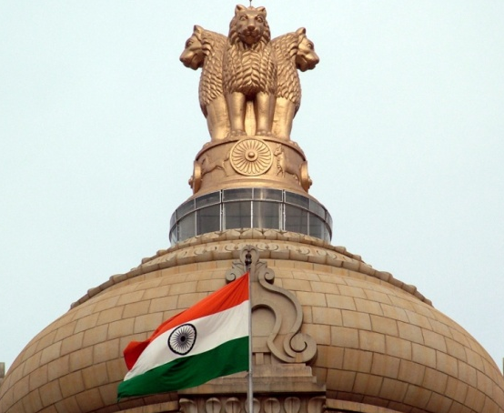
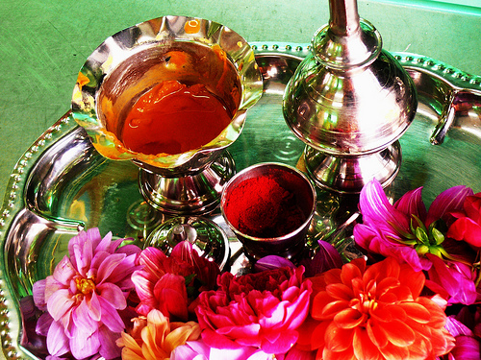
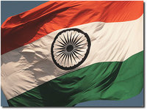
T’
O
D
A
R
A
B
B
A
?

Slide 16
Dell Theory of War Prevention
– “The World is Flat”, Thomas Friedman 2002
"Pakistan is using terrorism as an instrument of state policy. We have to prepare for a situation of two-front war. The challenge is to engage them diplomatically, create economic inter-dependence, and engage in various other fields, and at the same time build our deterrence capability."
– Ajit Doval, NSA November 22, 2014

