Slide 1
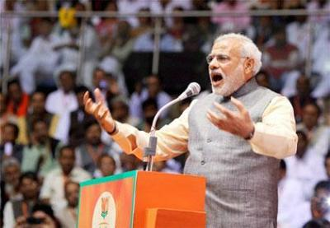
INDIA’S SUB CONVENTIONAL WAR IN KASHMIR : LESSONS FROM ISRAELI EXPERIENCE
SURGICAL STRIKES LIKE ISRAELI ARMY'S EXPLOITS, SAYS PM
(MEDIA EXCERPT) UPDATED: OCT 19, 2016, 10:09 IST
MANDI (HP): IN HIS FIRST DIRECT REFERENCE TO SEP 29 SURGICAL STRIKES ACROSS LOC, PM SAID THAT WHILE ISRAEL HAS BEEN KNOWN FOR SUCH OPS, INDIAN ARMY HAS PROVED IT IS NO LESS CAPABLE. THE PM SAID, ADDRESSING A RALLY HERE ON TUESDAY .

Slide 2
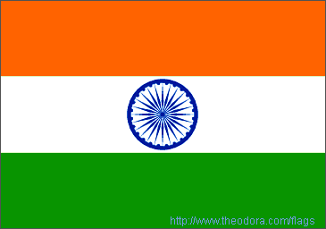
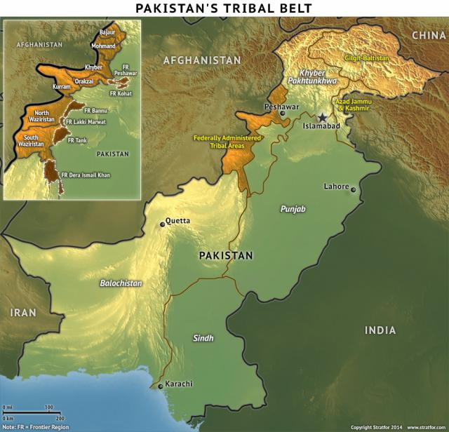
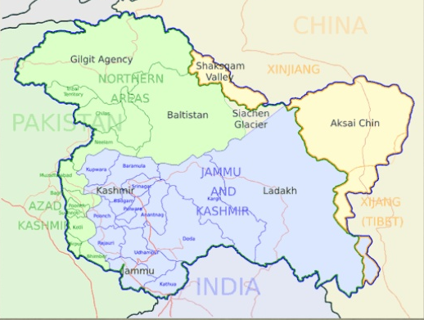
INDIA’S SUB CONVENTIONAL WAR IN KASHMIR: LESSONS FROM ISRAELI EXPERIENCE
AFGANISTAN
AFGANISTAN
CHINA
NA
CHINA
POK
AKSAI CHIN
PAKISTAN
J & K
LAND BDR– 3269 KM
GLOBAL HUB OF TERROR
HIGH - ISLAMIST RADICALISM
CONTINUES TO SUPPORT TALIBAN & HAQQANI NET WORK
PROXY WAR AGAINST INDIA
NW Part of Indian Sub Continent
Boundaries - Afghanistan , Pak & China
Comprises: J&K, POK, NA’s & Aksai Chin (China}
J & K Regions
Kashmir- 5.5 Mn, 97 % Muslims
Jammu- 4.5 Mn, 70% Hindus
Ladakh – 2.3 Mn – Buddhists 58 %
BANGLADESH

Slide 3
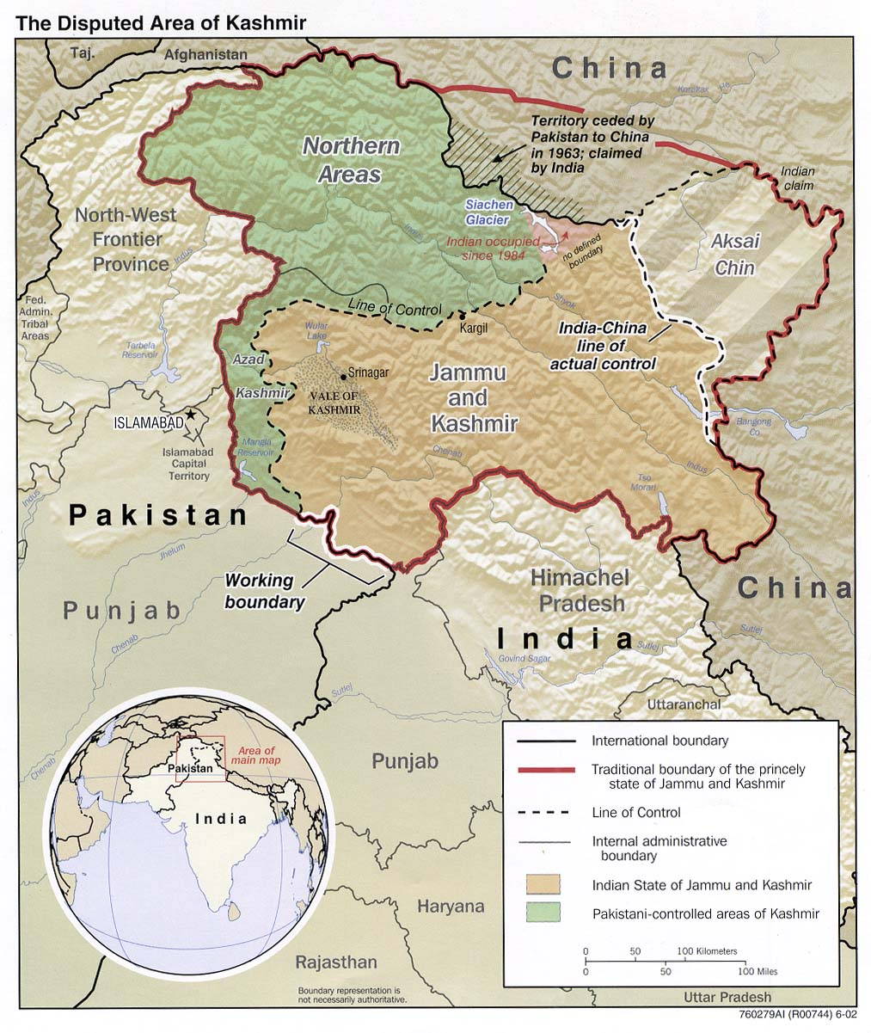
HISTORICAL PERSPECTIVE
PRE 1947 - UNDIVIDED INDIA UNDER BRITISH RULE
1947 - PARTITION AGREEMENT- KASHMIR ACCEED TO INDIA, FIRST WAR INDIA & PAK
1948 - UN RESOLUTION – CEASE FIRE LINE(LOC)
1957 - DECLARED A STATE OF INDIA UNION
1965 - SECOND WAR WITH PAK
1971 - INDIA LIBERATED EAST PAK (BANGLADESH}
THIRD INDIA PAK WAR- SHIMLA AGREEMENT
1989 - PAK : PORXY WAR & UPSURGE TO SEPARATIST
MOV EMENT
1999 - PAK VIOLATED LOC- KARGIL WAR
2005 - INDIA & PAK CEASE FIRE AGREEMENT
2010- 12 - FRESH ROUND OF MILITANCY
2016 - A MAJOR UPSURGE & INTERNAL UNREST

Slide 4
VIEWS & STANDPOINTS
Background
Maharaja of J & K keen to retain independence
Pak Misdeeds, intimidation and blockade led to signing instrument of accession
Large scale devastation by Pakistan tribesmen
Indian army offensive to liberate Kashmir
13 Jul 1948 UN Resolution
Stage 1- Cease fire
Stage 2- Truce agreement (Withdrawal to pre 1947 positions)
Stage 3 - Determination of will of people
Pakistan
Demands plebiscite Before stage 1 & 2
Failed to withdraw from occupied areas
Occupation of Northern areas and Siachen
Gifting of a portion of occupied Kashmir to China
Inciting violence in name of Islam
India
UN Resolution irrelevant – 1971 Simla Agreement
Religious issue irrelevant ( Indian has close to 200 million Muslims)
Ruled by a democratic government
Post Shimla agreement - An Internal & bilateral issue
Vindicate “Two Nation” theory, "raison d'etre" for existence of Pakistan
Strategically important state , the accession of State is legal & indisputable
STANDPOINT OF POSITION OF INTERNATIONAL ACTORS & ORGANISATIONS

Slide 5
INDIA’S SUB CONVENTIONAL WAR IN J & K
EXTERNAL DIMENSION
INFILT ACROSS LOC - TERRORIST ATTACKS
PROVISION OF MATERIAL, IDEOLOGICAL & MILITARY SUPPORT BY PAKISTAN
OVERT SUPPORT TO SEPARATIST ORGANISATIONS
INTERNAL DIMENSION
POLITICO,SOCIO ECONOMIC FAULT LINES
ALIENATION OF POPULATION , LACK OF OPPORTUNITIES & RADICALISTION OF YOUTH
INDIGENOUS INSURGENCY
COUNTER PROXY WAR STRATEGY - DEFENSIVE ORIENTATION
BASED ON POLITICAL RECONCILIATION & ACCOMMODATION AS PRIMARY ELEMENTS WITH MILITARY ACTING AS SUPPORT ELEMENT - MISMANAGEMENT & MISSED OPPORTUNITIES
OPERATIONS RESTRICTED ON OWN SIDE OF LOC
PHYSICAL CONTROL BASED ON GRID SYSTEM OF DEPLOYMENT- ENHANCED VULNERABILITY OF FORCES & MILITARY STRATEGY FAULT LINES

Slide 6
ISRAEL’ S EXPERIENCE WITH TERROR
MAJ SECURITY CHALLENGE SINCE INDEPENDENCE
HAMAS, PALESTINIAN ISLAMIC JIHAD & HEZBOLLAH – PROXIES OF INIMICAL STATES
MANIFESTATION
HEZBOLLAH- A POTENT MIX OF MIL, POL, SOCIAL ORG & A TRTS GP
INTIFADA 1 & 2 - TERROR & (SUICIDE ATTACKS)
CURRENT - HIGH TRAJECTORY RKT & MSL FIRE
RESPONSE –OFFN(PUNITIVE) DETERRENCE

Slide 7
BROAD CONTOURS : ISRAEL STRATEGY
External Arena
Global/ International Level
Not allow Hezbollah to grow militarily
Redlines; Punitive deterrence - Operations to hit wherever it counts, No illicit arms/ funds transfer
Tacit alliances, support /fund to those opposed & use of proxies
Regional Level
- Building security buffers in terms of regimes favorable to Israel & b unfavorable to Hezbollah
- Engage opportunity targets - Arms convoys etc. by use of Air force & armed drones
- Use UNIFIL to effectively control the area
Internal Arena
Relevant & precise intelligence - Detailed knowledge of human terrain & expl of cyber & social media
Depth to border security by exploiting occupational intelligence
Physical security measures base on human & technological effort at border and bases
Denial of exposed flanks -Intel /Special Forces driven operations
Sound legal framework to support operations

Slide 8
DIFFERENCES VS RELEVANCE
Indian apch aimed at pol accn & reconciliation vs Israeli at breaking mil capb & targeted killings
India's proxy war under a nuc overhang entailing a calibrated apch vs Israeli preemptive strikes aimed at existing & potential threats
India -grid dply entailing phy cont of area vs. Israeli model relying on int to undertake clinical standoff strikes
India unlike Israel does not enjoy force asymmetry & conducts most mil ops in as dominated by own population
Despite the differences in approaches – vast potential exists for adoption of relevant lessons from Israeli system of Intelligence, intelligence & op rational coordination /synergy, cyber, use of technology as a sp to human effort in security , and cross border covert & overt strikes

Slide 9
THE RELEVANCE GAP
BRIDGING OF GAP IS THE SCOPE OF PROPSED STRATEGY
RELEVANCE/
STRATEGIC GAP
WE WANT TO BE
PEACE PROSPERITY & INTEGRATION
P
E
R
F
R
M
A
N
C
E
GAP IS WIDE
WE ARE LIKELY TO BE
IF NO CHANGES ARE
MADE TO CURRENT SYS
WE ARE
HERE
WE
WERE
HERE
T-1
T-2
T n
UNEASY CALM - GRAVE SECURITY SITUATION
LEGACY SYS
CURRENT SYS
PROPOSED SYSTEM

Slide 10
THE RELEVANCE GAP
OVERT & COVERT SUPPORT FROM PAK- DILPLOMATIC & POLITCAL DEADLOOK (WATER AS LEVERAGE)
INEFF GOVERNANCE, ALIENATION, RADICALISATION OF YOUTH- IMPETUS OF HOMEGROWN MILITANCY
UNEASY CALM BORDERING ON GRAVE SECURITY SITUATION
SUCCESSFUL SURGICAL STRIKES SEP 2016
WORLD POWERS
INDIFFERENT -DISPUTE BETWEEN INDIA & PAKISTAN
POPULATION & YOUTH
GROWING SP TO MILITANTS
RISE OF UN ATTACHED MILITANTS
SEPARATISTS
ANTI INDIA AGENDA
MORAL SP TO TERRORISTS
SHUTDOWNS
GOVERNMENT
LACK OF POLITICAL INITIATIVE
NO ENGAGEMENT WITH SEPARATISTS
EXTERNAL ENVIRONMENT
INTERNAL
ENVIRONMENT
SECURITY FORCES
INCR TERROR ATTACKS
HIGH CAS
FATIGUE & GAPS IN STRATEGY
TERROR OUTFITS
HIGHER LEVEL OF MOTIVATION
INCR ATTACKS ON ARMY & SF
ENHANCED POTENCY
IDEOLOGICAL,
MORAL,
PHY & FIN SP

Slide 11
GOAL OF THE PAPER
TO STUDY INDIA’S SUB CONVENTIONAL WAR IN KASHMIR AND DRAW LESSONS FOR INDIA’S COUNTER PROXY WAR STRATEGY IN KASHMIR FROM ISRAELI EXPERIENCE
What are potential opportunities that will enable a relevant strategy & campaign concept?
What are major drawbacks of the national politico-social & economic strategy in Kashmir?
What are the shortcomings of the military strategy to fight effective counter terror operations in Kashmir?
Is India current strategy of restricting its counter terror operations to own side of LoC a failure?
Is it time that India considered paying back the Pakistan and wage a covert war in Pakistan? Can India adopt a preemptive/offensive counter terror strategy to hit terror camps across LoC in Pakistan?
What lessons can India derive to strengthen the its Intelligence agencies & information operations from the Israeli experience?
What can India learn from the Israeli border & physical security of army basses & camps with respect to use of modern technology systems?
What lessons can India derive from the Israeli counter terror strategy against Hezbollah and Hamas?
How can the Indian security forces carry out improvement in their systemic procedures & optimise existing structures/organisations to fight effective counter terror operations?
What could be the broad contours of India proposed overall counter proxy war strategy against Pakistan?
RESEARCH QUESTIONS

Slide 12
DRAWBACKS OF CURRENT STRATEGY
SECURITY/ MILITARY STRATEGY
Defensive response to terror(act of war)
Non Unified Institutional structure
Unintelligent Infrastructure -Lack of coordination between Intelligence Agencies
Deficiencies in Information operations & lack of synergy between operations & Intelligence
Reliance on physical security measures- no optimisation of available technologies for security
Chinks in counter terror capacities -Inadequacies in organisation,equipment at operational & tactical level
Lack of Legal Laws & frameworks
POLITICO,DIPLOMATIC STRATEGY
Political contestation and at National & state level
Political Mismanagement
Absence of broader framework to deal with terrorism
Inability to garner International support to isolate Pakistan globally
SOCIO ECONOMIC STRATEGY
Lack of Economic growth & Development
Sense of alienation of local population
Fresh recruitments- Rise in number of locals joining militancy
Inability to separate youth from Pakistan’s influence and radicalisation

Slide 13
POTENTIALS
POLITICO,DIPLOMATIC STRATEGY
Maj powers indifferent to Pak attempt to internationalise issue -Isolate Pakistan diplomatically
Exploit Internal situation in Pakistan
Changes in Political atmosphere - Dialogue
Forward movement on demand of autonomy
SECURITY/ MILITARY STRATEGY
Optimise success of Surgical strikes to put in place a pre-emptive & offensive counter proxy strategy
Cooperation & synergy in Intel setup & info gathering mechanism
Technology to supplement human effort in border & physical security
Enhance and capacity build counter terrorism structures & organisations
Incorporate law & order mechanism, PSA
Review existing Legal framework- Avoid misuse of AFSPA,
SOCIO ECONOMIC STRATEGY
Reaching out to moderates among Separatists
Youth engagement & empowerment
Separation of youth from Pakistan propaganda & radicalisation
Crackdown on illegal money transactions
Exploit cyber & social media

Slide 14
RECOMMENDATIONS : PROPOSED STRATEGY
POLITICO,DIPLOMATIC STRATEGY
Leveraging & coordinating the tools of governance- Synergetic use all denominations od national power
Political engagement
Isolate Pakistan globally
SECURITY/ MILITARY STRATEGY
Creation of leverage & options for trans LoC operations
Evolution of superior intelligence system
Cooperation & Synergy
Concept of relevant intelligence
Providing depth to intelligence
Use of tech for intelligence & information supremacy
Force build up in cyber space
Border fencing & physical security
Reorganisation ,Equipping & Training of forces -Force Restructuring & Modernisation
Counter Terror Operations
Address systemic deficiencies at operational & tactical level
Improvement in individual protective gear & Eqpt
Training & readiness.
Fine tuning of drills & procedures
Strengthening procedural & legal security
Psychological operations
Incorporate Law order component for operations with state of art riot control equipment
SOCIO ECONOMIC STRATEGY
Improved local governance
Mainstream the Kashmiri youth
Engagement of Religious Leaders- Influence
Initiatives to meet aspirations of local population
Special development/ financial schemes, CSR

Slide 15
METHOD OF PRESENTING IDEA OF RESEARCH
CHAPTER 1. HISTORICAL BACKGROUND- JMMU & KASHMIR BACKGROUNDER
CHAPTER 2. THE PROXY WAR IN KASHMIR
CHAPTER 3. ANLYSIS OF KEY FACTORS & ACTORS
CHAPTER 4. DRAWBACKS OF INDIA’S CURRENT PROXY WAR STRATEGY IN KASHMIR
CHAPTER 5. PROPOSED STRATEGY FOR INDIA
POLITICO – ECO AND SOCIAL LEVEL
MILLEVEL

Slide 16
KEY TAKE AWAYS
Strategic Level
Overall- Formulation of a Coherent strategy
Politico-Social & Economic Sterategy
Leveraging & coordinating the tools of governance- - use all denominations od national power
Political engagement
Isolate Pakistan globally
Initiatives to meet aspirations of local population
Mainstream the Kashmiri youth
Special packages and schemes
Military Strategy- Creation of leverage & options for trans LoC operations
Operational & Tactical Level
Evolution of superior intelligence system
Cooperation & Synergy
Providing depth to intelligence
Use of tech for intelligence & information supremacy
Force build up in cyber space
Border fencing & physical security
Reorganisation ,Equipping & Training of forces -Force Restructuring & Modernisation
Counter Terrorism Operations
Address systemic deficiencies at operational & tactical level
Improvement in individual protective gear & equipment
Fine tuning of drills & procedures
Training & readiness
Strengthening procedural & legal security
Psychological operations
Incorporate Law order component for operations with state of art riot control equipment

Slide 17
KEY TAKE AWAYS : ISRAELI EXPERIENCE
Creation of leverage & options for overt and covert trans LoC operations
Evolution of superior intelligence system
Use of tech for intelligence & information supremacy
Force build up in cyber space
Use of Technology for border fencing & physical security
Strengthening procedural & legal security
Incorporate Law order component for operations with state of art riot control equipment

Slide 18
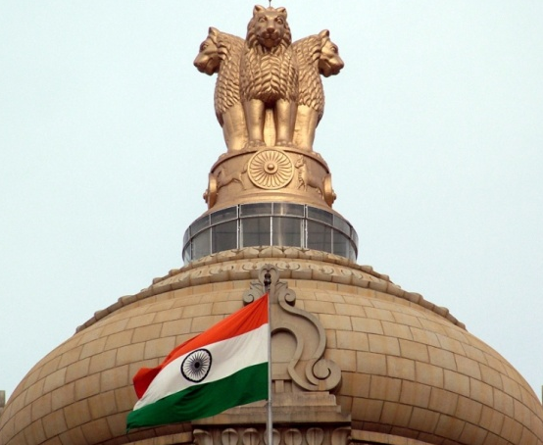
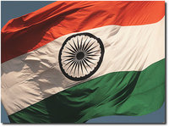
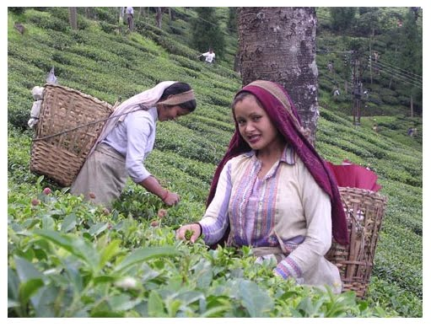
T’
O
D
A
R
A
B
B
A
?

