Slide 1
JUN
N A T I O N A L
S E C U R I T Y
S E M I N A R
National Security Staff Ride (NSSR) #1 (Gettysburg) 20-21 SEP; NSSR #2 (NYC) 5-7 APR; Army Strategy Conference 26-28 APR; NSSR #3 (DC) 9-
11 MAY; Graduation 9 June 17
National Security Policy Program Advanced Strategic Art Program
Student Social Activities Noontime Lectures Student Athletic Program
Perspectives/Kleber Lectures
MAY
N S S R
# 3
D C
Electives
A R M Y
S T R A T E G Y
C O N F
APR
N S S R
# 2
N Y C
School of Strategic Landpower
Resident Program AY2017
MAR
O R A L
C O M P
E X A M S
▪
▪
▪
▪
G L O B A L
S E C U R I T Y
S Y M P O S I U M
▪
▪
Defense Manage- ment
FEB
I F
T R A V E L
STRATEGY RESEARCH PROJECT
COMPLEMENTARY PROGRAMS
Theater Strategy and
Campaigning
Regional Studies Program
SPECIAL PROGRAMS
JAN
DEC
Eisenhower Series College Program
Carlisle Scholars Program
National Security Policy And Strategy
NOV
Senior Leader Development and
Military History Program Strategic Arts Film Program
OCT
L E A D E R S H I P
S T R A T E G I C
N S S R
# 1
G E T T Y S B U R G
Resiliency Program
SEP
Theory Of War and
Strategy
AUG
I N T R O
T O
S T R A T E G I C
S T U D I
E
S
▪
▪
▪
▪
▪
O R I E N T A T I O N

Slide 2
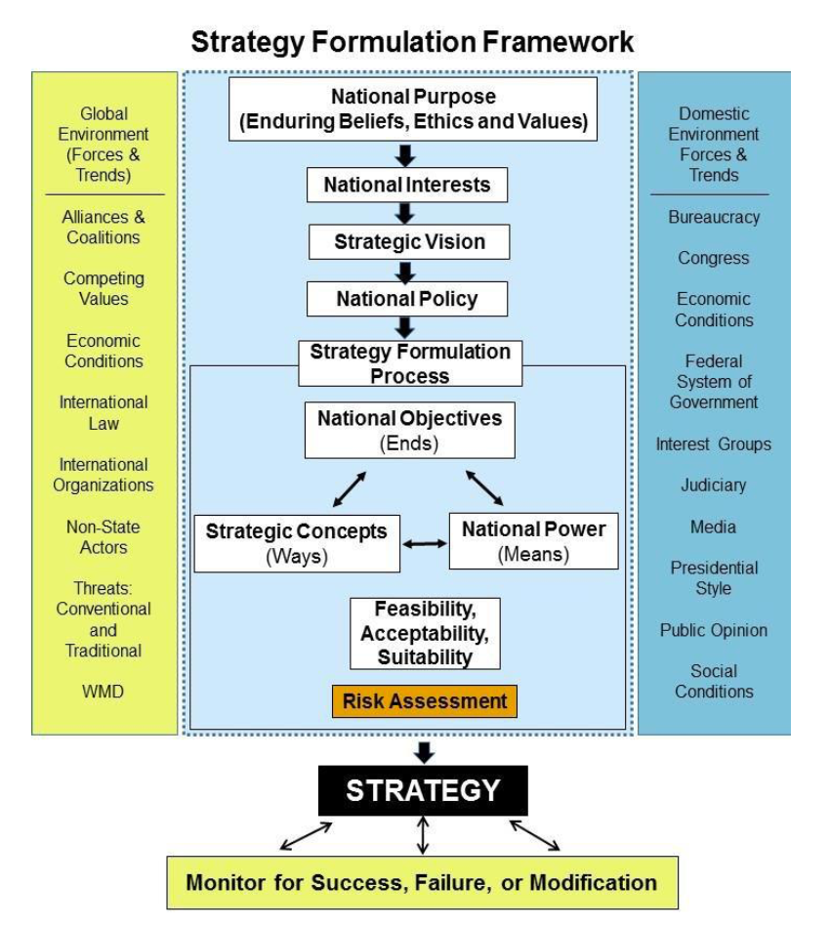
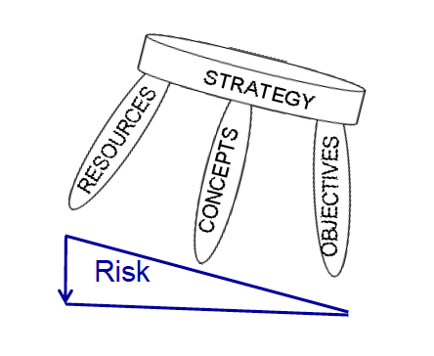
NSPS – Card 1
Policy and Strategy Test
Must determine if it is Feasible, Acceptable, and Suitable.
Another way to look at it:
Suitable: Corresponds to the “Ends” (Will this actually give us our intended outcome?)
Acceptable: Corresponds to the “Ways” (Are the methods compatible with our values? Any unintended consequences?)
Feasible: Corresponds to the “Means” (Do we even have the capability / capacity to do this?)
In practical application, these three typically combine into the National Security Strategy, written by the President.
NSPS Definition of Grand Strategy
The use of all instruments of national power in peace and war to support a strategic vision of America’s role in the world that will best achieve national objectives.
All strategy is a calculation of ways and means directed towards the accomplishment of ends, balanced against a continuous assessment of risk.

Slide 3
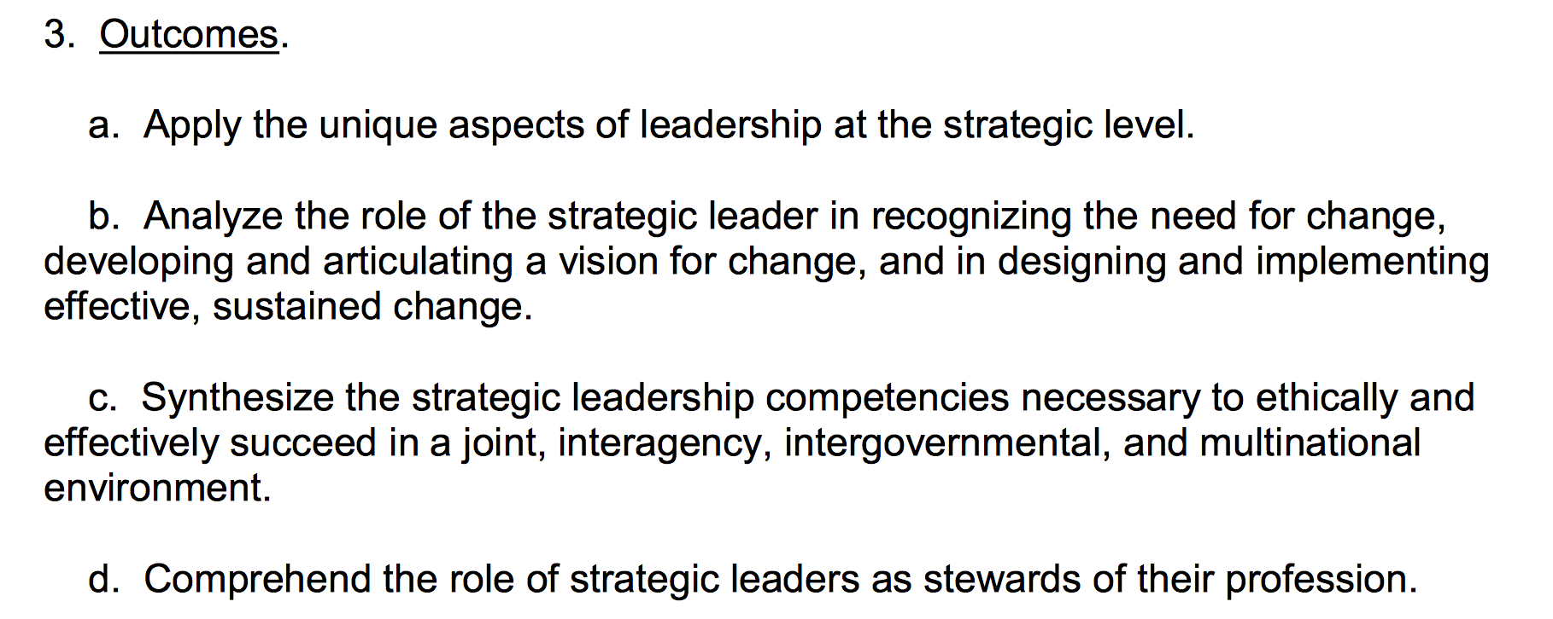
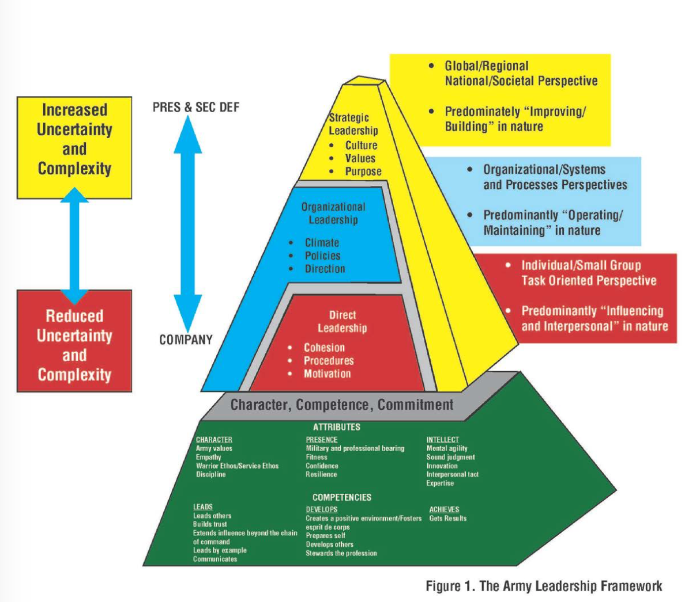
SL – Course Objectives

