Slide 1
INDC
April 2019
State Budget

Slide 2
Issues in Macroeconomic Policy in Israel
Budget Preparation Process
Fiscal Review
Background and Macro Snapshot

Slide 3


Budget Division - Nice to meet
About 70 economists have a degree in economics
Age ranges from 25-40 years

Slide 4
Budget Division - Areas of Responsibility
Formulation of fiscal policy
Preparing the state budget, submitting it for the approval of the government and the Knesset, and running it on a regular basis
Structural reforms - identifying failures in government involvement and formulating appropriate solutions in cooperation with other branches of the Ministry of Finance and the relevant ministries

Slide 5
Work Method
Macroeconomic situation
Dealing with the challenges of the economy in various fields

Slide 6
During the course of 2018, the growth rate moderated, and the growth rate in the coming years is expected to be close to a long-term potential
An average annual growth rate of about 4% in the years 2016-2003
The global economic crisis
The Second Intifada Period
מקור: למ"ס. *2018 – תחזית למ"ס, 2019 ואילך תחזית כלכלן ראשי מעודכנת לינואר 2019

Slide 7
GDP per capita by international comparison (2018, in current dollars, adjusted in terms of purchasing power)
Dollars Flow
מקור: IMF
Notes:
תוסיפו טבלה עם מיקום יחסי בעשורים קודמים (כמו בדה מרקר...)

Slide 8
The labor market in a full employment environment
January - November

Slide 9
Massive entry of various populations into the labor
market - there are still gaps
The participation rate, the main working age groups (25-64)
מקור: למ"ס

Slide 10
Significant demographic changes in the labor force
מקור: הלמ"ס ועיבודי הכלכלן הראשי, גילאי 25-64, חלופה בינונית

Slide 11
A significant gap in the inventory of economic infrastructures (2015% of GDP)
Source: McKinsey, Infrastructure Report 2030

Slide 12




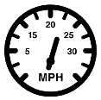


The infrastructure gap is felt in many sectors
234 min Non-supply of electricity per year
(Compared with an average of 42 minutes in European countries)
2.5% renewable energy out of total production
(Compared with 14% in the OECD countries in Europe)
Fill coefficient of about 1.2
(Compared with a European average of about 1.6)
The coefficient of a split of about 20%
(Compared to 40% in the target cities)
Commercial speed is about 30%
(17 mph vs. 25 mph compared to target cities)
80% of landfill waste treatment
(Compared to an average of 40% in European countries)
Average Speed
Slow Cellular
(9 Mbps vs. 18 Mbps international)

Slide 13
Action Directions
Productivity
Population
Local-central government relations

Slide 14
שיטת העבודה
Macroeconomic situation
Coping with the challenges of the economy
Economic Plan / Reforms
State Budget

Slide 15
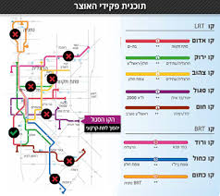
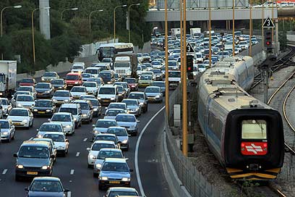
Providing solutions in the field of transportation infrastructure
Economic Plan / Reforms
State Budget
Removing barriers to advancing infrastructure
Increasing the budget for investment in public transportation infrastructure
And demand management

Slide 16
Issues in Macroeconomic Policy in Israel
Budget Preparation Process
Fiscal Review
Background and Macro Snapshot

Slide 17
State Budget: The Rules of the Game
Government Expenditure
Deficit
and Debt
Tax Policy

Slide 18
Public Expenditure as Percent of GDP
(2000-2018)
מקור: סה"כ הוצאה הממשלה הרחבה, בנק ישראל

Slide 19
Public Expenditure as Percent of GDP
Iceland
Poland
Italy
Israel
Portugal
Slovakia
Greece
Holland
Slovenia
Finland
Austria
France
Sweden
Belgium
Denmark
Czech Republic
Norway
Germany
Hungary
מקור: OECD

Slide 20
Public Expenditure as Percent of GDP
מקור: OECD

Slide 21
Civilian Expenditure as Percent of GDP Compared to OECD Countries -2017
מקור: OECD

Slide 22
The Tax Burden as a Percentage of GDP
(2000-2017)
Source: General Government income, Bank of Israel
*estimate

Slide 23
The Tax Burden 2002
מקור: OECD

Slide 24
The Tax Burden in Percent of GDP - 2017
מקור: OECD

Slide 25
A starting Point for Building a Budget: High Expenditure
on Security and Interest and a Relatively Low Tax Burden
Notes:
1 . בואו נניח את השכונה בה אנו גרים לרגע בצד. לגבי תשלומי הריבית – אם נשכיל היום לשמור על גרעון נמוך אז נפנה לעצמנו מקור עתידי בשנים הבאות.
2. לגבי תקציב הביטחון – נדבר בקצרה בהמשך.

Slide 26
Issues in Macroeconomic Policy in Israel
Budget Preparation Process
Fiscal Review
Background and Macro Snapshot

Slide 27
State budget: the Rules of the Game
Government Expenditure
Deficit
and
Debt
Tax Policy

Slide 28
Budget Rules
Basic Law: The State Economy
Fiscal Framework Law
Budget Foundations Law
The Annual Budget Law
Economic Plan (Arrangements Law)

Slide 29
Budgeting Methodology
Autopilot Consequential increase
An increase in the expenditure limit according to Growth is allowed
Adjusting the budget
growth and revenue projections + Allowed budget Deficit
gap
Autopilot
The permitted
budget does not
meet the
deficit ceiling
The
Permitted
budget
is the
deficit ceiling
Deficit 2020
Original budget 2020
גידול מותר
Forecast of tax revenues for 2020
תקציב מקורי
לשנת 2019
Make additional
adjustments to
your revenue
or budget

Slide 30

January-Febuary
Formulation of a work plan
Budget Construction Process
March-April
Prepare handouts and calculating the autopilot
April-May
Determining the growth projections and estimate the State revenues
April-May
The expenditure limit and the deficit ceiling
May-June
Policy Decision: Prime Minister + Minister of Finance
June-July
Final formulation of structural changes
Applying required budget adjustments
July-August
Government Decision
Final Discussion
August-September
Building the detailed budget
Ministerial Committee on Legislation
September-October
Submission of the Budget Law and Economic Policy to the Knesset
November-December
Discussion and approval of the Budget Law and the Economic Plan

Slide 31



Structure of the State Budget
The Original Budget for 2019, NIS billion

Slide 32
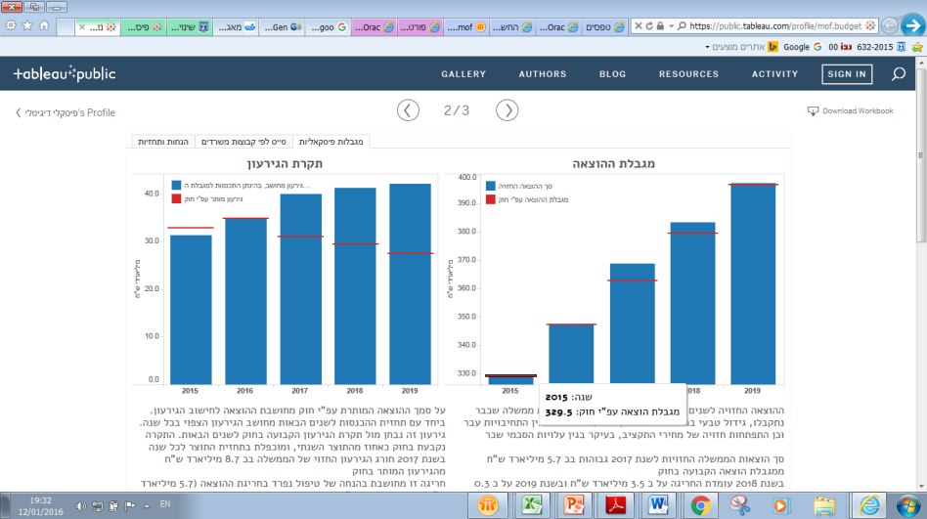
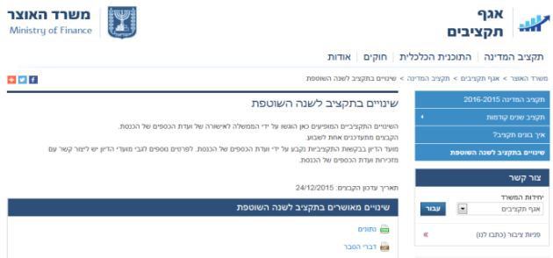
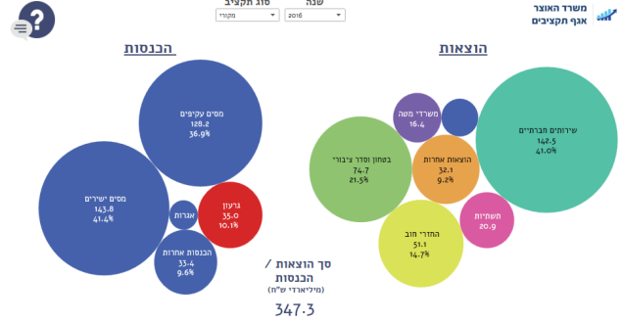
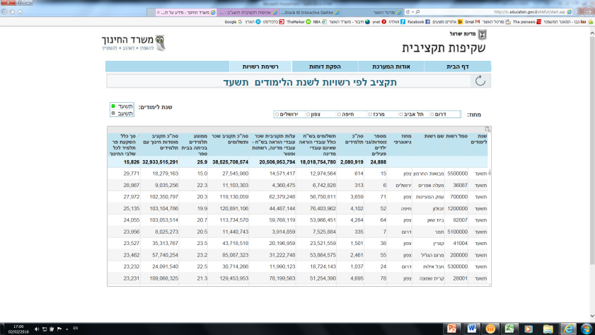

Making the Budget Accessible to the Public
Multi-Annual Budget Data
Budget Changes
Budget Videos
"Fiscal Digital"
Detailed Information by the Offices
Budget Launch
Notes:
לחדד כי מדובר בתהליכים שנעשו כולם בשלוש השנים האחרונות. העולם של היום שונה מהעולם של פעם והממשלה נדרשת לרמה גבוהה יותר של שקיפות (וכך גם משרד הביטחון)

Slide 33
Thank You for Listening!

