Slide 1
National Defense Strategy
Compete, Deter, and Win

Slide 2
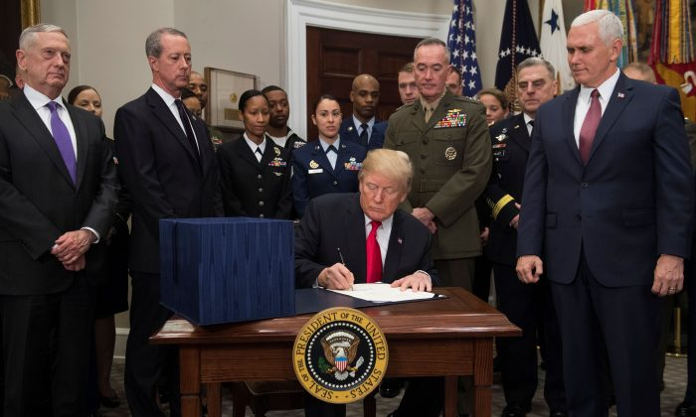
מה היא אסטרטגית ההגנה הלאומית?
What is the NDS?

Slide 3
“a security environment more complex and volatile than any we have experienced in recent memory"
ההקשר (1)
The framework (1)

Slide 4
“our competitive edge has eroded in every domain of warfare -- air, land, sea, space and cyberspace -- and is continually eroding,"
ההקשר (1)
The framework (1)

Slide 5
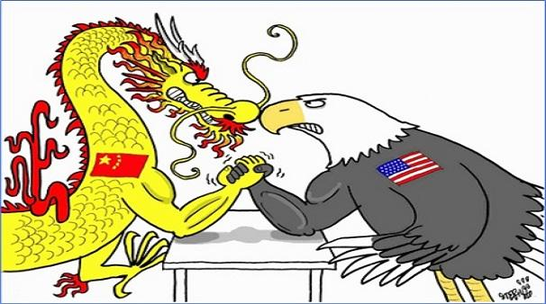
בלב האסטרטגיה – התחרות המעצמתית
Strategic Competition

Slide 6
“Inter-state strategic competition, not terrorism, is now the primary concern in U.S. national security"

Slide 7
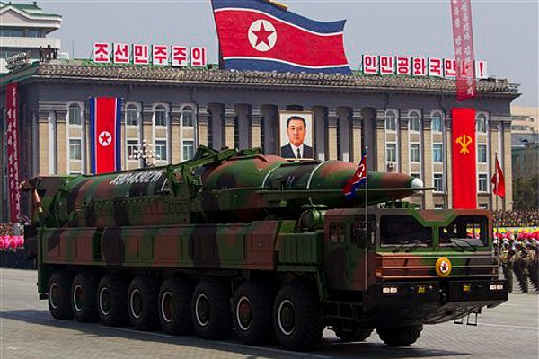
האיומים האזוריים – צפון קוריאה ואיראן
Regional threats – DPRK & Iran

Slide 8
“Rogue regimes such as North Korea and Iran are destabilizing regions through their pursuit of nuclear weapons or sponsorship of terrorism"

Slide 9
טרור ושחקנים לא מדינתיים
Terror and non-state actors

Slide 10
“Terrorists, trans-national criminal organizations, cyber hackers and other malicious non-state actors have transformed global affairs with increased capabilities of mass disruption"

Slide 11
עקרונות המענה - התפיסה האסטרטגית
Integrating multiple elements of national power
Be strategically predictable and operationally unpredictable
Foster a competitive mindset
Strategic approach

Slide 12
עקרונות המענה – 3 היעדים המרכזיים
Rebuilding military readiness and more lethal Joint Force
Strengthening alliances and attracting new partners
Reforming DoD
Three lines of effort

