Slide 1
Multidimensional & Innovative Intensification / Concept in the IDF

Slide 2
Hello!
I am Lieutenant-Colonel Avner Rouach, Head of General Training Department.
I work for the Innovation & Combat Methods Division.
I served for 18 years as a fighter in the Airborne Combat Search & Rescue Unit, and become a Unit Commander.
Notes:
Introduce yourself.

Slide 3
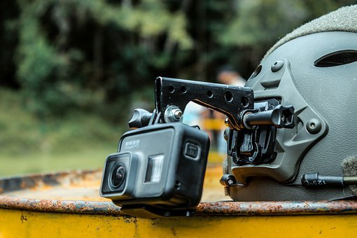
Airborne Combat Search & Rescue | Unit 669
Immediate need + Shelf product = Quick solution

Slide 4
Why Now?
The world is changing faster.
We should keep running for the Maximum Value in short time
Or
Minimum Viable Product.

Slide 5
Within 3 years
92% of Startups failed

Slide 6
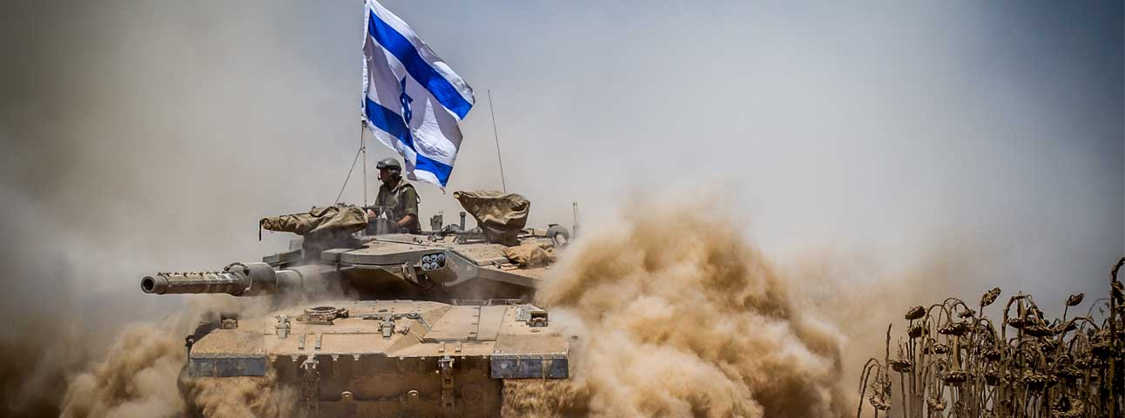
How many IDF projects failed?

Slide 7
WHAT went WRONG?

Slide 8
Top Mistakes
Building something nobody wants
Hiring Poorly

Slide 9
HOW do we make a CHANGE?

Slide 10
Waterfall Model
Develop
Design
Sweet Spot
Test
Maintenance
Industrialization

Slide 11
Experimental Program by MVP
Industrialization
Industrialization
Divisions G, H, I
MVP
MVP
MVP
Divisions D, E, F
Experience &
Learning
Experience &
Learning
Experience &
Learning
Sweet Spot
Divisions A, B, C
MVP Report

Slide 12
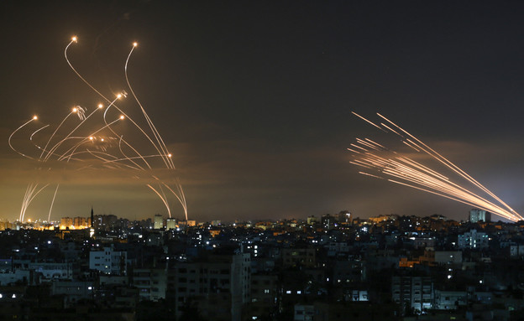
Iron Dome
Israeli Defense System Against Short Range Artillery Rockets
Notes:
Introduce yourself.

Slide 13
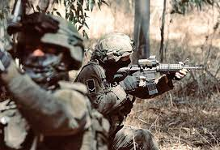
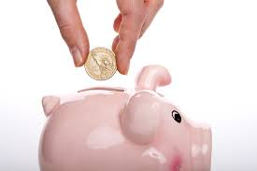
Benefits
Notes:
Introduce yourself.

Slide 15
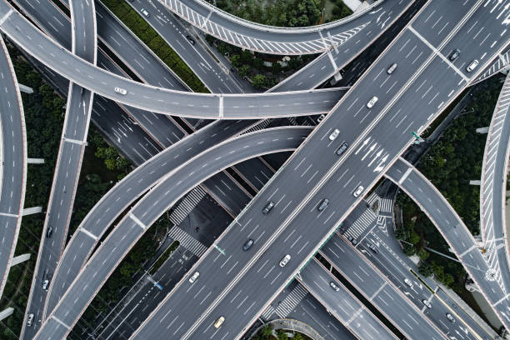
איפה אנחנו באים לידי ביטוי - אבנר
Notes:
מנהלים מספר בעיות / צרכים מבצעיים – אחיזה טובה על בנין הכוח בצה"ל
חיבורים – משתמשי קצה, מפתחים, בעלי ענין
SEED MONEY
פלטפורמה להתנסות – משתמש, אישורים, וכו'
למידה – מנהלים צוותי תחקור מטכ"ליים

Slide 17
Thank You!

Slide 18
SlidesCarnival icons are editable shapes. This means that you can:
Resize them without losing quality.
Change fill color and opacity.
Change line color, width and style.
Isn’t that nice? :) Examples:
Find more icons at slidescarnival.com/extra-free-resources-icons-and-maps

Slide 19
Diagrams and infographics

Slide 20
Free templates for all your presentation needs
For PowerPoint and Google Slides
100% free for personal or commercial use
Ready to use, professional and customizable
Blow your audience away with attractive visuals

