Slide 1
The Visual Image of the Academic Year at the INDC
The image is in the form of a “subway transit map” (Metro)
The map reflects the network learning concept which is non-linear.
The latitude lines – represent the seasons. Each season is represented with a different color.
Stations are marked on the lines. The important stations are the transitional stations between the seasons.
The longitude lines are the fields of study – the components of national security.
The methods of study are scattered throughout all seasons.
The map reflects personal learning: every passenger gets on and off freely. And yet, there is a path, a road, a journey.

Slide 2
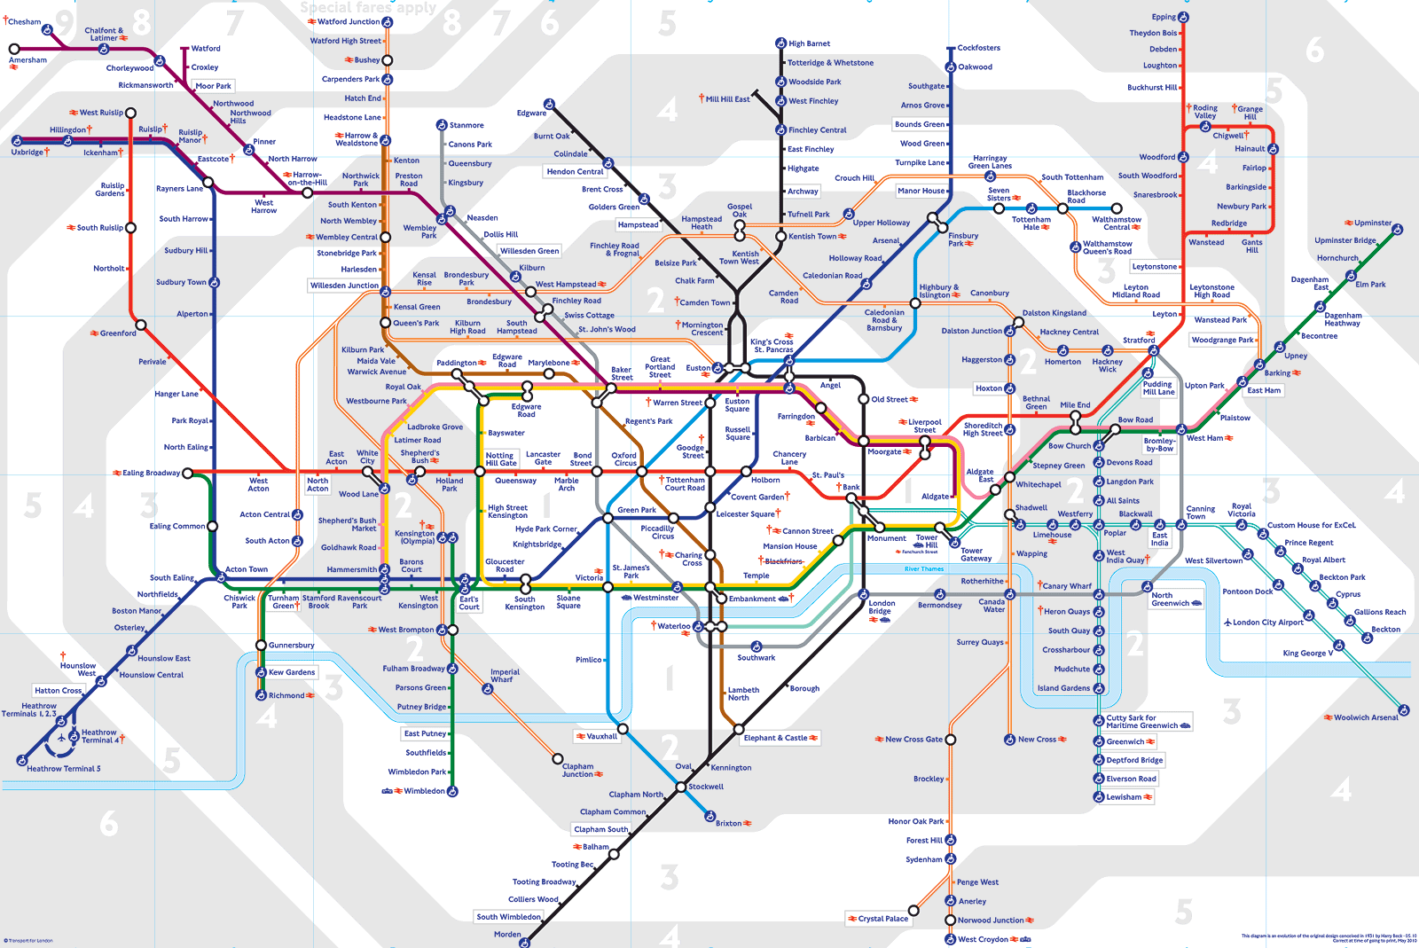
The Visual Image of the Academic Year at the INDC – Metro Map
INDC

Slide 3
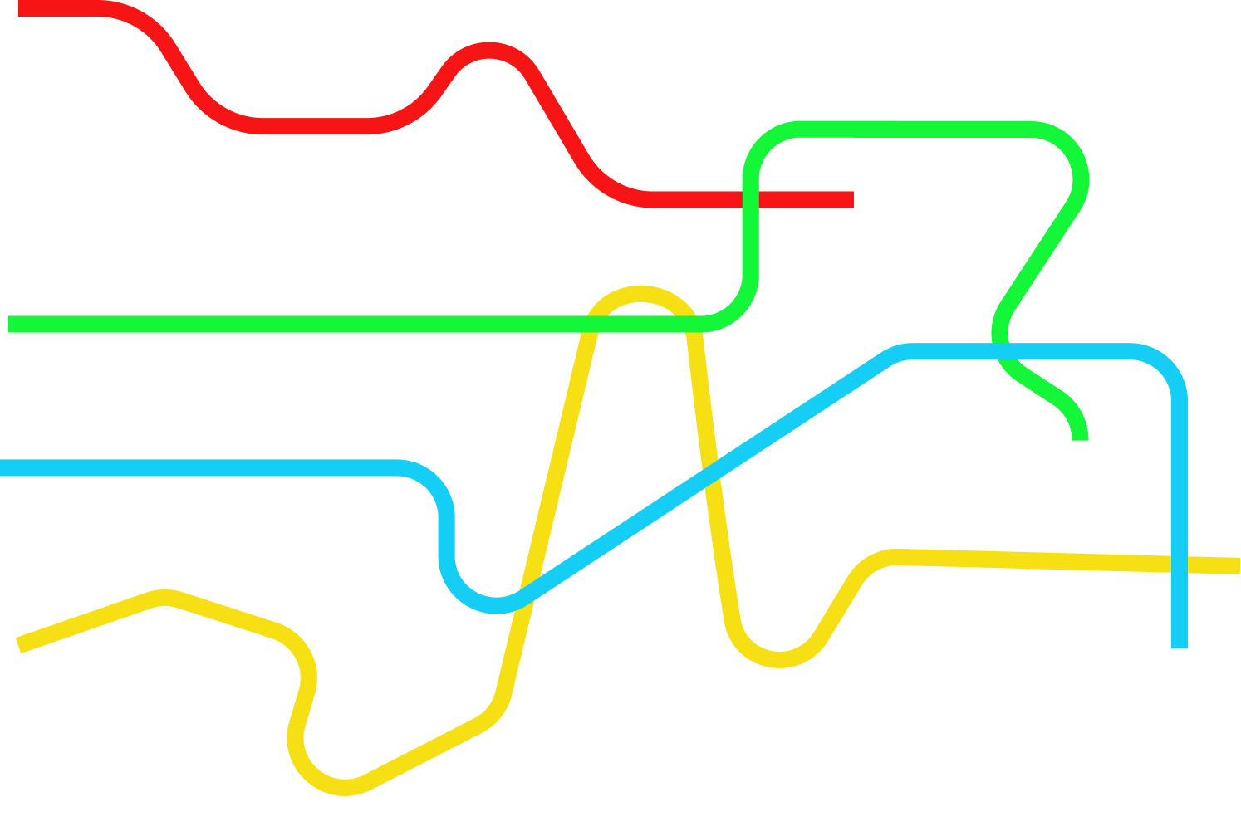
The Seasons
T1 Global Season
T2 Israeli Season
T3 Specialization
T4 Integrative Season

Slide 4
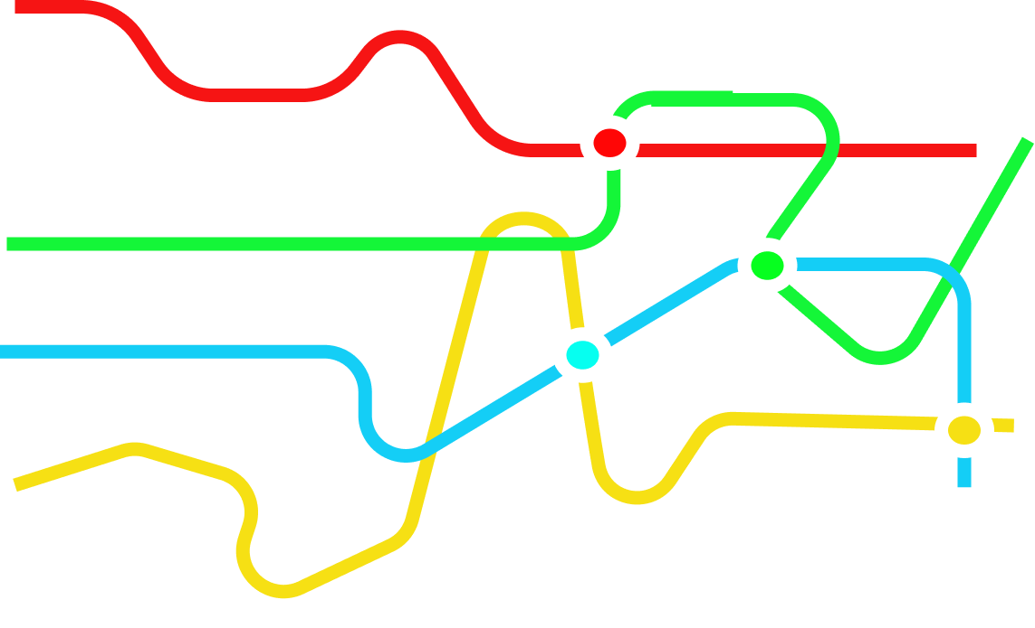
Important Stops
T1 Global Season
Europe Research Seminar
T2 Israeli Season
Simulation
T3 Specialization
East Seminar
USA Research Seminar
T4 Integrative Season

Slide 5
Other Stops
T1 Global Season
From the Polis to Globalization
Politics / Statesmanship
Global National Security
Europe Research Seminar
Strategic Thought
Personal Expertise
Forefathers of the Nation
Concepts in National Security
Strategic Thinking
National Security Tours
T2 Israeli Season
Simulation
The Digital World
2nd Seminar
T3 Specialization
Main Seminar
East Seminar
USA Research Seminar
T4 Integrative Season
Final Project

Slide 6
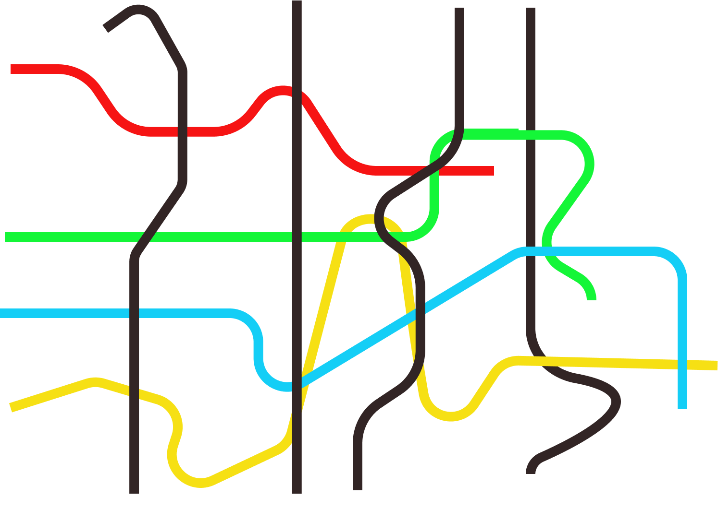
The 4 Fields of Study – Components of National Defense
T1 Global Season
T2 Israeli Season
T3 Specialization
T4 Integrative Season
National Security
Economy
Society
Statesmanship

Slide 7
The Purple Line - Strategy
T1 Global Season
T2 Israeli Season
T3 Specialization
T4 Integrative Season
National Security
Economy
Society
Statesmanship

Slide 8
The Orange Line – The Personal Learning Process
T1 Global Season
T2 Israeli Season
T3 Specialization
T4 Integrative Season
National Security
Economy
Society
Statesmanship

Slide 9
Learning Methodology
Plenum
Team
Teaming up
Independent
Integrative

