Slide 1
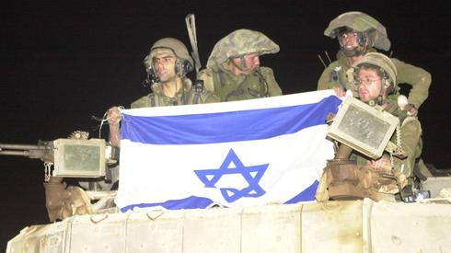
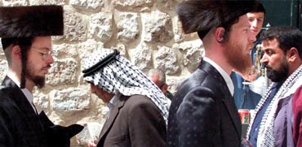
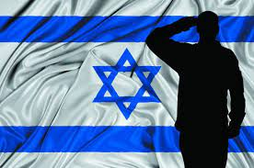
Israel: Politics, History and Society
Israel: Politics, History and Society
NDC
Dr. Ehud Eiran
17 Aug, 2022
Meeting 11
Current security challenges
and responses

Slide 2
Current events? Questions

Slide 3
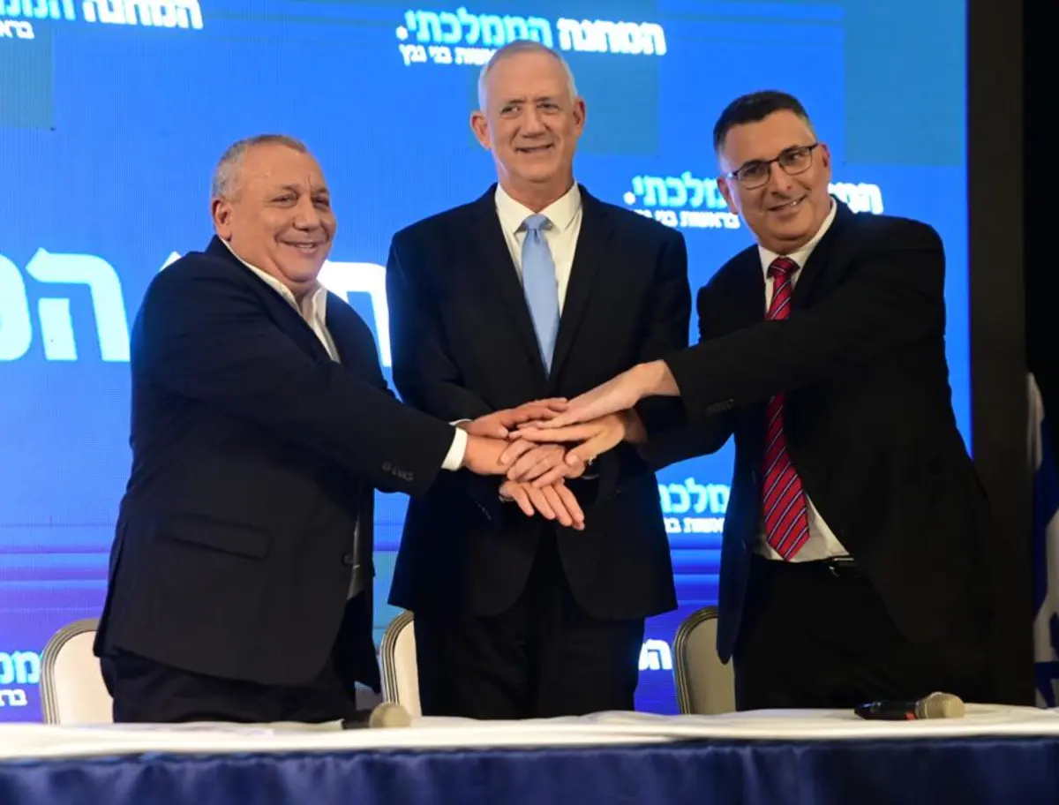

Slide 4
Two conflicts
1929-1948
1948-1982
1982-
Between Israelis and Palestinians
Between Israel and other Arab states
Jews Vs. Arabs under the British
Israel vs. Egypt, Syria, Iraq, Jordan (Supported by others)
Israel VS. Palestinians, Hezbollah, Iran
Jewish Victory
Egypt and Jordan control portions of Arab-Palestanin States
1.Israel defeats Egypt, Jordan. Syria
2. Peace with Egypt (1979), Jordan (1994)
Israel-PLO agreement
Israel withdraws from Lebanon under Hezbollah pressure
Israel quiet armed conflict with iran
Abraham accords with Bahrain, UAE, Morocco, Sudan

Slide 5
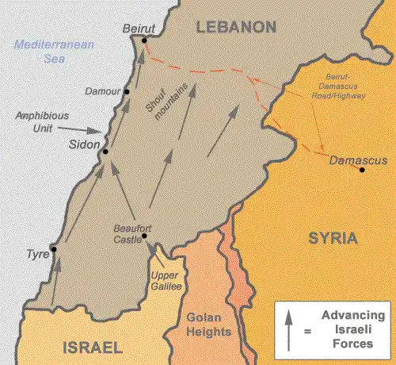
War # 5’: 1982 Lebanon War: the transition

Slide 6
A war of transition and change
A full war against the Palestinians (first one since 1948)
Led to the PLO’s demise in, and removal from, Lebanon
Also a clash with the Syrian forces in Lebanon (but not Golan Heights)
Contributed to the birth of Hezbollah
Led to a long deployment in a small portion of Lebanon (1985-2000)
Led to deep internal conflicts in Israel

Slide 7
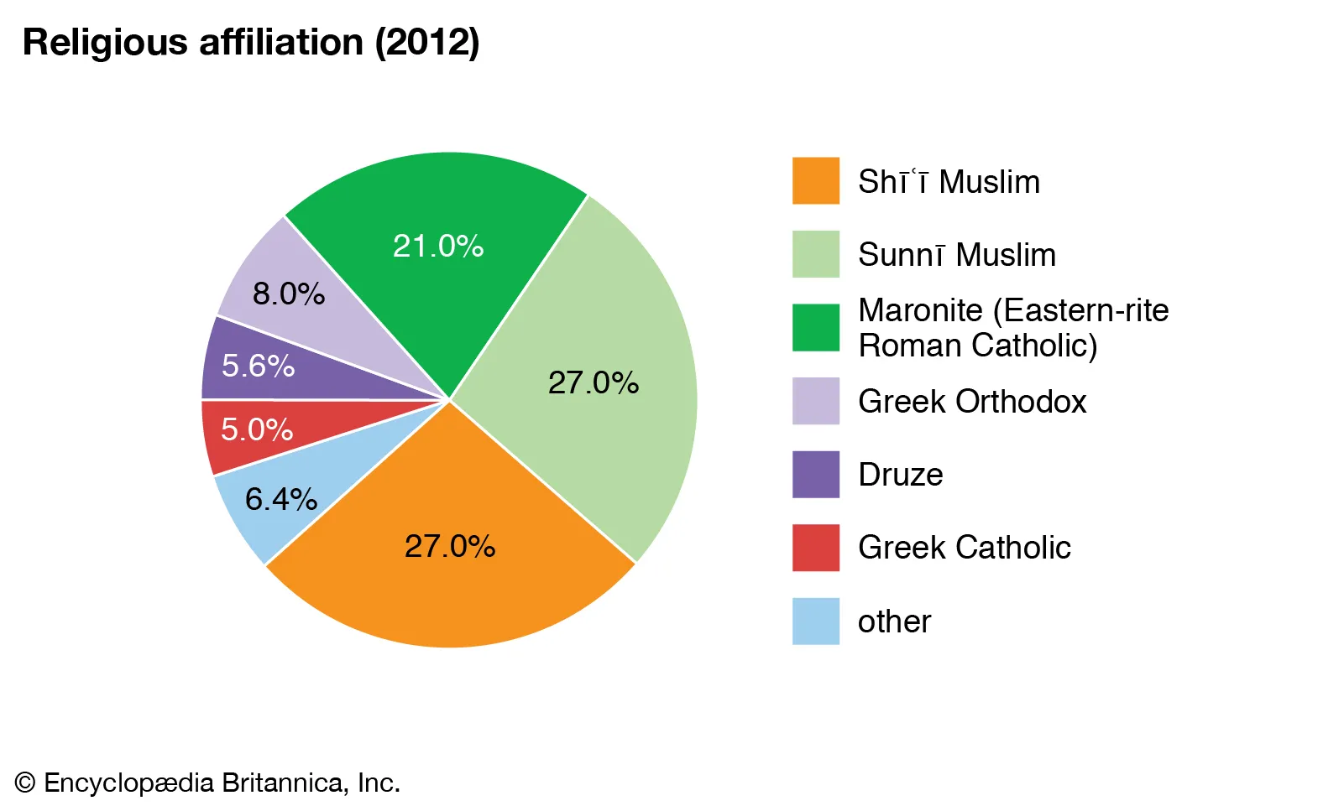
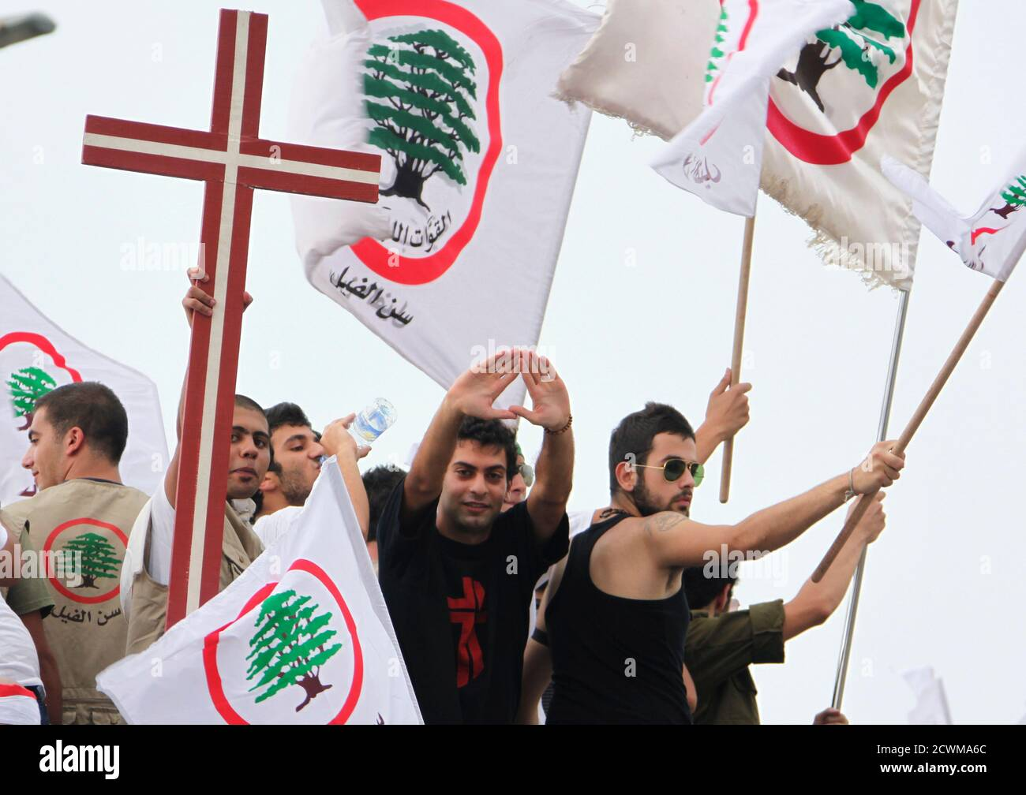
Background 1: Lebanon-internal weakness, Christianity, Civil War

Slide 8
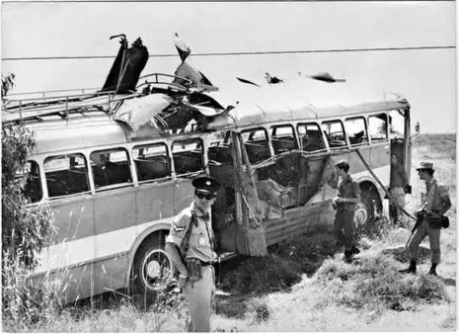
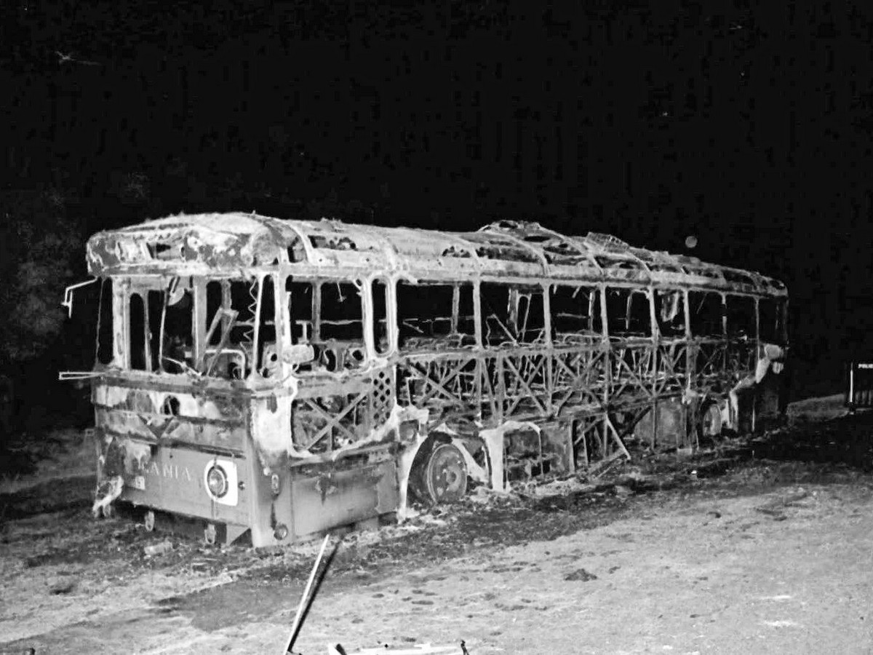
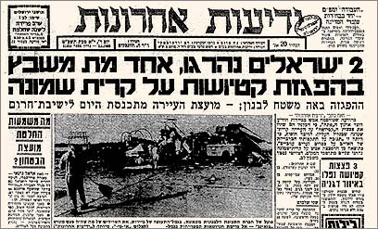
Background 2: A decade of attacks from Lebanon (1969-1982)

Slide 9
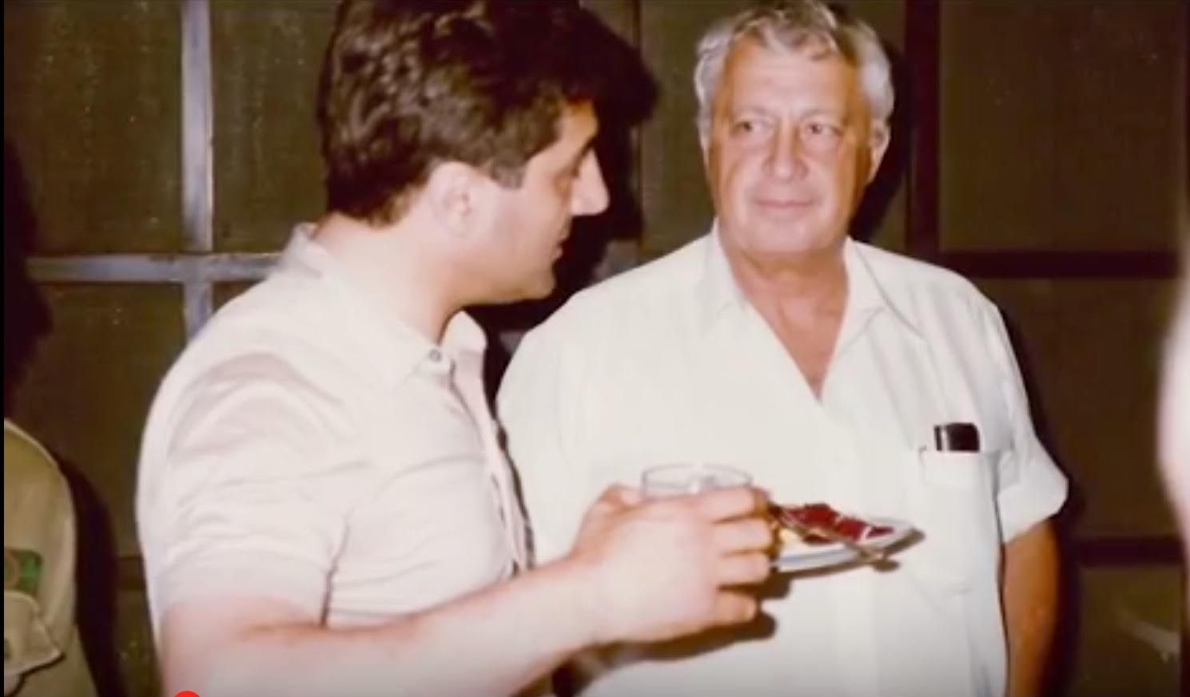
Goals: Public and secret

Slide 10
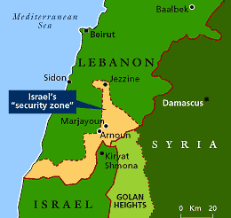
Israel’s security Zone in South Lebanon: 1985-2000

Slide 11
The rise of Hezbollah
1982-1985: Resistance against Israel, West: alongside Iran, Syria
Iranian connection
Its competing identities: Mukawama, Lebanese, Iranian proxy, armed, political
Attacks in Argentine

Slide 12
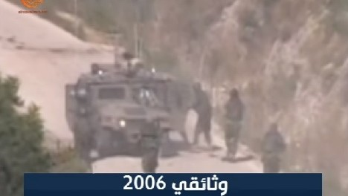
Israel-Hezbollah war: 2006

Slide 13
Hezbollah: further developments
Fighting in Syria
Maritime dispute
Affecting internal legislation against Israel
Lebanon’s internal (further) collapse

Slide 14
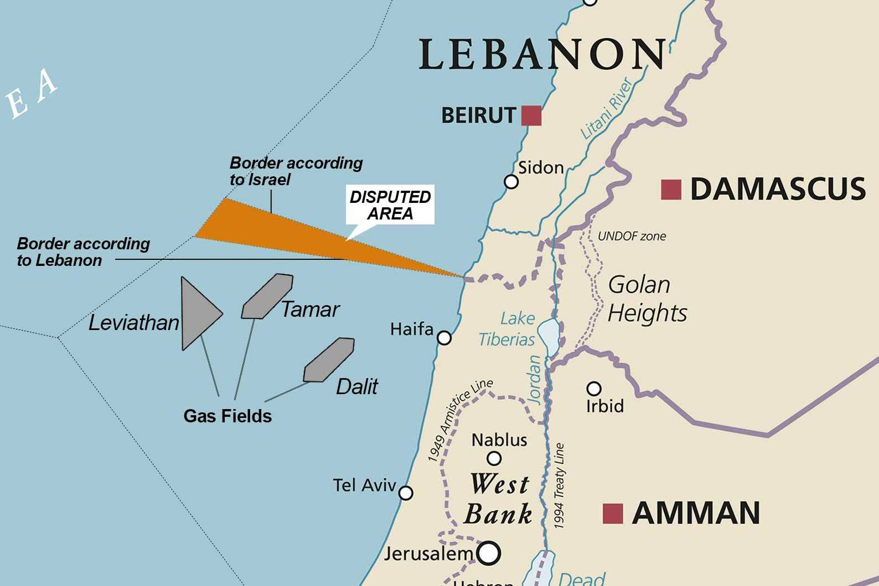

Slide 15
The challenge
Military challenge 1: Rockets
Military challenge 2: Attacks on Gas facility
Military challenge 3: Ground forces attacks
Strategic challenge: how to deter the organization ?

Slide 16
Effect on Ideology
Security can lead to internal conflict
Society (Peace Now attack, 1983), within IDF (Eli Geva)
Security requires constant change and adaptation: Change of foe from PL to Hezbollah, from offense to defense

Slide 17
The Iranian challenge
History of IL-Iran relations
The nuclear program
Iranin proxies in Israel’s immediate areas

Slide 18
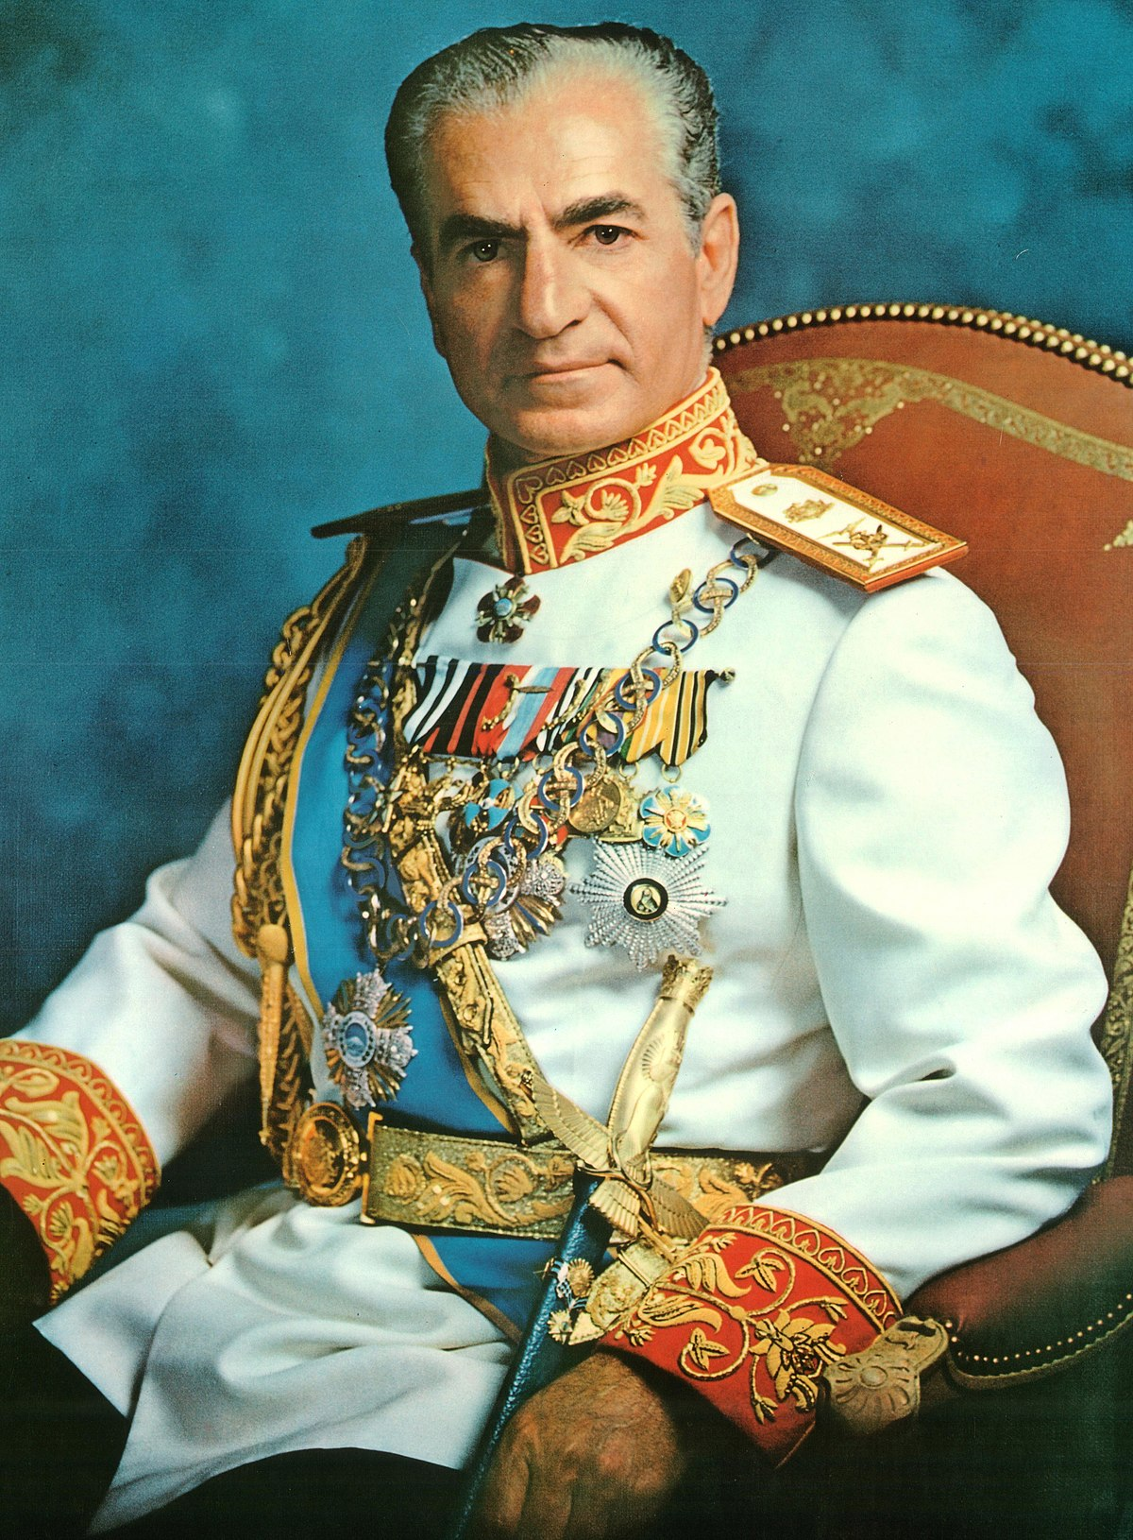
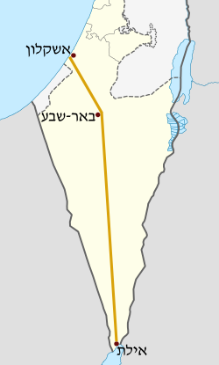
History: Acceptance, power (Iraq), Oil

Slide 19
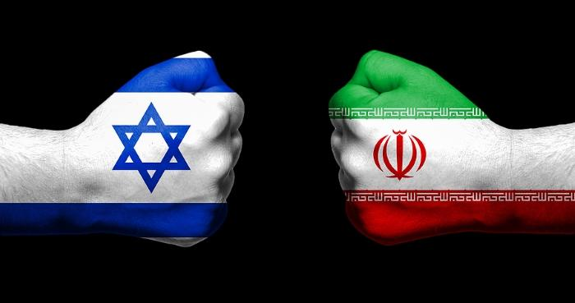

Slide 20
Background
Ideology: Radical Shia Islam
Realism:
Power: The Shia crescent:
From and Iranian perspective: A friendly and supportive regional environment

Slide 21
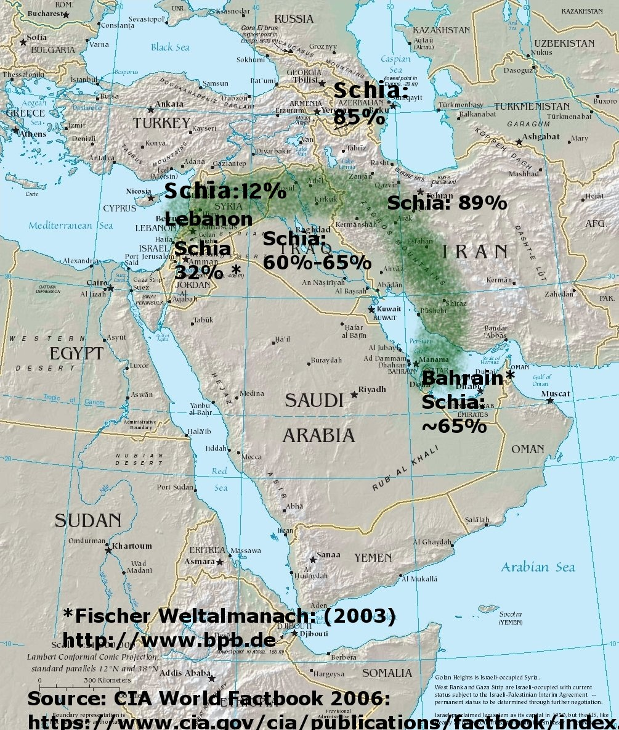

Slide 22
So why is Israel concerned?

Slide 23
The nuclear project: An Israeli perspective
Direct threat and the shadow of the Holocaust: The Begin Doctrine
Support for regional power
Cascade effect
Ideological challenge: first real possibility of annihilation
Economic challenge

Slide 24
What was done ?
Effort in intl fora
The debate about JCPOA
Clandestine operations
Attack ? 2009-2011: internal tensions
Tied to the alliance with the US

Slide 25
The regional context
Lebanon
Syria
Response: alliance in the Gulf, and Interwar campaign

Slide 26
Interwar campaign or the war between the wars
Denial of capabilities
All in fire (mostly air force)
Effort to keep quiet (to limit escalation)
Russian aspect
May change

Slide 27
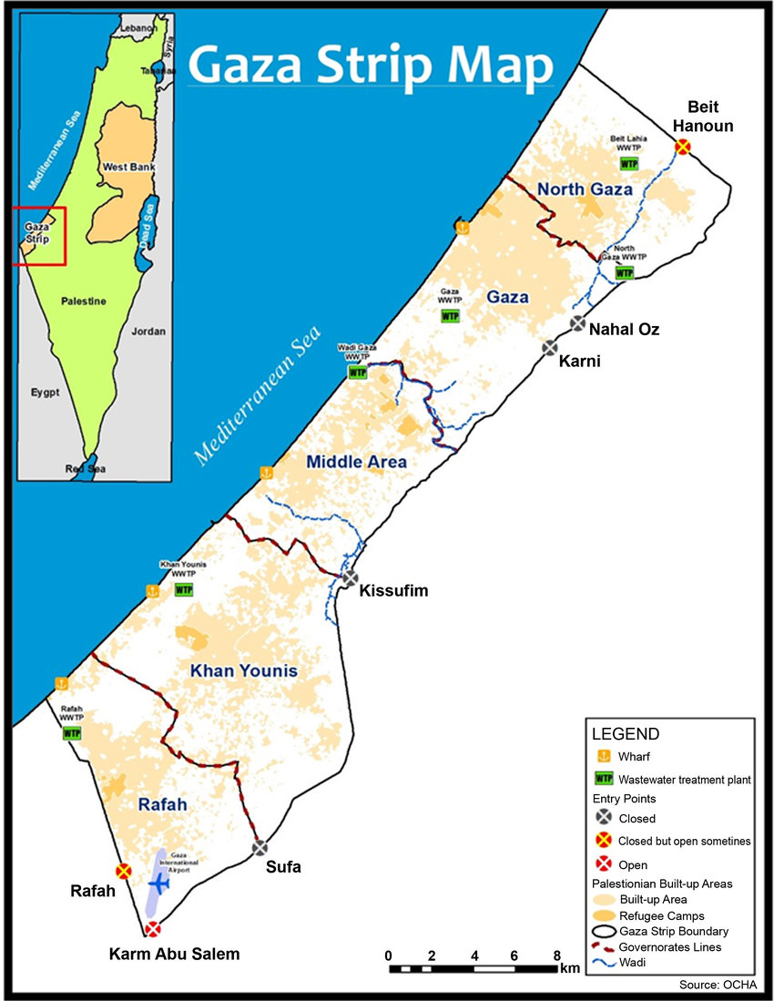
Last challenge: Hamas and Gaza

Slide 28
Beyond the Horizon
The future of the West Bank
The future of the Palestinian Authority
Great power competition
Climate change
The nature of warfare (AI)

Slide 29
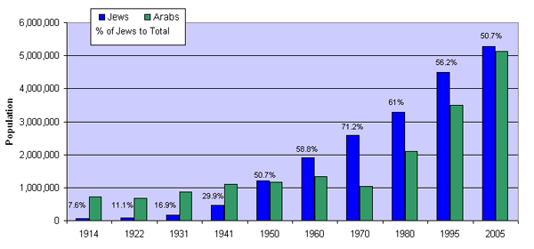
A demographic battle

Slide 30
