Slide 1
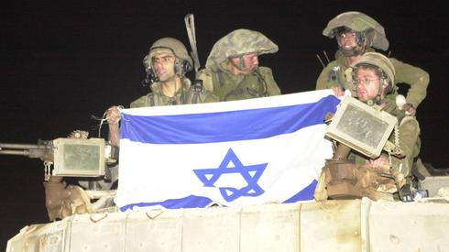
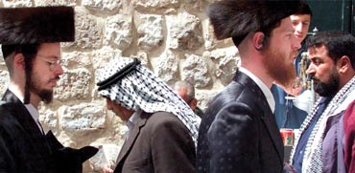
Israel: Politics, History and Society
Israel: Politics, History and Society
NDC
Dr. Ehud Eiran
15 Aug, 2022
Meeting 10
Arab-Israeli Conflict

Slide 2
Two conflicts
1929-1948
1948-1982
1982-
Between Israelis and Palestinians
Between Israel and other Arab states
Jews Vs. Arabs under the British
Israel vs. Egypt, Syria, Iraq, Jordan (Supported by others)
Israel VS. Palestinians, Hezbollah, Iran
Jewish Victory
Egypt and Jordan control portions of Arab-Palestanin States
1.Israel defeats Egypt, Jordan. Syria
2. Peace with Egypt (1979), Jordan (1994)
Israel-PLO agreement
Israel withdraws from Lebanon under Hezbollah pressure
Israel quiet armed conflict with iran
Abraham accords with Bahrain, UAE, Morocco, Sudan

Slide 3
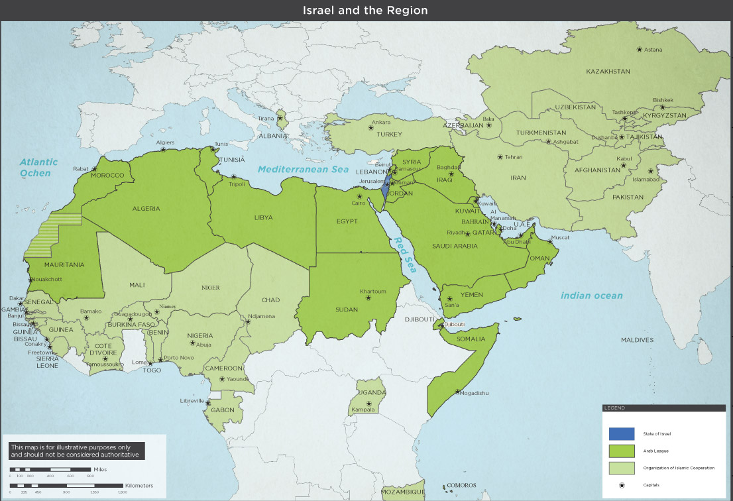

Slide 4
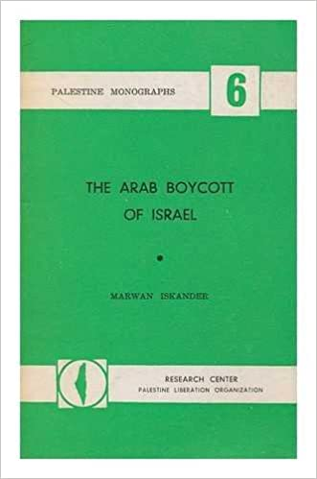
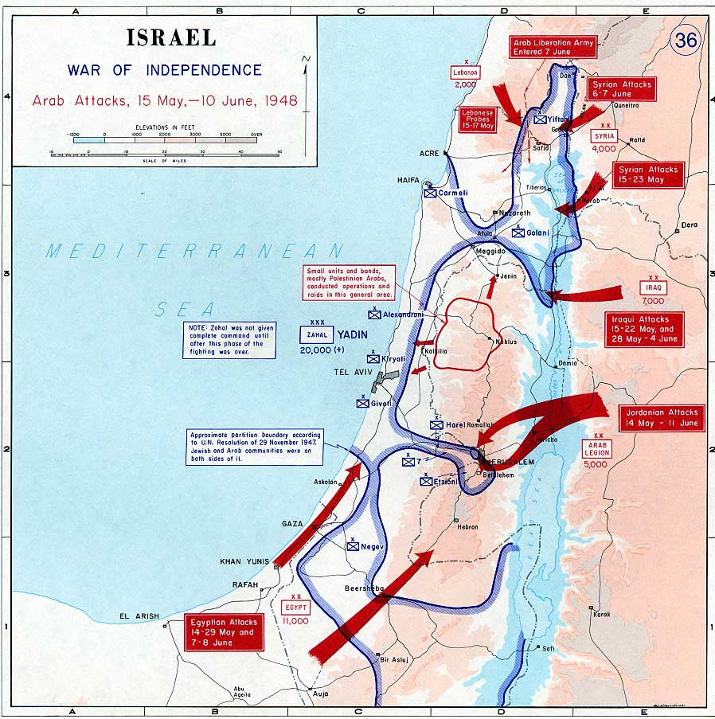
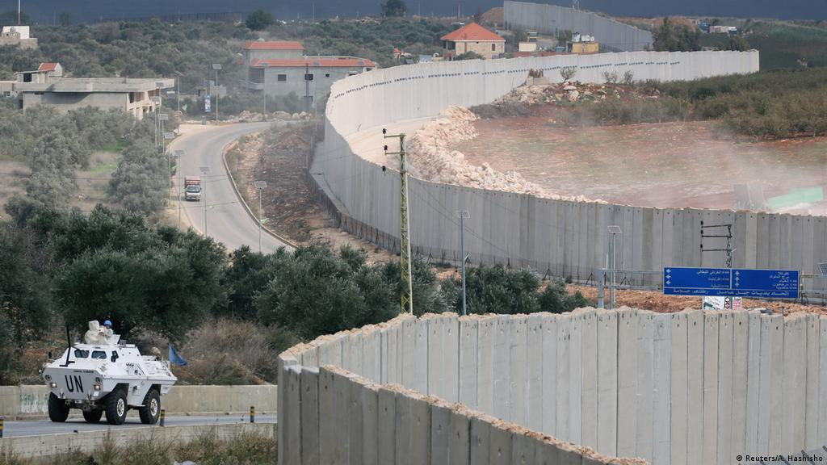

Slide 5
Effect 1: Security emerged as the single most important question for Israel
Compare to challenges at the early phases of Zionism:
intl legitimacy,
immigration,
nation building

Slide 6
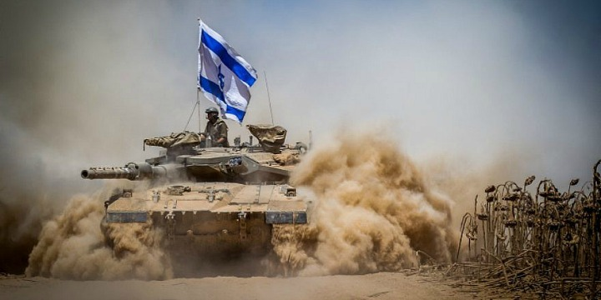
Effect 2 of conflict with the region: strong armed forces

Slide 7
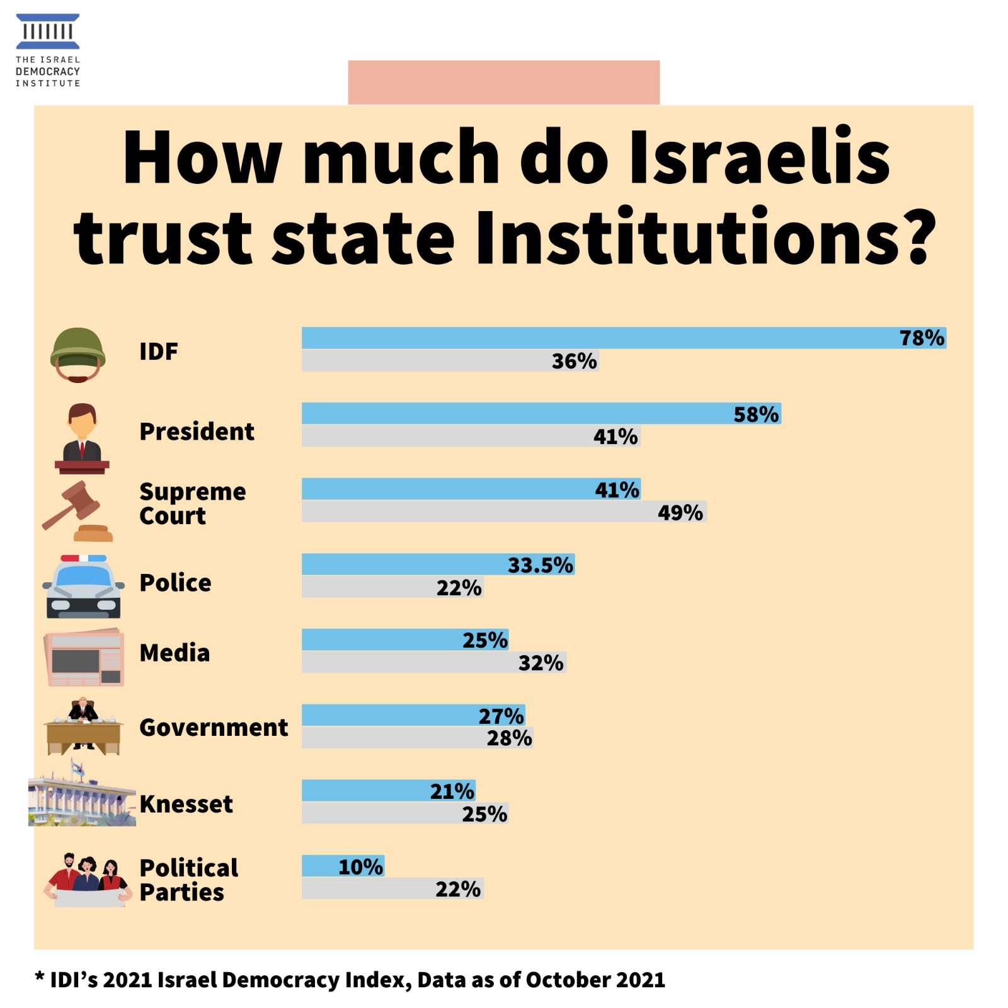
Effect 3: Military highly valued by society

Slide 8
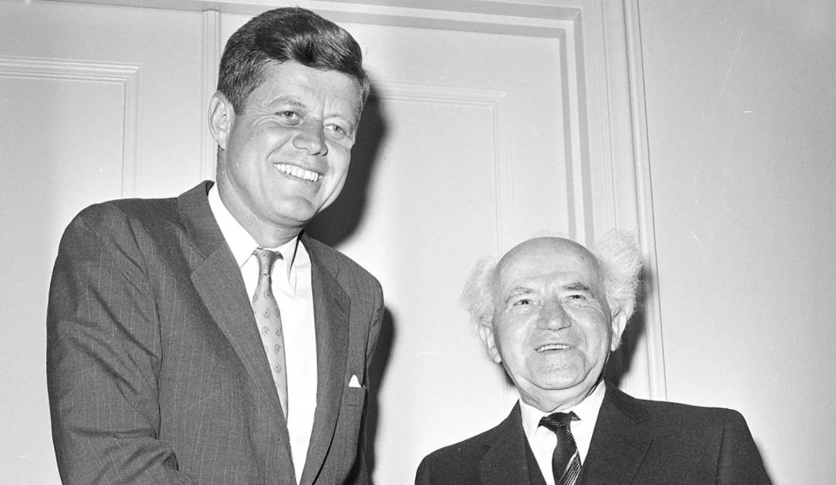
Effect 4 of regional isolation: Israel connected to the West

Slide 9
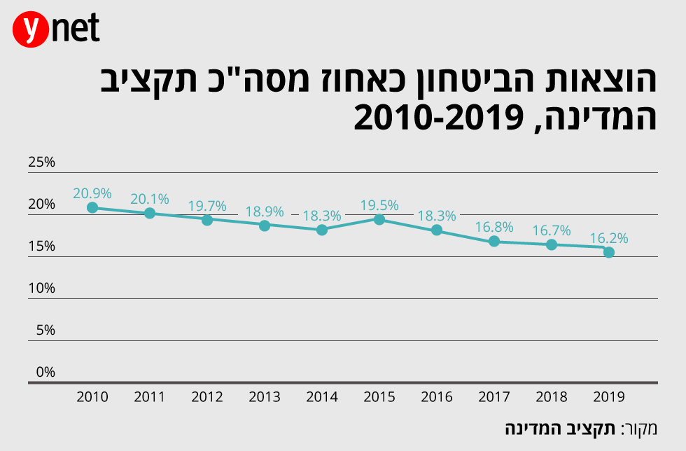
Effect 5: heavy demand for resource (Defense as a percentage of national budget)

Slide 10
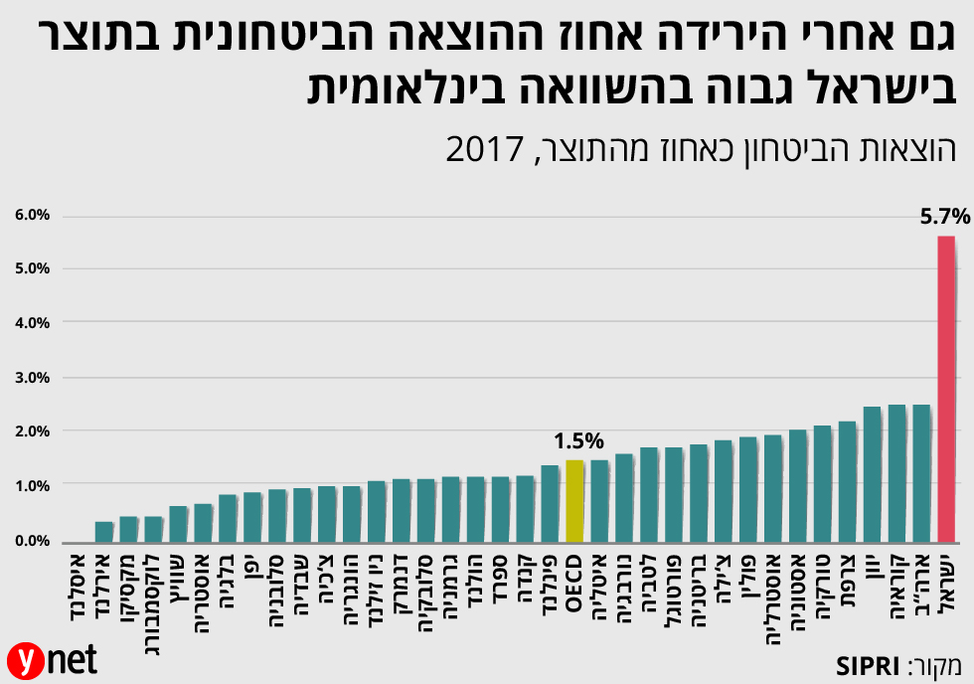
Defense as percentage of GDP

Slide 11
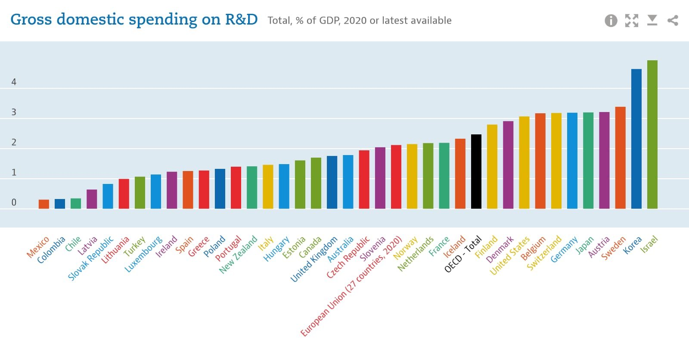
Effect 6 (asymmetric conflict): reliance on education and technology

Slide 12
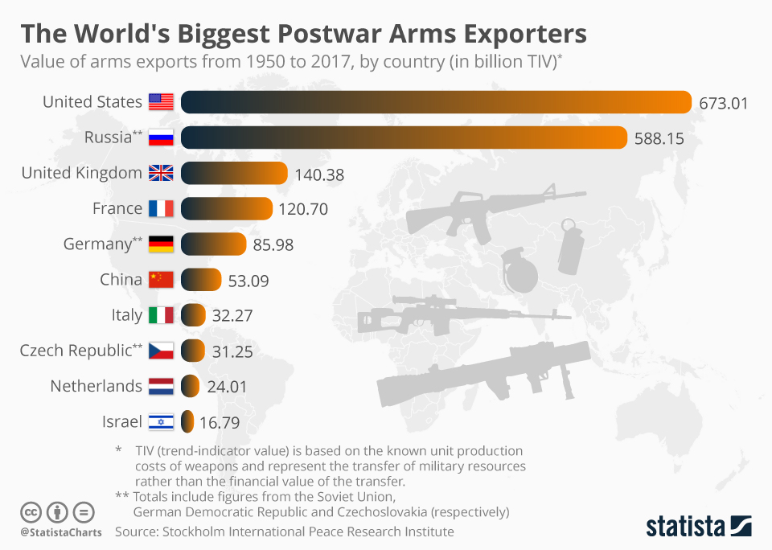
Effect 7 of conflict: arms industry

Slide 13
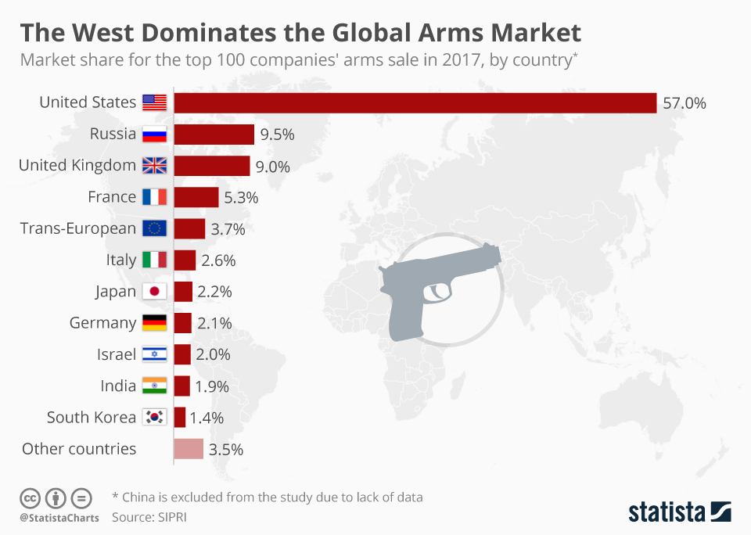
Effect of conflict with the region: arms industry

Slide 14
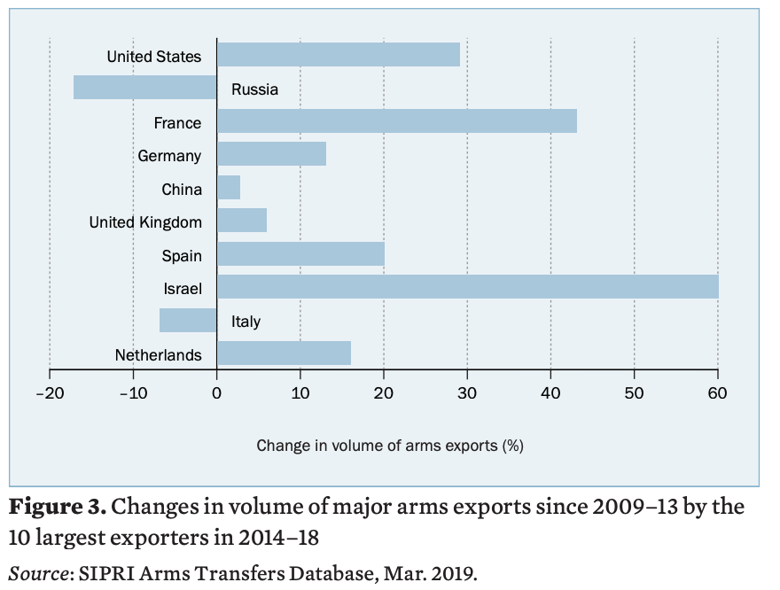
Effect of conflict with the region: arms industry

Slide 15
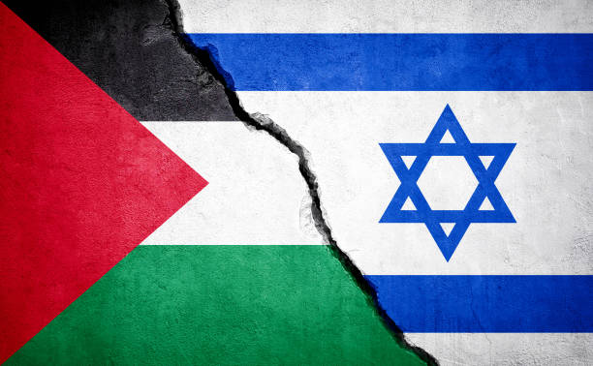
Israeli-Palestinian conflict

Slide 16
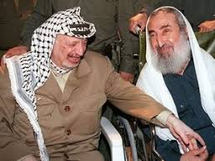
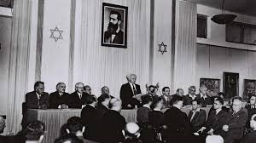
Foundational texts
Israeli declaration of independence 1948
The Palestinian National Charter, 1968
The Covenant of the Islamic Resistance Movement, 1988

Slide 17
 | Israel | PLO | Hamas
Source of claim to the land
View of the “other”
Means to achieve goal
Approach to international norms

Slide 18
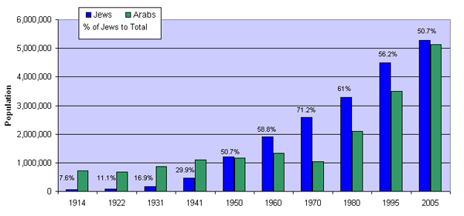
A demographic battle

Slide 19
The Land

Slide 20
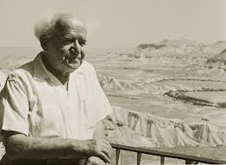
Zionist Strategy: Immigration, land, international legitimacy
Operationally: the Iron Wall

Slide 21
Palestinian struggle
1949-1960’s: Politically weak, strategy: reliance on Arab States
1967 as a turning point
1968-1988 independent armed struggle/Terrorism, including aboard (Such as Munich 1972/ Entebbe 1976)
1993: Oslo Accord

Slide 22
Why is the Palestinian perspective important for a class about Israel ?
The heart of the conflict
Will determine Israel’s future
Tests its values
Affects Israeli identity

Slide 24
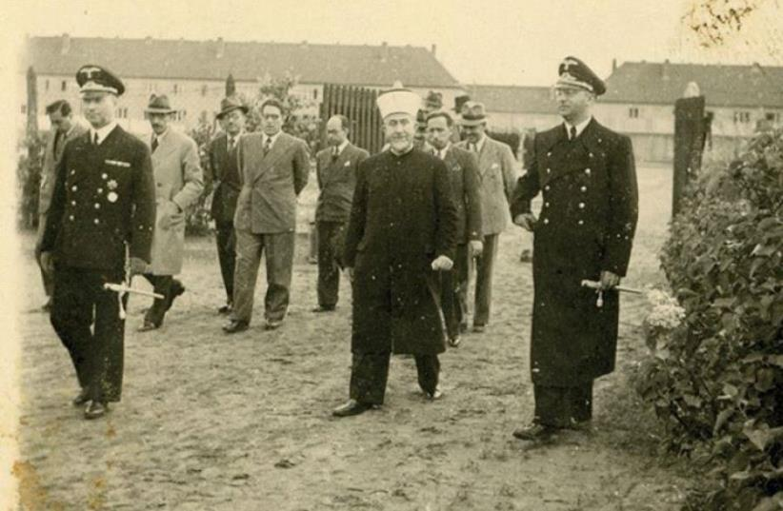
1949-1967: Why Political weakness?

Slide 25
1949-1967: Why Political weakness?
Loss of war
Failure of Elites: Husseini’s past and weakness
Loss of territory
Population under the control of different states: Israel, Jordan, Lebanon, Egypt, Syria, Iraq
Hence: difficulty to organize political life
Identity was local/agrarian in a context in which identities are debated anyways (Watania vs. Qumiya)
Activities: Fedayeen (mostly from Gaza, Jordan)

Slide 26
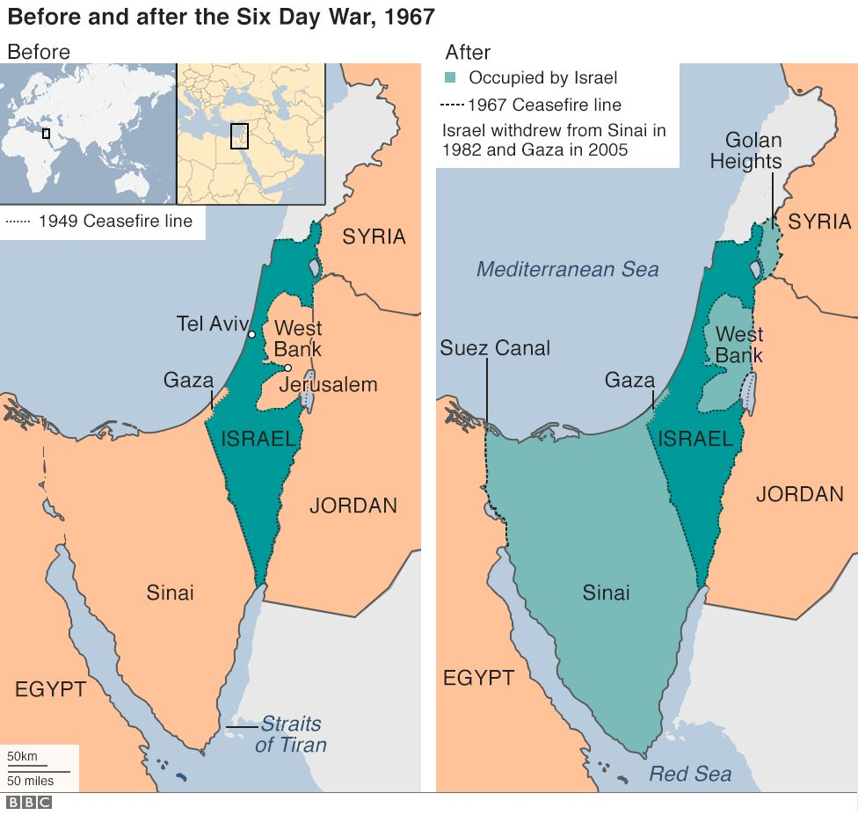
1967 as a turning point: Why ?

Slide 27
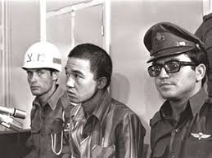
1967 as a turning point: Why ?
Began brewing earlier, with the failure of the Egyptian-Syrian Unity (UAR 1958-1961)
Arab states did not deliver
Arab states lost some territory
Arab state were weaker in containing young Palestinian activist
West Bank: fell under Israeli control: the Whole of historic Palestine now under Israeli control
Global radical movements: led to cooperation

Slide 28
Patterns of armed struggle

Slide 29
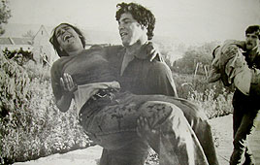
Patterns of armed struggle
Cross border attack (mostly from Jordan, then Lebanon)
Rockets (mostly from Lebanon)
International attacks (Munich Olympics 1972)
Hijacking of planes (Entebbe 1976)

Slide 30
Significance of armed struggle ?

Slide 31
Significance of armed struggle ? (Sayigh)
Confirmation of national identity
Avenue for political action: political space and institutional embodiment
Set the patterns for state building (and its challenges down the road)

Slide 32
Why (a limited) move away from armed struggle ? 1974-1993
Force did not work: Goals not achieved, small numbers joined
The effect of the 1973 war:
limits of Arab military power
The model of combined force + negotiation
A more favorable international arena

Slide 33
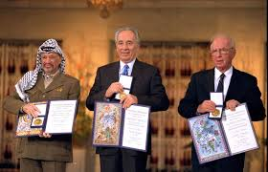
Main aspects of the accords
Mutual recognition
Interim phase (1994-1999) – Why interim ?
Final Status accord, with 4-6 core issues; Borders, Refugees, Security, Jerusalem, Water, Economy
Partial Israeli withdrawal from Gaza and West Bank
Creation of Palestinian Authority/Political Space

Slide 34
Failure 2000-onwards
Rabin assassination and right wing government (1996-1999)
Failure in Camp David 2000
Second Intifada 2000-2004: 4000 deaths, suicide bombings in Israeli streets, Israel retakes parts of West Bank
Withdrawal from Gaza 2005 and its aftermath

Slide 35
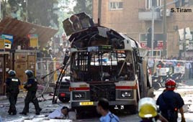
Why failed: Internal Israeli debates ?
Strategic? Did the Palestinians/Israelis really want peace or a piece (PL) and continued control (IL)
Process? was it flawed (long interim period)
Spoilers? Rabin assassination and Hamas bombing
Failure of leadership? Arafat (Allowing Hamas etc.), Abu Mazen and Barak

Slide 36
Arab-Israel War 1: 1948-1949

Slide 37
Arab - Israeli War 2: 1956-7 Sinai campaign

Slide 38
Arab-Israeli Wars 3: the 1967 Six Day War
https://www.youtube.com/watch?v=H1-ZZObkSI8&t=39s

Slide 39
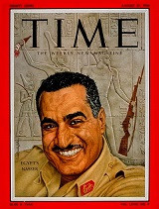
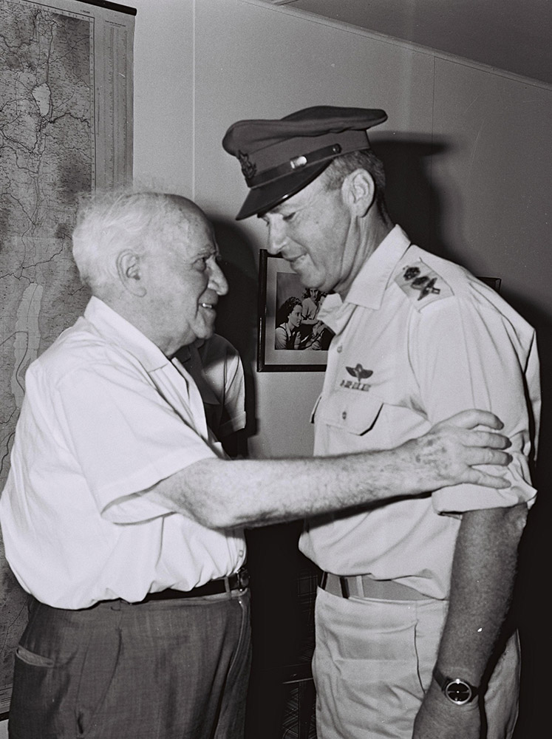
Possibly the most important war since 1948

Slide 40
Territory: Expansion

Slide 41
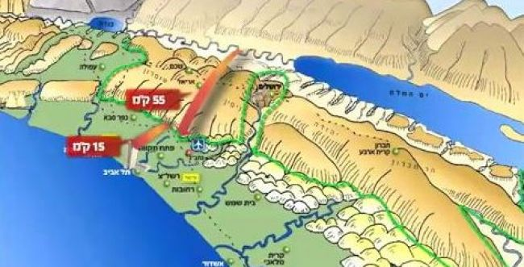

Slide 42
The Six Days War
Israel's Expands its territory
UNSCR 242 Land for peace
Israel begins to run the lives of Palestinians in the West Bank and Gaza
The internal debate about the future of the new lans begins
Become a great power play
Decline of Arab nationalism and the birth of political Islam

Slide 43
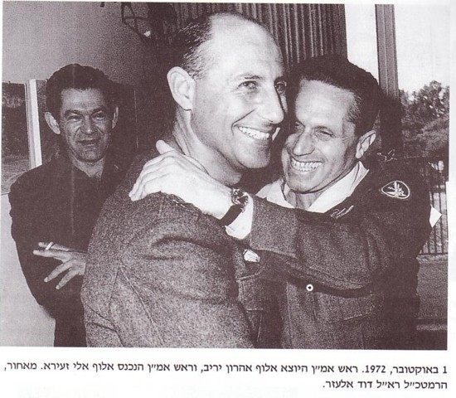
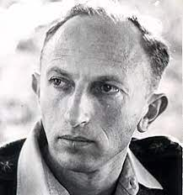
1973 war and the intelligence failure

Slide 44
מהלכי הקרבות?

Slide 46
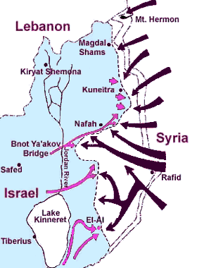
October 6, 1973: Egyptian-Syrian attack

Slide 48
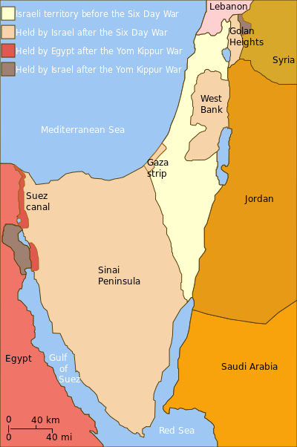

Slide 49
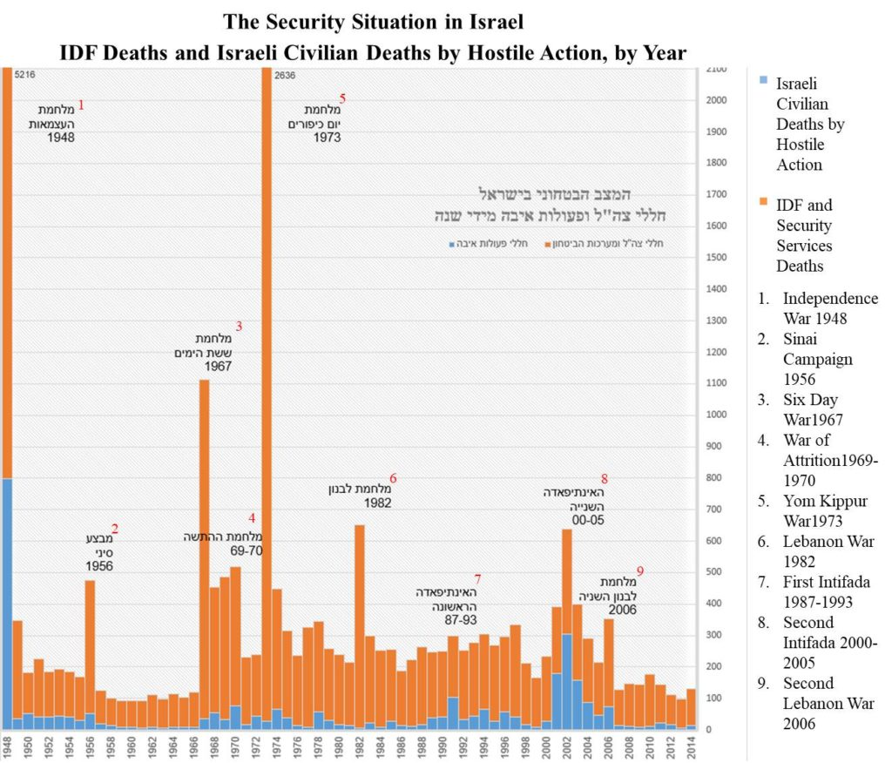

Slide 50
A Huge economic toll

Slide 51
Peace !
https://www.youtube.com/watch?v=mbc9ElB5vfQ

Slide 52
Peace in Perspective
https://www.youtube.com/watch?v=Ja7YIRrrgnY

