Slide 1

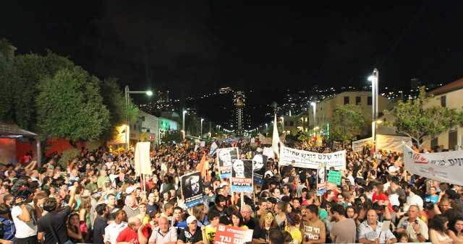
?
The people demand social justice
The Great Paradox:
Economic Success ←→ Social Failure
The Challenge Facing the New Government
Prof. Manuel Trachtenberg
Tel Aviv University & Samuel Neaman Institute for National Policy at the Technion
Lecture at INDC
22.12.2019

Slide 2
The Great Paradox
    In Israel, there is a deceptive combination of:
      Macroeconomics Success: a stable and growing economy
      Social Failure: poverty and inequality, crises in critical areas - housing, transport, health and education.
      The macroeconomics dimensions are immense, but young families are having a hard time carrying the burden
The Key Message:
    Not a decree from heaven, but rather government made: fixated, myopic
    It can be done differently: Requires a perceptual change to translate economic success into individual well being without shifting to populism
2

Slide 3
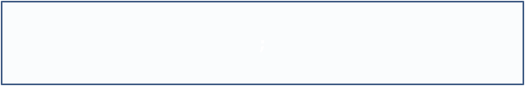
Primary Data: Macroeconomic Success
  Excellent macroeconomic performance, continuous growth
  Low unemployment, high participation rate
  Excess export, accumulation of foreign exchange reserves
  Lack of inflation, strong currency (Shekel)
  Stability of the financial sector
3
12/16/2019

Slide 4
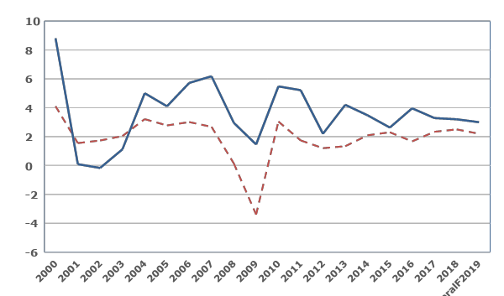
GDP Growth
Israel in International Comparison
%
Forecast
Israel
Advanced Countries
0
The Great Crisis
4
12/16/2019
Notes:
מעודכן ל9/16
המדינות המפותחות מתוך מדינות OECD: אוסטרליה, אוסטריה, בלגיה, קנדה, דנמרק, פינלנד, צרפת, גרמניה, איטליה, יפן, קוריאה, הולנד, ניו זילנד, נורבגיה, פורטוגל, ספרד, שבדיה, שווייץ, ארה"ב, בריטניה.
המשקים המתעוררים לפי הגדרת IMF : ארגנטינה, בנגלדש, ברזיל, בולגריה, צ'ילה, סין, קולומביה, הונגריה, הודו, אינדונזיה, מלזיה, מקסיקו, פקיסטן, פרו, פיליפינים, פולין, רומניה, רוסיה, דרום אפריקה, תאילנד, אוקראינה וונצואלה. הנתונים מחושבים כממוצע פשוט
4

Slide 5
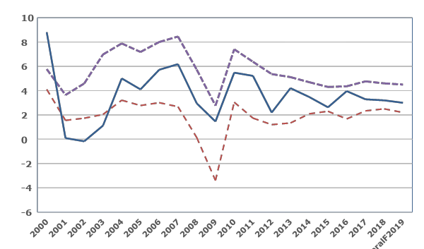
GDP Growth
Israel in International Comparison
%
Developing Countries
Forecast
Israel
Advanced Countries
0
Average growth:
Developing: 5.7
Israel: 3.7
Advanced: 1.9
5
12/16/2019
Notes:
מעודכן ל9/16
המדינות המפותחות מתוך מדינות OECD: אוסטרליה, אוסטריה, בלגיה, קנדה, דנמרק, פינלנד, צרפת, גרמניה, איטליה, יפן, קוריאה, הולנד, ניו זילנד, נורבגיה, פורטוגל, ספרד, שבדיה, שווייץ, ארה"ב, בריטניה.
המשקים המתעוררים לפי הגדרת IMF : ארגנטינה, בנגלדש, ברזיל, בולגריה, צ'ילה, סין, קולומביה, הונגריה, הודו, אינדונזיה, מלזיה, מקסיקו, פקיסטן, פרו, פיליפינים, פולין, רומניה, רוסיה, דרום אפריקה, תאילנד, אוקראינה וונצואלה. הנתונים מחושבים כממוצע פשוט
5

Slide 6
Debt- GDP 2000-2018:
Israel vs. The OECD
%
2003:
94%
OECD
Israel
2018:
Rose to:
61.5%
12/16/2019

Slide 7
Labor Market
Quarterly, 1995-2016, 25-64
Employment Market:
Unemployment Rate
2001-03:
התפוצצות הבועה, אינתיפאדה שנייה
2001-03:
Bubble burst, The Second Intifada
Unemployment %
% אבטלה
2009:
The Global Crisis
2009:
המשבר העולמי
The big immigration from the former USSR
העלייה הגדולה מברה"מ לשעבר
12/16/2019
Source : Central Bureau of Statistics Labor Force Survey
Notes:
עודכן

Slide 8
The Employment Market
Participation Rate & Unemployment Rate
  שוק התעסוקה
  שיעור ההשתתפות ושיעור אבטלה
Labor Market
Quarterly, 1995-2016, 25-64
Participation%
Unemployment %
% השתתפות
% אבטלה
Participation Rate
שיעור השתתפות
Unemployment Rate
שיעור אבטלה
73%
The unemployment rate dropped as the employment rate peaked!
שיעור האבטלה ירד בו בזמן ששיעור ההשתתפות בתעסוקה עלה לשיא!
Source : Central Bureau of Statistics Labor Force Survey
Notes:
עודכן

Slide 9
Macroeconomic Success
Continued
  Excellent Macroeconomic Performance -
  Yes, but slowdown on the horizon, deficit growth (“net damage”)
  Low Unemployment - Labour Participation Rate
Yes but - some of them in part-time job, raising up in poor families of 2 employees
9
12/16/2019

Slide 10
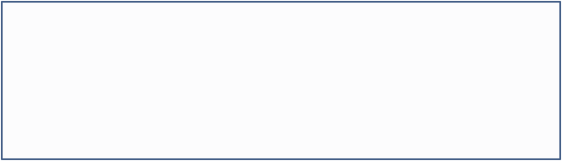
Macroeconomic Success
Continued
  Excellent macroeconomic performance - yes, but slowdown on the horizon, deficit growth ("net damage")
  Low unemployment, high participation rate - yes, but some are in part-time jobs, raising up in poor families of 2 employees
  Export surplus, $ 120 billion foreign exchange reserves, which is about 31% of GDP
  Lack of inflation, a strong currency (shekel)
  The Financial Sector: Continued stability
10
12/16/2019

Slide 11

The Macroeconomic Success
How?
  Responsible and Consistent Economic Policy Since 1985:
    Tight fiscal discipline despite politicians (but…)
    Opening and liberalizing the economy, reforms
  Leveraging and fostering immense technological-scientific entrepreneurial talent
+ supporting policy: R&D Law, Chief Scientist + “Luck”: Immigration from the Soviet Union
High Tech Breakthrough, “The Start-up Nation”
11
12/16/2019

Slide 12
Macro Success Yes, but
Grating Social Failure
Norway
  On a general-social level:
1. Cost of living very high
2. Inequality, widespread poverty
3. Growth yes, but little per capita
  Crises in critical areas:
        Housing
          Transportation
            Health
              Education
2011 protest, committee and report
and subsequent protests
12
12/16/2019

Slide 13
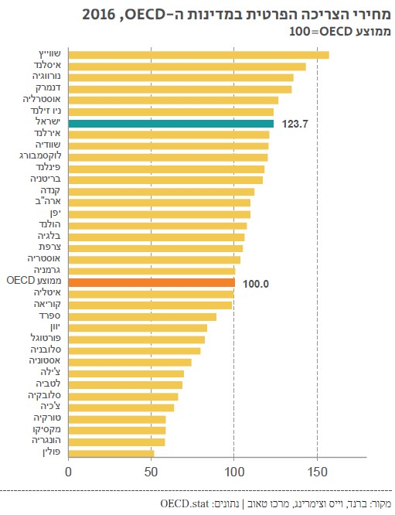

Cost of Living - OECD 2016
Average 100 = OECD
  יוקר המחייה – OECD 2016
  ממוצע OECD= 100
Switzerland
Island
Norway
Denmark
Australia
ישראל: יוקר מחיה גבוה ב-24% מעל ל-OECD
New Zealand
Israel: Cost of living is 24% higher than OECD Countries
Israel
Ireland
Sweden
Luxemburg
Finland
Britain
Canada
United States
Japan
Holland
Belgium
France
Austria
Germany
OECD Average
Italy
Korea
Spain
Greece
Portugal
Slovenia
Estonia
עוד שש מדינות זולות יותר
Chile
Six cheaper states
Latvia
Slovakia
Czech Republic
Turkey
Mexico
Hungary
Poland

Slide 14
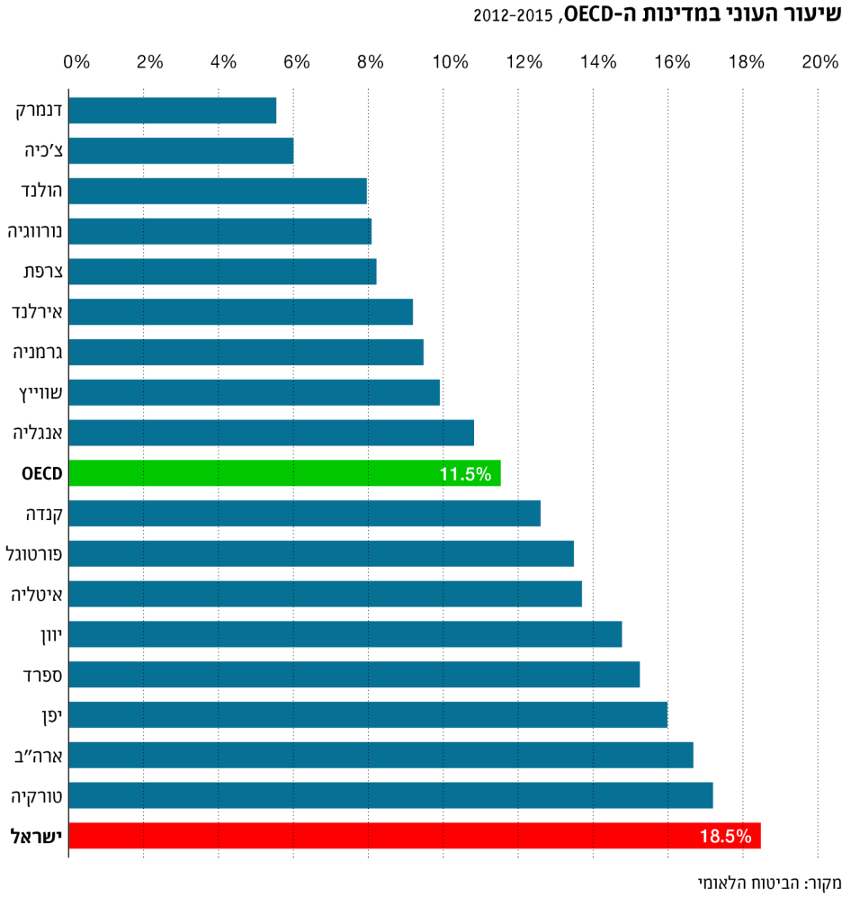
Denmark
Czech Republic
Poverty Rate in Israel & in the OECD
Holland
Norway
France
Ireland
Germany
Switzerland
England
OECD
11.5%
OECD
Canada
Portugal
Italy
Greece
Spain
Japan
Israel
18%
United States
Turkey
Israel
Source: The National Social Security Agency
14
12/16/2019

Slide 15
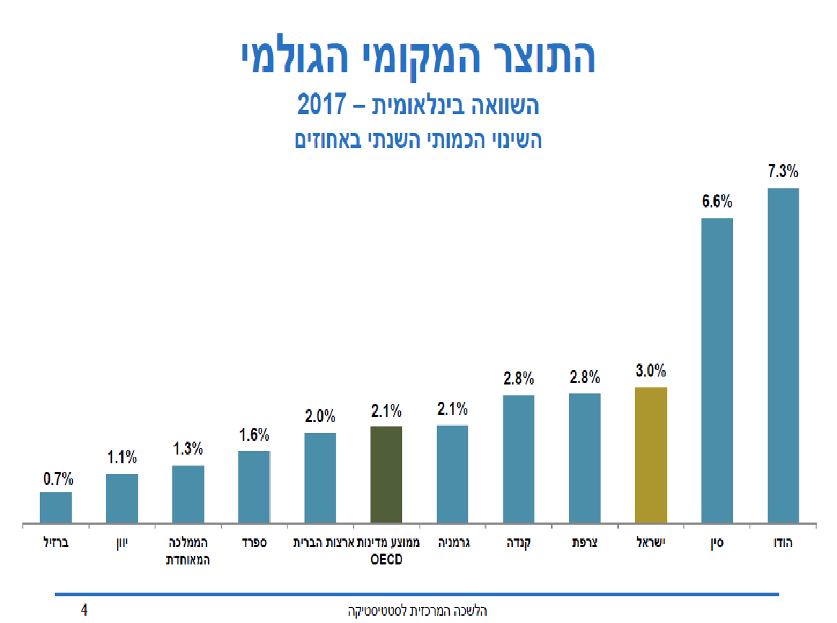
Growth yes,
But a lot less per capita...
GDP Growth Rate 2017
But per capita growth in Israel is only 1.3% per year! Because the population grows by 2% a year
Israel:
3.3%
India
OECD Average
2.1%
China
Brazil
Greece
United Kingdom
Spain
U.S.
OECD Average
Germany
Canada
France
Israel
China
India
Israel Center Bureau of Statistics
15
12/16/2019

Slide 16
Social Failure - Why?
  Governments over the last decade have sanctified the "macro" and neglected the "micro", no social policy ("growth permeation"?), have been captured in archaic concepts:
    Reduction in government has become an example, government spending has been cut too much ("the fat and lean")
    The tax burden allegedly has dropped, but the "hidden taxes" have gone up!
16
12/16/2019

Slide 17
Less government, more burden on families:
Israel versus the OECD
As a percentage of GDP
OECD Average |  | Israel
2017 | 2001 | 2017 | 2001
43% | 43% | 40% | 50% | Government Spending
21% | 18% | 16% | 18% | Social spending
%34 | %34 | 31% | 35% | נטל המס
1% GDP: NIS 12 billion
17
12/16/2019

Slide 18
Social failure - why ?!
  Governments in the last decade have sanctified the "macro" and neglected the "micro", there was no social policy ("growth permeation"?), were captured in archaic views:
    Reduction in government has become an example, government spending has been cut too much ("the fat and lean")
    The tax burden has allegedly dropped, but the "hidden taxes" have gone up!
  These governments have been dazzled by the "start-up state”, but there is no such state as the “start-up state” is only about 8-9% of it!
  The opportunity given by the 2011 protest and the Commission's report to make a profound change were untapped!
12/16/2019

Slide 19
The “Micro” Is Not Waiting for the “Macro”
Crises in Critical Areas
        Housing
    Impossible price Level for young families: living where it is possible not where it is suitable, “mortgaging the future”, despair.
          Transportation
    The state is “stopped”, huge costs for traffic jams, congestion will only get worse.
3. Health
    The public health system is collapsing yet the private system is expanding
    Huge gaps: Life expectancy in the periphery is 7 years lower!
4. Education
    Failed performance, great variance, no equal opportunity
    Not preparing youngsters for the challenges of the 21st Century
19
12/16/2019

Slide 20
Are These Crises A Decree From Heaven?
  No! The result of fixation and neglect - this is where the "Gaza Syndrome" has also been implemented:
    A difficult problem that hurts us over time, seemingly "we tried everything but nothing works" => frustration, cynicism, skepticism.
  What To Do? A Different Narrative:
    Certainly there are solutions, but a paradigm shift is needed, breaking conventions, no hassle on hustle
    A long-term strategy that begins immediately (not "Israel 2048")
    To instill consciousness that doing otherwise is possible Yes we can (!)
"Fast" trains ?! Affordable housing?!
Come on ...as there is no solution for Gaza, neither will those have”
20
12/16/2019

Slide 21
Breaking "Gaza Syndrome" (1)
Principles for Resolving The Housing Crisis
The state will cease to consider land as an asset that should be maximized in value. The price of residential land will be reduced to a minimum (only to cover development expenses).
No building of "sleeping towns" / new complexes where land is available, but rather in areas where there is demand and employment, with service availability. How?:
  Massive Urban Renewal: Doubling Residential Buildings in Cities to 7-8 Floors. No luxury towers !!!
  Incentivization of Local authorities: Budgeting civil services due to population increase; Change in property taxes; Fines for rejections.
Building a variety of types and sizes of apartments to meet the needs of the general population, some in real affordable housing.
Perceptual Change Is Required, Courage, and Resources:
Even today, it costs a lot, but most comes out of the young families' pockets!
21
12/16/2019

Slide 22
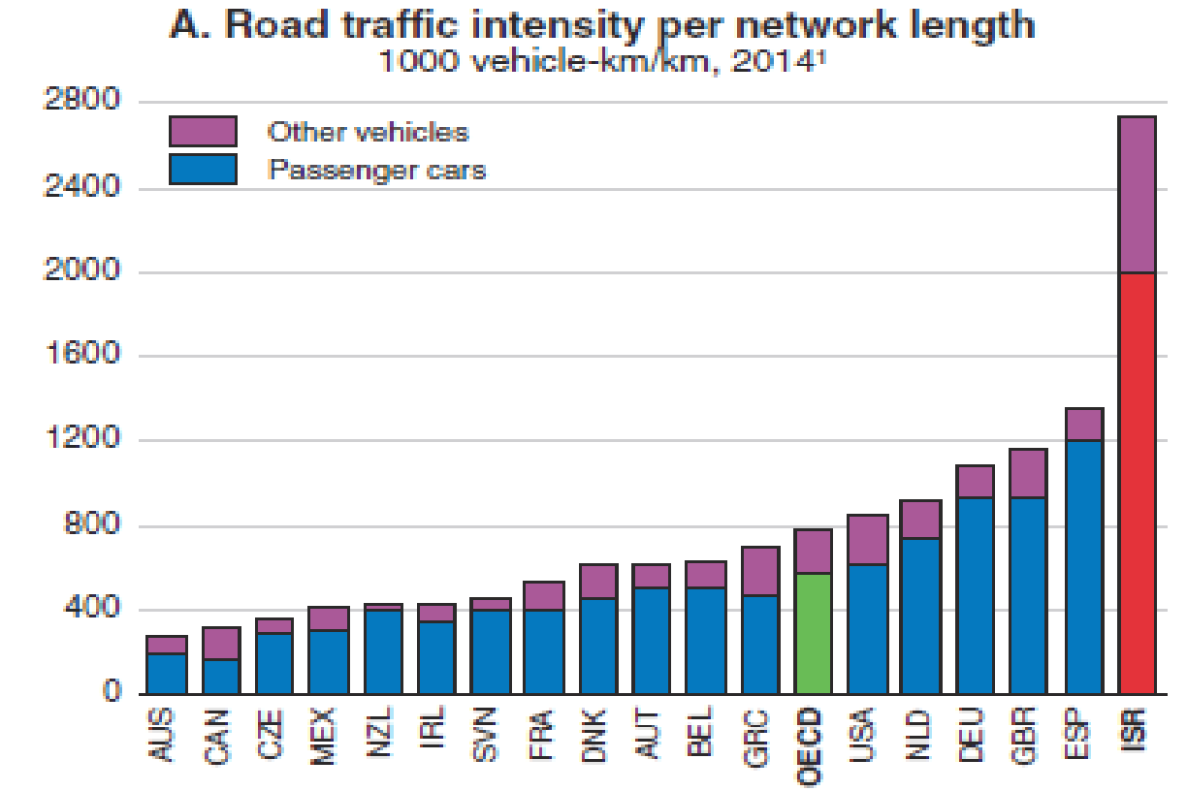
Congestion:
Israel is the most congest among OECD Countries
Israel
Source: OECD Report on Israel, March 2018, page 56 figure 41
22

Slide 23
Breaking "Gaza Syndrome" (2)
Principles for solving the transport crisis
  More interchanges and more road widening will not help, congestion will only get worse. What to do?
  Inducing behavioral change through incentives and technology, less single-passenger vehicles on the road,and more collaborative drives:
    Cancellation of all taxes on the vehicle and in lieu of payment per km according to route and time of travel, and the number of passengers in the vehicle.
    Using Carpool platforms such as Waze and Via
    Incentivizing employers to drive cooperatively to major employment centers.
  Developing smart public transport:
    Upgraded Bus lines to commuting routes based on big data
    Inter-city mass transit systems, combined with means of transport for the first and last miles.
23
12/16/2019

Slide 24
Breaking "Gaza Syndrome" (3)
Principles for solving the health crisis
  Resources:
    Raising health tax for development needs: building hospitals, standards and beds, physician and paramedical training
    An additional state budget to boost the health basket.
  Regulation and Reward:
    Establish clear boundaries between the public and private system: No more glorious medicine for the rich, and diverting the best doctors there!
  Focus on Family Preventive Healthcare:
    Empowering Family Healthcare as a "First Line": Remuneration of the Family Physician and the HMOs not by Quantity; Expanding "TMR" as a Second Line.
    Proactive Active Medicine with Big Data.
    May aspire to greatness: “smoke and fat free nation”
24
12/16/2019

Slide 25
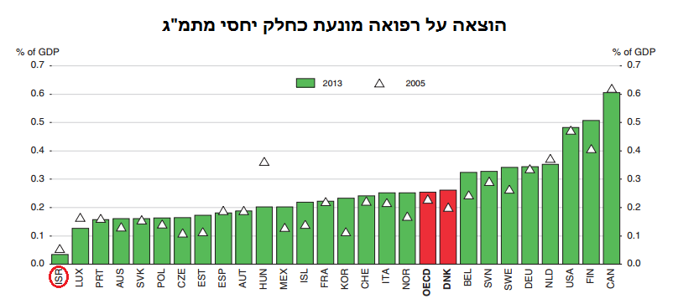
Expenditure on Preventive Healthcare -% of GDP
Israel: 0.26% (a quarter percent ...) OECD: 2.6% 10x!
Israel
25
Notes:
Preventive care:
Information, education and counseling programmes
Immunisation programmes
Early disease detection programmes
Healthy condition monitoring programmes
Epidemiological surveillance and risk and disease control programmes
Preparing for disaster and emergency response programmes
25

Slide 26
Breaking "Gaza Syndrome" (4)
Principles for solving the education crisis
  Schools:
    Focus on skills not on acquiring knowledge, not on tests, not on grades
    Innovative Learning Frameworks: Reverse Class, Project-Based Learning (PBL), Critical Approach; Preparation for the Age of Artificial Intelligence.
    Striving for actual equality between sectors - budget, quality
  Reverse the Pyramid - Invest in Much More Preschool! Where an individual’s fate is determined, and gaps are fixed
    Running the Early Childhood Council and Its Budgeting
    Establishing "Early Childhood Camps"
  Educational sequence:
    Upgraded Baccalaureate recognized in the academy
    Combining studies with military service
    Higher Education: Post-Secondary Education and Training for All, Modular, Technological-Professional, Not necessarily Academic Degree
12/16/2019

Slide 27
Can it really be done differently?
  Yes! One can definitely overcome the "Gaza Syndrome"!
  Yes! You can successfully deal with the crises in the most important domains for families in Israel!
  No! It does not involve fiscal lawlessness, but recognition of failures, professionalism and long-term vision
Such profound change is necessary
And it's up to us…
27
12/16/2019

Slide 28


Thank you very much!
28
12/16/2019

