Slide 1
Mad Scientist Initiative
Mad Scientist is an Army initiative and Community of Action (CoA) that continually explores the Operational Environment (OE) and its military implications.
Focuses on the Changing Character of Warfare
Develops collaborative partnerships with academia, industry, and Government representatives
Hosts conferences with world-class experts at the nation's premier academic institutions
Engages innovators through a robust virtual ecosystem
Crowdsources through writing programs and online wargaming
Continuous outreach to academic, industry, and government thought leaders

Slide 2
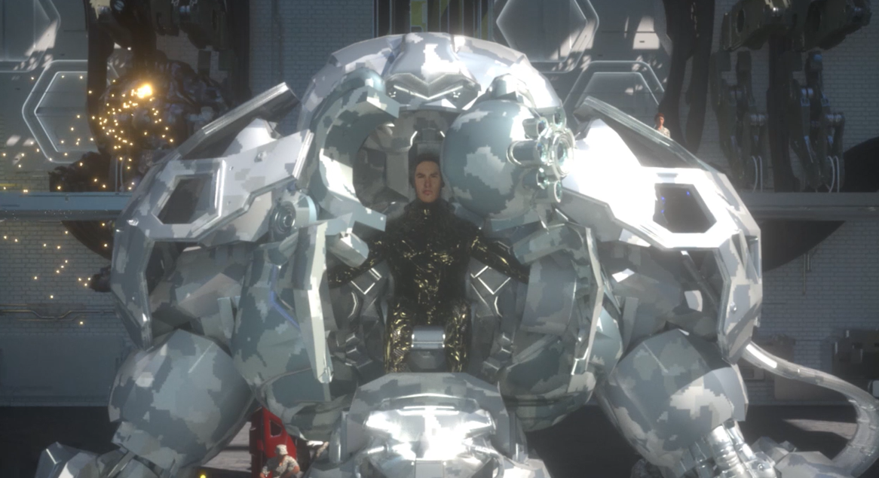
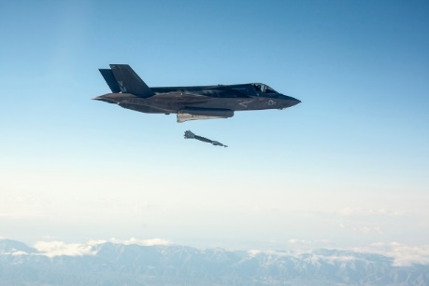
Visioning the Future
Story Telling
Crowdsourcing
Creative fictional writing and narrative building that helps us see how technologies are employed and operationalized…
The gathering of ideas, thoughts, and concepts from a widespread variety of interested individuals assists us in diversifying thought and challenging assumptions…
Edge Cases
Historical Analogy
Examining what is at the extreme possible regarding new and emerging technologies allows us to contextualize the future…
The comparison of past events to current and future happenings allows us to imagine the transformational and sometimes radical changes the Army of the future may experience…
These tools are used to help us view and add context to the the 12 Military Trends that we follow

Slide 3
The Mad Scientist Laboratory
https://madsciblog.tradoc.army.mil
Mission:
To expand the U.S. Army’s reach by engaging global innovators from across industry, academia, and the Government on the Operational Environment (OE), emergent disruptive technologies and their individual and convergent impacts, and the changing character of warfare.
Simultaneously, the site has broadened public access to related open source content on the OE, facilitating further dialog and enhancing its role as “a marketplace of ideas.”
Site Analytics:
191 blog posts published to date.
54% of these by guest bloggers, sharing diverse contributions and perspectives.
193K views to date by readers from around the world.
Subscribers have increased 7% over the past 90 days.

Slide 4
Mad Scientist Initiative FY20 Engagement Plans
Global Views of the Operational Environment
Hackathon with CCDC Armament Center - focus on commander’s vision in dense urban
Carnegie Mellon University and Army AI Task Force - AI/ML/Autonomy
Georgetown University – Weaponized Information in Competition and Conflict
Launch Mad Scientist Podcast

