Slide 1
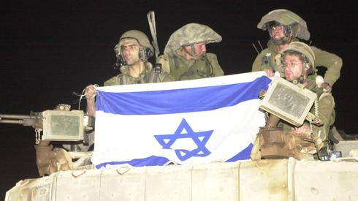
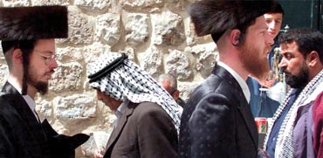
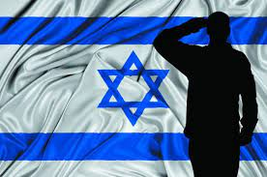
Israel: Politics, History and Society
Israel: Politics, History and Society
NDC
Dr. Ehud Eiran
28 July, 2022
Meeting 2

Slide 2
Questions? Current affairs

Slide 3
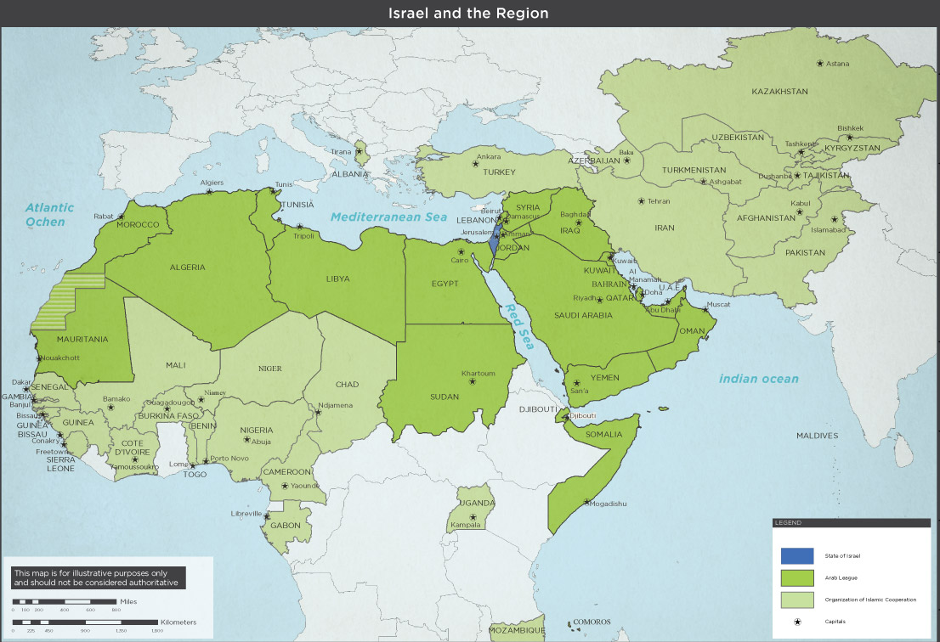

Slide 4
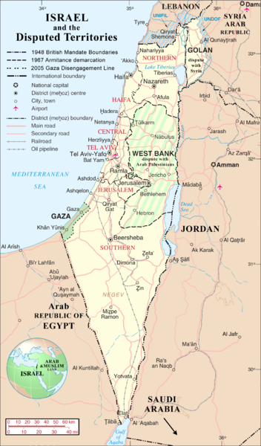
The Land: 22,145 SQ KM
Contested areas:
West Bank: 5655 SQ KM
Golan Heights: 1800 SQ KM
Gaza Strip: 376 SQ KM
In the past: Israel occupied:
Sinai peninsula: 61,000 SQ KM
South Lebanon: 849 SQ KM

Slide 5
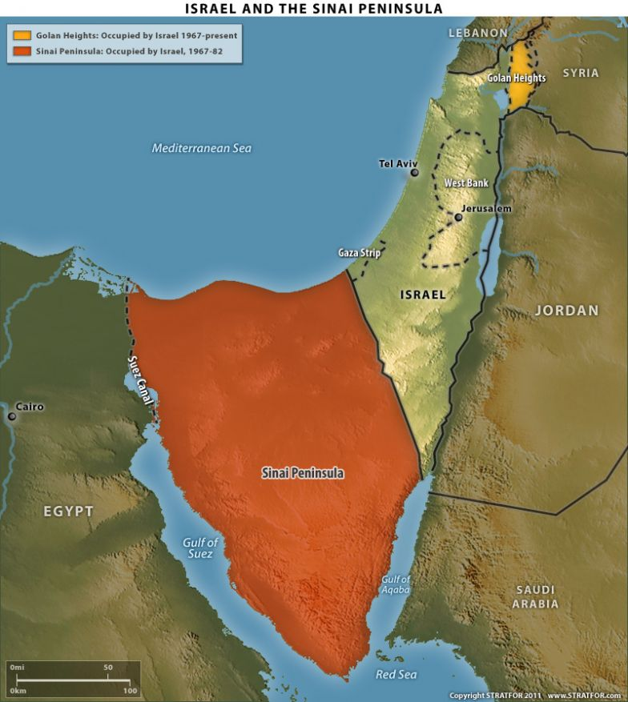

Slide 6
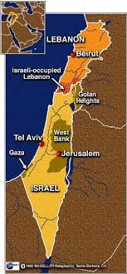

Slide 7
Highlights
Surrounded by Arab League nations
No military solution to grand strategic challenge
Long and narrow: no strategic depth
At a global historical crossroads
Disputed borders
Most of the population, in the coastal place/center
Long shore
Borders: waxed and waned, not final/ Reflects

Slide 8
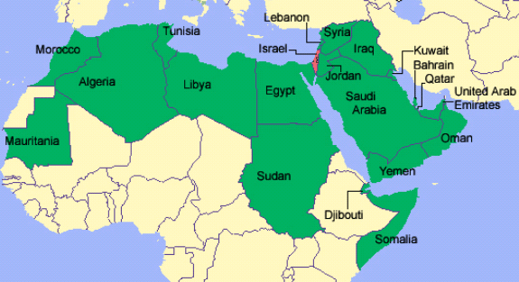

Slide 9
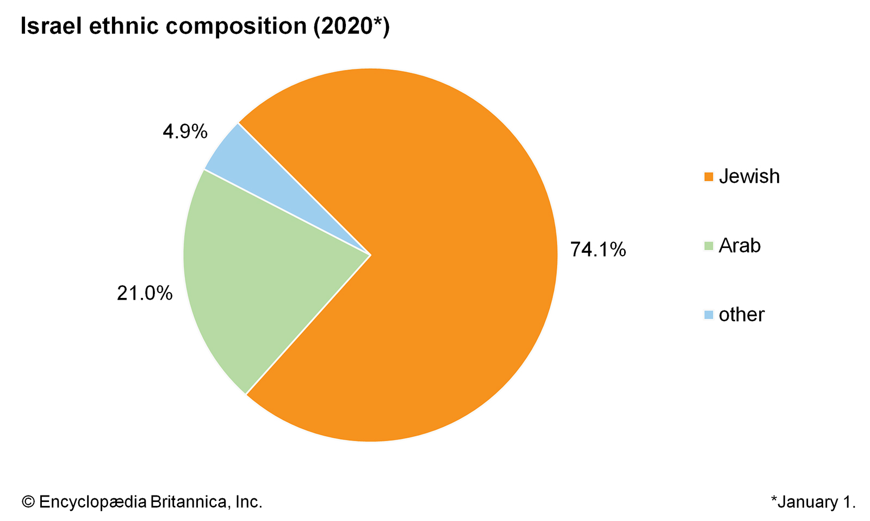
The people: 9.2 Million

Slide 10
A Brief History of the place

Slide 11
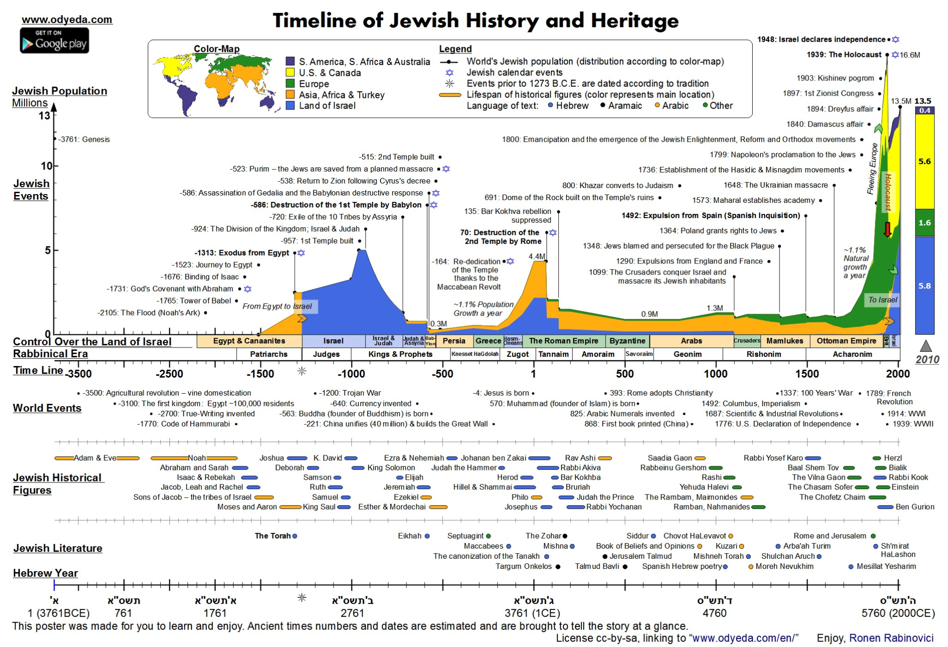
A Brief History of the people

Slide 12
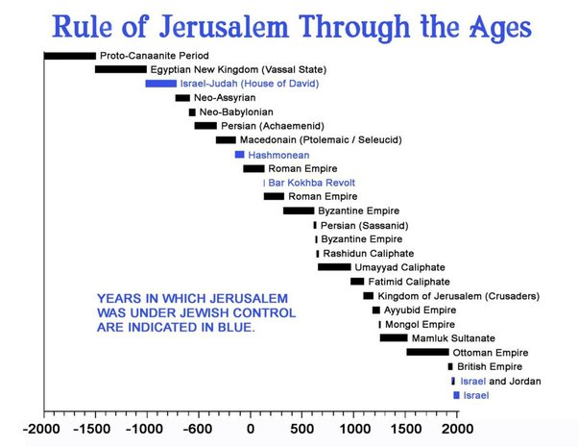

Slide 13
More effects
Respect to ideas
An ethos of against all odds
An avant garde, anarchic/erophet elements

Slide 14
Israel as an Idea: Zionism
Jewish national movement
Goal: the creation and support of a Jewish national state in Eretz-Yisrael/Palestine,

Slide 15
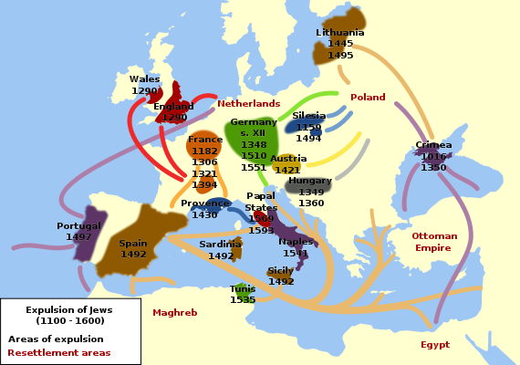
Background: Jewish experience in Europe

Slide 16
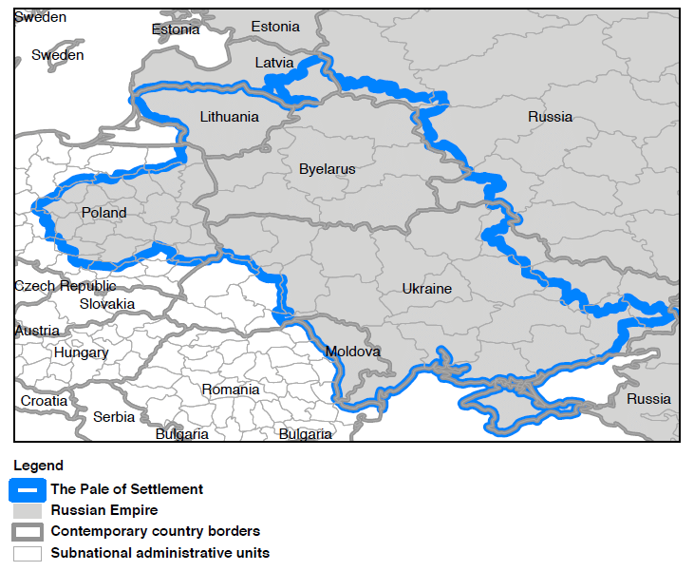
19th century world Jewry: Eastern Europe

Slide 17
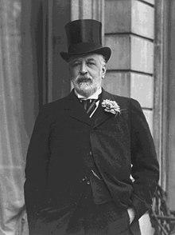
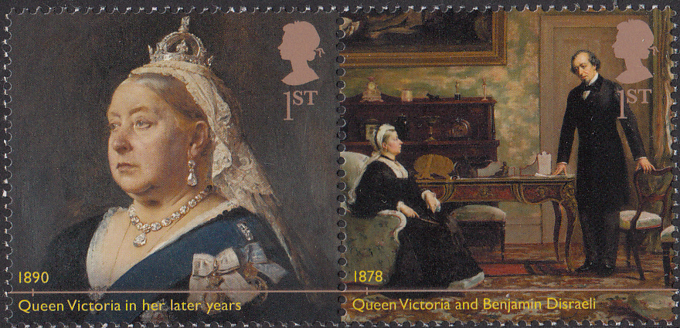
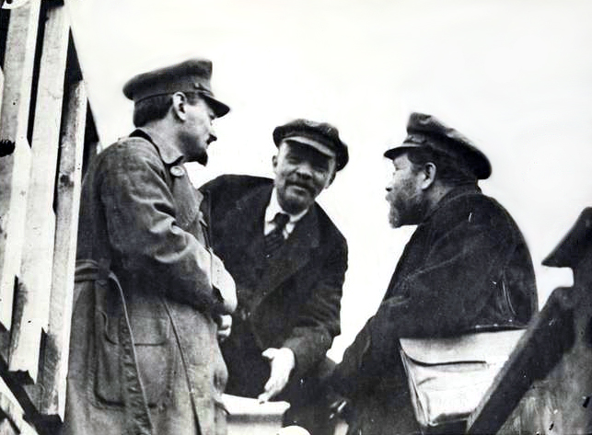
Jews in the 19th Century: from the margins to the center

Slide 18
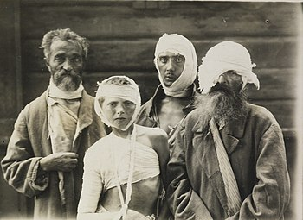
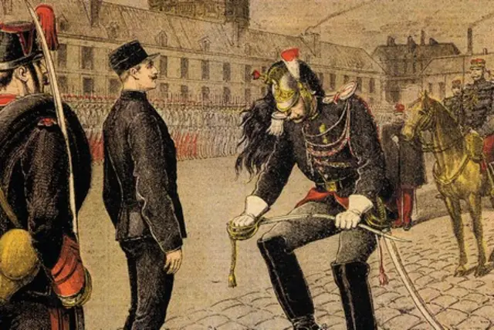
But Jews still under threat in 19th century Europe: East and West

Slide 19
So…A solution for a security problem

Slide 20
What are current day implications of this ideological commitment ?

Slide 21
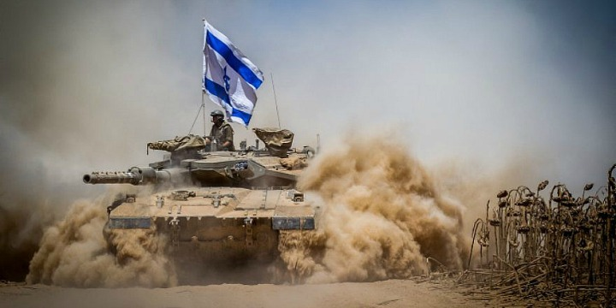
Centrality of the IDF

Slide 22
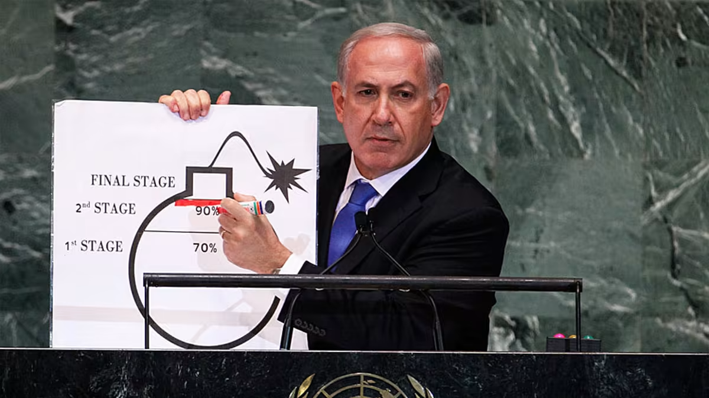
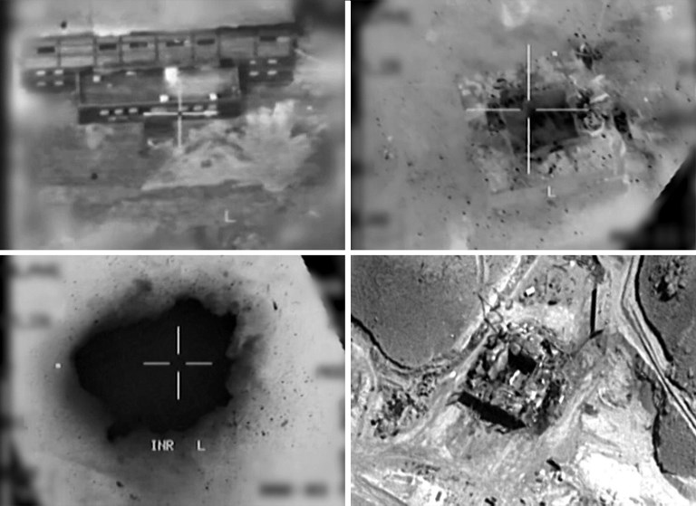
Absolute defense: the nuclear challenge: 1981, 2007 and now

Slide 23
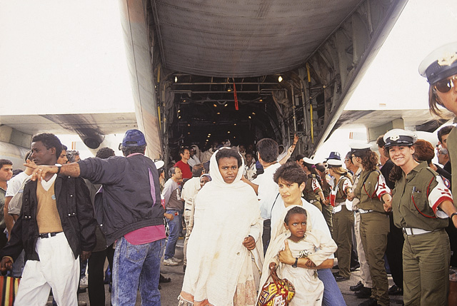
Commitment to world Jewry

Slide 24
How Are States Born?
‹#›
Notes:
‹#›

Slide 25
How are States Born?
The Westfelian order: A European idea that dominates the world.
At its heart: a group of people in a territory are a nation, entitled to a nation-state.
A few exceptions: The “New World” (USA…), but even there, idea emerged out of a reality of colonization
‹#›
Notes:
‹#›

Slide 26
The Exceptions to the Exception
Israel and Liberia
‹#›
Notes:
‹#›

Slide 27
The idea: Zionism
Jews are a nation, not a religious community.
Jews seek power/sovereignty
Jews “want to come back” to ancestral land.
But idea has deeper sources…
‹#›
Notes:
‹#›

Slide 28
Deliverance: the foundation of the Jewish vision (Walzer)
So pharaonic oppression, deliverance, Sinai, and Canaan are still with us, powerful memories shaping our perceptions of the political world. The “door of hope” is still open; things are not what they might be—even when what they might be isn’t totally different from what they are. We still believe, or many of us do, what the Exodus first taught, or what it has commonly been taken to teach, about the meaning and possibility of politics and about its proper form:
—first, that wherever you live, it is probably Egypt;
—second, that there is a better place, a world more attractive, a promised land;
—and third, that “the way to the land is through the wilderness.” There is no way to get from here to there except by joining together and marching.
‹#›
Notes:
‹#›

Slide 29
Zionism as Traditional Deliverance
National deliverance: Reinventing ourselves: Jews are a nation, entitled to a state.
Geographical deliverance: back to Zion
Historical deliverance: Moving from cyclical time back to history
Personal deliverance: from Jews that lend, to the Jews’ land
‹#›
Notes:
‹#›

Slide 30
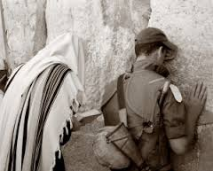
National deliverance:
‹#›

