Slide 1
Economic wars and geopolitical consequences
Professor Chalom Schirman (University of Haifa)
At Israel College of National Security
September 25, 2019

Slide 2
GeCoPolitics
A new paradigm : Did GeoEconomics replace GeoPolitics?
(Edward Luttwak’s article National Interest, 1989)

Slide 3
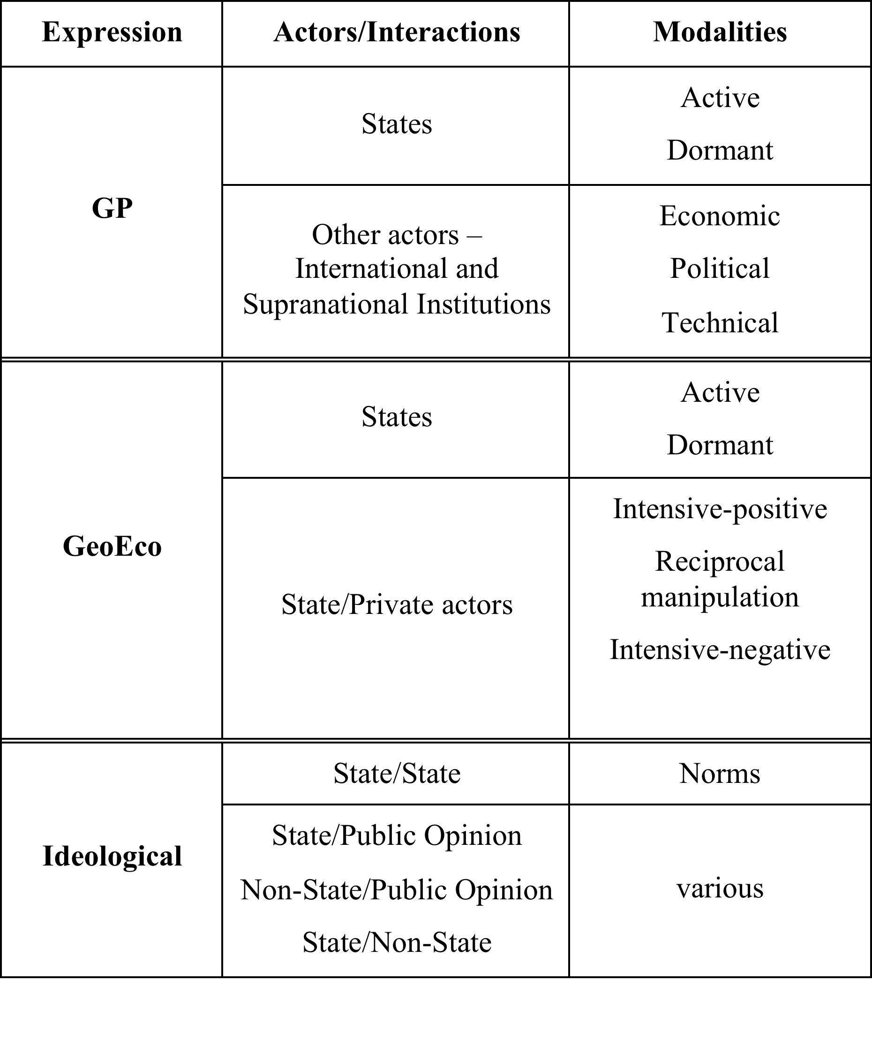
GCP
The Model

Slide 4
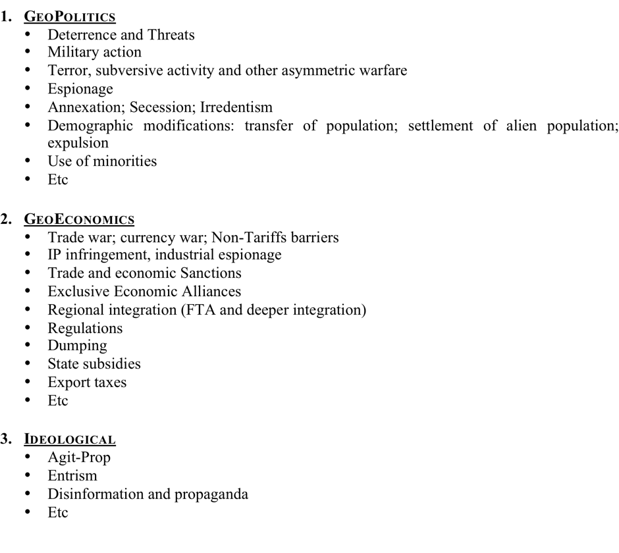
GCP tools
GCP Instruments and Levers

Slide 5
Sources of information
Where do you get your information?
How can you evaluate/judge its relevance/ degree of certainty?

Slide 6
Trade wars today
Many instruments/weapons: tariffs; boycotts; embargoes; subsidies; national champions; discriminatory regulations; non-tariff barriers; quotas; export limitations; economic espionage; IP theft; etc, etc.
Brexit
US-NAFTA
US-EU
US-CN
Japan-Sth Korea
Arctic Sea
South China Sea
BRI-Indo-Pacific

Slide 7
World Order? or Disorder?
End of Washington Consensus?
Paralysis of WTO
Bypassing of IMF
World Bank Versus AIIB
End of Globalization latest wave?
American withdrawal and regulation of International relations?

Slide 8
US-CN conflict competition
For regional or global hegemony?
Asian Pacific Rim
CN-IN competition

Slide 9
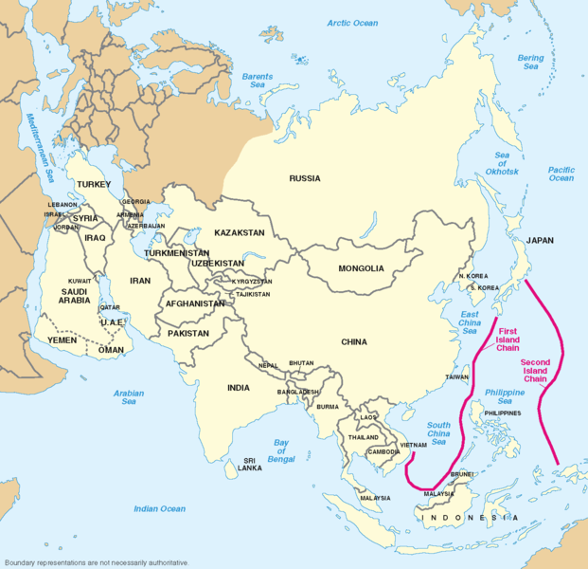
Pacific
Asian Rim

Slide 10
US withdrawal from the M E
Oil/Gas is much less important
Increase of Islamic radicalism
Tribalization of the M E
Who will profit from a temporary vacuum of power?
Who will replace the USA?

Slide 11
IL-CN relations
How to strengthen them?
Avoiding to antagonize the US!
IL is not alone in this predicament

